Slide 1
Growing a Cell Therapy Industry: Opportunities and Challenges
October 27th, 2014
ct.catapult.org.uk
Catapult is a Innovate UK programme.

Slide 2
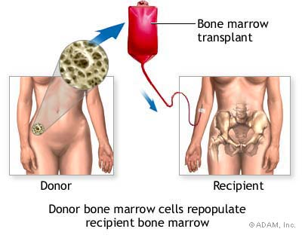
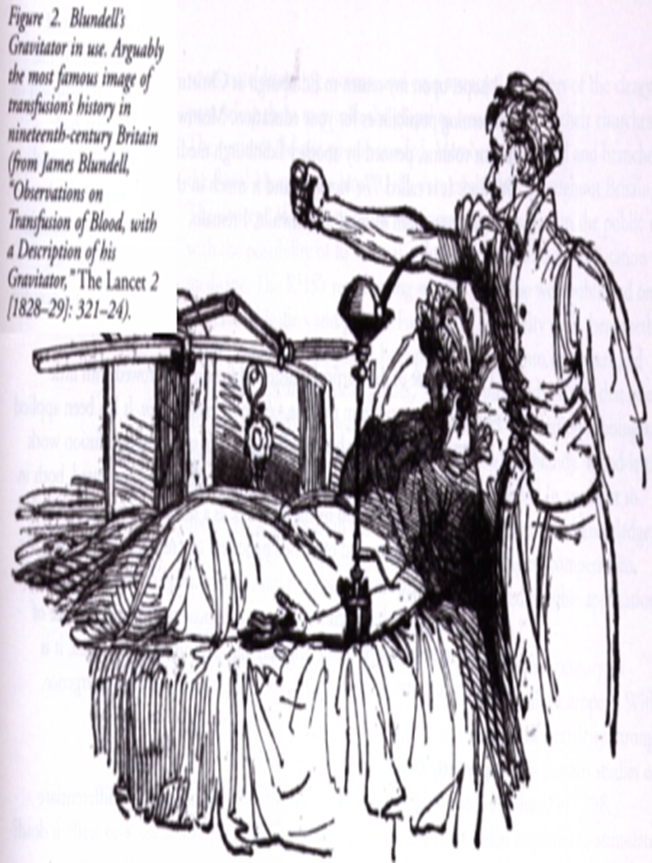
Cell therapy – New and not so new
Blood Transfusion
The oldest cell therapy?
Bone Marrow Transplant
Till and McCulloch 1960s

Slide 3
Potential of Cell Therapies
Potential cell sources include:
Somatic cells
Pluripotent stem cells
Immune cells
Gene modified cells
Stroke
Traumatic brain injury
Alzheimer’s disease
Parkinson’s disease
Baldness
Lou Gehrig’s disease
Blindness
Missing teeth
Deafness
Wound healing
Myoardial infarction
Bone marrow transplantation
(currently established)
Spinal cord injury
Muscular dystrophy
Osteoarthritis Rheumatoid arthritis
Diabetes
Multiple sites: Cancers
Crohn’s disease

Slide 4
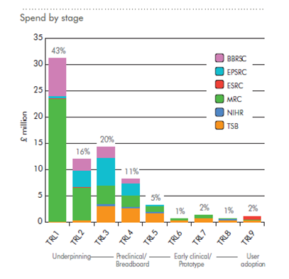
Cell Therapy-Translational gap
UK have a world leading research base in the area of Cell Therapies
UK have many very strong clinician led innovative therapies but at early translation stage
UK have a globally competitive environment in translation towards commercialisation and clinical reality.
Limited commercial investment
Working to help bring effective therapies to patients
Catapult

Slide 5
The UK Cell Therapy environment: Regenerative medicine as an example
Working to help bring effective therapies to patients.

Slide 6
The Cell Therapy Catapult
An independent, not for profit, company limited by guarantee, founded in 2012 as part of the Innovate UK/BIS Catapult program
Revenue is generated from:
Public sector investment. £70m core government grant for first 5 years with a further >£50m for the coming 5 years
Subcontract agreements with industry and academia
Collaborative project grants
A personnel count of 90 (Sept, 2014) with in-depth expertise in business, manufacturing and clinical development
A 1200 m$²$ state-of-the-art laboratory facility in central London enabling advanced process and analytical development, including translational GXP laboratories
In April, the UK Government announced it is investing £55m over 5 years in a late stage clinical trials and commercial manufacture facility under Catapult/Innovate UK governance.

Slide 7
Strategic Goals
Goal
Build a £10bn industry
Pipeline
Increase cell therapies in UK clinical trial and clinical use
Value
Investible propositions created leading to cell therapy companies that succeed and stay in the UK
Attractiveness
Demonstrating that the UK is the place to do this work, with increased inward investment
Notes:
Existing firms getting funding
Most still small beer
Reneuron raise significant funds
GSK expanding Regen med portfolio
AZ doing due diligence on cell therapy opportunity
Investors more engaged
TAP sold
UK is certainly in the game as inward investor location
Research council environment is positive
Academics largely positive (and healed)
Window is open
Enough firms with well organised approach to late stage trials
Osiris Acquired by Mesoblast resulting in consolidation to three major MSC players
Mesoblast, Athersys, Pluristem
Shake out starting as money finds its way to the leading companies?
Organogenesis reimbursement , Dermagraft acquisition , Shire Exit
CIRM still in trouble but still has 1.4bn to spend
Catapult seen as the EU entry mechanism and European Authority

Slide 8
Addressing Barriers: Catapult Capabilities
Business
Health Economics
Manufacturing
and
Supply Chain
Robustness & Reliability
Clinical
And
Regulatory
Complex Regulatory Landscape
Reimbursement
Partnering
Characterisation & Analytical
CMC
Pre Clinical Packages
Clinical trial design
NHS partnering
Delivery
COGS & Scale up
GMP
Business Models
Business Development
Process Development
Clinical Operations & Regulatory Affairs

Slide 9
Project led approach
9
Pathfind therapies into and through the Clinic
Core projects with direct investment
Rounded phase II data package
Investible propositions
Assist industry to progress to commercialisation
Collaboration (also JV)
Contract research
UK as entry point into the EU
Assist academia to progress to commercialisation
Collaboration
Contract research
Technology platforms
Develop novel technologies and license to industry

Slide 10
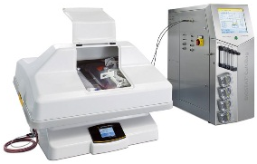
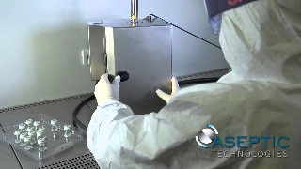
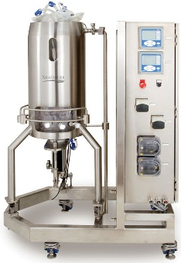
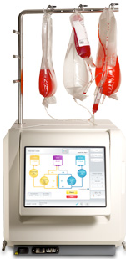
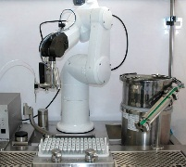
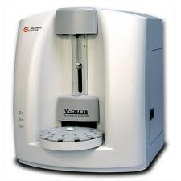
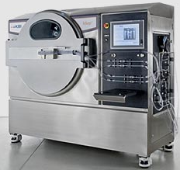
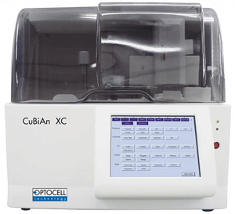
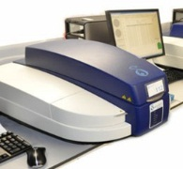
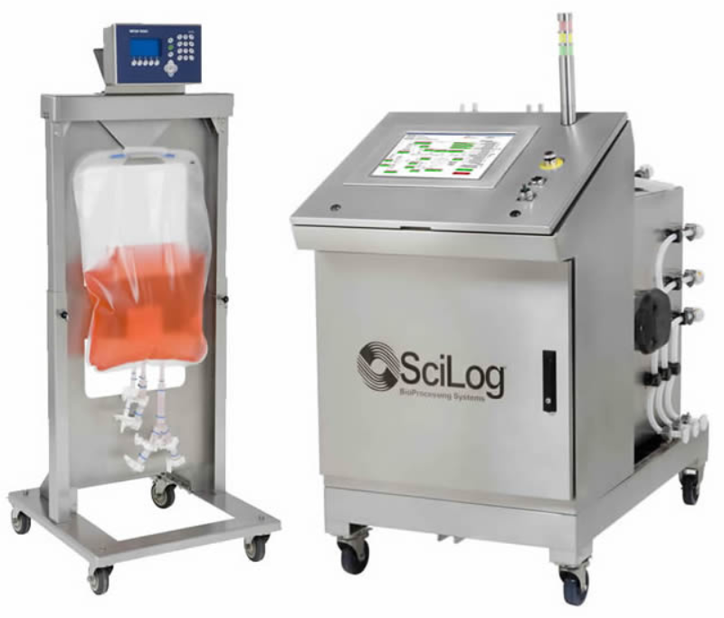
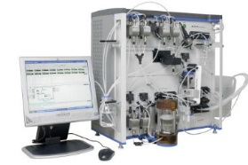
Process Development Capability all the way to GMP proving
Manual
Rocking platform
Automated
Fill finish
Cell Expansion
25 FTE’s
£2 Million Investment
Stirred platform
Quantum®
In process control
Primary recovery
Vi-CELL
KSep
Akta TFF
Cubian XC
Peregrine
SciLog TFF

Slide 11
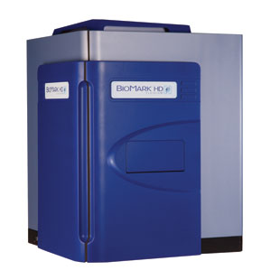
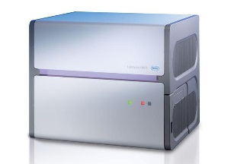
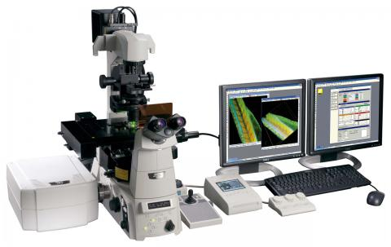
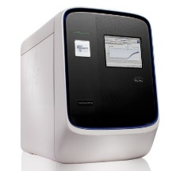
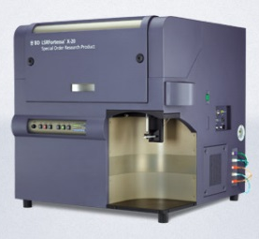
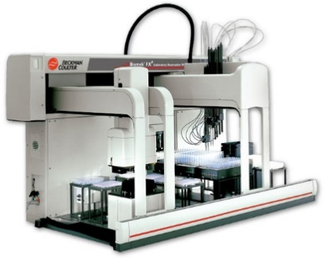
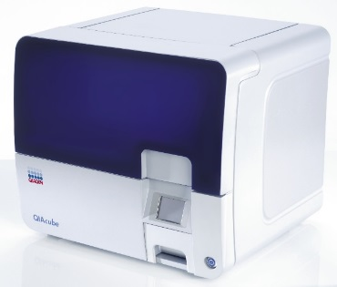
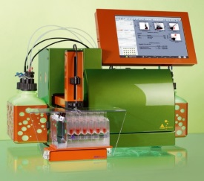
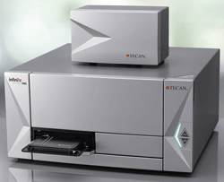
Analytical Capability
Molecular Biology
Imaging
10 FTE’s
£1.5 Million Investment
Protein
Automation

Slide 12
UK preclinical and clinical stage cell therapies
Category | # 2014 (2013) | Comparison
Preclinical (<2 yrs from clinic) | 45 (37) | A larger variety of cell types and a larger range of indications in preclinical stages Seven of the projects identified in the 2013 pre-clinical database have moved into the UK Clinical Trials Database along the timeline anticipated Trials in the UK Clinical Trials Database are mainly early stage
Clinical (UK trial ongoing) | 41 (34)
Total | 86 (71)

Slide 13
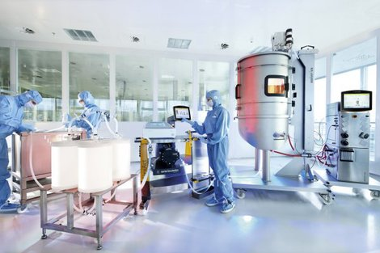
Large-scale Manufacturing Centre
£55m manufacturing hotel to support industry growth
Allowing CMOs and product development companies enable the manufacture at large scale
Access large scale infrastructure without the capital outlay
5000m² Flexible/modular space
Operated as a subsidiary of Cell Therapy Catapult sharing corporate services
Capital, Revenue (Start up and initial operating costs and supporting TSB programmes)

Slide 14
Funding for Cell Therapy in the UK
Govt.
Support
Medical Charities
Financial Investment
Corporate Venturing
Commercial
Development
Plan

Slide 15
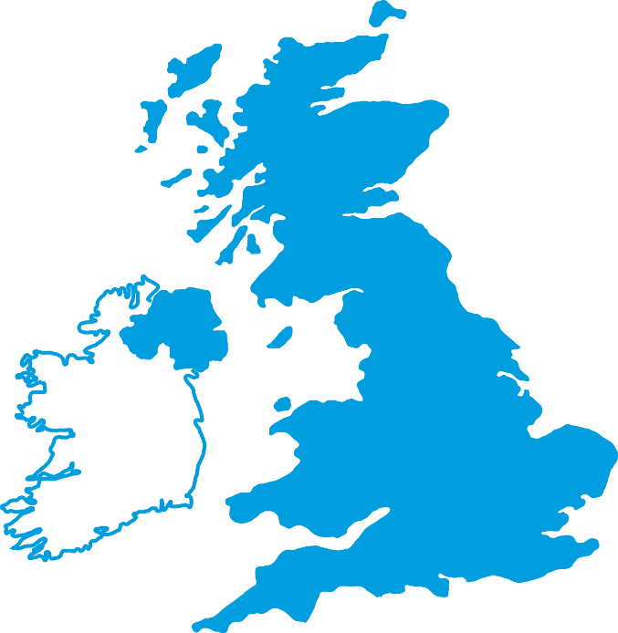
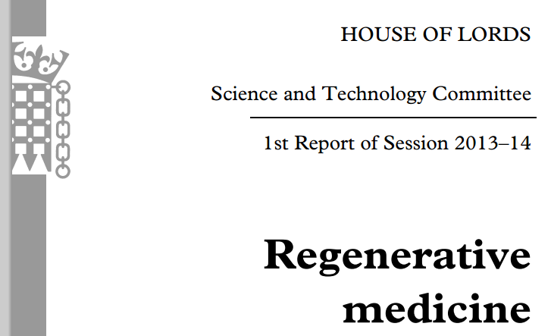
Future in collaboration

Slide 16
Contract or co-develop cell therapy products
Next Generation process and technology development
Solve generic industry barriers
Driven by success of the industry

