Slide 1
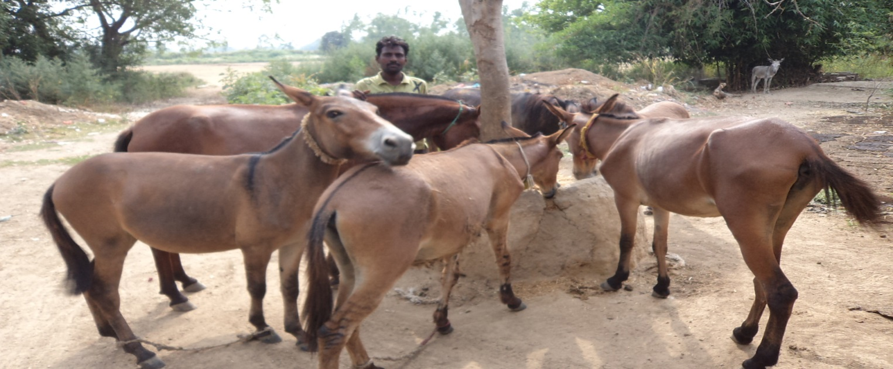
Formulation of Balanced feed for Working Equids under field conditions
2nd International Conference on ANIMAL & DAIRY Sciences, September 15 – 17, 2014 HICC, Hyderabad, India
                By Dr. Jogen Kalita
                Brooke Hospital for Animals(India)

Slide 2
Contents of this Presentation
Current Equine Population in India
A brief Introduction to Brooke Hospital for Animals(India)
Brooke Hospital for Animal(India)'S community engagement model
Gaps in feeding of working equids
Methods of Intervention made by BHA
Feed formula developed
Owners’ observation after piloting
Associations takes on this business
Insights

Slide 3
Equine population in India
(19th Livestock census 2012)
HORSES and PONIES | 0.62 million
MULES | 0.19 million
DONKEYs | 0.32 million
Total Equines | 1.13 million

Slide 4
About Brooke Hospital for Animals(BHA), India
Brooke Hospital for Animals(BHA), India is an affiliate of the Brooke, UK
BHA works for reducing pain & suffering of working equids
In India, BHA works in 11 states covering around 160000 working equids mainly in northern India
Service provision & Community Engagements are two pivotal approaches practiced by BHA, India

Slide 5
BHA’s Community Engagement Model
Services
Stakeholders
ASSOCIATION in Block level
Equine Welfare Group in Village
Equine Welfare Group in Village
Owner in Village
Owners in Village
Owners in Village
Owners in Village

Slide 6
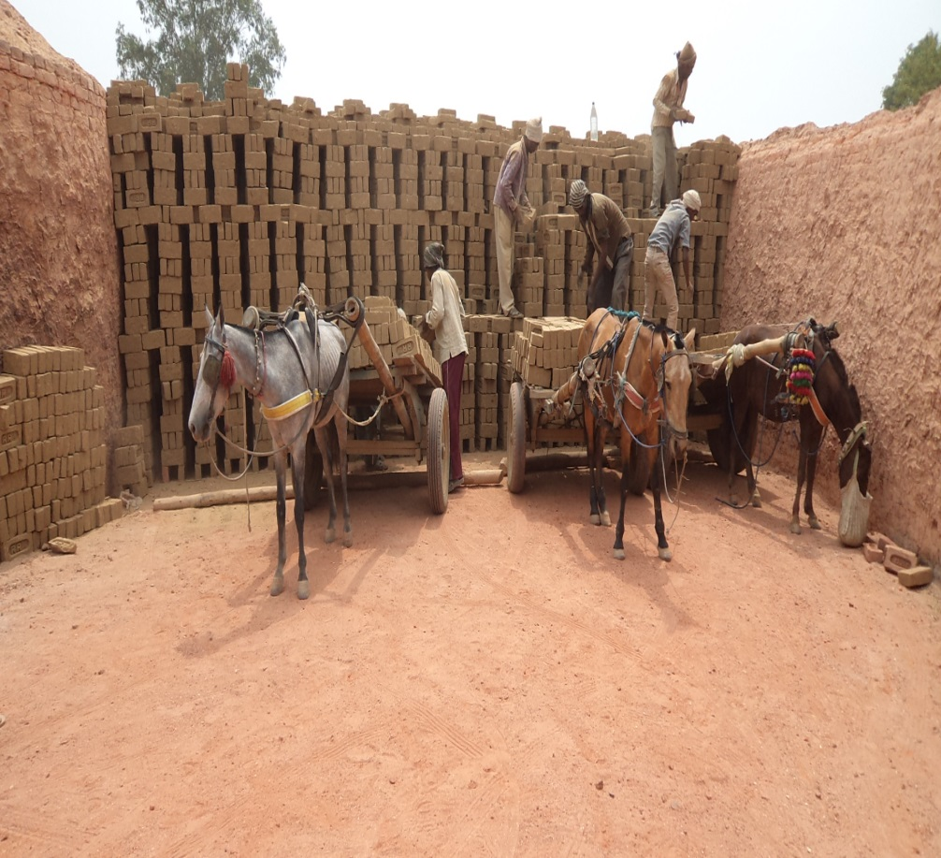
Gaps in feeding of working equids
No balanced feed for equine is available in the local market
Owners are poor and desire cheaper feed
Rice bran, wheat bran, gram are traditional feeds used in North India
Improper feeding can lead to higher susceptibility to diseases, potentially lowering working capacity and life span with many other adverse effects.

Slide 7
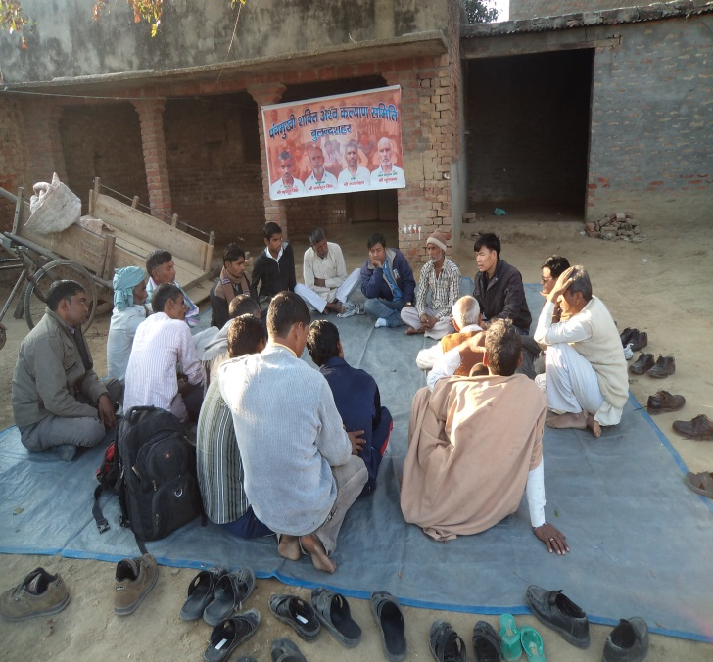
Methods of Intervention
Development of Computer Based Feed Software
Analysis of gaps in feeding practice through series of community meetings
Development of cheap & best Formulation by community considering technical & economic factors
Pre-piloting body condition status recorded
Feed formulation by EWG & Feeding to 14 equids for 4 weeks
Post piloting body condition status recorded, analyzed in community meeting

Slide 8
Feed Formula for a working equid with 250 Kg body weight working for 4-8 hours/day
Feed stuff | DM % | CP % | Digestible Energy M calories | Ca % | P % | Kg per 100Kg feed | Cost per Kg INR | Total cost INR
Maize | 88 | 9.1 | 3.88 | 0.04 | 0.3 | 20 | 15 | 300
Barley | 88 | 12 | 3.67 | 0.06 | 0.04 | 20 | 13 | 260
Wheat | 88 | 14 | 3.83 | 0.05 | 0.43 | 26 | 14 | 364
Gram Husk | 90 | 20 | 3.7 | 0.15 | 0.35 | 6.5 | 25 | 163
Wheat Bran | 89 | 17 | 3.22 | 0.13 | 1.18 | 26 | 13 | 338
Mineral Mix |  |  |  |  |  | 1.5 |  | 150
Labour, transportation cost & profit to association |  |  |  |  |  | ----- |  | 575
Total |  |  |  |  |  | 100 |  | 2000

Slide 9
Owners’ Observation after piloting
Palatability has increased
The animals are more alert than before
The animals are alert even after heavy work
The animals’ ability to cope with daily work has increased
Balanced feed costs less that earlier(INR 20 per kg of feed against INR 40 per kg of gram)
Animals’ body condition has begun to improve

Slide 10
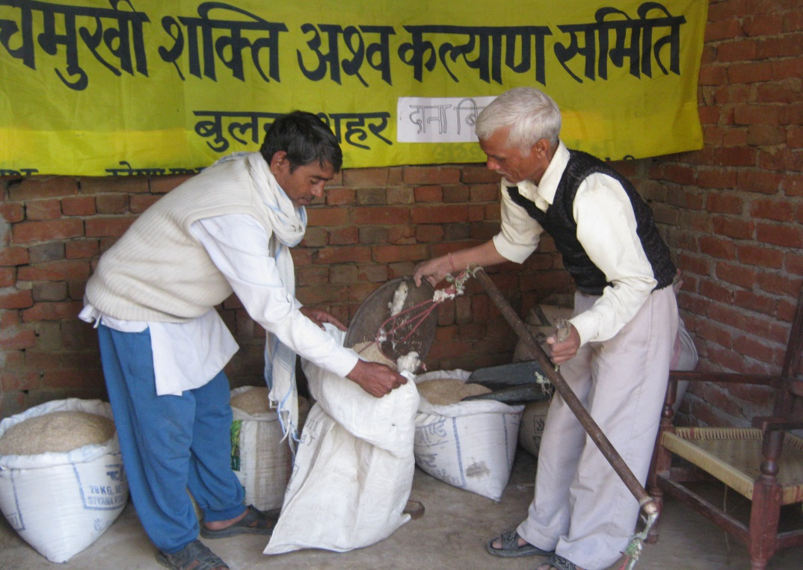
The Association takes on the business
The local Equine welfare association has taken up production of the balanced feed as business opportunity
They organized exposure visit of owners from their 12 member villages
The Owners could see the impact both in financial & nutritional aspects
This resulted in adoption of formula by 100 owners
The formula has been diffused to 5 nearby districts

Slide 11
Insights
To develop ownership on any intervention participation of owners in each step is helpful
Computer Based Feed Software was the key input in implementing scheme.
Local association became the pivotal platform for rapid diffusion of the formula
As the formula was cheaper as well as nutritious, it could attract owners more rapidly

Slide 12
THANKS

