Slide 1
Metalloproteinases and their inhibitors gene expression profiles in leukocytes of primary hypertension (PH), non-alcoholic fatty liver disease (NAFLD), and obese children.
Joanna Trojanek
Dept. of Microbiology & Clinical Immunology
The Children’s Memorial Health Institute, Warsaw

Slide 2
Matrix metalloproteinase - MMPs
also known matrixins
zinc endoproteinase
25 distinct MMPs identified in vertebrates, 23 in human (encoded for 24 genes)
degrade (cleave) protein components of the extracellular matrix (ECM)
collagens, elastin, fibronectin, gelatin and aggrecan, as well as non-ECM
molecules – transforming growth factor (TGF)-β, pro-IL-1β, pro-IL-8, Fas ligand,
and pro-TNF
cause renewal and reconstruction of ECM (ECM turnover)
maintain the correct structure of the ECM and basement membrane
major players in many physiological and pathological processess

Slide 3
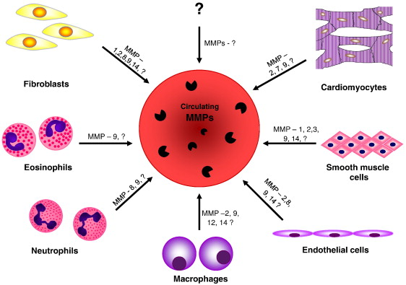
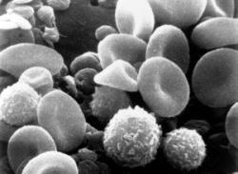
Which cells synthetise/express MMPs ?
LEUKOCYTES
Fontana V et al. Clin Chim Acta 2012

Slide 4
Domain structure
PS
Pro
Catalytic Zn
MMP-7, -26
PS
Pro
Catalytic Zn
Hpx
MMP-1, -3, -8, -10, -12, -13, -18, -19, -20, -22, -27
Fn II
PS
Pro
Catalytic Zn
Hpx
MMP-2, -9
PS
Pro
F
Catalytic Zn
Hpx
MMP-11, -28
PS
Pro
F
Catalytic Zn
TB
Hpx
C
MT-MMP 1, 2, 3, 5 (MMP-14, -15, -16, -24)
PS
Pro
F
Catalytic Zn
GPI
Hpx
MT-MMP 4, 6 (MMP-17, -25)
PS
Pro
Vn
F
Catalytic Zn
Hpx
MMP-21
F
Ig
PS
Pro
Catalytic Zn
Cys
MMP-23

Slide 5
MMPs classification
Class | Common name | No MMP | Substrat - collagen | Other substrates
Collagenases | Collagenase-1 Collagenase-2 Collagenase-3 | MMP-1 MMP-8 MMP-13 | I, II, III, VII, VIII, X I, II, III, V, VII, VIII, X I, II, III, IV, V, VII, IX, X | gelatin, MMP-2, -9, proteoglycans, fibronectyn, laminin, pro TNFα gelatin, fibronectyn, proteoglycans, ADAMTS-1, proMMP-8 gelatin, laminin, proteoglycans, fibrinogen, proMMP-9, -13
Gelatinases | GelatinaseA Gelatinase B | MMP-2 MMP-9 | I, II, III, IV, V,VII,X,XI III, IV V, VII, X,XI | gelatin, fibronectin, laminin, elastyn, proMMP-9, -13, IGFBPs, IL-1β, TGF-β, α1−antyproteinase gelatin, elastyn, laminin, fibronectin, vitronectin, CXCL5, IL-1β, TGF-β, plasminogen
Stromelysins/ Matrilysins | Stromelysin 1 Stromelysin 2 Stromelysin 3 Matrilysin 1 Matrilysin 2 | MMP-3 MMP-10 MMP-11 MMP-7 MMP-26 | III, IV, V, VII, IX, X, XI I, III. IV, V, IX, X IV I, IV I, IV | gelatin, fibronectin, laminin proMMP-1, -7, -8, -9, -13, proTNFα, E-cadheryn, L-selectyn gelatin, laminin, casein, MMP-1, -8, fibronectin, proteoglycans gelatin, fibronectin, laminin gelatin, laminin, elastin, fibronectin, proteoglycans, proMMPs, proTNFα, E-cadheryn gelatin, laminin, elastin, fibronectin, proteoglycans, proMMPs, proTNFα, E-cadheryn
Transmembrane Type II | MT1-MMP MT2-MMP MT3-MMP MT4-MMP MT5-MMP MT6-MMP | MMP-14 MMP-15 MMP-16 MMP-17 MMP-24 MMP-25 | I, II, III | gelatin, fibronectin, laminin, vitronectrin, proteoglycans, proMMP-2 i proMMP-13 proMMP-2 proMMP-2 proMMP-2 proMMP-2 gelatin
Other MMPs | Macrophage metalloelastase Collagenase 4 Xenopus RASI-1 Epilizyn | MMP-12 MMP-18 MMP-19 MMP-21, -27 MMP-28 | IV I IV | elastyn, fibronectin, gelatin, proteoglycans, plasminogen gelatin elementy błon podstawnych gelatin gelatin, casein autocatalise proTNF-β

Slide 6
Activation
„cysteine-switch” mechanism
H
active
HO
Zn²⁺
HS N N N
non-active
PRCGXPD AHEXGHXXGXXH
PS
Pro
Catalytic
PRCGXPD
MMP 14
TIMP-2
Inactive MMP-2
PRCGXPD
Active MMP-2
Zn
Zn

Slide 7
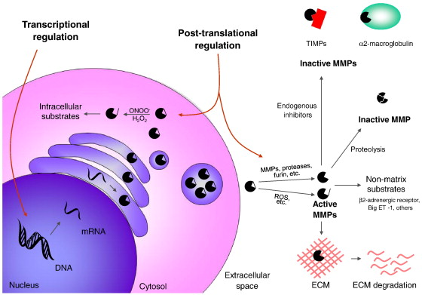
Regulation of MMP expression and activity
Fontana V et al. Clin Chim Acta 2012

Slide 8
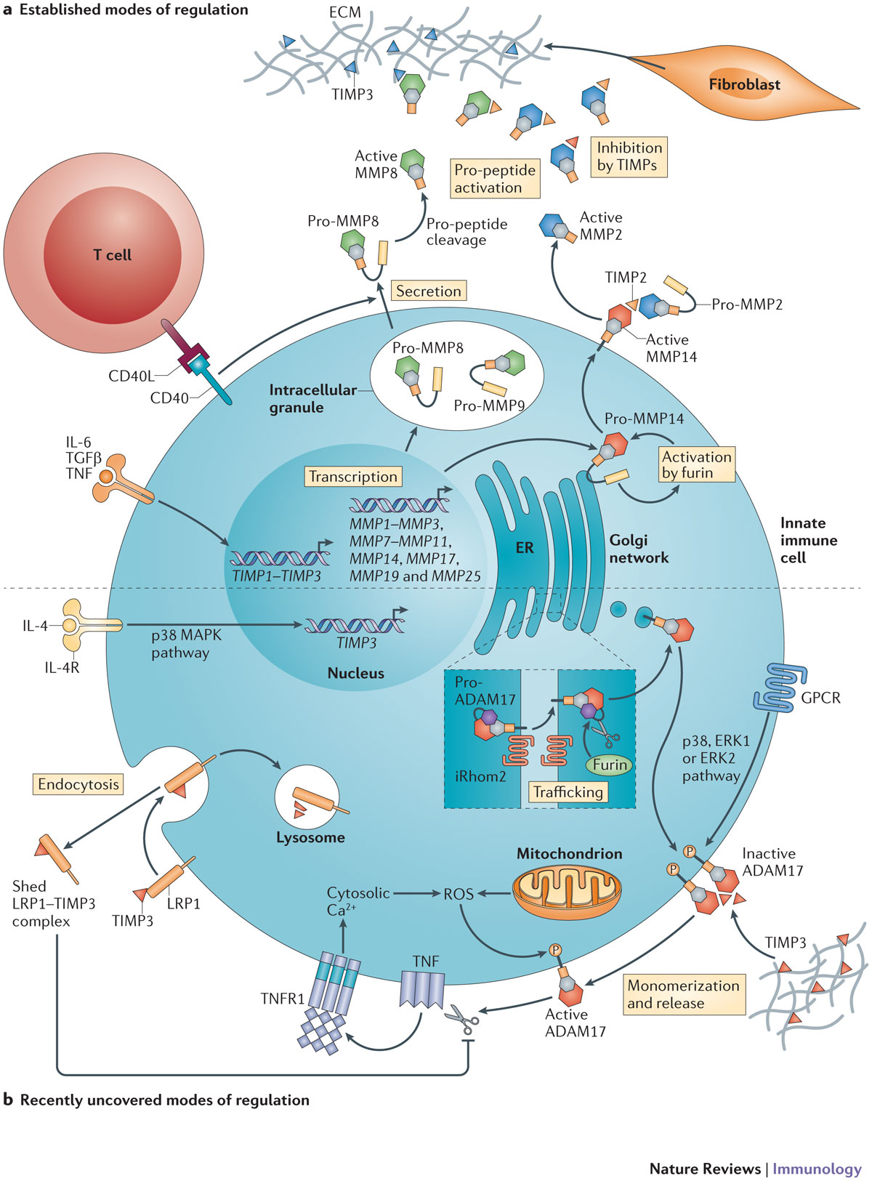
Immunological context of view…..

Slide 9
Physiological processes | Pathological processes
embryogenesis angiogenesis apoptosis bone growth, tooth enamel development of the nervous system wound healing repair of spinal cord injury reconstruction of the endometrium development and implantation of the embryo during pregnancy processes associated with the development and reconstruction of connective tissue | etiology and progress of inflammatory processes fibrosis cancer dysplasia of bone muscular dystrophy cardio - vascular diseases atherosclerosis myocardial infarction aneurysms hypertension autoimmune diseases degenerative rheumatoid arthritis - RA multiple sclerosis neurological diseases chronic obstructive pulmonary disease COPD 1. Primary Hypertension - PH 2.Non-alcoholic fatty liver disease - NAFLD 3. Obesity

Slide 10
Tissue inhibitor of metalloproteinases - TIMPs
TIMPs
ensure a balance of MMPs / TIMPs
inhibit excessive degradation of ECM
form a coordination bond stable and reversible MMP in a
stoichiometric ratio of 1: 1 or 2: 2
blocking access of substrate to the catalytic site of MMPs
four types of the vertebrate
involved in all processes of development and tissue remodeling
in pathological processes disturbed balance of MMPs / TIMPs
MMPs

Slide 11
Classification of children’s blood pressure level
Normal blood pressure | < 90 cc | < 120 < 80
Prehypertension | > 90 cc and < 95 cc (always ≥ 120/80 mmHg even if it corresponds to <90 cc values) | 120-139 80-89
Stage I hypertension | ≥ 95 cc + 5 mmHg > 99 cc | 140-159 90-99
Stage II hypertension | ≥ 99 cc + 5 mmHg | > 160 >100
Classification
(USA)
Children (percentile values
of systolic and/or diastolic)
Adults [mmHg]
systolic diastolic

Slide 12
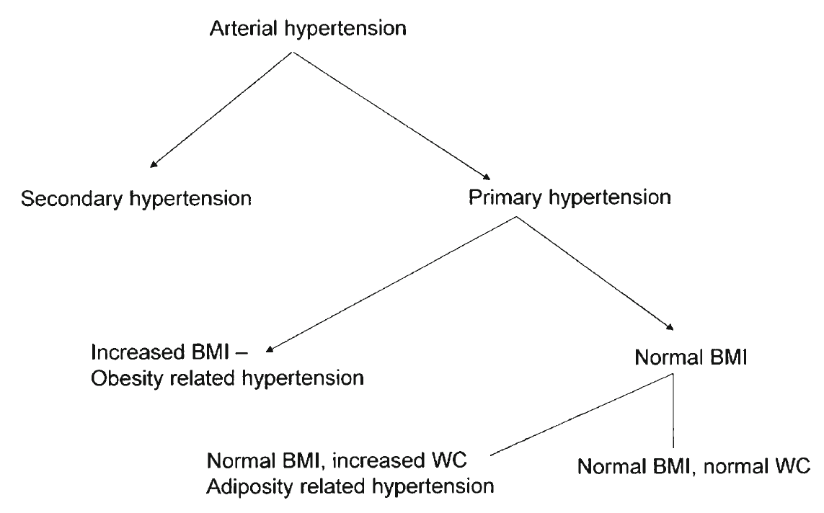
Litwin M et al. Curr Hypertens Rep 2013

Slide 13
Immune activation in children with primary hypertension – association with metabolic abnormalities and visceral obesity
p = 0.006
Increased serum concentrations of MIP-1β and RANTES of hypertensive children in comparison with normotensive controls
The greater number of metabolic abnormalities, the greater immune activity.
The greater immune activity, the greater cIMT.
Litwin M et al. Pediatr Nephrol 2010; 25: 1711-8
p = 0.006
p = 0.007
p = 0.0001
r = 0.479

Slide 14
Evidences for MMPs/TIMPs implications in hypertensions
Remodeling of arterial wall structure
Target organ damage
Interactions with RAAS system
Plasma/serum level
Implication in other metabolic disease
Fold change mRNA level in PH leukocytes !!!

Slide 15
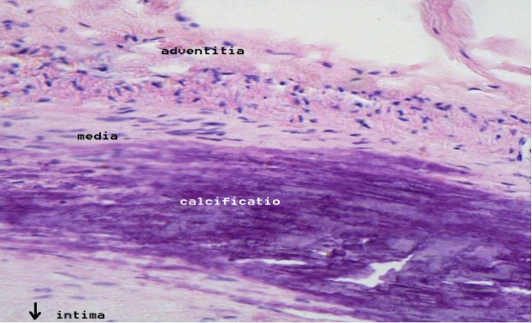
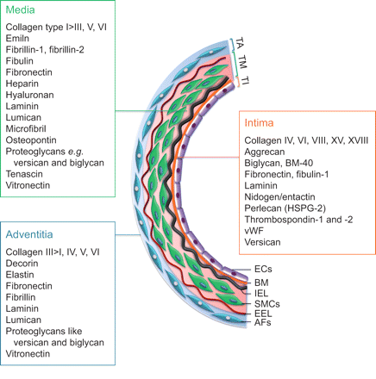
Arterial wall structure and its extracellular matrix components
Chelladurai P. et al.Eur Respir J, 2012

Slide 16
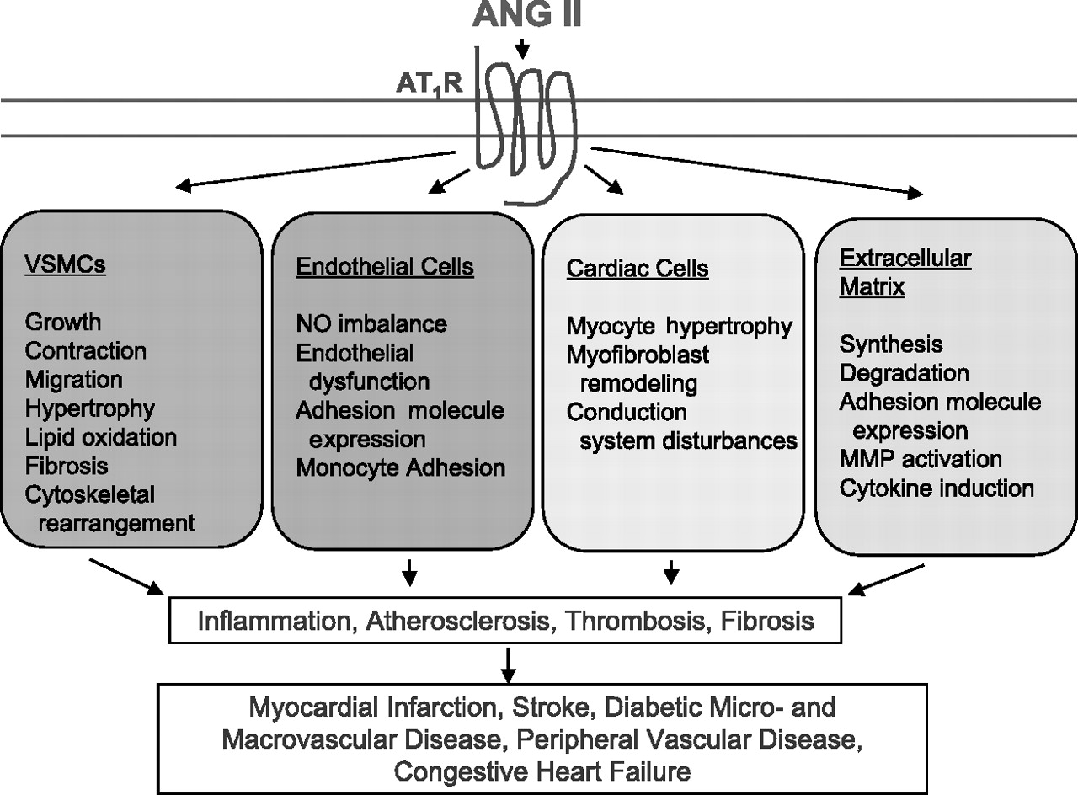
Mehta PK et al. Am J Cell Physiol

Slide 17
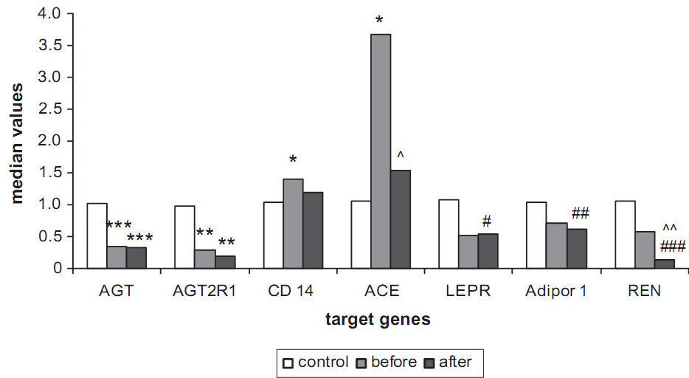
Genes expression in peripheral blood leukocytes of 23 hypertensive adolescents
(15 ±2.1 yrs) before and after 6 mts of non-pharmacological treatment – comparison with normotensive control group (n = 23). Normalization to constitutive genes expression in PBLs.
Litwin M & Michalkiewicz J, Hypertension 2013

Slide 18
Selected inflammatory mediators level in plasma of children with
PH, NAFLD and obesity
Parameters | PH children (n=113) | NAFLD children (n=51) | OBESE children (n=31) | CONTROL(n=40)
MMP9 [ng/ml] | 49 ±27* | 54 ±23* | 54 ± 26* | 38 ± 18
TIMP1 [ng/ml] | 115 ± 50* | 172 ± 126* | 133 ± 72 | 98 ± 51
IL-6 [pg/ml] | 11 ± 8 | 8 ± 5 | 9 ± 8 | 12 ± 10,5
s CD14 [ng/ml] | 861 ± 211* | 1296 ± 172* | 1282 ±249* | 1039± 311

Slide 19
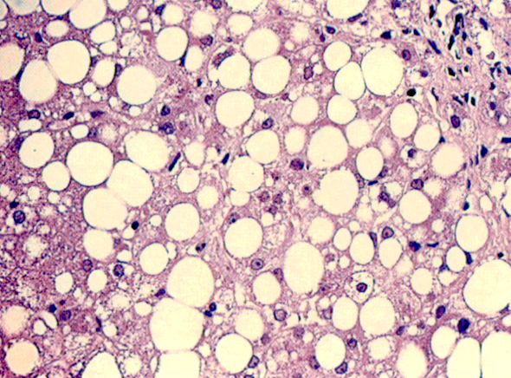
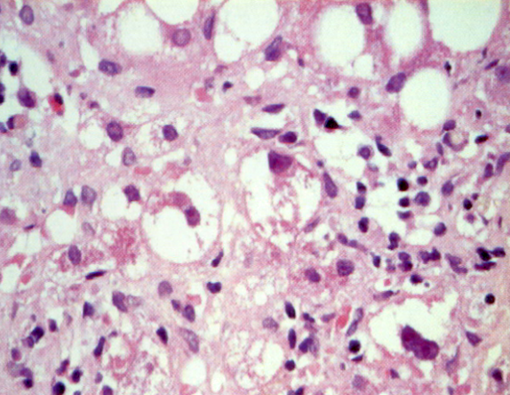
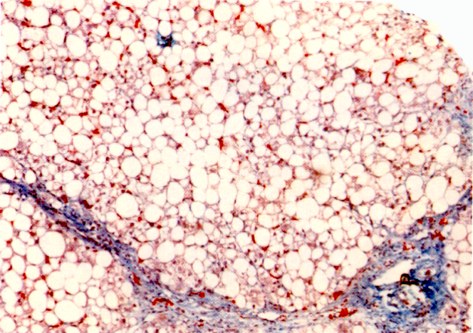
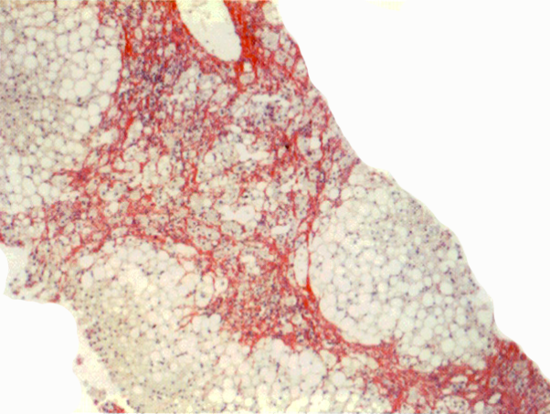
NAFLD – progress of the disease
fatty-inflammation-fibrosis-cirrhosis
Fibrosis- 58% NAFLD children wg Nobili, Hepatology 2006

Slide 20
NAFLD - some information
excessive accumulation of fatty substances in hepatocytes
Reasons - depend on the patient age
1. systemic (e.g. obesity / metabolic syndrome, anorexia, diabetes mellitus
type 1; polycystic ovarian syndrome; Hepatitis C)
2. metabolic (e.g.. Wilson's disease, deficiency of a 1-antitrypsin;
cystic fibrosis; other congenital diseases)
3. toxic (eg. Ethanol, ecstasy, cocaine, solvents, pesticides, etc.)
Clinical symptoms:
- visceral obesity (waist circumference)
- metabolic syndrome/diabetes
- hepato-/splenomegaly, cholestasis
- other systemic disorders

Slide 21

OBESITY
The cause of fatty liver
More likely to have cirrhosis
Distribution of body fat - visceral obesity - cardiovascular risk
Lipid disorders - Insulin Resistance
CAUSES AND CONSEQUENCES
lifestyle, lack of physical activity
increased appetite - positive energy balance
reducing the secretion of corticotropin
pronounced effect of neuropeptide Y in the
hypothalamus
increased concentrations of TNF-alpha
suppression of adiponectin secretion from adipocytes
complications of the cardiovascular system
the risk of coronary heart disease, hypertension,
diabetes t II and hyperlipidemia
Visceral obesity=metabolic disorders
dominant intermediate phenotype
15-20% children with PH

Slide 22
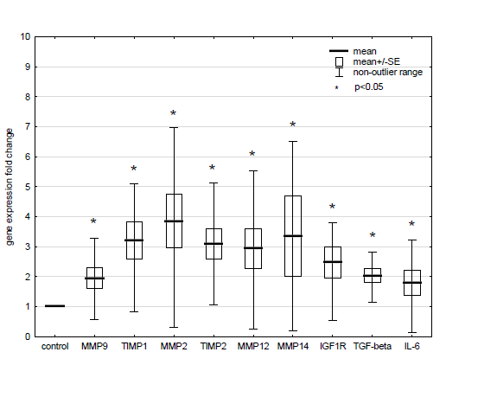
Genes expression -1 (PH nw/Contr nw)

Slide 23
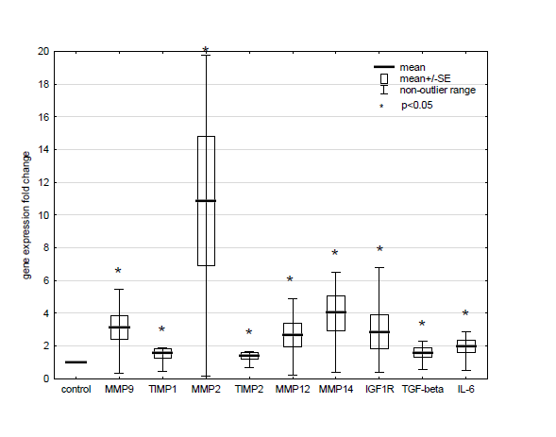
Gene expression -2 (PH Ob/Contr Ob)

Slide 24
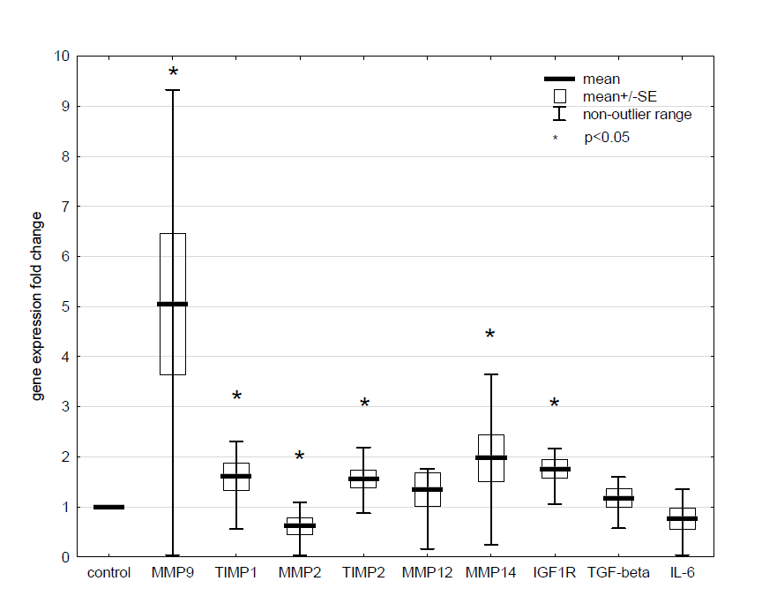
Gene expression – 3 (Contr Ob/Contr nw)

Slide 25
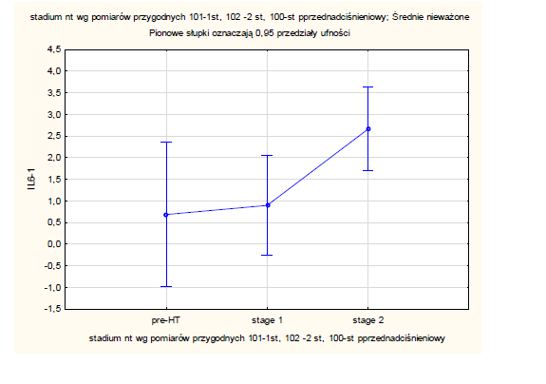
Correlations -1

Slide 26
Correlations - 2 (PH ob/Contr ob)
R = 0.4376 p<0.05
R=-0.6487 p<0.05

Slide 27
R=-0.3303 p<0.05
Correlations - 3 (PH nw/Contr nw)
R = 0.2502 p<0.05
R=-0.3317 p<0.05

Slide 28
Genes expression levels in PH leukocytes
Fold change: 55 PH nw/19 contr nw
*
*
*
*
*
*
*
*
*
p<0,05
*
*
Fold change: 23 PH obese/26 contr obese
*
*
*
*
*
*
*
*

Slide 29
Genes expression levels in NAFLD leukocytes
Fold change: 20 NAFLD/20 contr SDS-BMI
*
*
*
*
*
*
*
*
*
p<0,05
*

Slide 30
Genes expression levels in obesity leukocytes
Fold change: 26 obese pts/19 contr nw
*
*
*
*
*
*
p<0,05
*

Slide 31
Gene expression levels in PH and obese children leukocytes
Fold change: 55 PH nw/19 contr nw
#, &<0,05
#
Fold change: 23 PH obese/
26 contr obese
TIMPs
MMPs
p=0,07
#
#
#
Fold change: 26 obese pts/19 contr nw
&
p=0,06
&
&
&
p=0,08
#
p=0,06
p=0,07
&
# &
&

Slide 32
Conclusions:
1. Obesity significantly up-regulates MMP-2 expression in the
PH leukocytes
2. MMP-2 over-expression in the PH leukocytes is not counter-
-regulated by TIMP-1 and -2
3. MMP-9 expression is highly specific for obesity but not PH

Slide 33

Department of Microbiology and
Clinical Immunology
Jacek Michałkiewicz MD PhD
Ewa Balas tech assist
Department of Nephrology and Arterial
Hypertension
Mieczysław Litwin MD PhD
Anna Niemirska MD
Department of Biochemistry,
Radioimmunology and
Experimental Medicine
Paweł Płudowski PhD
Aldona Wierzbicka-Rucińska MSc
Department of Gastroenterology,
Hepatology, and Feeding Disorders
Piotr Socha MD PhD
Wojciech Jańczyk MD
Department of Immunology, Collegium
Medicum, Bydgoszcz, Nicolaus Copernicus
University , Toruń, Poland
Lidia Gackowska PhD
Izabela Kubiszewska MSc
Department of Endocrinology
Mieczysław Szalecki MD PhD
Children’s Memorial Health Institute, Warsaw, Poland

