Slide 1
Oral health, dental needs and barriers in children with an autism spectrum disorder
Joanna Granich, Anna Hunt, Alena Dass, Ashleigh Lin and Andrew J O Whitehouse
4th Asia Pacific Congress and Expo on Dental and Oral Health
28th of July, 2015
Brisbane, Australia

Slide 2
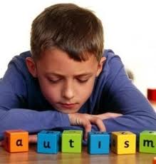
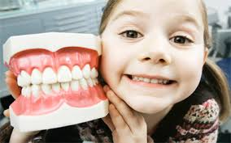
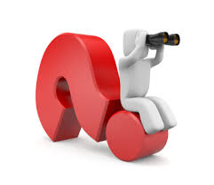
Outline
1. Overview of Autism Spectrum Disorder (ASD)
2. Oral health and ASD is it a problem?
what’s the evidence?
3. What we wanted to find out…
4. How we did it…
5. What the key results tell us…
6. What can we do about it?
7. A way forward…

Slide 3
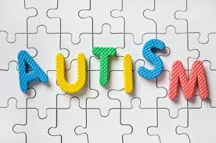
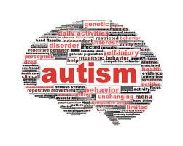
What is Autism?
Social
communication
difficulties
Repetitive
behaviours
Neurodevelopmental condition
- Cluster of disorders…
  1% population and increasing
    More than combined number of children with cerebral palsy,
    diabetes, deafness, blindness and leukaemia.
    Gender ratio 4:1 between males and females
  Symptoms vary in severity
  Highly heritable but 85% unknown cause
  No ‘cure’ = life-long condition and no standard Tx
  Often presents with many other difficulties & co-morbidities
  e.g., ADHD, ID, OCD, Epilepsy, Sensory Processing Difficulties, Sleep or GIT Problems
  Effects on family are significant
    e.g., high parental divorce of any childhood condition
Social
Difficulties
Repetitive
Behaviours
Deficits in
Communication
Notes:
Autism is a neurodevelopmental disorder characterised by impairments in language and communication, social interactions and restricted and repetitive behaviours. Under the DSM IV there were three criteria’s of impairments or a triad of impairments, and three autism labels (autism or autistic disorder; PDD-NOS and Aspergers Syndrome (which essentially is HFA). Since, May 2013 and the release of DSM V, the social and language core impairments have been combined to make the criteria a dyad of impairments rather than a triad of impairments (social communication and RRB).
ASD is an umbrella term that is often used and I will most likely use autism and asd interchangeably in my talk today.
Autism affects at least 1 in 100 people with most recent prevalence rates coming out of US from CDC state that Autism affects 1 in 88 people.
With an explosion of an unexplained 25 fold increase in autism over the last few decades.
It is often said that if you have met one person with autism – you have met just one person with autism and that’s because the characteristics of their autism are essentially unique to them, having their own strengths and weakness in the three domains that I’ve just describe.
It is a highly heritable condition and at present there is no cure nor standard tx for ASD.
ASD is a life-long condition that can be further complicated by some individuals having other sig medical problems
Due to its pervasive and debilitating nature, and ongoing therapy and behavioural management of individuals with autism this collective impact is enormous on families daily living. So it is no surprising that Autism families have the high rate of marriage dissatisfaction or divorce when compared with other childhood disorders.

Slide 4
Autism & Implications for Oral Health
Clinical features of autism:
Communication difficulties
expression and comprehension
Attention and hyperactivity deficits
Repetitive and uncooperative behaviours
Anxiety/depression
Impaired executive function
Emotional dysregulation
Altered pain receptors
Sensorimotor deficits – sensory processing
sensory stimuli over-responsivity
Dietary factors – selective eaters
  edible rewards = carbohydrate intake
✪ Influences the ability to receive:
Oral Care
Dental visit
Treatment & Management
Prevention
At – risk for tooth
decay
Notes:
So what type of impact does autism have on the individual and what are the implications for oral health.
Communication deficits effect their ability to express needs and concerns, and understand others.
Coupled with inattention lead to comprehension issues, and in understanding for eg dental treatments or post operative care plans.
Individuals with autism have in general heightened levels of anxiety with dental visits posing even greater anxiety. And in some cases other comorbid conditions like depression that once again impact on their capacity to deal with dental situations.
Other features of ASD can present as poor executive function – the inability to plan, organise, coordinate and process information and behaviours.
Emotional outburst and decreased pain perception.
Sensory processing difficulties can trigger escalation in behaviours and over-responsiveness to various elements in the environment…causing potential melt downs. Or adding to the already heightened anxiety level.
Many people with ASD also have restricted diets and tend to eat certain types of foods like for eg: only white food…pasta,rice, bread…refined carbohydrates. Or, receive many sugary treats or rewards for good behaviour or efforts during therapies or through out the day. All of which contributes to increased levels of food intake, freq acid attacks.
To add, over 50 % of individuals with ASD are usually taking some form of psychotropic medication (SSRI or antipsychotics) which typically have general side effects – dry mouth, reduced salivary flow hence reduced saliva’s natural buffering capacity and thus predisposes people with asd who are taking medication to increased risk of caries experience.
As you can see all of these factors either directly or indirectly influence the ability of individuals with asd to care for themselves, attend dental visits, receive dental tx , perform OH and act on appropriate preventive strategies.

Slide 5
More Background
So what has Oral Health got to do with Autism?
1) Integral to general health & well-being
2) Poor oral health associated with chronic conditions & mental illness
(Anders and Davis, 2010; Sischo, 2011; Kisely, et al., 2015)
Priority area in the National Oral Health Plan (2015-2024)
People with autism represent a high-risk group for oral health problems
Identified as a dentally disadvantaged population
Notes:
So now that we understand the impact of ASD on oral health we also now understand that asd has plenty to do with oral health, But most importantly oral health is integral and important for general health and well being.
We’ve got some evidence that tells us that Poor oral health has been linked with mental illnesses and chronic conditions.
People with disabilities have been identified as a priority group in the NOHP and I’ve just presented an excellent rationale as to why they present as a high risk group for oral health issues.

Slide 6

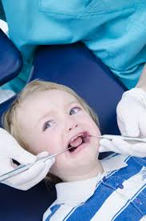
Background Cont’d
No specific reports in Australia about dental health of people with autism
Globally, limited scientific information and inconclusive but few studies showed:
rates of…
      dental disease compared to the general population
        Poor oral hygiene and dental habits
          Dental anxiety -ve experience & stress
              Early years - vulnerable period
                Life-time of oral health problems
Notes:
To date there are no designated reports about oral and dental health of people with asd. At the global level there are only few reports that have reported on individuals with asd, with some inconclusive results however in general the rates of ….

Slide 7


AIM of this Study
To gather descriptive data about oral & dental health
of children with autism
To identify…
oral health status
  dental needs
    oral care routines and practices
      barriers to oral hygiene
        previous experience / dental visits
          access & barriers to dental services
            what may assist…?

Slide 8
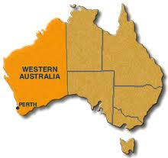
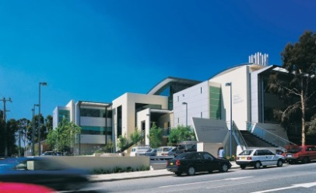
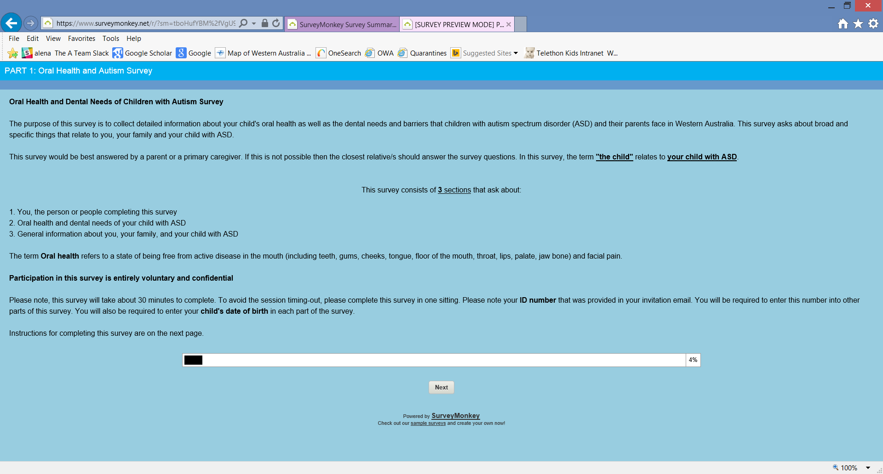
Methods
Sampling frame – Western Australian Autism
Biological Registry (WAABR)…now…
Australian Autism Bio-bank (CRC for Living with Autism)
Online Survey n=74 (October 2014 – April 2015)
Parents of children (diagnosed) with autism
self-completed about…their
Children aged 2-17 years
Notes:
WAABR or the CRC AA Biobank is essentially a storehouse of autism data, it’s a comprehensive study that collects phenotypical and biological information on children and adolescents with asd and their biological parents to identify the causes of autism by studying genetics and behaviours.
We adopted an online survey method for this study and received 74 responses from primary caregivers about their child with asd.

Slide 9

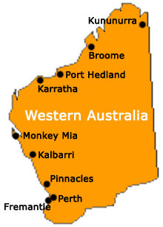
Methods Cont’d
Measures used:
WAABR CHQ
Oral Care and Sensory Measure (Stein, 2012)
Special Needs Measure
Child and Teenager Dental Survey
Parent Perception Questionnaire
Family Impact Scales
WHO QoL
(ARCPOH, 2012)
Comprehensive Oral Health Survey of children with Autism
Notes:
The online survey was developed from a range of existing measures (from Uni of South California – thru a collaborator Amy Stein and items derived from a number of surveys developed by the Australian Research Centre for Population Oral Health at University of Adelaide. We also included the World Health Organisation Quality of Life scale and asked the carers or parents to rate themselves on this scale.
So in general relevant items were used or adapted to ask parents about various aspects of their child’s oral habits, hygiene routines and care, dental visits experience and barriers when seeking dental treatments. And the final product resulted in a comprehensive online oral health, dental needs and barriers survey of children with asd.
Unfortunately due to time restrictions and the extent of the data I’ll only be presenting key survey results.

Slide 10
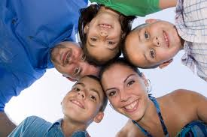
Participant Characteristics
Characteristics | N=74 n (%) | Mean (±SD)
Parents: Mother Father Both parents Caregiver | 68 (91.9) 4 (5.4) 1 (1.4) 1 (1.4)
Main Language at home*: English Other | 64 (97.0) 2 (3.0)
Child’s Gender*: Female Male | 8 (12) 59 (88)
Child’ age |  | 10.92 (5.92)
Family Income#*: Below Poverty <47,800 Above Poverty >$47,801 | 7 (11.9) 45 (76.3)
Maternal Education*: High School Completion or less Trade Qualification Bachelor or higher Degree | 18 (30.5) 6 (10.2) 35 (59.3)
* Missing values #Threshold for the ‘family poverty line’ in Australia (Melbourne Institute of Applied Economic and Social Research, 2014)
Notes:
So now lets have a look at the type of people that engaged with the survey…

Slide 11
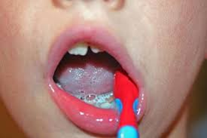
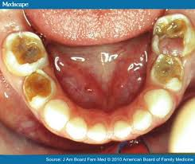
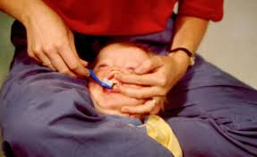
Key Survey Results
40% of children had oral health problems
  stained teeth
  halitosis
  dental decay
  53% of children required physical, verbal or visual supports to brush their teeth everyday
  55% of parents experienced difficulties with their child’s oral care at home
Notes:
and what did the parents tell us…

Slide 12
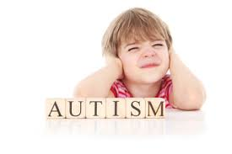
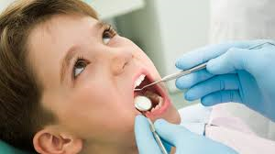
Key Survey Results Cont’d
“My child doesn't understand why he has to brush his teeth. And dislikes doing so”
“…he refuses to brush teeth”
“ he has…sensory issues about the whole thing”
“The main issues we have found are around sensory and anxiety issues to the sounds, taste, lights and sitting still.”
“ …(he) has to be reminded and assisted everyday - just wouldn't do it unless prompted”
Notes:
To support these figures…parents also left us with these comments that capture and support the quantitative data…

Slide 13
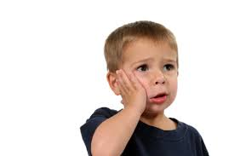
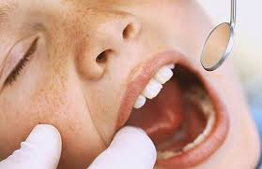
Key Survey Results Cont’d
25% of children had a very bad experience at the last dental visit
32% of children would feel afraid or anxious to visit the dentist again…reasons:
oral instrumentation
bright lights
smells and sounds
= Sensory Sensitivities
Notes:
One quarter of parents reported that their child……
While just over one third said that their child…
And this has been signified as a major issue for people or children with ASD.

Slide 14
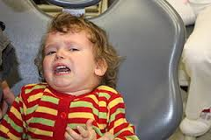
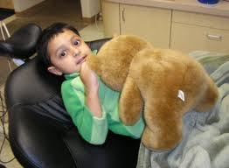
Key Survey Results Cont’d
20% of children required routine dental treatment under general anaesthesia…
due to
  Extreme anxiety
  Uncooperative behaviour
  Inability to tolerate oral instrumentation
Notes:
Further more, the survey revealed that that one in five children required to have….

Slide 15
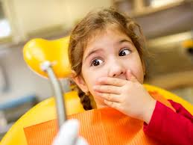
Key Survey Results Cont’d
53% of parents identified barriers when seeking dental services…most commonly reported:
  Unwilling dentists
  Lack of operator skills to adequately manage and treat children with autism

Slide 16
Key Survey Results Cont’d
“…school dentists - not willing to treat children with disabilities“
“…dentist had no skills for special needs children”
“…lack of knowledge about who will see people with disabilities”
“…wait time needed to get to see a dentist…they're always full”
Notes:
Once again, few parents further commented on those quant items and this allowed us to gather some valuable data that provides us with insight as to the barriers experiences by people with asd.

Slide 17
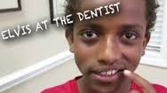
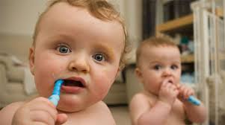
Key Survey Results Cont’d
70% of parents indicated they want to learn more about…
Oral hygiene for their child with autism
Develop or access dental social stories
Learn about desensitisation to daily oral care
and dental visits
Notes:
The vast majority of parents told us that they’d like to learn more

Slide 18
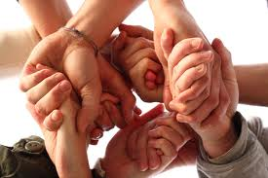
Key Survey Results Cont’d
“We only recently successfully attended a dentist in October (2014) after nearly 8 years of zero dental input”
“…they could ask questions on the initial form (medical history) for more information about the condition (autism) and talk to parents before (dental) visits and treatment”
“…(develop) social stories”
“…more time allocated to give the person with autism time to look, feel and process what's going on”

Slide 19
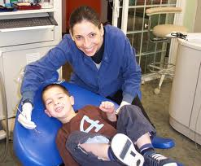
Conclusions & Looking Forward
Identified an urgent need to address oral and dental health of children (and people) with Autism
We need to develop…
  Specific dental education for parents of children with
  Autism
Educational tools; teach modifiable strategies
that are Autism friendly (for home care and dental
settings)
Improve child, parent and operator dental
experience

Slide 20

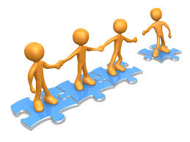
Looking Forward…
Develop industry and all sector partnerships
promoting and delivering oral health to disadvantaged populations should be everyone’s business! Public and Private!
Gather more evidence – improve dental reporting and surveillance
direct oral examinations
Forge a Vision = Develop a sustainable dental action and prevention plan for dentally disadvantaged population
i.e., children (and people) with Autism
We need to continue this conversation so it
gains momentum!
Notes:
As Leoni said yesterday “it’ll take a village to get this to develop but it can be done… and done very well with the right approach, commitment, persistence and resources that are sustainable.

Slide 21

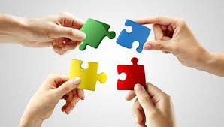

Collaboration
Dr Kate van Dooren
Dr Nick Lennox
Ms Lyn McPherson
QCIDD |
Queensland Centre
for Intellectual and
Developmental Disability, The University of Queensland
n=74
Parents of children and adolescents with Autism
Target at least 30 adults with ASC
Online Survey (x2) of Oral and Dental Health Needs and Barriers of
People with Autism
Notes:
What else are we doing in the research space to further this area…we are also interested in finding out what are the dental needs and barriers for adults living with ASC… so we are collaborating with UofQ to gather adult with ASC self reported data. So we can look at the differences or similarities across the life span that affect various individuals with autism. So we can better understand their dental problems

Slide 22
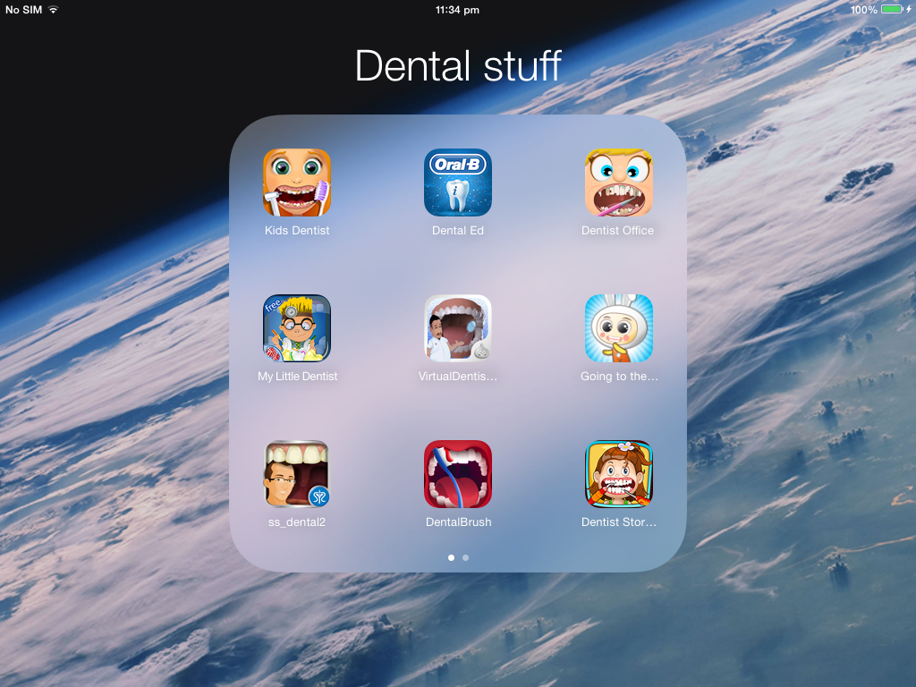
Future Plans = Innovation
To develop an interactive ‘virtual’ educational iPad App addressing the needs of dental patients with autism
Notes:
What do we think is the future for a specific educational program… we feel that the rigth iPad App holds the key to this approach…because tehr eis nothing out there that is specific for or comprehensive enough to cut the mustard so to speak…

Slide 23

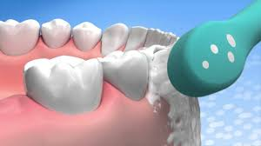
iPad App Innovation
Target: children with autism aged 3-8 and parents
iPad App will include educational modules:
Combining dental education, oral health promotion and sensory profiling
2) Virtual dental landscape using principles of
desensitisation to tailor to children’s needs
3) Social stories – context specific

Slide 24
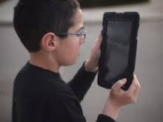

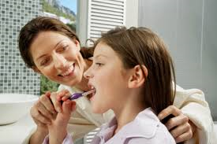
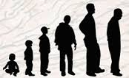
Innovation = potential to make a difference!
iPad = a highly accessible platform to create…
  Awareness
    Education
      Give skills and empower
        Prepare and anticipate
          Seek dental services
            Improve dental experience
              Encourage continuing dental care across the lifespan
Notes:
We feel that this is a plan that is very much doable, realistic, relevant and would be beneficial and helpful to families living with autism but also to practitioners who are willing to treat and dentally manage people with autism.
We feel that the pervasive nature of digital media in the lives of young people and families these days presents as a perfect opportunity and a popular landscape to hit the mark and make a difference to individuals and families affected by disability.
This type of App has the potentially to significantly increase awareness; improve knowledge thru education; give skills to child and parent and empower parents to feel more confident and take control over the child’s oral hygiene and daily care.

Slide 25
Final (Parent) Comment…
“Thank you for conducting this research! I pray that there is an excellent outcome for autistic people's ability to access relevant dental health experiences in the future. We were literally in dental 'limbo' for nearly 10 years with no hope of seeing a dentist due to our earlier negative experiences with dentists…many dentists. It's taken me years to help my children be able to successfully see the dentist in October 2014 and we are currently working with a psych AND our dentist to continue to support both our children to have a pleasant experience, as we have YEARS ahead of us of orthodontic treatments for both of them. Thank you for seeing dental therapy as a burden for families with ASD children and seeking a solution for us! :-)”
(Mother of two boys with autism)
Notes:
Lastly, I want to share this last slide with you…it’s a survey comment made by a parent of two boys with autism. I think it encapsulates the dental health issue for children with autism and supports this study and inspires us to charge forth to make a difference for people with autism and beyond.

Slide 26

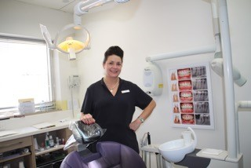
Notes:
Thank you and I welcome your questions and comments on this issue.

Slide 27
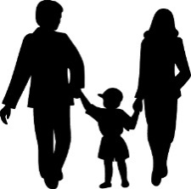
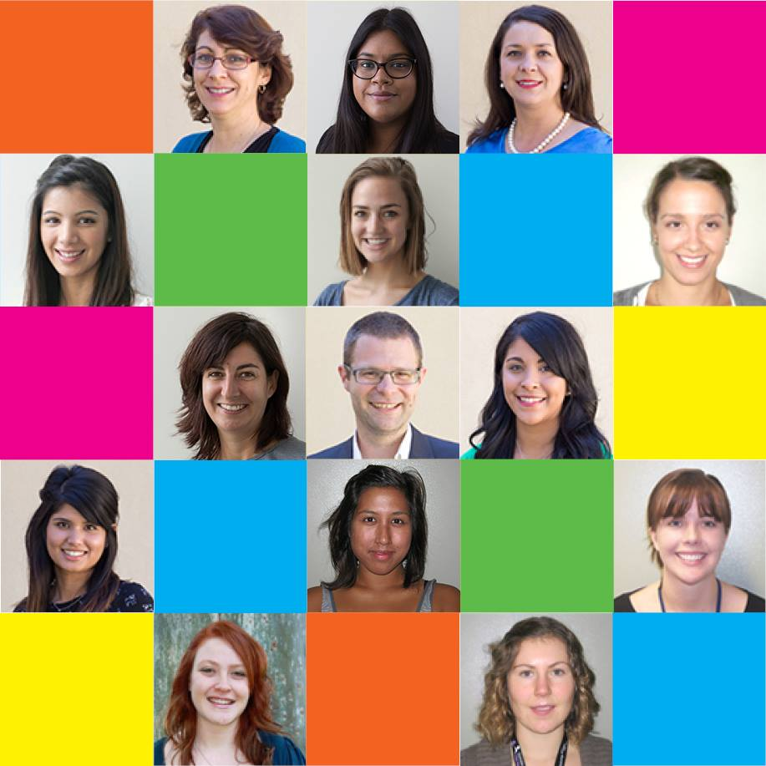
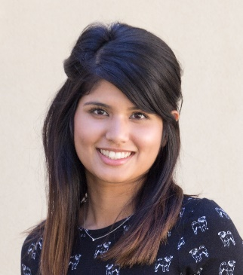
Acknowledgements
WAABR Children and Parents
Investigators
Ms Anna Hunt
Dr Ashleigh Lin
Prof Andrew Whitehouse
Miss Alena Dass

Slide 28
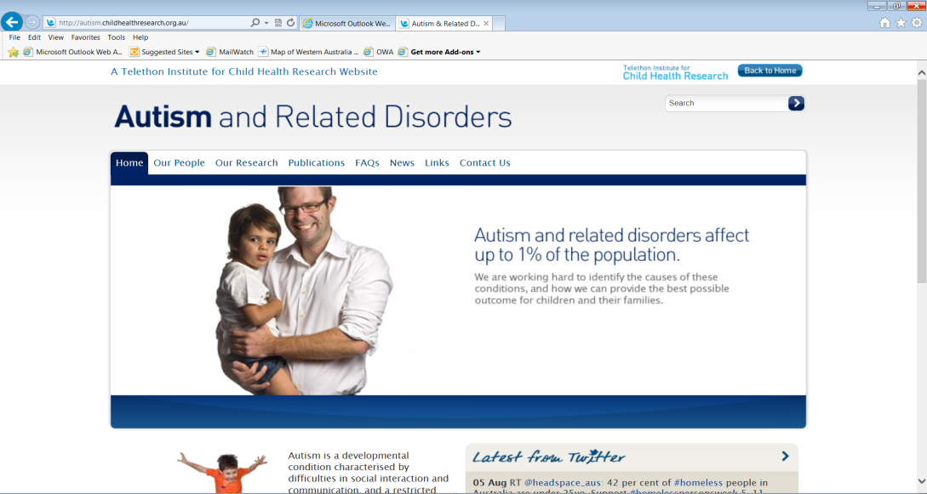



For Further Information…
autism@telethonkids.org.au
joanna.granich@telethonkids.org.au
autism.telethonkids.org.au
www.facebook.com/TelethonKidsAutismTeam

