Slide 1
The influence of sulfide ion on viscosity of HPAM solution used in oil recovery and the concerning mechanisms
East China University of Science and Technology
Jinfeng Liu
21th July, 2016
Notes:
1

Slide 2
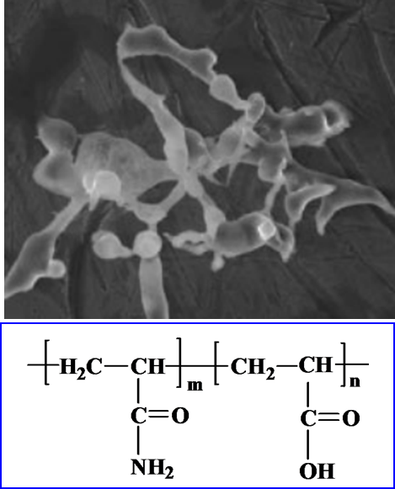
Sulfide influence on HPAM viscosity
and the concerning mechanism
Background of this research
Clasification
Anionic / Cationic
Nonionic
Zwitterionic
Properties
M_{W} : 0.2-20×10⁶ Da
Hydrophilic, Good water solubility
Flow property, Flocculation……
Applications
Oil-displacing agent
Regulator / stabilizer of drilling fluid
Water treatment agent
The structure and property of HPAM
Feng Y, et al. Polymer International, 2002, 51(51):931-938

Slide 3
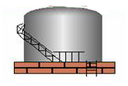
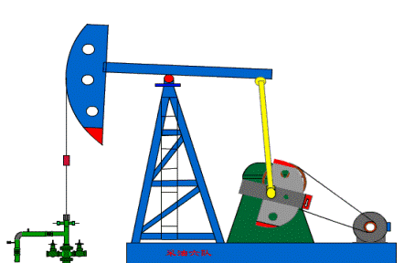
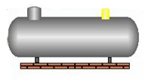
Sulfide influence on HPAM viscosity
and the concerning mechanism
Background of this research
Viscosity reduction negatively and notably influenced the HPAM flooding effect
Physical factors: pH, Temperature, Salinity, Shearing and etc
Biological factors: Biodegradation …
Production
Injection
Oil reservoir

Slide 4
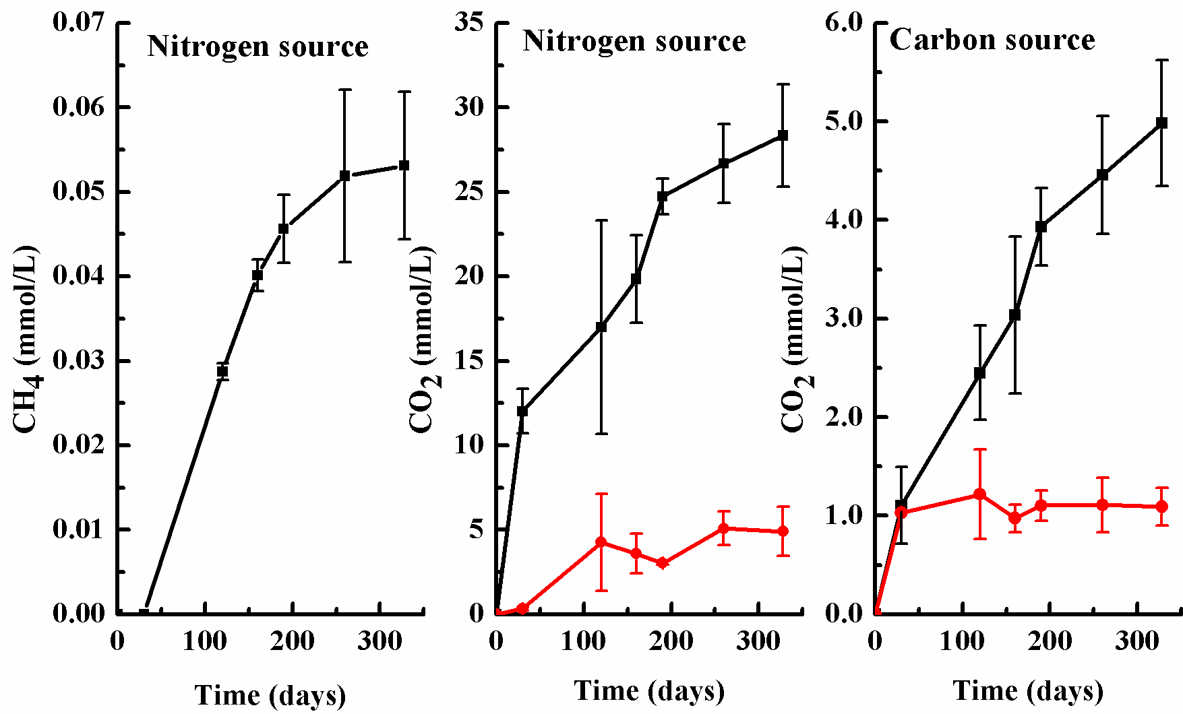
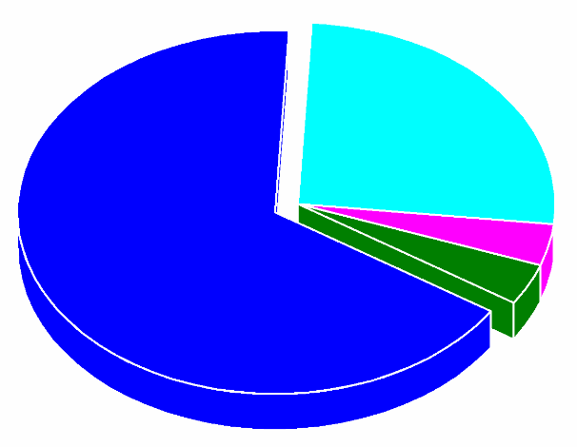
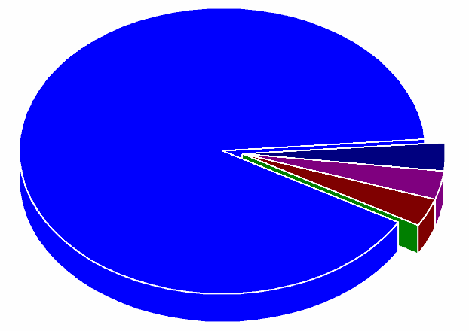
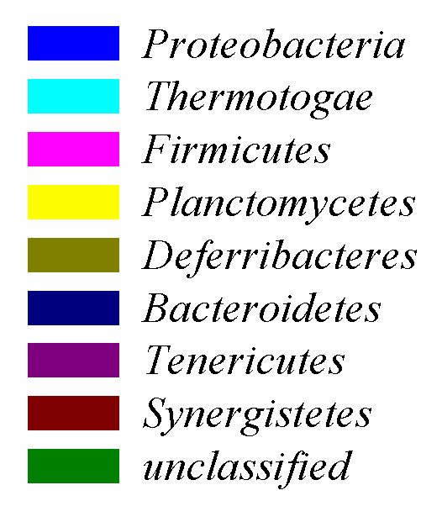
Sulfide influence on HPAM viscosity
and the concerning mechanism
Background of this research
氮源
碳源

Slide 5
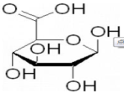
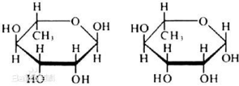
Sulfide influence on HPAM viscosity
and the concerning mechanism
Background of this research
Pseudomonadaceae
Flavobacteriaceae
Clostridiales Incertae
Campylobacteraceae
Desulfobulbaceae
Rhodocyclaceae
Alcaligenaceae
Bacteriovoracaceae
Comamonadaceae
Oxalobacteraceae
Moraxellaceae
Methanomicrobiales
Thermoplasmatales
Methanosarcinales
HCOONa
CH₃COONa
CH₃CH₂COONa
CH₃CH₂CH₂COONa
CH₄
CO₂
H₂S
-CONH₂
NH₃
NH₄⁺
NO₂⁻
NO₃⁻
SO₄²⁻
S²⁻
HS⁻
Fe²⁺
Fe(OH)₂
H₂O
FeS
4 Fe²⁺
4 Fe⁰
Li Cai-Yun et al. Journal of Hazardous Material, 2016

Slide 6
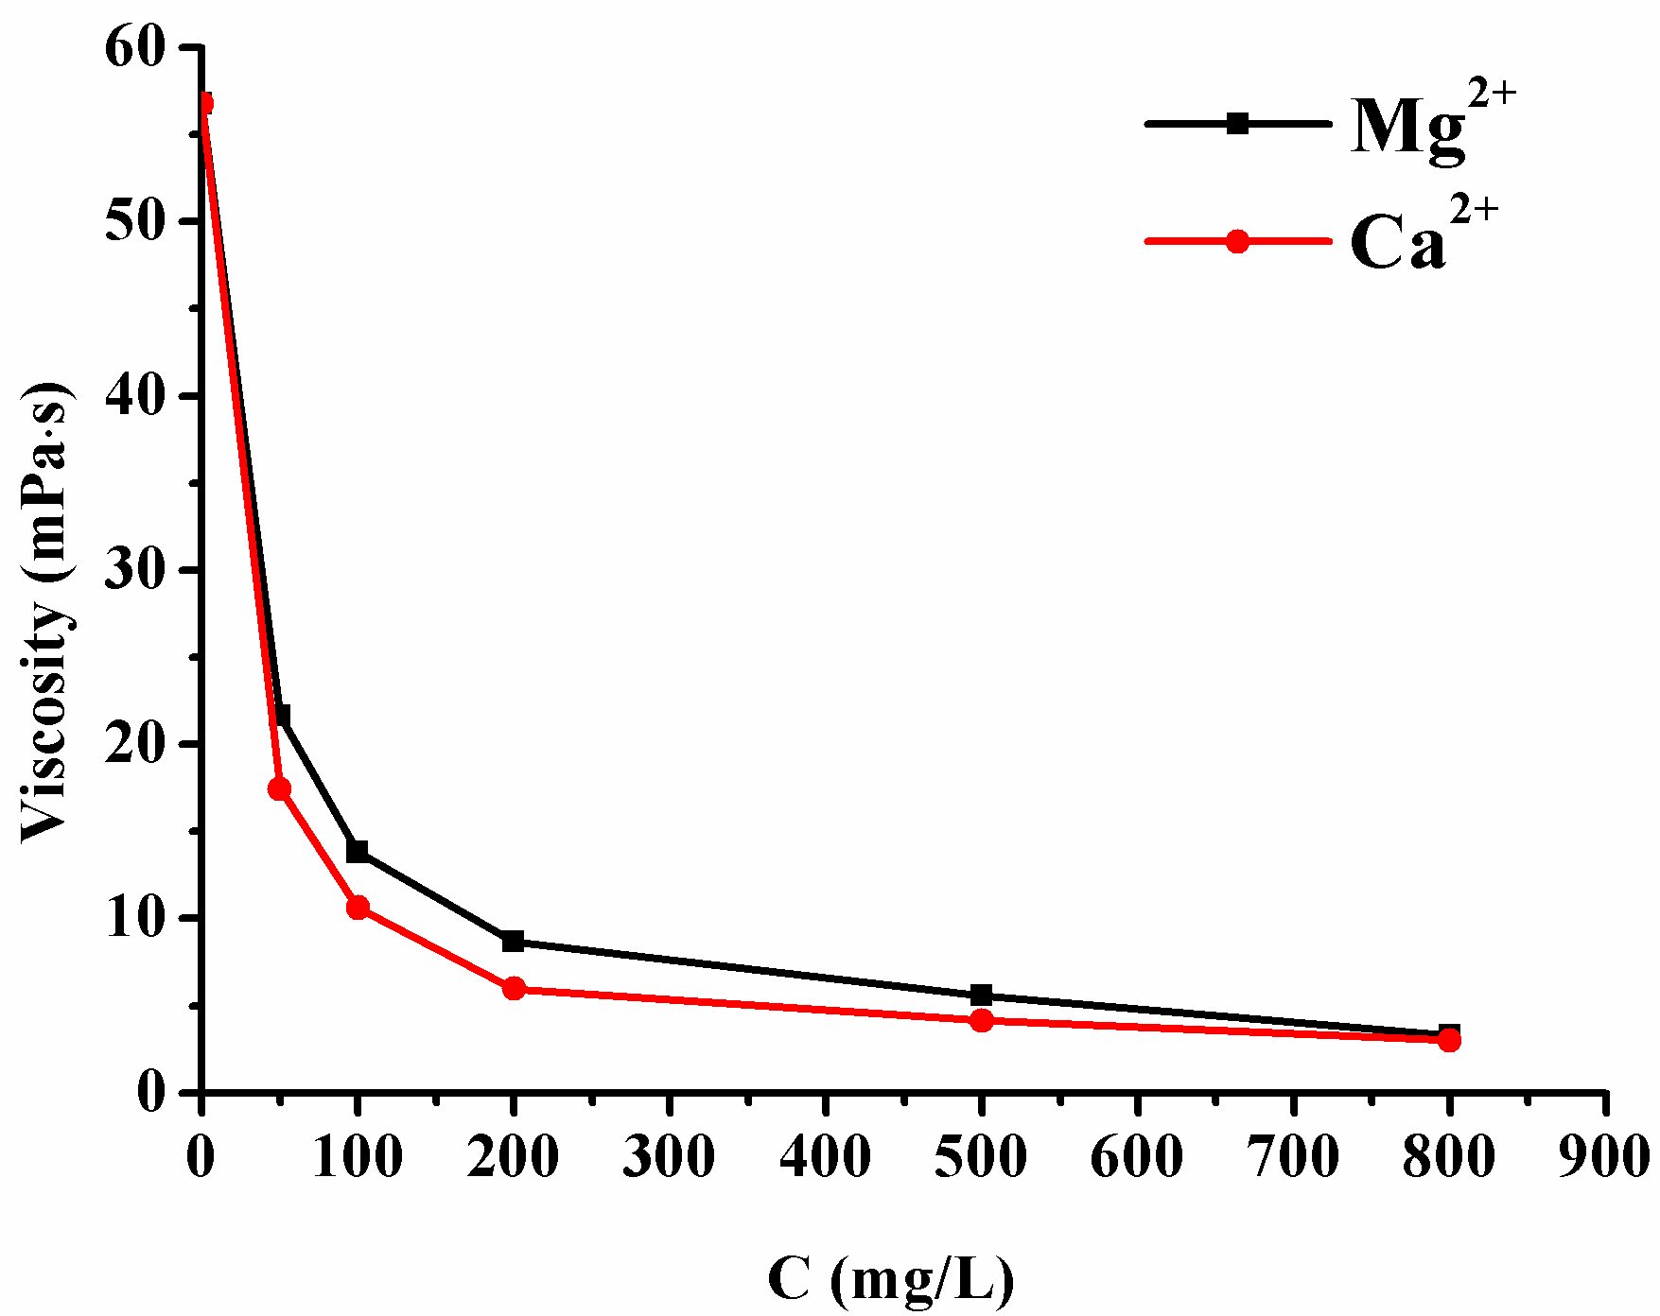
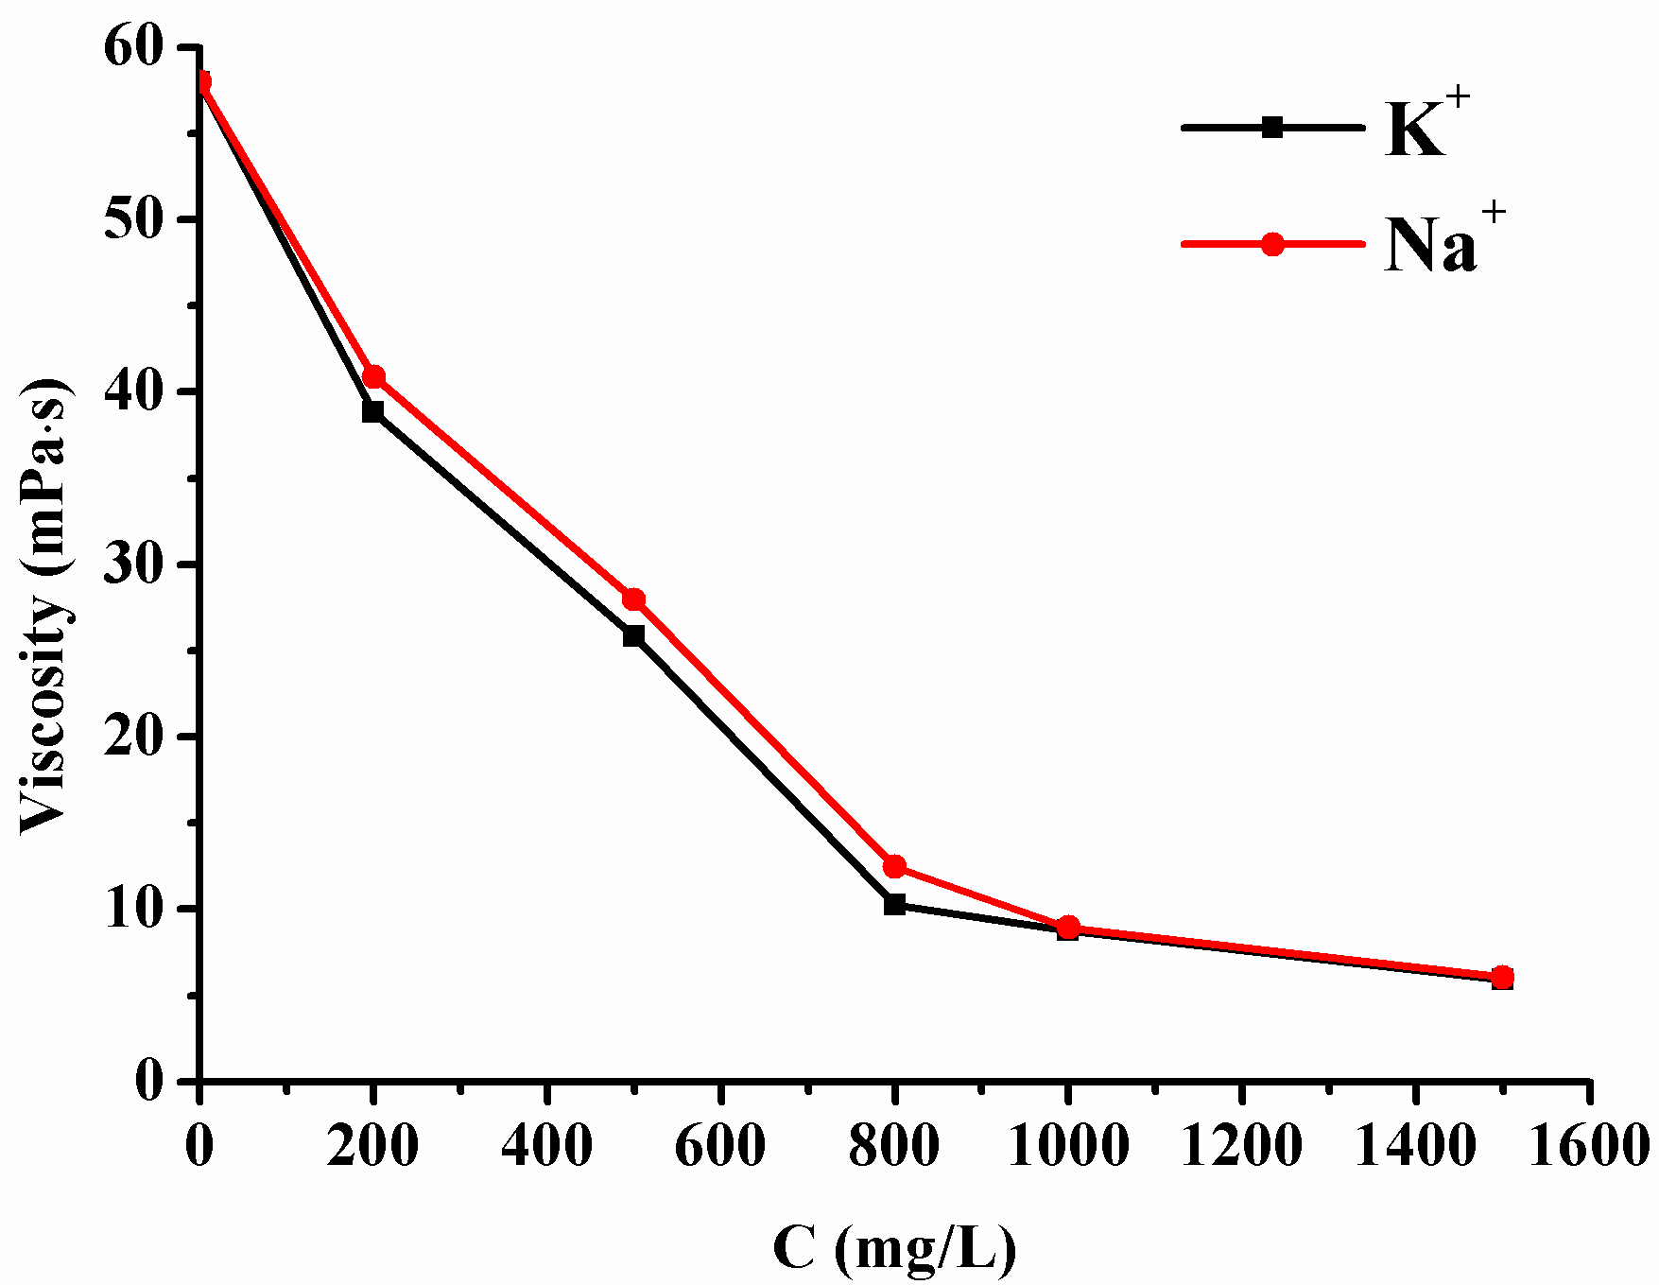
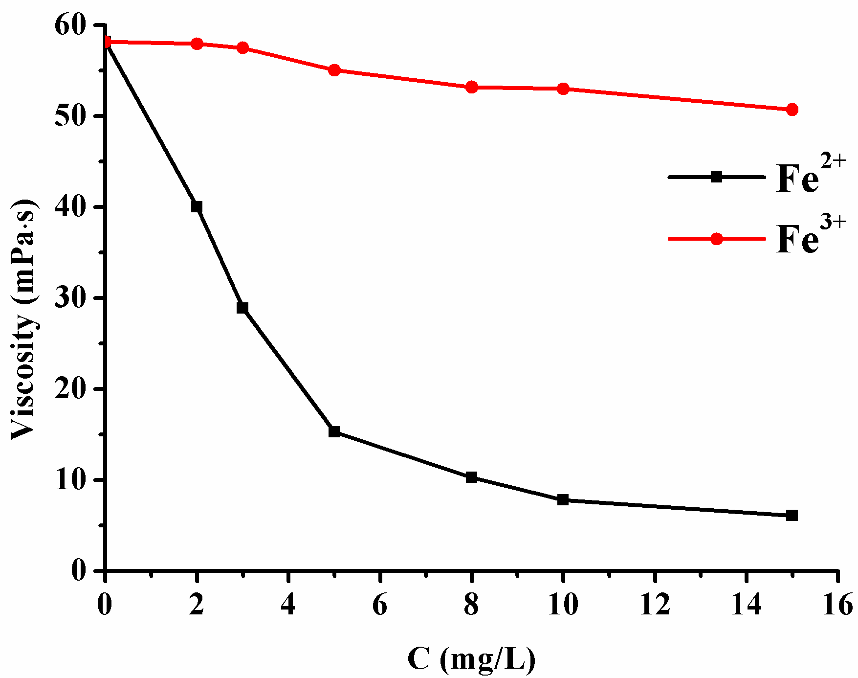
Sulfide influence on HPAM viscosity
and the concerning mechanism
Background of this research
Mg²⁺ / Ca²⁺ effect on viscosity of HPAM solution
Na⁺ / K⁺ effect on viscosity of HPAM solution
Fe²⁺ / Fe³⁺ effect on viscosity of HPAM solution

Slide 7
Sulfide influence on HPAM viscosity
and the concerning mechanism
Background of this research
Mechanical shear force exceeds the range of tolerance force of HPAM / Well Characterised
Viscosity decreases with increasing temperature. Dramatically under acidic conditions / Well Characterised
Shearing
Ions
Tem & pH
Microorganisms
The higher cation valence, the greater effect on the viscosity, / Well Characterised
Biodegradation reduces the viscosity via scission of HPAM backbone chain / Characterised
Principal factors impacting on HPAM viscosity

Slide 8
Sulfide influence on HPAM viscosity
and the concerning mechanism
Background of this research
?
Viscosity
Cl⁻
NO₃⁻
CO₃²⁻
Influence of S²⁻ on HPAM viscosity
S²⁻
Anion

Slide 9
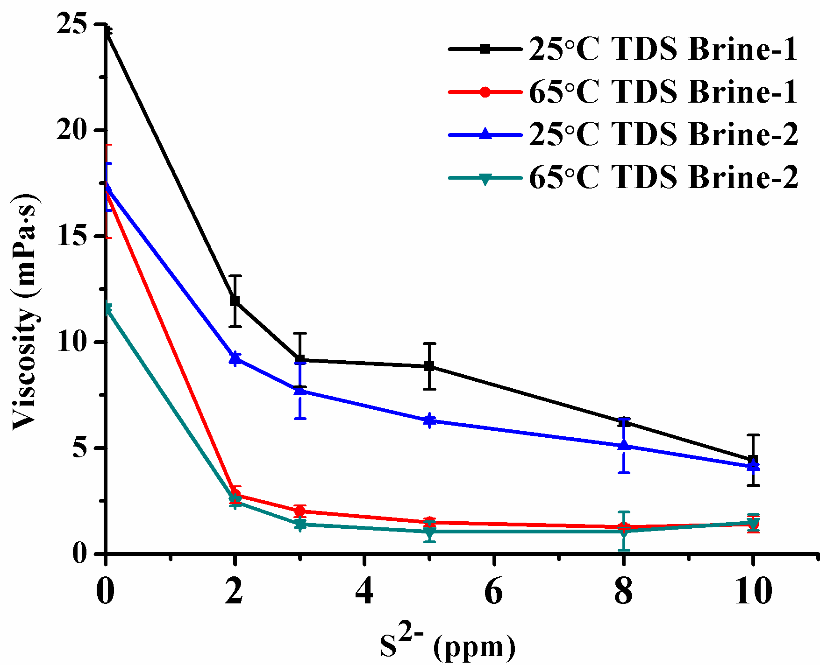
Sulfide influence on HPAM viscosity
and the concerning mechanism
The influence of sulfide ions on viscosity of HPAM solution
25℃ Brine-1: 5330 ppm
65℃ Brine-1: 5330 ppm
25℃ Brine-2: 12219 ppm
65℃ Brine-2: 12219 ppm
The effect of S²⁻ on viscosity of HPAM solution prepared with simulated formation water

Slide 10
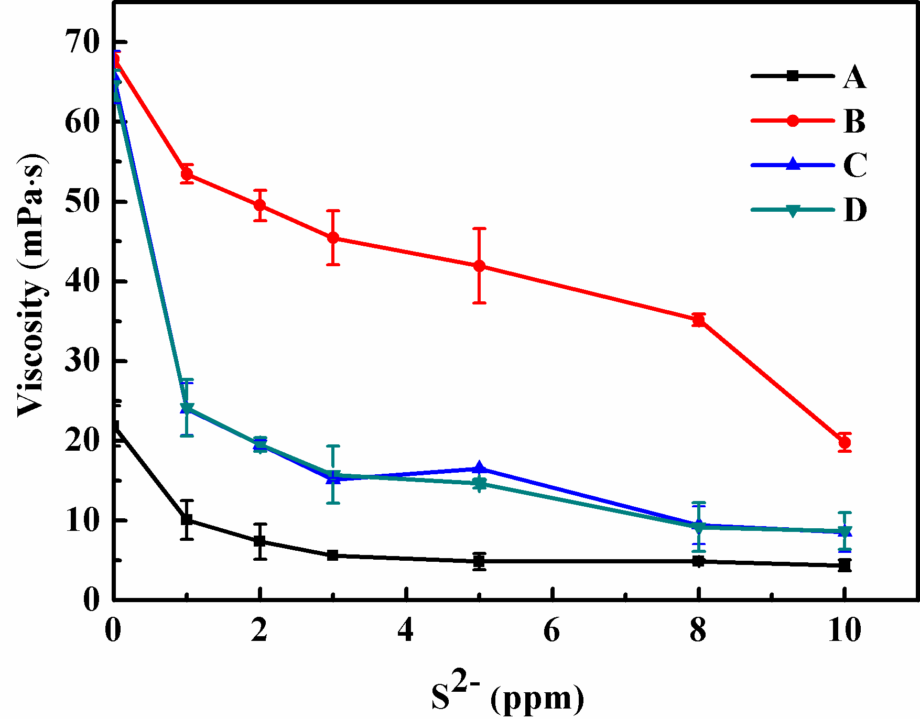
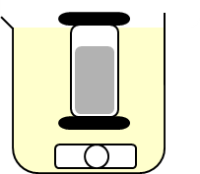
Sulfide influence on HPAM viscosity
and the concerning mechanism
The influence of sulfide ions on viscosity of HPAM solution
S²⁻
72h
HPAM
HPAM+S²⁻
(A)
A
48h
Dialyzate of A
(B)
S²⁻
72h
B
B+S²⁻
(C)
C
Dialyzate of C
48h
(D)
The viscosity of HPAM solution with different concentration of S²⁻ before and after dialysis treatment
A: Viscosity at 72 hrs after addition of S²⁻ B: Viscosity of the 48 hrs dialysate from A
C: Viscosity of B after addition of S²⁻ for 72 hrs;
D: Viscosity of the 48 hrs dialysate from C

Slide 11
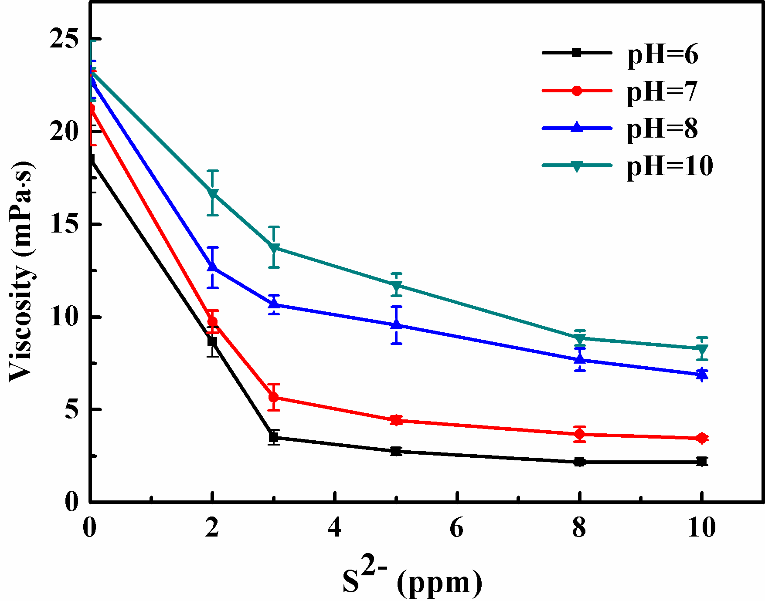
Sulfide influence on HPAM viscosity
and the concerning mechanism
The influence of sulfide ions on viscosity of HPAM solution
The viscosity of HPAM solution under different concentration of S²⁻ and pH conditions

Slide 12
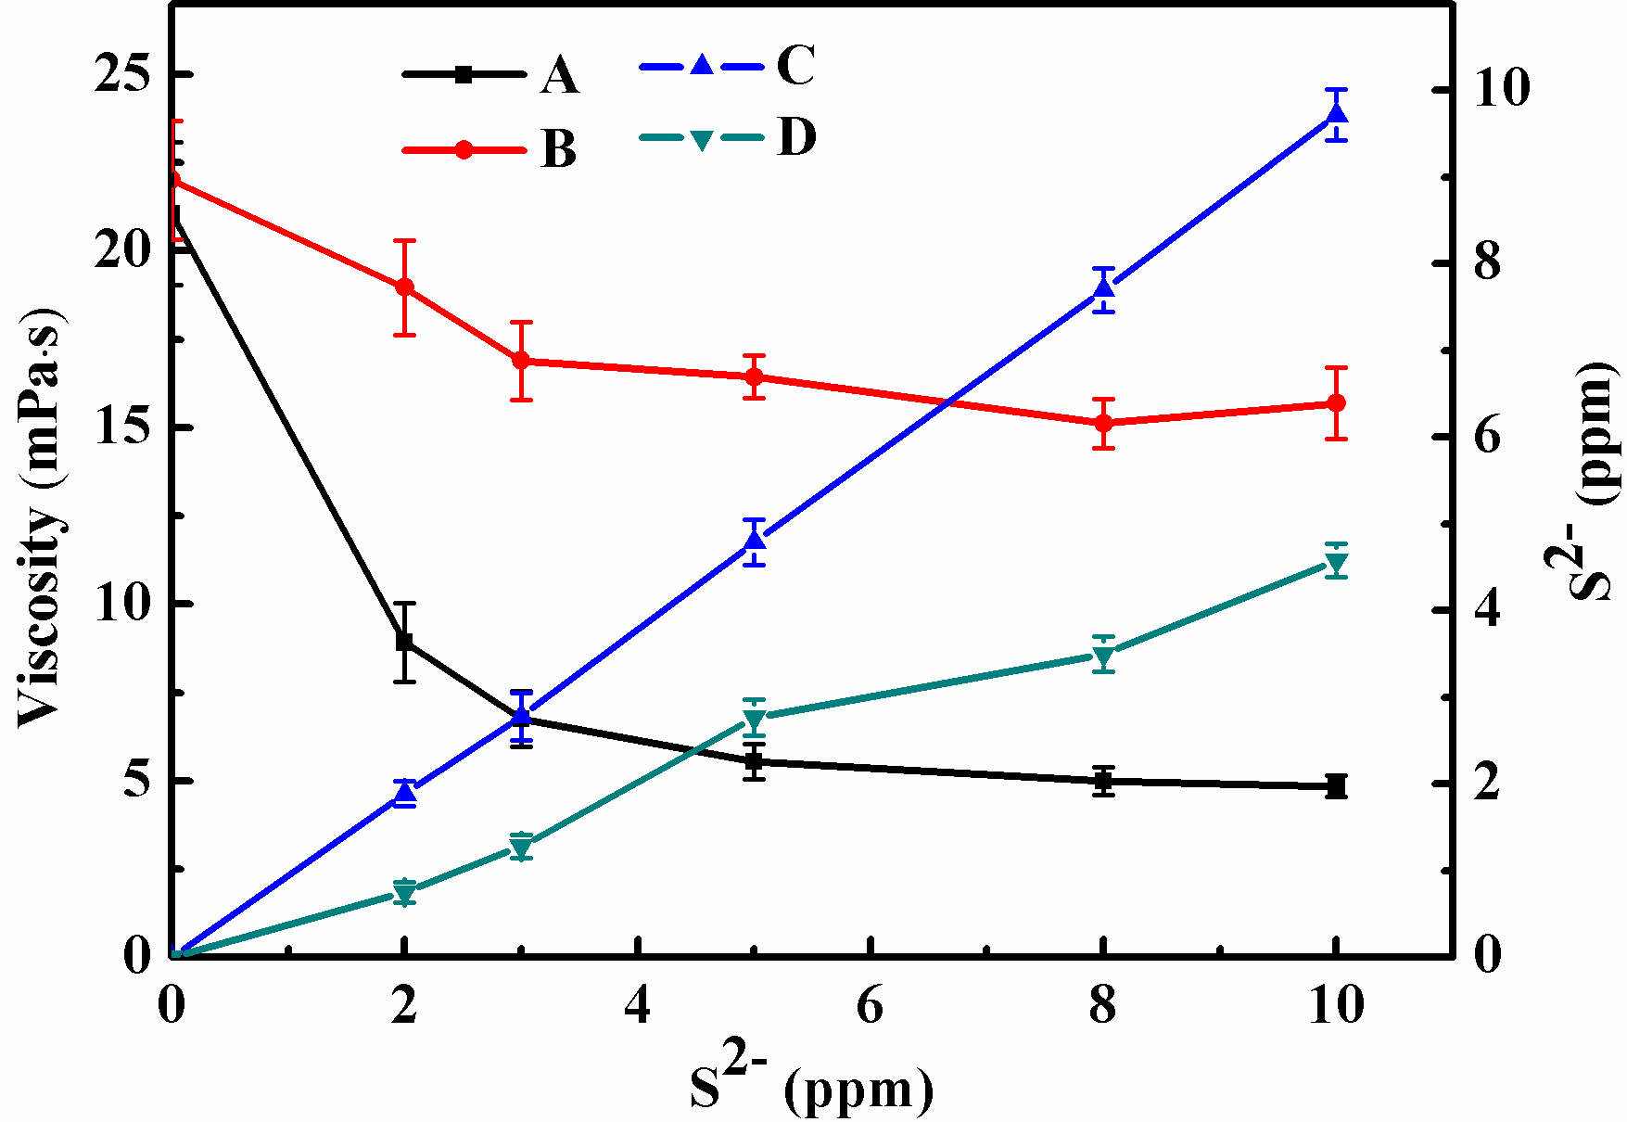
Sulfide influence on HPAM viscosity
and the concerning mechanism
The influence of sulfide ions on viscosity of HPAM solution
Stronger influence of S²⁻ on viscosity of HPAM was observed under DO conditions than that without DO; So, this influence is proposed to be oxygen dependent.
A: Viscosity with S²⁻ under DO conditions D: S²⁻ concentration under DO conditions
B: Viscosity with S²⁻ under anoxic condition; C: S²⁻ concentration under oxygen-free conditions
The viscosity of HPAM solution with different concentration of S²⁻ with and without DO

Slide 13
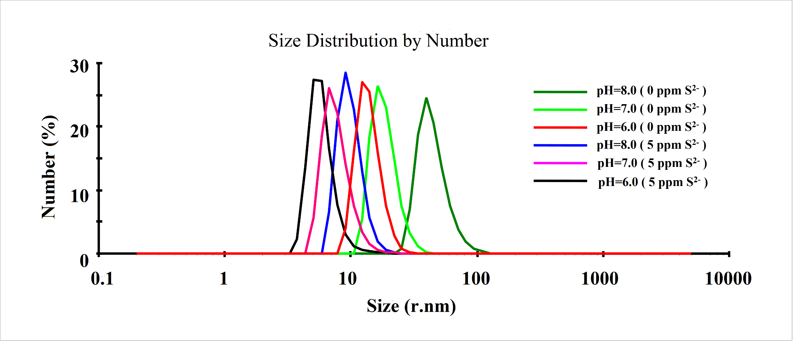
Sulfide influence on HPAM viscosity
and the concerning mechanism
The influence of sulfide ions on hydrodynamic radius of HPAM
Zetasizer Nano ZS90
Detect temperature: 25 ℃
Scattering angle: 173 ℃
Operating wavelength: 633 nm
The change in particle size of HPAM under different concentration of S²⁻ and pH conditions

Slide 14
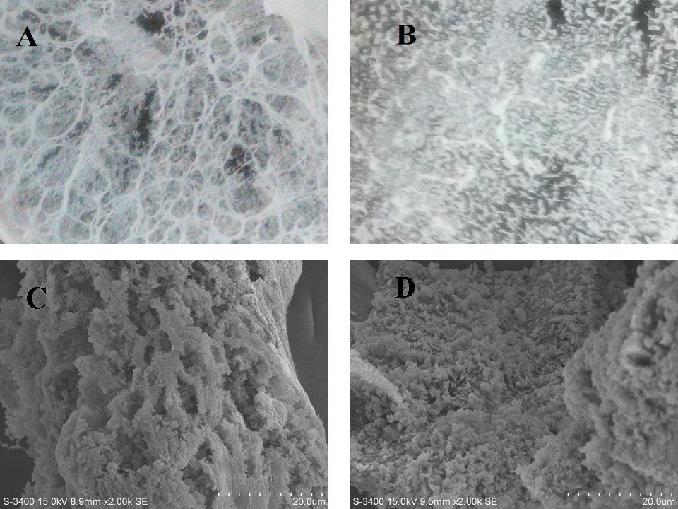
Sulfide influence on HPAM viscosity
and the concerning mechanism
The influence of sulfide ions on microstructure of HPAM
A
B
A&C: 0 ppm S²⁻
B&D: 5 ppm S²⁻
Without S²⁻ (A and C), HPAM forms a network structure, resulting in high viscosity; while S²⁻ added (B and D), the network structure is significantly damaged, thus the viscosity be greatly reduced.
C
D
The micromorphology of HPAM

Slide 15
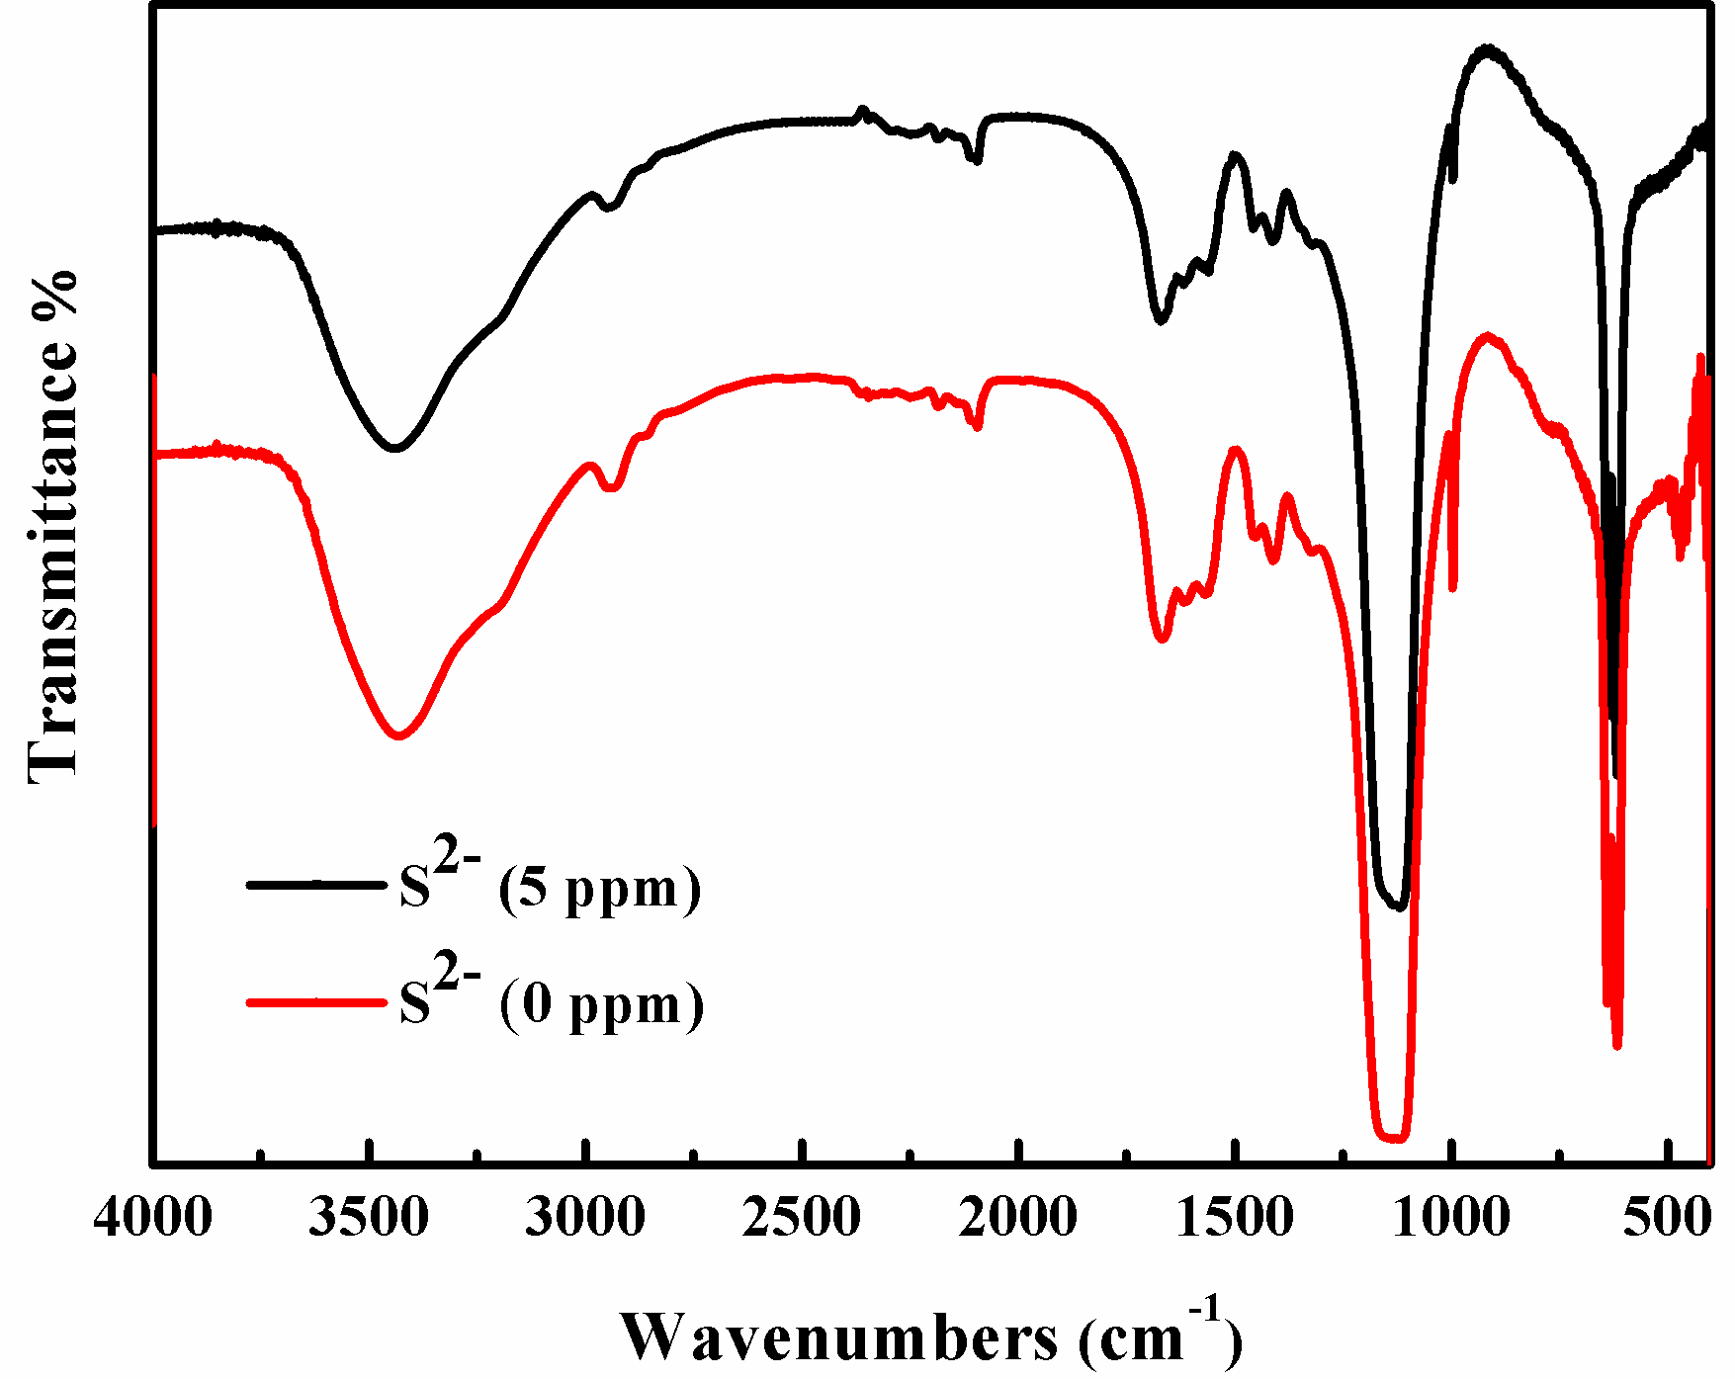
Sulfide influence on HPAM viscosity
and the concerning mechanism
The influence of sulfide ions on the structure of HPAM
N-H: 3100-3500 cm⁻¹
(stretching vibration)
N-H: 1475 cm⁻¹
(bending vibration)
C=O: 1615 cm⁻¹
(stretching vibration)
C-N: 1415 cm⁻¹
(stretching vibration)
C-O: 1130 cm⁻¹
(stretching vibration)
The FT-IR spectroscopy of HPAM before and after interaction with S²⁻

Slide 16
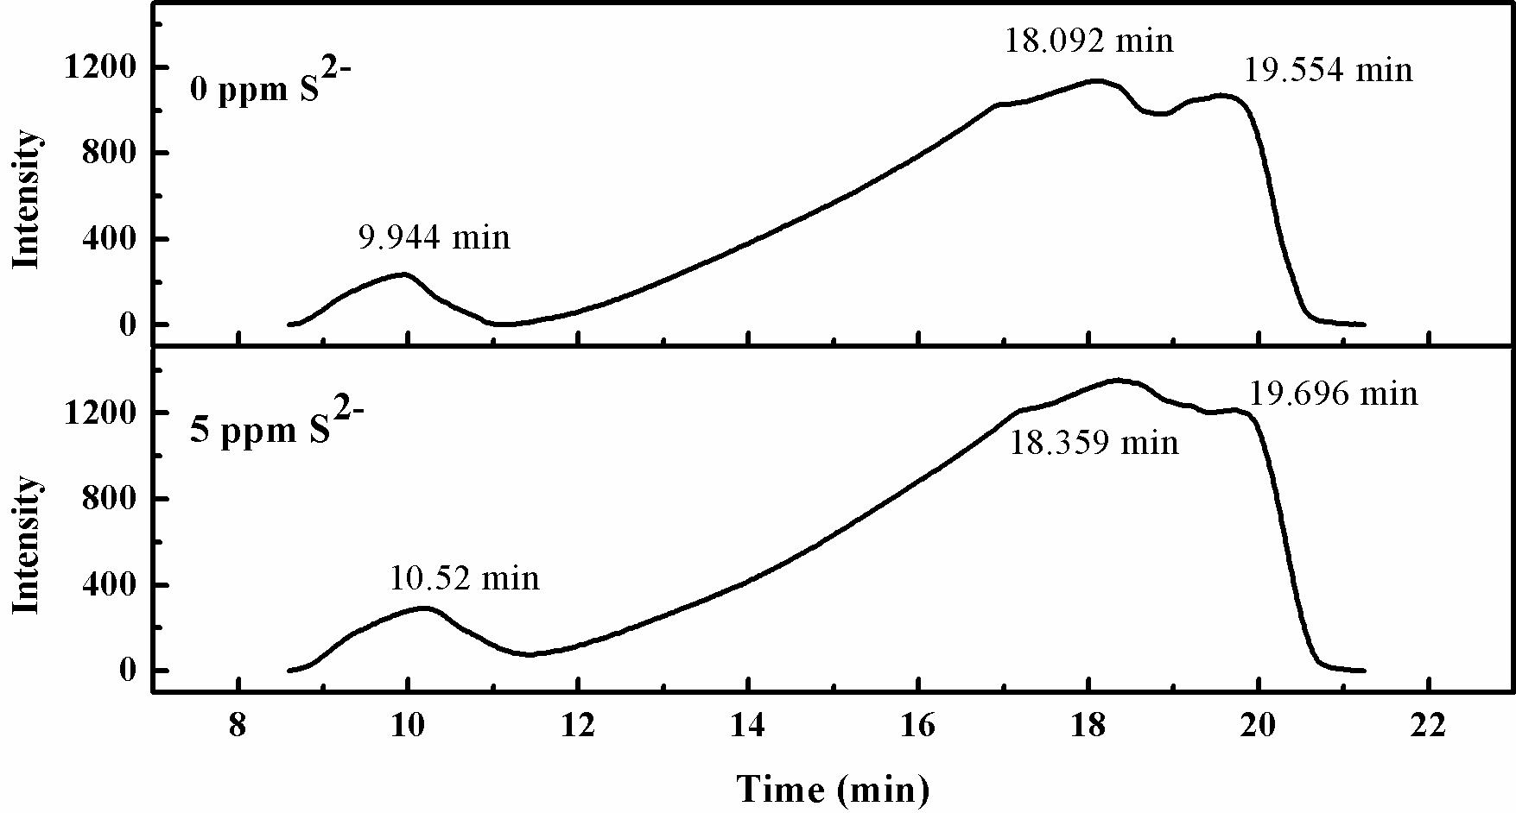
Sulfide influence on HPAM viscosity
and the concerning mechanism
The influence of sulfide ions on Mw of HPAM
The GPC analysis of HPAM before and after interaction with S²⁻

Slide 17
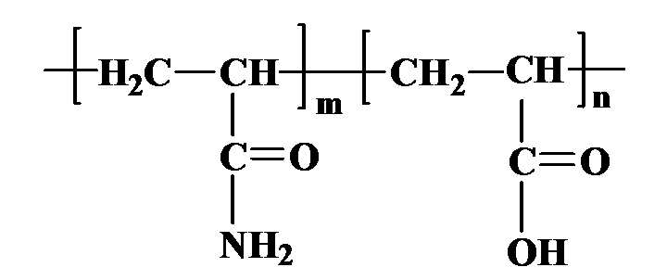
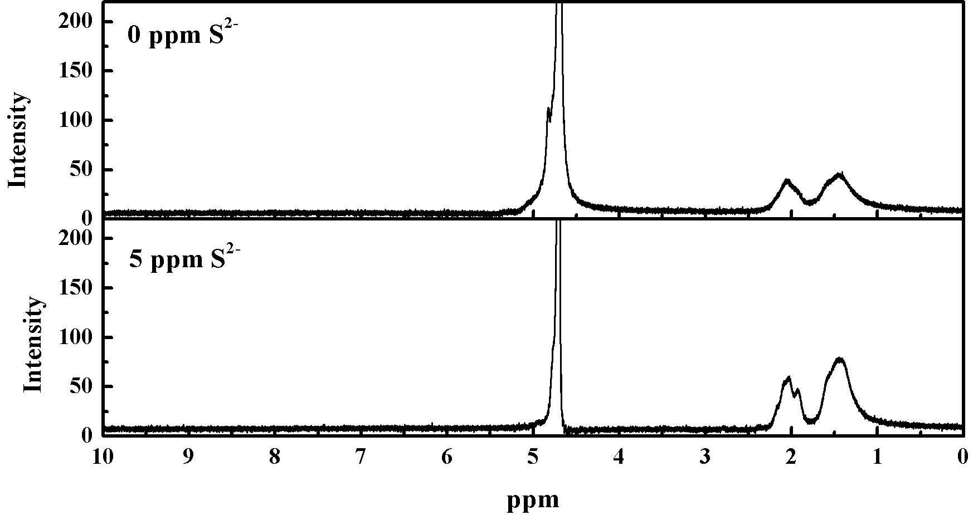
Sulfide influence on HPAM viscosity
and the concerning mechanism
The interaction site of sulfide ions and HPAM
AVANCE III 400 NMR
The ¹H NMR before and after interaction with S²⁻

Slide 18
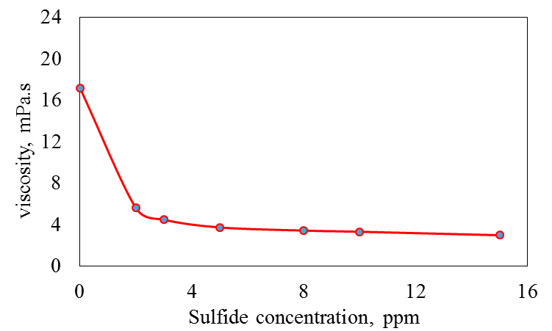
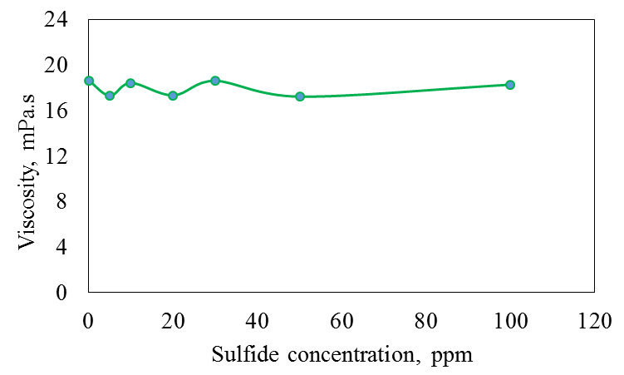
Sulfide influence on HPAM viscosity
and the concerning mechanism
The interaction site of sulfide ions and HPAM
Polyacrylamid
Polyacrylicacid
OH
+S²⁻
+S²⁻
The viscosity of HPAM solution with different concentration of S²⁻ at pH =7
The viscosity of HPAA solution with different concentration of S²⁻ at pH =7

Slide 19
Sulfide influence on HPAM viscosity
and the concerning mechanism
Summary
The viscosity of HPAM solution is sensitive to cationic ions, the sensitivity is in this order as: Fe²⁺ > Ca²⁺ > Mg²⁺ > K⁺ > Na⁺; wherein, Fe²⁺ is the most distinguish one which can significantly reduce the viscosity of HPAM solution at a concentration of 5 mg/L.
Under sufficient oxygen, the lower the pH and the higher the temperature, the more significant the influence of S²⁻ on viscosity of HPAM solution. However, under anaerobic conditions, S²⁻ shows no or not significant effect on the viscosity.
S²⁻ largely reduce the viscosity through destroying the network structure of HPAM in solution rather than cutting down the HPAM chain, and this action is reasonably related to the amid group of HPAM.

Slide 20
Sulfide influence on HPAM viscosity
and the concerning mechanism
INTRODUCTION
Engineering Research Center of Microbial Enhanced Oil Recovery of the Ministry of Education was established in Oct. 2013, and was built based on East China University of Science and Technology. The center consists of four platforms as key Technology Development & Integration, Engineering R&D, Scaling up & Pilot Protocols, and Technology Transfer.
VISION
As one of the leading research center, it strives to attract nurture frontiers in green and sustainable technologies in microbial enhanced oil recovery, and to serve as an open platform for research, technical training, technology transfer, information sharing, and international collaboration.
MISSION
The objectives of the center are focus on cost-effective approaches for enhancement of energy recovery. The on-going tasks include (1) roles of microbial community in-situ petroleum, (2) bio-conversion of residues oils into natural gas in oil reservoirs, (3) microbial and bio-based surfactants, and (4) biofixation and bio-conversion of carbon dioxide to methane energy by geo-microorganisms in-situ oil reservoirs.

Slide 21
Sulfide influence on HPAM viscosity
and the concerning mechanism
Faculty and students in our group
Biodegradation & Products
Microbial communities
Academic members (including Postdoctors)

Slide 22
Thanks for your attentions
East China University of Science and Technology
21th July, 2016

