Slide 1
Track 3
NanoMedicine
Session 2

Slide 2
Magnetic vectoring for drug delivery to tumors: Past, present and is there a future?
December 4, 2014
Nanotek-2014, San Francisco, CA
EJ Auzenne¹, RD Weiss², J Klostergaard¹
The University of Texas, MD Anderson Cancer Center, Houston, TX¹
Arkival Technology Corp, Nashua, NH²
2

Slide 3
Hari S Sharma Uppsala University, Sweden
Nanodrug delivery of a multimodal novel drug Cerebrolysin reduces engineered nanoparticles induced aggravation of heat stroke induced ubiquitin expression and brain pathology
Jerzy Leszek Wroclaw Medical University, Poland
Early detection and treatment of Alzheimer’s disease-­‐Nanotechnology as a tool
Candan Tamerler University of Kansas, USA
Tunable self-nanopatterned fluorescence proteins on metallic surfaces
Anna SalvaI University of Groningen, The Netherlands
Nanoparticle interactions with cells for targeting nanomedicines and potential impact of nanomaterials
Wassana Yantasee Oregon Health and Science University, USA
Bioreducible cross‐linked polymer coated mesoporous silica nanoparticles for targeted delivery of siRNA and chemotherapeutics to HER2+ breast cancer

Slide 4
Viya Fedoseyeva Russian Academy of Sciences, Russia
Types of self-assembling of lengthy Intron RNA presented in the regions of homologue chromosomes somatic pairing
Niren Murthy University of California at Berkeley, USA
In vivo delivery of transcription factors with chemically modified oligonucleotides
Ebru Basaran Anadolu University, Turkey
Ocular application of dirithromycin with chitosan based polymeric nanoparticles
Evrim Yenilmez Anadolu University, Turkey
Formulation and characterization of dirithromycin nanoparticles for topical treatment
Sree Harsha King Faisal University, Saudi Arabia
Optimization of particles size for lung specific drug delivery by way of microspheres

Slide 5
Manuel Fuentes University of Salamanca‐CSIC, Spain
Functional Proteomics for Biomarker and Drug Discovery
Hussein Ammar National Research Center, Egypt
New trends in site-specific drug delivery
ArI Goel Amity University, India
Green Nanotechnology
Archana M Raichur Toyo University, Japan
Strategist PLGA nano‐capsules to deliver siRNA for inhibition of carcinoma and neuroblastoma cell lines by knockdown of proto-oncogene
Lamees Nayef McGill University, Canada
Testing the efficiency of a hybrid nanoparticulate drug delivery system for use in bone regeneration with distraction osteogenesis

Slide 6
EPR (Enhanced Permeability and Retention) Effect
Matsumura, Y., and Maeda, H. (1986) A new concept for macromolecular therapeutics in cancer chemotherapy: Mechanism of tumoritropic accumulation of proteins and the antitumor agent SMANCS. Cancer Res. 46, 6387–6392.
Demonstrated advantages in uptake/retention of macromolecules vs. small molecules/free drugs in tumor vs. normal tissues.
Due to typically chaotic neovascularization of tumors and resultant architectural defects, tumor vasculature is hyperpermeable to macromolecules compared to normal vasculature.
The lymphatic system is also defective or even essentially nonexistent in tumor tissue, causing delayed egress/increased retention of macromolecules/fluid.
Combined with greater interstitial volume of tumor compared to normal tissue, in totality, typically increased uptake/retention of macromolecules by tumors.

Slide 7
Barriers to Successful NP Extravasation into Tumors
Renal filtration
Clearance by mononuclear phagocytes in liver (Kupffer cells), spleen, lung
Transport from plasma into tumor interstitial fluid (e.g., gaps, fenestrations, among endothelial cells lining vessel; mural cells/pericytes)
Distribution within tumor interstitial fluid (e.g., gradient of interstitial pressure, tumor ECM)

Slide 8
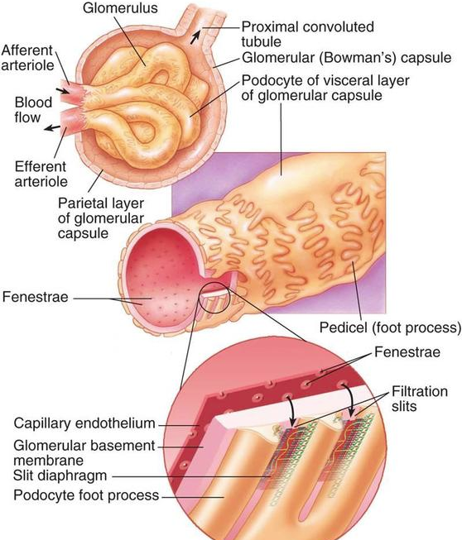
Renal Clearance

Slide 9
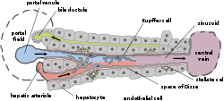
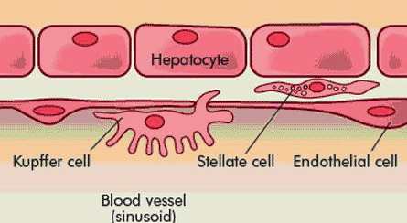
Hepatic Clearance (MPS)

Slide 10
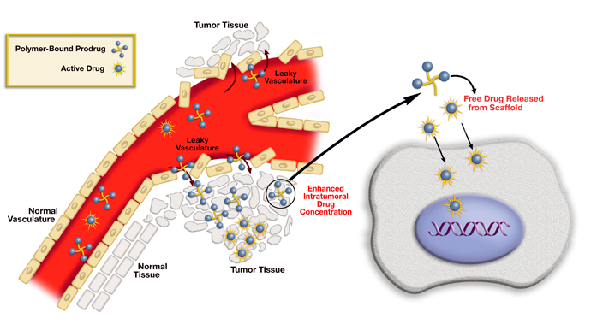
NP Extravasation and Drug Payload Delivery
(largely diffusion controlled)

Slide 11
Early Clinical Experience
Lubbe et al. in Germany reported in 1996 Phase I clinical trial results with magnetic targeting of Epirubicin-loaded magnetite NP in 14 patients.
Key observations:
With magnetic targeting, systemic drug side effects and drug plasma concentrations were reduced.
Macroscopic and slowly reversible skin discoloration due to NPs, corresponding to boundary of over-laying magnets on superficial tumors.
NP accumulation verified by histological techniques
MRI also provided evidence of accumulation/extravasation
Thus, predictions of EPR effect were validated in humans.

Slide 12
The Challenge: to extend beyond current capability of magnetic localization only to superficial tumors to visceral/deeper sites
Superficial Visceral
Locally Advanced Breast Pancreatic
Melanoma/Sarcoma ColoRectal
Focal Recurrent Ovarian
To depths of up to several cm To depths beyond several cm
Gradient created by one magnet/array Gradient created by multiple magnets/arrays
Gradient on axis orthogonal to magnet face Gradient nadir focused on tumor

Slide 13
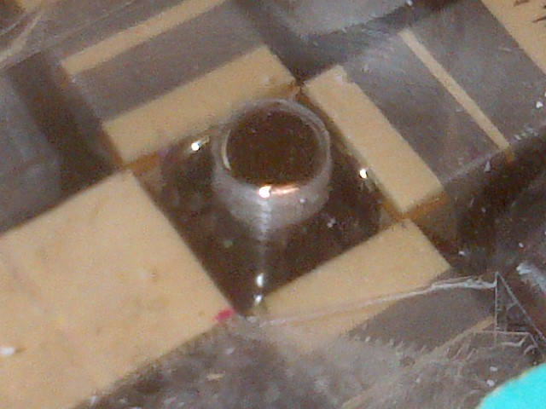
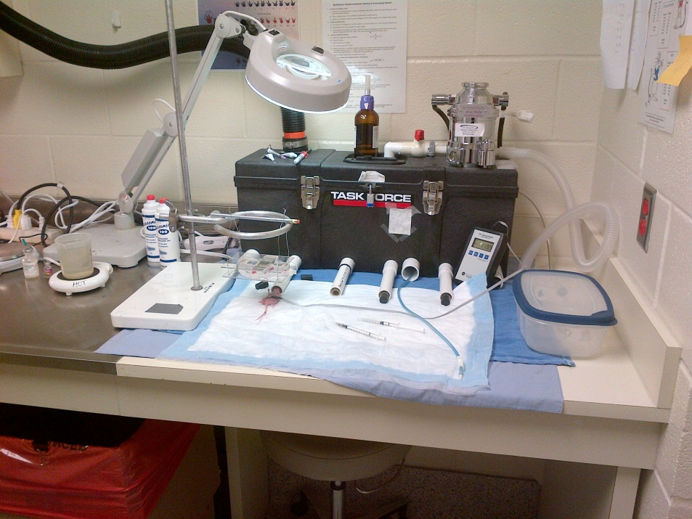
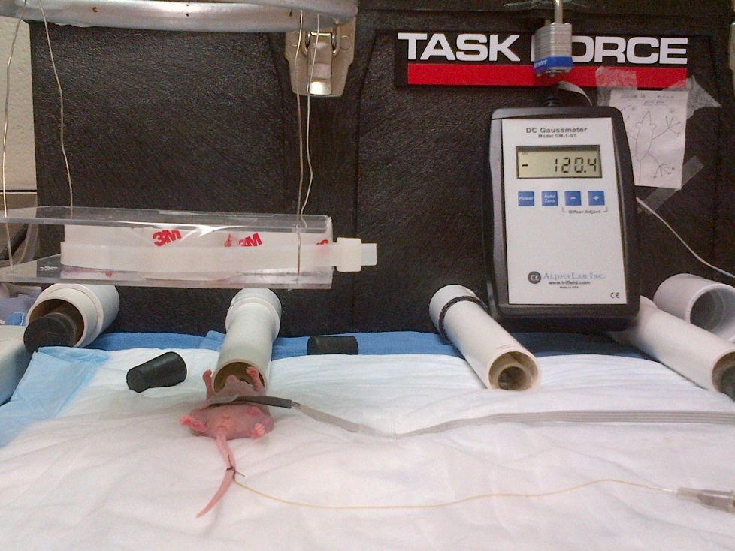

Slide 15
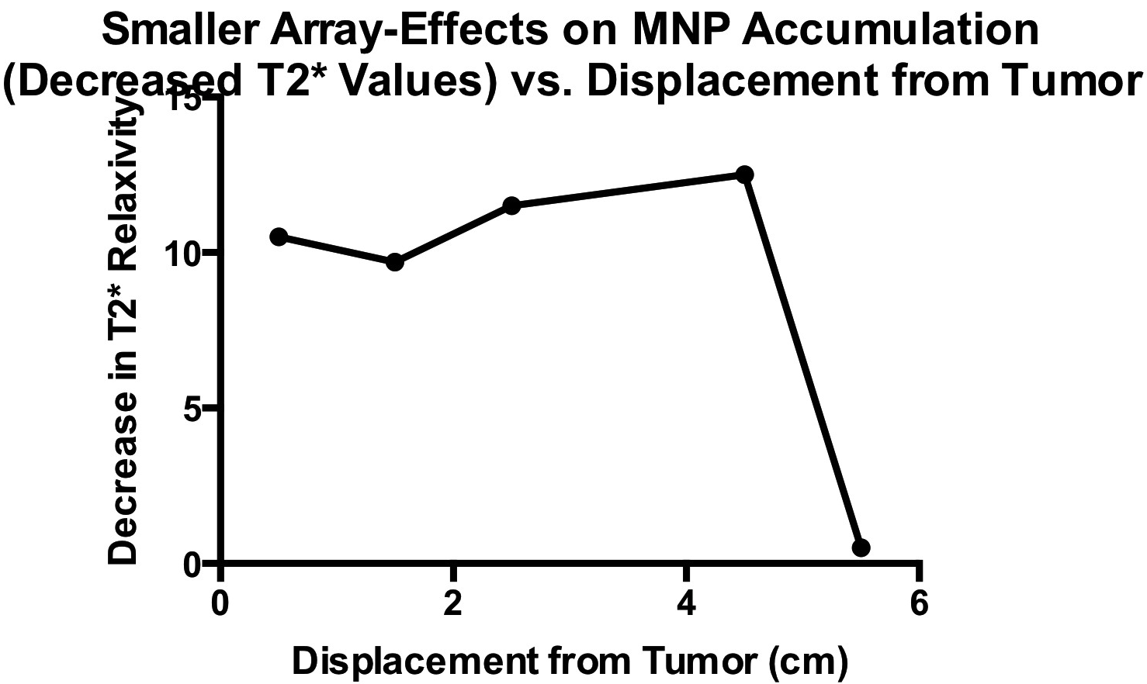

Slide 17
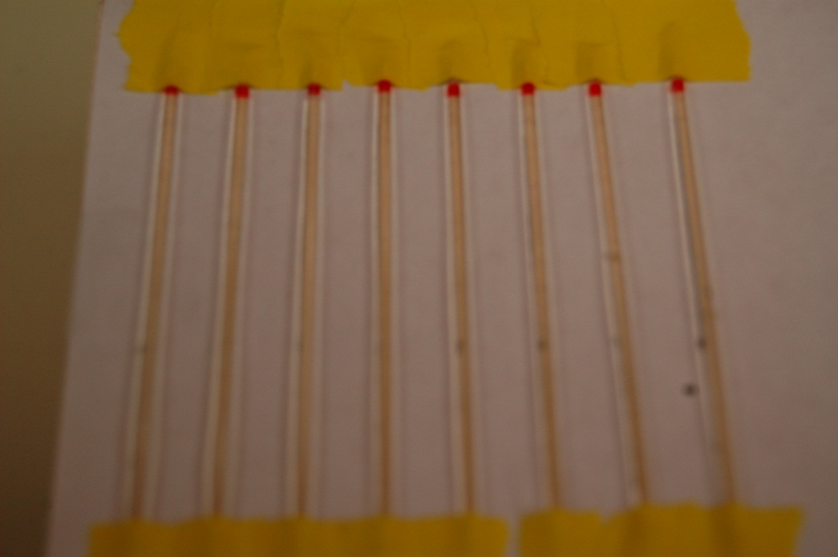
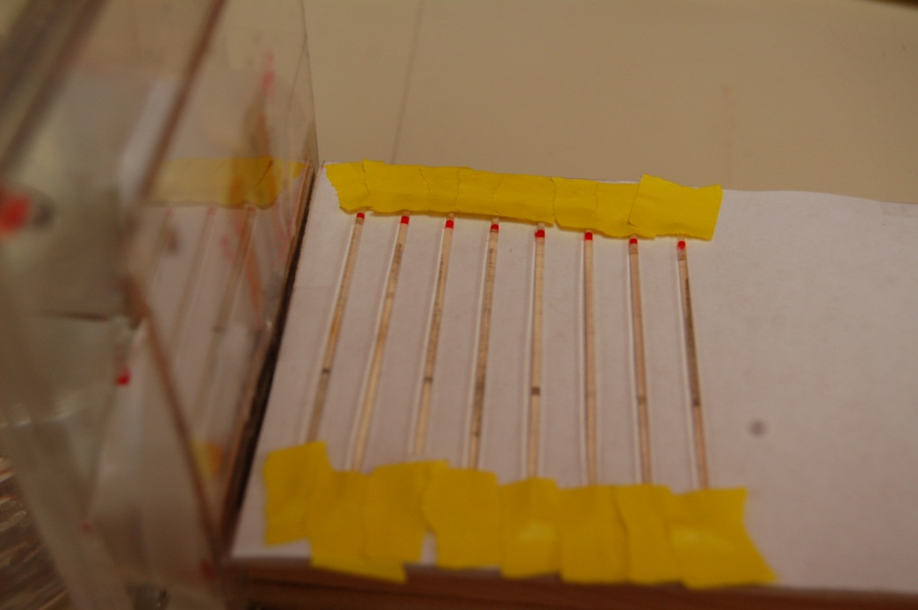
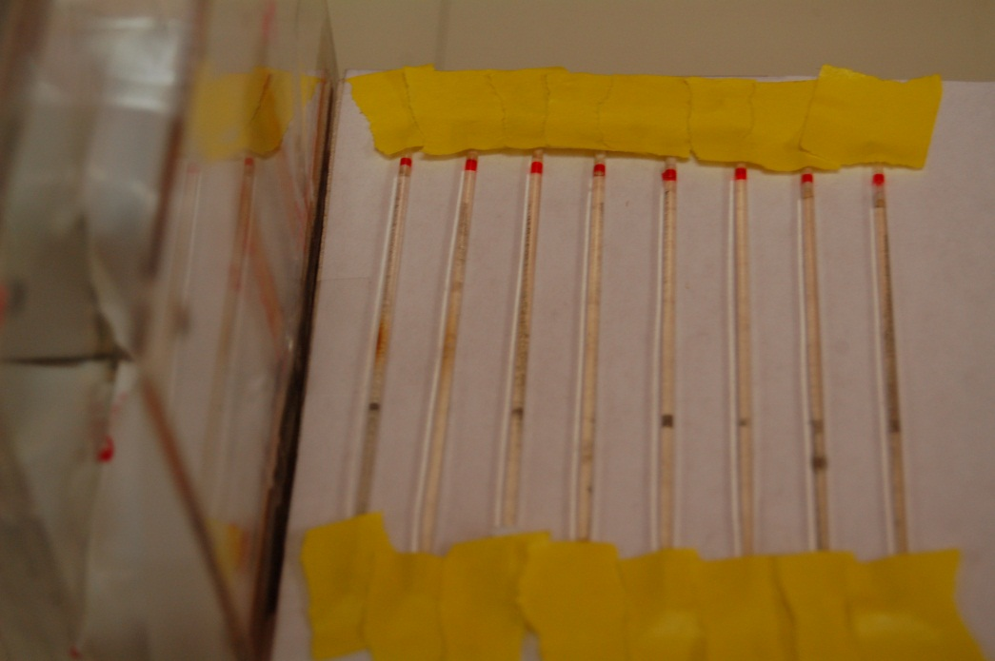
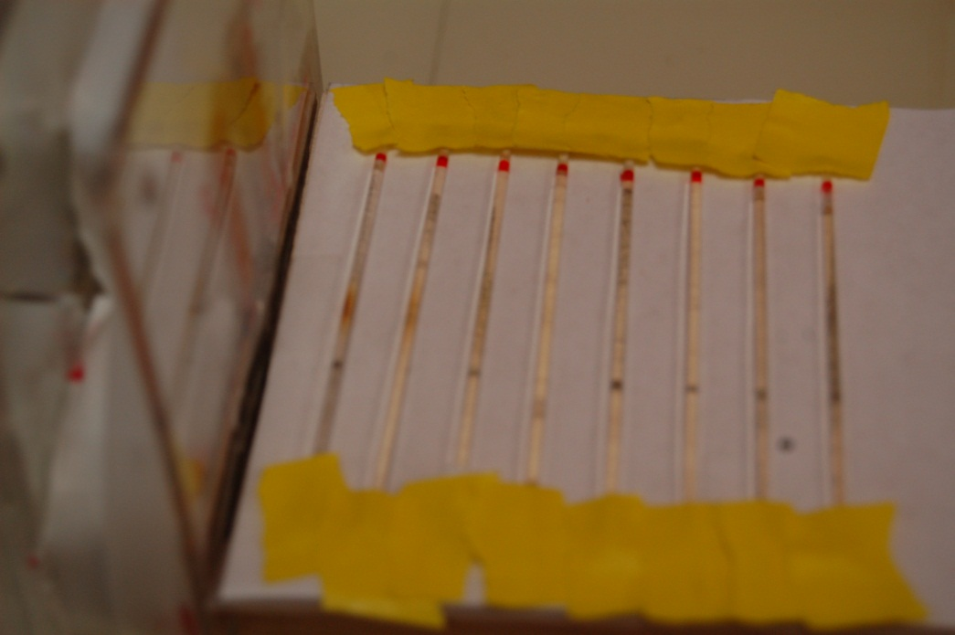

Slide 18
Small array distance vs. T2*

Slide 19
Large array

Slide 20
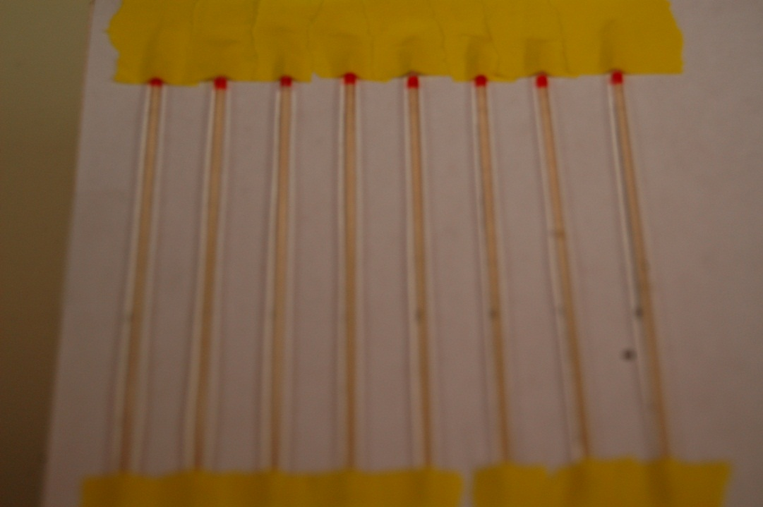
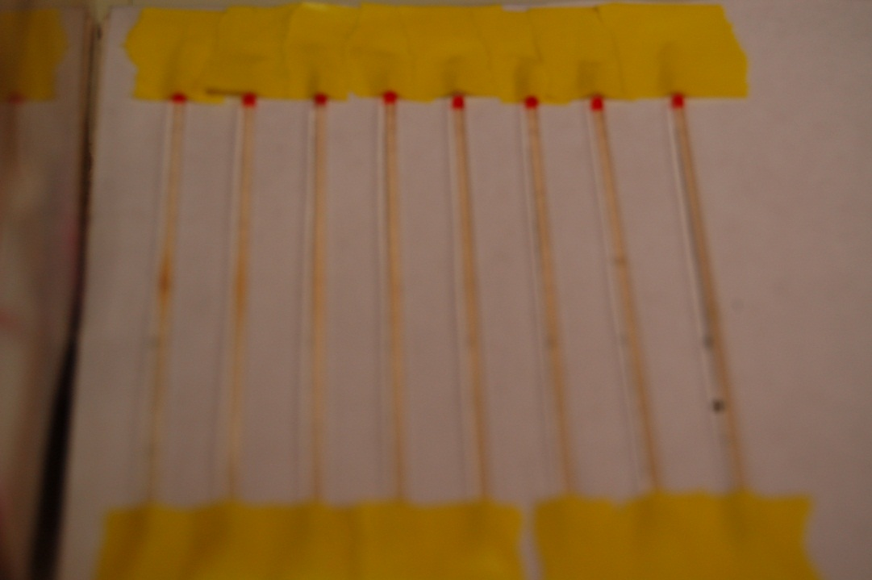
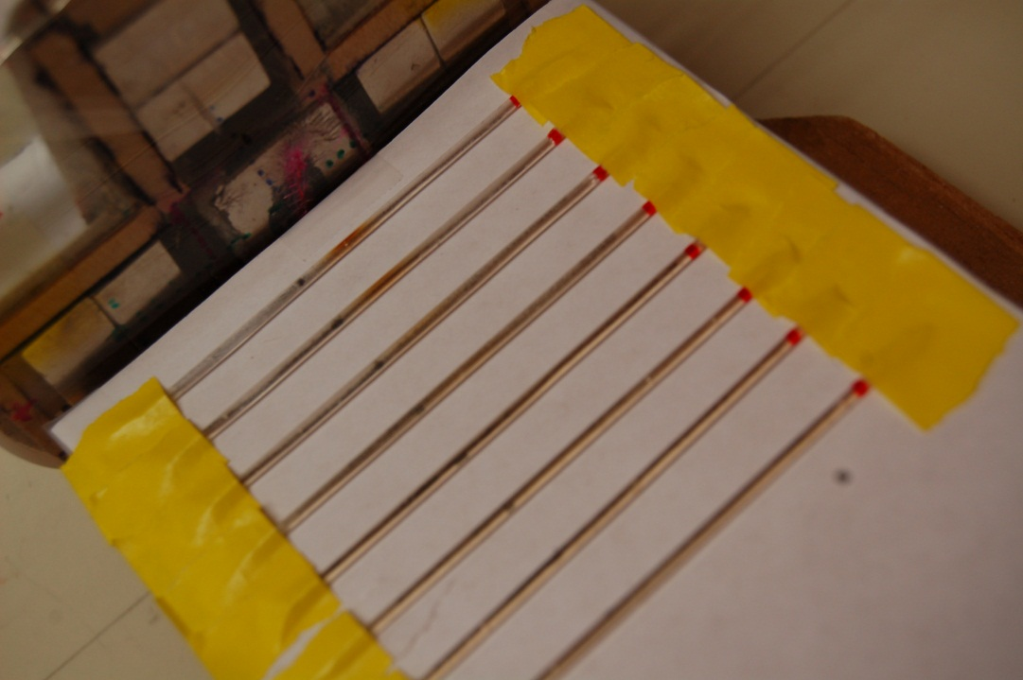
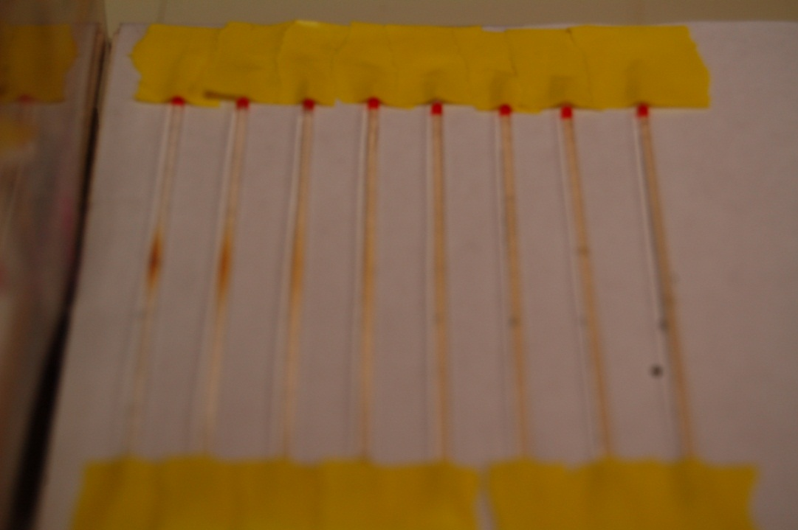

Slide 21
Large array distance vs. T2*

Slide 22
summary

Slide 23
Thank You!
Funding: NCI, NSF, DOD, NanCogenics, Inc.

