Slide 1
Use of passive sampling methods to understand sources of mercury to high elevation sites in the Western United States
Jiaoyan Huang
Mae S. Gustin

Slide 2
Acknowledgement
Undergraduate students at UNR
Matthew Peckham, Douglas Yan, Travis Lyman, Musheng Alishahi, and Jennifer Arnold
The site operators
Jeff Morris (BISP), Cody Tingey (CGSP), Tim Forsell (CCRS), Russ Merle (PRMP), Jerry Dries (ECHO), Daren Winkelman (AGPK), and Li Zhang (AGPK), Tony Lesperance (PAVA), Ben Roberts (GBNP), and Peter Weiss-Penzias (CHALK)

Slide 3
Methods
Box sampler-concentration
Surrogate surface-dry deposition
A 3-times correction factor
Multiple-resistance model
α=β=2, α=β=10, no canopy resistance
Hybrid Single Particle Lagrangian Integrated Trajectory
${Probablity function, P}_{i,k}=\frac{N_{ i, k}}{M_{i,k}}$

Slide 4
Sampling sites

Slide 5
Different materials and exposure times
polysulfone membranes, ICE 450
polyethersulfone membrane,
Mustang S

Slide 6
Correlations

Slide 7
Spatial and temporal variation

Slide 8
Modeled and measured results
thorn shrubs sites

Slide 9
Probability function domain

Slide 10
Source regions
AGPK
LA and MBL boxes-high elevation
LA, Las Vegas, MBL, and San Joaquin Valley low elevation.
PEAV
SF all elevations
LA less points

Slide 11
Asian long range transport

Slide 12
Summary
Hg amount collected on Mustang S is comparable that on ICE 450.
Hg dry deposition was higher at high elevation sites than at low elevation sites.
Dry deposition uncertainties are still high and different GOM species were observed.
Regional and long range transport sources affect Hg level at high elevation sites in the Western US.

Slide 13
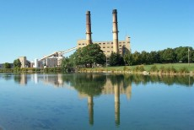
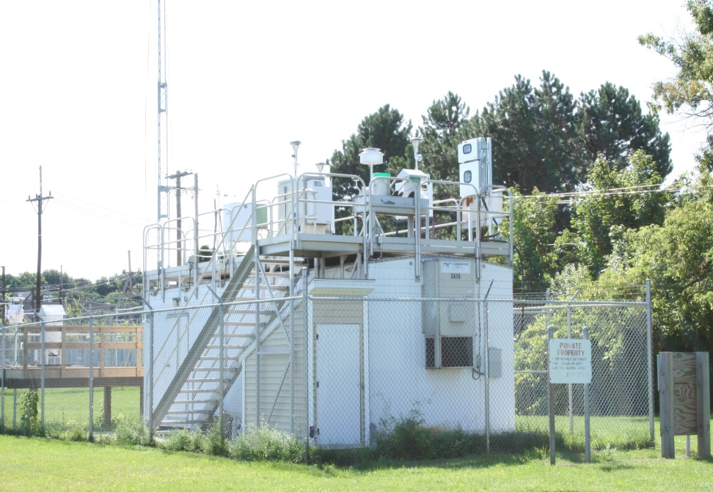
The Influence of a Local Coal-Fired Power Plant on Ambient Mercury Concentrations
Jiaoyan Huang
Yungang Wang
Philip K. Hopke
Thomas M. Holsen
Notes:
Introduce this project, sampling site, and Russell coal-fired power plant

Slide 14
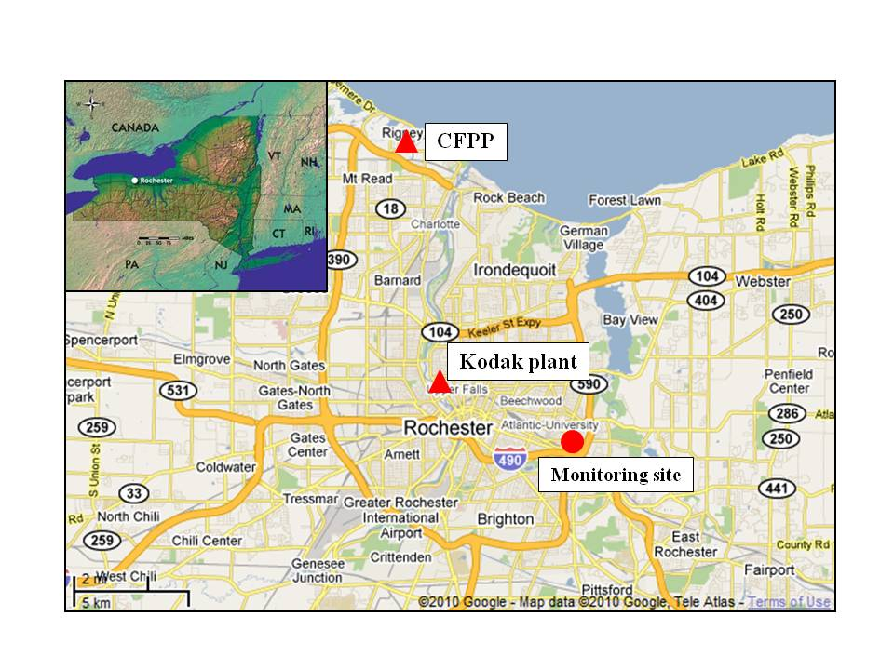
Site Map
Notes:
Talk about this site location, and the sources nearby

Slide 15
Instruments
Tekran® 2537/1130/1135
Trace gases instruments (CO, ozone, SO₂)
Scanning mobility particle sizer
differential mobility analyzer
⁸⁵Kr aerosol neutralizer
Condensation particle counter
PM_{2.5}: tapered element oscillating microbalance (TEOM)
Two-wavelength aethalometer
Notes:
Instruments were used in this project

Slide 16
Positive Matrix Factorization
A weighted factorization problem with non-negativity constraints using known experimental uncertainties as input data thereby allowing individual treatment (scaling) of matrix elements
Notes:
Describe the principle of PMF

Slide 17
Ambient Air Hg Concentration Downwind Influences
Significantly higher before than after the CFPP closure
Notes:
Hg concentrations changes when the air coming from local CFPP before and after it was closed

Slide 18
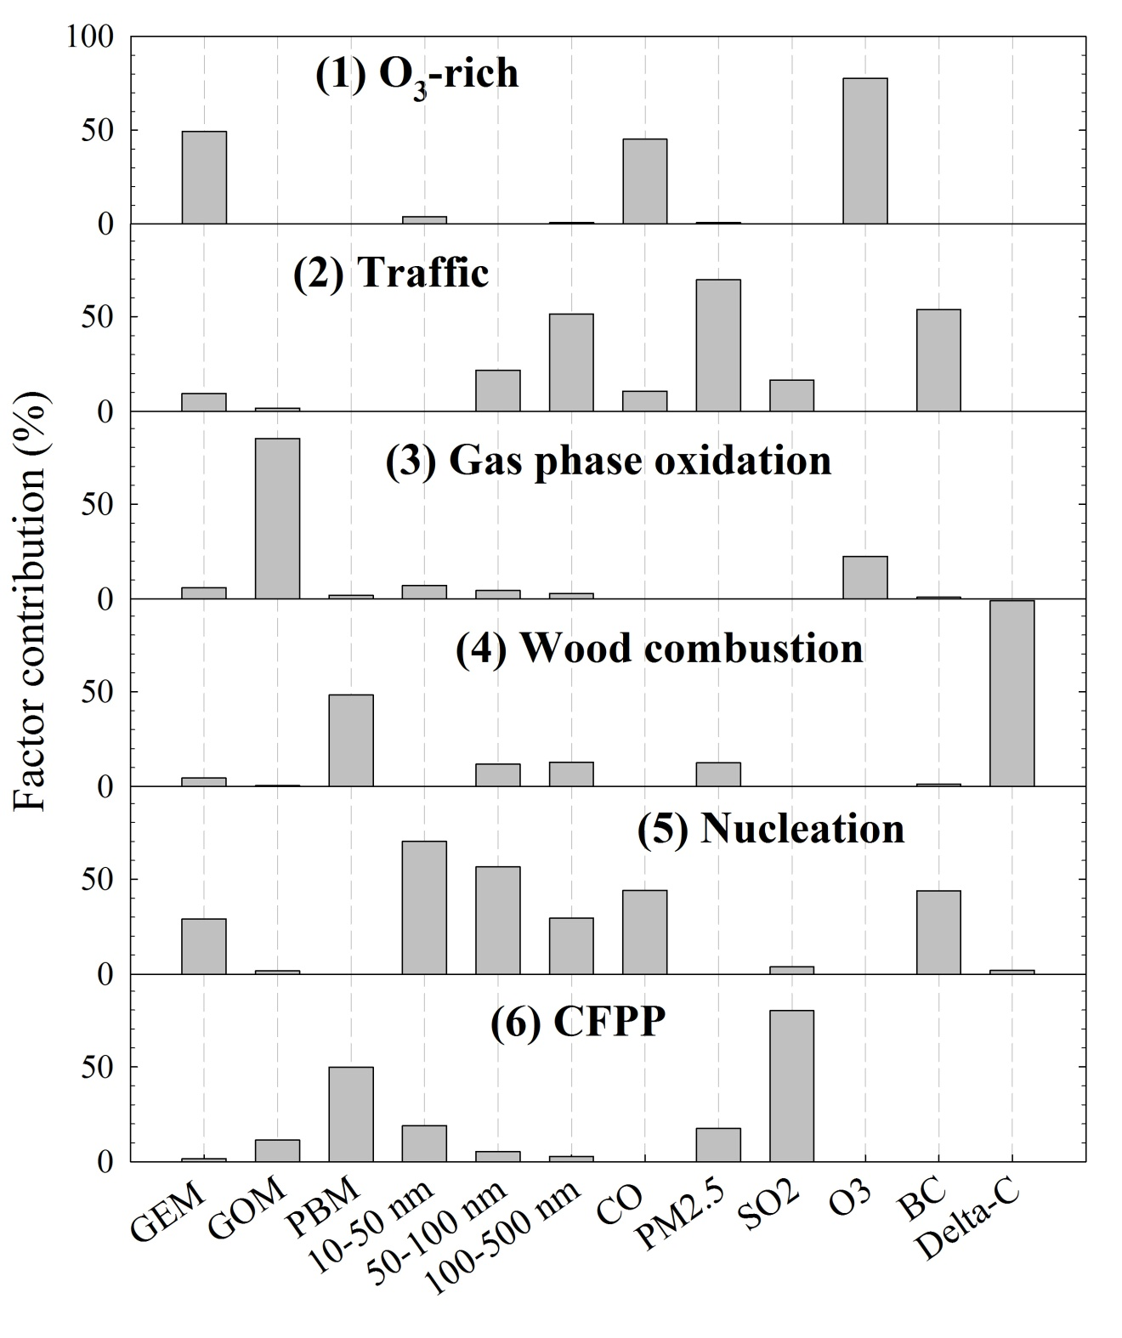
PMF Results
Notes:
PMF results, focus on CFPP factor, briefly talk about gas phase oxidation and wood conmustion

Slide 19
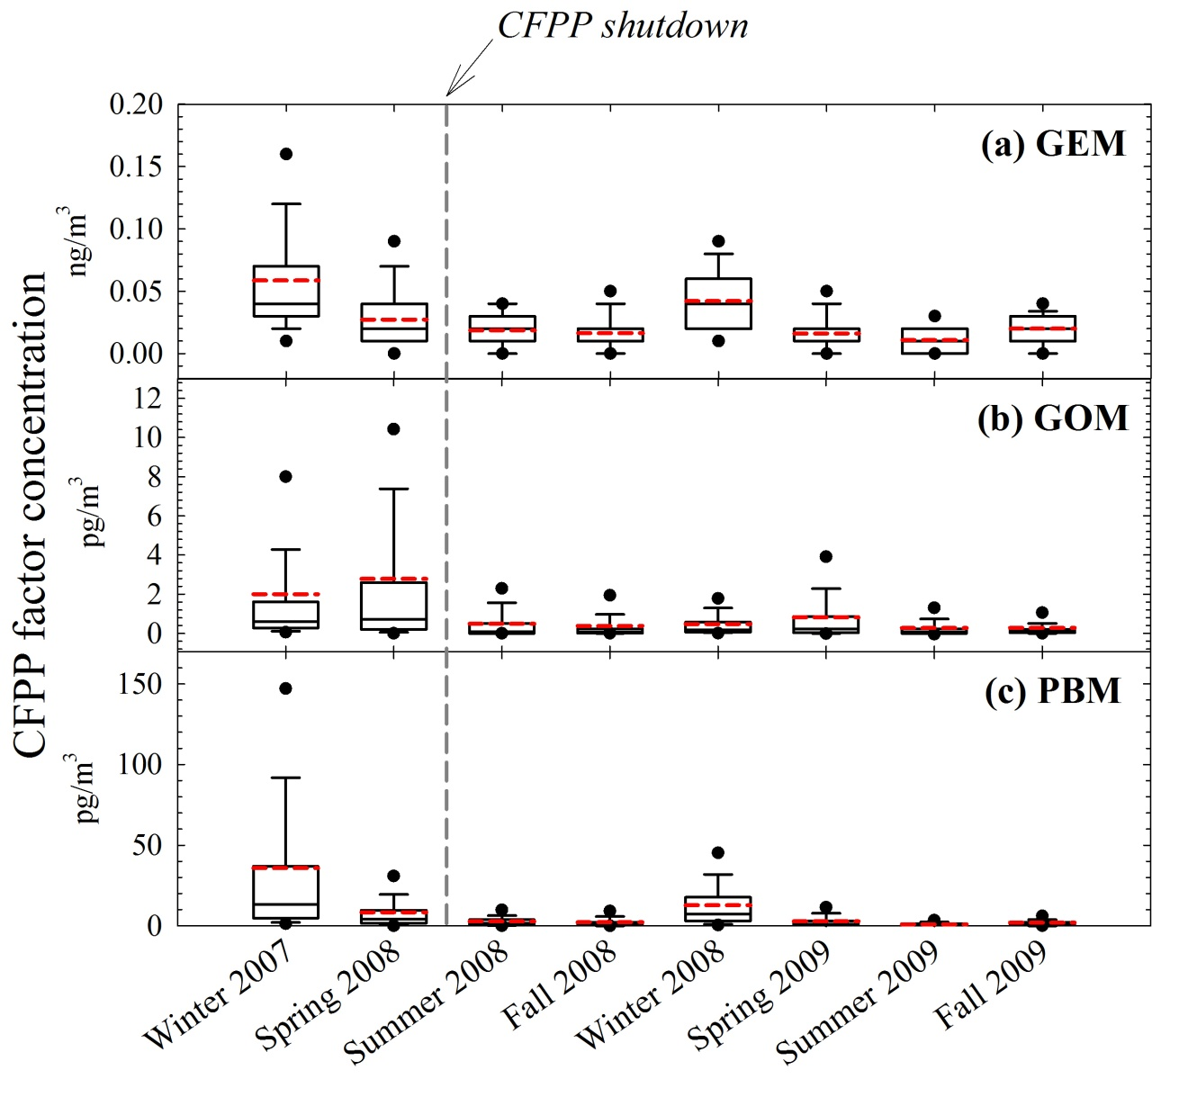
CFPP Contribution
Notes:
Hg concentrations from CFPP, try to compare at same seasons, dramatic drop

Slide 20
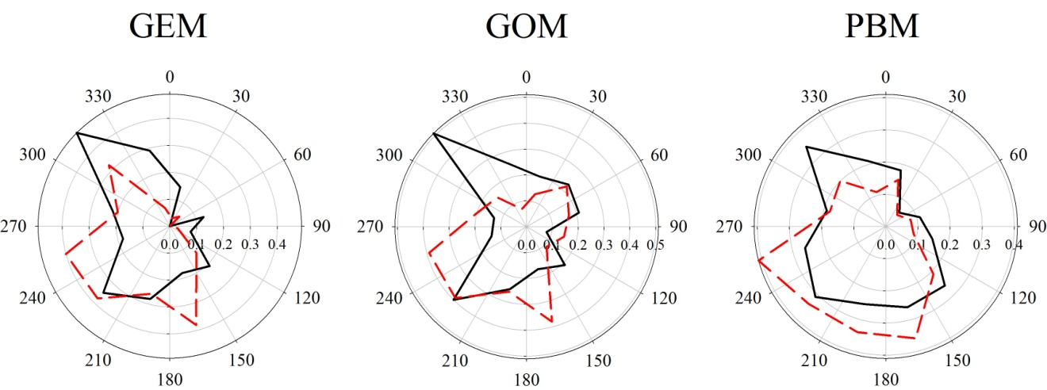
Conditional Probability Function
black line: before the CFPP closure
red line: after the CFPP closure
Notes:
Hg CPF shifted after CFPP closed from northwest to more southwest

Slide 21
Reactive Hg Partitioning Coefficient
$$K_{p}=\frac{PBM/{PM}_{2.5}}{GOM}$$
Time period | slope | intercept | r² | K_{p} (m³/μg)
Overall | -1300 ± 120 | 5.0 ± 0.4 | 0.11, p< 0.01 | 1.1 ± 4.0
12/7/2007-4/24/2008 | -1400 ± 330 | 5.7 ± 1.2 | 0.09, p< 0.01 | 0.5 ± 0.5
12/7/2008-4/24/2009 | -3500 ± 260 | 13 ± 1.0 | 0.35, p< 0.01 | 1.5 ± 6.7
4/25/2008-12/6/2008 | -1100 ± 280 | 4.3 ± 1.0 | 0.06, p< 0.01 | 1.2 ± 1.3
4/25/2009-12/6/2009 | -2000 ± 490 | 7.4 ± 1.7 | 0.07, p< 0.01 | 1.2 ± 4.0
Partitioning coefficient significantly changed after the CFPP closure
Notes:
Partitioning coefficient changed after the local CFPP closed

Slide 22
Summary
A significant reduction of three Hg concentrations after the CFPP closure
PMF results indicates a low contribution of three Hg forms for the CFPP factor after shutdown
CPF results also show the low contribution from the CFPP location after shutdown
A significant change of reactive Hg gas-particle partitioning coefficient

Slide 23
Acknowledgements
New York State Energy Research and Development Authority (NYSERDA)
United States Environmental Protection Agency (US EPA) through Science to Achieve Results (STAR)
US EPA Atmospheric Clean Air Markets Division and NADP Hg Monitoring Network
Syracuse Center of Excellence Collaborative Activities for Research and Technology Innovation (CARTI)
New York State Department of Environmental Conservation

Slide 24
References
Effect of the shutdown of a large coal-fired power plant on ambient mercury species Y Wang, J Huang, PK Hopke, OV Rattigan, DC Chalupa, MJ Utell, ... Chemosphere 92 (4), 360-367
Ambient mercury sources in Rochester, NY: results from principle components analysis (PCA) of mercury monitoring network data J Huang, HD Choi, PK Hopke, TM Holsen Environmental science & technology 44 (22), 8441-8445
Questions??

