Slide 1
About OMICS Group
OMICS Group is an amalgamation of Open Access publications and worldwide international science conferences and events. Established in the year 2007 with the sole aim of making the information on Sciences and technology ‘Open Access’, OMICS Group publishes 500 online open access scholarly journals in all aspects of Science, Engineering, Management and Technology journals. OMICS Group has been instrumental in taking the knowledge on Science & technology to the doorsteps of ordinary men and women. Research Scholars, Students, Libraries, Educational Institutions, Research centers and the industry are main stakeholders that benefitted greatly from this knowledge dissemination. OMICS Group also organizes 500 International conferences annually across the globe, where knowledge transfer takes place through debates, round table discussions, poster presentations, workshops, symposia and exhibitions.

Slide 2
About OMICS International Conferences
OMICS International is a pioneer and leading science event organizer, which publishes around 500 open access journals and conducts over 500 Medical, Clinical, Engineering, Life Sciences, Pharma scientific conferences all over the globe annually with the support of more than 1000 scientific associations and 30,000 editorial board members and 3.5 million followers to its credit.
OMICS Group has organized 500 conferences, workshops and national symposiums across the major cities including San Francisco, Las Vegas, San Antonio, Omaha, Orlando, Raleigh, Santa Clara, Chicago, Philadelphia, Baltimore, United Kingdom, Valencia, Dubai, Beijing, Hyderabad, Bengaluru and Mumbai.
.

Slide 3
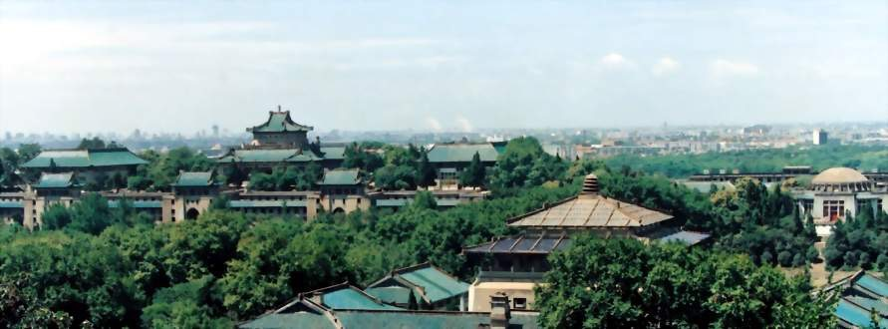
International Conference on Transcriptomics
Transcriptome and Small RNA Gene
Expression Changes in Synthetic
Allohexaploids of Brassica
Jianbo Wang
Wuhan University, China

Slide 4
Outline
 Background
 Transcriptomic changes in synthetic trigenomic allohexaploids of Brassica
 Characterization and expression patterns of small RNAs in synthesized Brassica hexaploids

Slide 5
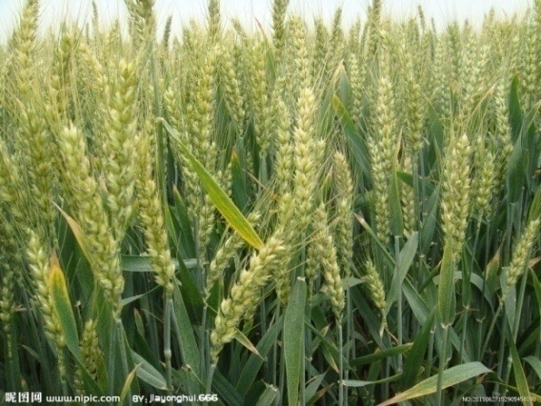
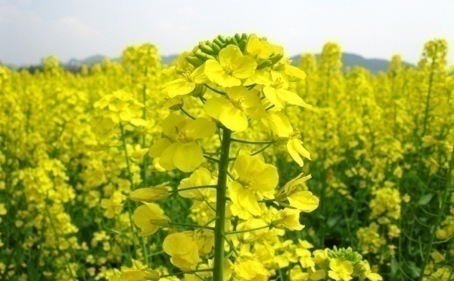
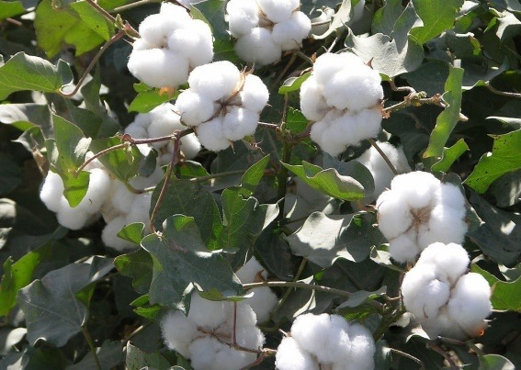
1. Background
 Polyploids are divided into autopolyploids and allopolyploid.
 Both autopolyploids and allopolyploids are prevalent in nature. Seventy percent, even all of the flowering plants are polyploid.
 Polyploidy has played an important role in promoting plant evolution through genomic merging and doubling
Notes:
for example, potato, alfalfa, and sugarcane are autopolyploids, whereas wheat, cotton, coffee, and Brassica napus are allopolyploids.

Slide 6
Genome changes in polyploid plants
Genomic shock (McClintock, 1984), including
 DNA sequence elimination
 Chromosomal rearrangements
 Transposon activation
 DNA methylation……

Slide 7
Gene expression changes in polyploid plants
Gene expression changes detected in polyploids:
 Gene silencing
 Gene activation
 Non-additive expression
 Gene subfunctionalization
 Gene neofunctionalization
Transcriptomic shock (Buggs et al. 2011)

Slide 8
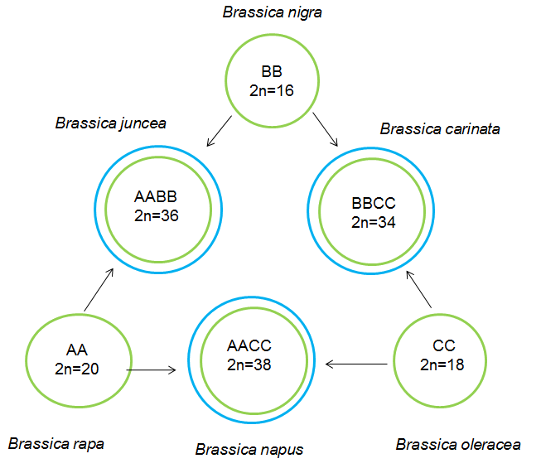
Synthesized polyploids
  Synthesized polyploids with known parents allow us to investigate the effects of polyploidization through more critical comparisons of polyploids and parents.
  Genus Brassica is commonly used as a model system to track early genomic changes following allopolyploidization.
U triangle in Brassica

Slide 9
2
Transcriptomic changes in synthetic trigenomic allohexaploids of Brassica

Slide 10
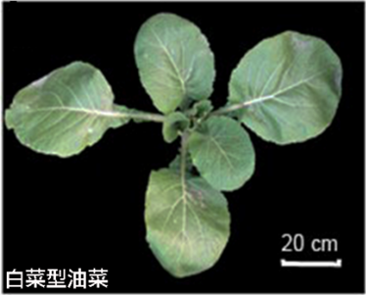
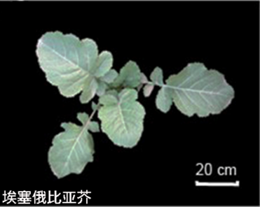
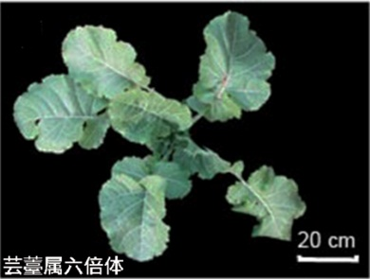
New synthesized allohexploids
（B. rapa， AA，2n = 20）
（B. carinata， BBCC，2n = 34）
Chromosome doubling
(BBCCAA，2n = 54）
From Prof. Meng, HAU, China
Notes:
分别取正常生长三个月的芸薹属六倍体及其亲本的叶片（图2-1），三个单株混合取样，存于液氮中用于RNA的提取。

Slide 11
RNA-Seq flowchart
Sequencing
Total RNA
Enriched mRNA
200nt mRNA fragments
cDNA library
PCR amplification
Illumina sequencing

Slide 12
Bioinformatics analysis
Raw date
Clean reads
Mapping to reference genome
Sequencing evaluation
Statistics of gene expression
Distribution of reads on
genome
Distribution of reads on genes
Saturation analysis
Screen of
DEG
Repeatability analysis
Cluster analysis of expression pattern
Gene ontology analysis
Pathway
analysis

Slide 13
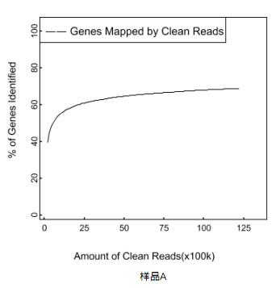
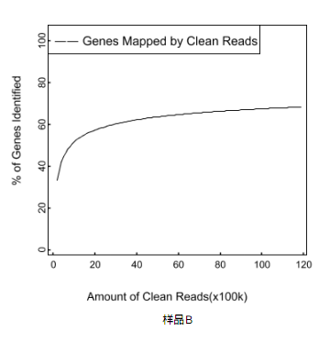
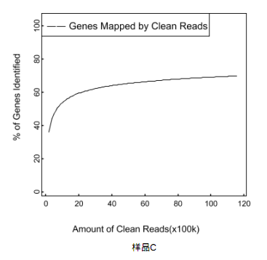
Saturation analysis of genes detected by sequencing reads
B. rapa
B.carinata
Brassica hexaploid
Notes:
The saturation analysis of genes detected by sequencing reads. The gene saturation analysis are taken in the
libraries of B. rapa (A), B. carinata (B), and Brassica hexaploid (C) respectively. The curve indicated that the number of detected
genes almost ceases to increase when the number of reads reaches 10 million.

Slide 14
Number of reads matched to B. rapa genome
 | A （B. rapa） | B (B.carinata) | C （Brassica hexaploid）
Total reads | 12,216,743 | 11,859,888 | 11,567,778
Mapped reads | 9,359,218 (76.61%) | 6,360,133 (53.63%) | 7,026,728 (60.74%)
Unique match | 8,594,083 (70.35%) | 5,479,383 (46.20%) | 6,267,830 (54.18%)
Multi-position match | 765,135 (6.26%) | 880,750 (7.43%) | 758,898 (6.56%)
Unmapped reads | 2,857,525 (23.39%) | 5,499,755 (46.37%) | 4,541,050 (39.26%)

Slide 15
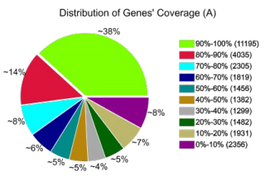
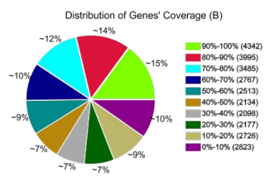
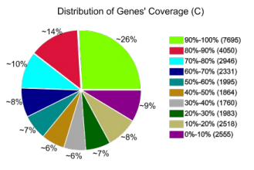
The different read coverage of genes in three libraries
Notes:
Figure 2. The different read coverage of genes in three libraries. The genes with different read coverage were indicated by
different colours. The capital letters A, B, and C in brackets refer to libraries of B. rapa, B. carinata, and Brassica hexaploid
respectively.在三个文库中检测到的覆盖度达90%及以上的基因数目是最多的，分别是38%、15% and 26%；其次是覆盖度为80%至90%的基因；其它还有8个不同覆盖范围的基因，所占的比列都为10%左右

Slide 16
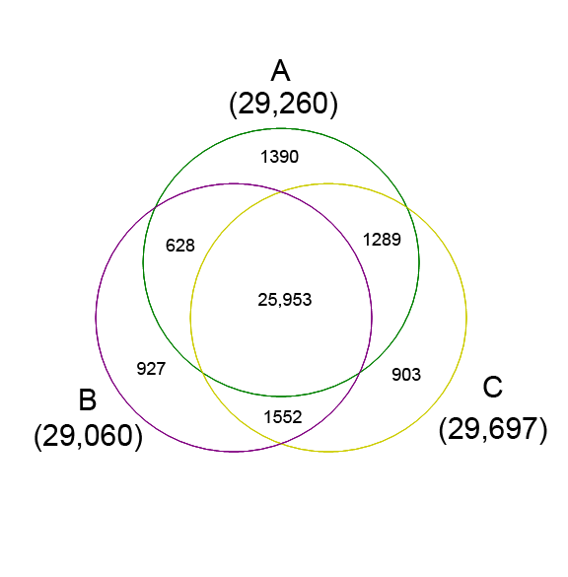
Gene expression in Brassica hexaploid and its parents
Total: 32642
Notes:
Figure 3. Venn diagram showing genes expressed in Brassica hexaploid and its parents. A, B. rapa; B, B. carinata; C,
Brassica hexaploid.

Slide 17
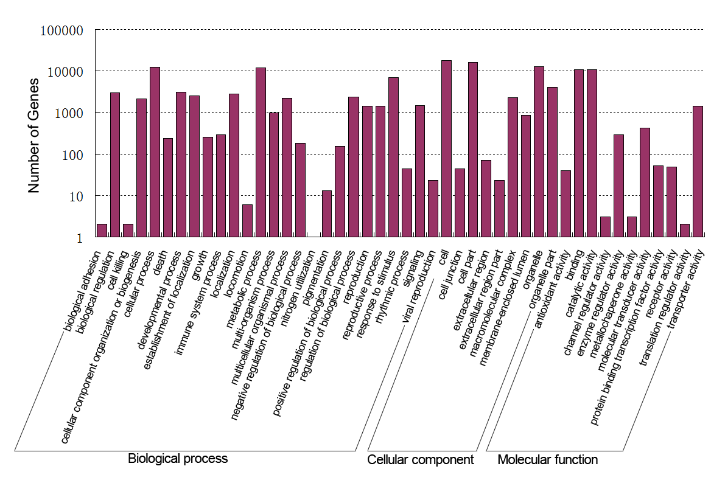
Gene ontology (GO) annotations of all detected genes
.
Notes:
Figure 4. Gene ontology (GO) annotations of all detected genes. The histogram shows the result of classifying 24658 genes to the secondary classification of GO terms. The y-axis indicates the number of genes in a functional term.
24658 个（75.54%）得到了相应的GO功能注释。生物过程、细胞组成和分子功能各有26、9和11个功能组。生物过程这一个大类中“细胞过程”（GO:0009987）和“代谢过程”（GO:0008152）分别有12537和12007个基因，是包括基因最多的两个功能组。在细胞组成和分子功能两大类中，“细胞”（GO:0005623）与“结合”（GO:0005488）是含有基因最多的功能组。另外我们注意到在这三大类别中，还有“应激反应”（GO:0050896）、“细胞部分”（GO:0044464）和“催化活性”（GO:0003824）的基因数也较多。

Slide 18
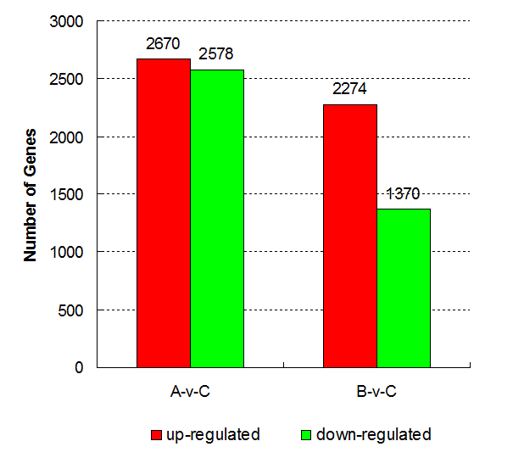
Differentially expressed genes detected
between Brassica hexaploid and its parents
Notes:
Figure 5. Differentially expressed genes detected between Brassica hexaploid and its parents. The number of upregulated and down-regulated genes between Brassica
hexaploid (C) and B. rapa (A), Brassica hexaploid (C) and B. carinata (B) are revealed.差异基因占到了总基因数的22.66%，六倍体植物与父本相比的所有差异基因的差异倍数之和为15640.92，而六倍体植物与母本相比所有差异基因的差异倍数之和为10371.10，可见六倍体植物与其父本之间基因表达量的差异更大，且差异基因的数目也多于六倍体植物与母本的差异基因数目。

Slide 19
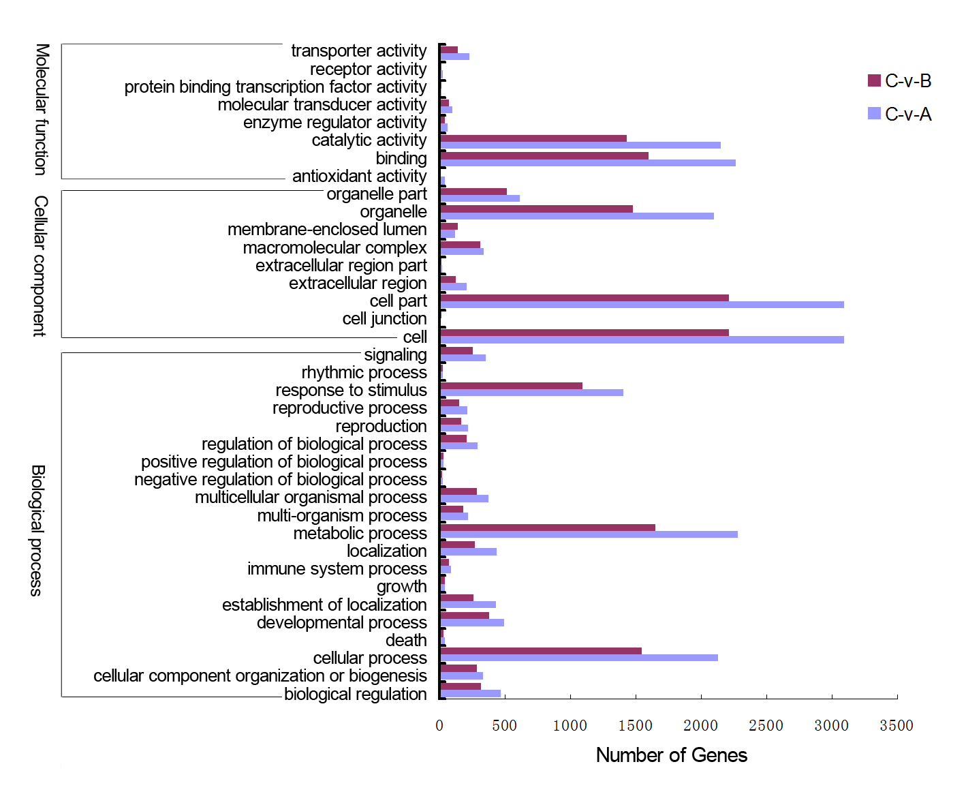
Functional annotation of DEGs between
Brassica hexaploid and its parents based on GO terms
Notes:
Figure 6. Functional annotation of DEGs between Brassica hexaploid and its parents based on GO terms. DEGs between Brassica hexaploid (C)-B. rapa (A) and Brassica hexaploid (C)-B. carinata (B) are grouped to the secondary classification of GO terms. There are 8, 9, and 20 functional groups in the three main categories (molecular function, cellular component, and biological
process) of GO classification, respectively.在GO的三大类别（分子功能、细胞组成和生物过程）中我们分别得到了8、9和20个功能组。“结合”（GO:0005488）和“代谢过程”（GO:0008152）分别是分子功能和生物过程大类中基因数目最多的功能组，在细胞组成大类中，“细胞”（GO:0005623）和“细胞部分”（ GO:0044464）两个功能组所具有的基因数目一样，且高于其它的功能组。另外，功能组“催化活性”（GO:0003824）、“转运功能”（GO:0005215）、“细胞器”（GO:0043226）、“细胞过程”（GO:0009987）和“应激反应”（GO: 0050896）所具有的差异基因数目也相对较多。

Slide 20
C-vs-A C-vs-B
Hierarchical clustering analysis of 7397 DEGs based on log ratio RPKM data
Notes:
基于分析差异基因表达模式的相似性和差异性的目的，我们应用MATLAB 7.8软件对7397个差异基因进行分层聚类分析。我们将每个差异基因的RPKM值除以其在对照组中的值，再将结果转化为以2为底数的对数值来进行聚类，聚类的结果用Java TreeView软件显示（图2-7），图中红色表示上调的基因，绿色表示下调的基因。

Slide 21
Nonadditive genes expressed in Brassica hexaploid
 A total of 2,545 genes, accounting for 7.8% of the total detected genes, were nonadditively expressed in Brassica hexaploid.
 Of these nonadditive genes, 2,445 showed differential expression either between Brassica hexaploid and B. rapa or between Brassica hexaploid and B. carinata.

Slide 22
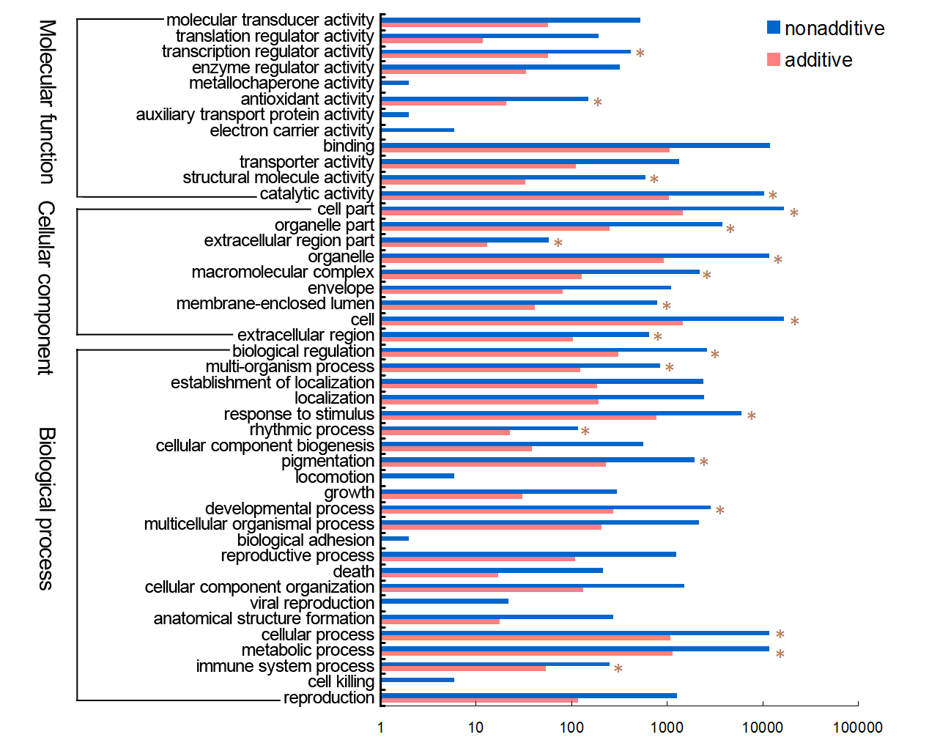
Functional annotation of nonadditive genes and
additive genes in Brassica hexaploid based on GO terms
Notes:
Figure 9. Functional annotation of nonadditive genes and additive genes in Brassica hexaploid based on GO terms. Nonadditive genes and additive genes are grouped to the secondary classification of GO terms. There are 12, 9, and 23 functional groups in the three main categories (molecular function, cellular component, and biological process) of GO classification,
respectively.在GO的三大类别（分子功能、细胞组成和生物过程）中我们分别得到了12、9和23个功能组。在分子功能这一大类中，功能组“转录调节活性”（GO:0030528）、“抗氧化剂活性”（GO:0016209）、“结构分子活性”（GO:0005198）和“催化活性”（GO:0003824）在加性表达基因和非加性表达基因间具有显著差异，其中“转录调节活性”、“抗氧化剂活性”和“催化活性”功能组在非加性表达基因中显著富集。在细胞组成大类中，功能组“细胞部分”（GO:0044464）、“细胞器部分”（GO:0044422）、“胞外区部分”（GO:0044421）、“细胞器”（GO:0043226）、“复杂大分子”（GO:0032991）、“膜封闭腔”（GO:0044464）、“细胞”（GO:0005632）和“胞外区”（ GO:0005576）在加性表达基因和非加性表达基因间具有显著差异，其中4个功能组（“细胞部分”、“胞外区部分”、 “细胞”和“胞外区”）在非加性表达基因中显著富集。在生物过程大类中，9个功能组，包括“生物调节”（GO:0065007）、“多生物过程”（GO:0051704）、“应激反应”（GO:0050896）、“生物节律”（GO:0048511）、“色素沉淀”（GO:0043473）、“发育过程”（GO:0032502）、“细胞过程”（GO:0009987）、“代谢过程”（GO:0008152）和“免疫过程”（GO:0002376）在加性表达基因和非加性表达基因间具有显著差异，且都在非加性表达基因中较加性表达基因更为富集。

Slide 23
Analysis of putative transcription factor genes
  Putative TF genes detected:
----589 genes, belonging to 49 TF gene families
  Significant differential expression:
----143 genes, belonging to 36 families
  Differentially expressed between B. hexaploid and B. rapa
----101 genes, with 49 genes upregulated
and 52 genes downregulated in Brassica hexaploid.
  Differential expression between B. hexaploid and B. carinata:
----76 genes, with 46 genes upregulated
and 30 downregulated in Brassica hexaploid
Notes:
。 589 putative TF genes were detected
143 genes belonging to 36 families showed significant differential expression, accounting for
24.28% of the total TF genes
101 putative TF genes differentially expressed between Brassica hexaploid and B. rapa, with 49 genes upregulated and 52 genes downregulated in Brassica hexaploid.
Seventy-six putative TF genes showed differential expression between
Brassica hexaploid and B. carinata: 46 genes were upregulated
and 30 were downregulated in Brassica hexaploid

Slide 24
Analysis of TCP transcription factor gene family
 TCP gene family presents in various plant species. We detected 15 TCP and five showed significantly different expression between Brassica hexaploid and its parents
 Three TCP genes (Bra001992, Bra003959, and Bra006616) were expressed at higher levels in Brassica hexaploid compared with B. rapa
 Two genes (Bra003959 and Bra006616) were upregulated in Brassica hexaploid compared with B. carinata.
 The other two differentially expressed TCP genes (Bra009679 and Bra011803) showed lower expression levels in Brassica hexaploid compared with B. rapa.
 Ten of the 32 genes potentially regulated by TCP genes that we examined showed significant differential expression between Brassica hexaploid and its parents.
Notes:
3个差异表达的TCP基因（Bra001992，Bra003959，Bra006616）在六倍体植物中表达高于白菜型油菜，这其中的两个（Bra003959，Bra006616）在六倍体植物中的表达同时也高于埃塞俄比亚芥，另外的两个TCP基因（Bra009679, Bra011803）在六倍体植物中的表达低于白菜型油菜。我们还检测到了32个TCP转录因子家族的可能的靶基因，其中有10个为差异基因。 The TCP gene family is a family of transcription factors present in various plant species. We detected 15 TCP and five showed significantly different expression between Brassica hexaploid and its parents
Three TCP genes (Bra001992, Bra003959, and Bra006616) were expressed at higher levels in Brassica hexaploid compared with B. rapa;
two genes (Bra003959 and Bra006616) were upregulated in Brassica hexaploid compared with B. carinata.
The other two differentially expressed TCP genes (Bra009679 and Bra011803) showed lower expression levels in Brassica hexaploid compared with B. rapa.
Some putative target genes of the TCP gene family also showed differential expression. Ten of the 32 genes potentially
regulated by TCP genes that we examined showed significant differential expression between Brassica hexaploid and its parents.

Slide 25
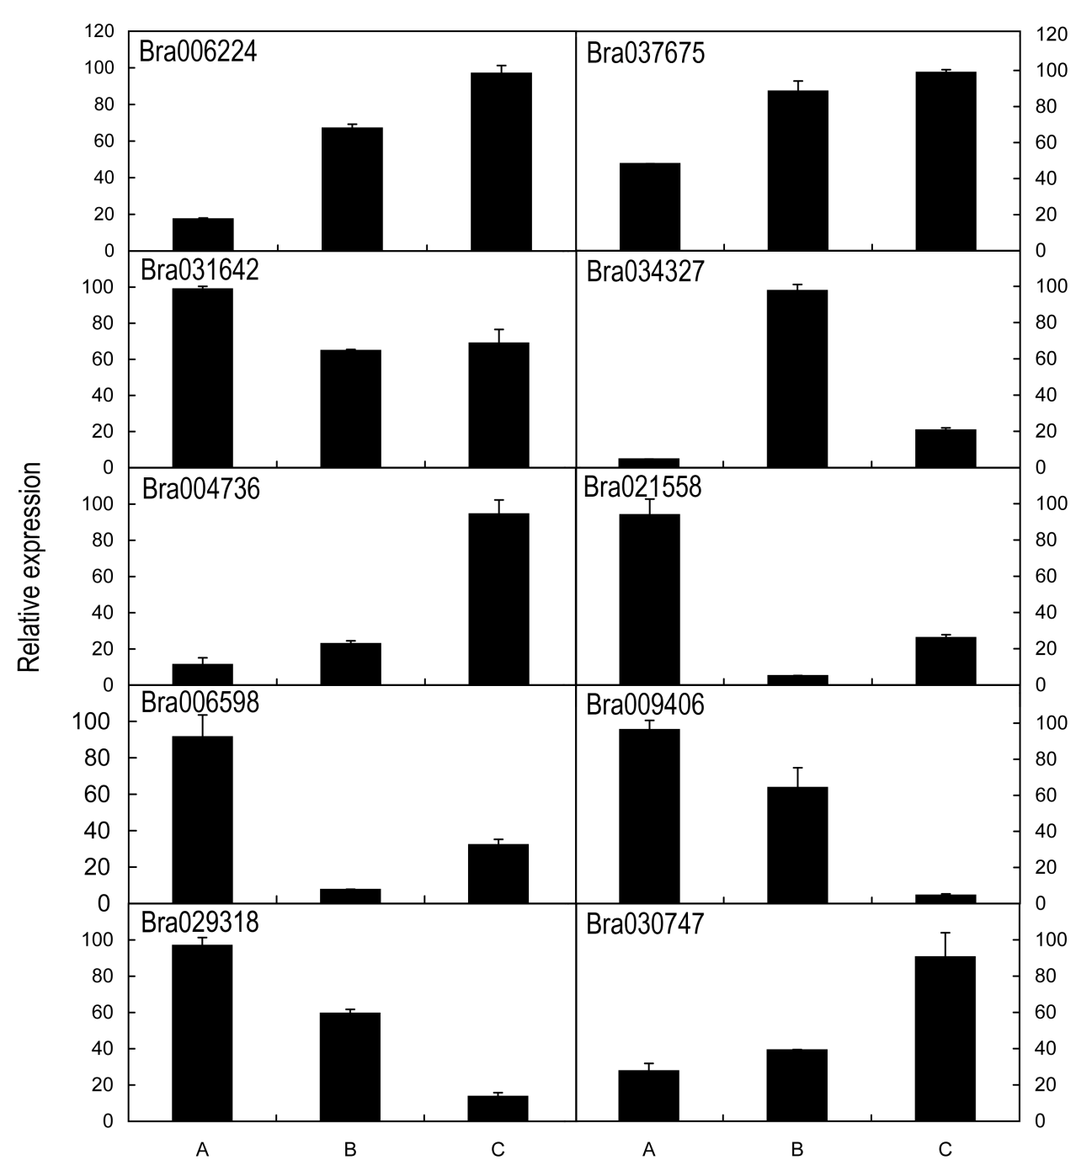
Validation by qRT-PCR
Notes:
基因Bra006224，Bra037675，Bra004736，Bra030747在六倍体植物中表达量高于两亲本，属于模式4；基因Bra031642，Bra021558，Bra006598在六倍体植物中表达量高于埃塞俄比亚芥而低于白菜型油菜，属于模式2；基因Bra034327在六倍体植物中的表达量高于白菜型油菜低于埃塞俄比亚芥，属于模式3，基因Bra009406，Bra029318在六倍体植物中的表达量则低于两亲本，属于模式1。

Slide 26
Summary of gene expression
 A large proportion of the DEGs between Brassica hexaploid and its parents was involved in biosynthesis of secondary metabolites, plant-pathogen interaction, photosynthesis, and plant hormone signal transduction
There were bigger differences on the level of gene expression between the hexaploid and its paternal parent compared with its maternal parent. This variation may partly be affected by the cytoplasmic and maternal effects.
 Gene expression analyses showed that Brassica hexaploid can generate extensive transcriptomic diversity compared to its parents. These changes may contribute to the growth and reproduction traits of allohexaploid.
Notes:
从差异基因的数目和差异的程度上来看，六倍体植物中基因表达水平与其父本白菜型油菜的差别更大，从而更接近其母本埃塞俄比亚芥，这与Xu的研究结果是一致的。然而，Albertin等（2006）对人工合成甘蓝型油菜的蛋白质组研究显示，四倍体中超过60%的蛋白质水平与其父本更接近，考虑到实验所用的多倍体材料来源不同，以及蛋白质组与转录组水平的差异，我们与Albertin的结果不一致也是可以理解的。
芸薹属六倍体中基因表达的母本偏向性可能与细胞的核质效应有关，因为卵细胞受精后为子代的发育提供了大部分的细胞质，加上细胞核中部分表观遗传的调控，使得后代的基因表达更偏向于母本 We explored the transcriptomic changes of synthetic Brassica allohexaploid by comparing to its parents using a high-throughput RNA-Seq method. A total of 35644409 sequence reads were generated, and 32642 genes were aligned from the data. There were 29260, 29060 and 29697 genes identified in B. rapa, B. carinata, and Brassica allohexaploid, respectively. We screened differentially expressed genes (DEGs) by a standard of two-fold or greater change in expression and false discovery rate (FDR) no more than 0.001. As a result, 7397 DEGs were detected between Brassica hexaploid and its parents. A large proportion of the 3184 DEGs between Brassica hexaploid and its paternal B. rapa was involved in biosynthesis of secondary metabolites, plant-pathogen interaction, photosynthesis, and circadian rhythm. Between Brassica hexaploid and its maternal B. carinata, 2233 DEGs were screened. A lot of them had functions of plant-pathogen interaction, plant hormone signal transduction, ribosome, limonene and pinene degradation, photosynthesis, and also biosynthesis of secondary metabolites. Based on the analysis of the DEGs between Brassica hexaploid and its parents, we discovered there were bigger differences on the level of gene expression between the allohexaploid and its paternal parent than that between the allohexaploid and its maternal parent. This variation may partly be affected by the cytoplasmic and maternal effects. In addition, we found many transcription factor genes, methyltransferase and methylation genes that showed differential expression between Brassica hexaploid and its parents. Accounting to 7.797% of the total detected genes was nonadditively expressed in Brassica hexaploid. Compared with the additive genes in Brassica hexaploid, the nonadditive genes were significantly enriched in biological processes related to stimulus response, immune system, cellular metabolic, rhythmic process, developmental process, pigmentation, seed germination, and tropism, and in the molecular functions associated with catalytic activity, antioxidant activity, and transcription regulator activity. Our results demonstrated that Brassica allohexaploid can generate extensive transcriptomic diversity compared to its parents. These changes may contribute to the normal growth and reproduction of allohexaploid.

Slide 27
3
Characterization and expression patterns of small RNAs in synthesized Brassica hexaploids

Slide 28
New synthesized allohexploids
（B. rapa， AA，2n = 20）
（B. carinata， BBCC，2n = 34）
Chromosome doubling
(BBCCAA，2n = 54）
From Prof. Meng, HAU, China
Notes:
分别取正常生长三个月的芸薹属六倍体及其亲本的叶片（图2-1），三个单株混合取样，存于液氮中用于RNA的提取。

Slide 29
RNA-Seq flowchart for sRNA
Total RNA
Size fractionation (18-30 nt)
5，
+
3’
5’ adaptor ligation
5，
+
3’
3’ adaptor ligation
5，
+
3’
RT-PCR
5，
+
3’
3，
-
5’
Sequencing…
5，
3，
-
5’

Slide 30
Bioinformatics
analysis
Solexa 50nt tags
Filter low quality tags
High quality tags
Data cleaning
Common/Specific sequences
Full length
small RNA tags
Length distribution
Standard analysis
rRNAs, tRNAs,
snRNAs, snoRNAs
Known
miRNA
Exon,
intron
Unannoted sRNAs
Repeat
associated sRNAs
Differential expression
Target prediction
Novel miRNA
siRNA
Integrated analysis
with mRNA

Slide 31
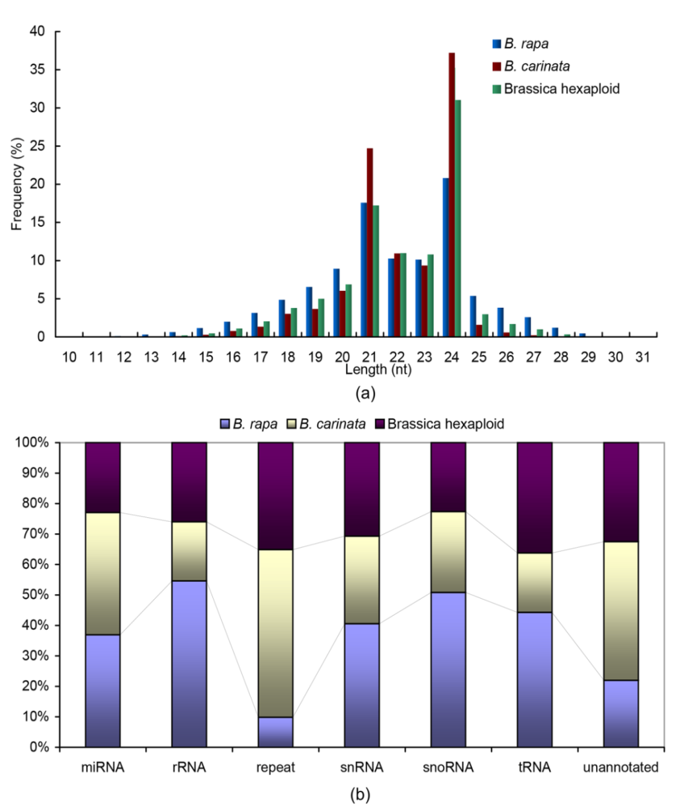
The length distribution and
category distribution of small RNAs
Notes:
Fig. 1 The length distribution and categories distribution of small RNAs in B. rapa, B. carinata, and Brassica hexaploid. a The length distribution of small
RNAs in B. rapa, B. carinata, and Brassica hexaploid. b Categories distribution of small RNAs in B. rapa, B. carinata, and Brassica hexaploid

Slide 32
Distribution of small RNAs classes
in Brassica hexaploid and its parents
RNA class |  | B. rapa |  |  | B. carinata |  |  | Brassica hexaploid
 |  | Unique sRNAs | Total sRNAs |  | Unique sRNAs | Total sRNAs |  | Unique sRNAs | Total sRNAs
Total |  | 3591336 | 22927959 |  | 7007879 | 23372602 |  | 5851489 | 19622844
miRNA |  | 47090 | 2479434 （10.81%） |  | 58068 | 2696740 （11.54%） |  | 48548 | 1541989 （7.86%）
rRNA |  | 192750 | 10385626 |  | 101728 | 3692146 |  | 121908 | 4947980
repeat |  | 1984 | 4710 |  | 7003 | 26352 |  | 5405 | 16802
snRNA |  | 4273 | 18378 |  | 3976 | 13027 |  | 4270 | 13899
snoRNA |  | 3691 | 15178 |  | 3056 | 7917 |  | 2496 | 6765
tRNA |  | 23145 | 1148451 |  | 12675 | 505697 |  | 16199 | 939337
Unannotated |  | 2888218 | 7579140 |  | 6603404 | 15712069 |  | 5302796 | 11221168

Slide 33
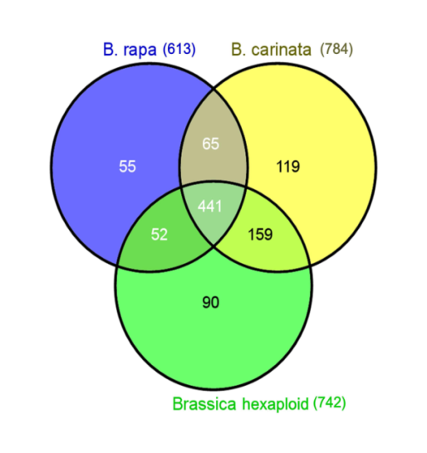
Venn diagram showing the known miRNAs expressed
in B. rapa, B. carinata, and Brassica hexaploid
Notes:
Fig. 2 Venn diagram showing the known miRNAs expressed in B.rapa, B. carinata, and Brassica hexaploid. Among all known miRNAs, 441 are expressed at all three RNA libraries. In addition, 506 are co-expressed in B. rapa and B. carinata, and 600 are co-expressed in Brassica hexaploid and B. carinata, while 493 are co-expressed in Brassica hexaploid and B. rapa. The number of specific-specifically expressed miRNAs is 55 (B. rapa), 119 (B. carinata), and 90 (Brassica hexaploid), respectively

Slide 34
Distribution of abundance of known miRNAs
in Brassica hexaploid and its parents
Abundance of known miRNAs | Total number of known miRNAs in the three libraries | Percentage (%)
1-100 | 1401 | 65.49
100-500 | 407 | 19.03
500-1,000 | 81 | 3.79
1,000-5,000 | 145 | 6.78
5,000-10,000 | 25 | 1.16
>10,000 | 80 | 3.74
Total | 2139 | 100
miR168, miR166, miR167, miR172, miR157

Slide 35
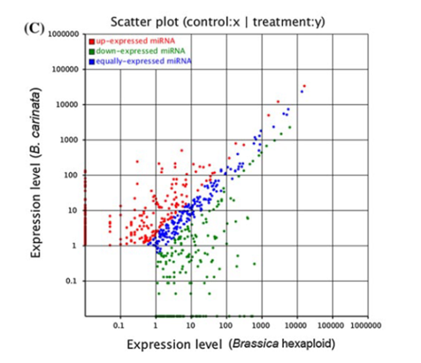
Differential expression of known miRNA
184
276
169
310
188
Comparison of expression patterns of miRNAs between B. carinata and B. rapa (A), Brassica hexaploid and B. rapa (B), as well as Brassica hexaploid and B. carinata (C)
239
Notes:
The total value based on the fold change in differentially expressed miRNAs between Brassica hexaploid and B. rapa was 2,557.83, while the value was 2,182.84 between Brassica hexaploid and B. carinata. These results suggested that more differentially expressed miRNAs with larger differences in expression exist between Brassica hexaploid and B. rapa, which may be affected by genome dosage and composition.

Slide 36
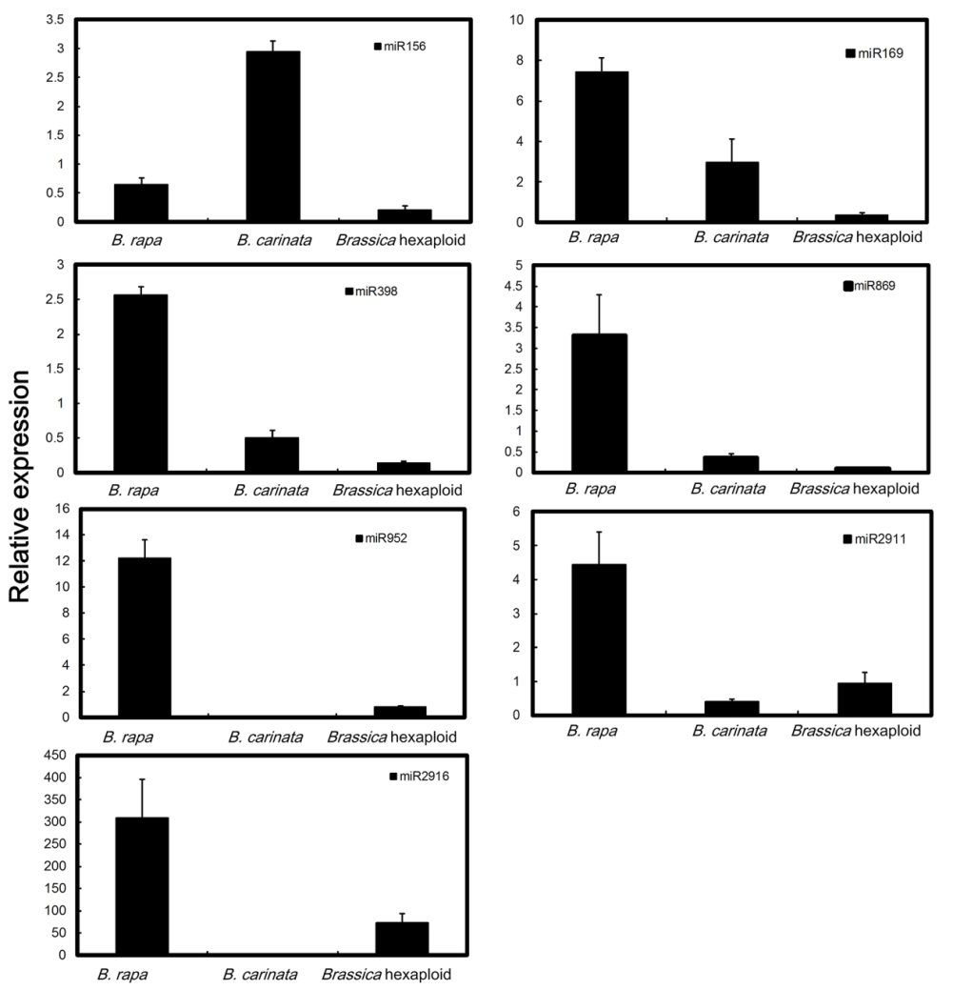
Validation by qRT-PCR
Notes:
Fig. 4 Validation via quantitative real-time RT-PCR of differentially expressed known miRNAs obtained from deep sequencing.

Slide 37
Integrated analysis of miRNA with mRNA
 We associated GO terms with coherent target genes of miRNAs that exhibited differential expression between Brassica hexaploid and its parents to identify the significantly changed GO biological process terms.
 The results suggested that target genes involved in “response to stimulus” are significantly enriched in coherent target genes of down-regulated miRNAs in Brassica hexaploid .

Slide 38
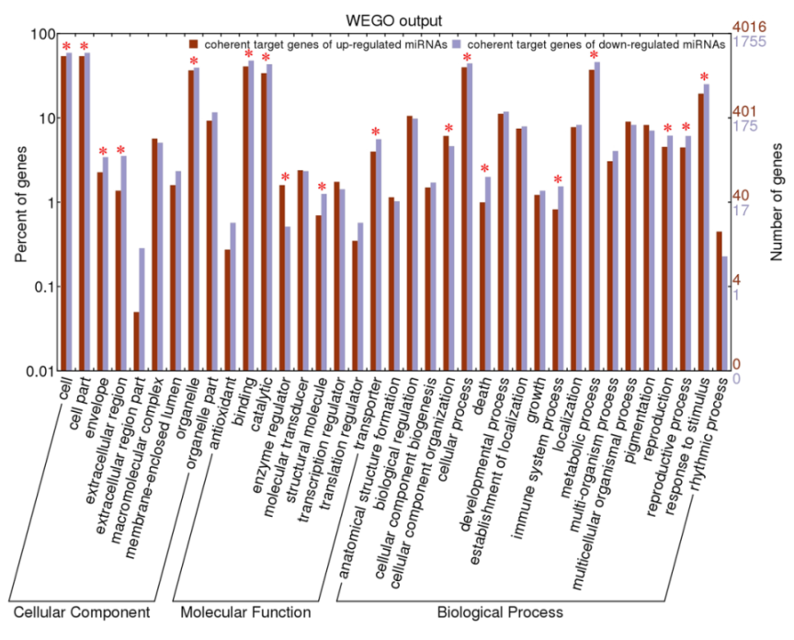
GO classifications of coherent target genes of up-regulated and down-regulated miRNAs in Brassica hexaploid compared with B. rapa
Notes:
Fig. 2-12 GO classifications of coherent target genes of up-regulated and down-regulated miRNAs in Brassica hexaploid compared with B. rapa (A) and in Brassica hexaploid compared with B. carinata (B).

Slide 39
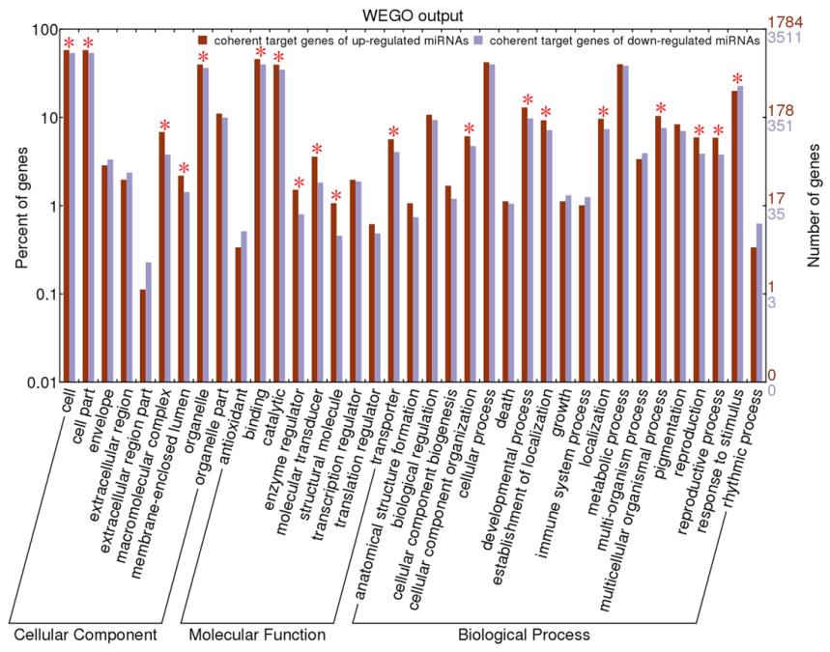
GO classifications of coherent target genes of up-regulated and down-regulated miRNAs in Brassica hexaploid compared with B. carinata
Notes:
Fig. 2-12 GO classifications of coherent target genes of up-regulated and down-regulated miRNAs in Brassica hexaploid compared with B. rapa (A) and in Brassica hexaploid compared with B. carinata (B).

Slide 40
Distribution of nonadditively expressed miRNAs
detected in Brassica hexaploid
MPV：mid-parent value

Slide 41
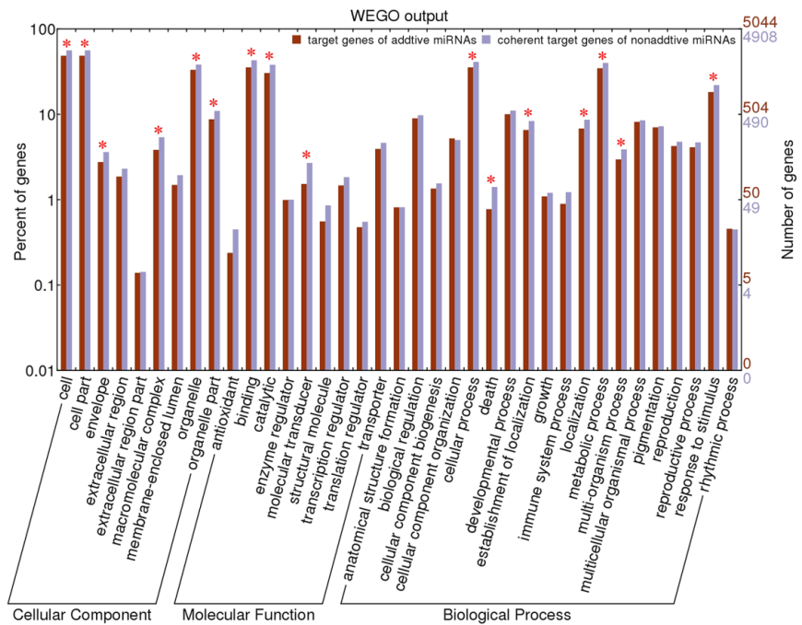
GO classifications of target genes of additive and
non-additive miRNAs in Brassica hexaploid
Notes:
Fig. 2-14 GO classifications of target genes of additive and non-additive miRNAs in Brassica hexaploid. The results are summarized in three main categories: cellular component, molecular function, and biological process by GO analysis.

Slide 42
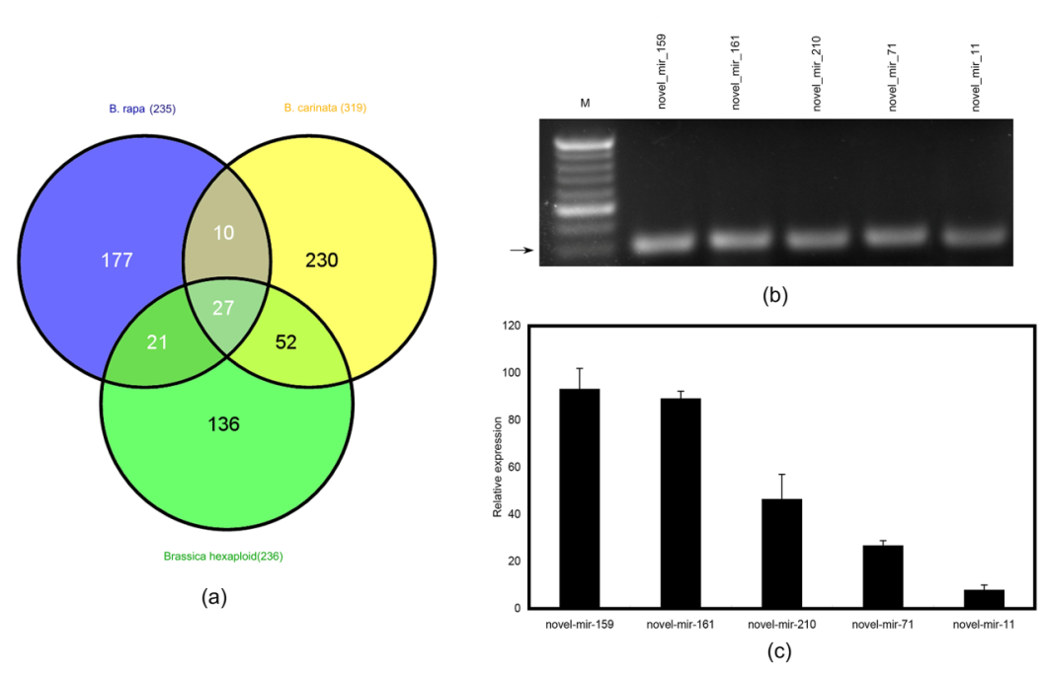
Identification and validation of potential novel miRNAs
Notes:
Identification of potential novel miRNAs…. In addition to the identification of known miRNAs, 653 small RNAs (235, 319, and 236 in B. rapa, B. carinata,and Brassica hexaploid, respectively) met the criteria as established according to Allen et al. (2005) and were considered putative novel miRNAs in the three libraries
Fig.2-16 Predicted novel miRNAs in this study. (a) Venn diagram showing the novel miRNAs expressed in B. rapa, B. carinata, and Brassica hexaploid. (b) Stem-loop RT-PCR analysis for the identified novel miRNAs. Five novel miRNAs were confirmed via quantitative real-time RT-PCR. The sizes of the obtained PCR products were approximately 60 bp. M indicates a 20 bp DNA Ladder Marker (Takara, Japan). The arrow indicates 60 bp. (c) Validation via quantitative real-time RT-PCR of the predicted novel miRNA

Slide 43
Distribution of abundance of novel miRNAs
in Brassica hexaploid and its parents
Abundance of novel miRNAs | Total number of novel miRNAs in the three libraries | Percentage (%)
1-100 | 648 | 82.03
100-500 | 80 | 10.13
500-1,000 | 13 | 1.64
1,000-5,000 | 37 | 4.68
5,000-10,000 | 8 | 1.01
>10,000 | 4 | 0.51
Total | 790 | 100
Notes:
In this study, the expression levels of novel miRNA
candidates were examined (Supplemental Table 2c). We
found that the expression levels of predicted novel miRNAs
varied markedly from 5 to 240,279 reads among the three
libraries. However, 82.15 % of predicted novel miRNAs
generated less than 100 reads. This result indicated that
novel miRNAs were expressed at lower levels than known
miRNAs, which may suggest a specific role in Brassica
hexaploid and its parents.

Slide 44
Summary of small RNA expression
Total of 618 differentially expressed miRNAs were detected between Brassica hexaploid and its parents.
More differentially expressed miRNAs with larger differences in expression existed between Brassica hexaploid and B. rapa, which is consistent with the progenitor-biased gene repression in this hexaploid.
 The target genes involved in response to stimulus are significantly enriched in coherent target genes of down-regulated miRNAs.
 These results increase our understanding of the gene expression regulation mechanism in Brassica polyploids.

Slide 45
Acknowledgement
 Prof. Jinling Meng, HAU
 Qin Zhao, Ph.D., WHU
Yanyue Shen, Ph.D., WHU
 The National Science Foundation of China

Slide 46
Thanks for your attention !

Slide 47
Let Us Meet Again
We welcome you all to our future conferences of OMICS International
Please Visit: http://transcriptomics.conferenceseries.com/
http://conferenceseries.com/
http://www.conferenceseries.com/genetics-and-molecular-biology-conferences.php

