Slide 1
About OMICS Group
OMICS Group International is an amalgamation of Open Access publications and worldwide international science conferences and events. Established in the year 2007 with the sole aim of making the information on Sciences and technology ‘Open Access’, OMICS Group publishes 400 online open access scholarly journals in all aspects of Science, Engineering, Management and Technology journals. OMICS Group has been instrumental in taking the knowledge on Science & technology to the doorsteps of ordinary men and women. Research Scholars, Students, Libraries, Educational Institutions, Research centers and the industry are main stakeholders that benefitted greatly from this knowledge dissemination. OMICS Group also organizes 300 International conferences annually across the globe, where knowledge transfer takes place through debates, round table discussions, poster presentations, workshops, symposia and exhibitions.

Slide 2
About OMICS Group Conferences
OMICS Group International is a pioneer and leading science event organizer, which publishes around 400 open access journals and conducts over 300 Medical, Clinical, Engineering, Life Sciences, Phrama scientific conferences all over the globe annually with the support of more than 1000 scientific associations and 30,000 editorial board members and 3.5 million followers to its credit.
OMICS Group has organized 500 conferences, workshops and national symposiums across the major cities including San Francisco, Las Vegas, San Antonio, Omaha, Orlando, Raleigh, Santa Clara, Chicago, Philadelphia, Baltimore, United Kingdom, Valencia, Dubai, Beijing, Hyderabad, Bengaluru and Mumbai.

Slide 3


Herbal Hepatotoxicity:
Convert Blame into Rational Usage
302 Military Hospital of China
Jia-bo Wang
302 Military Hospital, PR China
China Military Institute of Chinese Medicines
pharm_sci@126.com

Slide 4
The challenges:
Fast expansion of TCM DILI
Global consumption of TCM
Fast expansion of adverse reactions
Drug-induced liver injury (DILI) contributes to most of the severe adverse reactions of TCM.

Slide 5
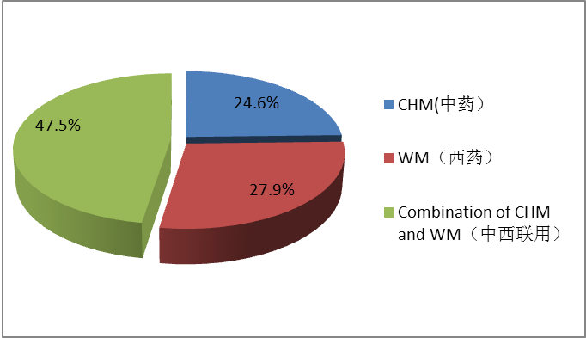
The challenges:
Fast expansion of TCM DILI
DILI percentage in hospitalized patients
TCM
24.6%
47.5%
TCM + WM
(unknown)
27.9%
WM
TCM vs Western medicine
DILI cases increase rapidly in China.
Nearly 1/4 of DILI cases are attributed to TCM.

Slide 6

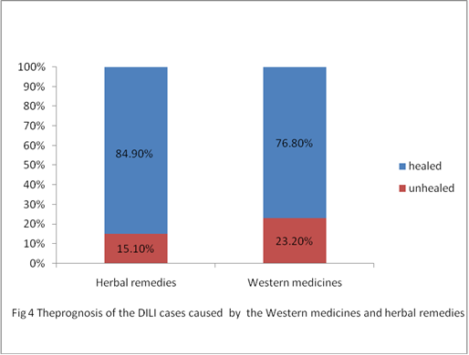
Question:
Are TCM toxic ?
The estimated incidences of TCM DILI are 0.01~ 1%.
JAMA 1999; 282:
The healing rate of TCM DILI cases is significantly higher than that of WM.
Healed
Unhealed
TCM
WM

Slide 7
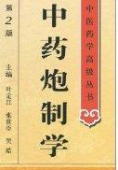


Question:
How to balance risk and benefit?
Every drug is a poison and every poison is a drug.
Lots of TCM DILI cases are caused by irrational applications.
Overdose
Overtime
Wrong
indication
Unprocessed
TCM
It is critical to guarantee the rational usage of TCM to avoid unnecessary risks.

Slide 8
Toxicity-attenuating methods of TCM
In 5000-years TCM history, lots of toxicity-attenuating methods are documented to avoid adverse reactions.
Processing, formulae attenuation, and syndrome differentiation.
×
？
Toxic Decoction Pieces
×
？
×
？
？
Toxic Components
Toxic Herbs
Toxic Formulae
×
Drug Intoxication
Toxicity-attenuating methods of TCM
Composition-synergy
Attenuation
Processing Attenuation
Formulae Attenuation
Syndrome Differentiation Attenuation

Slide 9
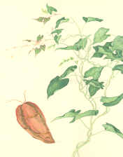
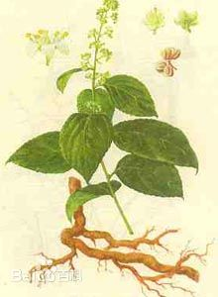
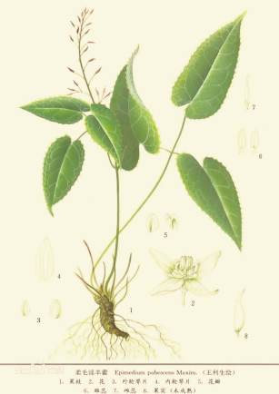
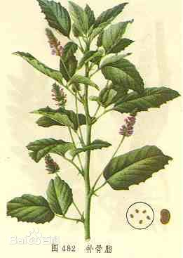
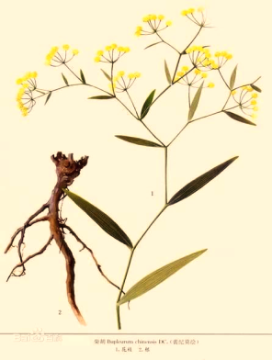


Common TCMs related to DILI
Dried root of
Polygonum multiflorum
family Polygonaceae
Heshouwu 何首乌
Polygonum multiflorum Thunb.
Leigongteng 雷公藤
Tripterygium wilfordii Hook. f.
Yinyanghuo 淫羊藿
Epimedium brevicornu Maxim.
Buguzhi 补骨脂
Psoralea corylifolia Linn.
Chaihu 柴胡
Bupleurum chinense DC.
……
Tonic to liver and kidney
Preventing hair loss and graying
Prevent aging and extend lifetime
Liver-restorative
VS
Hepatotoxic

Slide 10
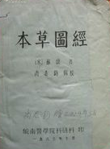
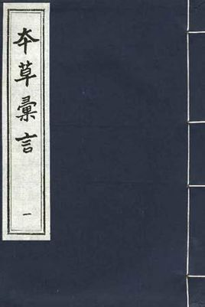
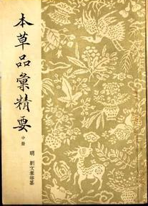
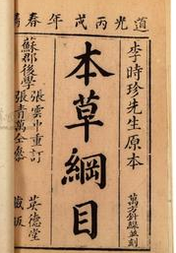
Attenuating toxicity of Heshouwu by processing
The processing method of Heshouwu is highlighted in many ancient TCM books to attenuate its toxicity.
宋《本草汇言》
明《本草汇言》
明《本草品汇精要》
明《本草纲目》
制非九次，勿寝其毒
Steaming and solarization of nine times each 九蒸九曝

Slide 11
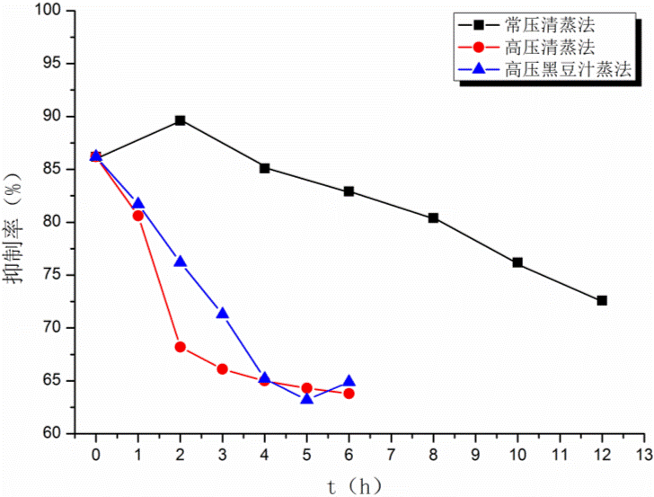
Insufficient processing of Heshouwu
It needs a long time (48 hours at least without high pressure) of steaming to attenuate the hepatotoxicity of Heshouwu.
Lots of commercial processed Heshouwu are not sufficiently processed to attenuate its hepatotoxicity.
Inhibition to hepatocytes

Slide 12
Attenuating toxicity of Heshouwu by processing
*
*
*
*
*
*
*
*
*
*
Ctrl
12 24 48
12 24 48 64 128
g/kg
Ctrl
12 24 48
12 24 48 64 128
g/kg
Unprocessed
Processed
Unprocessed
Processed
Completely processing attenuates the hepatotoxicity of Heshouwu and enlarges its therapeutic window for 4 folds.

Slide 13
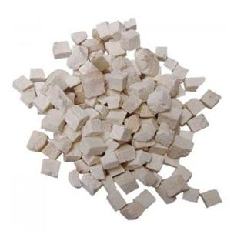
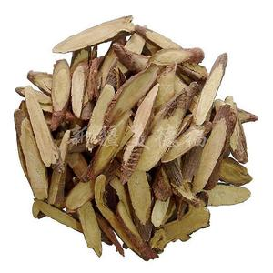
Attenuating toxicity of Heshouwu by formulae combination
Fuling 茯苓 is traditionally used in combination with Heshouwu to reduce its toxicity documented in ancient TCM books.
以茯苓为使
Gancao 甘草 is traditionally used as detoxicant in TCM formulae.
Fuling 茯苓
Poria cocos (Schw.) Wolf.
Gancao甘草
Glycyrrhiza uralensis Fisch
0.07
0.22
0.67
2.00
0.07
0.22
0.67
2.00

Slide 14
Early discovering the liver injury of Heshouwu
Aminotransferases (ALT and AST) are not sensitive to the injury of Heshouwu.
Bilirubin (TBIL) elevates before ALT or AST does.
Normal
CCl₄
Unprocessed HSW
Processed HSW
1wk
2wk
3wk
4wk

Slide 15
Early discovering the liver injury of Heshouwu
Metebolomic biomarkers can reveal Heshouwu-induced alteration of liver function in early stage.
Metebolomic biomarkers also assist diagnosis Heshouwu DILI from the other confounding liver diseases (e.g. autoimmune hepatitis).
Processed HSW
CCl₄
Normal
Unprocessed HSW
PLS-DA plot of rats at 1st week
PLS-DA plot of patients with different liver diseases

Slide 16
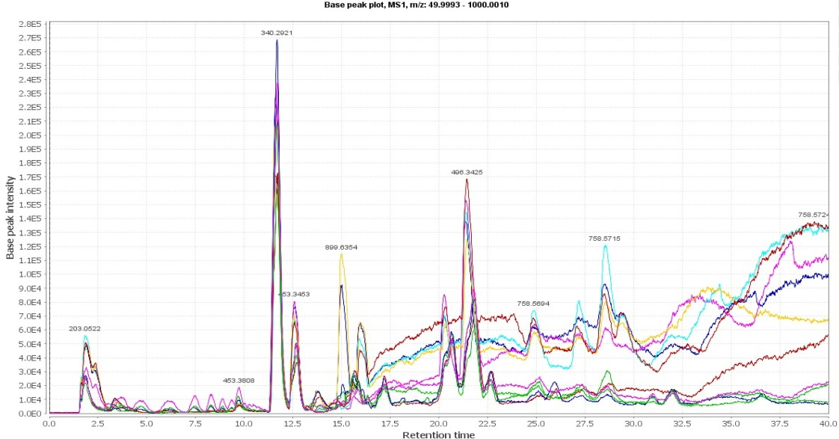
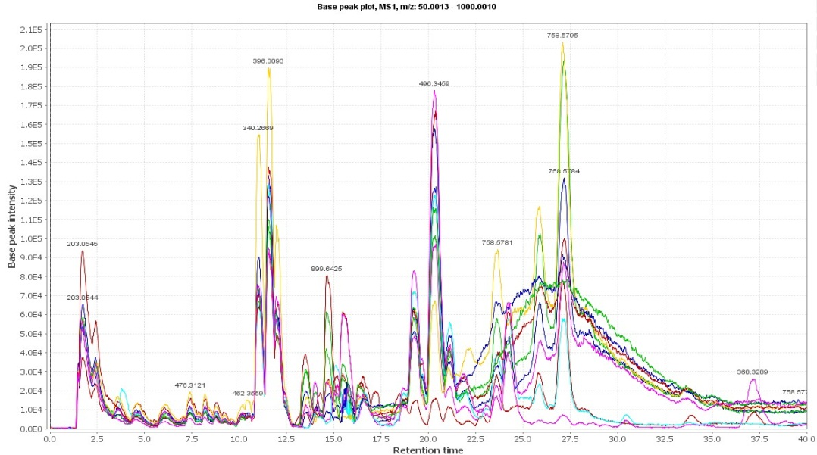
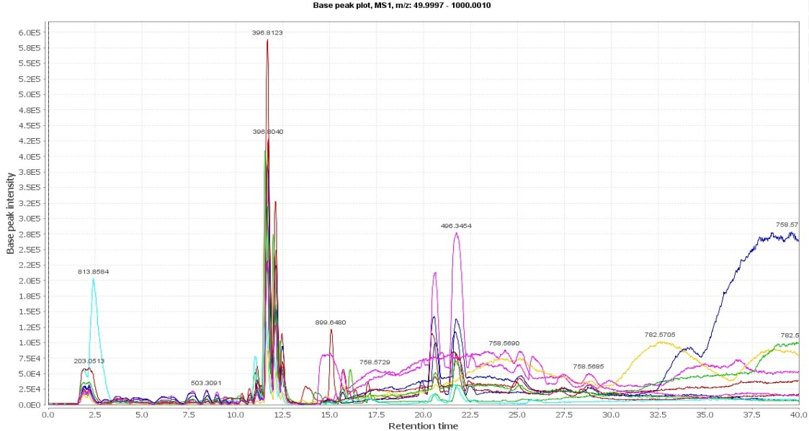
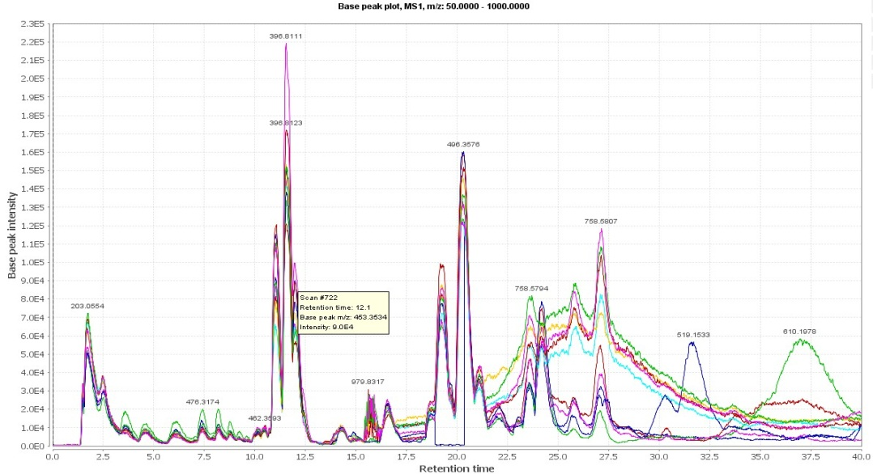
LC-QTOF Analysis
LF
AIH
HSM-DILI
Non HSM-DILI
Healthy

Slide 17
Metabolomic biomarkers of Heshouwu DILI

Slide 18
Perspective
Cautious to the liver injury of Heshouwu.
Suggestions to rational usage of Heshouwu:
  Do not overdose and overtime.
  Surveil the sensitive indices (TBIL) of liver functions.
  Always use the completely processed drug when treating chronic diseases.
  Metabolomic biomarkers assist early discovery of liver injury induced by Heshouwu.

Slide 19
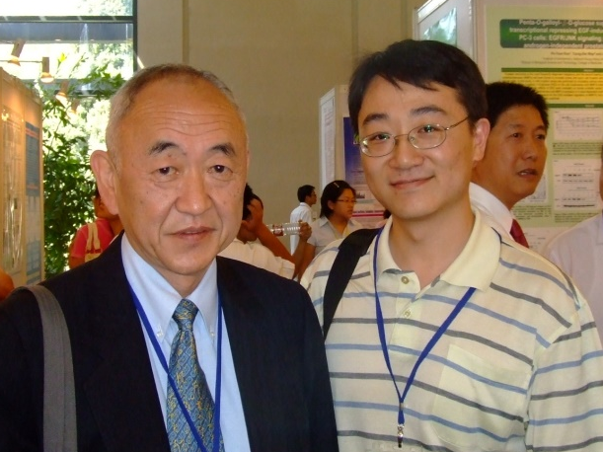

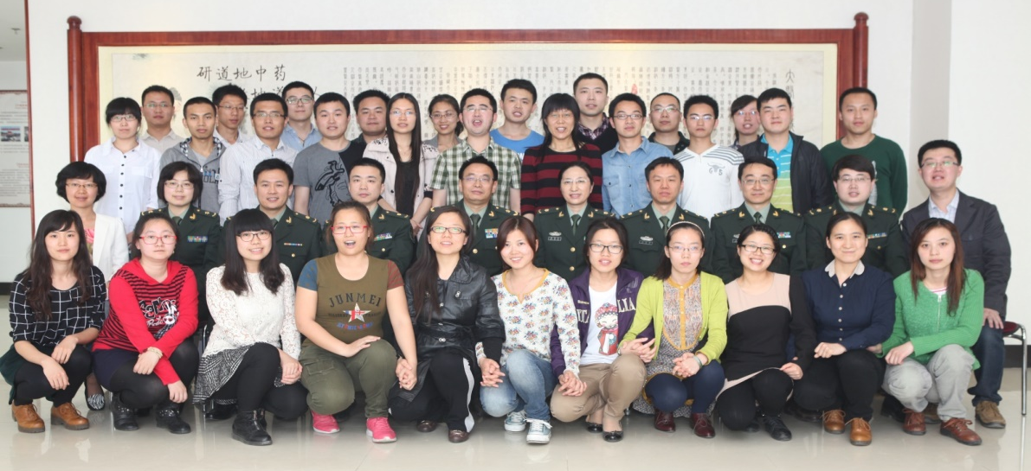


Acknowledgements
Prof. Yong-chi Cheng, Yale University
Prof. Xiao-xi Du, CFDA Center for Drug Reevaluation
Prof. Xiao-he Xiao, China Military Institute of Chinese Medicine

Slide 20
Lets Meet again at Pharmacognosy-2015
3rd International Conference and Exhibition on Pharmacognosy, Phytochemistry and Natural Products
October 26-28, 2015 Hyderabad, India
Theme: Advanced trends for the future of Herbal Drugs and Products
Website: http://pharmacognosy-phytochemistry-natural-products.pharmaceuticalconferences.com/

