Slide 1
“In seeking knowledge, the first step is silence, the second listening,
the third remembering, the fourth practicing, and the fifth teaching others”
- Solomon Ibn Gabirol

Slide 2
Galanza, Jefferson S. , Camcam, Jewel An Mischelle R.,
Co, Alyssa Karryl C. , De Guzman, Stephanie P., Domingo, Kojin Q., Dongui-is, Jet Jet K. , Frias, Rodolfo Dane C. , Jueco, Ovelle C., Matbagan, Harvey L. , Rillon, Victoria Luzette T.,
Saruca, Christelle Romyna H. , Villasper, Jeanette Roma M.

Slide 3
INTRODUCTION
OBJECTIVES
SIGNIFICANCE OF THE STUDY
CONCEPTUAL FRAMEWORK
Nursing as a profession is very complex, both to learn and to teach.
Amidst numerous studies conducted on learning styles of students from a variety of courses and levels, a recent study conducted recommended a great need for research on learning styles of student nurses.
Moreover, related literatures have not been found exploring the learning styles and teaching style of nursing students.
Notes:
Given the increasing complexity and pressures of health care delivery, new approaches to teaching and learning, faculty members and students require a broad range of teaching and learning strategies that can be used in diverse settings to increase the learning outcomes
Contradicting results of what is really the learning style developed in a student nurse
Inadequacy of exploring the teaching styles of students who educate their patients in clinical placements

Slide 4
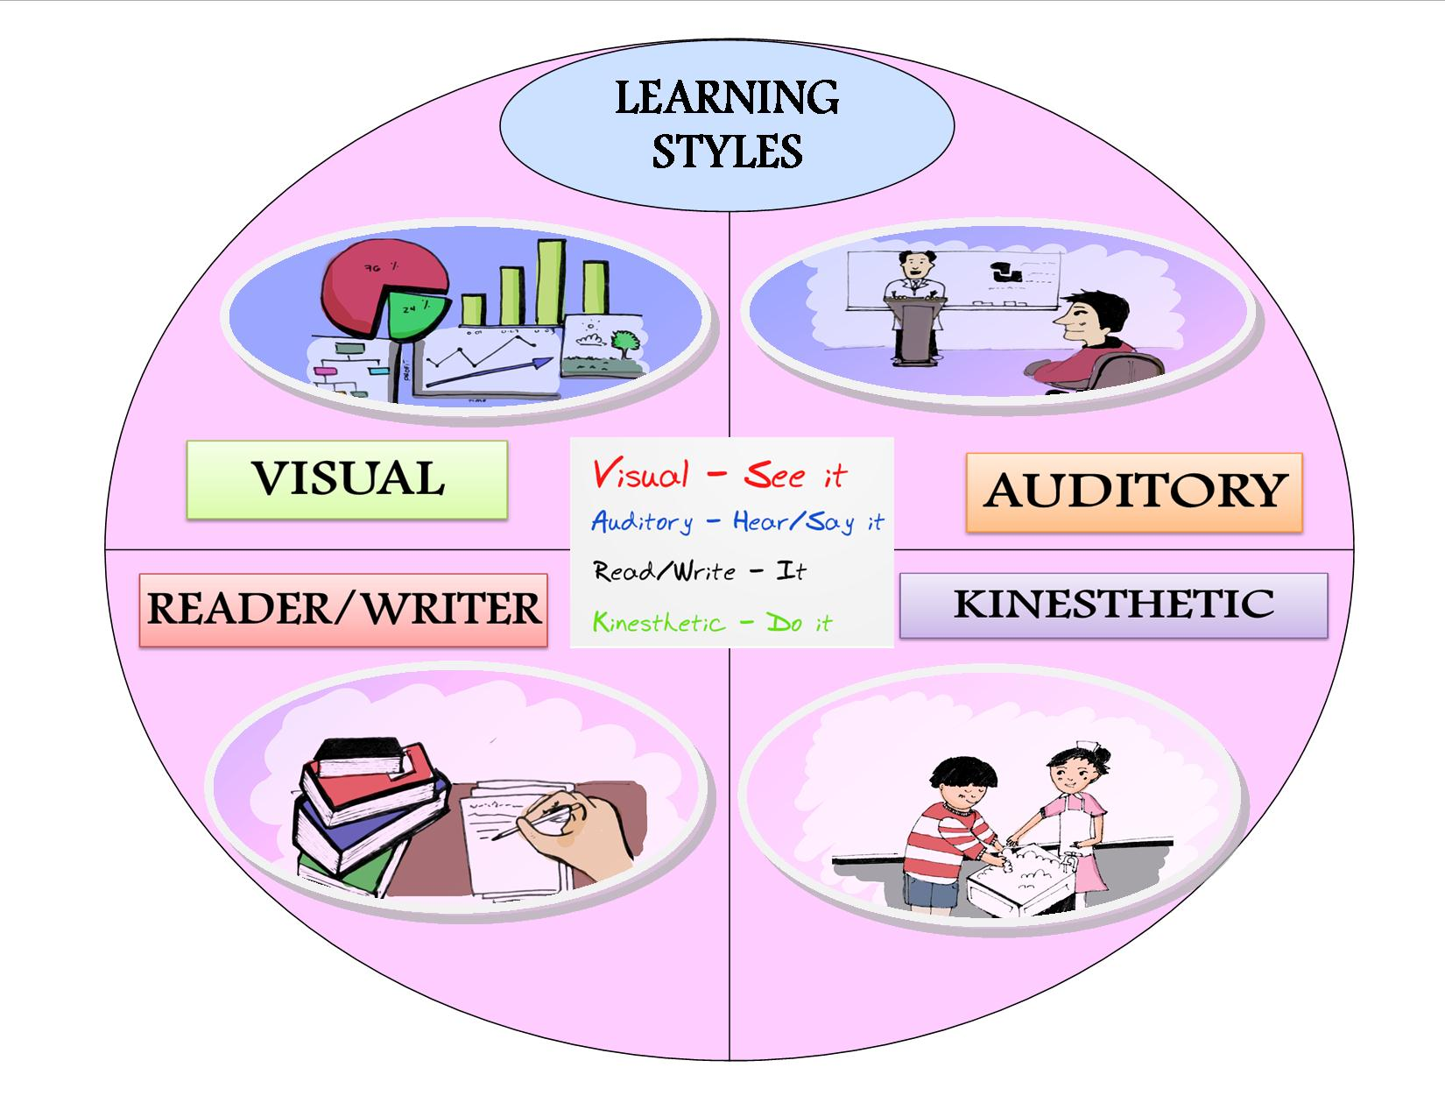
INTRODUCTION
OBJECTIVES
SIGNIFICANCE OF THE STUDY
CONCEPTUAL FRAMEWORK

Slide 5
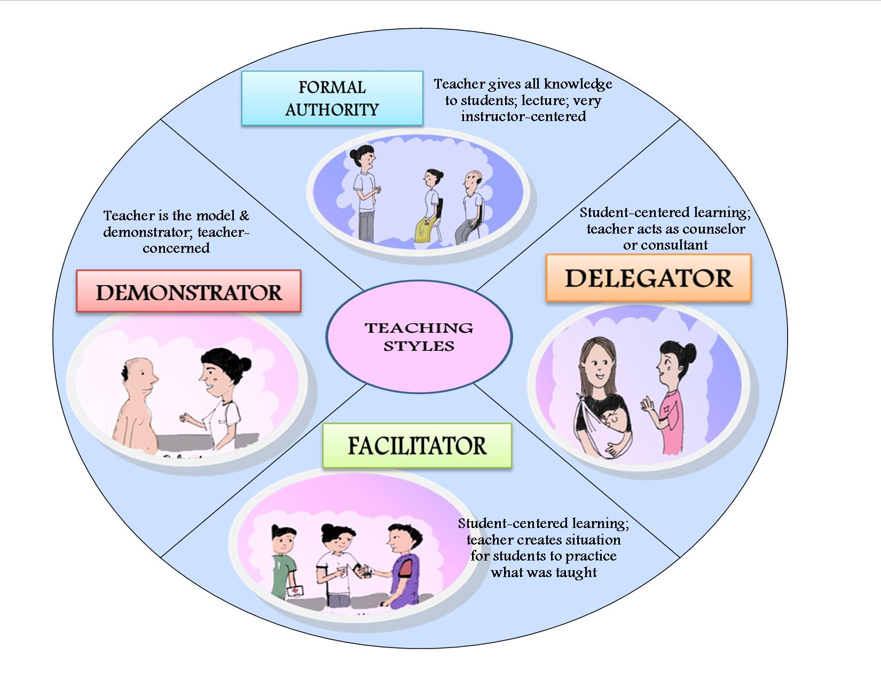
INTRODUCTION
OBJECTIVES
SIGNIFICANCE OF THE STUDY
CONCEPTUAL FRAMEWORK

Slide 6
OBJECTIVES
SIGNIFICANCE OF THE STUDY
CONCEPTUAL FRAMEWORK
The study aimed to determine the learning and teaching styles of student nurses and if there is an association between them.
It also intended to identify which faculty teaching style affords maximum outcome
for student’s learning styles.
Lastly, it further attempted to discover whether student nurses are unimodal or multimodal in their styles.

Slide 7
RESEARCH
QUESTIONS
SIGNIFICANCE OF THE STUDY
CONCEPTUAL FRAMEWORK
1. What are the LEARNING Styles of Student Nurses?
2. What are the TEACHING SYLES of Student Nurses?
3. What faculty teaching style affords maximum learning for student’s learning style?
4. Are the student nurses UNIMODAL or MULTIMODAL in their learning and teaching styles?
5. Is there an association between learning and teaching styles of student nurses
Notes:
In line with the study objectives…we arrived at this research questions
Number 1….2…3….4…lastly, is there an association between learning and teaching styles of student nurses…for those who are unimodal in their learning and teaching modalities

Slide 8
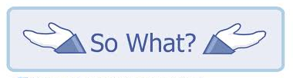
SIGNIFICANCE OF THE STUDY
CONCEPTUAL FRAMEWORK
DESIGN
PARTICIPANTS
Being aware of individual learning style is already achieving the first step in maximizing the learning outcome of every learner
Serve as a basis for training students to utilize appropriate learning strategies, which can help them better deal with academic tasks and may
even reduce stress
Notes:
The significance of the study is the SO WHAT part…So what if we identify the learning and teaching styles of student nurse….first,

Slide 9
SIGNIFICANCE OF THE STUDY
CONCEPTUAL FRAMEWORK
DESIGN
PARTICIPANTS
Faculty can adjust their learning methods and evaluation too to best match the different needs of their students
Understanding how students learn will help improve the quality of instruction
May empower their learning experiences of student nurses, which could be the ultimate goal.
Will increase academic achievement when there is congruency of learning and teaching styles

Slide 10
INTRODUCTION
OBJECTIVES
SIGNIFICANCE OF THE STUDY
CONCEPTUAL FRAMEWORK
Kolb’s Experiential Learning Theory
Grasha’s Teaching Style
.
Individual learning styles emerges through: Genetics, life experiences, and demands of our current environment
There is a symbiotic relationship among our personal qualities, the instructional processes we employ to convey the content of our disciplines, and the styles our learners display.

Slide 11
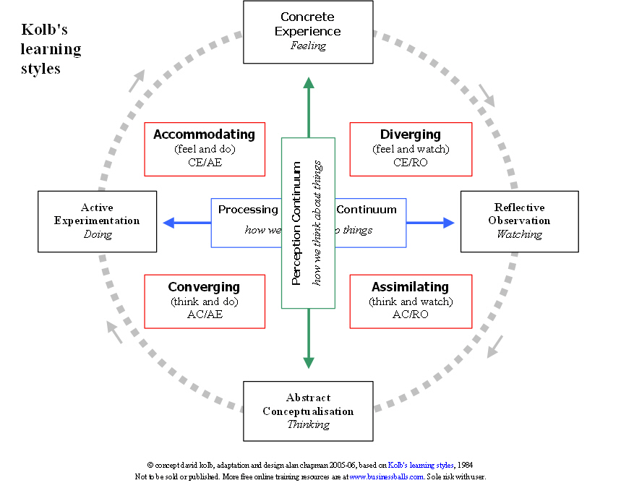

Slide 12
DESIGN
PARTICIPANTS
PROCEDURE
ETHICAL CONSIDERATION
DESCRIPTIVE-CORRELATIONAL QUANTITATIVE RESEARCH
Notes:
We finally included correlational design after consult was sougth from Ms. Zenaida Garambas, an author of a book entitled “Introduction to Statistics”, and she suggested that we could use Chi square to correlate the learning and teaching styles of those who are unimodal in their learning and teaching modality.

Slide 13
DESIGN
PARTICIPANTS
PROCEDURE
ETHICAL CONSIDERATION
INCLUSION CRITERIA
Level 2, 3, & 4 Student Nurses of SoN “X”
Enrolled for 2nd Semester SY 2013-12014
Exposed in the clinical and community rotations
Locale: Baguio City, Philippines

Slide 14
DESIGN
PARTICIPANTS
PROCEDURE
ETHICAL CONSIDERATION
210 Level II
289 Level III
583 Level IV
1082
312
60 Level II
84 Level III
168 Level IV
20 Males
40 Females
29 Males
55 Females
53 Males
110 Females
Notes:
Proportionate Sampling Method
Out of 1119 student nurses enrolled, we obtained 312 respondents, using OpenEpi software.
We used fishbowl method in choosing a clinical group that will form part in the study. Since we needed a 14 respondent in each section we randomly selected additional respondent to complete the 14.

Slide 15
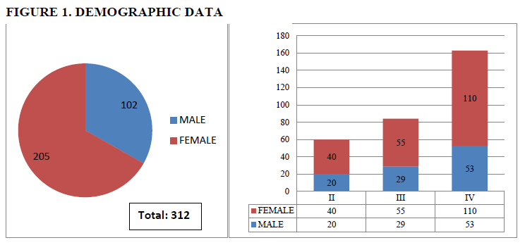
DEMOGRAPHIC DATA
RESULTS and DISCUSSION
CONCLUSION
RECOMMENDATION

Slide 16
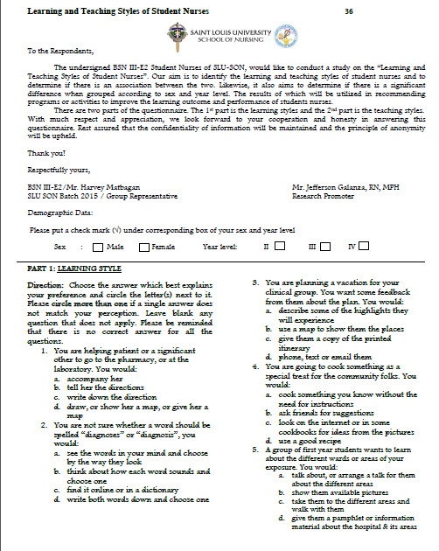
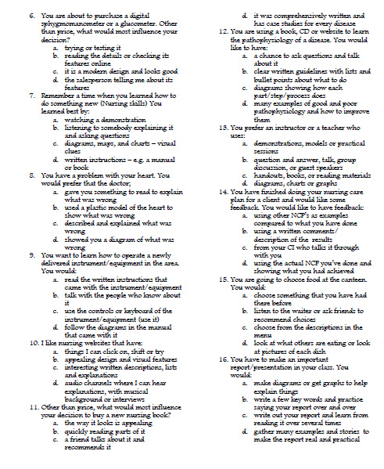
DESIGN
PARTICIPANTS
TOOL
ETHICAL CONSIDERATION
Notes:
We used a modified version of an adapted tool from Neil Fleming’s VARK version 7.2 for the learning styles for student nurses, while the teaching styles questionnaire was modified an adapted from Grasha’s. Among all the questionnaires available, we opted for VARK has four learning styles, namely; Visual, Auditory, Reader and Kinesthetic. Visual learners prefer using visual resources such as diagrams, pictures, and videos. Auditory learners need to talk about situation and ideas with range of people and enjoy hearing stories from others. Reader or Writer learning is prolific note-takers; textbooks are important to them and love extensive use of journals to write down the facts and stories. Lastly, Kinesthetic learners prefer hands on experience within real setting and for global learning. We modified the questionnaire for student nurses to better understand the terminologies.
The questionnaire was divided into four parts; the first part contains the letter to the respondents, followed by the demographic data. The third part consist of 16 questions for learning style and 9 questions for teaching styles, and a question to assess what faculty teaching styles could afford maximum learning fort them. Lastly, the last portion is a simple scoring chart, where student nurses are able to identify their learning and teaching styles…….

Slide 17
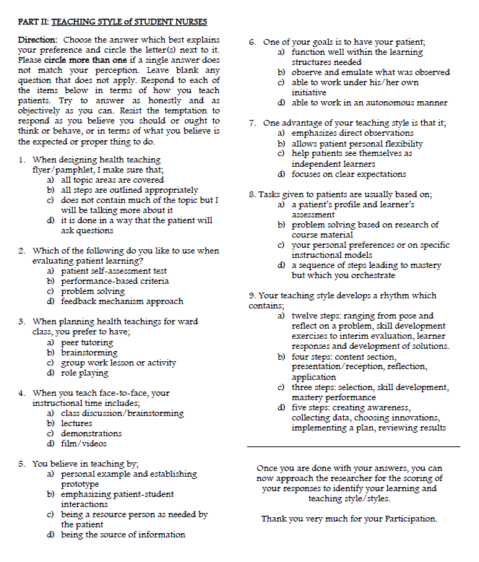
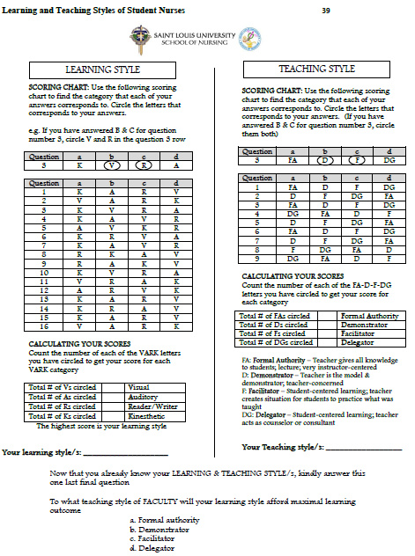
DESIGN
PARTICIPANTS
TOOL
ETHICAL CONSIDERATION

Slide 18
DESIGN
PARTICIPANTS
PROCEDURE
ETHICAL CONSIDERATION
Context Validity Index (CVI) :
Result 0.8
Readability Test
Results: Grade 7
Test - Retest
Result: 0.8
Letter to the Dean: Commitment of Researchers
Computation of Sample Population:
OpenEpi Software
Another fishbowl method to get the lacking number of respondents
Proportionate sampling: 14 Student Nurse per Block
Fishbowl Method (4 clinical groups)
Researchers were divided in to 3 groups (levels 2, 3 and 4)
Notes:
The tool was reviewed by Dr. Jose Reinhard Laoingco, Ms. Norenia Dao-Ayen and Sir Roderick Ortega. The result of the computation was 0.8, which means that the tool is valid.
Readability test was done for the tool using Readability score.com, which yielded an average of grade 7, meaning that the questionnaire can be understood by a grade 7 student.
Test-retest was done utilizing 10 students (3-3-4) floated the questionnaire twice with one week interval. The results yielded 0.8 based on SPSS utilizing the pearson’s R correlation

Slide 19
DESIGN
PARTICIPANTS
PROCEDURE
ETHICAL CONSIDERATION
Asked permission to the Instructor to float the questionnaire
Floating of questionnaire before or after class.
Explained the AIM of the study (guided by a Script for uniformity)
CONSENT were given first
Collected the Consent
Researchers answered questions and clarifications from the respondents
Questionnaire was then floated
Respondents were taught how to interpret
Expressed gratitude

Slide 20
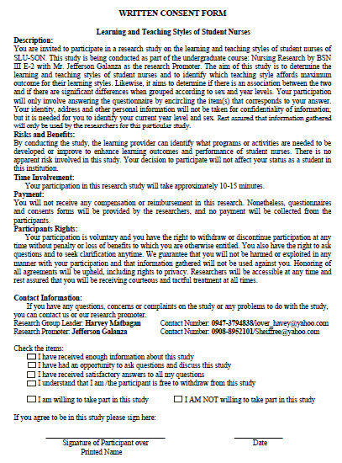
DESIGN
PARTICIPANTS
PROCEDURE
ETHICAL CONSIDERATION

Slide 21
DESIGN
PARTICIPANTS
PROCEDURE
ETHICAL CONSIDERATION
Freedom from exploitation (Information will not be used against the respondents)
Respected rights for human dignity (right to full determination & full disclosure)
Justice or right to fair treatment (rights to privacy & confidentiality)
Informed consent
Notes:
Consent was obtained from students of legal age; Fortunately, all respondents are above 18 years old. The participants had the right to refuse and decide voluntarily to participate in our study. We complied with their right for human dignity by answering their questions graciously. All information were kept in strictest confidentiality. Lastly, we honoured all agreement, which demonstrated justice or right to fair treatment.
-Beneficece-Freedom from exploitation – information will not be used against them in any way
- Right to full determination – right to decide voluntarily to participate (right to ask questions, to refuse to give information, ask clarification, terminate participation, freedom from coercion)
- Right to full disclosure – fully describe the nature of study, researchers responsibilities, right to refuse participation, risk and benefits

Slide 22
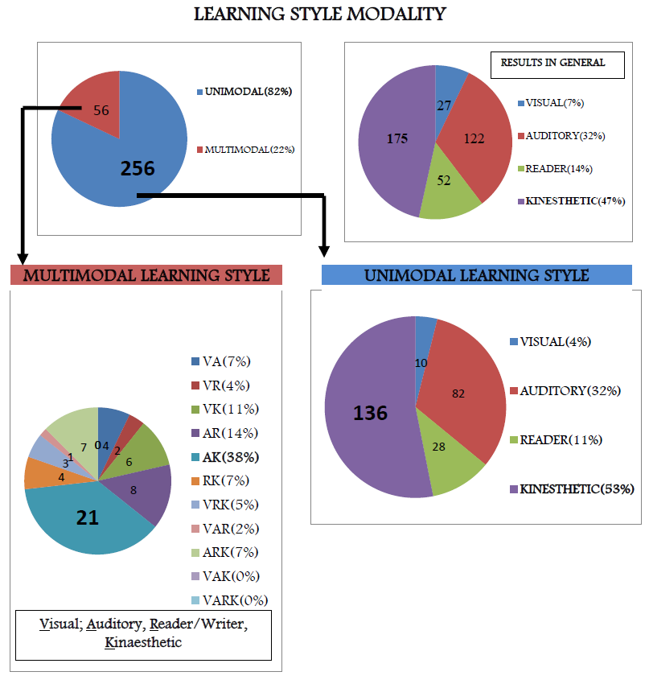
RESULTS
DEMOGRAPHIC DATA
RESULTS and DISCUSSION
CONCLUSION
RECOMMENDATION

Slide 23
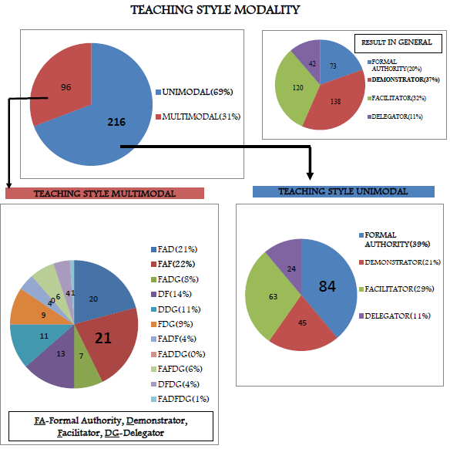
RESULTS
DEMOGRAPHIC DATA
RESULTS and DISCUSSION
CONCLUSION
RECOMMENDATION

Slide 24
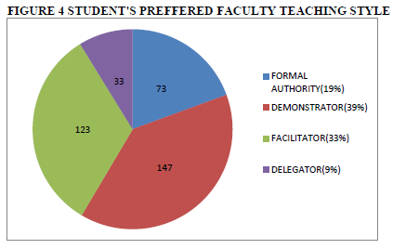
DEMOGRAPHIC DATA
RESULTS and DISCUSSION
CONCLUSION
RECOMMENDATION
RESULTS

Slide 25
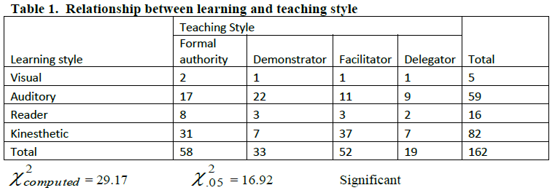
DEMOGRAPHIC DATA
RESULTS and DISCUSSION
CONCLUSION
RECOMMENDATION
RESULTS
At the 5% level of significance, there is a significant relationship between the learning styles and the teaching styles of the student nurses
Notes:
In this table only had 162 out of 312 respondents the reason we only had this number of respondents is that this respondents had a single response which makes them included in the criteria that the chi square requires. We cannot include those respondents who have multiple response in the learning and teaching style.
The “Facilitator” teaching style yielded highest proportion of kinesthetic learners, and “Formal authority” teaching style also affords maximum kinesthetic learners. This implies that kinesthetic learners are more inclined to “Formal authority” or “Facilitator” strategies of teaching
At the 5% level of significance, there is a significant relationship between the learning styles and the teaching styles of the student nurses. This means that the learning style of the student is related to his/her teaching style. Visual learners, on the other hand, are least affected by the different teaching styles.

Slide 26
DEMOGRAPHIC DATA
RESULTS and DISCUSSION
CONCLUSION
RECOMMENDATION
CONCLUSION
Study conclude that there is not much variation on the student nurses’ learning styles but are varied in their teaching styles. This exemplifies the UNIQUENESS of every learner.
However, being cognizant of the learning & teaching styles of student nurses is highly important for both the students and the faculty.
Student’s awareness on how they learn best contribute
to their own learning.

Slide 27
DEMOGRAPHIC DATA
RESULTS and DISCUSSION
CONCLUSION
RECOMMENDATION
CONCLUSION
The findings also supports the on-going paradigm shift to Outcome-Based Education (OBE) which requires the students to demonstrate the skills and course content that they are required to learn.
Lastly, the study provided useful information for improving the quality of teaching and learning experiences of student nurses.

Slide 28
DEMOGRAPHIC DATA
RESULTS and DISCUSSION
CONCLUSION
RECOMMENDATION
RECOMMENDATIONS
Future studies could be carried out in varied school of nursing with bigger and equal gender sample population.
Replication of the study utilizing faculty or clinical instructors as respondents
Conducting assessment of learning style at the onset of classes/clinical placements

Slide 29
