Slide 1
NOVEL ANTICANCER AGENT, SQAP, BINDS TO FOCAL ADHESION KINASE AND MODULATE ITS ACTIVITY
Jesus Izaguirre Carbonell
指導教員 菅原 二三男

Slide 2
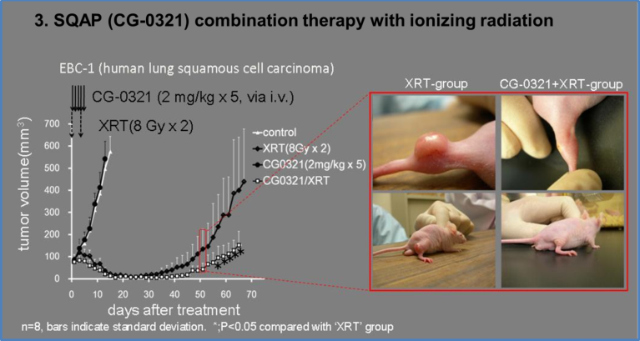
SQAP background
SQAP was combined with indirect
ionization against human cancers
transplanted in mice to synergistically
enhance tumor arrest via an antiangiogenic effect.
Radiobiological mechanisms of SQAP are not fully understood.
Notes:
My research has been based on a novel anticancer agent named SQAP. SQAP was chemically designed from SQMG which was isolated from the small intestine of sea urchins as result of natural products research. SQAP is a promising radiosensitizing agent for anticancer therapy. SQAP has the ability to trigger antiangiogenesis in vivo with very few side effects, similar to SQMG, and it has been confirmed in previous biological studies. However, the radiobiological mechanisms that modify the tumor microenvironment are still unknown. Revealing these mechanisms has been my research purpose.
Here we have an example using lung cancer EBC-1 cells: We can see how SQAP synergistically inhibits angiogenesis at lower doses in a combined therapy with ionizing radiation. The test was initiated when the tumor reached around 100 mm3. 2 mg/kg of SQAP were administered daily through five injections. Radiation therapy (XRT) was carried out two times on days 0 and 3 (each) upon tumor formation area and proximities.

Slide 3
Research purpose
Understand SQAP molecular mechanisms by:
Identification of SQAP-binding proteins targets using a T7 phage display screen.
Validation of the interactions.
Study the relation of the interacting proteins and SQAP at cell level.
Summary
Notes:
: I have divided my research into different steps. First one will be the search of SQAP-binding targets and for this method I used the phage display assay which I will introduce first.

Slide 4
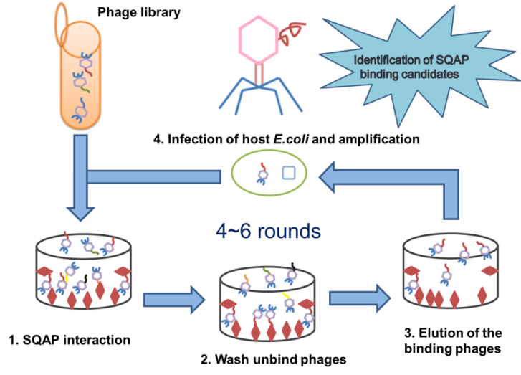
Identification of SQAP-binding proteins: Phage display
Notes:
Phage display is a method that works for the detection of various interactions. The method allows the presentation of large peptide and protein libraries on the surface of phage particles, which leads to the selection of peptides and proteins with high affinity and specificity to almost any target. In this method, first a phage library is constructed by extracting the mRNA from any desired target, in our case cancer cells. cDNA is synthesized using random primers and these sequences are cloned into the T7 phage gene so that peptides were displayed at the capsid. For this method we additionally need a biotinylated compound (show slide 6). The compound has to be biotinylated in order to be immobilized in a streptavidin coated well. After allowing immobilization, we insert the phage libraries and incubate them on the SQAP immobilized wells for 1 hr. Then we wash away the non-immobilized phages, and we elute the binding ones. Finally, we use these binding phages to infect a host E.coli and amplify them.

Slide 5
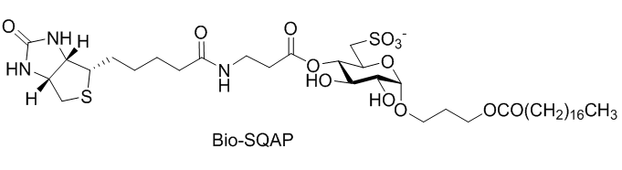
Identification of SQAP-binding proteins: Phage display
Biotin
Propanediol
Sulfoquinovose
Fatty acid

Slide 6
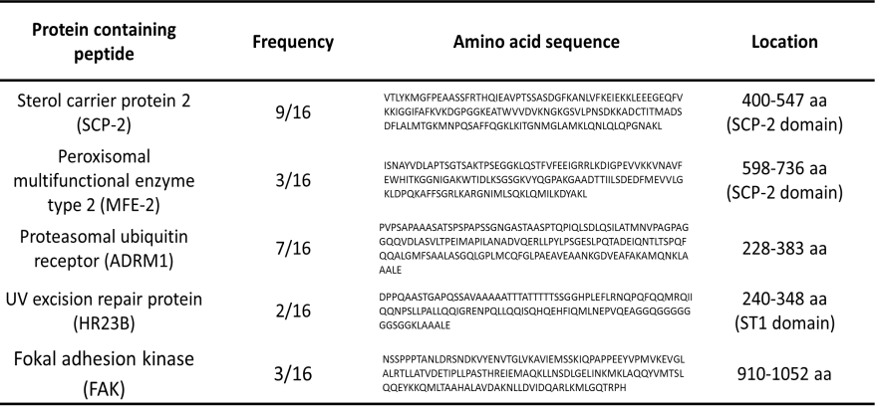
Identification of SQAP-binding proteins: Phage display
Five SQAP-binding peptides identified.
SCP-2 and MFE-2 SQAP binding points correspond to a SCP-2 domain.
SCP-2 and MFE-2 were found across two different libraries: Lung and Huvec.
Notes:
We obtained SCP-2 and MFE-2 from lung tumor and the HUVEC phage library, ADRM1 and HR23B obtained from the HeLa library and FAK obtained from the lung tumor library. The frequency number indicates that out of 16 samples peaked randomly 9 corresponded to SCP-2. The aa sequence is the peptide displayed by the phage capsid while one of the strong points of phage display is that we can identify in which region does SQAP binds. Interestingly, SCP-2 and MFE-2 SQAP binding points correspond to a SCP-2 domain while on the other hand SCP-2 and MFE-2 were found across two different libraries: Lung and Huvec.

Slide 7
Research purpose
Understand SQAP molecular mechanisms by:
Identification of SQAP-binding proteins targets using a T7 phage display screen.
Validation of the interactions.
Study the relation of the interacting proteins and SQAP at cell level.
Summary
Notes:
On the next section I will explain about the validation of the interactions between SQAP and binding candidates.

Slide 8
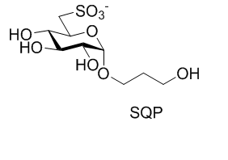
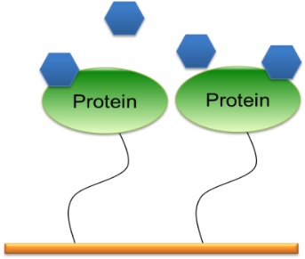
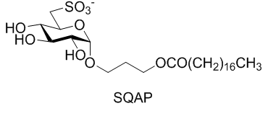
Validation of the interaction: SPR analysis Surface plasmon resonance
Sulfoquinovose
Propanediol
SQAP or SQP
Fatty acid
Notes:
Our first experiment was the SPR (surface plasmon resonance) analysis. On this experiment we compared the affinity of SQAP and SQP with the binding candidates. SQP was used as a negative control and it is an analog of SQAP that lacks the fatty acid. In the SPR experiment we immobilized the proteins on a sensor chip layer which utilize free carboxymethil groups where the proteins can be attached. After that, the compounds are injected and allowed to bind with the immobilized proteins. If the compound and the protein binds, the mass change is detected by SPR system and expressed as RU (response units).

Slide 9
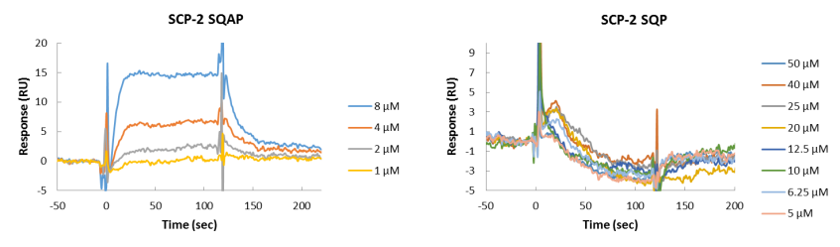
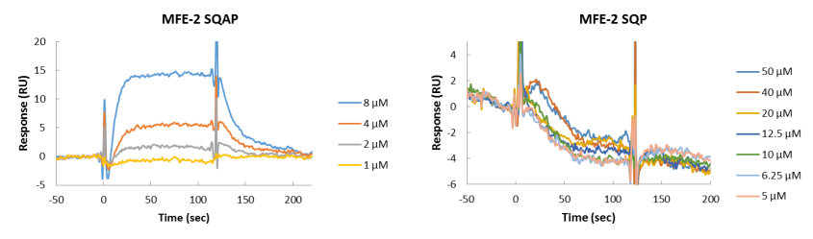
Validation of the interaction: SPR analysis Surface plasmon resonance
Notes:
Here we have the results for the SPR analysis. On the y axis the RU referring to the mass change are noted while on the x axis we have the time. As it can be observed, SQAP showed binding with all the candidates while SQP did not bind to any of them.

Slide 10
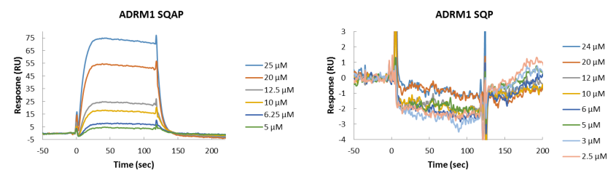
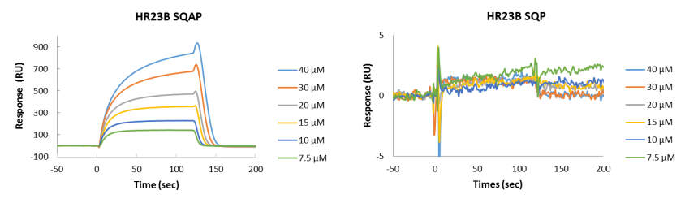
Validation of the interaction: SPR analysis Surface plasmon resonance
Notes:
Here we have the results for the SPR analysis. On the y axis the RU referring to the mass change are noted while on the x axis we have the time. As it can be observed, SQAP showed binding with all the candidates while SQP did not bind to any of them.

Slide 11
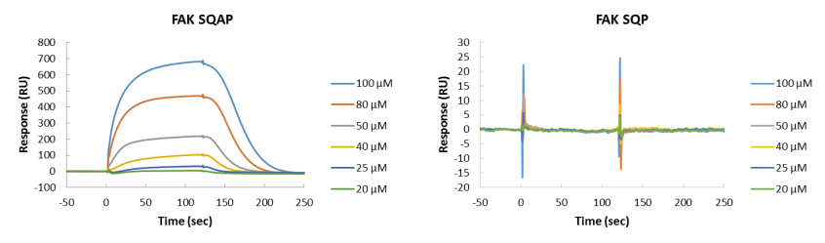
Validation of the interaction: SPR analysis Surface plasmon resonance
The SPR data was analyzed to determine the K_{D} which were estimated to be 15.6 μM for SCP-2, 14.2 μM for MFE-2, 9.65 μM for ADRM1 and 3.24 µM for FAK.
Notes:
Here we have the results for the SPR analysis. On the y axis the RU referring to the mass change are noted while on the x axis we have the time. As it can be observed, SQAP showed binding with all the candidates while SQP did not bind to any of them.

Slide 12
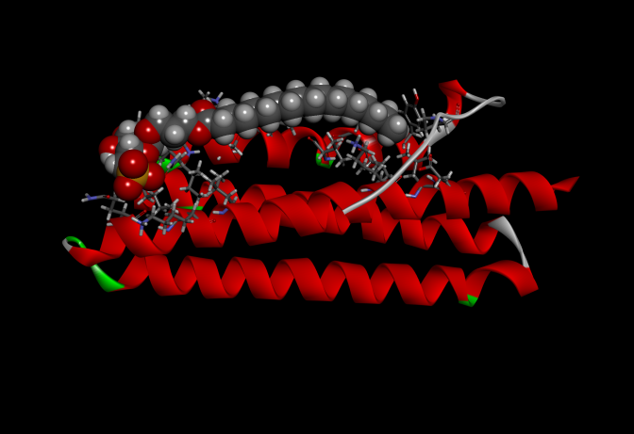
Validation of the interaction: Docking assay
Validation of the interaction:
FAK (906-1047 FAT domain)-SQAP
Y925
Docking simulation indicated that the fatty acid moiety of SQAP can interact with side chains of residues, Y925, V932 and K1032 of FAK.
Notes:
From here we selected FAK for further research because of its involvement in angiogenesis in endothelial cells and its role in development of human cancer. We carried out a docking simulation analysis on SQAP employing the focal adhesion targeting (FAT) domain (906-1047) of FAK which is the same region where SQAP was detected to bind through the phage display. The docking simulation indicated that the sulfone group of SQAP can interact with side chains of residues, N943 (asparagine), N1014 and K1018 (lysine) of FAK, and the fatty acid moiety of SQAP can interact with side chains of residues, Y925, V932 and K1032 of FAK.

Slide 13
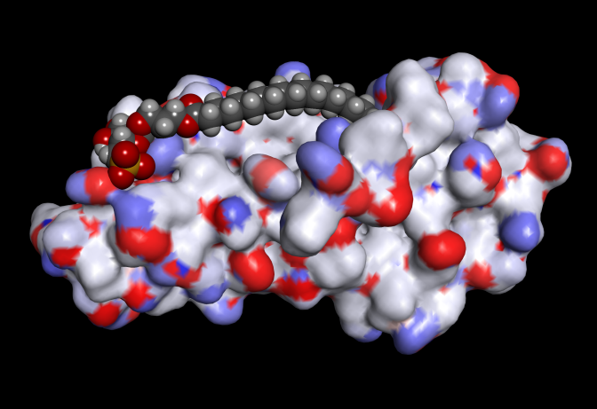
Validation of the interaction: Docking assay
Electron map
FAK (906-1047 FAT domain)-SQAP
3D structure of FAK FAT domain had been published before and was used on this docking assay. Sulfone group interacts with N943, N1014 and K 1018.
Notes:
From here we selected FAK for further research because of its involvement in angiogenesis in endothelial cells and its role in development of human cancer. We carried out a docking simulation analysis on SQAP employing the focal adhesion targeting (FAT) domain (906-1047) of FAK which is the same region where SQAP was detected to bind through the phage display. The docking simulation indicated that the sulfone group of SQAP can interact with side chains of residues, N943, N1014 and K1018 of FAK, and the fatty acid moiety of SQAP can interact with side chains of residues, Y925, V932 and K1032 of FAK.

Slide 14
Research purpose
Understand SQAP molecular mechanisms by:
Identification of SQAP-binding proteins targets using a T7 phage display screen.
Validation of the interactions.
Study the relation of the interacting proteins and SQAP at cell level.
Summary
Notes:
From here we continue our research on the relation between SQAP and FAK through cell based assays.

Slide 15
SQAP study with interacting proteins at cell level: FAK
SQAP binding peptide (910-1052)
Src, apoptosis
Cell motility
397
407
576,577
732
861
925
N
FERM Domain
Kinase Domain
FAT
C
Pro-1
Pro-2
FAK: is a cytoplasmic tyrosine kinase that has a critical role in angiogenesis during embryonic development and cancer progression. FAK expression is increased in a variety of human cancers.
Notes:
Here we have a map with the structure of FAK (read FAK depiction). It is known that FAK is phosphorylated and hence activated in response to VEGF in endothelial cells and this plays an important role during angiogenesis. FAK is phosphorylated at Y397 and Y925. Y397 is an important point related to apoptosis and tumor growth while Y925 leads to the regulation of adhesion turnover and cell motility.

Slide 16
SQAP study with interacting proteins at cell level: FAK
VEGF
VEGF
SQAP
pAkt
pAkt
pFAK
pFAK
pPaxillin
pPaxillin
Paxillin binds to FAK 919-938 residues which is a sequence contained within the region where SQAP is predicted to bind. Binding between paxillin and FAK results in paxillin phosphorylation at Y118.
FAK is known to control Akt activity through Akt phosphorylation at S473.
Notes:
Around Y925 FAK also binds to paxillin being paxillin therefore phosphorylated resulting in an FAK signaling pathway.

Slide 17







SQAP study with interacting proteins at cell level: FAK and downstream factors
HUVEC
+VEGF
0 0 1 5 10
SQAP (µM)
FAK it is known to be phosphorylated and hence activated in response to VEGF in endothelial cells.
pFAK Y397
pFAK Y925
Total FAK
24 h
20 h
pPaxillin Y118
Protocol
Culture (4.0 × 10⁵ cells/dish)
FBS-depletion 20 h
SQAP input 30 min
VEGF input 30 min
Cell lysates
Total paxillin
VEGF
Actin
Notes:
The phosphorylation level of FAK at Y397 and at Y925 after VEGF stimulation was appreciably reduced by SQAP after 1 h in a dose-dependent manner for HUVEC cells. Paxillin phosphorylation was also reduced as expected. We additionally examined the VEGF protein level, but did not observe appreciable changes after 1 hour treatment.

Slide 18









SQAP study with interacting proteins at cell level: FAK and downstream factors
HUVEC
+VEGF
(10 µM)
+VEGF
(10 µM)
SQP
SQP
- - - - - +
- - - - - +
SQMG
SQMG
- - - - + -
- - - - + -
SQAP
SQAP
- + - + - -
- + - + - -
pFAK Y397
pAkt S473
pFAK Y925
Total Akt
24 h
21 h
Total FAK
Protocol
Culture (4.0 × 10⁵ cells/dish)
SQAP input
VEGF input 30 min
Cell lysates
pPaxillin Y118
Total paxillin
VEGF
Actin
SQAP and SQMG can inhibit FAK phosphorylation, but not SQP, which is consistent with the SPR data.
Notes:
We investigated whether SQAP could inhibit FAK phosphorylation independently of VEGF. We analyzed FAK phosphorylation in the absence of VEGF and observed that SQAP inhibited the phosphorylation of FAK signal within 1 h in a VEGF independent manner. Additionally, we treated HUVEC with VEGF in the presence of SQMG and SQP observing that while SQAP and SQMG can reduce FAK-p, SQP does not. In Akt case, the phosphorylation reduction took 21 hr.

Slide 19







SQAP study with interacting proteins at cell level: FAK and downstream factors
A549
+ Fibronectin
Fibronectin is a glycoprotein located in the extracellular matrix that binds to integrins. When A549 is stimulated by fibronectin FAK phosphorylation increases.
0 0 1 5 10
SQAP (µM)
pFAK Y397
pFAK Y925
24 h
40 h
Total FAK
pAkt S473
Protocol
Culture (4.0 × 10⁵ cells/dish)
FBS-depletion 40 h
SQAP input 30 min
Fibronectin input 30 min
Cell lysates
Total Akt
VEGF
Actin
Notes:
With A549 cells we repeated the experiment using Fibronectin instead of VEGF. Here SQAP also decreased FAK-p in a dose dependent manner and interestingly Akt-p could also be inhibited within 1 hr.

Slide 20









SQAP study with interacting proteins at cell level: FAK and downstream factors
A549
+ Fibronectin
(10 µM)
SQP
+ Fibronectin
- - - - +
(10 µM)
SQMG
- - - + -
SQP
- - - - +
SQAP
- - + - -
SQMG
- - - + -
SQAP
pPaxillin Y118
- - + - -
pFAK Y397
Total paxillin
pFAK Y925
24 h
21 h
Total FAK
Protocol
Culture (4.0 × 10⁵ cells/dish)
SQAP input
Fibronectin input 30 min
Cell lysates
pAkt S473
Total Akt
VEGF
SQAP reduces FAK phosphorylation in HUVEC and A549 cells explaining antiangiogenesis and anticancer activity and resulting in disruption of downstream signaling.
Actin
Notes:
On the other hand, paxillin-p required 21 hr. VEGF concentrations was not remarkably modified.

Slide 21
SQAP study with interacting proteins at cell level: FAK and downstream factors
HUVEC
A549
24 h
6 h
Protocol
Culture (4.0 × 10⁵ cells/dish)
SQAP input
Cell lysates
SQAP mediated FAK Y925 phosphorylation decrease might arrest VEGF production
Notes:
It was previously reported that a point-mutation in FAK Y925 phosphorylation disrupted FAK ability to promote VEGF expression so SQAP disruption of FAK Y925-p could affect VEGF production. We can see that while VEGF production level was reduced after 6 h SQAP treatment on HUVEC cells, A549 required an increased concentration of SQAP that lead to a mild production decrease.

Slide 22
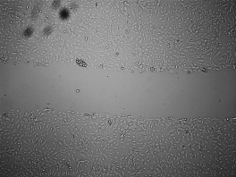
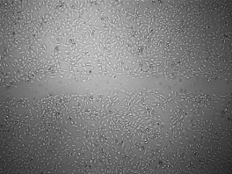
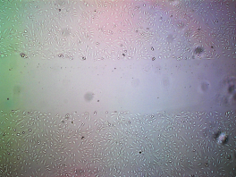
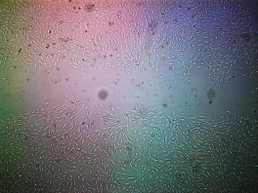
SQAP study with interacting proteins at cell level: Antiangiogenesis activity
HUVEC
0 h
11 h
Control
SQAP 10 µM
HUVEC cells cultured in 1% FBS+VEGF (50 ng/ml).
Notes:
Since both Y397 and Y925 phosphorylation are related to cell turnover we examined if SQAP has any activity against cell migration using a cell migration assay. We observed that SQAP was able to decrease HUVEC (32 vs 62% wound size) and A549 (46 vs 68% wound size) cell migration rate into the wounded area.

Slide 23
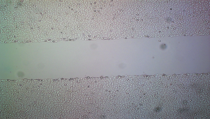
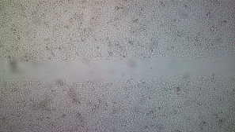
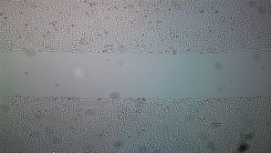
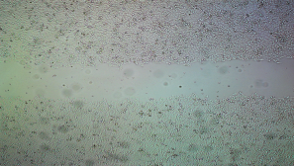
SQAP study with interacting proteins at cell level: Antiangiogenesis activity
A549
0 h
25 h
Control
SQAP 10 µM
A549 cells cultured in 1% FBS+Fibronectin (10 µg/ml).
Notes:
Since both Y397 and Y925 phosphorylation are related to cell turnover we examined if SQAP has any activity against cell migration using a cell migration assay. We observed that SQAP was able to decrease HUVEC (32 vs 62% wound size) and A549 (46 vs 68% wound size) cell migration rate into the wounded area.

Slide 24
SQAP study with interacting proteins at cell level: Antiangiogenesis activity
Change in cell migration
HUVEC
A549
****
****
**
****
Notes:
On these graphs the change in wound width was measured based on the previous pictures.

Slide 25
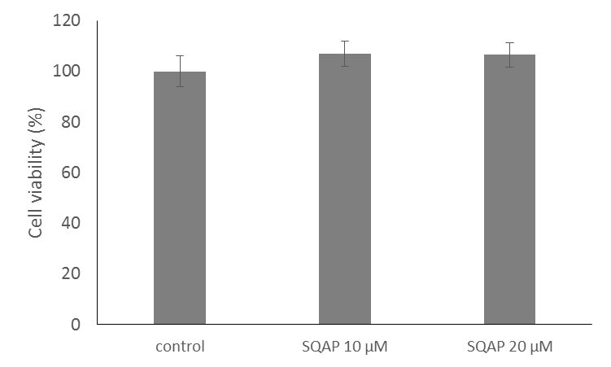
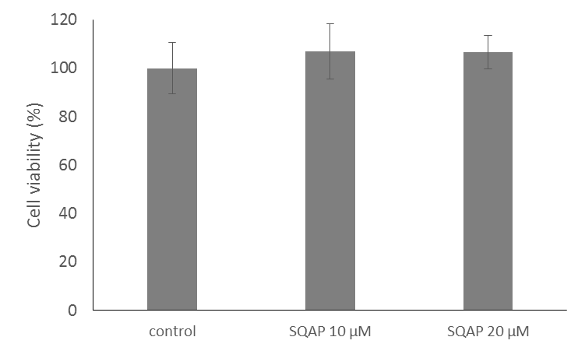
SQAP-FAK interaction promotes anti-angiogenesis
HUVEC
11 h
A549
25 h
SQAP exhibited noncytotoxic effects against either HUVEC or A549 cells.
Notes:
To rule out the possibility that inhibition of the cell migration by SQAP was due to cytotoxicity, a WST-8 assay was performed. SQAP exhibited noncytotoxic effects against either HUVEC or A549 cells.

Slide 26
Research purpose
Understand SQAP molecular mechanisms by:
Identification of SQAP-binding proteins targets using a T7 phage display screen.
Validation of the interactions.
Study the relation of the interacting proteins and SQAP at cell level.
Summary
Notes:
Finally we will review summary and conclusions.

Slide 27
Summary
Phage display showed that SQAP binds to: SCP-2, MFE-2, ADRM1, HR23B and FAK. Affinity study for individual T7 phages and SPR confirmed these interactions.
SCP-2 and MFE-2 host a SCP-2 domain and they were both found in different libraries; Lung tissue and HUVEC.
Binding between SQAP and FAK was further confirmed through a docking assay.
SQAP could reduce phosphorylation of FAK at Y397 and Y925, truncated FAK signaling signals as for paxillin and Akt, and furthermore, arrested cell migration in HUVEC and A549 cells.
The interaction between SQAP with FAK and subsequent reduction of FAK phosphorylation may explain the antiangiogenic and radiotherapy synergistic activities of SQAP.
27
Notes:
Read conclusions.

Slide 28


Thanks

Slide 29
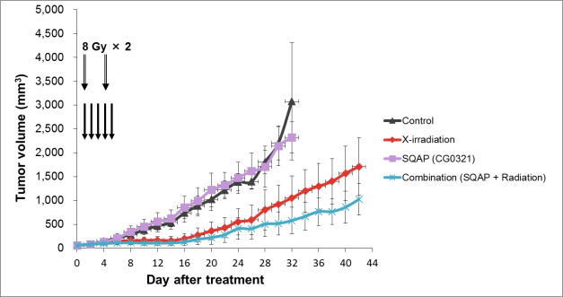
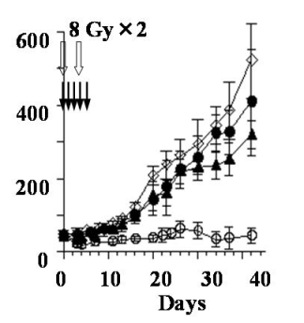
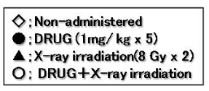
SQAP background
Lu-65
The ability of SQAP to trigger antiangiogenesis in vivo with very few side effects, similar to SQMG, has been confirmed in previous biological studies.
A549
Notes:
: On the next slide we have another example this time using another type of lung cancer cells, Lu-65. Five injections of SQAP (2 mg/kg, i.v.) plus two fractions of X-irradiation (8 Gy/fraction) were administered. Four kinds of treatments, Vehicle, SQAP (2 mg/kg/injection), X-irradiation (8 Gy/fraction), and Combination with SQAP and X-irradiation are represented.

Slide 30
Identification of SQAP-binding proteins: Phage display
Lung cancer
HeLa
HUVEC
Notes:
On these graphs we can see the round selections that I performed to find SQAP-binding candidates. The process is normally repeated between 4 to 6 times.

Slide 31
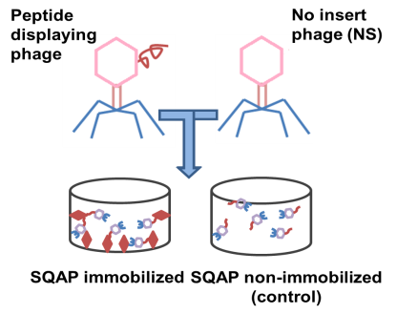

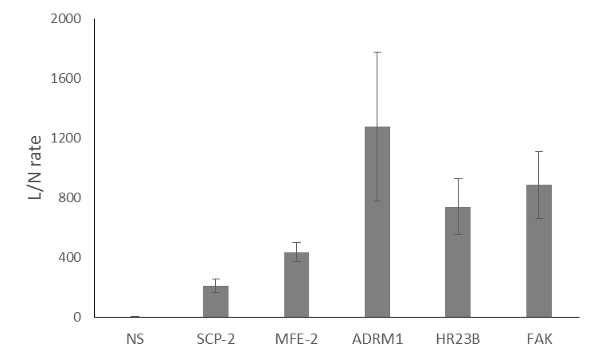
Validation of the interaction: affinity study for individual T7 phages.
Notes:
To confirm the affinity to SQAP of the peptides obtained from the phage display, we amplified each phage clone and a control phage displaying no peptide (NS) and applied them to the SQAP-immobilized or nonimmobilized well. The ratio of recovered phage particles from the SQAP-immobilized well was compared with that from the nonimmobilized control well. We can see that the SQAP-binding phages recovery rates are higher than those of SQAP.

Slide 32
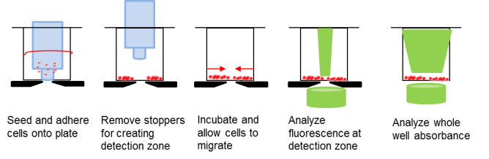
SQAP study with interacting proteins at cell level: Antiangiogenesis activity
HUVEC
A549
*
*
*
**
SQAP arrests migration affecting FAK phosphorylation.
Notes:
Moreover, we tried to reproduce these results by using an in vitro cell migration assay (explain how the assay works). Indeed HUVEC and A549 cell migrations were arrested by SQAP.

