Slide 1
Longitudinal changes in airway microbiome signatures and immunoregulatory cell dynamics following Bronchial Thermoplasty
Jessy Deshane, Ph.D.
Department of Medicine
Division of Pulmonary Allergy and Critical Care Medicine
University of Alabama at Birmingham
Innate Immunity Congress, Berlin
July 21-22, 2016

Slide 2
Asthma: A Chronic Inflammatory Disease
Asthma is a serious public health problem - affects more than 20 million people in the United States
Reversible airway obstruction associated with airway hyper-responsiveness
Th2 predominant inflammation
Oxidative Stress – ROS & RNS
Immune regulation in Asthma
Notes:
2

Slide 3
Myeloid-Derived Regulatory Cells
iNOS
Arginase
NADPH oxidase
IDO
TGF-β, IL-10, IL-6
T
T
T cell suppression
Induction of Tregs
Arora et al., Mucosal Immunol. 2010 Nov;3(6):578-93
Deshane et al., Mucosal Immunol. 2011 Sep;4(5):503-18
Notes:
3

Slide 4
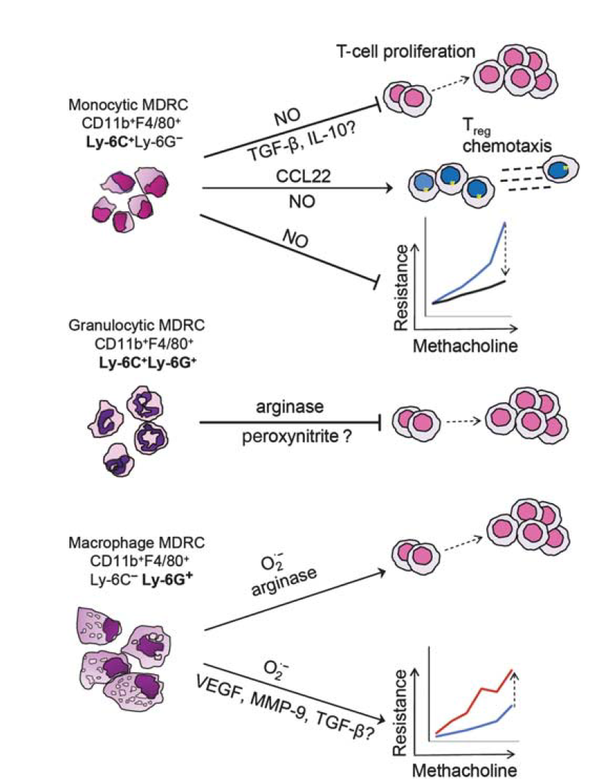
Differential regulation of airway responses by MDRC subsets
Deshane et al
Mucosal Immunol. 2011 Sep;4(5):503-18

Slide 5
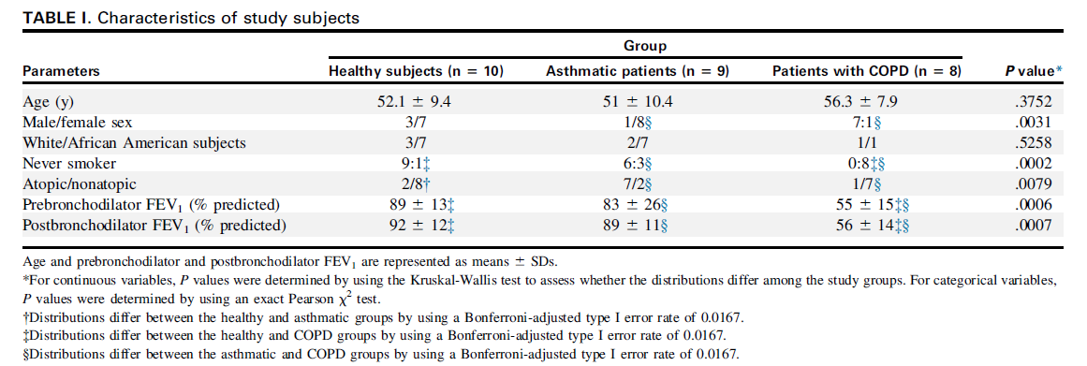
MDRCs in Human Asthma
Deshane et al
JACI. 2015 135:413-424

Slide 6
Phenotypic and Functional Characteristics of Airway MDRCs
CD11b⁺DAF-FM-DA⁺HLA-DR⁻
CD14, CD16
CD14⁺CD16⁺
CD14⁺CD16⁻
CD14⁻CD16⁺
CD11b⁺DHE⁺HLA-DR⁺CD11c⁺
CD163⁺/CD163⁻
CD163⁺
CD163⁻

Slide 7
Immune regulation by MDRCs in Bronchial Thermoplasty?
Bronchial Thermoplasty (BT) is an FDA approved therapeutic option for a subset of asthmatics who continue to be symptomatic despite high dose steroid therapy.
Three bronchoscopic procedures in which a catheter is used to deliver 65⁰C thermal energy to the airways.
BT patients experience improvements in asthma control, quality of life, and a reduction in severe exacerbations.
Mechanisms underlying the impact of BT on airway inflammation are largely unknown.

Slide 8
Modulation of MDRCs in BT is unknown
Microbiome changes in BT are unknown
Functional relationships between MDRCs and airway microbiome are unknown

Slide 9
Longitudinal changes in MDRCs and airway microbiome following BT contributes to improved outcomes

Slide 10
Patient Characteristics
Five patients with severe asthma managed by allergists or pulmonologists affiliated with UAB
All five patients were poorly controlled as determined by ACT score <20 despite using inhaled corticosteroids and/or daily oral steroids plus additional controller medications.
All patients demonstrated airway hyper-responsiveness as determined by either bronchodilator reversibility or a positive methacholine challenge test

Slide 12
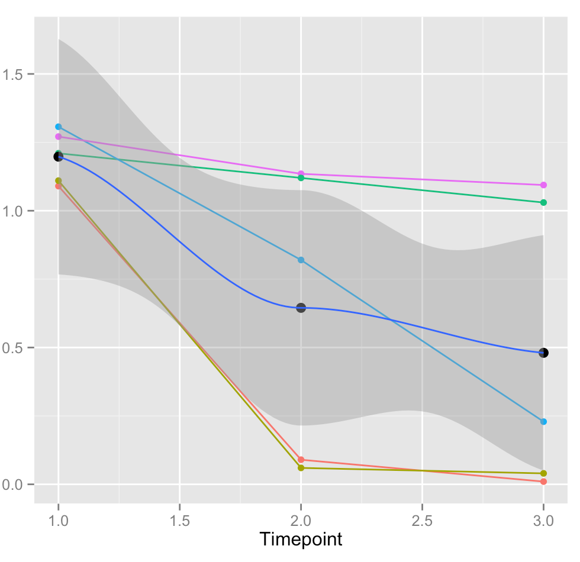
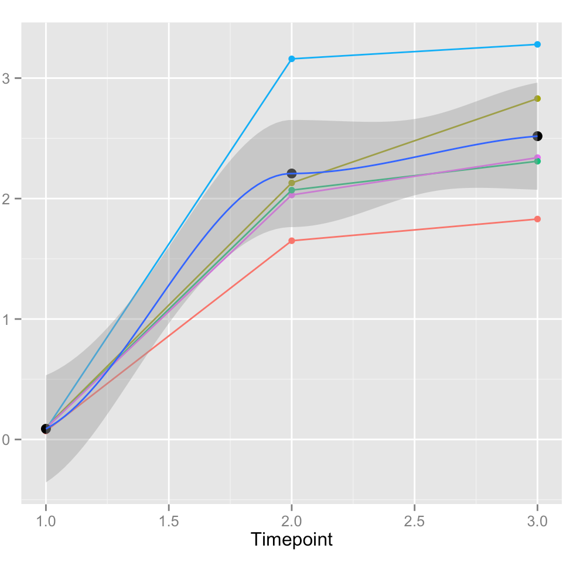
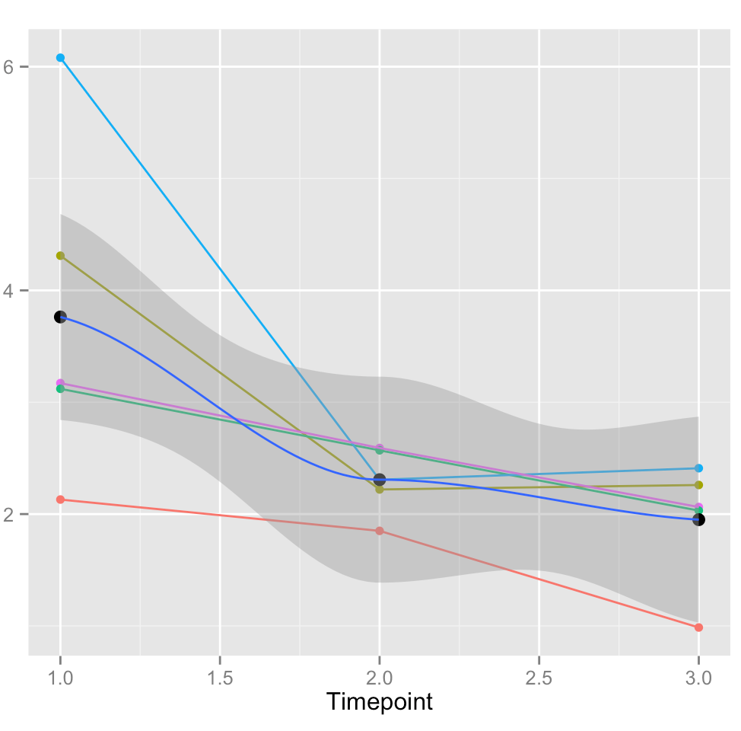
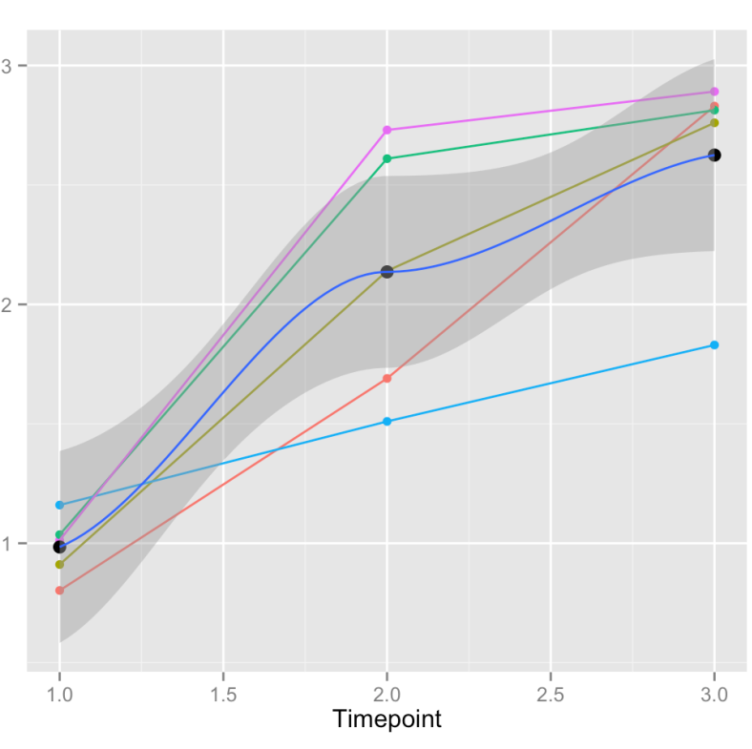
BRONCHIAL
WASH
HLA-DR⁻CD11b⁺CD14⁺CD16⁻
HLA-DR⁻CD11b⁺CD14⁺CD16⁺
Subset A
Subset B
P=0.0036
P=3.888e⁻⁰⁸
HLA-DR⁺CD11b⁺CD163⁺CD11c⁺
CD4⁺CD25⁺CD127^{lo}Foxp3⁺
Percent Subsets in Bronchial Wash
Subset C
T regs
P=0.0046
P=8.7474e⁻⁰⁶

Slide 13
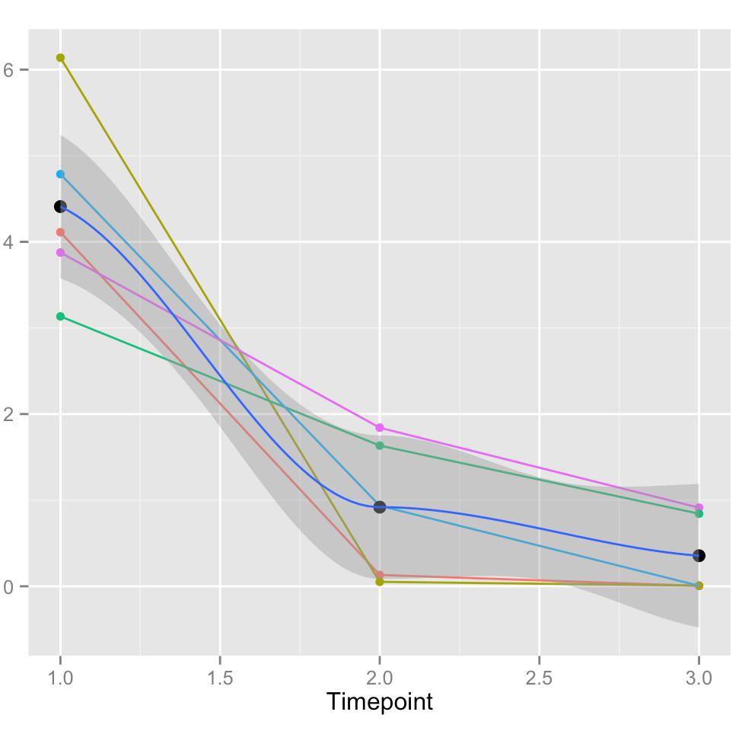
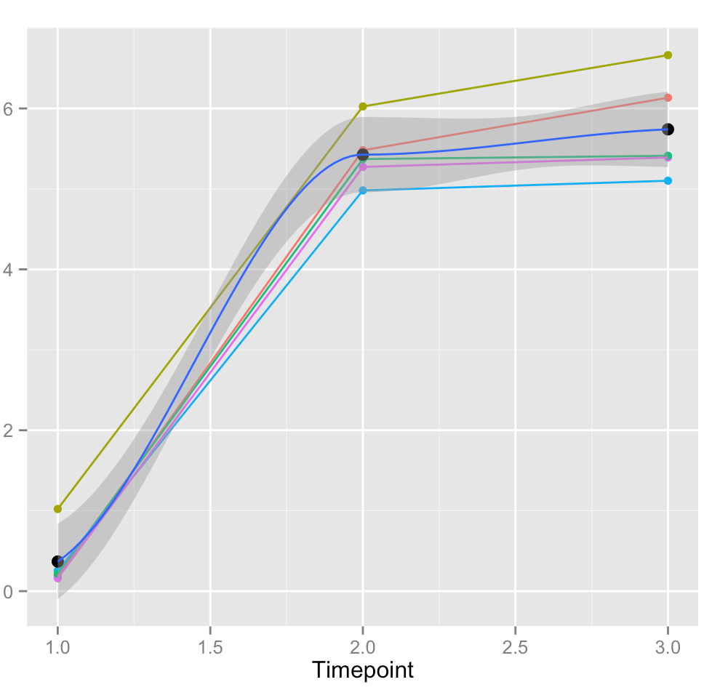
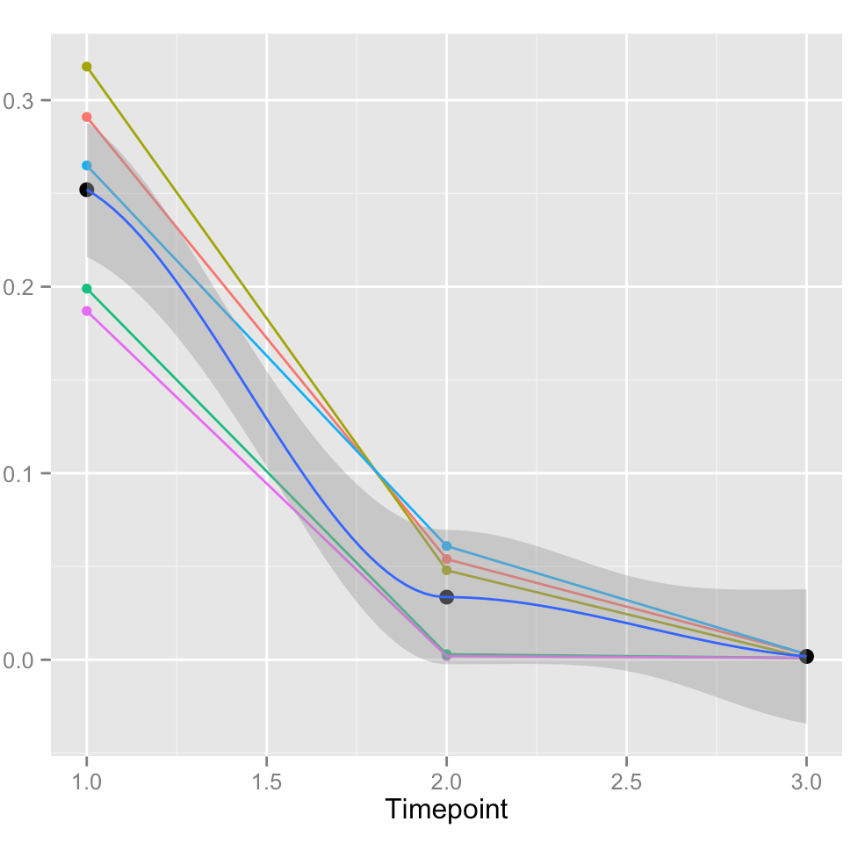
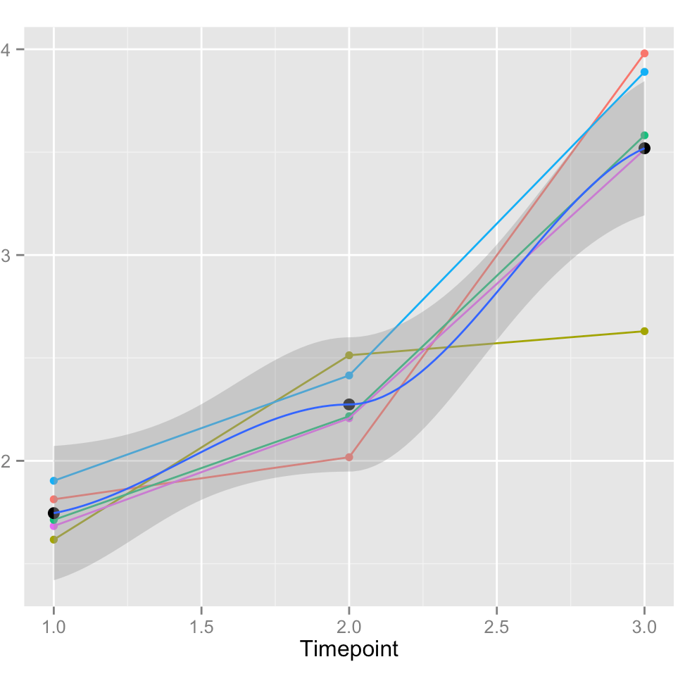
BLOOD
HLA-DR⁻CD11b⁺CD14⁺CD16⁻
HLA-DR⁻CD11b⁺CD14⁺CD16⁺
Subset A
Subset B
P=8.0605e⁻⁰⁷
P=2.236e⁻¹⁴
HLA-DR⁺CD11b⁺CD163⁺CD11c⁺
CD4⁺CD25⁺CD127^{lo}Foxp3⁺
Subset C
T regs
Percent Subsets in Peripheral Blood
P=2.699e⁻⁰⁹
P=3.8787e⁻⁰⁷

Slide 14
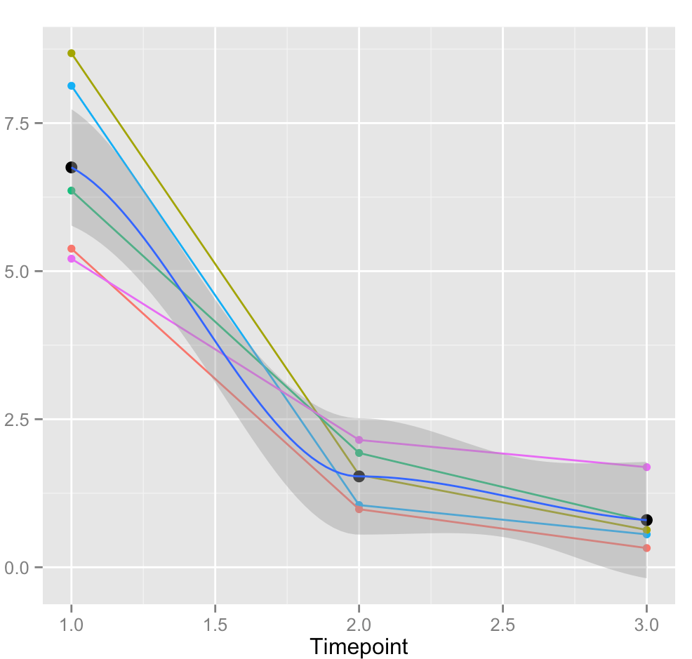
BLOOD
HLA-DR⁻ CD15⁺CD166b⁺CD11b⁺CD16⁺
Neutrophilic MDRCs
Percent Subsets in Peripheral Blood
P=4.1980e⁻⁰⁸

Slide 15
 | mean abundance | Group2-1 | Group3-1 | p-value
k__Bacteria;Other | 0.001265626 | 0.0004224558 | -0.0001157003 | 0.3910571
k__Bacteria;p__Actinobacteria | 0.05889575 | -0.0111165 | 0.001884219 | 0.496534
k__Bacteria;p__Bacteroidetes | 0.1579293 | 0.005732235 | 0.009157824 | 0.39593
k__Bacteria;p__Cyanobacteria | 0.001442555 | 0.0007041906 | 0.0004424789 | 0.483212
k__Bacteria;p__Firmicutes | 0.5970713 | 0.07983223 | 0.06346952 | 0.1458097
k__Bacteria;p__Fusobacteria | 0.005077856 | 5.470576e-05 | 0.002246956 | 0.4060238
k__Bacteria;p__Proteobacteria | 0.1606404 | -0.07639408 | -0.07695898 | 0.04095912
k__Bacteria;p__Spirochaetes | 0.002110084 | -0.00127247 | 0.001637145 | 0.3951153
k__Bacteria;p__Tenericutes | 0.001089895 | 7.112489e-05 | 0.001380949 | 0.1580867
k__Bacteria;p__Verrucomicrobia | 0.009186785 | 0.002910648 | -0.001814545 | 0.0200815
k__Bacteria;p__[Thermi] | 0.002361206 | -0.0003325322 | -0.0003957534 | 0.8506804
invidivual OTU vs Timepoint

Slide 16
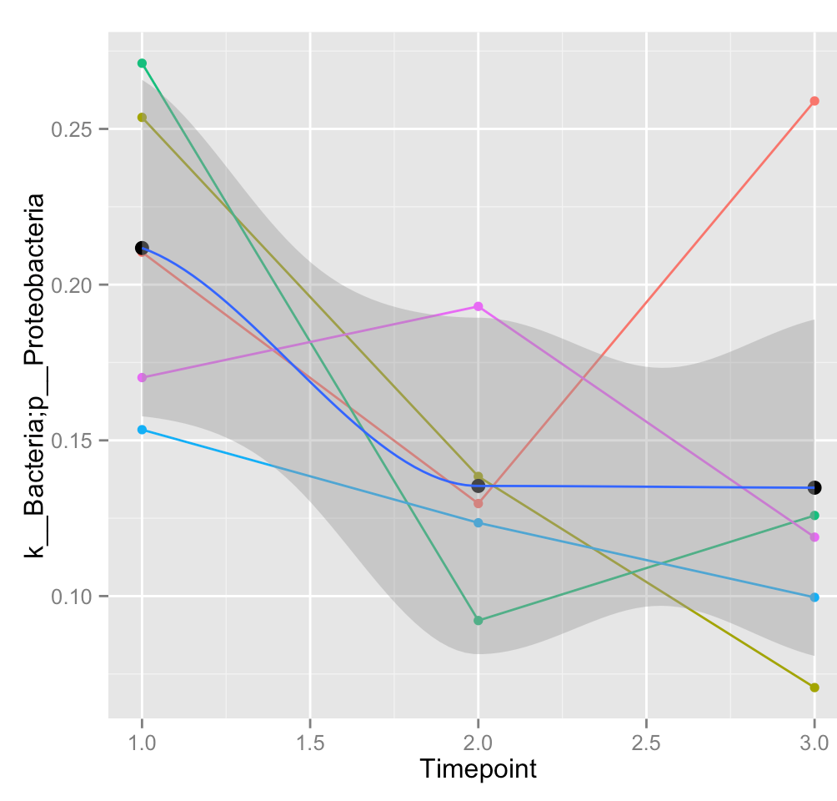
Longitudinal changes in Proteobacteria

Slide 17
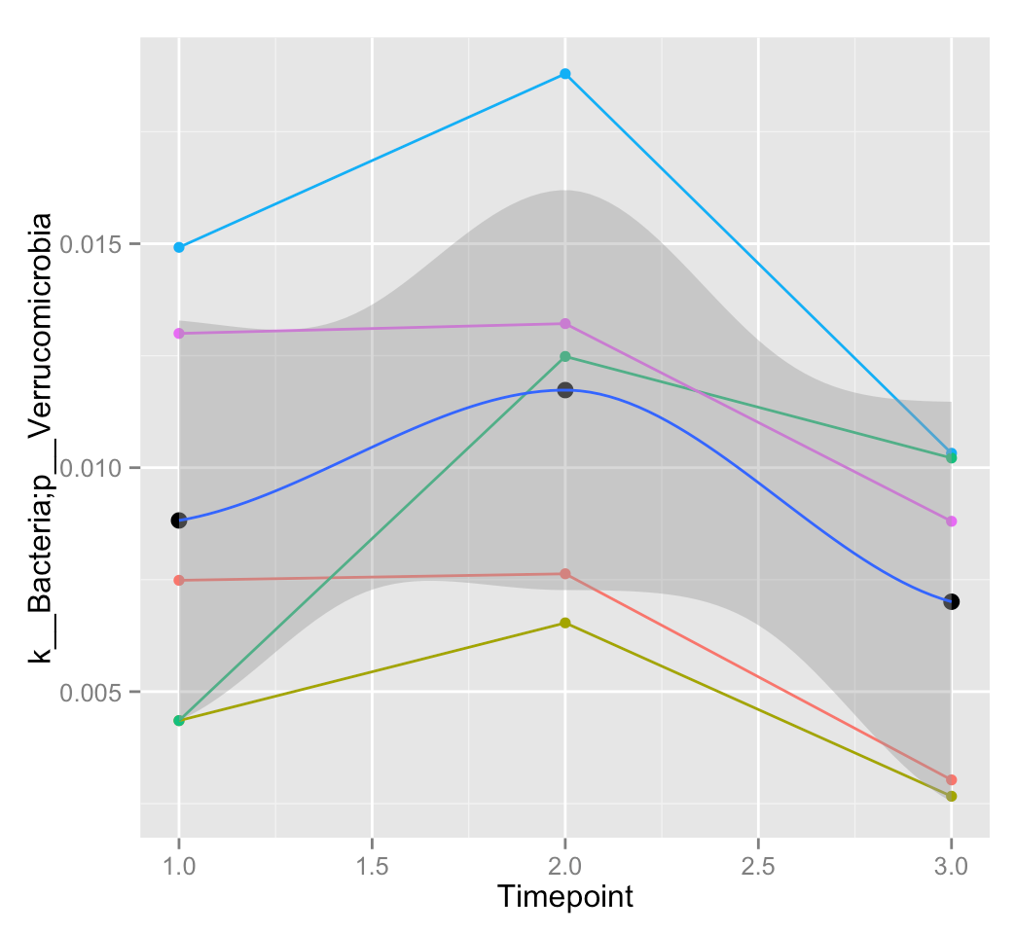
Longitudinal changes in Verrucomicrobia

Slide 18
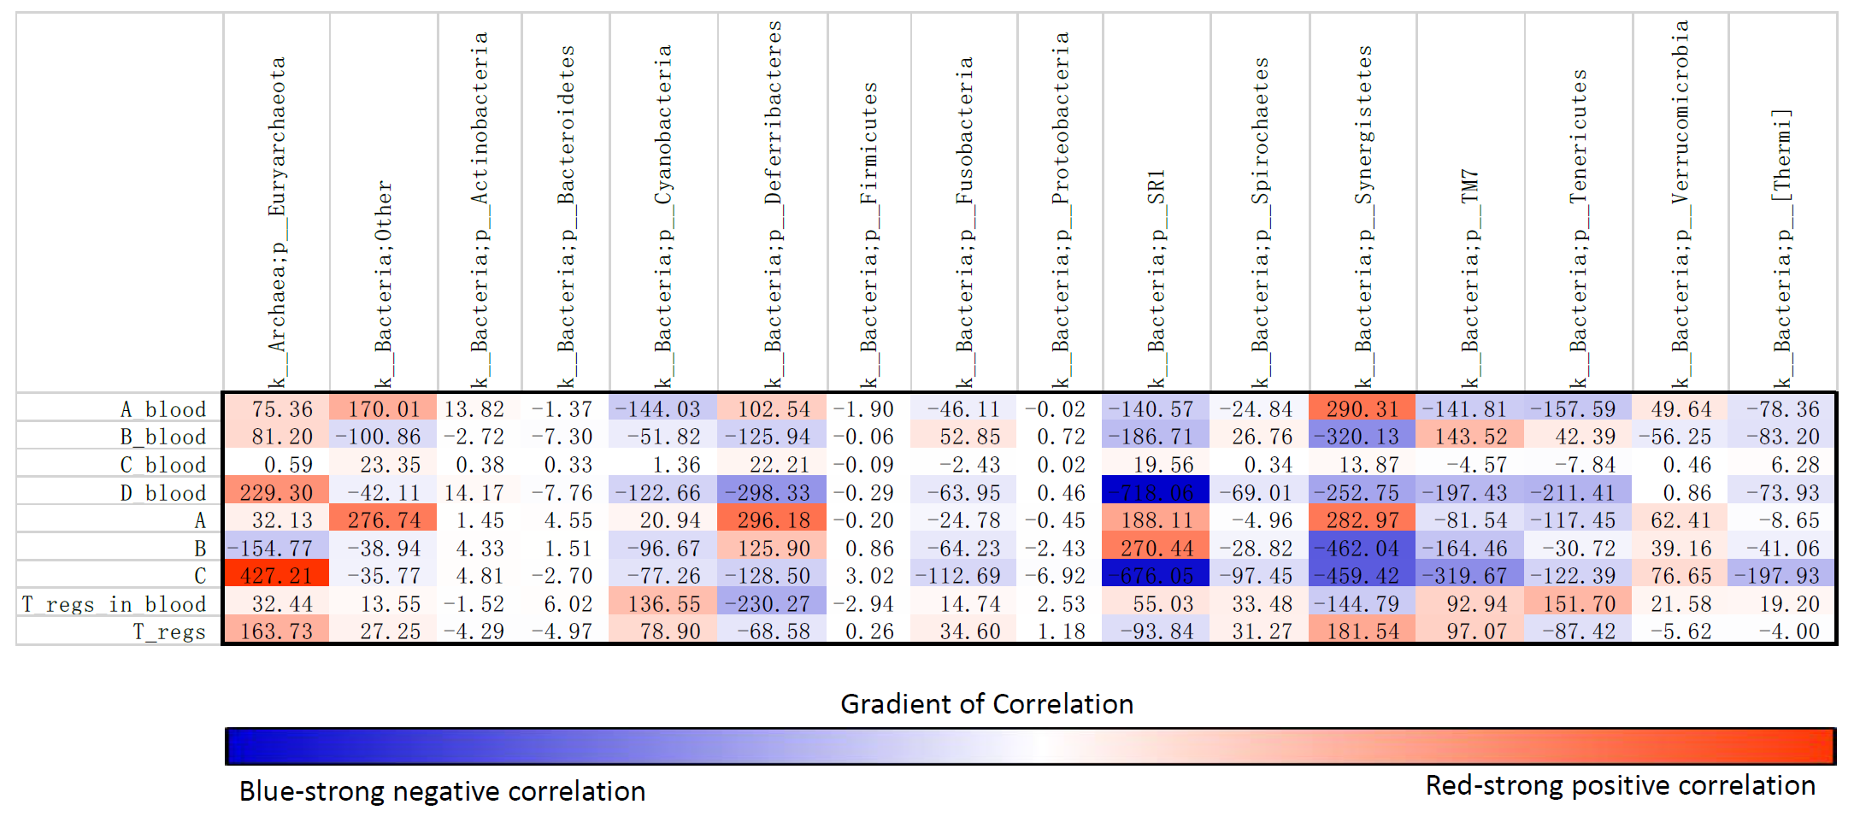

Slide 19
Changes in Kingdom Archaea; phylum euryarchaeota correlated with progressive reduction of pro-inflammatory CD163⁺HLA-DR⁺CD11b⁺CD33⁺MDRCs (P=0.00003) and enhancement of both CD4⁺CD25⁺CD127^{lo}Foxp3⁺ T_{regs} (P=0.0135) and CD14⁺CD16⁺HLA-DR⁻ MDRCs (P=0.04).
Changes in phyla proteobacteria and fusobacteria correlated (P=0.002, P=0.017) with the enhancement of CD14⁺CD16⁺HLA-DR⁻
MDRCs in the BW.
Alterations in phyla tenericutes and verruccomicrobia signficantly correlated (P=0.039, P=0.0131) with the reduction in CD14⁺HLA-DR⁻ MDRCs.

Slide 20
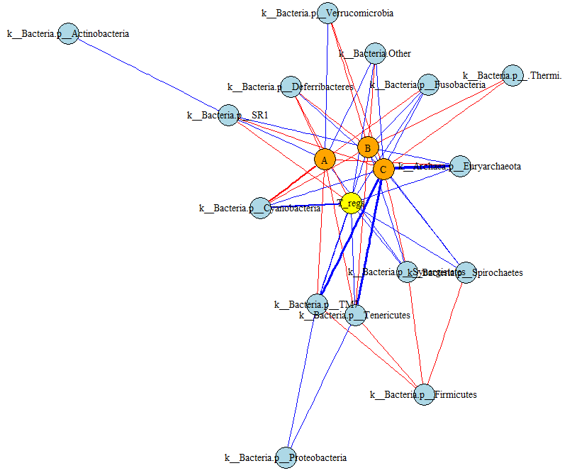

Slide 21
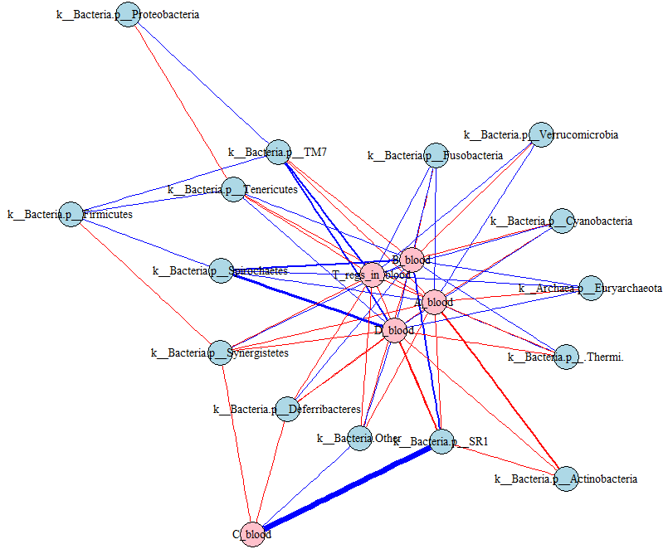

Slide 22
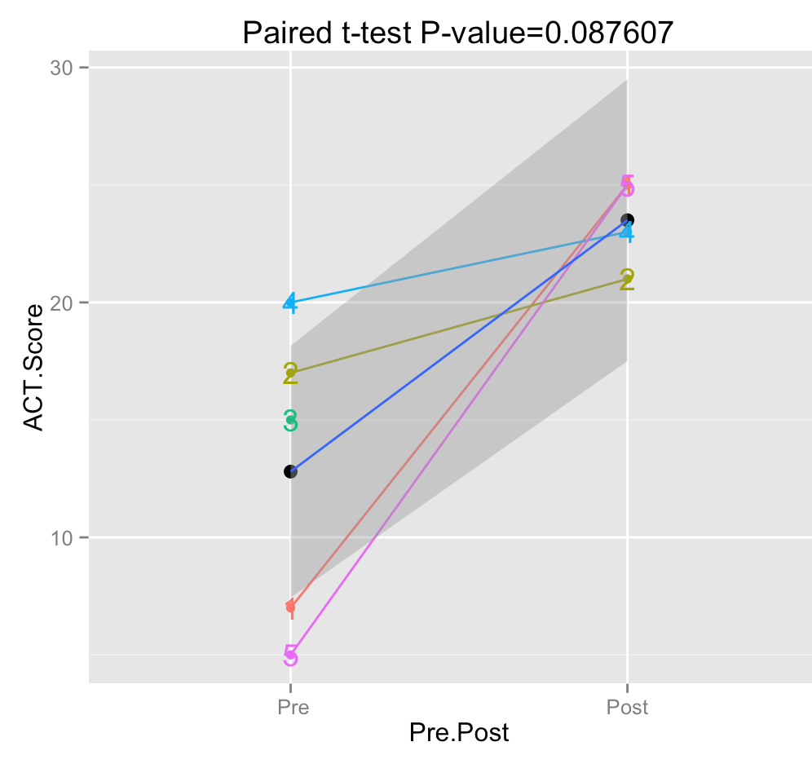

Slide 23
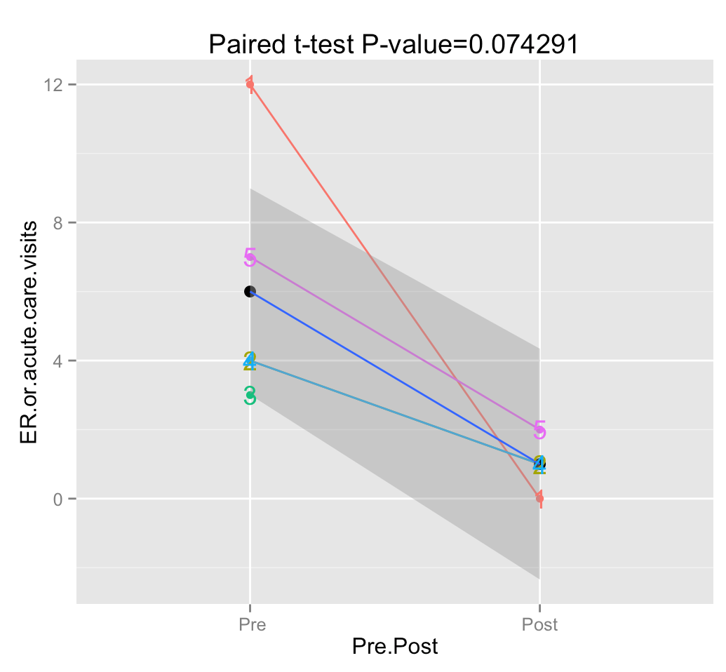

Slide 24
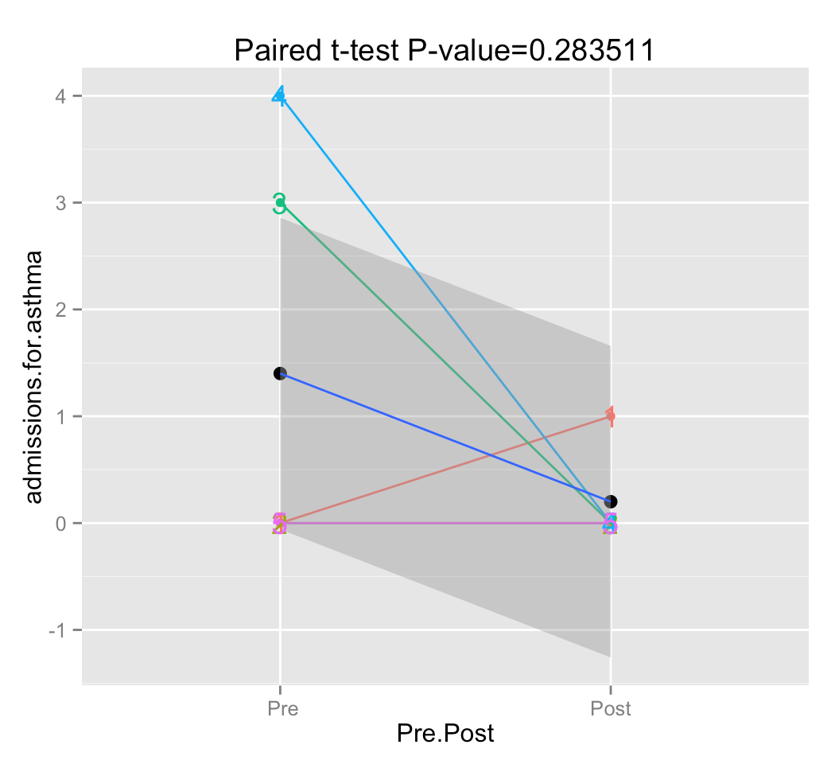

Slide 25
Acknowledgements
Jennifer Trevor
Mark Dransfield
Yong Wang
Miranda Curtiss
Chad Steele
Tong Huan Jin
Cara C. Schafer
Nirmal Shyam Sharma
Kenneth Hough
Colleen Adkins
Steven Duncan
Stephen Barnes
Sadis Matalon
Jaroslaw Zmijewski
Victor J. Thannickal
David D. Chaplin
Serpil Erzurum

