Slide 1
About OMICS Group
OMICS Group International is an amalgamation of Open Access publications and worldwide international science conferences and events. Established in the year 2007 with the sole aim of making the information on Sciences and technology ‘Open Access’, OMICS Group publishes 400 online open access scholarly journals in all aspects of Science, Engineering, Management and Technology journals. OMICS Group has been instrumental in taking the knowledge on Science & technology to the doorsteps of ordinary men and women. Research Scholars, Students, Libraries, Educational Institutions, Research centers and the industry are main stakeholders that benefitted greatly from this knowledge dissemination. OMICS Group also organizes 300 International conferences annually across the globe, where knowledge transfer takes place through debates, round table discussions, poster presentations, workshops, symposia and exhibitions.

Slide 2
About OMICS Group Conferences
OMICS Group International is a pioneer and leading science event organizer, which publishes around 400 open access journals and conducts over 300 Medical, Clinical, Engineering, Life Sciences, Phrama scientific conferences all over the globe annually with the support of more than 1000 scientific associations and 30,000 editorial board members and 3.5 million followers to its credit.
OMICS Group has organized 500 conferences, workshops and national symposiums across the major cities including San Francisco, Las Vegas, San Antonio, Omaha, Orlando, Raleigh, Santa Clara, Chicago, Philadelphia, Baltimore, United Kingdom, Valencia, Dubai, Beijing, Hyderabad, Bengaluru and Mumbai.

Slide 3
FORENSIC SCIENCE TODAY AND TOMORROW
The 3rd Annual Conference on Forensic Research & Technology
Dr. Jerry Melbye, PhD, Fellow –AAFS, Diplomate-ABFA
Laboratory of Human Identification
University of North Texas

Slide 4
“Forensic Science is the application of science to the analysis of evidence”

Slide 5
“Forensic Science is the application of science to the analysis of evidence”
“Forensic Science is the recovery and analysis of evidence for presentation in courts of law”

Slide 6
Some Sub-disciplines of Forensic Science
Forensic Entomology
Forensic Odontology
Forensic Pathology
Forensic Botany
Forensic Anthropology
Forensic Documents
Forensic Chemistry
Etc……

Slide 7
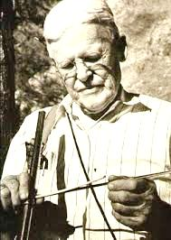
Dr. A.E. Douglass

Slide 8
Tree Rings

Slide 9
Wet and Dry Years

Slide 10
Older that any living tree

Slide 11
Ancient Anasazi Ruin a.d. 1210

Slide 12
The unifying principle
“The paradigm of forensic science is the search for truth in courts of law.”

Slide 13
Forensic Entomology

Slide 14
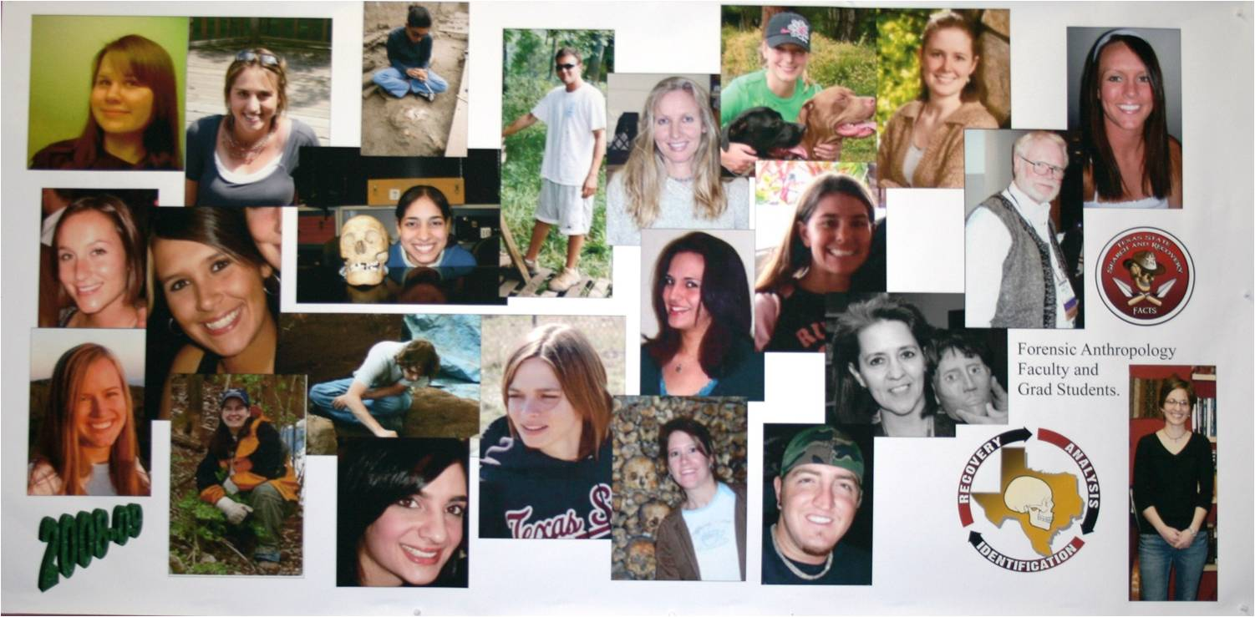
Working Together
The 3rd Annual Conference on Forensic Research and Technology

Slide 15
Thank you and enjoy your conference

Slide 16
Let Us Meet Again
We welcome you all to our future conferences of OMICS Group International
Please Visit: www.omicsgroup.com
www.conferenceseries.com

