Slide 1
The Use of Topical Flurbiprofen Cream to Treat Plantar Fasciitis, a Randomized, Prospective Trial vs Oral NSAID Therapy
Jeffery Alexander, DPM FACFAS
Rush University Medical Center
Chicago, IL

Slide 2
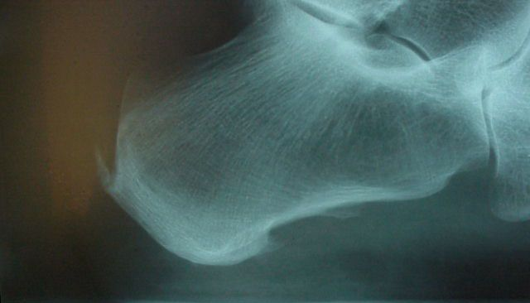
Plantar Fasciitis
Most common cause of plantar heel pain
Affects up to 10% of US population
Accounts for >600,000 patient visits annually in the US

Slide 3
Plantar Fasciitis
Inflammation and pain along the plantar fascia - the tissue band that supports the arch on the bottom of the foot
Pain is usually found on the bottom of the heel at the point where the plantar fascia attaches to the heel bone
Becomes chronic in 5-10% of all patients
Is not necessarily associated with a heel spur
Over 90% resolve with conservative treatment

Slide 4
Plantar Fasciitis Symptoms
Pain on standing, especially after periods of inactivity or sleep
Pain subsides after a period of time, returns with activity after rest (post static dyskinesia)
Pain related to footwear – can be worse in flat shoes with no support
Radiating pain to the arch and/or toes
In later stages, pain may persist/progress throughout the day
Pain varies in character: dull aching, “bruised” feeling. Burning or tingling, numbness, or sharp pain, may indicate local nerve irritation

Slide 5
Plantar Fasciitis Risk Factors
Biomechanical abnormalities
Overly tight calf muscle
Poor shoe choices
Weight gain
Barefoot walking
Work surface

Slide 6
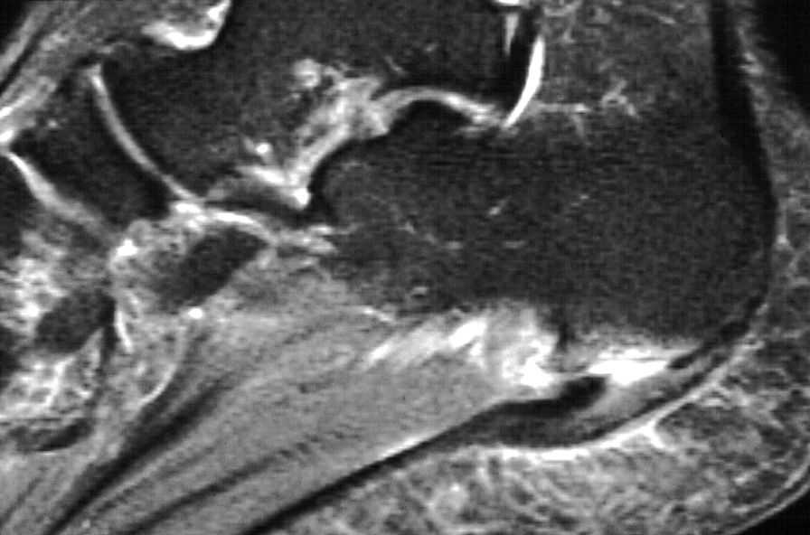
Plantar Fasciitis Treatment- Overview
Mechanical –
treat the cause
Anti-inflammatory – treat the pain
Neither done in isolation

Slide 7
Plantar Fasciitis Treatment
Stretching, shoe modifications, avoid walking barefoot
Icing and rest
Night or resting splint
Supplemental arch support (OTC vs. custom orthotics)
Anti-inflammatory medication
Steroid injections
Physical therapy
If conservative measures fail, surgery is an option

Slide 8
Other options for heel pain
Over 90% of heel pain patients respond to initial therapies within a relatively short period of time
For unresponsive cases, options include:
Minimally invasive procedures like ESWT (Extracorporeal Shock Wave Therapy)
Autologous Platelet Concentrate (APC) injection
Surgical procedures, open or endoscopic
Cryosurgery
Radiofrequency techniques

Slide 9
What Does Research Tell Us About Treatment?
Approximately 80% of patients treated conservatively had complete resolution of their symptoms¹
No evidence strongly supports the effectiveness of any treatment for plantar fasciitis
Cochrane Review² showed corticosteroid injections improved plantar fasciitis symptoms at one month but not at six months when compared to placebo

Slide 10
Research Specific to NSAIDs and Plantar Fasciitis
Treatment protocols in most studies include ice and NSAID therapy. No studies have specifically examined their effectiveness. ³
Although no data supports the use of NSAIDs or ice, their effectiveness in managing other musculoskeletal conditions makes them reasonable choices for adjunctive therapy ⁴ ⁵

Slide 11
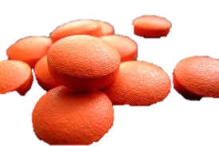
Complications of Oral NSAID Use
High incidence events
GI disturbances
Nausea, Vomiting, Dyspepsia
Potential Serious Events
GI ulceration or bleeding
Hypertension
Cardiovascular events
Acute renal impairment
Hepatotoxicity
Notes:
The side effects of oral NSAID use are well known and as we will discuss in the following slide, are not without costs.

Slide 12
Oral NSAIDs - Cost of Adverse Events
In 1983, it cost an estimated $8.6 billion to treat arthritis in the USA
It cost an additional $3.9 billion to treating gastrointestinal side effects of NSAIDs for a total cost of 12.5 billion.
Conclusion: 30% of medical costs when using oral NSAIDs can be attributed to gastrointestinal side effects.
Notes:
A study published in1988 reported the actual expenditure of treating arthritis as well as the medical costs of associated NSAID-induced GI side-effects. Arthritis treatment costs per quarter were found to be $145 per patient. Approximately 25% of the population experienced related GI side-effects requiring further medical care. Cost for the treatment of these adverse effects was found to be 30% of the overall costs for treating arthritis. This included pharmaceutical claims, hospital claims and physician charges.

Slide 13
Are Oral NSAIDs Still the Answer?
The authors sought to determine if alternative therapies could offer equal efficacy with improved side effect profile
With advancements in available transdermal carrier agents, topical NSAID formulations were selected

Slide 14
Background
Topical anti-inflammatories^{7,9}:
Advantages: Little to no systemic absorption, no GI upset, considered safe for renally impaired, good for patients that do not want to take more medications.
Disadvantages: Application can be difficult (locations and flexibility of patient), cost, variability in penetration/absorption.
Recent study showed significantly higher concentrations of flurbiprofen in tendon, muscle and periosteal tissues when administered through a patch vs. oral, however, there was a large degree of variability between individuals.⁸
Purpose: Determine if topical anti-inflammatories can be an equally effective alternative to oral NSAIDs.

Slide 15
Effect of Compounded Topical Anti-Inflammatory Cream (Flurbiprofen) vs PO NSAID (Ibuprofen) in the Treatment of Plantar Fasciitis- A Pilot Study
Jeffey Alexander, DPM
Gene Choi, DPM

Slide 16
Methods
Power analysis, study designed to be a non-inferiority study
60 patients with unilateral plantar fasciitis were randomized into 2 groups: (40 experimental, 20 control)
Exclusion criteria: Previous professional treatment, suspicion of nerve involvement (+ tinels/valleix sign, tarsal tunnel syndrome), contralateral pain, h/o NSAID intolerance (GI upset, hypersensitivity), renal impairment, CV disease, cortisone injections, failure to comply.
Inclusion criteria: Symptomatic for > 4 weeks and not resolving.
Age: ranged from 29 – 79 (Avg: Experimental 55.7, Control 59.5)
All patients instructed to reduce activity, ice (20min 3x/day), perform stretching exercises (written and visual instructions), and use standard OTC orthotics.

Slide 17
Methods
Experimental group: Compounded topical anti-inflammatory medication containing: Flurbiprofen 10%, Baclofen 2% and Lidocaine 5% in a Lipoderm base with pentoxifylline 3%.
Control group: Ibuprofen 800mg PO TID
Record weekly pain scores using VAS
Follow up weekly for 3 months.

Slide 18
Data
Patients’ weekly pain scores were rated using the visual analog pain scale (VAS) on initial visit and subsequent weekly follow up visits.
Experimental group:
Avg: 4.3667 point decrease in pain. (σ: 1.846)
Avg: 65.3% (0.6526) relief in pain (σ: 0.1945)
Control group:
Avg: 3.6 point decrease in pain. (σ: 0.5477)
Avg: 60.9% (0.6086) relief in pain (σ: 0.1132)
Reported adverse events
Topical: Texture complaints (2/40)
Oral: GI Upset (4/20)
Notes:
18

Slide 19
Statistics
F-Test Two-Sample for Variances (CI=95%)
Descriptive Statistics: Using Mean differences
VAR | Control | Experimental
Sample size | 20 | 40
Mean | 3.6 | 4.36667
Variance | 0.3 | 3.40952
Standard Deviation | 0.54772 | 1.84649
Mean Standard Error | 0.24495 | 0.47676
Summary
F | 11.36508 | F Critical value (5%) | 5.87335
p-level 1-tailed | 0.01526 | p-level 2-tailed | 0.03052
H0 (5%)? | rejected
F-Test Two-Sample for Variances (CI=95%)
Descriptive Statistics: Using % differences
VAR | Control | Experimental
Sample size | 20 | 40
Mean | 0.60857 | 0.65264
Variance | 0.01282 | 0.03781
Standard Deviation | 0.11321 | 0.19446
Mean Standard Error | 0.05063 | 0.05021
Summary
F | 2.95047 | F Critical value (5%) | 5.87335
p-level 1-tailed | 0.1528 | p-level 2-tailed | 0.30559
H0 (5%)? | accepted
F-test: % Change in VAS
P = 0.30559
Accept H_{o}: No significant difference between oral vs. topical.
F-test: Mean differences in VAS
P = 0.03052
Reject H_{o}: Topical significantly better relief than oral.
19

Slide 20
Statistics
Analysis of Variance (One-Way) CI=95%
Using Mean differences
Summary
Groups | Sample size | Sum | Mean | Variance
Experimental | 40 | 65.5 | 4.36667 | 3.40952
Control | 20 | 18. | 3.6 | 0.3
ANOVA
Source of Variation | SS | df | MS | F | p-level | F crit
Between Groups | 2.20417 | 1 | 2.20417 | 0.8108 | 0.37977 | 4.41387
Within Groups | 48.93333 | 18 | 2.71852
Total | 51.1375 | 19
ANOVA: Mean differences in VAS
P = 0.37977
Accept H_{o}: No significant difference between oral vs. topical.
ANOVA: % Change in VAS
P = 0.64041
Accept H_{o}: No significant difference between oral vs. topical.
Analysis of Variance (One-Way) CI=95%
Summary
Groups | Sample size | Sum | Mean | Variance
Experimental | 40 | 9.78958 | 0.65264 | 0.03781
Control | 20 | 3.04286 | 0.60857 | 0.01282
ANOVA
Source of Variation | SS | df | MS | F | p-level | F crit
Between Groups | 0.00728 | 1 | 0.00728 | 0.22574 | 0.64041 | 4.41387
Within Groups | 0.58066 | 18 | 0.03226
Total | 0.58795 | 19
20

Slide 21
Statistics
Comparing Means [ t-test assuming unequal variances (heteroscedastic) ]
Descriptive Statistics: Using Mean differences
VAR | Sample size | Mean | Variance
 | 40 | 4.36667 | 3.40952
 | 20 | 3.6 | 0.3
Summary
Degrees Of Freedom | 18 | Hypothesized Mean Difference | 0.E+0
Test Statistics | 1.43033 | Pooled Variance | 2.71852
Two-tailed distribution
p-level | 0.16975 | t Critical Value (5%) | 2.10092
One-tailed distribution
p-level | 0.08488 | t Critical Value (5%) | 1.73406
Pagurova criterion
Test Statistics | 1.43033 | p-level | 0.83023
Ratio of variances parameter | 0.79116 | Critical Value (5%) | 0.06359
Comparing Means [ t-test assuming unequal variances (heteroscedastic) ]
Descriptive Statistics: Using % differences
VAR | Sample size | Mean | Variance
 | 40 | 0.65264 | 0.03781
 | 20 | 0.60857 | 0.01282
Summary
Degrees Of Freedom | 12 | Hypothesized Mean Difference | 0.E+0
Test Statistics | 0.61802 | Pooled Variance | 0.03226
Two-tailed distribution
p-level | 0.54811 | t Critical Value (5%) | 2.17881
One-tailed distribution
p-level | 0.27406 | t Critical Value (5%) | 1.78229
Pagurova criterion
Test Statistics | 0.61802 | p-level | 0.45089
Ratio of variances parameter | 0.49584 | Critical Value (5%) | 0.06414
T-test: Mean differences in VAS
P = 0.16975
Accept H_{o}: No significant difference between oral vs. topical.
T-test: % Change in VAS
P = 0.54811
Accept H_{o}: No significant difference between oral vs. topical.
21

Slide 22
Results
Topical compounded anti-inflammatory cream with flurbiprofen is NON INFERIOR to oral NSAIDs in treating plantar fasciitis.
Adverse Events:
Topical Cream: 5% (2/40) complained that the cream was “sticky” (1/40) or “gritty” (1/40), but both of these patients continued to use it because of the efficacy
Oral NSAID: 20% (4/20) with GI Upset, but none of these patients discontinued therapy

Slide 23
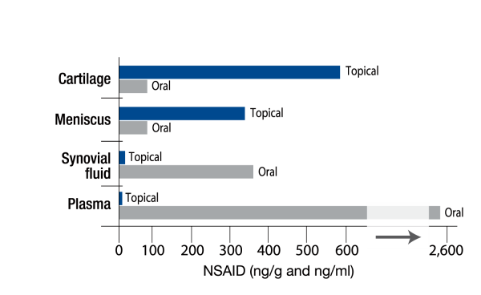
Where Does the NSAID Go? ⁶
Oral vs. Topical NSAID
Comparison of Median Maximum Concentrations, cMax, of NSAID in Joint Tissue after Topical and Oral Administration
NSAID is Maximized in Cartilage and Meniscus and Minimized in Plasma After Topical Application
Rolf C, et al. Intra-articular absorption and distribution of ketoprofen after topical plaster application and oral intake in 100 patients undergoing knee arthroscopy. Rheumatology (1999); 38:564-567.

Slide 24
What about Flurbiprofen and Plantar Fasciitis?
Better penetration into soft tissues in topical formulations than oral ⁸
All percents are tissue:plasma concentrations
Tendon
Oral 7%
Topical 160%
Muscle
Oral 3%
Topical 77%
Periosteum
Oral 9%
Topical 65%
Bone
Oral 4%
Topical 11%
⁸ Kai S, Kondo E, Kawaguchi Y, et al. Flurbiprofen concentration in soft tissue is higher after topical application than after oral administration. British J Clinical Pharm. 2012. 75:3;799-804.

Slide 25
Advantages of Topicals
Improved Safety Profile
Avoids GI 1st pass metabolism
Traditionally 25% GI side effects using PO NSAIDs
Most topical components do not reach systemic levels
Finch et al (2009)- Ketamime levels were below detectable limits
ME Lynch et al (2003)- Blood levels showed no significant absorption of Amitriptyline or Ketamime
No specific absorption of either agent after 7 days of treatment
15% of topical NSAIDs is thought to be absorbed systemically

Slide 26
Discussion
Limitations:
Small sample size, unable to appreciate safety advantages of topical formulations.
Limited follow up.
Future research: Blinded prospective study comparing the topical compound cream with a placebo cream.

Slide 27
References
¹ Wolgin M, Cook C, Graham C, Mauldin D. Conservative treatment of plantar heel pain: long term follow up. Foot Ankle Int. 1994:15:97-102.
² Crawford F, Thomson C. Interventions for treating heel pain. Cochrane Database Syst Rev. 2003;(3):CD000416.
³ Buchbinder R. Clincal Practice. Plantar Fasciitis. New Engl J Med. 2004;350:2159-66.
⁴ Pfeffer G, Bacchetti P, Deland J, Lewis A, Anderson R, Davis W. Comparison of custom and prefabricated orthoses in the initial treatment of proximal plantar fasciitis. Foot Ankle Int. 1999;20:214-21.
⁵ DiGiovanni BF, Nawoczenski DA, Lintal ME, Moore EA, Murray JC, Wilding GE, et al. Tissue-specific plantar fasciastretching exercise enhances outcomes in patients with chronic heel pain. A prospective, randomized study. J Bone Joint Surg Am. 2003;85-A:1270-7.
⁶ Rolf C, et al. Intra-articular absorption and distribution of ketoprofen after topical plaster application and oral intake in 100 patients undergoing knee arthroscopy. Rheumatology (1999); 38:564-567.

Slide 28
Referenced
⁷ Jorge LL, Feres CC, Teles VE. Topical preparations for pain relief: efficacy and patient adherence. J Pain Research. 2011. 4;11-24.
⁸ Kai S, Kondo E, Kawaguchi Y, et al. Flurbiprofen concentration in soft tissue is higher after topical application than after oral administration. British J Clinical Pharm. 2012. 75:3;799-804.
⁹ Pandey MS, Belgamwar VS, Surana SJ. Topical delivery of flurbiprofen from pluronic lecithin organogel. Indian J Pharm Sci. 2009. 71;87-90.
¹⁰ Dexter F, Chestnut DH. Analysis of statistical tests to compare visual analog scale measurements among groups. Anesthesiology. 1995. 82:896-902.

