Slide 1
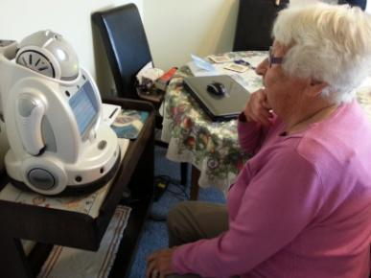
Can technology improve health outcomes in COPD patients?
Jeff Garrett, Liz Broadbent, Bruce MacDonald, Ngaire Kerse,
Ho Seok Ahn, Nicola Jepson, Vickie Li Ogilvie
Funded by HRC COPD partnership grant
between University of Auckland and CMDHB

Slide 2
What are we introducing for patients with COPD and Asthma in Auckland, New Zealand (CMDHB)

Slide 3
OECD Health Care Quality Indicators Database 2009

Slide 4
Number of hospital discharges in CMDHB (popn 480,000) by respiratory disease from 2000/03 to 2012/13 (Domicile view including IDFs), primary diagnosis
Year | Asthma | COPD | Bronchiectasis
2002/2003 | 1,241 | 741 | 183
2003/2004 | 1,337 | 869 | 208
2004/2005 | 1,264 | 921 | 193
2005/2006 | 1,339 | 908 | 179
2006/2007 | 1,351 | 952 | 185
2007/2008 | 1,313 | 949 | 222
2008/2009 | 1,511 | 975 | 251
2009/2010 | 1,349 | 898 | 231
2010/2011 | 1,236 | 1,037 | 254
2011/2012 | 1,309 | 1,100 | 222
2012/2013 | 1,205 | 1,197 | 207

Slide 5
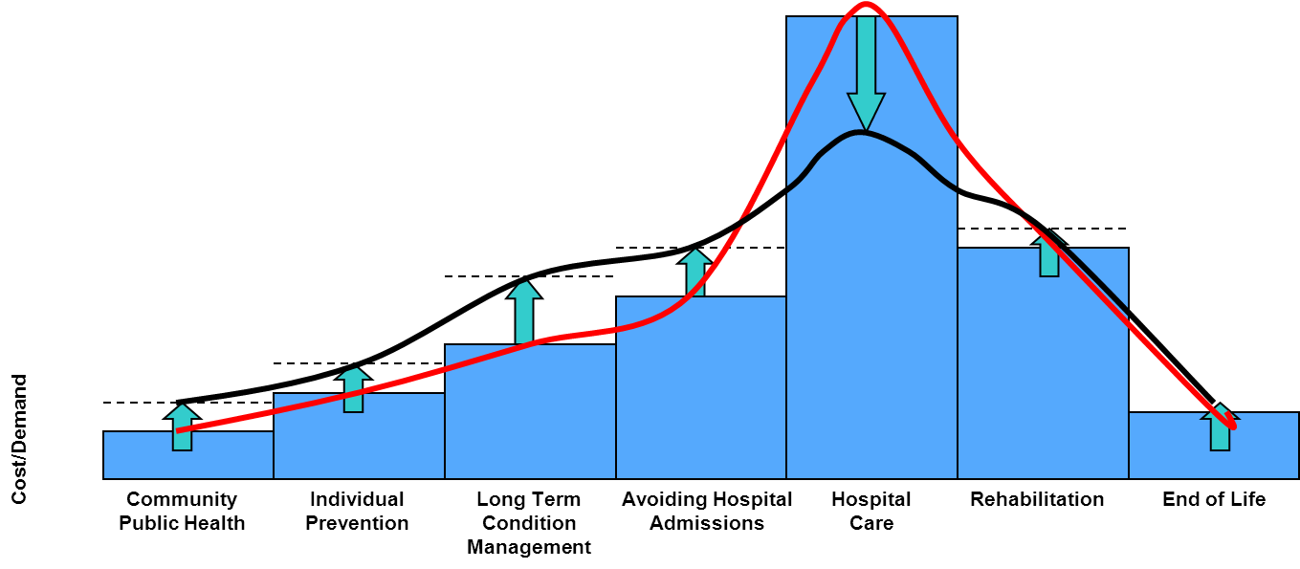
Changing models of care
Moving to care models that shift expenditure / activity away from hospital care, deploying resources more effectively to improve health outcomes and patient experience.
Ref: Dr Helen Bevan, NHS Institute

Slide 6
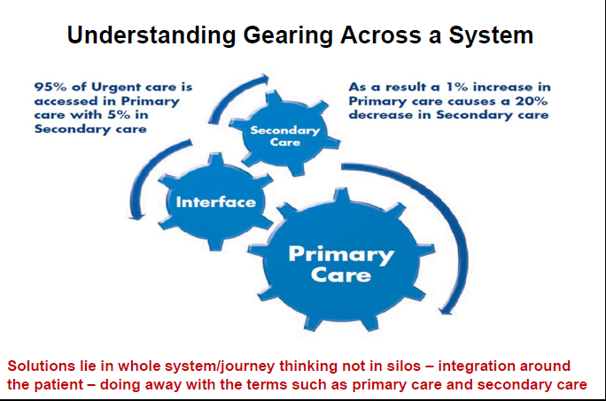
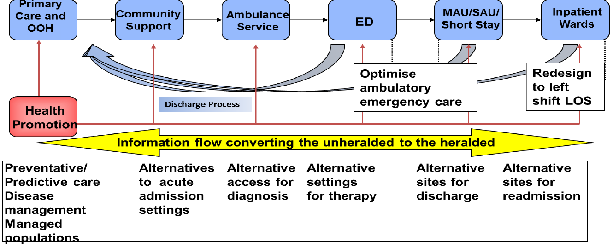
System integration focused on the patient journey
Goal: Right care, right time, right place.
Responsible for CM for frail older people & CDM and more effective responses to urgent care needs
Clear operational performance framework and integrated into primary care
Improved integration with primary responders
Front load senior decision process including primary care

Slide 7
COPD
Assessment of Dynamic Pathway in COPD in Primary care- J Garrett, F Horwood, A Collingwood, A Moffit, et al (HRC application/CMDHB)
Assessment of Effect of Discharge Bundles in COPD – F Horwood, N Jepsen, J Garrett, N Cornea (CMDHB)
Assessment of Effect of Robots on Readmission rates in recently discharged COPD patients- E Broadbent, J Garrett, B McDonald, et al (HRC, University of Auckland/CMDHB)

Slide 8
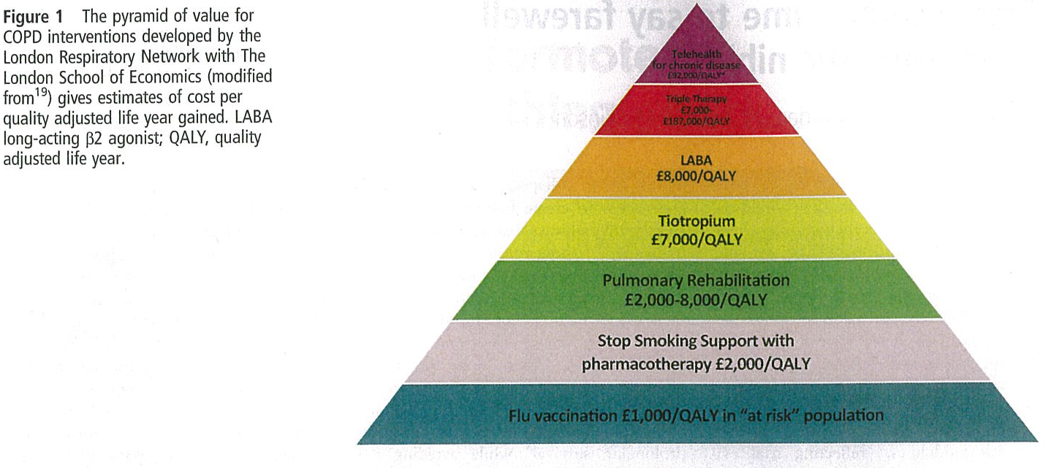

Slide 9
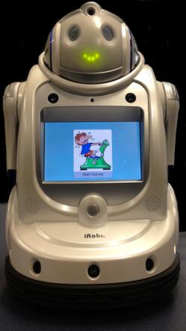
The robot
Irobi is made in Korea by Yujin Robot Ltd
Programmed for COPD patients by University of Auckland engineers
About 30cm high
Sits on a table
Can move (on wheels), move its arms, alarms with lights when medication due, talk
Most interactions are via touchscreen

Slide 10
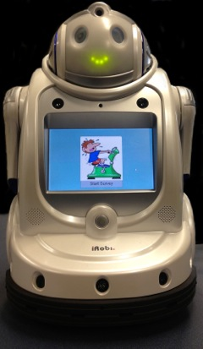
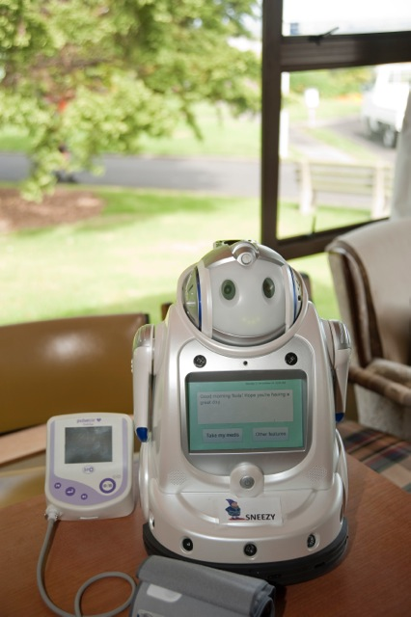
Robots

Slide 11
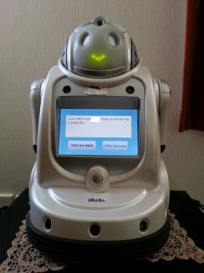
Hypotheses
Group with technology will have exacerbations diagnosed earlier resulting in fewer hospitalisations. Extra support will result in lower anxiety, reduced loneliness, higher adherence (rehab plus medication).

Slide 12
Intervention
Intervention includes standard care plus a robot that:
  Measure FEV1/FEV6, pulse oximetry, CCQ, weekly or if deteriorating
  Reminds patient to take medications daily
  Coaches patient to do exercise when due
  Has entertainment and relaxation functions
  Has education about COPD and ‘messages’ to encourage healthy behaviour
  Links to WiFi based smart inhalers that monitor adherence
  Mobility App to monitor activity and sleep
  Has a “I feel unwell button”
  Data regularly collected by robot once a week
  Data is regularly checked by research physiotherapists on server
  If patient showing signs of worsening breathlessness, non-adherence, increased use of reliever then Respiratory Physician alerted and can prescribe medication and/or order blood tests

Slide 14
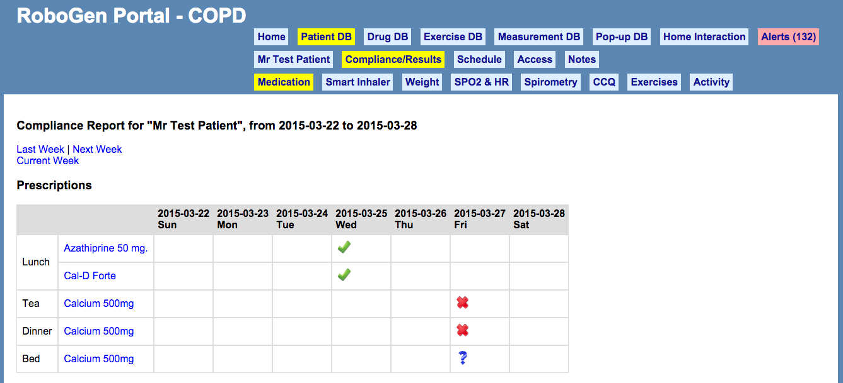

Slide 15
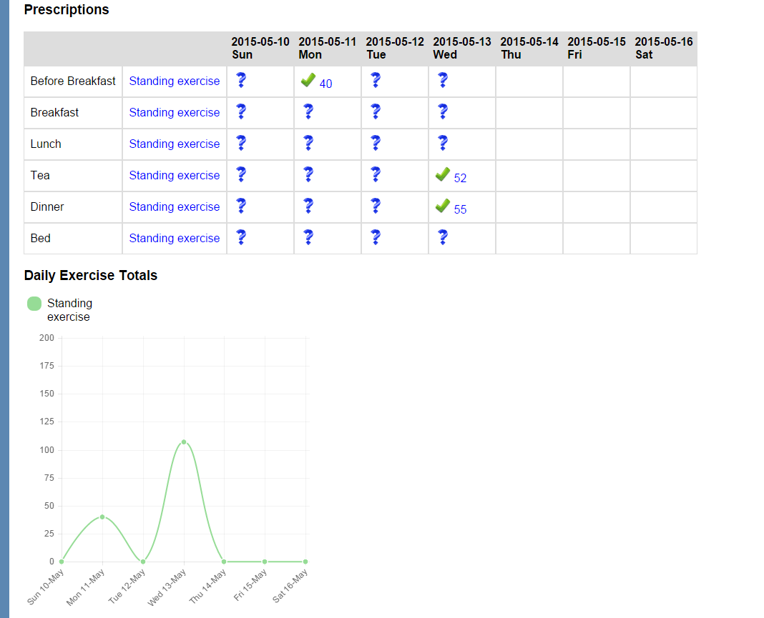

Slide 16
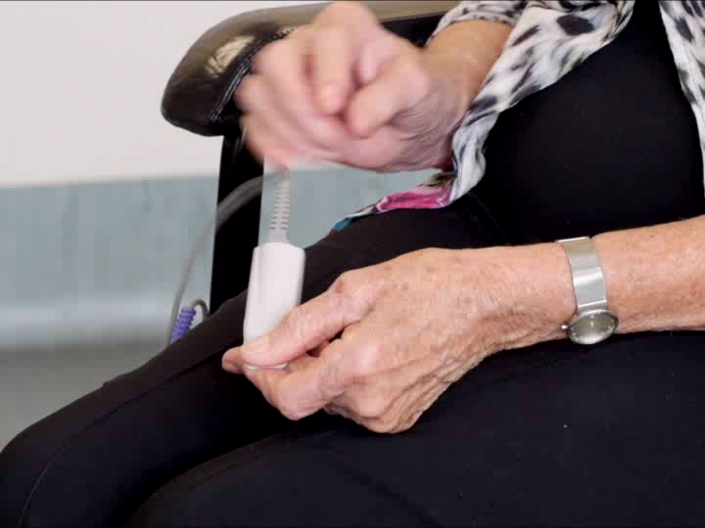
How to perform oximetry measurement

Slide 17
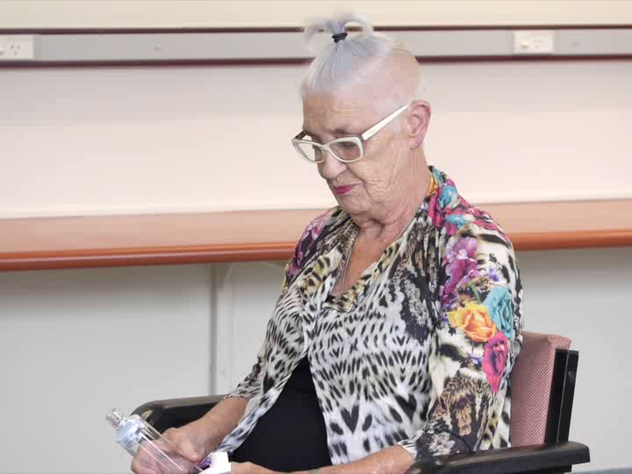
Inhaler technique-using spacer

Slide 18
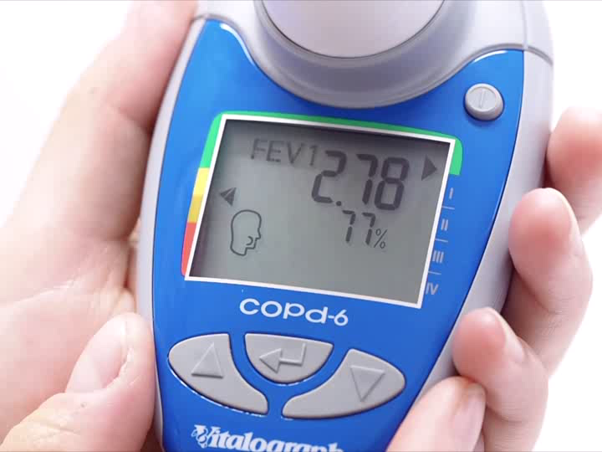
How to perform spirometry (lung function)

Slide 19
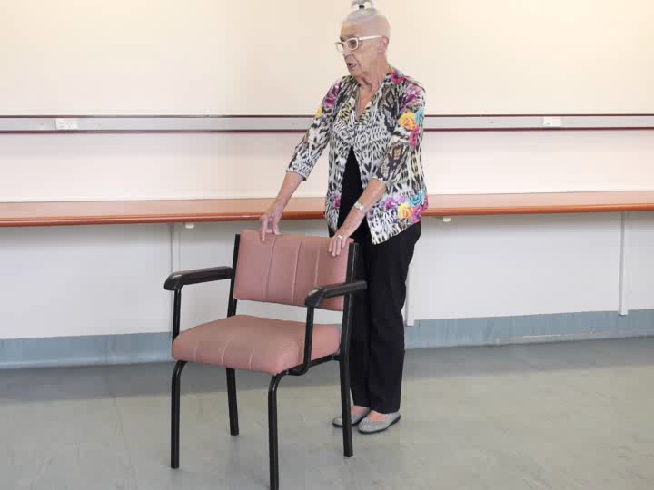
Home Rehabilitation exercises

Slide 20
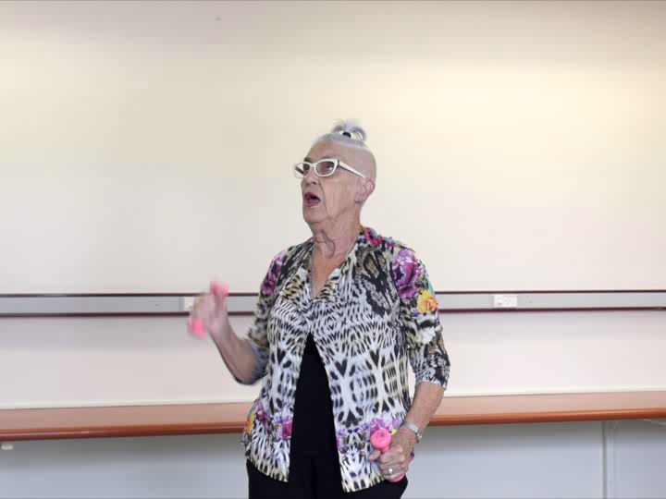
Home rehabilitation exercises

Slide 21
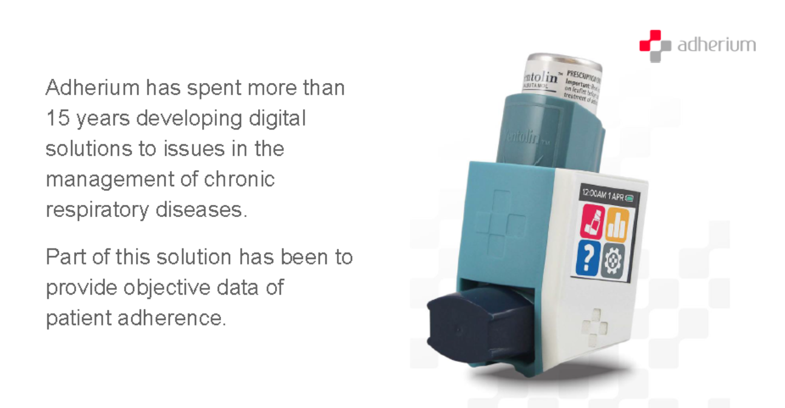
Smartinhaler

Slide 22
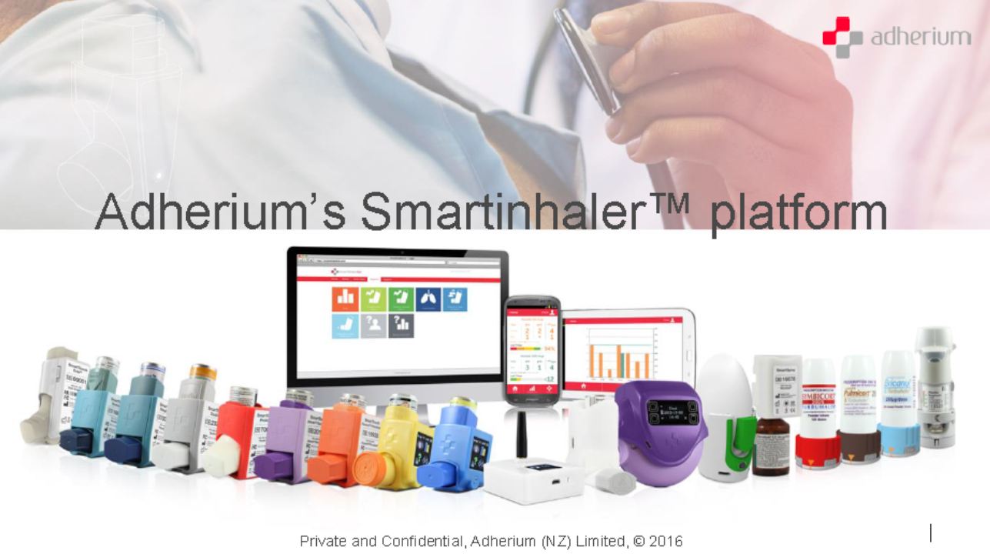
There are Smartinhalers available for every inhaler in NZ

Slide 23
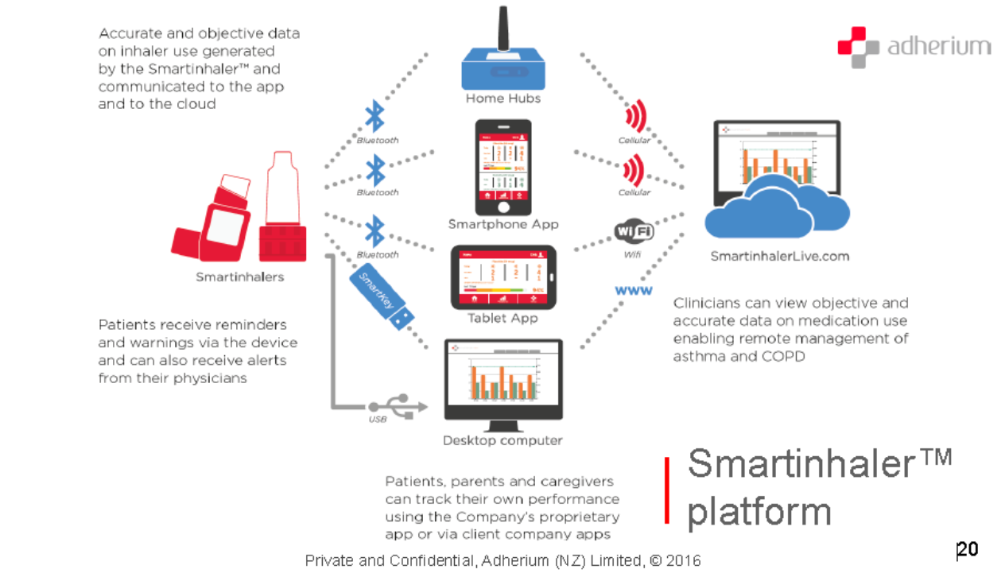
Smartinhaler Platform

Slide 24
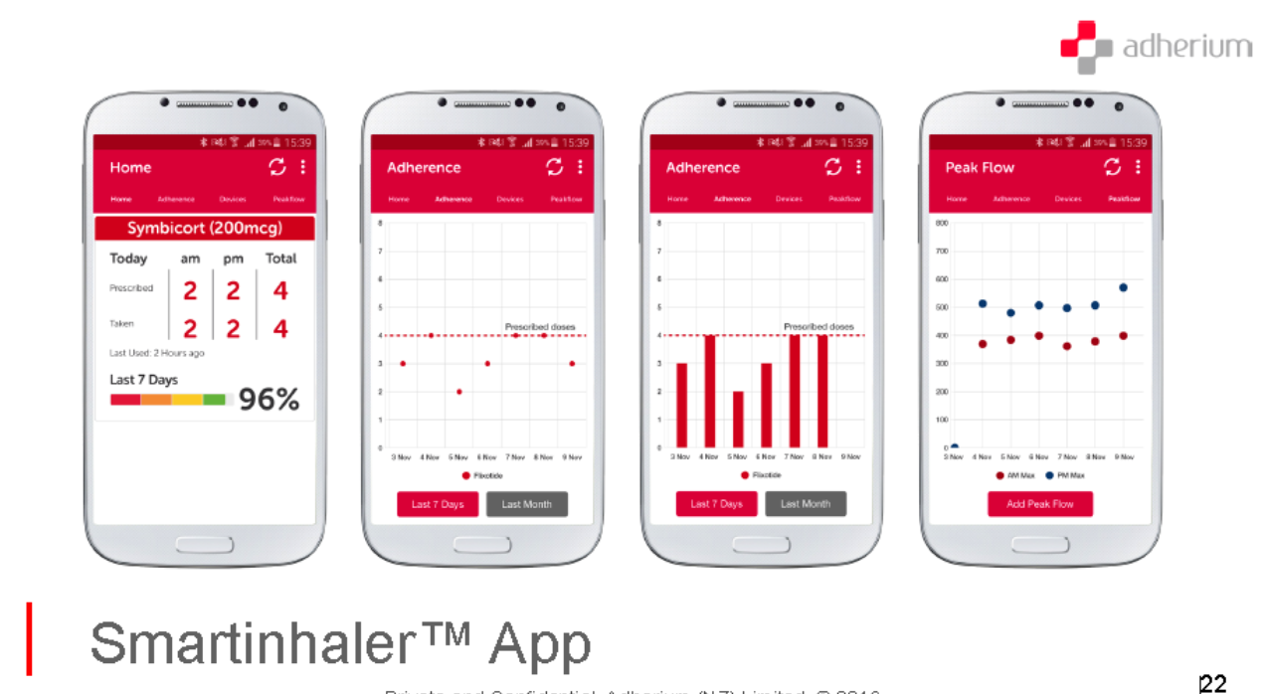
Smartinhaler App

Slide 25
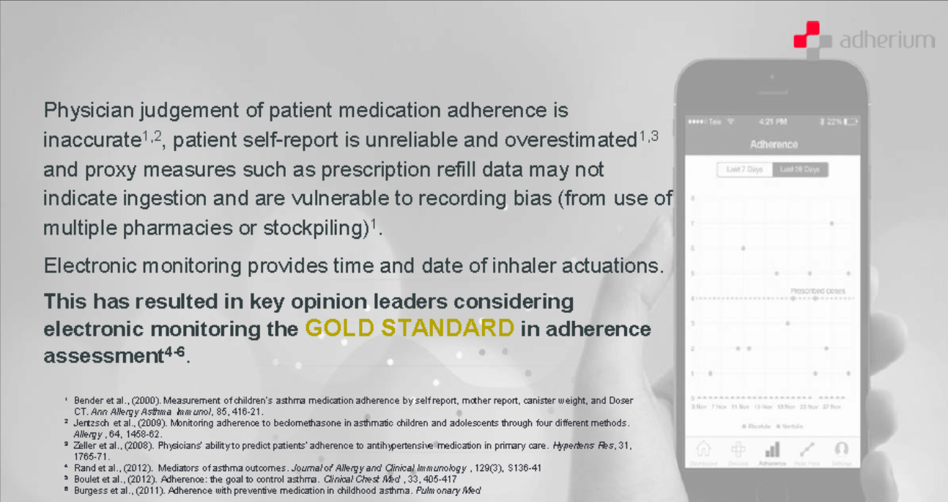
Clinicians ability to assess adherence compromised

Slide 26
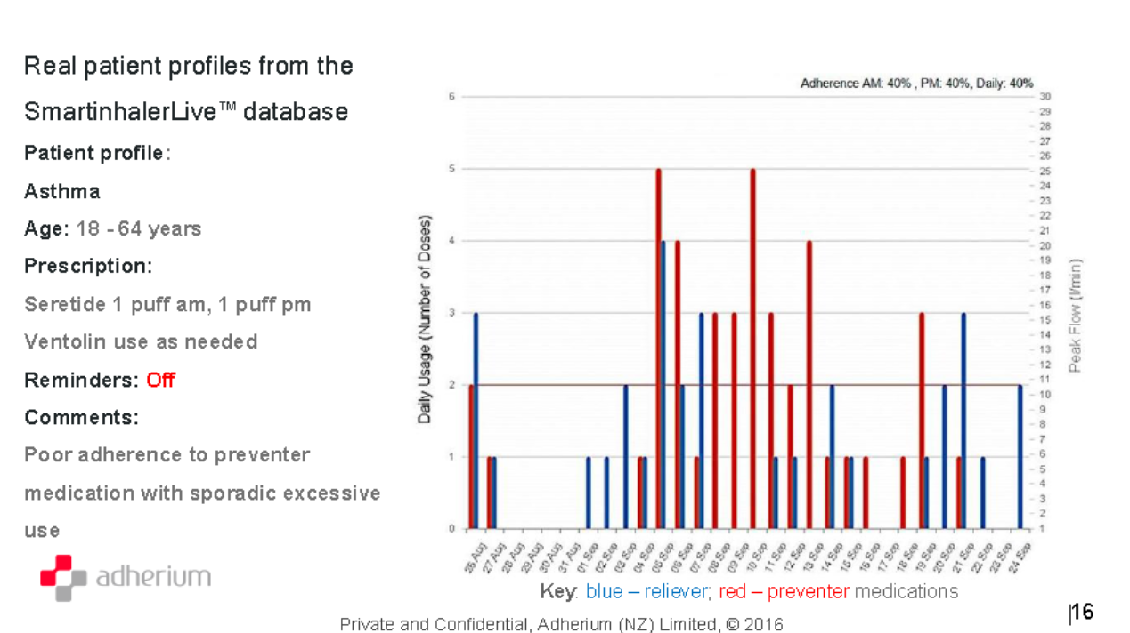
Typical asthma patient profile

Slide 27
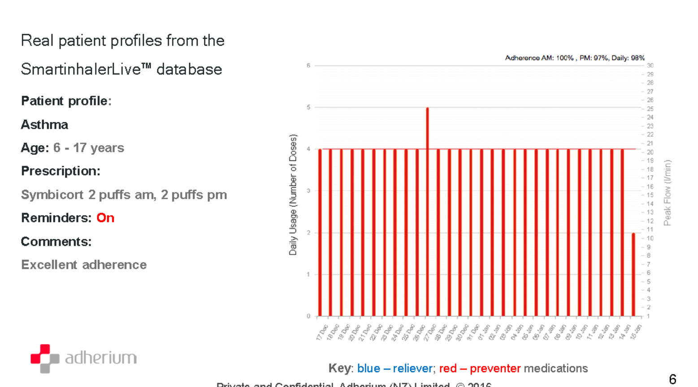
Excellent adherence with prompting via smartinhaler

Slide 28
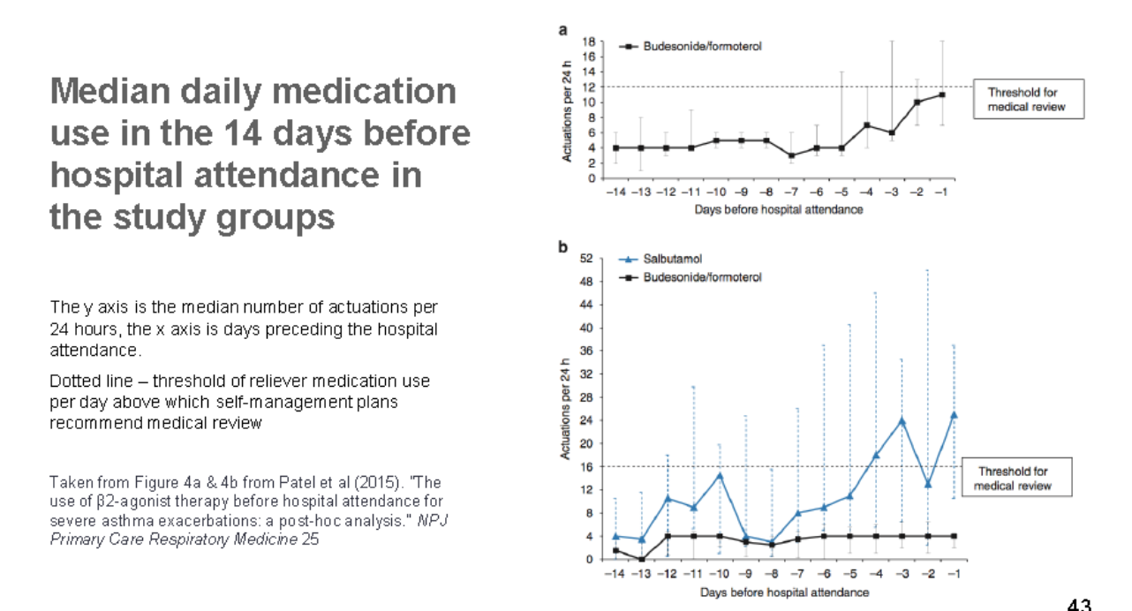
Median reliever medication use prior to ED attendance

Slide 29
Method
RCT with 60 patients (feasibility trial)
COPD patients recruited at hospital discharge. GP is informed.
Criteria: COPD main diagnosis, socially/geographically isolated, age <90, little risk of immediate death (CURB65, pro BNP)
Two groups – intervention and control
Intervention period 4 months
Primary outcome: number of admissions/days in hospital
Secondary outcomes: number of GP and nurse visits, CCQ (symptoms, functional status, anxiety/depression), loneliness, illness perceptions, self-efficacy, adherence to medication and exercise
Cost-benefit analysis will be done

Slide 30
Recruitment details

Slide 31
Inclusion/Exclusion Criteria for COPD Study
Inclusion Criteria:
Confirmed diagnosis of COPD and FEV1<60% predicted
COPD main cause of admission
Previous admission(s) in past year with COPD
Gets out of house <4 times/week (shopping, seeing friends)
Living alone (or with spouse but who is also largely housebound)
Geographic rural location (>5 km from town) ,
Poor social support (visit by friends/family <1/week) and
High levels of anxiety on the Clinical COPD Questionnaire (CCQ).
(Criteria 1-3 mandatory, minimum of 2 of criteria 4-8 mandatory)

Slide 32
Inclusion/Exclusion Criteria for COPD Study cont
Exclusion Criteria:
Increased BNP or troponin level on admission (predicts increased risk of death in subsequent 6 months)
CURB65 score >2 (similar)
Life expectancy <1 year
Diagnosis of incurable Cancer
Comorbid condition causing greater impact on quality of life than COPD e.g. severe CCF, CVA
Residence in rest home
Living with family/friends
Age >90
Still working (unless from home).

Slide 33
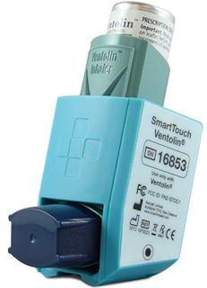
Control Group
Get standard care plus smart inhalers to monitor adherence to preventer and reliever use (not monitored)

Slide 34
Study Design
Aim
The primary aim of the study is to evaluate the feasibility, clinical effectiveness and cost-effectiveness of a COPD telehealthcare system delivered on a robot compared to a control group without telehealthcare

Slide 35
Primary Hypothesis
Robot telehealthcare will reduce hospital admissions and bed-care days compared to a control group

Slide 36
Secondary Hypotheses
Robot telehealthcare will reduce the number of primary care visits and telephone calls with the patient, improve mental health, loneliness, symptoms and adherence to medication and lifestyle behaviours and allow earlier interventions for exacerbations of bronchitis

Slide 37
Outcomes-(At 6 months)
Primary outcome
Hospitalisation rates, Days in Hospital
Secondary outcomes
  Adherence
  Symptoms, functional status and mental state
  Depression and Anxiety
  Loneliness
  Stanford Self-Efficacy for Managing Chronic Disease 6-Item Scale
Data Required for cost-benefit analysis

Slide 38
News Hub Video Link http://www.newshub.co.nz/nznews/companion-robots-help-chronic-lung-disease-patients-2016022415#axzz4186dyVuE

Slide 40
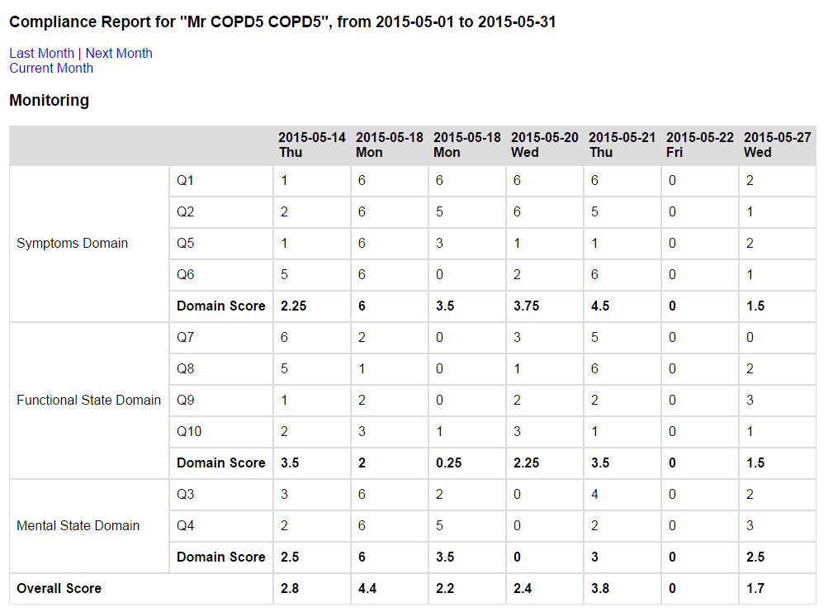

Slide 41
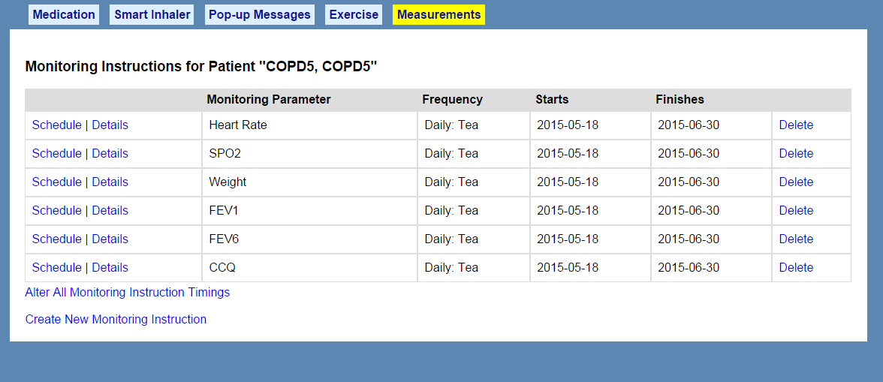

Slide 42
