Slide 1

PRS
Co-resident Objective Measure of
IHC Stain Performance for
Process QC and Diagnostic Aid
Frederick Husher
Jee Shum
Notes:
PRS Co-resident Objective Measure of IHC Stain Performance for Process QC and Diagnostic Aid
My name is Jee Shum and I will be presenting today
Welcome Ladies and gentlemen and thank you for attending.
It’s the next big thing in Pathology and the future of Pathology.

Slide 2

Successful IHC Diagnosis
Starts With an Effective
Process QC
Notes:
Successful IHC diagnosis starts with an effective process QC
Because the staining processes are dependent on many factors, often unique to each slide, an effective process QC must be incorporated ONTO every slide.
In this manner, IHC diagnosis starts with the knowledge that the stained result is valid.
Which, leads the result to being consistent and reliable.

Slide 3
For decades, The College of American Pathologists and their European counterparts have waited for a valid product to perform certifications of the Laboratory and the interpreting Pathologist.
While daily stand alone QC offers minimal assurance of IHC processing efficacy, the only 100% solution is an on-slide QC test for every slide processed.
Only the PRS offers this process verification with a permanent co-resident record.
Notes:
The need for PRS
Certification renewal of labs and pathologists
Currently not a good measure of a labs daily operations
Frequency of IHC process QC
Monthly
Daily
Really should be performed on every slide
Where is the QC record kept?
In the LIS
Co-resident with the patient tissue section on the slide to provide all the actual staining process info from start to finish

Slide 4
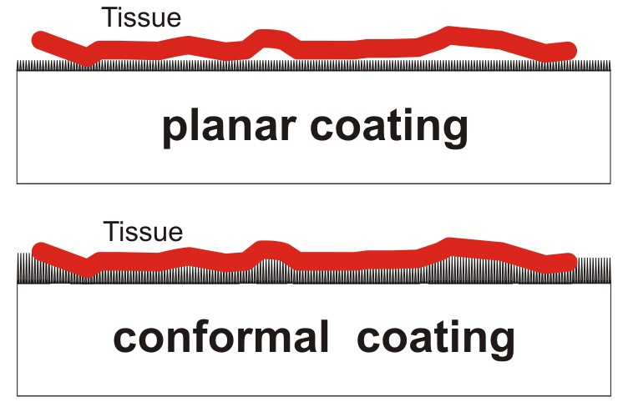
Adhesive Coated Slide Structure
Notes:
Adhesive coated slide structure
Point out the voids

Slide 5
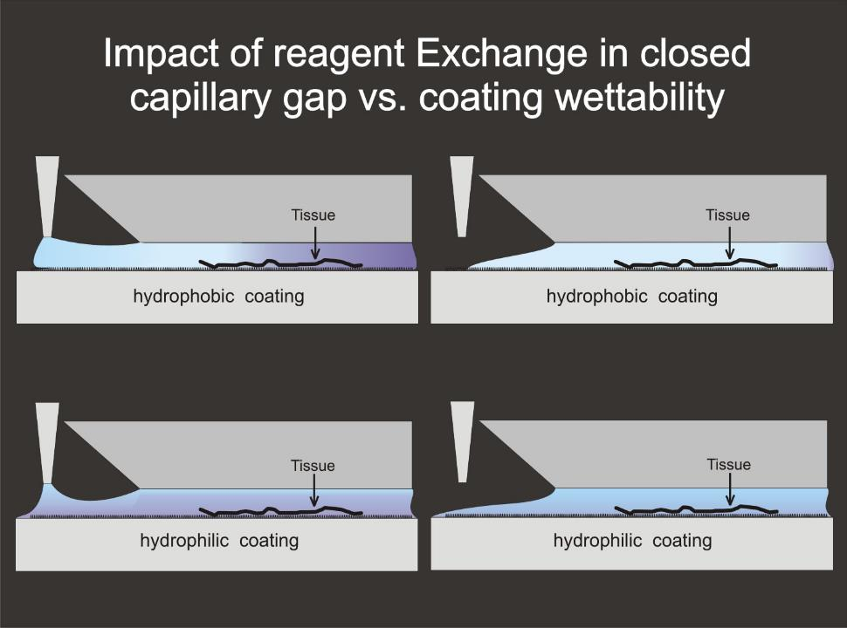
Notes:
Impact of reagent exchange in closed capillary gap vs. coating wettability
The top row shows hydrophobic coated slides
Left >> new reagent is dispensed in at the left, which displaces the previous reagent out to the right
Right >> The new reagent is fully in, but at the far right there is a slight blending of new & old because the velocity at the inside surfaces of the gap are close to zero
Hydrophilic slides even with porosity tend to reject aqueous fluids from getting into the porosity matrix >> water repelling after all
The bottom row shows hydrophilic slides
Left >> new reagent is dispensed in at the left and pushes reagent out to the right, but the new reagent cannot displace the old reagent near the hydrophilic
coating
Right >> new reagent is fully in, but it is really a blend of new and old
Why? >> Hydrophilic are sticky in regards to aqueous liquids. Worse yet is if the coating has porosity it takes time to leach out and become homogeneous

Slide 6
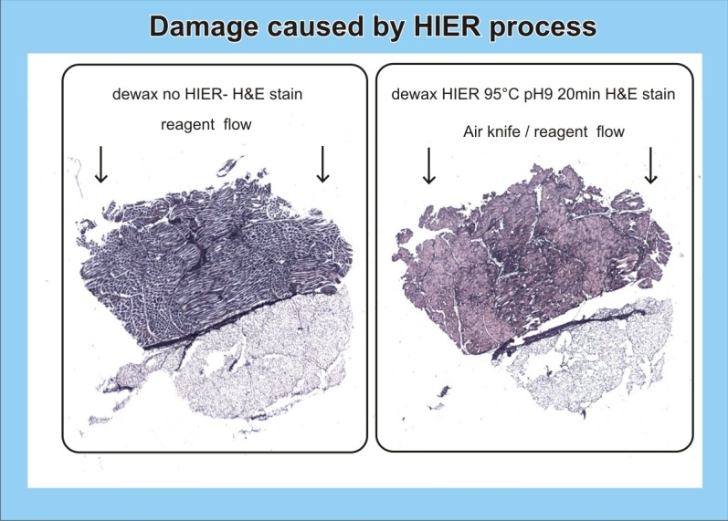
Notes:
Damage caused by HIER process
This slide shows the impact of HIER where the heat source is below the slide.
The slide adhesive in this situation is a planar structure that is moderately hydrophilic that we developed a while back.
Adhesive strength is high, but because of it being planar not all the tissue was captured covalently.
A 3d conformal adhesive, as we have now, is insensitive to this sort of failure because:
Sheds water fast to ensure all of the tissue lays down and becomes covalent captured.

Slide 7
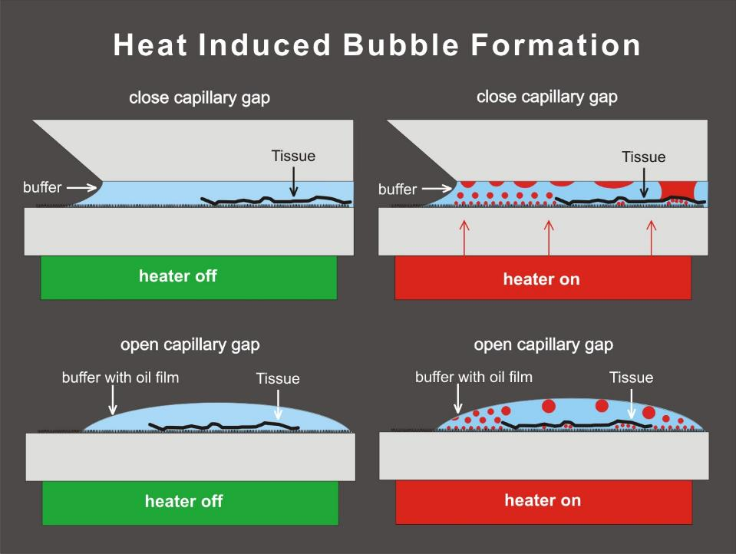
Notes:
Heat induced bubble formation in closed & open capillary gap
Bubble formation within a capillary gap has very different consequences between open and closed gaps.
Open capillary gap needs to have a hydrophilic coating to support the reagent pool to go past the tissue section.
Bubbles do not stay attached on a hydrophilic coating and they float to the top of the pool.
When washed with an air knife they are removed.
Closed capillary gap needs a have a hydrophobic coating to promote good reagent displacement.
Bubbles tend to stick to hydrophobic surfaces and do not wash away especially if grown to touch the top of the capillary gap.
Once stuck they prevent all subsequent reagent exposure, leaving that area unprocessed.
Usually, that location has a surface defect that allowed nucleated boiling.

Slide 8
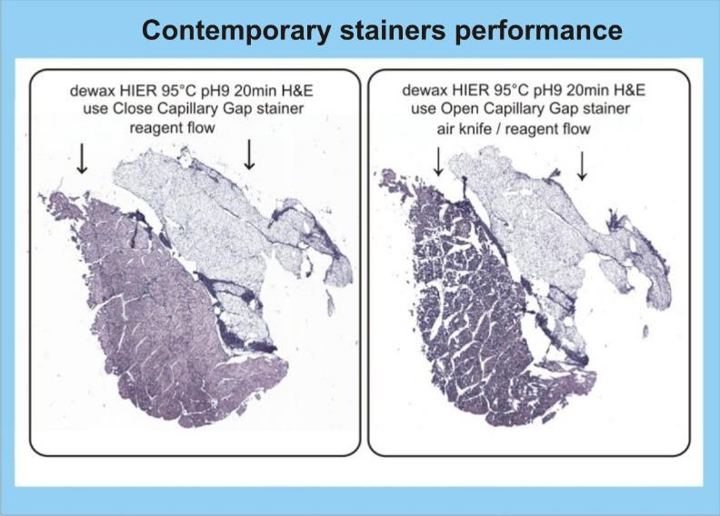
Notes:
HIER performance between closed and open capillary gap both with below slide heaters
This slide shows the stress impact of HIER upon a tissue section for a closed and open capillary gap situation, all else the same.
Our present 3d conformal adhesive coating does not lose tissue capture as on the right even with such stress.

Slide 9
3D conformal slide coatings
There are a number of important advantages to 3D coatings:
  More than one binding moiety
  Conformal to tissue surface
  Promotes fast transport of water
Wettability can be set at time of production.
There is one used in common IHC usage
We too have a suite of such coatings
Notes:
3d conformal slide coatings
Classically, adhesive slides have had only a single capture end group
The ability to be conformal to the ridges and valleys of the tissue section that result when being sectioned takes place. This is a HUGE advantage to securing any tissue or cells vs. a rigid monolayer coating.
Can provide very fast transport of water away from the section that ensures it will lay flat, especially important to frozen tissue
We have developed our own 3d coatings to optimally support different applications as nothing exists that meet our needs. Examples would be IHC, H&E, and Pap. The configurable elements include:
Configurable porosity to control spreading of protein & chemical deposits
Configurable wettability
Covalent binding to all tissue types
Stable over temperature

Slide 10
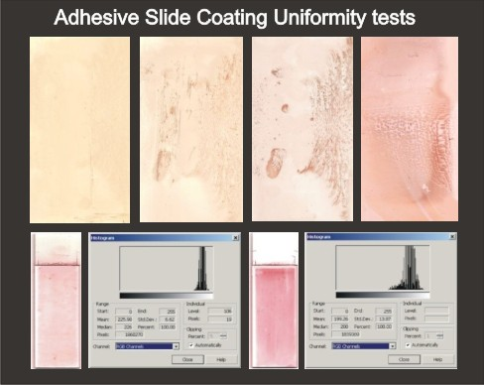
Notes:
Adhesive slide coating uniformity tests
This shows adhesive slides coated with a uniform deposit of Mouse IgG, stained with AEC secondary stain kit
DAB exhibits so much age drift that such experiments are fruitless
The upper three slides to the right slide images show the coating can be seriously non-uniform
Not too serious to tissue but useless for protein and bead deposits
Left side is an amino-silane vapor deposition
The others are dip-n-dunk coatings that are often plagued with non-uniform binding site densities
The lower two slides & histograms show the effect of reagent movement in open & closed capillary gap processing, Left to Right respectively
Notice the impact of incomplete reagent displacement in the closed capillary gap
From top to bottom
The open gap slide has more washing out due to the chromogen precipitate being mechanically displaced by the air knife.

Slide 11
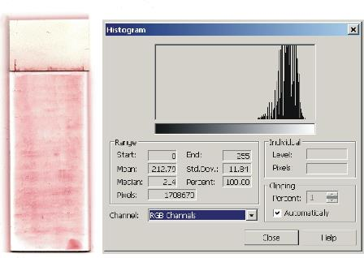
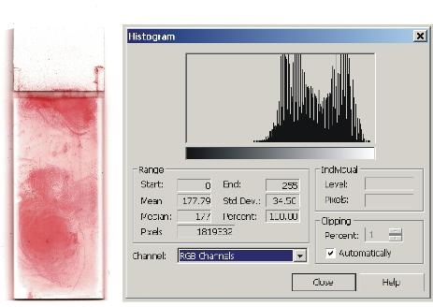
Here Are Two Currently Produced Amino-silane Coated Slides
Notes:
Examples of two currently produced amino-silane slides that have been characterized
As can be seen the vapor deposition is pretty even but of low binding site density while the dip-n-dunk is lumpy
This dip-n-dunk slide has some contamination along the long axis because it is ground after coating as an entire sheet. The intrusion darkness is from the ground paint of the label leaching into the coating area during the grinding process.

Slide 12
Heat Induced Epitope Retrieval
The HIER process uses a buffer ranging between pH 6 to 9
Heat is applied at about 95˚C for 10-15 minutes
Damage can cause feature loss and non-specific staining
Notes:
Heat induced epitope retrieval, HIER
The HIER process uses a buffer ranging between pH 6 to 9
Heat is applied at about 95˚C for 10-15 minutes
Implemented as:
Individual slide: Heat pushed through bottom of slide heats HIER buffer within capillary gap
Batch mode: Rice Cooker
Damage causes any loose biomaterials to move into buffer and often be redeposited on the slide
Rice Cooker: Cross contamination
Proteins become denatured and break free during fluid exchange

Slide 13

The PRS Targets
  Protein mixtures
    Secondary stain targets
    Primary Antigen stain targets
  Special Stain targets
  Black and white pigment targets
Notes:
The PRS Targets
Our IHC stain reactive targets are proteins and conjugated proteins that are covalently attached to the slide adhesive
Special Stain targets are specifically designed to covalently bind uniquely with only one Special Stain.
All Special Stain targets are inorganic structures that provide a covalent bond to the slide adhesive and the Special Stain. Example: Hematoxylin and Eosin
Pigments are used in place of paint as most all paints will produce bubbles during a HIER process

Slide 14
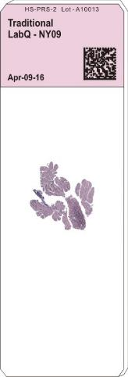
Traditional Subjective Biopsy Slide
Possible Errors:
  Human error
  Machine failure
  Cumulative processing variation
  Effect the final stained result
  Lack of QC and process control
  Subjective diagnostic interpretation
  False negative result
Notes:
Traditional subjective biopsy slide
Possible Errors impacting the usability of the IHC slide:
Human error
Machine failure
Cumulative processing variation
Effect the final stained result
Lack of QC and process control
Subjective diagnostic interpretation
False negative result

Slide 15
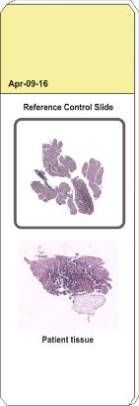
Control Slides Now Used
Known tissue
sausage
Multi-tissue sausage that is fixed and embedded for sectioning, whose members react with one of more primary antibodies.
There is no control over the antigen density so the QC is only pass/fail at best
Notes:
Multi-tissue sausage primary antigen QC mounted tissue control slide
No control over antigen density do QC is pass/fail at best

Slide 16
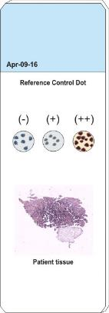
Peptide on
Compressed
polymer
Primary peptides attached to a polymer backbone that is compressed, embedded, and sectioned.
Typically, only one primary peptide per section.
Very difficult to from consistent antigen concentration density targets.
Thus, the result do not produce objective measure results.
Notes:
Primary antigen peptides formed as a polymer carried bead: Primary antigen QC
Peptides attached to a polymer backbone, compressed, and sectioned
Very difficult to form consistent antigen concentration targets

Slide 17
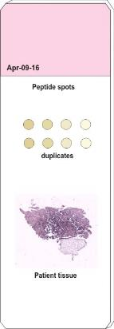
Primary peptides attached to coated beads, which are deposited in a mono-layer slurry.
The slurry can contain different peptide concentration beads as well as know density colored beads.
Requires each bead to be images. However, since the bead does not present a level surface to the imaging system and light source.
Peptides
on beads
Notes:
Control slide for primary antibody stain QC: Primary antigen peptides on coated beads
Contains multiple peptide concentrations and known density colored beads
Bead ranges from nothing at center to a dark ring at the edge. What part is the actual value?
Come up short because:
Targets do not offer specificity
Slides are labor intensive and expensive
Do not meet the criteria for regulatory approval

Slide 18
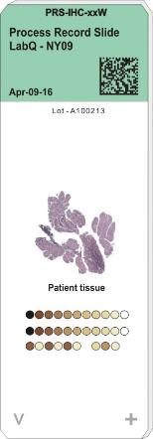
Introducing the new solution for IHC
Process
Record
Slide
Notes:
Introducing the PRS

Slide 19
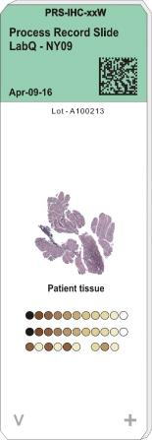
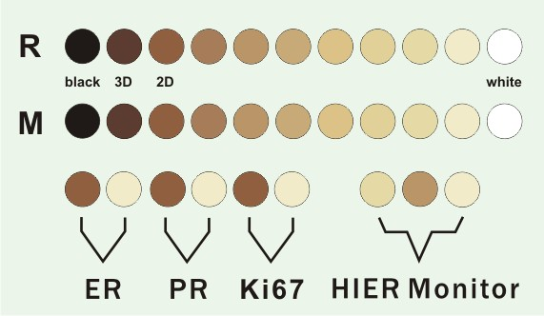
The Process Record Slide Targets
Notes:
The Process Record Slide Targets
There are three lines of protein deposits all covered by a Paraffin film layer
Two secondary gradient density arrays of mouse & rabbit each following a square law curve
Primary gradient density arrays for each primary antigen each following a square law curve
While dot pairs are shown, we will be using 3-dot arrays to better map onto the secondary array
A HIER monitor to capture the behavior of the antigen recovery process
All with the same protein blend but differing formaldehyde cross-linking densities

Slide 20
The Process Record Slide Targets
There are three lines of protein deposits all covered by a Paraffin film layer
Two secondary gradient density arrays of mouse & rabbit each following a square law curve
Primary gradient density arrays for each primary antigen each following a square law curve
While dot pairs are shown, we will be using 3-dot arrays to better map onto the secondary array
A HIER monitor to capture the behavior of the antigen recovery process
All with the same protein blend but differing formaldehyde cross-linking densities

Slide 21
The QC Use of The PRS
The PRS is broken into three basic regions of operation:
Mouse & Rabbit 2D secondary stain reactive gradient density array
One each of Mouse & Rabbit 3D secondary stain reactive targets
One of more 2D primary antigen gradient density arrays
Black and white reference targets
Notes:
The QC use of the PRS
The PRS is broken into three basic regions of operation:
Mouse & Rabbit 2D secondary stain reactive gradient density array
One each of Mouse & Rabbit 3D secondary stain reactive targets
One of more 2D primary antigen gradient density arrays
Black and white reference targets

Slide 22
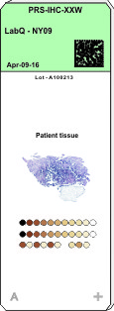
How the Secondary Stain Reagent Kit performance is Captured in the Mouse & Rabbit Arrays
Mouse & Rabbit arrays use verified concentrations of IgG proteins
All proteins are impacted the same by the antigen retrieval process
Notes:
How the secondary stain reagent kit performance is captured in the mouse & rabbit arrays
The 2d secondary gradient density arrays are composed of known concentrations of Mouse & Rabbit IgG proteins.
While the antigen retrieval process will cause some amount of protein degradation, all the protein targets will experience the same degradation because each target has the same density sum of active and filler proteins.
The secondary stain kit will stain the secondary targets. Those targets with a higher active protein density will stain darker than those with less.
The stain performance is then established by how many targets are stained more than 50% of the 100% target. As the targets are less affected by the antigen retrieval or the stain kit has higher reactivity the 50% will move towards the white target.

Slide 23
How the Primary Antibody Reagent performance is Captured in the Mating Antigen array
Primary antigen carrier proteins use verified concentrations
All proteins are impacted the same by the antigen retrieval process
Notes:
How the primary antibody reagent performance is captured in the mating antigen array
The 2d primary antigen gradient density arrays are composed of known concentrations of antigen peptides bound onto a carrier protein mixed with blank carrier proteins.
While the antigen retrieval process will cause some amount of protein degradation, all the protein targets will experience the same degradation because each target has the same density sum of active and filler proteins.
The primary conjugated antibody stain reagent will stain only those targets with a mating antigen. The conjugated antibody is then reacted with the secondary stain kit. Because the secondary gradient array has established its protein density via chromogen deposit the antibody concentration can be computed using the same chromogen deposit scale. Knowing the antigen density for each of the carrier proteins and the separation along a square law curve the three targets are, the antigen density in terms of chromogen deposit can be established. Thus, an antigen density scale is formed.

Slide 24
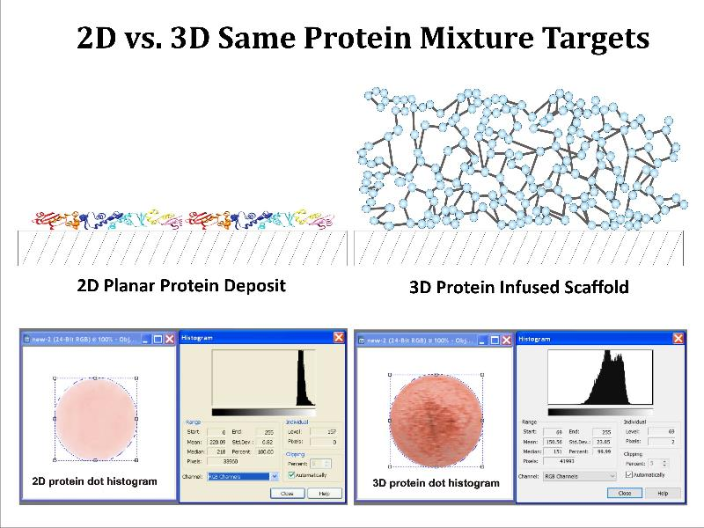
Notes:
Translation between 2d protein deposits and the 3d cellular structures
The main problem is using 2d planar targets to characterize the IHC staining reagents is that they ALWAYS appear lighter than what is happening in tissue
Why?
Simple: antigen sites exist along the vertical features of the tissue section. Thus, the enzyme site can cause a huge amount of chromogen precipitation to take place before becoming buried while on a planar deposit the chromogen pile is quite small before the enzyme site is buried.
So, how to resolve?
Make one 3d target that uses the same high concentration
Knowing the difference in chromogen density between the same secondary protein concentrations in 2d and 3d implementations then the 2d scale can be shifted and the 3d antigen density vs. chromogen density scale or ruler is developed.
Now objective measurement of antigen density on the tissue section is possible.

Slide 25
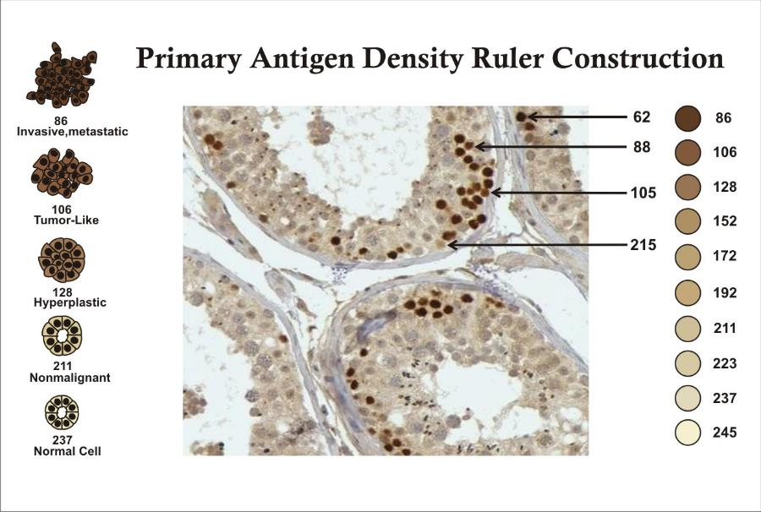
Notes:
Primary Antigen Density Ruler Construction
Here we have an example of applying the 3d antigen scale to tissue
Color density will be affected by:
Antigen retrieval degradation
Chromogen precipitation rate, big issue for DAB
User can elect to see as captured or normalized
As discussed earlier the color density can vary up/down as a function of antigen retrieval degradation and chromogen precipitation rate yet the scale will adjust to match.
The digital imaging does have the option to normalize the image so that as these factors vary the digital image presentation can stay reasonably consistent.

Slide 26
How does the PRS aid the Whole Slide Imaging (WSI)
Black and white baseline targets to set illumination level
Slide background: washed out or truncated
PRS incorporates black and white targets
Represents working range on slide
3D target builds antigen scale to apply to tissue
Notes:
How does the PRS aid the Whole Slide Imaging?
Black and white baseline targets to set illumination level
Slide background: washed out or truncated
PRS incorporates black and white targets
Represents working range on slide
3D target builds antigen scale to apply to tissue

Slide 27

• The PRS incorporates co-resident patient tissue and control targets which:
• Records the IHC staining experience
• Target data provides objective QC evaluation of the processing experience
• Target data forms the basis of an antigen concentration ruler
• The ruler provides digital imaging baseline for pre-screening
• The ruler supports imaging adjustment for best diagnostic
interpretation by the viewing Pathologist
• 2nd opinion possible as observer knows what was done to the PRS & tissue section
Notes:
The PRS incorporates co-resident control targets with patient tissue
The control targets record the IHC processing experience
The control targets provide objective QC monitoring of the IHC process
The control targets form the basis for establishing a antigen concentration measure on the co-resident tissue used with digital imaging
Combined with digital imaging the PRS supports normalization of the antigen density in the developed image
Viable 2nd opinion is possible as the processing experience remains forever with the tissue section

Slide 28

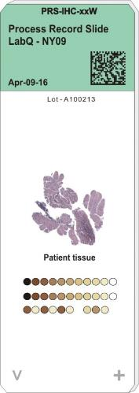
Subjective Result
Objective Result
Notes:
Subjective >>> Objective
The paradigm change brought about by the PRS changes the value and use of the IHC slide from subjective to objective measure
A reasonable amount of process variation can be compensated for when the PRS is paired with digital imaging.
The digital imaging being able to apply the PRS target information to normalize the image.

Slide 29
Does the PRS Require FDA Approval?
The PRS has been granted Class I approval by the FDA. It is important to note that the PRS does not act on the patient tissue section in any way. It can aid in the veracity of the diagnostic interpretation by validating the processing experience and provide process control feedback.
Additionally it can be use with digital imaging to
adjust the stained result to a normalized presentation.
Notes:
FDA Approval
The PRS does not actually require FDA approval because it does not interact with the patient tissue in any fashion through the IHC processing.
However, to satisfy the marketplace concerns we filed and have been approved as a Class I device.

Slide 30
Commercialization of PRS
The PRS is coming into commercial product reality via a joint venture with the Hong Kong Productivity Council.
The mass production line incorporates our protein printer technology that supports 2D and 3D printing of biomaterials and reagents.
Notes:
Commercialization of PRS
The PRS is coming into commercial product reality via a joint venture with the Hong Kong Productivity Council.
The mass production line incorporates our protein printer technology that supports 2D and 3D printing of biomaterials and reagents.

Slide 31
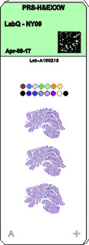
PRS-H&E Slide
The basic PRS concept has been extended to support H&E plus Special Stains
Notes:
PRS-H&E slide
There is a gradient density array for the Hematoxylin to capture the reagent performance decline.
There remains enough room for replicates, as often required in frozen tissue applications
Coating is moderately hydrophilic with 3d conformal ability that excels in total tissue and loose cell capture

Slide 32
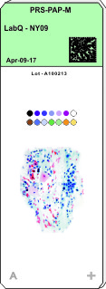
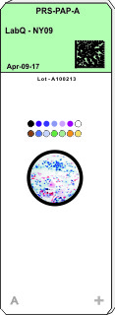
PRS-PAP Slide
We have also extended the PRS-H&E to support Pap smears
Notes:
PRS-PAP Slide
Both manual and automated Pap Smear slides support the market needs
There are gradient density arrays for the Hematoxylin
Coating is moderately hydrophilic with 3d conformal ability that excels in loose cell capture

Slide 33
Development of a 5th Generation IHC Stainer with Integrated Antigen Retrieval
Using the primitives of the PRS to make test slides
  We have characterized all the current IHC stainers
  Created critical path models of each system
  Supports observation and measurement to take place
  Used this in the development of our slide coating adhesives
This led to our stainer technology that is much easier on the tissue section
The first model is all manual and low cost to support use with field clinics and medical students. It supports IHC and H&E staining.
The second model supports the demand for Stat processing
Notes:
Development of a 5th generation IHC stainer with integrated antigen retrieval
The experience obtained developing the PRS has allowed us to develop better solutions, simply because we could objectively test them
Thus, we have made the critical path models of each stainer technology that incorporate observation and measurement to take place
These models were used to characterize the existing coated slides and test our slides
A unique low stress antigen retrieval solution has been developed
A better capillary gap technology has been developed
Our first stainer is all manual and low cost to support use with field clinics and medical students: IHC & H&E
The second model supports STAT processing for IHC

Slide 34
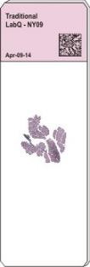
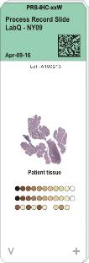

PRS: Use The Right Tool
For The Right Job In The Right Way
Subjective Result
Objective Result
Notes:
PRS: Use the right tool for the right job in the right way
Now that there is the right tool for the job when will you move forward to embrace the PRS
Hey Guys…
How many here have made the transition to the smart phone?
Would you go back to the rotary phone land line again?
Consider making the same change between phones you have already done
with the adoption of the PRS

Slide 35
The PRS technology enables many divergent applications to become realized for the medical and R&D arenas.
The present Pathology QC applications address the only remaining area in medical diagnostics not covered with process controls and standards.
Notes:
The PRS technology enables many divergent applications to become realized for the medical and R&D arenas.
The present Pathology QC applications address the only remaining area in medical diagnostics not covered with process controls and standards.

Slide 36
The PRS technology can also be used in process control, clinical studies, and R&D testing of new drugs opening new pathways for repeatable and objective analysis.
Additional derivatives from the PRS development will be forthcoming in the near future to continue the goals of better diagnostic support tools.
Bringing the PRS into commercial reality will significantly improve global health through objective diagnostic efficacy.
Notes:
The PRS technology can also be used in process control, clinical studies, and R&D testing of new drugs opening new pathways for repeatable and objective analysis.
Additional derivatives from the PRS development will be forthcoming in the near future to continue the goals of better diagnostic support tools.
Bringing the PRS into commercial reality will significantly improve global health through objective diagnostic efficacy.

Slide 37
Thank You For Your Interest and Attention
You can find more information on our web site
www.IHC-PRS.com
Notes:
Thank You For Your Interest and Attention
You can find more information on our web site

