Slide 1

Vaccine Development at Animal Biosafety Level Four: Standards and Challenges
Jean L. Patterson, Ph.D.
Chair, Department of Virology and Immunology
Texas Biomed BSL4 PIs: Ricardo Carrion, Jr., Ph.D.
Robert Davey, Ph.D.
Anthony Griffiths, Ph.D.
Andrew Hayhurst, Ph.D.
Luis Giavedoni, Ph.D.

Slide 2

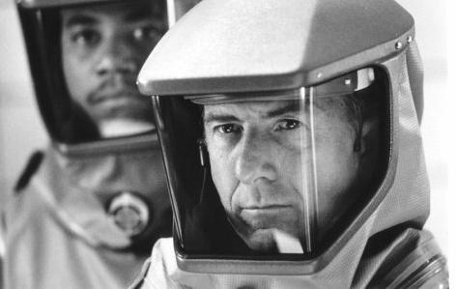

Select Agent Research

Slide 3
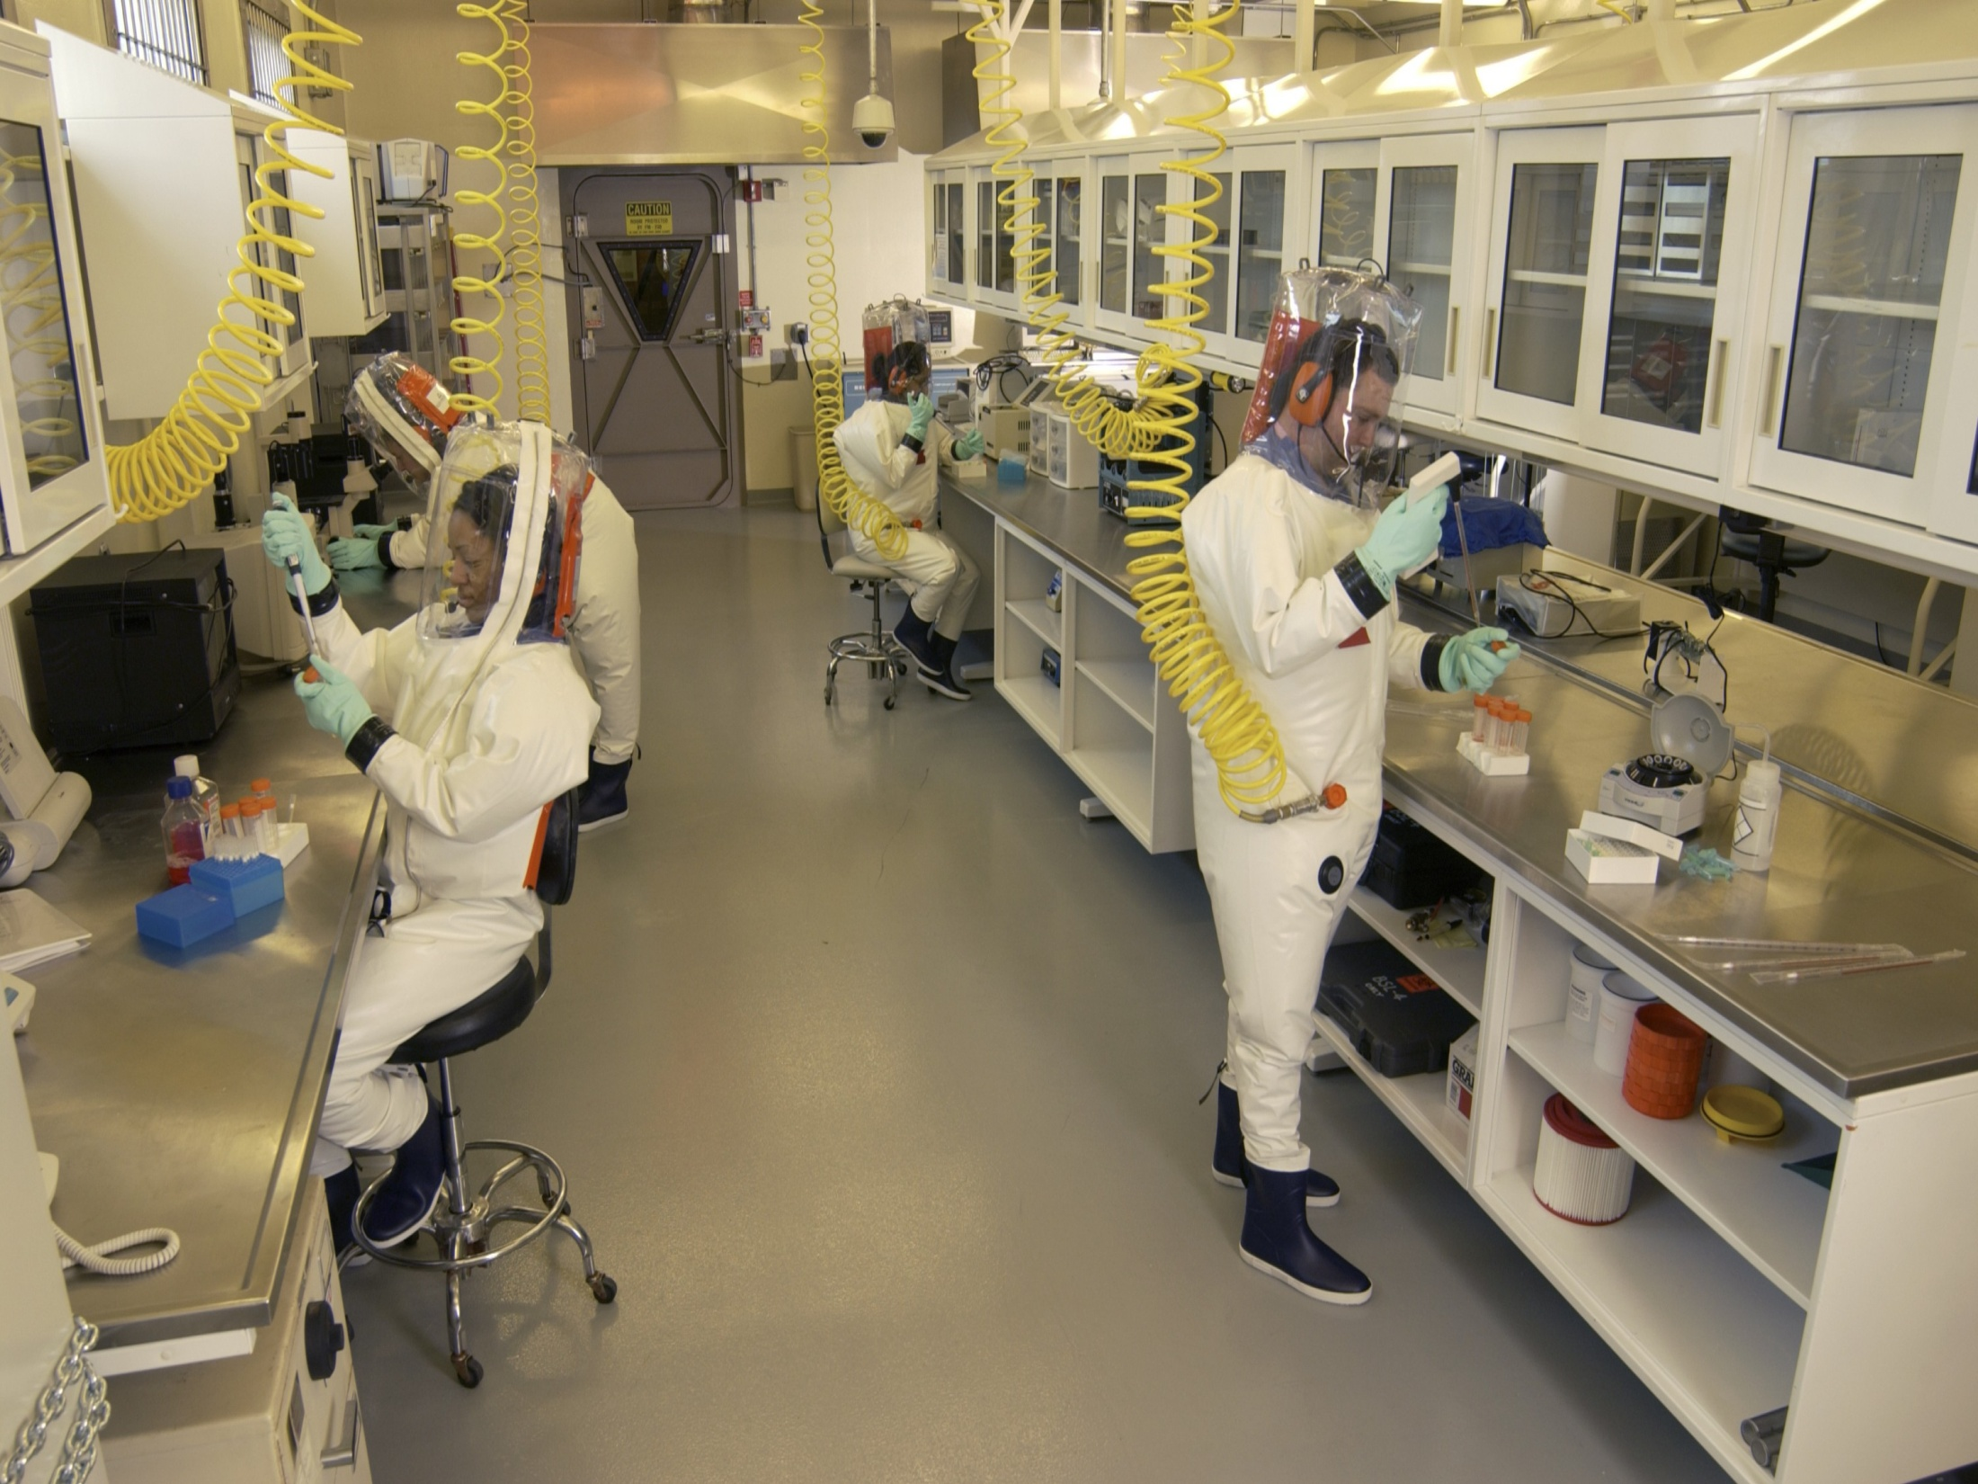

Slide 4
Texas Biomed ABSL-4 Layout
Biobubble
Duo Flow
Cbc/chem
Procedure Room
Blood Coll
Duo Flow
Rodent Rack
Nec
-80*C
freezer
Incubator
Bench Top
centrifuge
Duo Flow
-80*C
freezer
4*C
fridge
Duo Flow
Freezer
-80
-80*C
freezer
LN2
Sink
Incubator
Incubator
cryo
BSC
BSC
BSC
Dunk
Tank
Autoclave

Slide 5
Telemetry in filovirus infected nhps

Slide 6
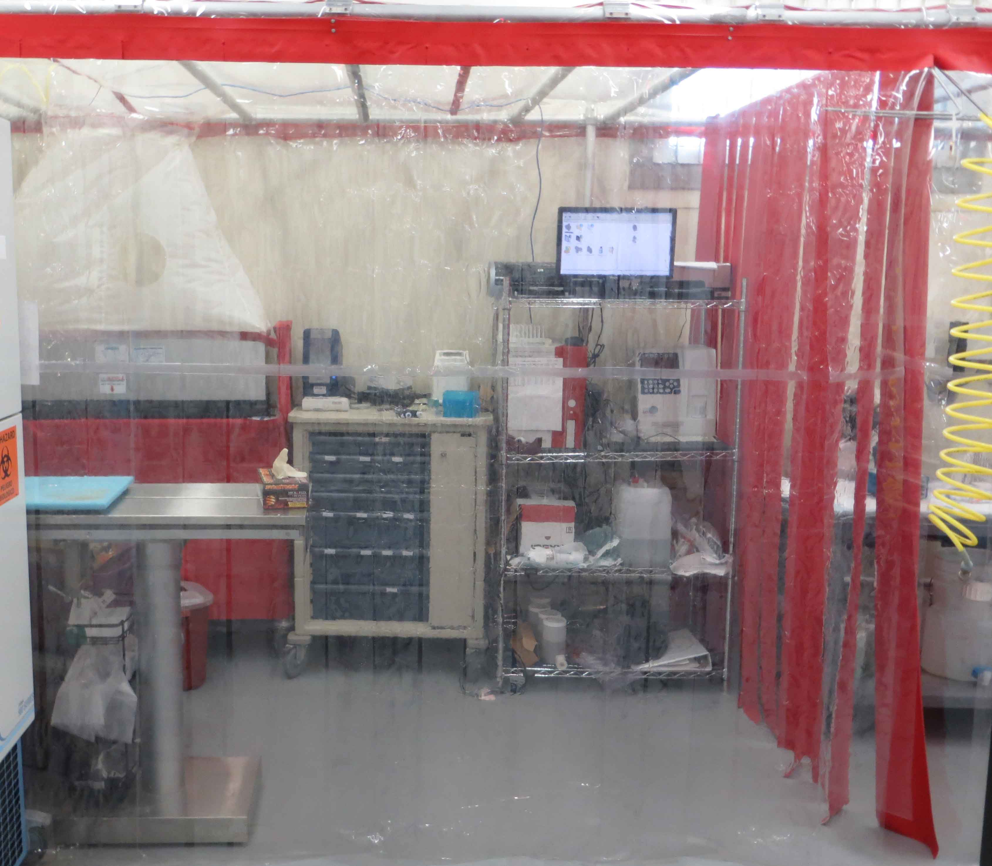
Biobubble: Procedure Area
Macaques and
Marmosets
Inoculation NHPs
Blood Collection
Blood Analysis
Necropsy
Air Line drops
Clear vinyl allows
for appropriate
lighting
Certified annually

Slide 7
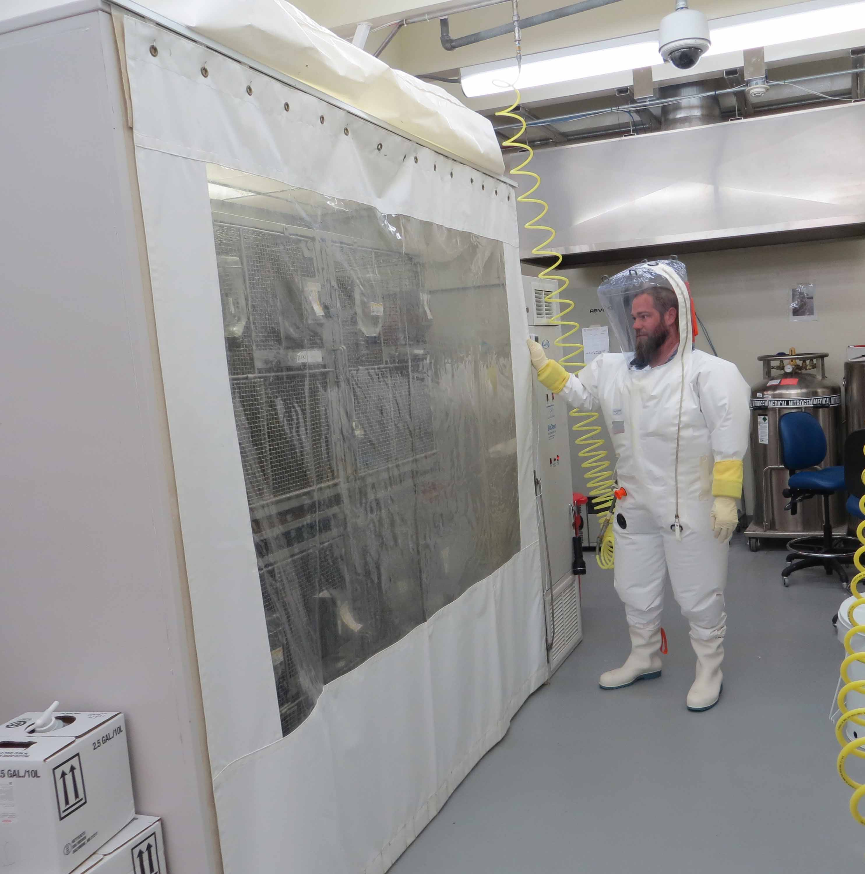
Duo Flow: NHP Housing
Macaques=4
Marmosets=6
Consistent
environmental
conditions
Light levels not affected
by duo flow, additional
lighting in ceiling of unit

Slide 8
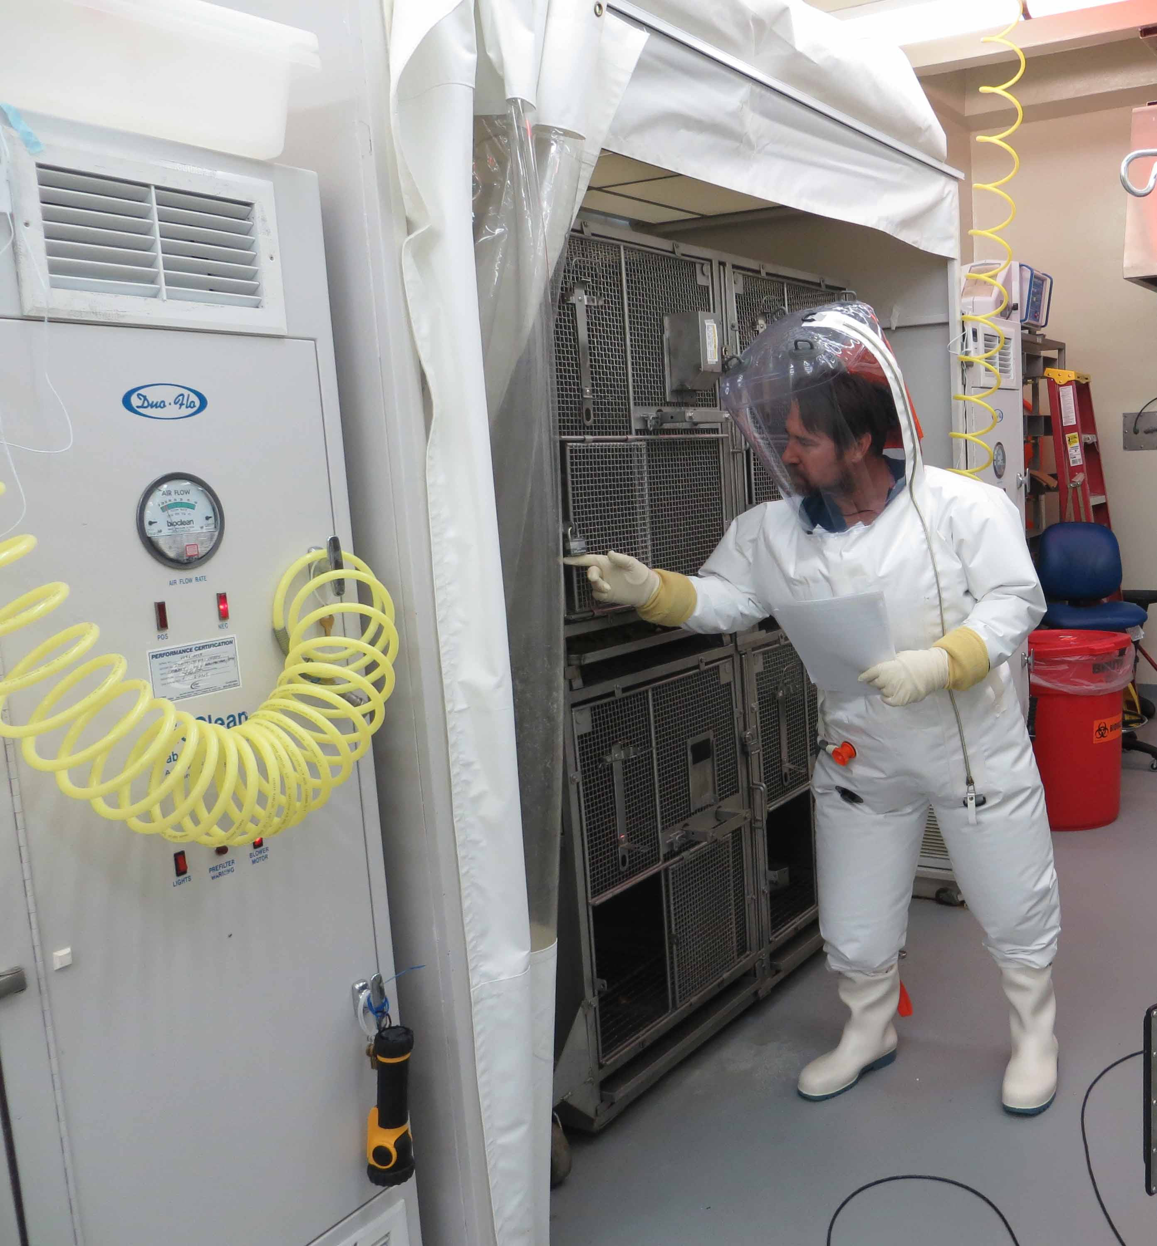
Duo Flow: NHP Housing
Easy access to NHPs
Sedation of NHPs via
squeeze mechanism
Additional PPE used
Air changes and light levels
Compatible with
“the guide”

Slide 9
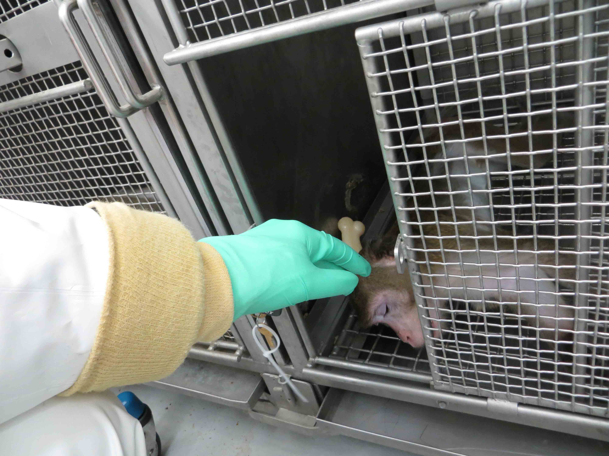
Duo Flow: NHP Housing
Sedated NHPs
PPE worn
Easy access to
NHPs
Permits dry
husbandry

Slide 10
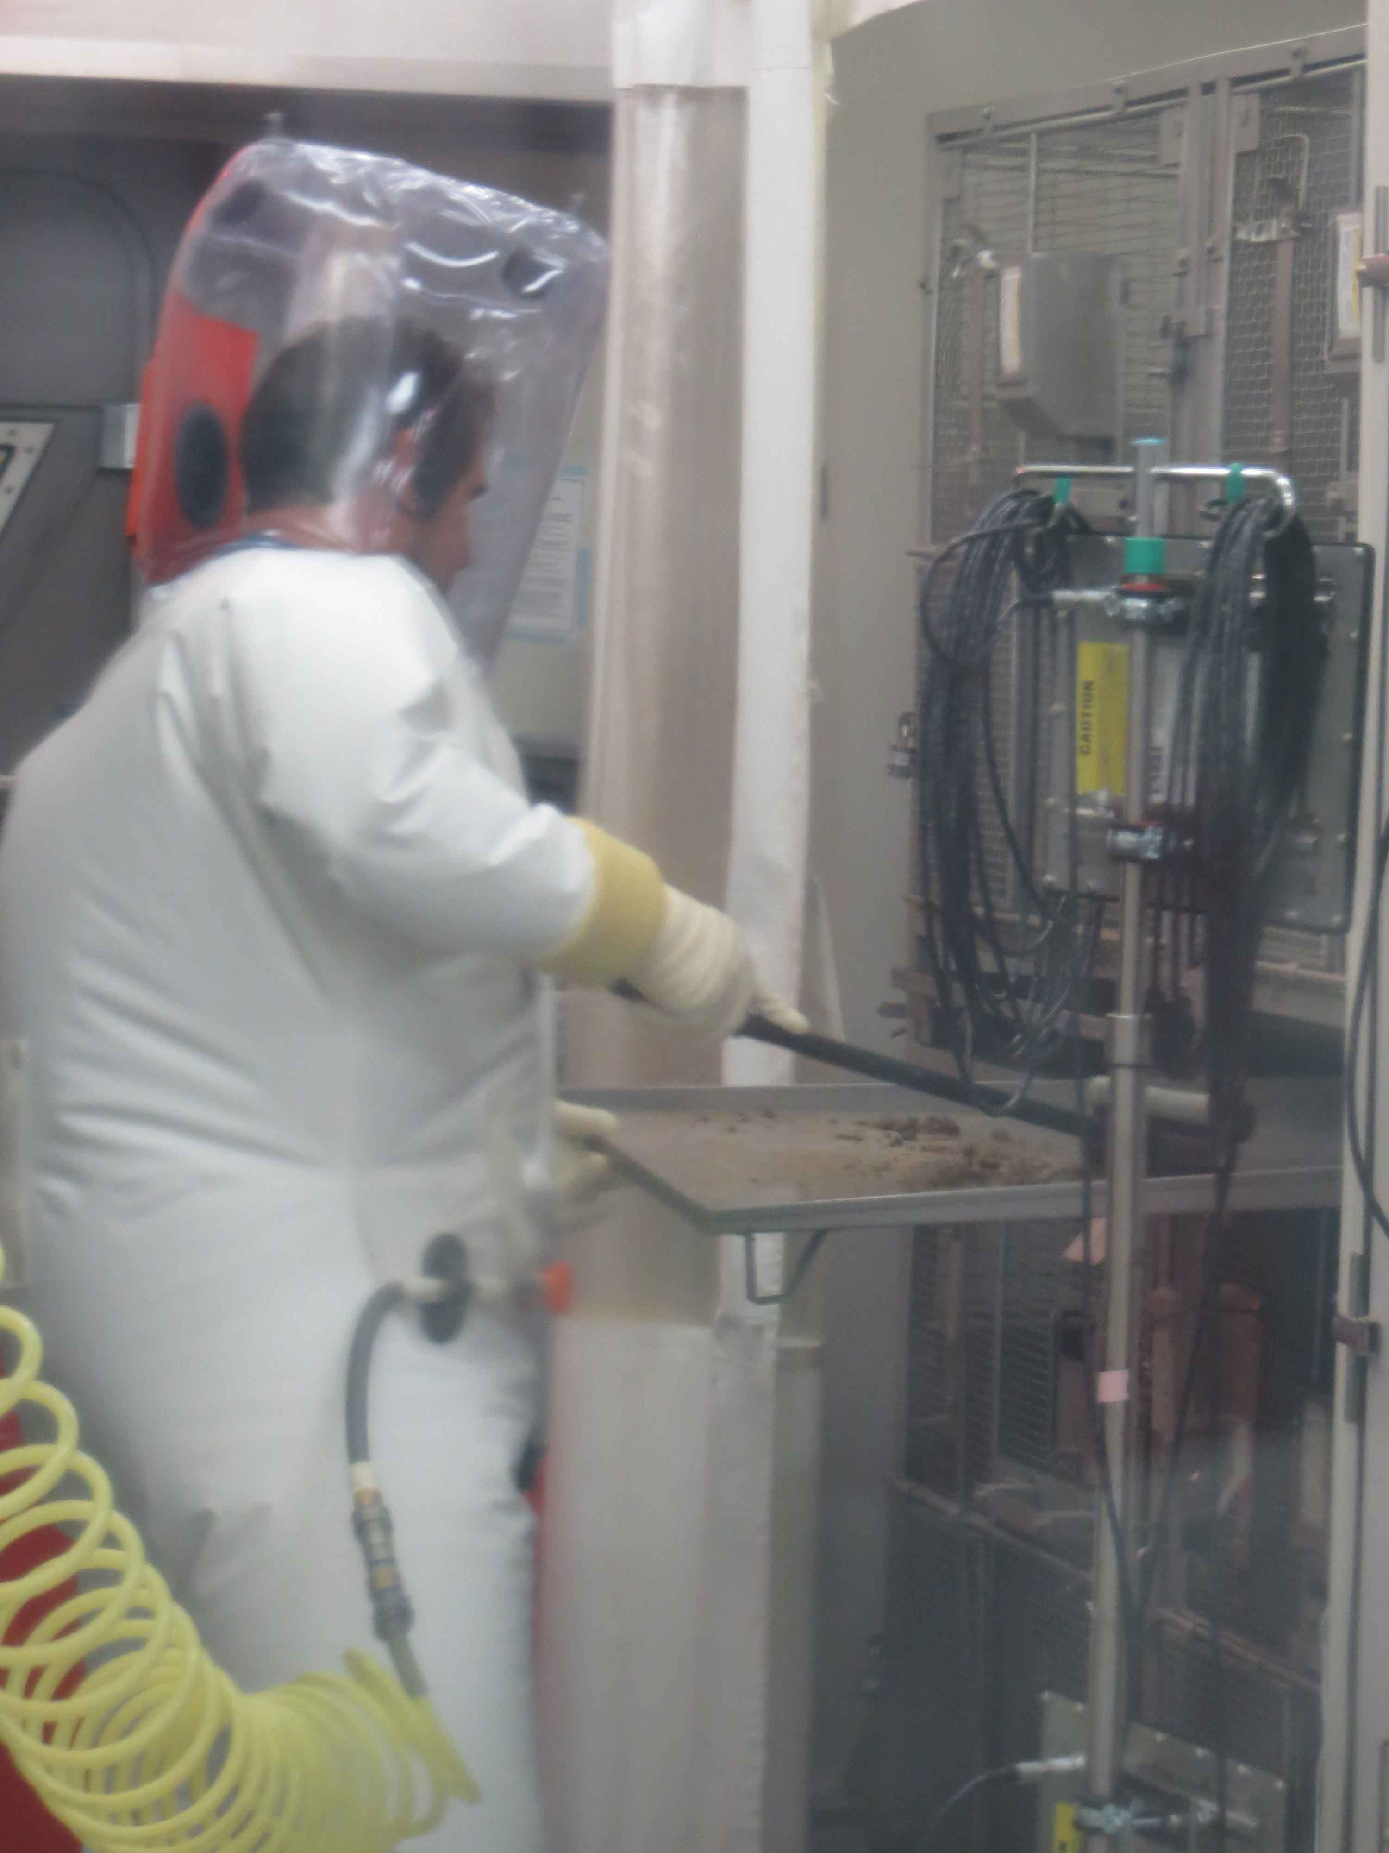
Duo Flow and Dry Husbandry
Dry Husbandry easily
performed
Minimized potential
for aerosols

Slide 11
Institutional Official/CEO
Quality
Agreements
Study Protocol
IACUC
Animal Rule
Studies
SNPRC
Vet
V&I
Attending Veterinarian
ACURO
Sponsor Audits
NIH/DOD
AUDITS
SNPRC/Vet Resources
Sponsor Audits
BSL-4 Vet Group
Suitability
Program
CDC/USDA
SA Inspections

Slide 13
Euthanasia
If total score is >15, animal is considered "terminally ill" and should be euthanized. Exceptions require consultation and approval by study veterinarian.
Additional Euthanasia criteria: Humanely euthanize the animals as soon as any of the following:
  1) Prostrate but able to rise if stimulated, moderate to dramatically reduced response to external stimuli with greater than 5 degree change from baseline or
  2) Prostrate but able to rise if stimulated, moderate to dramatically reduced response to external stimuli and if any two of the following are true: ALT >200; ALP>1100; GGT>170; the veterinarian will approve all euthanasia

Slide 14
Observation Frequency
Animals will be observed twice daily when animals score less than 4, if animals score 4 to 8 animals will be observed three times a day.
Observations will be increased to 4 times a day, 6 hours apart if any of the following is true:
  An animal scores 8 or greater during clinical observation
  Analgesic treatment is initiated
Once an animal is euthanized due to morbidity, 4 times daily observations as described above will continue for three consecutive days for the remaining animals in the challenge cohort or until all surviving animals score 0.

Slide 15





The Animal Rule
“New Drug and Biological Drug Products: Evidence Needed to Demonstrate Effectiveness of New Drugs When Human Efficacy Studies Are Not Ethical or Feasible”
  21 CFR 601, Subpart H (Biologics)
  21 CFR 314, Subpart I (Drugs)
It is NOT a simplified or expedited development process
Does not apply if approval can be based on efficacy
  standards elsewhere in FDA regulations

Slide 16
The Animal Rule (cont.)
Can be applied to human drugs/biologicals – not devices/diagnostics
To reduce or prevent serious or life threatening conditions caused by exposure to lethal or permanently disabling toxic chemical, biological, radiological, or nuclear substances
Use of animal efficacy data scientifically appropriate.
Animal Rule does NOT address human safety

Slide 17
The Animal Rule (cont.)
Requirements
There is a reasonably well-understood pathophysiological mechanism of the toxicity of the substance and its prevention or substantial reduction by the product
The effect is demonstrated in more than one animal species expected to react with a response predictive for humans, unless the effect is demonstrated in a single animal species that represents a sufficiently well-characterized animal model for predicting the response in humans

Slide 18
The Animal Rule (cont.)
Requirements
The animal study endpoint is clearly related to the desired benefit in humans, generally the enhancement of survival or prevention of major morbidity
The data or information on the pharmacokinetics and pharmacodynamics of the product or other relevant data or information, in animals and humans, allows selection of an effective dose in humans

Slide 19
Ensuring Data Quality and Integrity in Animal Studies
A good guideline – GLP (21 CFR Part 58)
  GLP principles are among examples of quality management systems that will ensure the quality and integrity of data that is the basis for regulatory decision making
  FDA recognizes that not all aspects of GLP will be possible for all
    studies – discuss with your review division
Data quality and integrity are critical in animal efficacy studies as these data are the “surrogates” for the human efficacy studies
  Natural history studies – model defining studies submitted for
    Qualification
Adequate and well-controlled efficacy studies – substantial evidence of effectiveness
Efficacy and PK/PD studies – define the human dose/regimen

Slide 20
Animal Rule (cont.)
Still need human clinical data
  PK/immunogenicity data
  Safety in population(s) representative of use
Approval subject to post-marketing studies
May impose restrictions on use
Please work closely with FDA on planning animal
  studies before starting them
Potential limitations
  Where there is no valid animal model of disease
  How to predictably bridge animal data to humans
  Confidence may be an issue, even in valid models

Slide 21
Risk/Benefit for MCMs
Risk/benefit differs and FDA assesses for each product & potential use
  Treatment: For otherwise untreatable serious illness,
    reasonable to tolerate significant risk & some
    uncertainty
  Prophylaxis: If given to well individuals before event
    or, post-event, to individuals who may not be at risk,
    balance shifts
All such products
  Need transparent, balanced and effective risk
    communication; may be challenging in emergencies

Slide 22
Thanks!
CBER’s CT page: http://www.fda.gov/BiologicsBloodVaccines/SafetyAvailability/ProductSecurity/ucm110311.htm
Manufacturer’s assistance (CBER):
  Phone – (301) 827-2000
  http://www.fda.gov/cber/manufacturer.htm
C. Kelley – (301) 827-0636
  Cynthia.Kelley@fda.hhs.gov
R. Roberts (CDER)– (301) 796-2210
  Rosemary.Roberts@fda.hhs.gov

