Slide 1
Surgery Under Regional Anesthesia
Jean Daniel Eloy, MD
Assistant Professor
Residency Program Director
Rutgers-New Jersey Medical School
Rutgers The State University of New Jersey

Slide 2
Regional Anesthesia
Peripheral Nerve Block
1) Some decrease in Stress Response
2) Decrease in Tumor Recurrence ( Mastectomy)
3) Better Glucose Control
4) Reduced Opiates Used and Requirement

Slide 3
Principles Of Solography
Frequency of medical US: 2MHz –13MHz
Structures >1mm
Nerves are 2mm-10mm

Slide 4
Quality and Resolution of US
High frequency probes: Better Images Resolution
Fat: Low resolution
Angle of Incidence
Gain=Brightness

Slide 5
Brachial Plexus Anatomy

Slide 6
ANATOMY
The Brachial Plexus is made up of anterior primary rami of C5, C6, C7, C8 and T1 with variable contributions from C4 and T2
After leaving their intervertebral foramina these nerves course between the anterior and middle scalene muscles
Between the scalene muscles the nerves unite to form three trunks. The superior (C5, C6,), middle (C7) and inferior (C8 and T1)

Slide 7
Anatomy of the Brachial Plexus

Slide 8
Interscalenene Nerve Block
Principal indication for interscalene block is shoulder surgery
This block is not performed for forearm and hand surgery because the inferior trunk (C8—T1) is often incomplete
Ultrasound guided block technique

Slide 9
Ultrasound Guided Brachial Plexus Block

Slide 10
Ultrasound Guided Brachial Plexus Block

Slide 11
COMPLICATIONS OF INTERSCALENE BLOCKS
Ipsilateral phrenic nerve resulting in diaphragmatic paresis occurs in 100% of patients undergoing interscalene blockade
a)This results in 25% reduction in pulmonary function
b)The phrenic nerve is blocked because of its location overlying the anterior scalene muscle

Slide 12
COMPLICATIONS OF INTERSCALENE BLOCKS
A cervical sympathetic block occurs frequently :
(Horner’s syndrome)
a) miosis
b) anhydrosis
c) ptosis
d) vasodilation
Recurrent laryngeal nerve block can occur resulting in hoarseness

Slide 13
SUPRACLAVICULAR BLOCKS
Is used for upper extremity surgery distal to the level of the shoulder
Is done at level of the trunks dividing into divisions
Has the fastest onset of all brachial plexus blocks because of its compact volume a this location
The incidence of pneumothorax with classical block technique was .5 to 6%

Slide 14
SUPRACLAVICULAR BLOCKS
Using a 22 G needle symptoms is usually delayed. May take up to 24 hrs.
Chest x-ray is not justified
Phrenic nerve block occurs 40 to 60% of the time
Horner’s syndrome is common

Slide 15
Supraclavicular Nerve Block

Slide 16
Supraclavicular Nerve Block

Slide 17
Supraclavicular Nerve Block

Slide 18
Supraclavicular Nerve Block

Slide 19
Supraclavicular Nerve Block

Slide 20
Supraclavicular Nerve Block

Slide 21
Supraclavicular Nerve Block

Slide 22
Supraclavicular Nerve Block

Slide 23
Infraclavicular Nerve Block
Provides anesthesia for any procedure below the level of shoulder
Blockade occurs at the level of the cords
Offers the theoretical advantage of avoiding pneumothorax while blocking the musculocutaneous when it is still in the plexus
Technique for performing block:
a) nerve stimulator
b) ultrasound guided
Complications are rare

Slide 24
INFRACLAVICULAR BLOCK

Slide 25
INFRACLAVICULAR BLOCK

Slide 26
Axillary Nerve Block
Axillary can be used for any surgery distal to the elbow
The block occurs at the level of the terminal nerves
Techniques for axillary block
a) trans arterial technique
b) nerve stimulator technique
c) ultrasound
The musculocutaneous nerve is not in the axillary sheath and must be blocked separately
a) it innervates biceps and coracobrachialis muscle
b) below the level of the elbow it innervates the skin on the lateral part of the forearm down to the base of the thumb

Slide 27
Axillary Nerve Block
c) the musculocutaneous nerve lies in the body of the coracobrachialis muscle which is deep and lateral to the axillary artery
d) the intercostobrachial nerve is often blocked at this level by injecting a subcutaneous wheal of local anesthetic 2 cm above and below the axillary artery
Complications are rare

Slide 28
Nerve Anatomy

Slide 29
Axillary Block

Slide 30
AXILLARY BLOCK

Slide 31
ANATOMY LOWER EXTREMITY BLOCKS
The nerve supply to the lower extremity is derived from the lumbar and sacral plexuses
The lumbar plexus is formed by the anterior rami of first four lumbar nerves and variable contributions from T12 and L5.
The plexus lies between the psoas major and quadratus lumborum muscles in what is called the psoas compartment
The lumbar plexus gives rise to the lateral femoral cutaneous, femoral and obdurate nerves
The sacral plexus is derived from the first, second, and third sacral nerves and the anterior rami of L4 and L5

Slide 32
ANATOMY LOWER EXTREMITY BLOCKS (cont.)
The sacral plexus gives rise to the posterior cutaneous nerve of the thigh and the sciatic nerve
The sciatic nerve passes down through the pelvis and greater sciatic foramen. It travels down the back k of the thigh to the popliteal fossa where it separates into the tibia and common peronei nerves

Slide 33
PSOAS COMPARTMENT BLOCK
Psoas compartment used for postoperative analgesia for patients undergoing major knee and hip surgery
Offers a simple injection technique for blocking femoral, obdurate and lateral femoral cutaneous nerves
Techniques:
a) locate L4 by drawing a line that connects the iliac crest
b) 10 cm insulated needle is inserted 4 cm lateral to the midline of spinouts process for L4 on the side to be blocked

Slide 34
PSOAS COMPARTMENT BLOCK (cont.)
c) Insert the needle perpendicular to the skin until a quadriceps response is obtained
e) Inject 30ml of local anesthetic
Complications:
a) epidural injection or spread
b) Subarachnoid
c) vascular injection

Slide 35
PSOAS COMPARTMENT BLOCK

Slide 36
PSOAS COMPARTMENT BLOCK

Slide 37
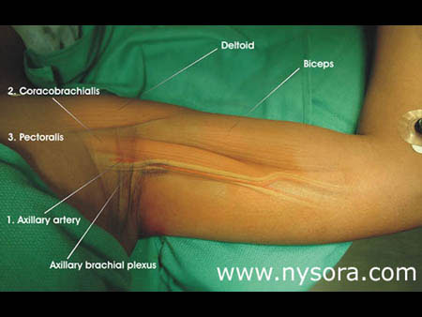
PSOAS COMPARTMENT BLOCK

Slide 38
PSOAS COMPARTMENT BLOCK

Slide 39
PSOAS COMPARTMENT BLOCK

Slide 40
ANTERIOR PSOAS COMPARTMENT BLOCK
Assumes that the facial sheath that surrounds the lumbar roots extends into the femoral canal and acts as an enclosed conduit for the spread of local anesthetic.
Work in the minority of cases even when large volumes of local anesthetic are used
Reliable and provides anesthesia for the femoral and lateral femoral cutaneous nerves

Slide 41
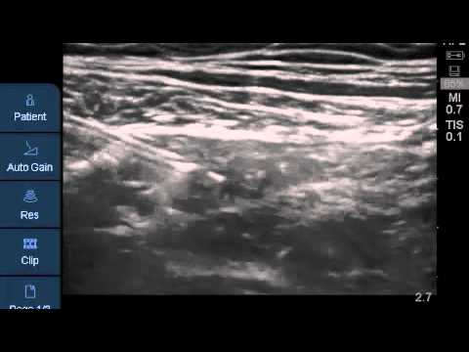
Fascia Iliaca Block

Slide 42
FEMORAL NERVE BLOCKS
Used for postoperative analgesia for knee surgery
Technique :
a) ultrasound stimulator
b) nerve stimulator
1) lateral to medial
nerve to artery to vein
2) insert insulated needle 1 cm lateral to femoral artery

Slide 43
FEMORAL NERVE BLOCKS
Look for patellar movement to make sure the main part of the femoral nerve is being stimulated
Complications are usually rare
The terminal branch of femoral nerve becomes the saphenous nerve

Slide 44
FEMORAL NERVE BLOCKS

Slide 45
FEMORAL NERVE BLOCKS

Slide 46
SCIATIC NERVE BLOCK
Can be used for any surgery below the knee when combined with a saphenous nerve block
Technique:
a) Ultrasound
b) Nerve Stimulator
1) Lateral position, with leg to be blocked rolled forward onto the flex knee as the heel rests on the dependent knee
2) A line is drawn to connect the posterior superior iliac spine to the greater trochanter
3) A perpendicular line is drawn bisecting this line and extending caudad
4) A second line is drawn from the greater trochanter to the sacral hiatus
5) Where the bisecting intersects this second line is the point of needle entry
Complications--Rare

Slide 47
SCIATIC NERVE BLOCK

Slide 48
SCIATIC NERVE BLOCK

Slide 49
SCIATIC NERVE BLOCK

Slide 50
SCIATIC NERVE BLOCK

Slide 51
SCIATIC NERVE BLOCK

Slide 52
SCIATIC NERVE BLOCK

Slide 53
POPLITEAL FOSSA BLOCK
Clinical application-foot and ankle surgery when combined with saphenous nerve block
This is a sciatic nerve block in the proximal part of the popliteal fossa before it divides into the tibia and common peronei nerves
Techniques:
a) Ultrasound
b) Nerve Stimulator
1) Outline the borders of the popliteal fossa

Slide 54
POPLITEAL FOSSA BLOCK
medial border- semimembranosus and semitendinosus
lateral border- biceps femoris
caudad border- crease formed by gastrocnemius muscles
2) Draw a line bisecting the fossa from the apex to the base
3) Mark a point at least 7 cm proximal to the base

Slide 55
POPLITEAL FOSSA BLOCK
4) Mark an injection point 1 cm lateral to this point
5) Insert stimulating needle (plantar flexion, tibia nerve stimulation provides more reliable block)
Complications- Rare

Slide 56
POPLITEAL FOSSA BLOCK

Slide 57
POPLITEAL FOSSA BLOCK

Slide 58
POPLITEAL FOSSA BLOCK

Slide 59
ANKLE BLOCKS
Provides surgical anesthesia to the foot not requiring a tourniquet
Four of five nerves are terminal branches of the sciatic nerve. The saphenous nerve is the terminal branch of the femoral nerve
Ankle block consists of two deep nerves below superficial facial (posterior tibia and deep peronei) and three superficial nerve above the superficial facial (surah, saphenous and superficial peronei)

Slide 60
ANKLE BLOCKS

Slide 61
ANKLE BLOCKS
Deep blocks can be performed with ultrasound guidance
Deep peronei nerve:
a) Provides anesthesia between the first and second toes
b) it is located between the extensor halluces long us and the exterior digit rum long us

Slide 62
ANKLE BLOCKS

Slide 63
ANKLE BLOCKS

Slide 64
ANKLE BLOCKS

Slide 65
ANKLE BLOCKS

Slide 66
ANKLE BLOCKS

Slide 67
PARAVERTEBRAL BLOCK
Clinical applications: post-thoracotomy and post-mastectomy pain
Paravertebral blockade occurs as the spinal nerves emerge from the vertebral foramina.
This results in somatic and sympathetic block of multiple contiguous thoracic dermatomes above and below the injection site

Slide 68
PARAVERTEBRAL BLOCK
Techniques:
a) Thoracic region
1) the spinouts processes are identified
2) a needle is inserted 2.5 to 3 cm lateral to the most cephalic aspect of the spinouts process and advanced perpendicular to the skin
3) the vertebral transverse process of the level below is contacted at 2 to 4 cm

Slide 69
PARAVERTEBRAL BLOCK
4) The transverse process is walked off in a cephalic direction and advanced until a loss of resistance is obtained (about 1 to 1.5 cm)
5) 15 ml of local results four or five dermatomes spread
b) Lumbar region;
1) Lines drawn across the cephalic edge of the spinouts processes

Slide 70
PARAVERTEBRAL BLOCK
2) 3 cm lateral along these lines a needle is advances perpendicular to the skin until the homologous transverse processes are contacted (about 3 to 5 cm)
3) Walk off the caudal edge of the transverse processes and insert needle and additional 1 to 2 cm
4) 6 to 10 ml of local in injected
5) Complications—Epidural or subarachnoid injections, intravascular injections, plural puncture, pneumothorax

Slide 71
PARAVERTEBRAL BLOCK

Slide 72
PARAVERTEBRAL BLOCK

Slide 73
PARAVERTEBRAL BLOCK

Slide 74
PARAVERTEBRAL BLOCK

Slide 75
Transverses Abdominals Plan Block
Regional anesthetic technique used to block sensation to the anterior abdominal wall.
Provides anesthesia and analgesia coverage from T9 to T11 dermatomes
Great for Appendectomies, ventral and inguinal hernia repairs as well as open gastrostomy tube insertion.

Slide 76
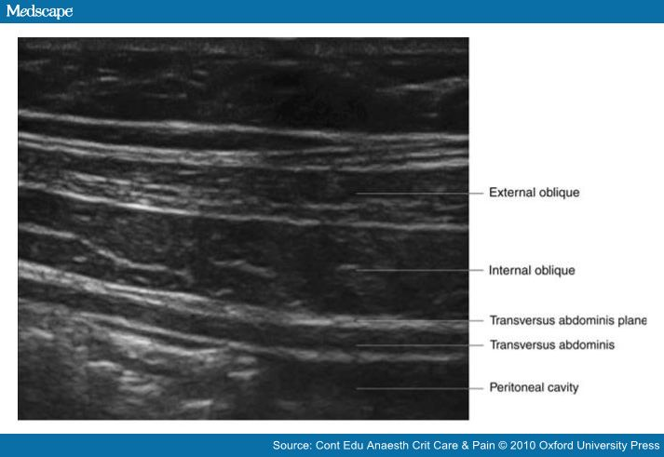
Transverses Abdominals Plan Block

