Slide 1
Harnessing the power of Infectious disease information with a relational database

Slide 2
Presenter Disclosures
I developed “IDdx: Infectious Disease Queries” which is currently a free download from Apple Store (iPhone or iPad) and Google Play (Android phone).

Slide 3
Presented by
Jay A. Brown, MD, MPH
Consultant for the U.S.
National Library of Medicine

Slide 4
Using infectious disease information is an important priority in global public health.

Slide 5
Medical Surveillance and Prevention
Disseminate
On the Internet
Control & Prevent
Collect Data
Analyze & Interpret
Index & Map
Notes:
And how do we improve medical practice and prevention? By feedback. With iteration, we get closer and closer to the desired result, which is the prevention of infectious diseases. Collaboration between medical and public health professionals can establish effective case definitions to identify and prevent infectious diseases.

Slide 6
About one half of all deaths in developing countries are caused by infectious diseases.
Notes:
In 2008, David L. Heymann, MD, editor of Control of Communicable Diseases Manual, stated in the preface that, “At the time of writing, approximately 46% of all deaths in low-income countries are due to communicable diseases.”

Slide 7
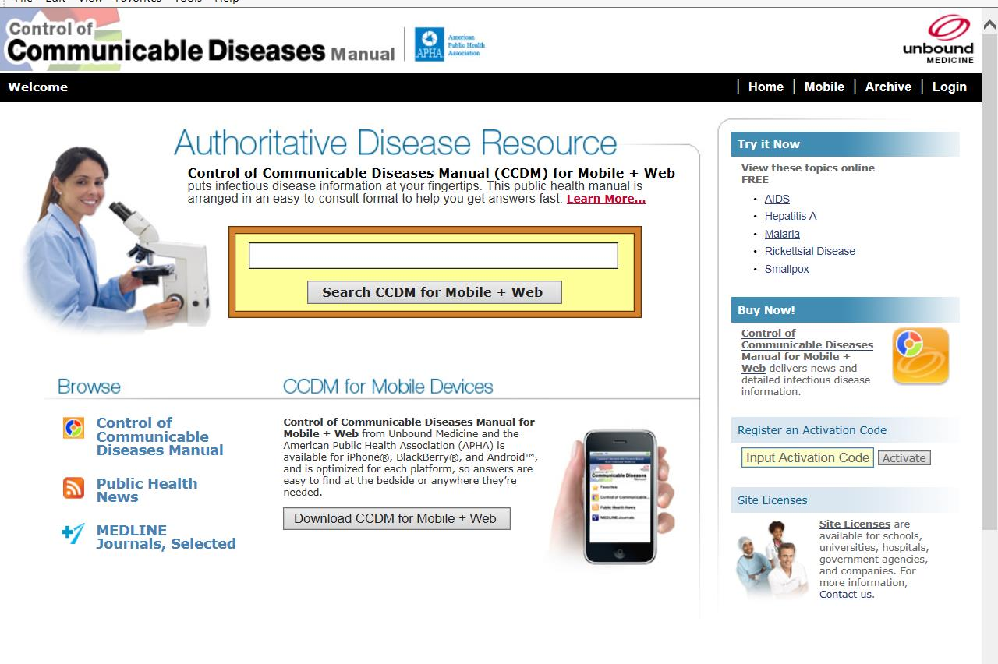
Notes:
There are online and iPad versions of Control of Communicable Diseases Manual. The book can be searched. For example, a search for “jaundice” finds 19 hits in 17 different infectious diseases.

Slide 8
Infectious diseases are no longer confined by geographical boundaries.
Notes:
This is because human beings are constantly traveling around the globe.

Slide 9
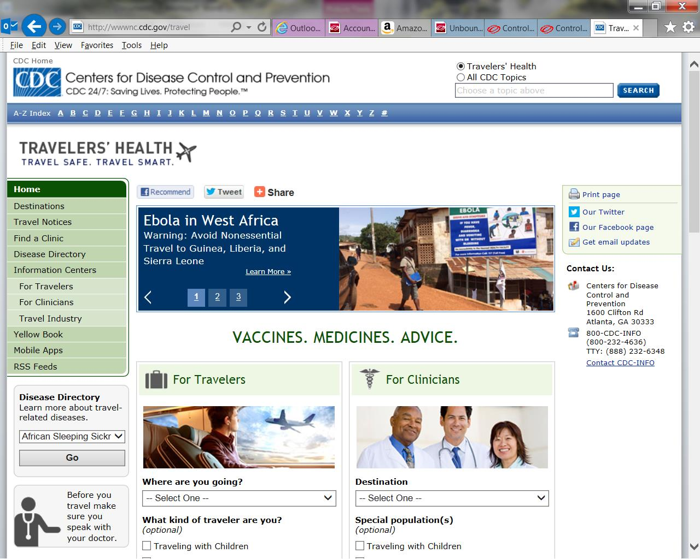
Notes:
More and more, we are affected by infectious diseases that are not endemic to the places where we live.

Slide 10
An outbreak of SARS in China can become an outbreak in Toronto a few days later.

Slide 11
A vast treasury of infectious disease knowledge has been discovered in the last 150 years
Notes:
This is sometimes referred to as an “explosion of knowledge.”

Slide 12
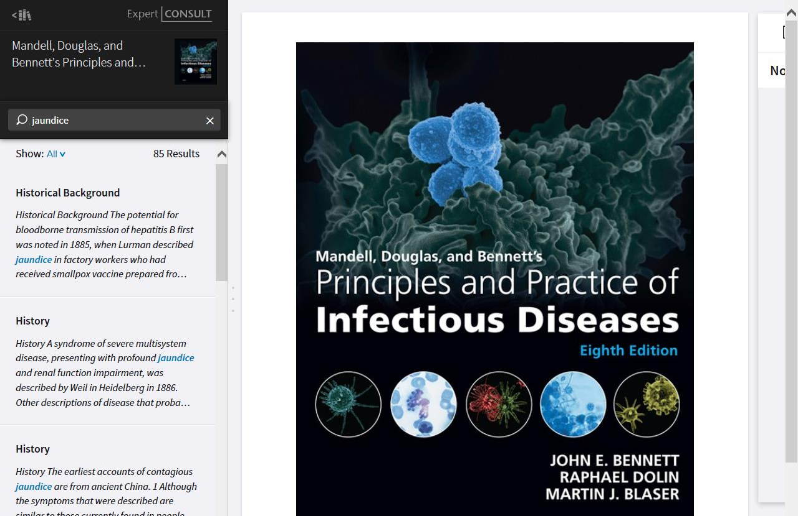
Notes:
Searching the online version of Principles and Practice of Infectious Diseases for “jaundice” finds 85 results. Searching online books of infectious diseases is very useful in defining the findings (signs & symptoms) for each disease in the database. Other books that were searched to confirm the findings in the IDdx database include Infectious Diseases (Cohen), Tropical Infectious Diseases (Guerrant), The Merck Manual, and Cecil Medicine (Cecil).

Slide 13
This knowledge, summarized in Control of Communicable Diseases Manual, includes signs & symptoms, diagnostic tests, geographical occurrence, mode of transmission, incubation period, and risk factors.
Notes:
Most of these facts have been discovered in the last 150 years.

Slide 14
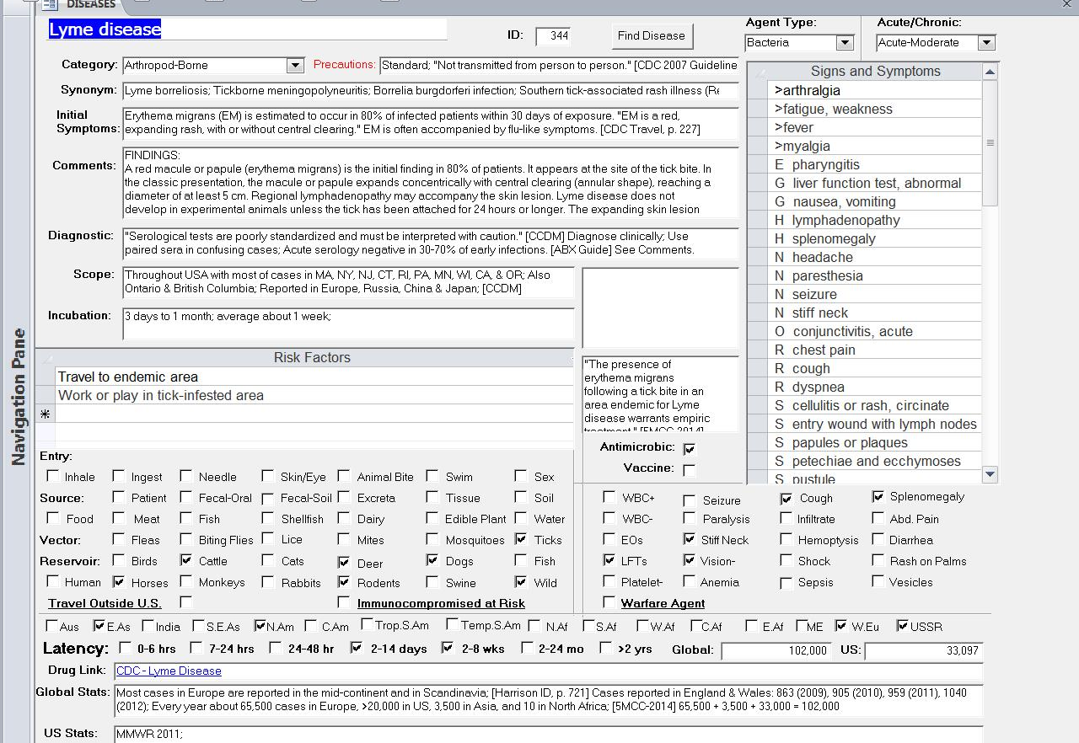
Notes:
The IDdx database was developed and is updated in Microsoft Access. This is a screenshot of the disease form, showing the profile for Lyme disease. Each of the 249 diseases in the database can be viewed and revised in this form, which links three tables: diseases, findings, and high-risk job tasks.

Slide 15
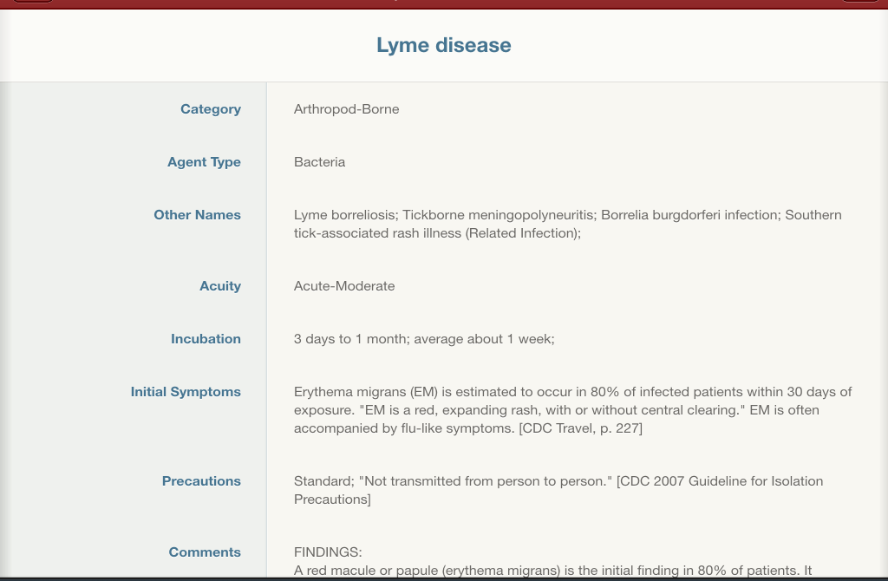
Notes:
This is a screenshot of the Lyme disease profile in the iPad version of IDdx.

Slide 16
With the current availability of fast hand-held computers, the Internet, and easy-to-use relational database software, the stage is set for the eradication or control of many infectious diseases that have ravaged mankind for thousands of years.

Slide 17
“. . . some diseases are close to being eliminated or eradicated completely, among them poliomyelitis, leprosy, neonatal tetanus, guinea-worm infection and Chagas disease." [WHO]
Notes:
This is a statement from the World Health Organization website.

Slide 18
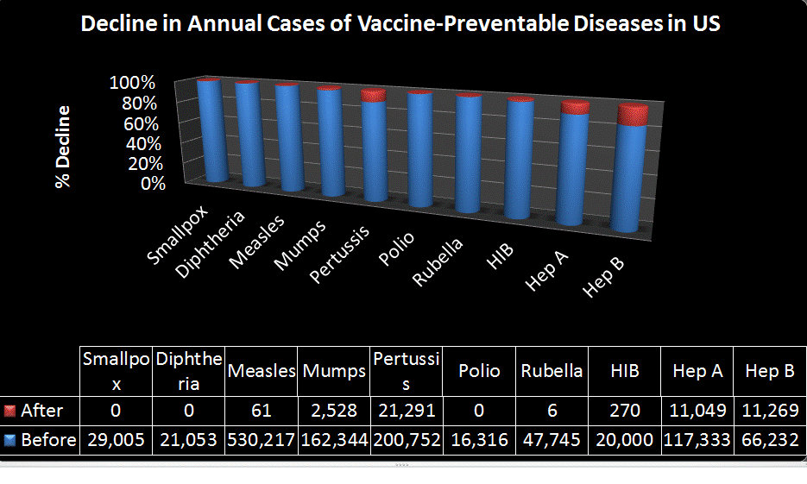
Notes:
After national vaccine programs, the annual cases in the United States dropped to zero or close to that for smallpox, diphtheria, measles, polio, rubella, and Haemophilis influenzae type B. The graph is based on Table 4-2 in Harrison’s Infectious Diseases, 2nd Edition.

Slide 19
A properly designed and updated relational database of infectious diseases can serve as a decision-support tool for physicians and other healthcare professionals.

Slide 20

Notes:
Decision support, not decision replacement: Air Force pilots are taught situation awareness; they use data collected and displayed by machines to make better decisions.

Slide 21
Information can be instantaneously updated for frontline doctors, who can query the database for all diseases that match specific symptoms, an occupation, a region of the world, or an insect vector.
Notes:
The content in the IDdx App can be electronically updated every day that new information becomes available. The user is not required to manually update the app to get these updates.

Slide 22
The results of a query become a differential diagnosis list based on the criteria of the query.

Slide 23
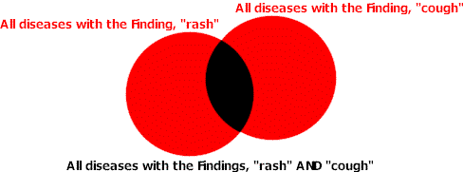
How “AND” Queries Work
Notes:
Relational databases use the logic of Venn diagrams.

Slide 24
For example, the user can find that 7 of 249 diseases match the criteria of "jaundice" and "ticks."

Slide 25
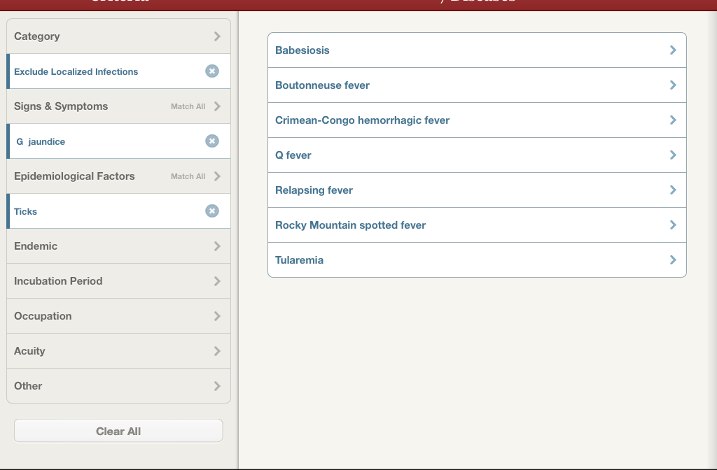
Notes:
This screenshot of the iPad interface shows the 7 diseases that match the criteria of “ticks” and “jaundice.”

Slide 26
In summary, all useful infectious disease information can be collected and indexed into a relational database to help practitioners quickly build differential diagnoses and find details about specific diseases.

Slide 27
Some Examples of Search Criteria for Zoom-Intersection
FINDINGS | ENTRY | VECTOR | RESERVOIR
Abdominal pain | Inhale | Biting flies | Birds
Encephalitis | Ingest | Fleas | Cats
Pneumonia | Animal bite | Lice | Cattle
Jaundice | Needle | Mosquitoes | Dogs
Stiff Neck | Sexual | Ticks | Fish
Notes:
This final slide illustrates the concept of zoom-intersection. The goal is to narrow down the list of infectious diseases using clues from the patient’s history or physical exam. General symptoms like fever or fatigue or not very useful because they are so common.

Slide 28
APPENDIX

Slide 29
Medical Informatics Problem
There is an explosion of information about infectious diseases.
How can we find the specific information we need when we need it?

Slide 30
Public Health Informatics Solution
Use available technology.
Index and map the wealth of information.
Create an intelligent database to store the information in such a way that specific information can be easily retrieved.
Use the Internet and mobile Apps to disseminate the information for improvement of medical practice and prevention.

Slide 31
Relational Database: A New Tool for Indexing and Mapping Information
Like a company database of employees, customers, products, and invoices, information is stored in tables that are linked together.
Indexing is done first by developing a controlled vocabulary specific for the knowledge domain.
Queries allow finding information by search criteria (the indexes) including “OR” and “AND” searches.
Categories are used to “drill down” to find information.

Slide 32
Indexing: At the Heart of Intelligence
“Indexing is a major problem at the heart of intelligence.” [Roger Schank. Tell Me a Story, p. 11]
“No intelligent system is likely to function effectively if it cannot find what it knows when it needs to know it.” [Schank, p. 112]
Show all diseases that match one or more criteria:
  Central Africa AND petechial rash;
  Cat contact AND diarrhea;
  Tick exposure AND anemia;

Slide 33
Indexes Used in IDdx
  Signs and Symptoms
  Endemic Regions of the World
  Epidemiological Factors
    Entry
    Source
    Vector
    Reservoir
  Occupations
  Incubation Periods

Slide 34
Sources of Information
Best and most recent;
Starting point is latest edition of Control of Communicable Diseases Manual (CCDM);
Now available for full-text online access are CCDM, Principles and Practice of Infectious Diseases (PPID), Infectious Diseases (Cohen), and Tropical Infectious Diseases (Guerrant);
Disease findings in IDdx were checked by doing text searches for each finding in each of the online books.

Slide 35
References in IDdx
For a full list of all references used in IDdx, see the bibliography page at http://www.iddx.com/bibliography.html

Slide 36
Knowledge Mapping
“Decision support systems can provide preliminary analysis that allows scarce human resources to focus on the key problems while ignoring a vast sea of irrelevancy.” [O’Carroll et al. 2003]
Knowledge is information in context.
Mapping means pulling together and sifting information from a lot of different sources.
Knowledge mapping is comprehensively collecting and systematically indexing a knowledge domain.
Notes:
The need for knowledge mapping is great because there is so much information about infectious diseases.

Slide 37
Knowledge Mapping
Begins with the big picture;
Helps one not to get lost in the details;
Keeps all information in context of the whole;
Distills the facts from the vast sea of data;
Most useful in information-intensive specialties;

Slide 38
Categories of Findings
Prefix | Finding Category | Prefix | Finding Category
> | General | O | Ophthalmologic
C | Cardiovascular | R | Respiratory
E | Ears, Nose & Throat | S | Skin
G | Gastrointestinal | U | Genitourinary
H | Hematologic | X | Chest X-ray
M | Musculoskeletal | * | Complication

Slide 39
Four Major Tables in the Database
Findings
Diseases
Job Tasks
Jobs
Notes:
This shows the relationships between tables in an intelligent database of infectious diseases. The first step in building the content was to list and define the most important infectious diseases. Next, each disease was linked to one or more hazardous job task. In documented cases, what was the worker doing that caused the exposure to a sufficient dose that led to the disease? Finally, each job task was linked to the appropriate jobs. In the following slides, we will look at some of the job tasks that link the diseases to the jobs.

Slide 40
Each Table Contains Records
249 Diseases
99 Findings
63 Job Tasks
94 Jobs

Slide 41
Which Diseases Are Covered?
The 249 diseases are very similar to those covered in the latest edition of Control of Communicable Diseases Manual (CCDM).
Each disease is linked to high-risk job tasks (63), signs & symptoms (99), epidemiological factors (39), endemic regions of the world (16), and incubation periods (7).
The main categories of diseases are arthropod-borne, childhood, person-to-person, foodborne, gastroenteritis, localized infections, sapronoses, sexually-transmitted, and zoonoses.

Slide 42
High-Risk Job Tasks and Prevention
Identify high risk groups.
What are the specific job tasks that put workers at risk for the disease?
Each hazardous job task links to one or more disease and one or more jobs.

Slide 43
Examples of Hazardous Job Tasks
Handle infected rodents (bite);
Handle infected rodents (not bite);
Handle dog or cat (bite or scratch);
Have dog or cat contact (fecal-oral);
Handle needles or surgical instruments;
Care for patients (fecal-oral pathogens);
Work in a medical or research lab;
Live together in close quarters;

Slide 44
Examples of Hazardous Job Tasks
Plow or excavate soil in endemic area;
Raise dust of excreta from rodents;
Travel to endemic area;
Work in building infested with fleas;
Work or play in tick-infested area;
For a summary of how jobs relate to infectious diseases through job tasks, see these two pages on the Haz-Map website: Occupational Infections and Skin Infections.

Slide 45
For More Information
See "Using a Relational Database to Index Infectious Disease Information" published in 2010 in the Int. J. Environ. Res. Public Health. The full-text article is available at: www.mdpi.com/1660-4601/7/5/2177/.
See the IDdx website at www.iddx.com.

