Slide 1
About OMICS Group
OMICS Group International is an amalgamation of Open Access publications and worldwide international science conferences and events. Established in the year 2007 with the sole aim of making the information on Sciences and technology ‘Open Access’, OMICS Group publishes 400 online open access scholarly journals in all aspects of Science, Engineering, Management and Technology journals. OMICS Group has been instrumental in taking the knowledge on Science & technology to the doorsteps of ordinary men and women. Research Scholars, Students, Libraries, Educational Institutions, Research centers and the industry are main stakeholders that benefitted greatly from this knowledge dissemination. OMICS Group also organizes 300 International conferences annually across the globe, where knowledge transfer takes place through debates, round table discussions, poster presentations, workshops, symposia and exhibitions.

Slide 2
About OMICS Group Conferences
OMICS Group International is a pioneer and leading science event organizer, which publishes around 400 open access journals and conducts over 300 Medical, Clinical, Engineering, Life Sciences, Pharma scientific conferences all over the globe annually with the support of more than 1000 scientific associations and 30,000 editorial board members and 3.5 million followers to its credit.
OMICS Group has organized 500 conferences, workshops and national symposiums across the major cities including San Francisco, Las Vegas, San Antonio, Omaha, Orlando, Raleigh, Santa Clara, Chicago, Philadelphia, Baltimore, United Kingdom, Valencia, Dubai, Beijing, Hyderabad, Bengaluru and Mumbai.

Slide 3




#SocialmediaTools & strategies for internet broadcasting
Presented by Jason Kolucki @horrorhappens

Slide 4
What We Will Be Covering…
My Experience
Factors For Using These Tools…
#MyToolbox
Suggestions for
#Yourtoolbox
Free & Pay Social Media Tools
Strategies for Effective Use

Slide 5
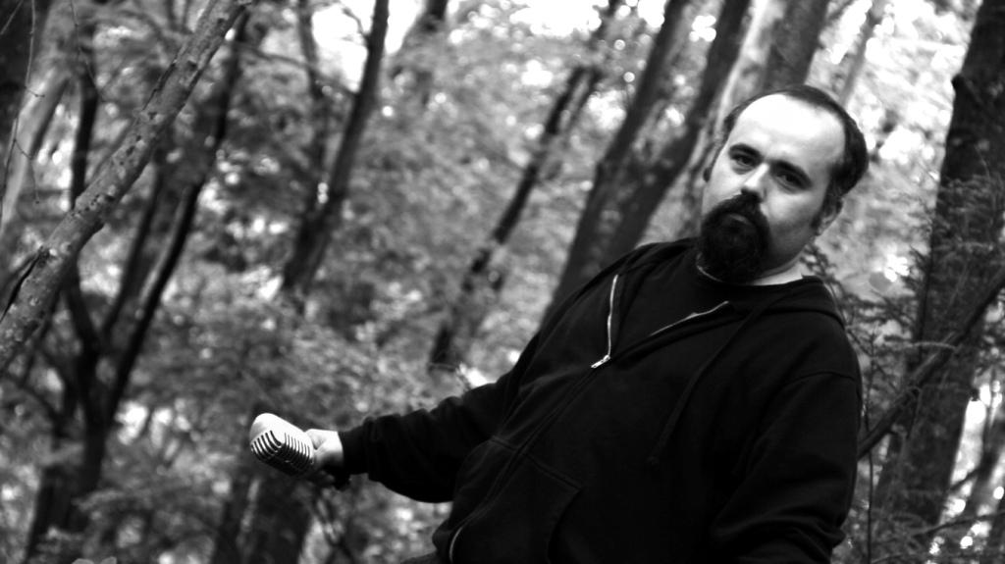
Who Am I?
Journalist… Film Fest Director… Actor… Photographer… Writer… Entrepreneur… Educator & Radio Producer & Host of…

Slide 6


Slide 7

Reasons for Use of Social Media
Available
Freedom
Impacting & Reach
Methods Are Changing
Performance of Product
or Service
Promotion & Advertising
Teaching
Visibility

Slide 8
Factors That Impact Me…
Fits my Business
Growing & Evolving
Networking & Connection
Reaching New Audiences
Reinforcing
Understanding my Listeners
Booking & Connecting with Guests

Slide 9





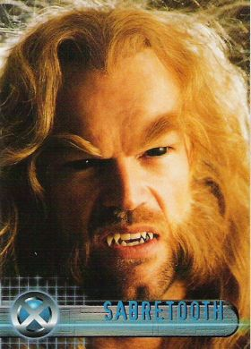




Booking with Buzz & Social Media …
TV Shows Like AMC “The Walking Dead”, “Supernatural”, “Star Trek” & FX’s “American Horror Story”
Plus Guests Within a Variety Businesses, Decades, Styles and Sub-Genres of Horror….

Slide 10
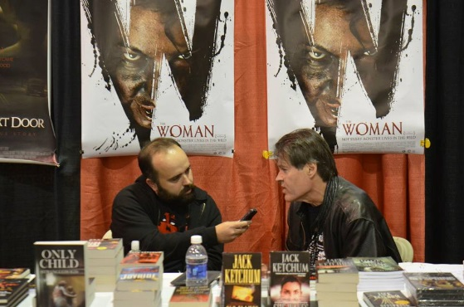
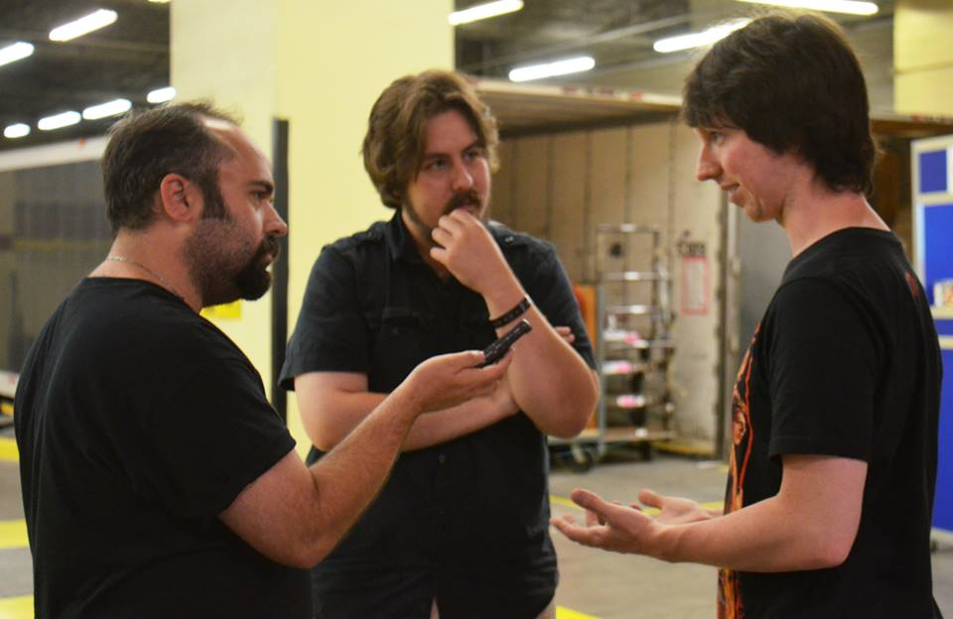
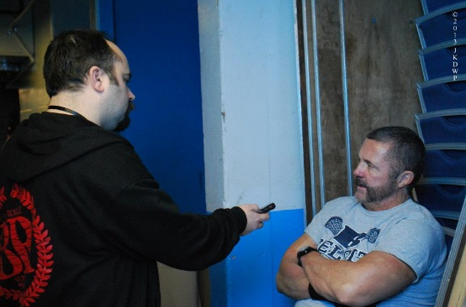
Booking & Connecting with Guests
Over 400 Guests Including Best-Selling Authors, Variety of Filmmakers, Actors, Producers, EFX/Makeup Artists, Journalists, Composers, Vendors, Photographers, Historians, Conventions & Film Festivals

Slide 11
Factors to Build Social Media Toolbox… What & Why?
$$$ & Sponsors
Building Balance & Visibility
Data Analytics
Fits Purpose… Business… Goals
Growing, Evolving, Changing & Learning
Our Society We Live In
Understanding Customer
Knowing Who Is Viewing & Stats

Slide 12
I’m That Popular…
Google Search Stats (Oct 15th)
Horror… About 625 Million Mentions
Podcast… About 240 Million Mentions
Horror Radio… About 190 Million Mentions
Internet Broadcasting… 47 Million Mentions
Social Media Tools Media Broadcasting…
47 Million Mentions
Horror Podcast… About 1.15 Million Mentions
Horror Happens Radio Show…
2.9 Million Mentions

Slide 13
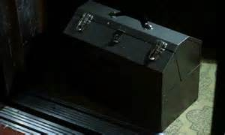
Basic Social Media Toolbox
Twitter, Facebook, Google+
Flickr & Instagram
Foursquare & LinkedIn
Reddit, Yelp & Blogs
Skype, Myspace & YouTube
Other Email Profiles, Fan Funding & Multimedia Website: Wix.com & Web.com

Slide 14




Simple Social Media Strategies
Patience & Persistence
Fluidity & Timing
Plan Out Objectives
& Goals
Select the Effective & Right Tools

Slide 15

Simple Social Media Strategies
Use #Effectivebuzzwords
#horrorhappens
#horror #film #slasher
#indiehorror #zombie #radio

Slide 16

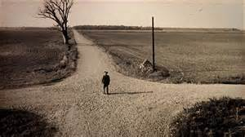
Simple Social Media Strategies
Be a Student & Learn
Structure Goals
Overall Flexibility
Cross Promote & Connect
on Everything…
No Pressure, Ego Aside
& No Fear

Slide 17
Ways to Manage Your Toolbox: Free Trail &/or Pay
Crowdbooster – Handles Twitter & Facebook ($9, $49 or $119 Depending on Number of Profiles)
Hootsuite - Handles Twitter, Facebook, Google+, Foursquare & LinkedIN ($8.99 a Month)
Postling - Handles Twitter, Facebook, Blogs, YouTube, Flickr & LinkedIN ($1 Per 1st Month then $10 a Month After)
Web Design - wix.com ($4-24 a Month) or webs.com ($25 a Year per Web URL)

Slide 18
Ways to Manage Your Toolbox: FREE!!!
Buffer - @bufferapp.com
(Shares Content Thru Facebook, Twitter, LinkedIn, Google+) - $10 After 3rd Profile
Google Analytics- google.com/analytics
(Tells Your Websites Story for the Week in Views, Social Media & Searches, Etc.)
Social Mention - @socialmention.com
(Tools for Relevant Searches, Metrics, Reaches, Mentions, Top Keywords & Social Media)
Tweetdeck - @about.twitter.com/products/tweetdeck
(Customizes Your Twitter Accounts)

Slide 19

Sites & Sources for Social Media Tool Recommendations
Google.com
Convinceandcovert.com
Socialmediaexaminer.com
Business2community.com
Blog.visual.ly

Slide 20
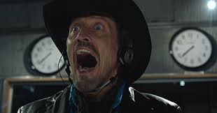
Internet Broadcasting Platform
Podcasts & Live Internet Radio Shows
Blogtalkradio.com
Iheartradio.com
Live365.com
Itunes.com
Stitcher.com
Spreaker.com
Toginet.com
Homegrownradionj.org & College Radio

Slide 21
Conclusion
Find the Right & Effective Social Media Tools for Your Business or Project
Never Ending Work… but Will Result in Doors and Rewards
Don’t Be Afraid to Grow and Evolve
Set a Plan and Goals for Social Media Success
Network and Cross Promote
LOVE WHAT YOU DO!!!

Slide 22
Contact Information
Thank you for attending!!!
Any questions or comments???
E-mail: horrorhappens6@gmail.com
Twitter: @horrorhappensrs or @horrorhappensff
Facebook: Facebook.com/horrorhappens
Website: horrorhappens.com
LinkedIn: Under Jason Kolucki
YouTube: Jay K HorrorHappensRS

Slide 23

Everybody Give Me a Scary Face…

Slide 24
Find This Photo on Twitter @horrorhappensRS
Thanks for Coming Out & Listen Live If You Dare Weekly Tuesday @ 4 PM EST only on HGRNJ.org

Slide 25
Thanks to…
My Wife and Co-Host “The Ghost”
My job and HomegrownRadio NJ
Broadcasting Media Conference
All the Guests on The Horror Happens Radio Show
8 Films to Die For…, Horror Films including Pontypool, X-Men, Scares That Care, TIFF, Universal Monster Movies, Astron-6, Kane Hodder, Jack Ketchum, Night of the Living Dead, Viva Las Vegas, Manny Serrano, Fest of Fear, Rock & Shock & Days of the Dead

