Slide 1
PROPERTIES OF MEDICAL PLANTS RELATED TO NIR SPECTROSCOPY
Marija Jakelić, Maja Benković, Tamara Jurina, Ana Jurinjak Tušek, Davor Valinger, Jasenka Gajdoš Kljusurić*
7th World Congress on Healthcare & Technologies
September 26-27, 2016 London, UK

Slide 2
Medical plants
source of bioactive components
Water extracts of medicinal plants
6 widely spread medicinal plant extracts from botanically distinct origins
properties of the plants
pH & d.m.
content of polyphenols & AO
Conductivity & TDS
NIR spectra

Slide 3
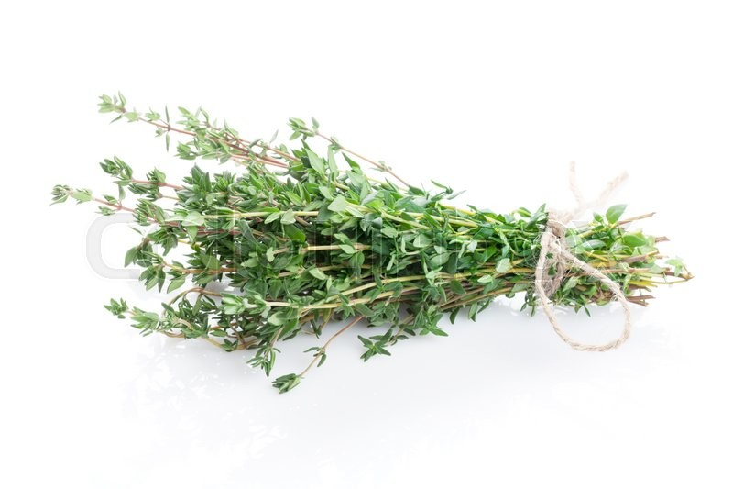
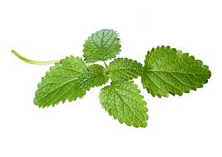
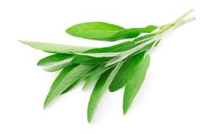
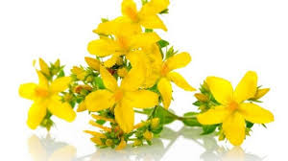
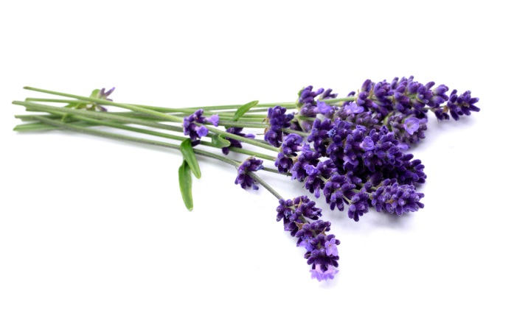
Medical plants
Mellisa (Melissa officinalis)
Sage (Salvia officinalis)
Lavender (Lavandula)
Garden Thyme (Thymus
serpyllum)
St. John's wort (Hypericum perforatum)
Marigold (Calendula officinalis)

Slide 4
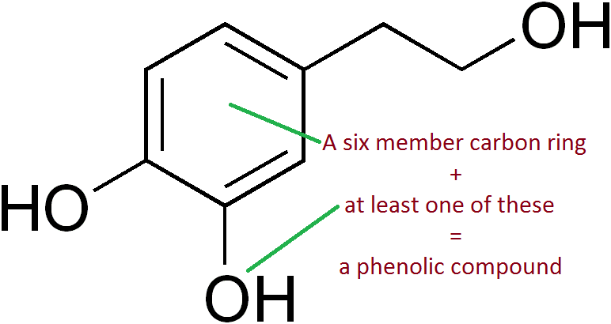
Polyphenols

Slide 5
The vast abundance of scientific data on the bioactive, especially polyphenolic fingerprints of different medicinal plants often require difficult and time-demanding pursuits

Slide 6
Plant material
Medicinal plants
originating from the north-eastern (Žumberak, Croatia) and coastal regions (Dalmatia) of Croatia
collected in 2015, dried and supplied by local herbalists
The homogenicity of samples ensured by the proper sampling and adequate (large) quantity of plant material
Preparation of medicinal plant extracts
simulated household preparation conditions,
a simple, conventional aqueous extraction of medicinal plants was conducted.
Extraction
was carried out by pouring V = 100 mL of distilled water heated to T = 80 °C over m = 2 g of ground tea, for t = 30 min
filtered through a tea strainer

Slide 7
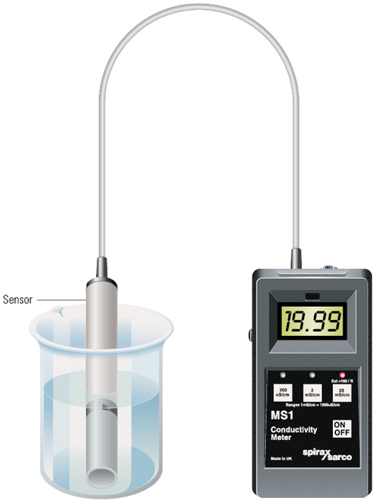
Properties (1)
pH
measured by pH meter
Extraction yield
expressed as the dry matter content of the extracts
dry matter was determined by a standard AOAC method(AOAC, 1995)
Electrical Conductivity & TDS
monitored at room temperature using a TDS/conductivity meter
All measurements were done in triplicate

Slide 8
Properties (2)
Total phenolic content
determined following the modified method of Singleton and Rossi
The values are expressed in mg of Gallic acid equivalents (GAE) per 100 g of fresh mass using Gallic acid standard curve (0–500 mg/L)
Antioxidant capacity as DPPH radical scavenging activity
spectrophotometric measurements, which were performed by the UV-Vis spectrophotometer
2,2-diphenyl-1-picrylhydrazil radical (DPPH˙) using the method proposed by Brand-Williams et al.
Final results are expressed in mmol of TE per 1 g of mass

Slide 9
Properties (3)
Inhibition time during Briggs-Rauscher reaction
oscillating reaction is based on the reactions of three colourless solutions that are prepared and mixed as proposed by Cervelati et al.
total volume of the BR mixture (15 mL).
BR reaction is potentiometrically monitored using a combined platinum electrode and the inhibition time (IT)
IT linearly depends on the
concentration of the added antioxidant
recalculated oscillation quenching using a standard solution (GA) –> RAC

Slide 10
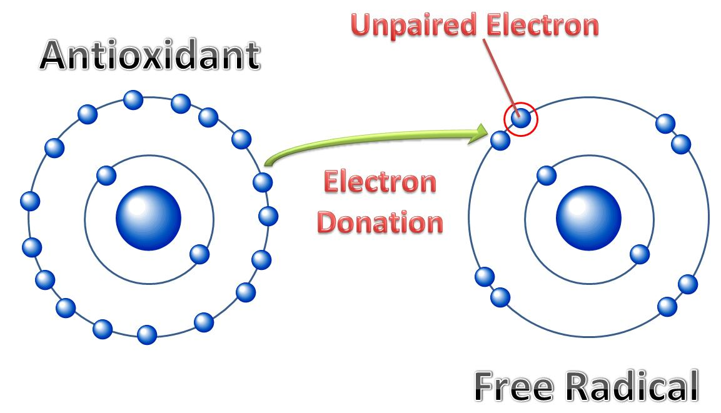
DPPH vs BR inhibition time

Slide 11
NIR measurements
Range: from 904 nm to 1699 nm
Medicinal plant extracts (V = 1 mL) were dispensed in quartz cuvette and three consecutive runs for every extract were initially recorded across the entire spectral range at 1 nm intervals
the arithmetic averages of three measurements were computed
data obtained were used to perform principal component analysis (PCA) and Partial least squares regression (PLS)

Slide 12
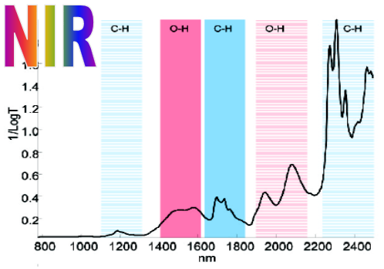
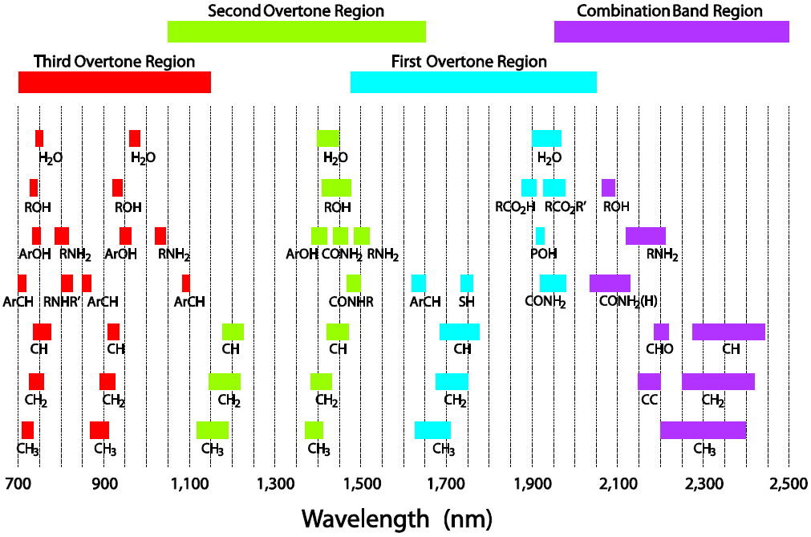
NIR

Slide 13
Results

Slide 14
Basic properties
Medical plant | pH | T (°C) | % d.m. | Polyphenols (mg/g) | AO (mmol/g) | BR- AO (mg/g)
St. John's wort | 5.18 | 24.4 | 0.4104 | 33.46 | 0.290 | 152.61
Sage | 6.20 | 24.2 | 0.5344 | 29.81 | 0.228 | 218.34
Lavender | 5.53 | 24.4 | 0.3964 | 15.46 | 0.081 | 320.03
Thyme | 6.61 | 24.2 | 0.4340 | 43.50 | 0.312 | 264.43
Melissa | 6.38 | 24.7 | 0.5021 | 60.46 | 0.445 | 344.51
Marigold | 5.36 | 24.7 | 0.5038 | 14.34 | 0.129 | 128.28

Slide 15
Conductivity and TDS

Slide 16
NIR spectra

Slide 17
PCA

Slide 18
NIR spectra
Analytical data
modelling
PLS models
(expected analytical parameter)

Slide 19
Chemometric analysis
PCA
used for identifying patterns in data and displaying the data in order to highlight similarities and differences
Its goal is to extract the important information from the data table and to express this information as a set of new orthogonal variables called principal components or factors.
represents the pattern of similarity of the observations and the variables by displaying them as points in maps
PLSR
which is a technique that generalizes and combines features from principal component analysis and multiple regression was used to predict and analyze a set of dependent variables from a set of independent variables or predictors.
Calibration and validation
conducted for medical plant extract spectra respectively. As the first group of scatter-corrective pre-processing method was used the Standard Normal Variate (SNV) followed by the Savitzky-Golay (SG) polynomial derivative Filter
data set
divided into calibration set and validation set.
PLSR model performance was assessed
R² ; RMSEC and RMSEP; RPD; RER

Slide 20
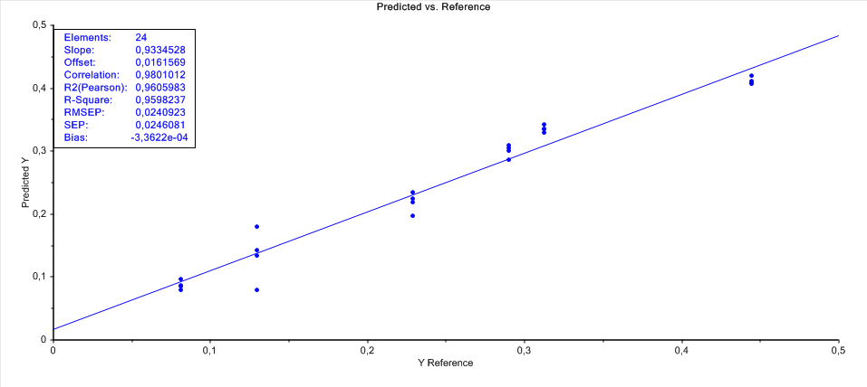
Models
observed component and spectra | Calibration |  | Prediction |  | RPD | RER
 | $$r_{c}^{2}$$ | RMSECV | $$r_{p}^{2}$$ | RMSEP
pH | 0,999 | 0,011 | 0,985 | 0,065 | 8,3 | 18,1
TDS (mg/L) | 0,996 | 2,246 | 0,998 | 9,705 | 21,3 | 62,4
Conductivity (µs/cm) | 0,994 | 29,183 | 0,994 | 28,31 | 14,0 | 42,1
Dry matter (%) | 0,999 | 0,001 | 0,995 | 0,004 | 13,7 | 31,9
Polyphenols (mg/g) | 0,999 | 0,175 | 0,990 | 1,577 | 10,5 | 29,2
AO (mmol/g) | 0,949 | 0,027 | 0,959 | 0,024 | 5,0 | 15,1
BR- AO (mg/g) | 0,994 | 6,0831 | 0,993 | 6,836 | 11,9 | 28,0
Rezultat PCA analize
Parametri PLSR modela
PLSR
modeli

Slide 21
FAILURE
SUCCESS

Slide 22
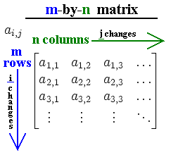
Medical plant | pH | T (°C) | % d.m. | Polyphenols (mg/g) | AO (mmol/g) | BR- AO (mg/g)
St. John's wort | 5.18 | 24.4 | 0.4104 | 33.46 | 0.290 | 152.61
Sage | 6.20 | 24.2 | 0.5344 | 29.81 | 0.228 | 218.34
Lavender | 5.53 | 24.4 | 0.3964 | 15.46 | 0.081 | 320.03
Thyme | 6.61 | 24.2 | 0.4340 | 43.50 | 0.312 | 264.43
Melissa | 6.38 | 24.7 | 0.5021 | 60.46 | 0.445 | 344.51
Marigold | 5.36 | 24.7 | 0.5038 | 14.34 | 0.129 | 128.28
PCA, PLSR
n = 805; m = 25
observed component and spectra | Prediction |  | RPD | RER
 | $$r_{p}^{2}$$ | RMSEP
pH | 0,985 | 0,065 | 8,3 | 18,1
TDS (mg/L) | 0,998 | 9,705 | 21,3 | 62,4
Conductivity (µs/cm) | 0,994 | 28,31 | 14,0 | 42,1
Dry matter (%) | 0,995 | 0,004 | 13,7 | 31,9
Polyphenols (mg/g) | 0,990 | 1,577 | 10,5 | 29,2
AO (mmol/g) | 0,959 | 0,024 | 5,0 | 15,1
BR- AO (mg/g) | 0,993 | 6,836 | 11,9 | 28,0

Slide 24
Conclusions
Multivariate tools
(NIR) spectra vs. analytical parameters
PCA was successful
PC1 & PC2 > 80 %
correlations
PLSR models were successful
R2 > 0.95
Majority, RPD > 8
Majority, RER > 15
obtained results confirmed that NIR spectroscopy coupled with multivariate analysis is a promising technique for rapid and environmentally friendly measurements allowing good calibration, validation and possible prediction of the observed parameters

Slide 25
PROPERTIES OF MEDICAL PLANTS RELATED TO NIR SPECTROSCOPY Marija Jakelić, Maja Benković, Tamara Jurina, Ana Jurinjak Tušek, Davor Valinger, Jasenka Gajdoš Kljusurić*
Acknowledgements
This presentation is a contribution to the project „Application of microreactors in the analysis of antioxidant activity of medicinal plants: MICRO-AA“, (HR.3.2.01-0069)
funded by the European Social Fund (ESF) through the Human Resources Development program
7th World Congress on Healthcare & Technologies
September 26-27, 2016 London, UK

