Slide 1
Tar-containing reclaimed asphalt
Recycling Expo,
Barcelona, July 2015
Environmental assessments for two treatment scenarios (incineration versus recycling)
Janez Turk¹, Ana Mladenovič¹, Vladimir Bras¹, Aljoša Šajna¹, Andrej Čopar²
¹Slovenian National Building and Civil Engineering Institute, Dimičeva ulica 12, 1000 Ljubljana, Slovenia.
² Trgograd d. o. o., Breg pri Litiji 56, 1270 Litija, Slovenia.

Slide 2
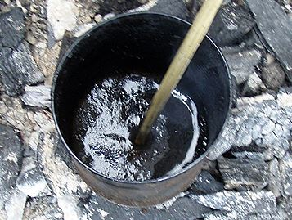
1. Introduction
Tar, which is a residue of gas and coke production from coal, was quite commonly used in the road construction industry almost until the end of the 20th century, in many countries around the world.
Tar, which technical performance is excellent, was used in the past as a binder in asphalt mixes (in asphalt sub-layers as well as in base layers).
Source:
Internet

Slide 3
The abandonment (and in several countries also prohibition) of tar was the result of its toxicity, and was also due to the fact that bitumen production from crude oil became an economically feasible alternative to coal tar.
Tar is a hazardous compound:
High concentrations of carcinogenic and mutagenic Polycyclic Aromatic Hydrocarbons (PAHs).
Tar-containing asphalt (i.e. asphalt which contains more than 0.1 % of coal tar) is classified as hazardous waste (European Waste Catalogue - Code 17 03 01*).

Slide 4
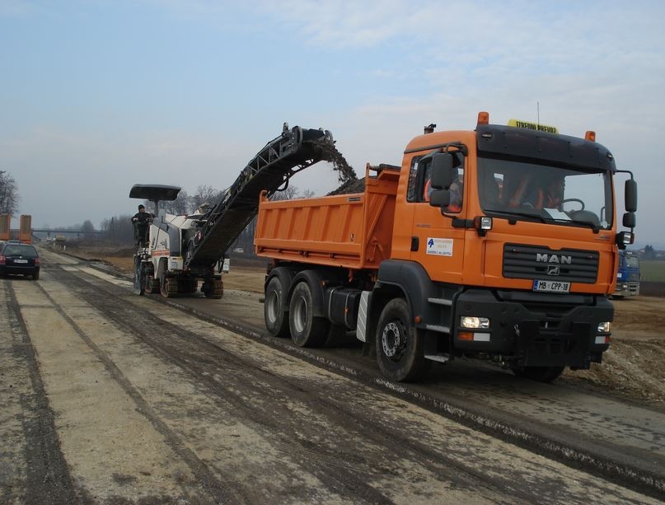
It is important to carry out inventory research into quantity of tar used in roads.
During road reconstruction and maintenance works, tar-containing asphalt is obtained by crushing, and after this process it becomes exposed to the environment.
Possible threats:
- spills,
- leaks,
- contamination of soil
and water.

Slide 5
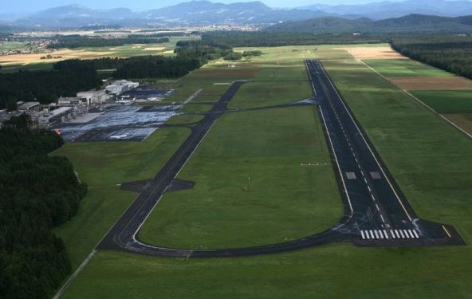
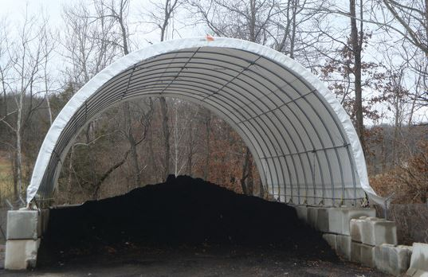
1.1 The problem
4500 tons of reclaimed asphalt containing tar (1120 mg/kg in the leachate) were generated during the reconstruction of the runway at Ljubljana Airport (Slovenia) in 2009. This material was temporarily stored under controlled conditions.
How to treat with this hazardous waste material?
Source: Internet

Slide 6
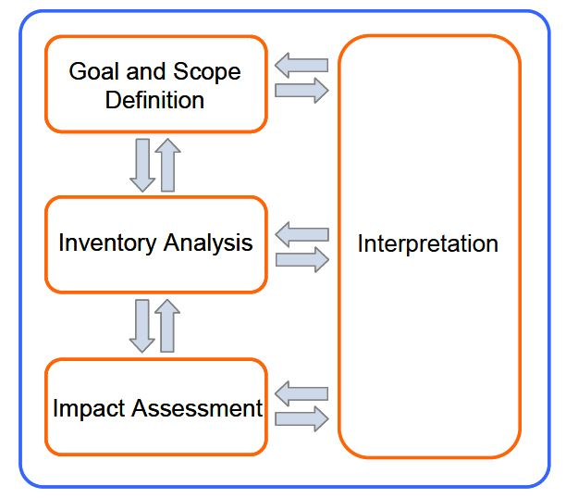
2. Goal
Life Cycle Assessment (LCA) analysis was carried out
to evaluate quantitatively the environmental benefits of the recycling of reclaimed asphalt in the concrete sector, in comparison with the most easily performed alternative, i.e. at an incineration plant for hazardous materials located outside Slovenia.

Slide 7
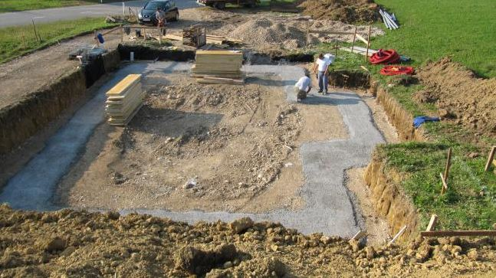
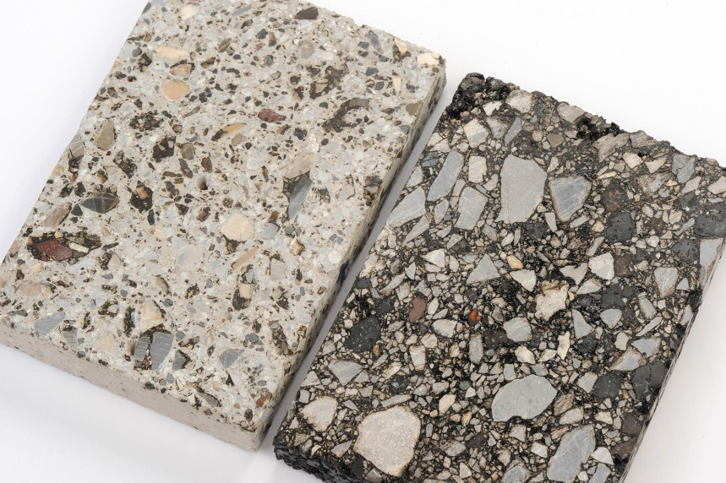
2.2 Two scenarios
First scenario: the tar-containing reclaimed asphalt is used for the production of lean concrete. Reclaimed asphalt is treated as recycled aggregate to replace 40 wt. % of the natural aggregates in the concrete mix.
Source: Internet

Slide 8
The mix proportions for conventional lean concrete and recycled lean concrete:
Constituent material | Unit | Conventional concrete | Concrete with 40 % of recycled materials
Cement (CEM II 42.5) | kg per m³ | 260 | 260
Aggregate | kg per m³
- dolomite 0/4 mm |  | 1156 | 915
- dolomite 4/8 mm |  | 210 | /
- dolomite 8/16 mm |  | 737 | 305
- reclaimed asphalt 0/16 mm |  | / | 729
Water | litres per m³ | 160 | 155
Plasticizer | kg per m³ | 1.2 | 1.2

Slide 9
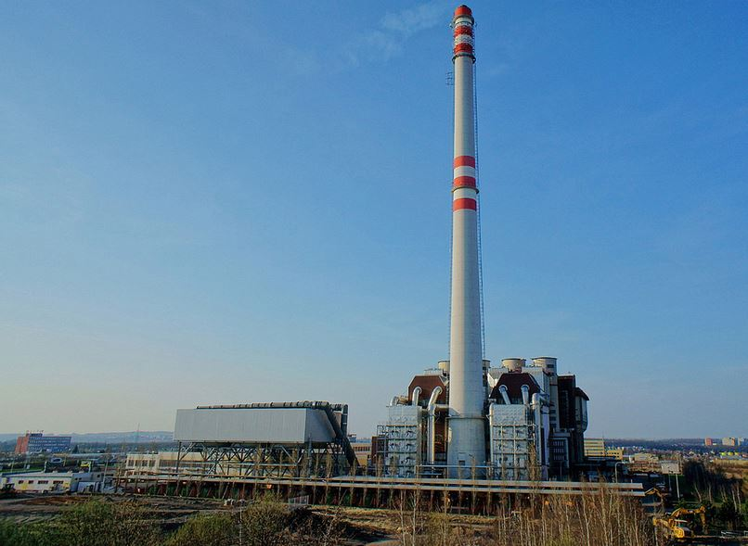
Second scenario: tar-containing reclaimed asphalt is simply considered as a type of hazardous waste. In this case it would be incinerated at an incineration plant.
The functional unit is treatment with 1000 kg of reclaimed asphalt.
Source: Internet

Slide 10
System boundaries of LCA
Asphalt layer with tar as a binder
Milling
Reclaimed asphalt
containing tar
Temporary storage
Incineration scenario
Recycling scenario
Transport
Transport
Hazardous waste
incineration plant
Mixing plant
Lean concrete

Slide 11
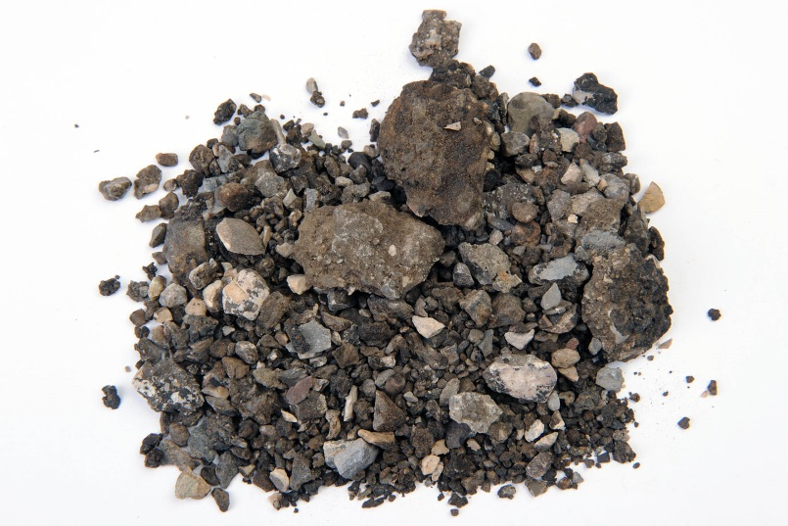
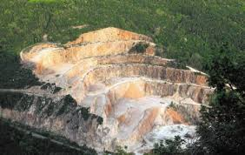
2.2.1 The recycling scenario
The reclaimed asphalt is treated
as a proper aggregate
(no additional crushing/screening
is needed).
The transport of the reclaimed asphalt from the temporary storage area to the mixing plant is taken into account (40 km).
Utilization of recycled aggregate →
the need for natural aggregate is reduced
Source: Internet

Slide 12
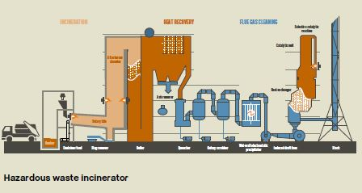
2.2.2 The incineration scenario
Truck transport from the temporary storage area to the hazardous waste incineration plant (a one way distance of 1050 km).
Incineration of the hazardous waste at rotary kiln incineration plant (900-1600 °C).
Source:
CURRENTA

Slide 13
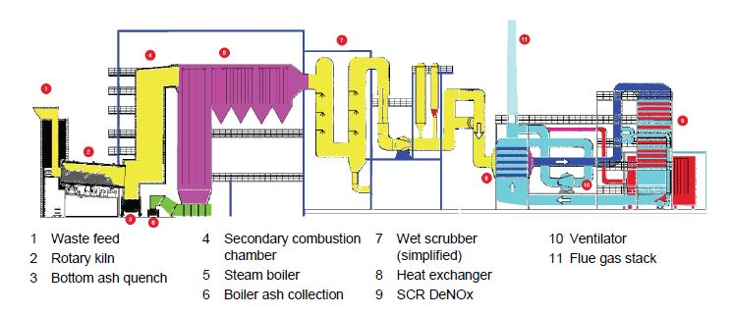
Operation of the plant:
A supply of main energy resources (fuel oil, steam, electricity).
Use of auxiliary materials for flue gas cleaning.
The products of the incineration (i.e. the residual materials) are transported to a landfill area for residual material.
Waste water leaving the incineration plant is treated in a treatment plant and discharged to the surface water drainage.
Source:
Doka G., 2007

Slide 14
Heat recovery in the steam boiler:
Wastes with high calorific values are able to produce their own process energy during incineration.
Amount of complementary fuel input is reduced in such a case.
This means that the environmental burdens related to the production of auxiliary fuel are partly reduced.
However, the calorific value of reclaimed asphalt is low → the reclaimed asphalt produces low amount of process energy.

Slide 15
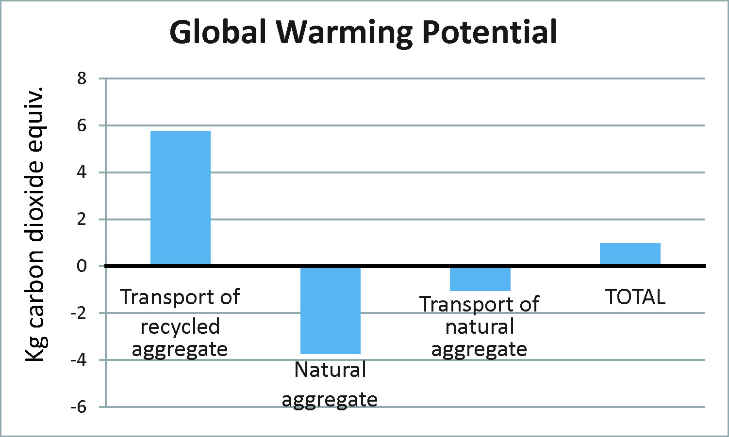
- Recycling scenario
3. Results of LCA analyis

Slide 16
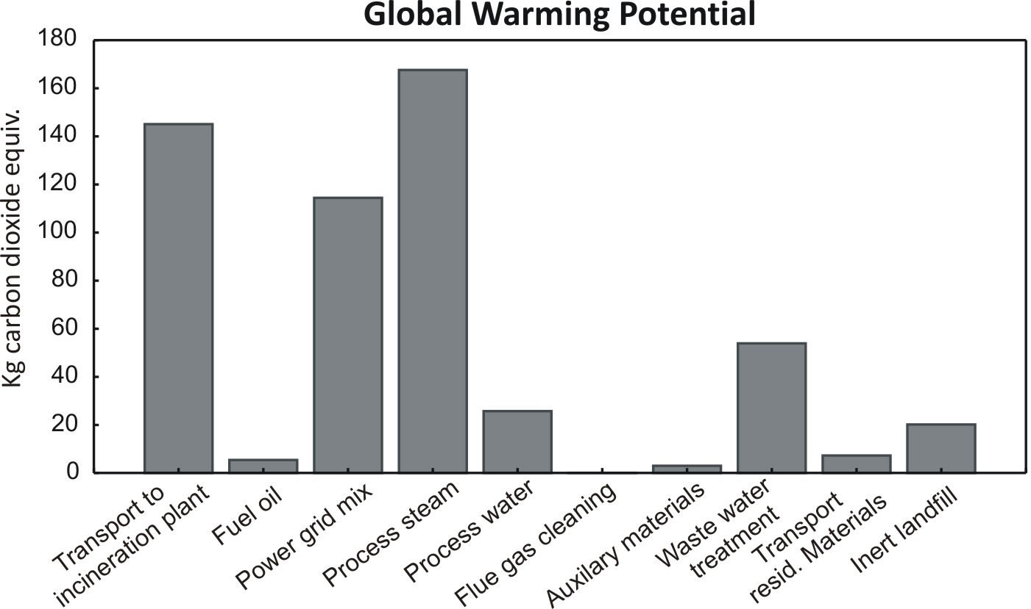
- Incineration scenario
SUM: 543 kg of carbon dioxide equivalent emissions

Slide 17
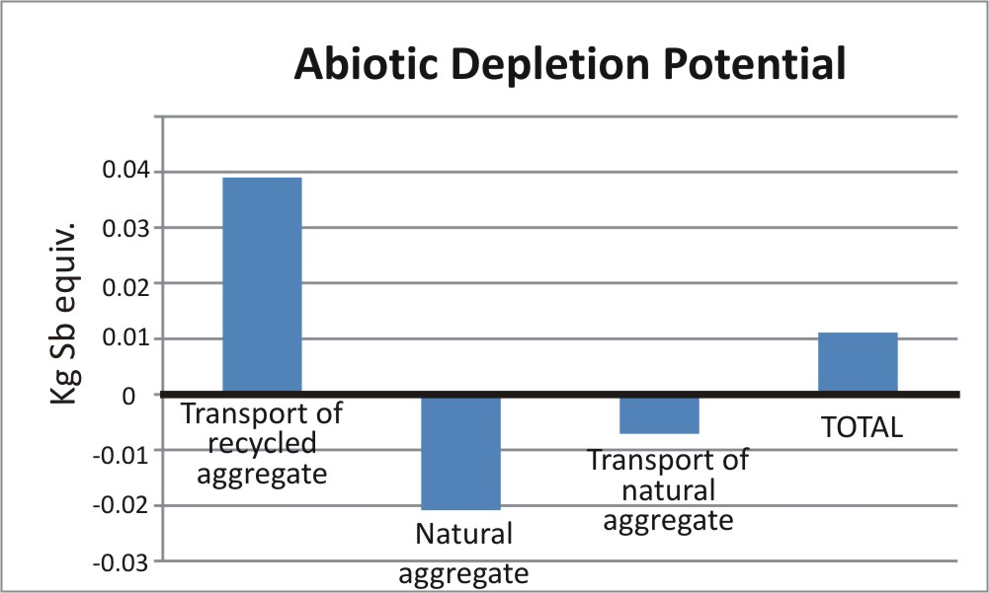
- Recycling scenario

Slide 18
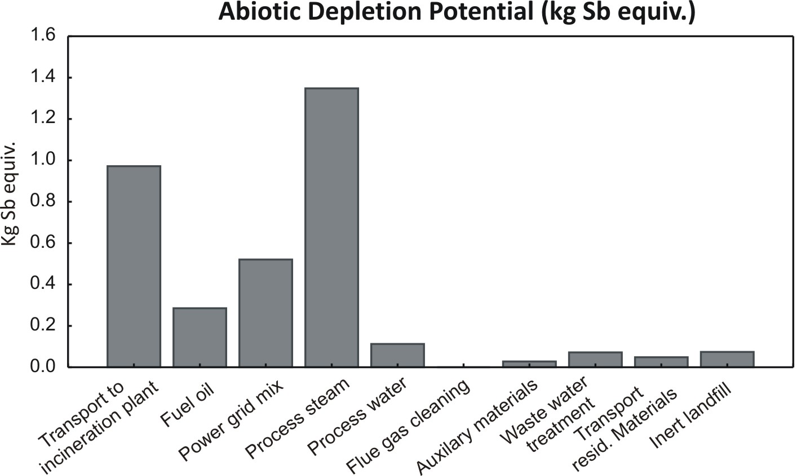
- Incineration scenario
SUM: around 3.5 kg of Sb equivalent emissions

Slide 19
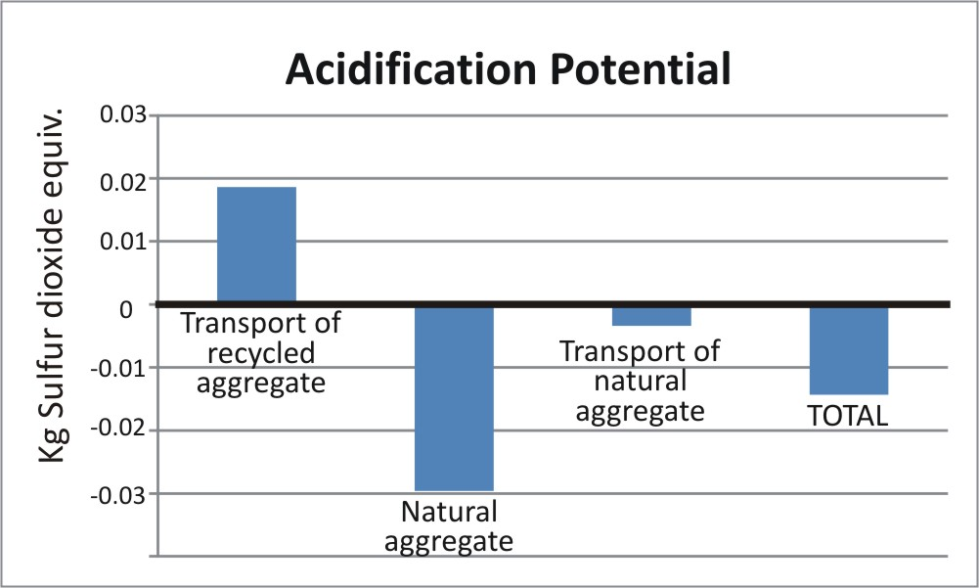
- Recycling scenario

Slide 20
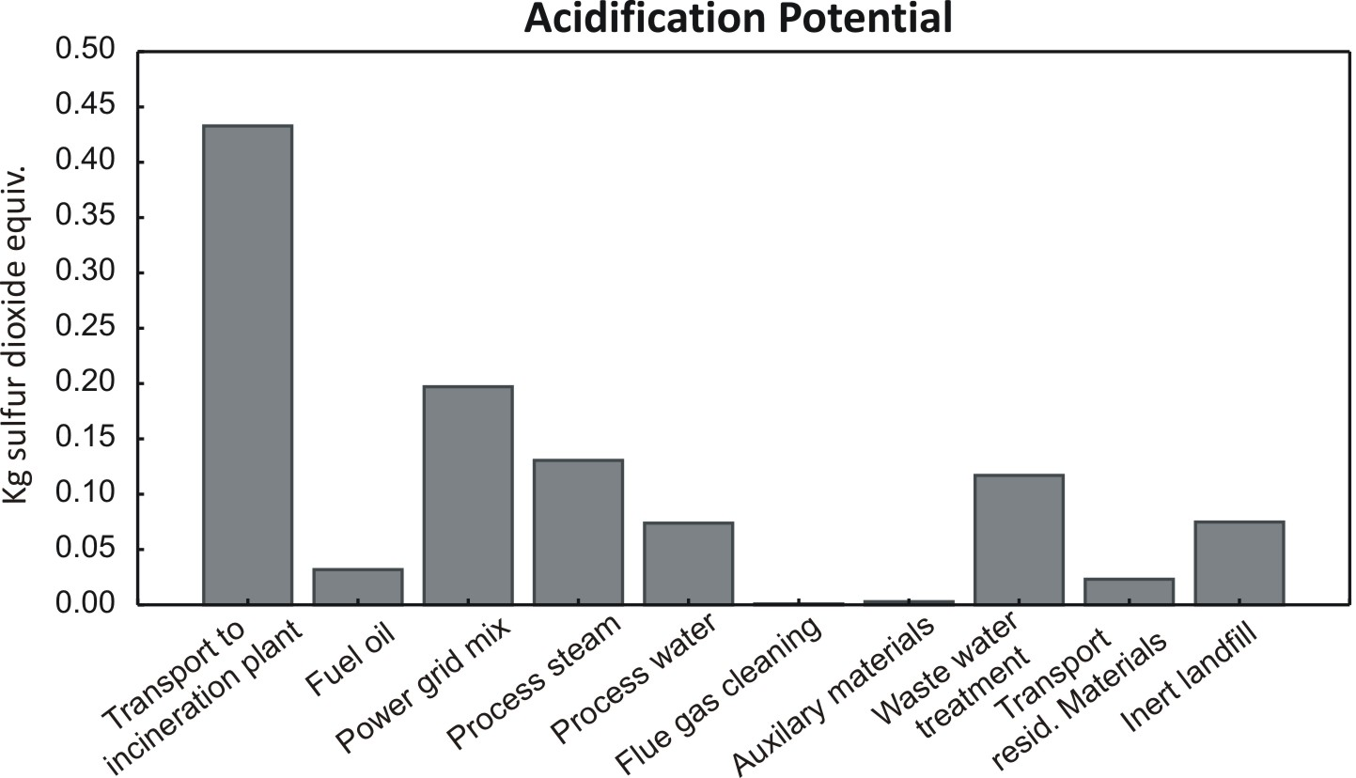
- Incineration scenario
SUM: around 1 kg of sulphur dioxide equivalent emissions

Slide 21
Relative comparison of two scenarios

Slide 22
4. Conclusions
The incineration scenario exhibits high effects on environmental indicators.
A lot of energy has to be used at the incineration plant in order to maintain high combustion temperatures.
The net generation of energy during the incineration of low calorific reclaimed asphalt is low.
Emissions associated with transport are significant, taking into account long delivery distance of the reclaimed asphalt from source to the incineration plant.

Slide 23
The recycling scenario was found to have low environmetal impact:
Impacts on Global Warming and Abiotic Depletion are significantly low.
In case of impact on Acidification, even some benefits were revealed.
Environmental footprint of recycling scenario greatly depends on delivery distance of tar-containing asphalt from source to asphalt plant (delivery distance was relatively short - 40 km in this case study).
However, certain limitations about the application of such recycled lean concrete need to be strictly taken into account (not exposed to groundwater).

Slide 24
Hvala! Thank you for attention!
For more information see:
Turk, J., Mladenović, A., Knez F., Bras, V., Šajna, A., Čopar, A., Slanc, K., 2014. Tar-containing reclaimed asphalt – Environmental and cost assessments for two treatment scenarios. Journal of Cleaner Production 81, 201-210.

