Slide 3
27th July 2015 – 4th Asia Pacific Congress & Expo on Dental & Oral Health
Dental hygiene student placement in residential aged care facilities: What do the students gain from the placement experience?
Dr Janet Wallace
Dip DT, Dip BM, BOH, GCPTT, PhD
Lecturer, Oral Health Therapy
Faculty of Health & Medicine
School of Health Sciences

Slide 4
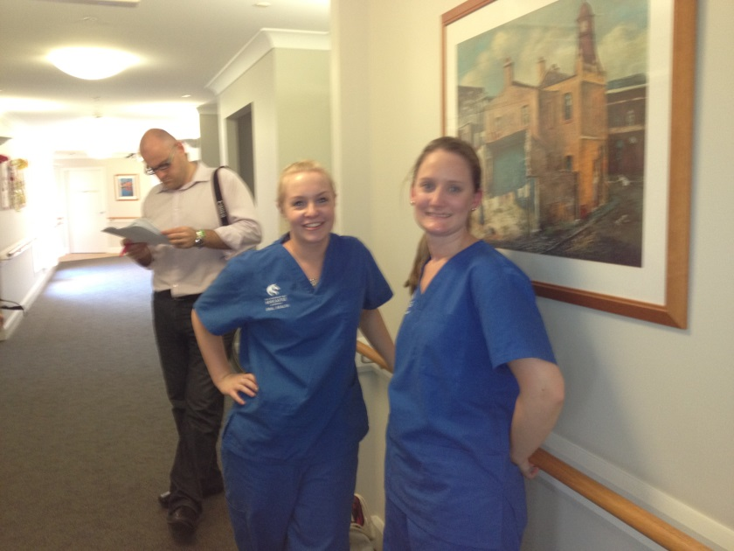
Overview
The University of Newcastle (UON) service-learning community oral health student placement program
Rationale
Conceptual framework
Course requirements
Aim
Methodology
Results
Discussion
Conclusion

Slide 5
The UON oral health student placement
Commenced 2009
Compulsory component of the bachelor of oral health undergraduate degree
Providing oral health advise to residents & staff
17 RACFs
NSW, Central Coast, Australia
Predominately health promotion

Slide 6
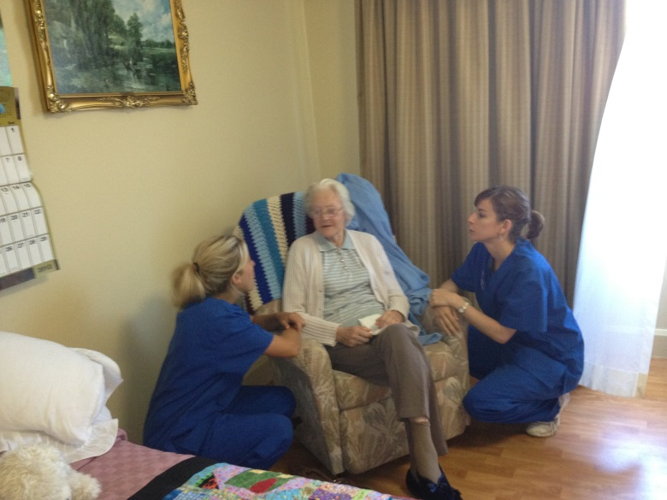
Rationale
To provide students with an experiential learning opportunity and to address the need for an oral health focus in RACFs

Slide 7
Modified conceptual frame-work
based on Yoder’s dental education model
Clear service-learning objectives
Student preparation
Sustained service
Reciprocal learning
guided reflection
community engagement
Ongoing evaluation

Slide 8
Course requirements
Compulsory course component
Final year dental hygiene students
Semester 1, 12 weeks, 1 day
Summative assessments
Reflective journal entries

Slide 9
Provided dental education sessions
Demonstrated cleaning of teeth/dentures
Provided advice on dental products for xerostomia, ulcers, minor oral ailments
Raise the profile of oral health in RACFs

Slide 10
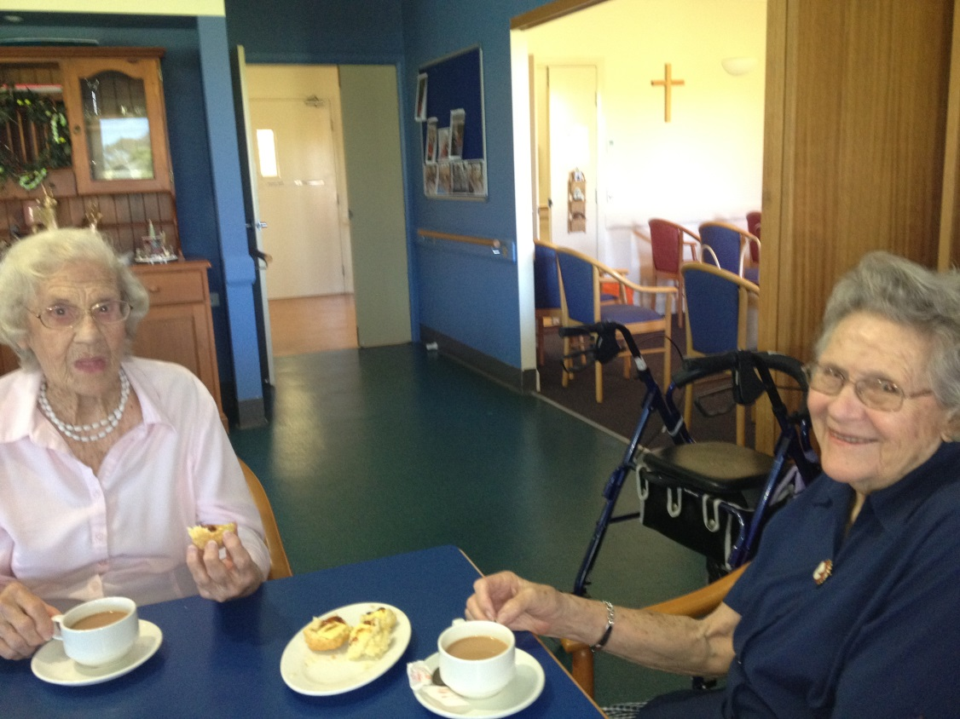
Aim
This study assesses whether the placement program had improved students’ knowledge of medical, dental and environmental issues pertaining to older people living in Residential aged care facilities

Slide 11
Methodology
All final year students (n=33) attended the placement
Pre-placement orientation
Randomly allocated to one of 17 RACFs
12 week placement, I day per week
Voluntary participation in the study

Slide 12
Pre & post placement questionnaires
40 questions
5 point Likert scale
Strongly agree (1) to strongly disagree (5)
Pre & post placement mean scores with standard deviations were produced for each question
P values were calculated using a paired t-test

Slide 13
The questionnaires were designed to assess specific outcomes, listed in 3 separate categories:
Category 1: Medical knowledge pertaining to the older person
Category 2: Dental knowledge specific to the older person
Category 3: Knowledge of the RACF

Slide 14
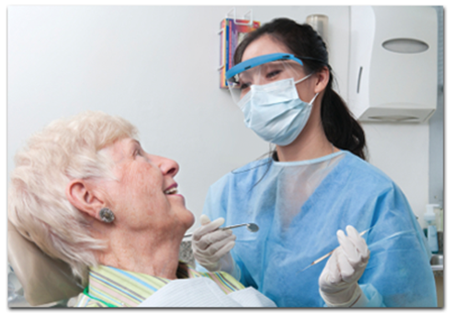
Category 1:
To investigate student knowledge of medical conditions and pharmacology specific to the older person, including Alzheimer's disease

Slide 15
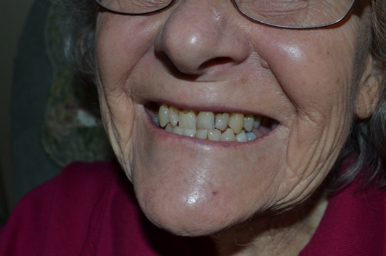
Category 2:
To consider student knowledge of the prevalence of dental caries, periodontal disease and oral mucosal lesions, as well as the availability of dental care and dental hygiene practices for older people living in RACFs

Slide 16
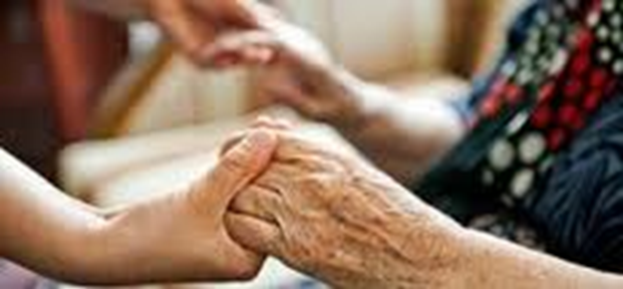
Category 3:
To ascertain student knowledge of whether staff in RACFs receive training in oral health and whether the training provides them with the ability to provide appropriate oral health advice and oral hygiene care for residents
(Students were also asked if RACF staff could recognize dental problems and prescribe appropriate oral hygiene products for the residents' and about the availability of oral hygiene care provided)

Slide 17
Results:
33 students attended the placement, 26 (79%) completed both pre & post questionnaires

Slide 18
Category 1: Pre & post mean Likert scale scores for student knowledge of medical issues of residents living in RACFs
Question | Pre-placement Mean (SD) n= 26 | Post-placement Mean (SD) n= 26 | P-value
Residents in RACFs are at risk of developing oral diseases and dental problems | 1.6 (0.6) | 1.0 (1.0, 2.0) | *<0.01
Most residents with Dementia are able to report dental pain | 3.4 (0.8) | 3.9 (0.8) | * <0.05
Polypharmacy contributes to poor oral health | 2.1 (0.8) | 1.4 (0.6) | * <0.01
Comorbid medical conditions rarely influence oral health in RACF residents | 3.9 (0.9) | 4.0 (0.8) | 0.8019

Slide 19
Category 2: Pre & post mean Likert scale scores for student knowledge of dental conditions of residents living in RACF
Question | Pre-placement Mean (SD) n= 26 | Post-placement Mean (SD) n= 26 | P-value
Residents in RACFs have a higher prevalence of oral mucosal lesions | 2.3 (0.8) | 1.7 (0.7) | *<0.05
Residents with Alzheimer’s disease have reduced saliva flow | 2.8 (0.6) | 2.3 (0.7) | * <0.05
Most RACF residents wear dentures | 1.8 ( 0.7) | 2.4 (0.5) | * <0.05
Periodontal disease is higher in residents in RACFs | 2.0 (0.7) | 1.7 (0.7) | 0.0951
Dental decay is higher in residents in RACFs | 2.1 (0.7) | 1.7 (0.7) | 0.0830
Residents in RACFs generally have good oral health | 3.8 (0.5) | 3.9 (0.9) | 0.5021
Residents in RACFs have minimal interest in their oral health | 3.1 (0.8) | 2.9 (1.2) | 0.6402
RACF residents often have dental pain | 2.5 (0.8) | 2.7 (1.1) | 0.6563

Slide 20
Category 3: Pre & post mean Likert scale scores for student knowledge about the RACF environment
Question | Pre-placement Mean (SD) n= 26 | Post-placement Mean (SD) n= 26 | P-value
Staff provide good oral hygiene care to residents with Dementia | 3.3 (0.6) | 4.0 (0.7) | *<0.01
RACF residents are given an oral health risk assessment every 12 months | 3.0 (0.4) | 3.7 (1.1) | * <0.05
Hygienists provide oral hygiene services at RACFs | 2.5 ( 0.7) | 3.4 (1.1) | * <0.01
RACF staff provide good oral hygiene care to residents | 3.3 (0.6) | 3.7 (0.7) | * <0.05
Oral hygiene products are available at RACFs for residents to purchase | 3.1 (0.6) | 4.0 (0.7) | *<0.001
Residents have adequate access to appropriate dental services in RACFs | 3.2 (0.6) | 4.0 (0.8) | *<0.001
Staff in RACFs have barriers to providing oral hygiene care to residents | 2.3 (0.8) | 1.8 (0.9) | * <0.05
Residents have their teeth and dentures cleaned by RACF staff regularly | 2.8 (0.5) | 3.3 (1.2) | * <0.05
Residents have their dentures cleaned after meals | 3.4 (0.6) | 3.9 ( 0.8) | * <0.05

Slide 21
Discussion:
This study is consistent with a body of research that recognises the link between classroom theory and service-learning community placements to progress student learning and consolidate theoretical concepts with ‘real life’ experiences enhancing knowledge and skills

Slide 22
Conclusion:
In this study students reported considerable improvements in knowledge of medical and dental conditions common to older people living in RACFs and reported significant improvements in their knowledge about the RACF environment after the placement, including identifying the lack of organized oral health care for the majority of RACF residents

Slide 23
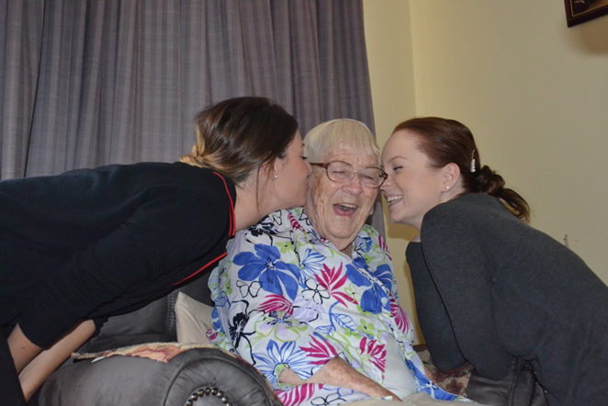
The results of this study confirm the value of service-learning in RACFs and its benefits for both students and residents
Fosters graduates who are better prepared to work effectively amongst diverse populations and able to function dynamically in the health policy area.

Slide 24
References
1 Jacoby B (ed.) Service-Learning in Higher Education: Concepts and Practices. San Francisco: Jossey- Bass; 1996.
2 Elkind A, Potter C, Blinkhorn F, Duxbury J, Hull P, Blinkhorn AS. Patients treated by dental students in outreach: The first year
of a pilot project. Eur J Dent Educ 2005; 9: 49–52.
3 Erhlich T. Service-learning in undergraduate education: where is it going? Carnegie Perspectives 2005.
4 Weaver RG, Haden NK, Valachovic RW. Annual ADEA survey of dental school seniors: 2003 graduating class. J Dent Educ 2004; 68:
1004–1027.
5 Woronuk JI, Pinchbeck YJ, Walter MH. University of Alberta dental students’ outreach clinical experience: An evaluation of the program.
J Can Dent Assoc 2004; 70: 233–236.
6 Oral Health in America: A Report of the Surgeon General. Rockville (MD): Department of Health and Human Services (US).
National Institute of Dental and Craniofacial Research, National Institutes of Health; 2000.
7 Yoder M. A framework for service-learning in dental education. J Dent Educ 2006; 70: 115–123.
8 Wallace JP, Taylor JA, Wallace LG, Cockrell DJ. Student focused oral health promotion in Residential Aged Care Facilities. Int J
Health Promot Educ 2010; 48: 111–114.
9 Wallace JP, Taylor JA, Blinkhorn FA. An assessment of a Service-learning placement programme in residential aged care facilities for
final year dental hygiene students. J Disabil Oral Health 2012; 13:163–167.
10 Howard J. Michigan Journal of Community Service-learning: Servicelearning course design workbook. Ann Arbor, MI: OCSL Press;
2001.
11 Eyler J, Giles DE Jr. Where’s the Learning in Service-Learning? San Francisco: Jossey-Bass 1999.
12 Brown D. Pulling it Together: A Method for Developing SERVICE-Learning and Community Partnerships Based on Critical Pedagogy.
Washington, DC: Corporation for National Service: 2001.
13 Aston-Brown RE, Branson B, Gadbury-Amyot CC, Krust Bray K.Utilising public health clinics for service-learning rotations in dental
hygiene: A four-year retrospective study. J Dent Educ 2008; 73:358–374.
14 Roff S. The Dundee Ready Educational Environment Measure (DREEM) – a generic instrument for measuring students’ perceptions
of undergraduate health professionals’ curricula. Med Teach 2005; 27: 322–325.
15 Hopcraft MV, Satur JG, Wright FAC. Dental service provision in Victorian residential aged care facilities. Aust Dent J 2008; 53: 239–
245.
16 Chalmers JM. Oral health promotion for our aging population. Aust Dent J 2003; 48: 2–9.
17 Australian Institute of Health and Welfare (AIHW). Residential Aged Care in Australia 2005-05: A Statistical Overview. AIHW cat no. AGE
45. Canberra: AIHW; 2006 (Aged Care Statistics Series no.22).

Slide 25
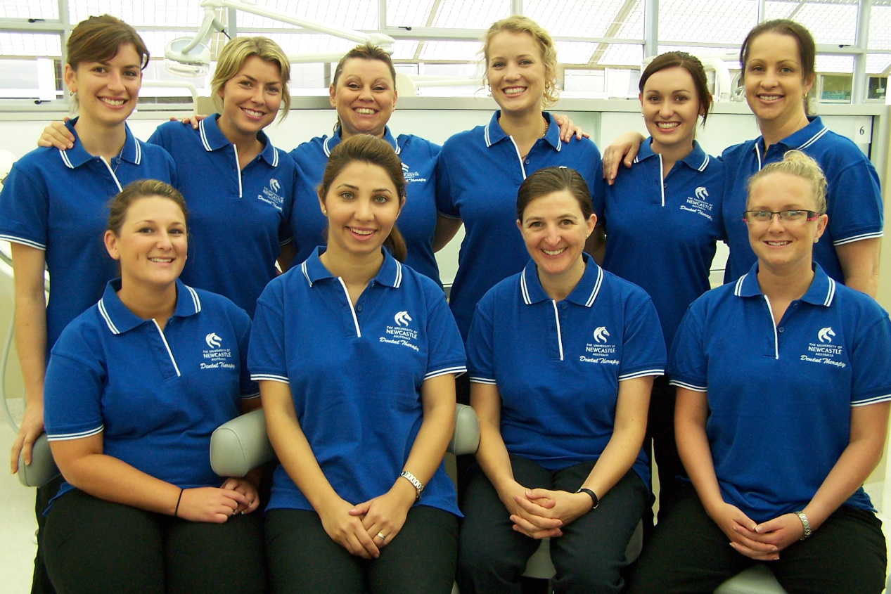
Thank you

Slide 26
Notes:
The University of Newcastle C50 Introduction/Final Slide
The UON C50 (Celebrating 50) badge is included on UON materials in the lead-up to and during UON's 50 year Celebrations in 2015.
When the celebrations are wrapped, new templates with the C50 badging removed will be available via the MRC . Please check the Marketing Resource Centre (MRC) at newcastle.edu.au/mrc to keep up to date with all the new templates.
This slide is not to be altered in any way.

