Slide 1
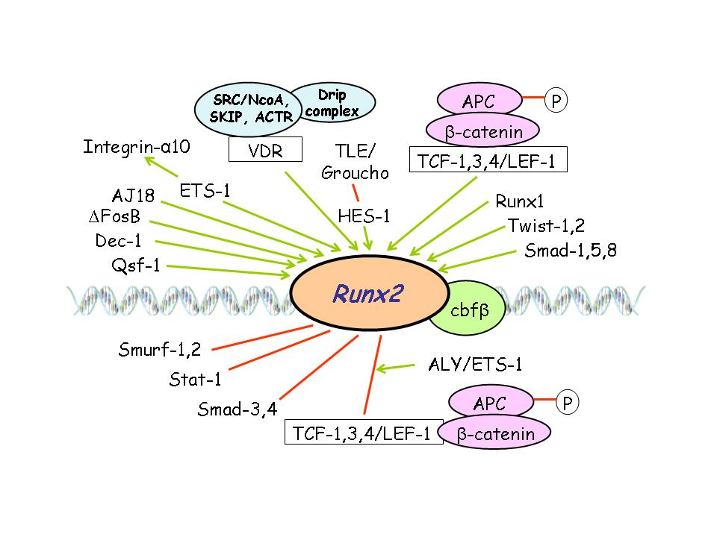
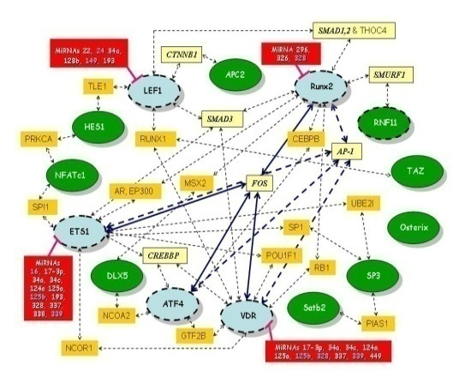
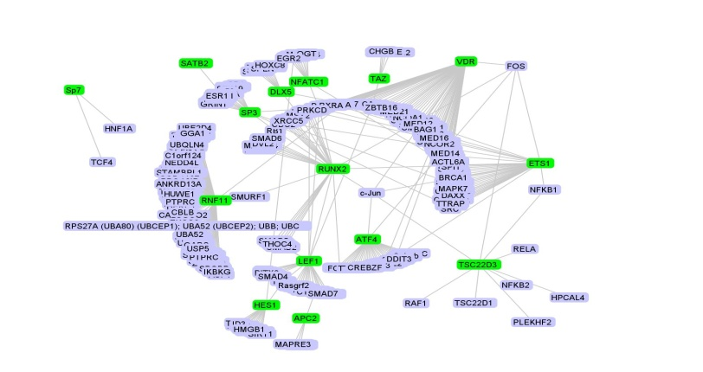
Key regulatory junctions
stabilizing the osteoblast phenotype
Implications for cell and tissue engineering
Jan O. Gordeladze^{1,2,3}, Janne E. Reseland⁴
Unni syversen⁵ and Mauro Valtieri⁶
¹Department of Biochemistry, Institute for Basal Medical Sciences of the Medical Faculty, University of Oslo, Norway; ²Institut National de la Santé et de la Recherche Médicale (INSERM) U844, Montpellier, France; ³Université Montpellier 1; ⁴University of Oslo, Inst. of Odontology; ⁵NTNU and Dept. of Endocrinology, St. Olav’s Hospital Trondheim, Norway; ⁶Istituto Superiore di Sanità, University of Rome, Italy,

Slide 2
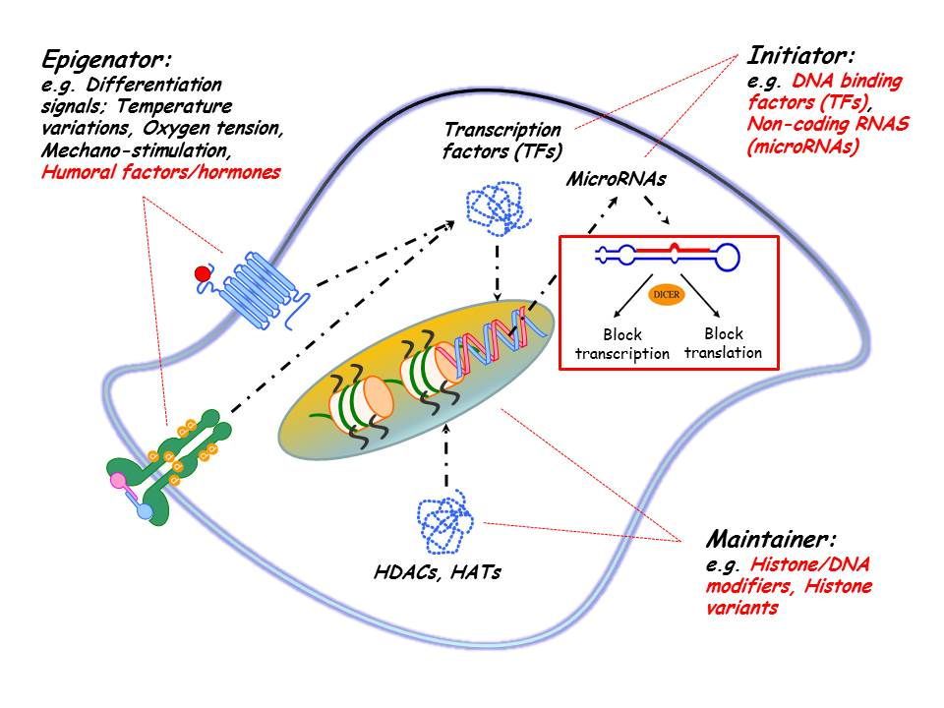
The «epigenator, initiator, and maintainer» principle of epigenetics on phenotype acquisition and maintenance

Slide 3
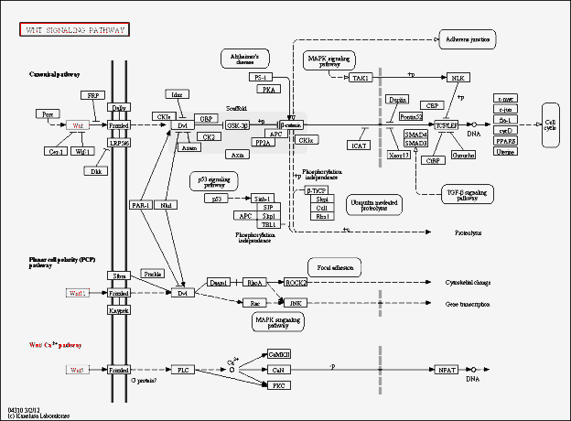
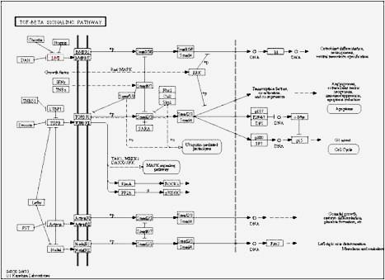
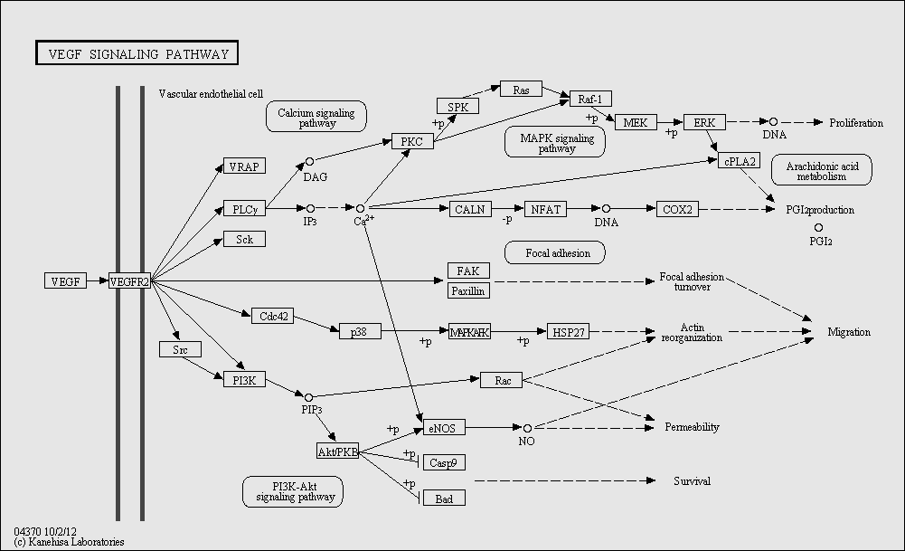
Factors to play with: Signaling molecules
For selected TFs: Skeletal system, p<10⁻¹⁷
GO-analysis (Panther)

Slide 4
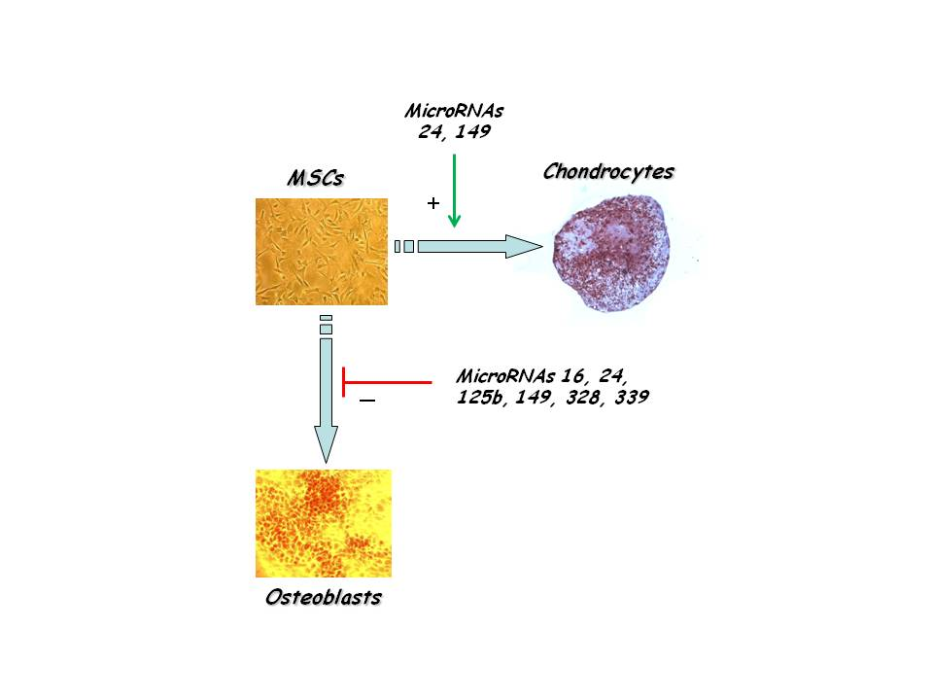
How the microRNA signature affects differentiation of osteoblasts and chondrocytes from hMSCs
6 microRNA species specifically block osteoblastogenesis, thereby promoting chondrogenesis, targeting at least 9 transcriptional modulators:

Slide 5
MiR-149 may serve as a switch-MiR yielding either osteoblasts or chondrocytes from stem cells
miR-149
ATF3
Runx2, APC2, RNF11
Precursor cell; e.g. stem cell
Pre-osteoblast; Osteoblast
SP1
TGFβ-R
Sox9
PPPIRI6B
(via SUMOylation)
cEBPA, ATF3, Stat3, PIAS1
PIAS1
miR-149

Slide 6
Experimental
approaches:
Identify and challenge regulatory loops including microRNA species of an osteoblast signature (16, 24, 125b, 149, 328, and 339), as well as 204 and 211, and transcription factors (TFs) instrumental in «guiding» stem cells to differentiate into osteoblasts, and
Test «stabilized» osteoblasts for resilience towards exposure to cytokines produced by Th-cells.

Slide 7
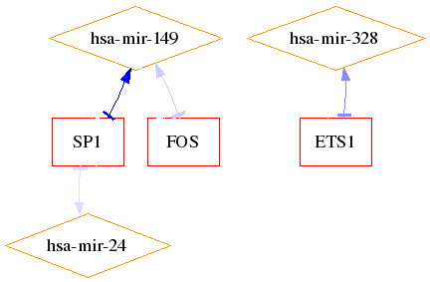
The use of the Mir@nt@n algorithm predicting interactions between transcription factors (TFs) and microRNAs
Osteoblast

Slide 8
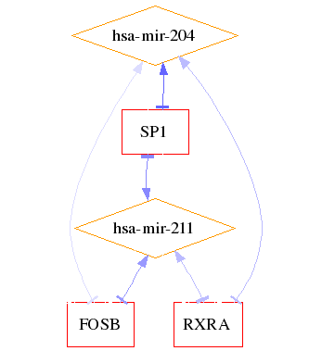
The use of the Mir@nt@n algorithm predicting interactions between transcription factors (TFs) and microRNAs
Osteo-chondro-adipocyte

Slide 9
Is SP1 important for Osteoblastogenesis?
“From a literature search (PubMed) on “SP1 transcription factor and osteoblasts”, SP1 is somehow interfering with the effect of Runx2, SP7 (osterix), FIAT (inhibitor of ATF4), ETS-like TFs, MZF1 (myeloid zinc finger), JUNB, and also directly affecting the transcription of marker genes like Col1α1, Col5α1, Col5α3, Col11α2, fibromodulin, osteocalcin, MGP (matrix-gla protein), RANKL, Pit phosphate transporter, Integrin β5, and TGFβ-R1.

Slide 10
Outline of interconnected experiments
Analyses:
Q-PCR of TFs, HDACs, marker genes, microRNAs, mineralizing surface

Slide 11
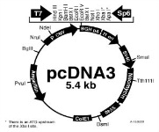
Outline of key experiments
Analyses conducted:
Mineralized surface,
Immunohistochemistry,
Q-PCR of microRNAs and
Osteoblast marker mRNAs
and others
Medium ± Cytokines
(TNFα,IL-1, IL-8, and IL-17A)
Petri dish with stem cells
Stem cells (MSCs or ASCs) are manipulated in terms of either:
SP1-expressing vector or Sh-RNA vs SP1
Polycistronic constructs with mir-204/211 or mir-149 and antago-mirs vs same microRNA species
Gene-manipulation: e.g. of SP1 or microRNAs

Slide 12
The effect of SP1
overexpression
in engineered osteoblasts
Parameters | Control = 100% | + Cytokines | + SP1 | + SP1 + Cytokines
Runx2 | 100 | 27 | 432 | 324
Collagen1α1 | 100 | 47 | 145 | 133
Osteocalcin | 100 | 23 | 345 | 288
Osterix | 100 | 18 | 182 | 171
Mineralizing «surface» | 100 | 22 | 234 | 198
OPG/Rank-L ratio | 100 | 435 | 27 | 321
PPARγ | 100 | 534 | 28 | 43
HSL | 100 | 385 | 35 | 58
Oil-Red-O «surface» | 100 | 689 | 36 | 32
Mir-149 | 100 | 546 | 34 | 75
Mir-328 | 100 | 465 | 37 | 58

Slide 13
The effect of mir-204/211
suppression
in engineered osteoblasts
Parameters | Control = 100% | + Cytokines | + Antago-mirs | + Antago-mirs + Cytokines
Runx2 | 100 | 25 | 389 | 319
Collagen1α1 | 100 | 36 | 319 | 272
Osteocalcin | 100 | 27 | 321 | 251
Osterix | 100 | 31 | 301 | 199
Mineralizing «surface» | 100 | 47 | 247 | 167
OPG/Rank-L ratio | 100 | 378 | 21 | 271
PPARγ | 100 | 444 | 19 | 39
HSL | 100 | 417 | 27 | 47
Oil-Red-O «surface» | 100 | 571 | 27 | 41
Mir-149 | 100 | 449 | 31 | 69
Mir-328 | 100 | 577 | 41 | 48

Slide 14
Summary and Conclusion
The use of bioinformatics (the Mir@nt@n algorithm) backed by PubMed searches yields interesting paradigm shifts as to which of many TFs are the better markers for cell phenotypes (SP1 instead of Runx2; Osterix = SP7) characterizing osteoblasts?
Manipulating members of regulatory loops encompassing TFs and microRNAs makes it easier to either disrupt or reinforce the stability of a certain phenotype (e.g. enhance osteoblast resilience against exposure to imflammation).
Identifying regulatory loops encompassing microRNAs and TFs may thus be important/mandatory for the success of cell engineering/replacement cell therapy.

Slide 15
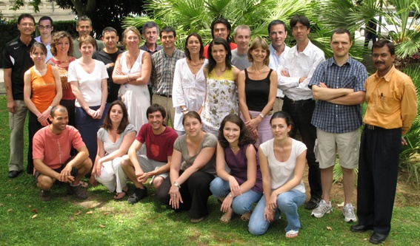
To be commended for their scientific and technical support and never-ceasing enthusiasm:
INSERM U844, Montpellier, France
&
Université Montpellier 1, enabling me to work within the U844 as a guest professor for 3 years
Thank you for your attention!

