Slide 1
About OMICS Group
OMICS Group International is an amalgamation of Open Access publications and worldwide international science conferences and events. Established in the year 2007 with the sole aim of making the information on Sciences and technology ‘Open Access’, OMICS Group publishes 400 online open access scholarly journals in all aspects of Science, Engineering, Management and Technology journals. OMICS Group has been instrumental in taking the knowledge on Science & technology to the doorsteps of ordinary men and women. Research Scholars, Students, Libraries, Educational Institutions, Research centers and the industry are main stakeholders that benefitted greatly from this knowledge dissemination. OMICS Group also organizes 300 International conferences annually across the globe, where knowledge transfer takes place through debates, round table discussions, poster presentations, workshops, symposia and exhibitions.

Slide 2
About OMICS Group Conferences
OMICS Group International is a pioneer and leading science event organizer, which publishes around 400 open access journals and conducts over 300 Medical, Clinical, Engineering, Life Sciences, Phrama scientific conferences all over the globe annually with the support of more than 1000 scientific associations and 30,000 editorial board members and 3.5 million followers to its credit.
OMICS Group has organized 500 conferences, workshops and national symposiums across the major cities including San Francisco, Las Vegas, San Antonio, Omaha, Orlando, Raleigh, Santa Clara, Chicago, Philadelphia, Baltimore, United Kingdom, Valencia, Dubai, Beijing, Hyderabad, Bengaluru and Mumbai.

Slide 3
Flavonol acyl glucosides from the aril of Schotia brachypetala Sond. and their antioxidant, antibacterial, and antimalarial activities
Jan H van der Westhuizen
Directorate Research Development, University of the Free State, Bloemfontein, South Africa

Slide 4
South African Biodiversity
South Africa is one of richest centres in the world in diversity of plant species
More than 20 000 different plant species
Particularly the seeds have not been well studied

Slide 5
Seeds from South African plants
A variety of seeds were collected and their methanol extracts screened for bioactivity in autobiographic DPPH radical scavenging and the acetylcholinesterase inhibition bioassays (TLC) and for antibacterial and antiplasmodial activity
S. brachypetala was chosen for further investigation

Slide 6
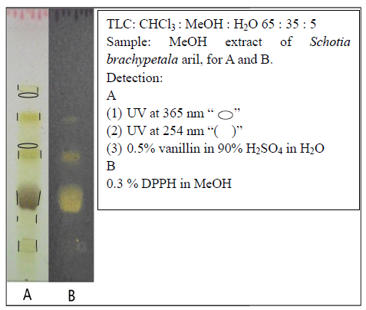
Strong DPPH radical scavenging activity of the MeOH extract of S. brachypetala aril on TLC
Antibacterial activities of the crude MeOH extract of the MeOH extract of S. brachypetala aril MIC values (mg/mL).
 | E. coli ATCC 8739 | K. pneumoniae ATCC 13883 | Staph. aureus ATCC 25923 | E. faecalis ATCC 29212
Crude extract | 0.5 | 8.0 | 16.0 | 8.0
Culture control | >16.0 | >16.0 | >16.0 | >16.0
Negative control | >16.0 | >16.0 | >16.0 | >16.0
Ciprofloxacin control (μg/mL) | 0.63 | 0.12 | 0.30 | 0.63
Sample load on TLC: 10 μL of a stock solution (10 mg/mL)
Moderate Antiplasmodial activity of the MeOH extract of S. brachypetala aril
IC₅₀ ± s.d. (μg/mL) 18.95 ± 2.97
NO Inhibition of acetylcholinesterase by the MeOH extract of S. brachypetala aril on the TLC

Slide 7
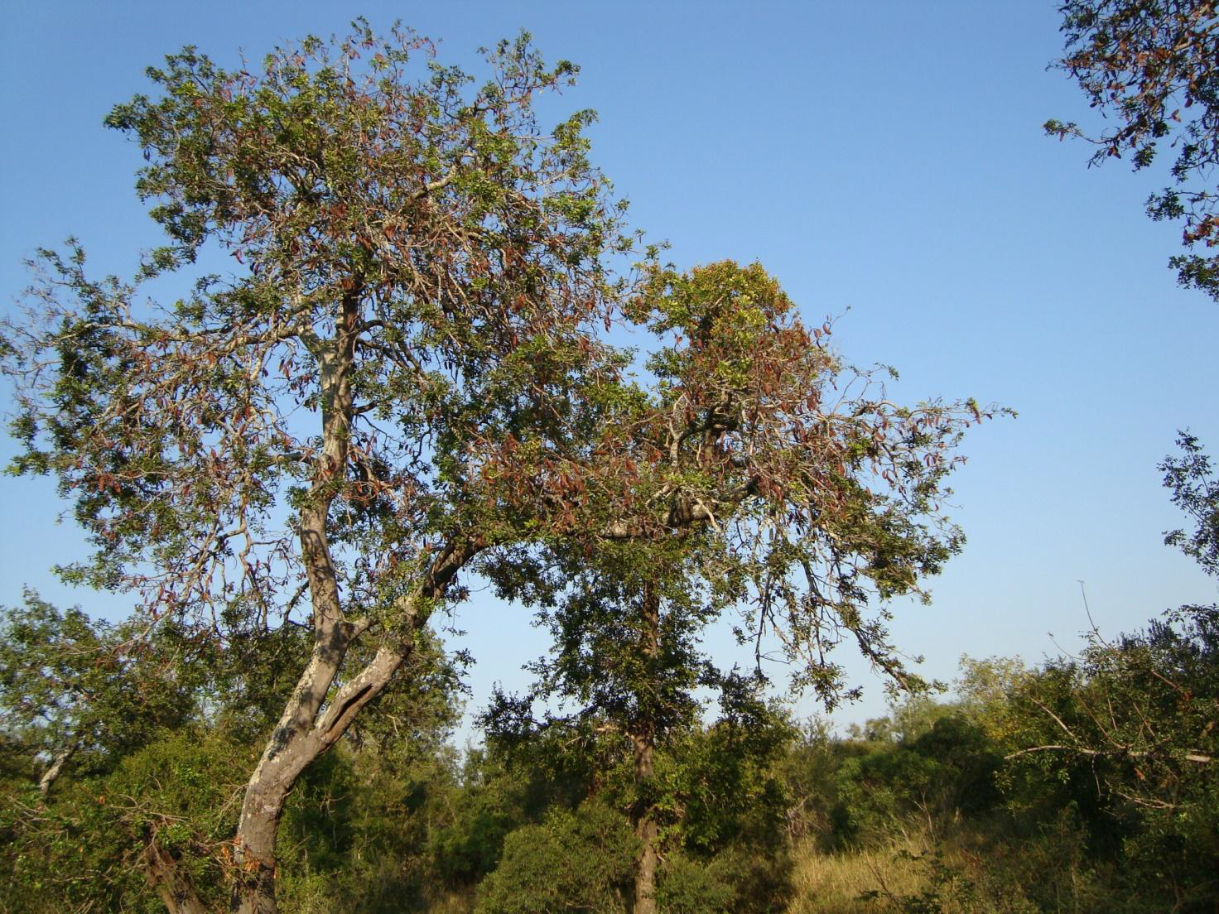
Schotia brachypetala trees Mpumalanga Province

Slide 8
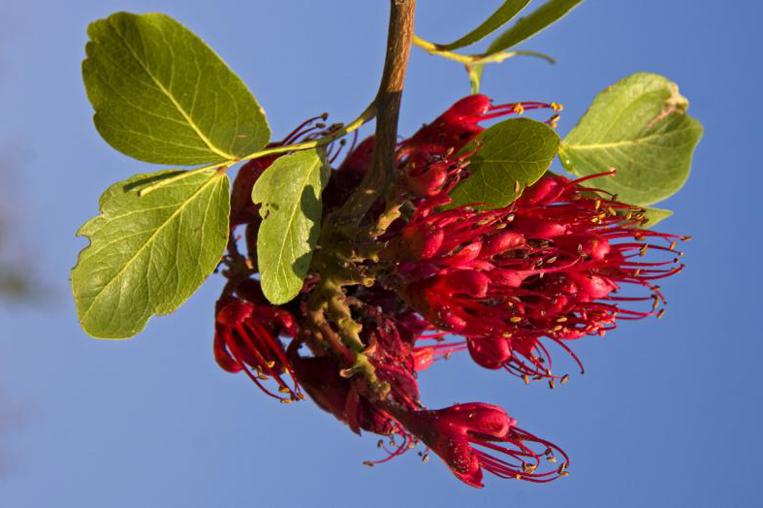
Flower of Schotia brachypetela

Slide 9
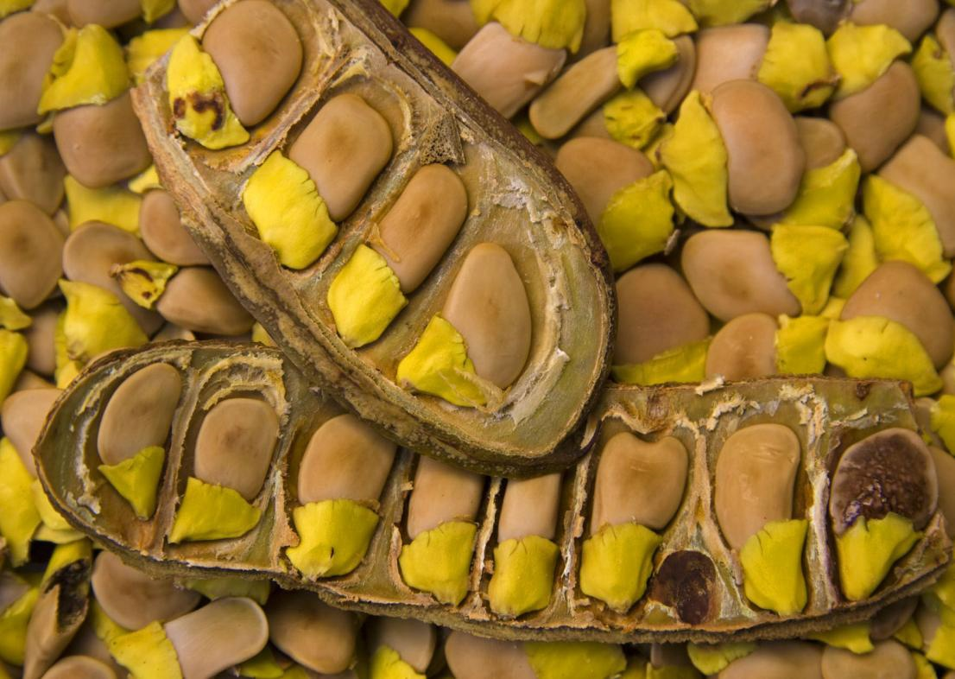
Fruit pods of Schotia brachypetala with the yellow arils

Slide 10
Some traditional uses of S. brachypetala
Traditional healers use a decoction of the bark to treat dysentery and diarrhoea, nervous heart conditions, flu symptoms, excessive beer drinking and as an emetic and to strengthen the body. The roots are also used to treat diarrhoea and heartburn
The seeds can be roasted and eaten and the plant was listed in a review for its potential value as a new crop
Watt J.M., Breyer-Brandwijk M.G. The Medicinal and Poisonous Plants of Southern and Eastern Africa. 2nd ed. 1962. E. & S. Livingstone (Edinburgh), Livingstone, London. A. Hutchings. Zulu Medicinal Plants. University of Natal Press, Pietermaritzburg (1996).

Slide 11
“Semi-bioguided” isolation strategy
Active fractions, not necessarily active compounds, were identified
All the compounds, not necessarily the active ones, in the active fractions were isolated
Isolated compounds were then evaluated for their biological activity
Whole process was monitored by TLC
Reduce time in contact with chromatographic materials

Slide 12
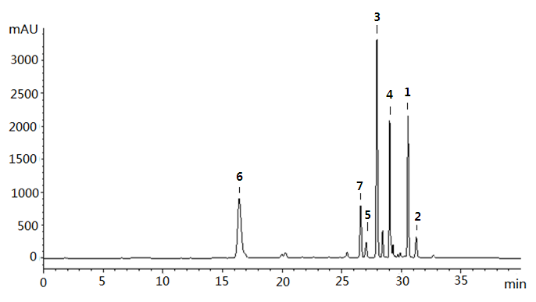
HPLC chromatogram of the methanol extract of Schotia brachypetala aril (detection: 254 nm)
Column: Phenomenex C18 reverse phase column (150 x 4.6 mm, 5 micron); solvents: A: distilled H2O + 0.1% formic acid, B: 70% MeOH/ H2O + 0.1% formic acid, gradient: 0-15 min, 10-30% B; 15-25 min, 30-70% B; 25-27 min, 70-100% B; 27-35 min, 100% B; flow rate: 1 ml/min; injection: 10 μl of a stock solution of S. brachypetala aril MeOH extract at a concentration of 10 mg/ml in MeOH.

Slide 13
Countercurrent Chromatograpy
Countercurrent chromatography was employed as the main chromatography technique
In this technique, the stationary phase and mobile phase are two immiscible solvents and no solid support (e.g. silica gel) is present
Adsorption of analyses to the solid phase and decomposition is avoided and a high recovery rate is thus achieved
By using fast spinning coils, it is possible to pump two immiscible solvents in opposite directions in the same tube
Easy scaling up to preparative level a major advantage

Slide 14
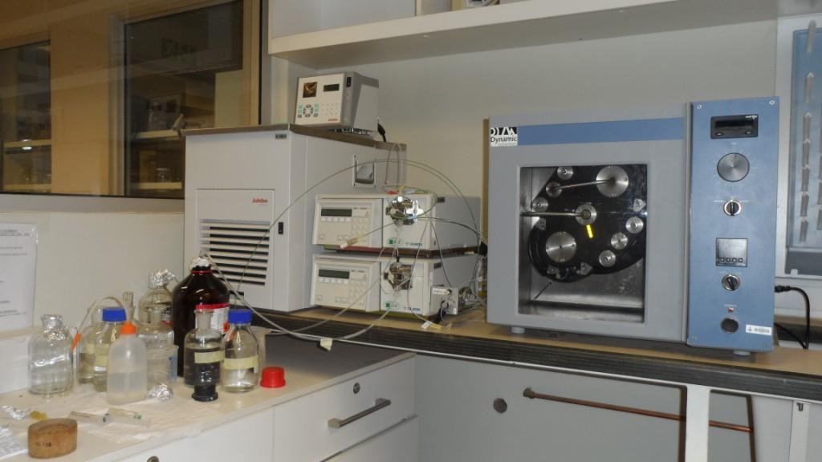
High-speed Contercurrent Chromatography (HSCCC) equipment

Slide 15
Solvent selection and coil loading
The choice of solvent systems was based on TLC analyses
Sample (5 mg) was dissolved in a mixture of 1 ml of the upper and 1 ml of the lower phase and 10 μL of each phase was deposited on a TLC plate.
Solvent systems which afforded an even distribution of the analytes between upper and lower phase were chosen
The coils of the chromatograph were first filled with stationary phase and then the mobile phase was pumped into the apparatus under rotation until conditions were stable and no more stationary phase eluted. The sample was then dissolved in equal amounts of upper and lower phases and injected via a sample loop

Slide 16
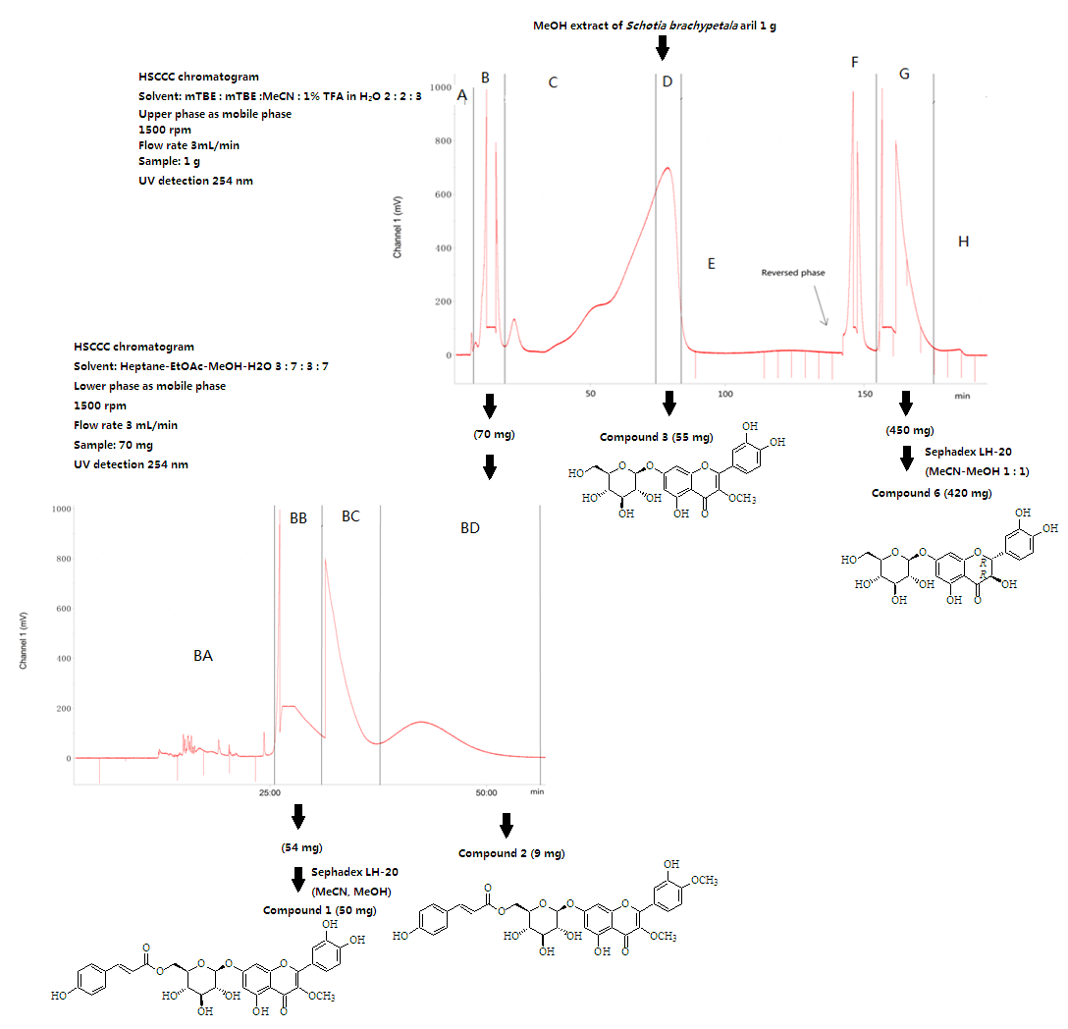
Preparative isolation scheme of cCompounds 1, 2, 3 and 6

Slide 17
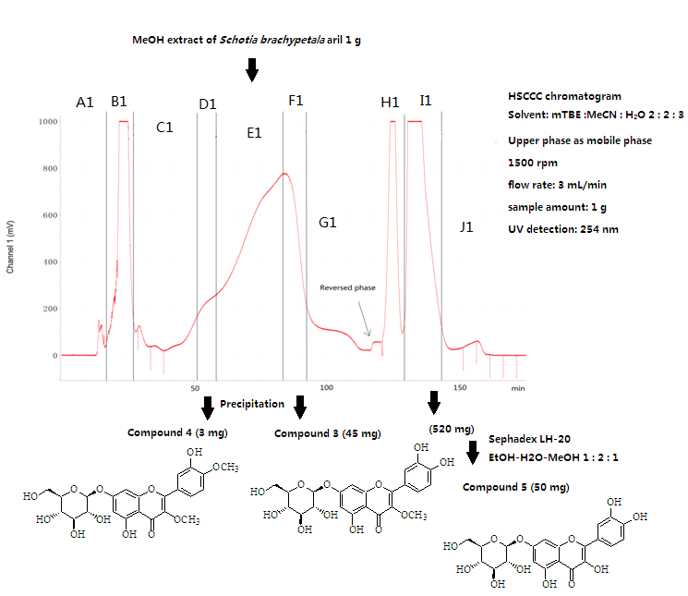
Preparative isolation scheme of compounds 3, 4 and 5

Slide 18
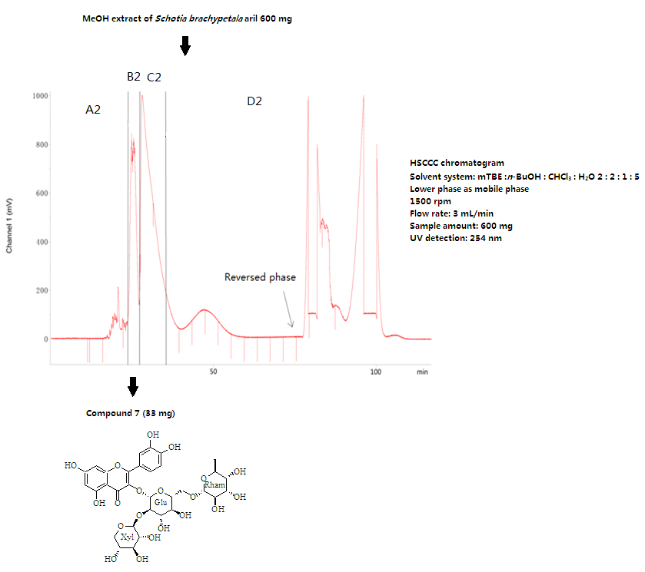
Preparative isolation scheme of compound 7

Slide 19
Compounds 1 and 2

Slide 20
Structure elucidation of 1
Molecular ion (m/z 625.1539 [M+H]⁺ ) corresponds with a molecular formula of C₃₁H₂₈O₁₄
One of the six oxygenated carbon resonances in the δ 60-80 region correlates with a three proton singulet in the HSQC spectrum, suggesting a methoxy group
The other five, and an anomeric carbon at 99.78 correlating with doublets in the 3.6 to 5.1 region, suggest a sugar.
Acid hydrolysis gives β-glucose (TLC, ref standard)
D-glucose via GC of thiazolidine derivative
The J = 15.75 Hz suggests a trans double bond
The significant downfield shift of two H-6'' resonances (δ 4.62 and 4.29) suggests that the coumaryl moiety is attached at 6''- OH. Corroborated by the HMBC correlation between the ester carbonyl at 167 and H-6 ''
Basic hydrolysis give coumaric acid

Slide 21
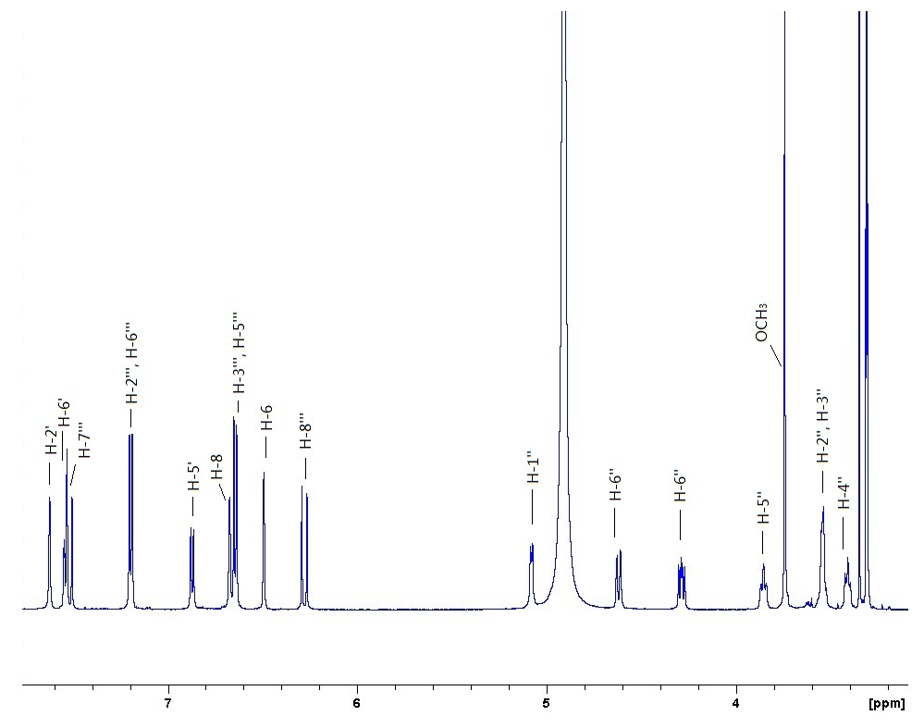
¹H NMR spectrum (600 MHz, CD₃OD) of compound 1

Slide 22
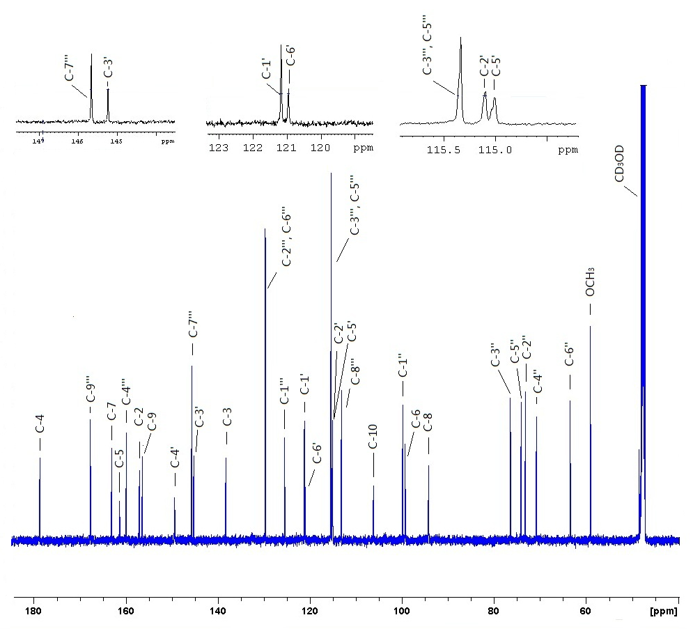
¹³C NMR spectrum (150 MHz, CD₃OD) of compound 1

Slide 23
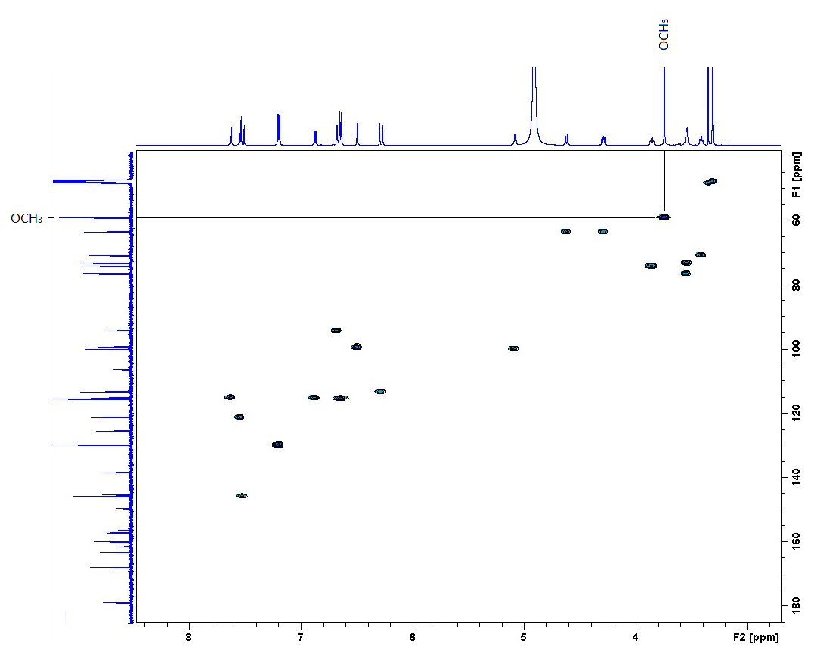
HSQC spectrum of compound 1

Slide 24
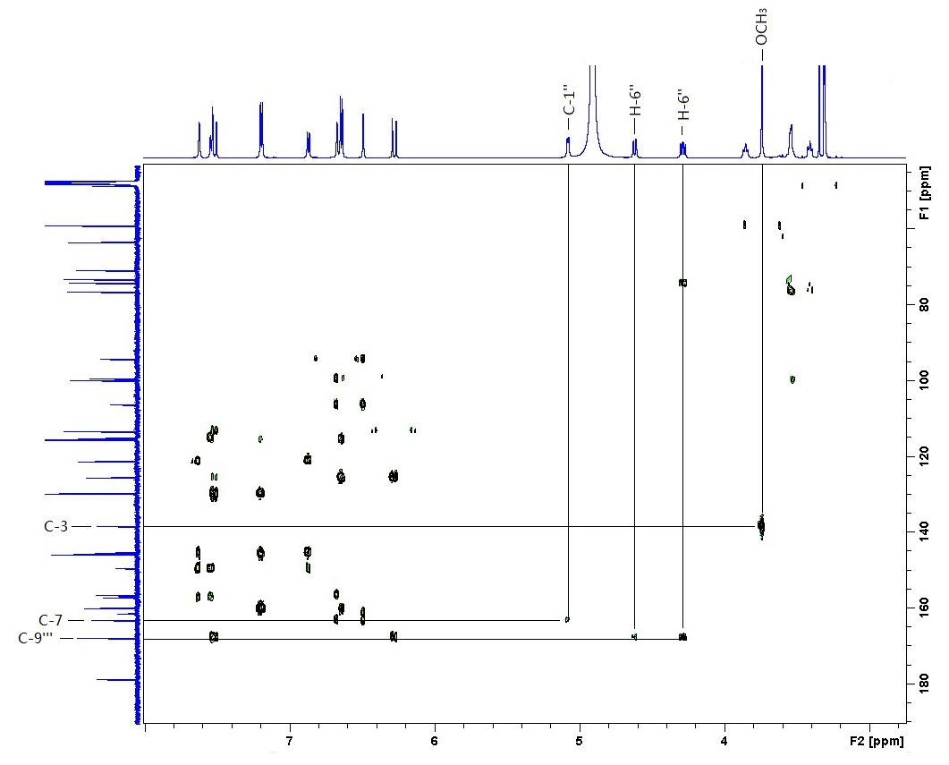
HMBC spectrum of compound 1

Slide 25
MS identification of coumaric acid moiety
Product ion scan of m/z 163 fragment in MS of compound 1 (M⁺:m/z 623) (negative mode)
Product ion scan of coumaric acid reference standard samples showing the precursor ion [M - H]⁻ at m/z 163 and the product ions produced by collision induced dissociation.

Slide 26
HPLC identification of coumaric acid
HPLC chromatogram of p-coumaric acid (reference standard) at a retention time of 1.92 minutes.
HPLC chromatogram of p-coumaric acid in hydrolised sample at a retention time of 1.92 minutes

Slide 27
Absolute configuration of hydrolised sugars
GC chromatogram of the thiazolidine derivatives of the acid hydrolyzed sugars from the crude MeOH extract
Chromatogram of the thiazolidine derivatives of the mixture of the acid hydrolyzed sugars from the crude MeOH extract spiked with the thiazolidine derivative of L-glucose

Slide 28
Compounds 3 to 5

Slide 29
Compounds 6

Slide 30
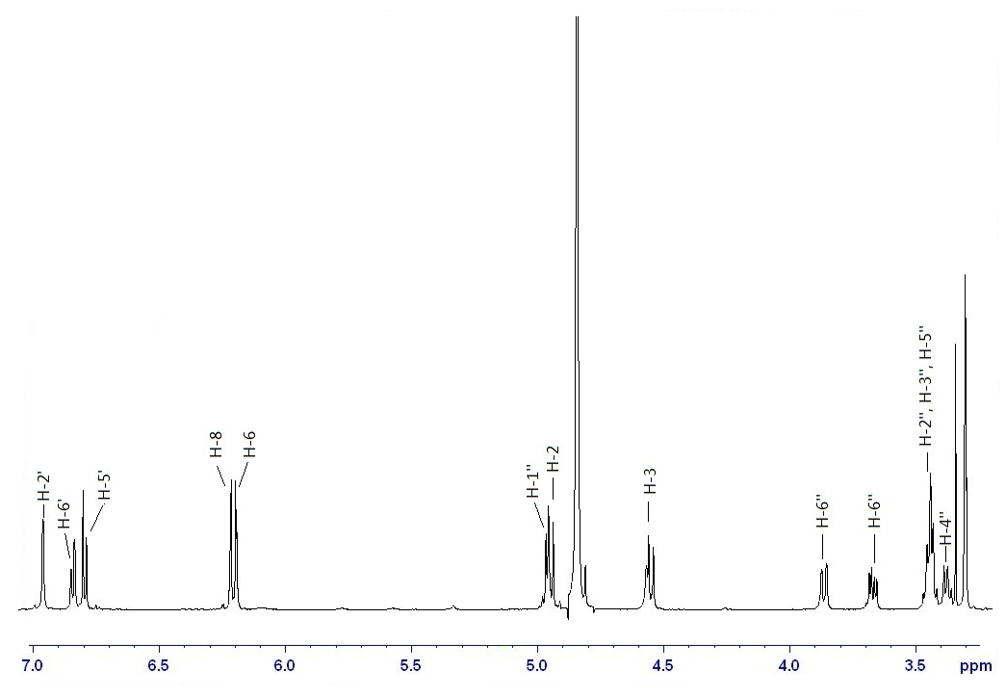
¹H NMR spectrum (600 MHz, CD₃OD) of compound 6

Slide 32
Compound 7

Slide 33
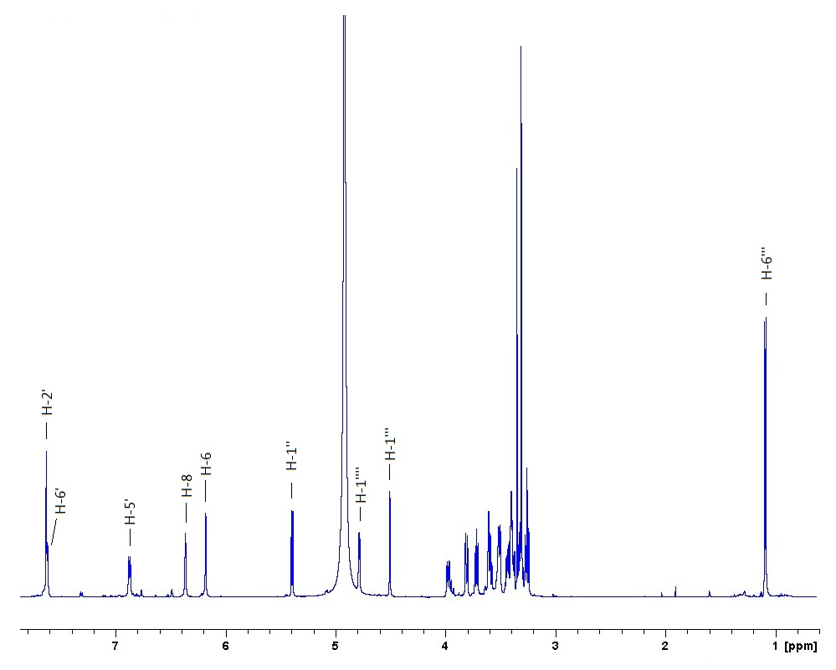
¹H NMR spectrum (600 MHz, CD₃OD) of compound 7

Slide 34
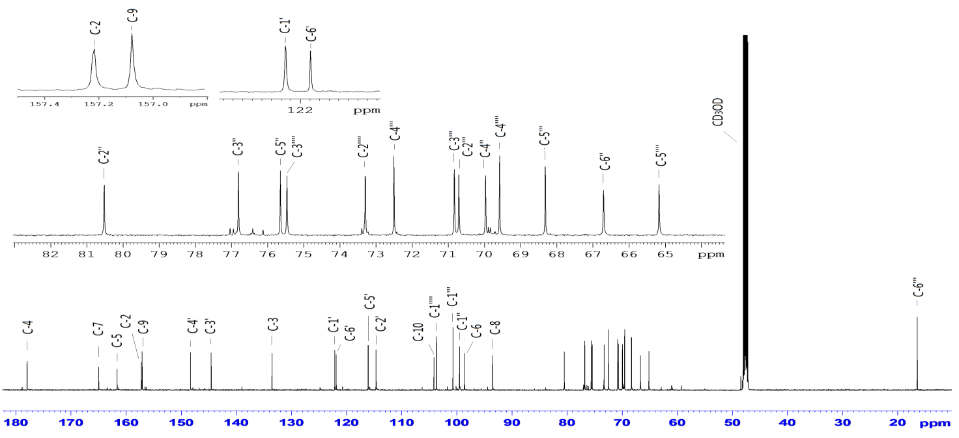
¹³C NMR spectrum (150 MHz, CD₃OD) of compound 7

Slide 35
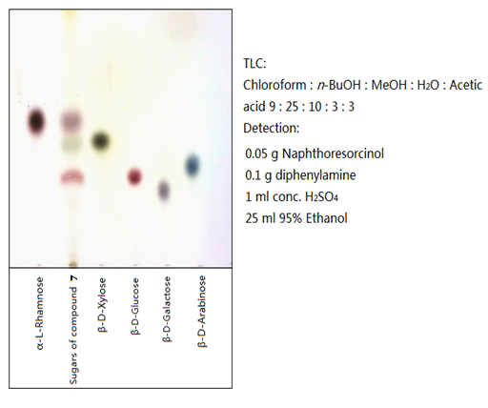
Sugars via acid hydrolysis of compound 7

Slide 36
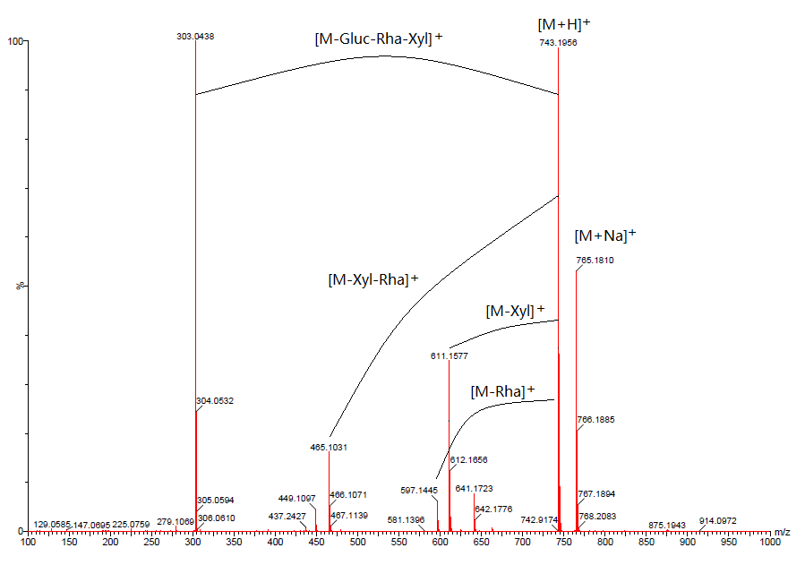
Fragmentation MS of compound 7

Slide 37
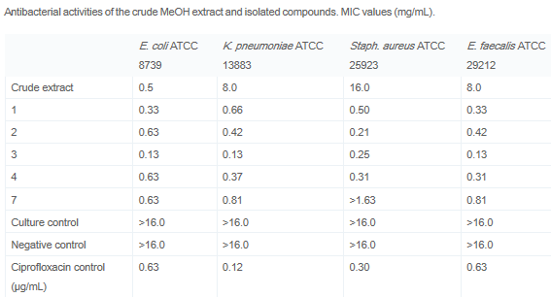
Antimicrobial activities

Slide 38
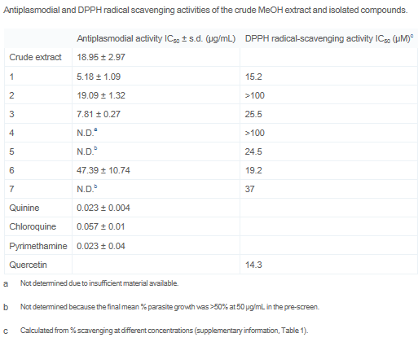
Antiplasmodial and DPPH radical scavenging activities of the crude MeOH extract and isolated compounds

Slide 39
Radical scavenging activity of 1 and 2

Slide 40
4'-OH required DPPH scavenging (quinone methide)

Slide 41
CO-WORKERS
Kun Du, University of the Free State, South Africa (MSc thesis)
Andrew Marston (deceased), University of the Free State, South Africa
Sandy F. van Vuuren, University of the Witwatersrand, South Africa (antimicrobial bioassay)
Robyn L. van Zyl, University of the Witwatersrand, South Africa (antiplasmodial bioassay)
Christina Coleman, University of Mississippi, USA
Pieter C. Zietsman, National Museum, Bloemfontein, South Africa (plant collection)
Susan L. Bonnet, University of the Free State, South Africa
Daneel Ferreira, University of Mississippi, USA (CD spectra)

Slide 42
Acknowledgements
University of the Free State for financial assistance
Multi-Disciplinary University Traditional Health Initiative (MUTHI): Building Sustainable Research Capacity on Plants for Better Public Health in Africa European Union Seventh Framework programme. Grant number 266005

Slide 43
Lets Meet again at Pharmacognosy-2015
3rd International Conference and Exhibition on Pharmacognosy, Phytochemistry and Natural Products
October 26-28, 2015 Hyderabad, India
Theme: Advanced trends for the future of Herbal Drugs and Products
Website: http://pharmacognosy-phytochemistry-natural-products.pharmaceuticalconferences.com/

