Slide 1
A New Approach to the Treatment of Severe Pain – A Topical Liniment made from a California Plant
James David Adams, Jr.
Professor of Pharmacology
Chumash Healer
Humans have existed for about 200,000 years and have always used plants as medicines. There has been a natural selection. Those who responded to plant medicines survived and passed on their genes. We must continue to use plant medicines today.

Slide 2
Transient Receptor Potential Cation Channels
Modified from Nat Rev Drug Discov 8(1): 55–68 (2009)
JPET 325: 1007-1015 (2008)
Plant derived monoterpenes are powerful pain relievers at TRP channels. J Pharmacog
Phytother 5: 1-11 (2013)

Slide 3
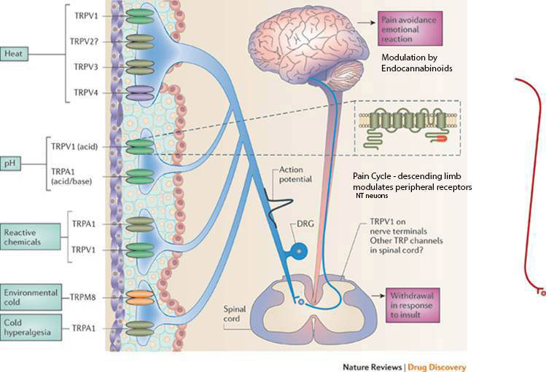
Endocannabinoids – Anandamide, arachidonoylglycerol, arachidonoyldopamine
Modified from Nature Reviews Drug Discovery 10, 601-620 (2011)

Slide 4
Chronic Pain and Cyclooxygenase 2
Chronic pain is a learned response that involves induction of COX2 in the skin.
Prostaglandins from COX2 alter the cAMP dependent phosphorylation of TRP in the skin and enhance pain (Hingtgen et al, 1995).
Oral medications do not adequately inhibit COX2 in the skin (Ma and Quirion, 2008).
Toxicity from oral COX inhibitors
100,000 ulcers yearly at $50,000 per ulcer = $ 5 billion
10,000 of the ulcers die
Kidney pathology, liver pathology (acetaminophen)
Strokes
Heart attacks
Hingtgen CM, Waite KJ, Vasko MR. Prostaglandins facilitate peptide
release from rat sensory neurons by activating the adenosine 3’,5’-cyclic
monophosphate transduction cascade. J Neurosci 1995; 15: 5411-9.
Ma W, Quirion R. Does COX2 dependent PGE2 play a role in
neuropathic pain? Neurosci Lett 2008; 437: 165-9.

Slide 5
Opioids for Pain
Oral opioids inhibit opioid receptors in the brain and brain stem, inadequate for the skin opioid receptors.
Carpenter approach – If the hammer does not work, get a bigger hammer.
Addiction, tolerance, toxicity, opioid hyperalgesia possibly induced by nociception (Pan et al., 2000)
14,000 deaths yearly from prescription opioids
Respiratory depression, seizures
Pan ZZ, Hirakawa N, Fields HL. A cellular mechanism for the
bidirectional pain modulating action of orphanin FQ/nociception.
Neuron 2000; 26: 515-22.

Slide 6
Currently Available Monoterpenoid Medicines are Inadequate
Camphor, cineole and menthol are currently available for topical use but do not provide pain relief for severe pain.
They are too specific. They only inhibit a few TRP.

Slide 7
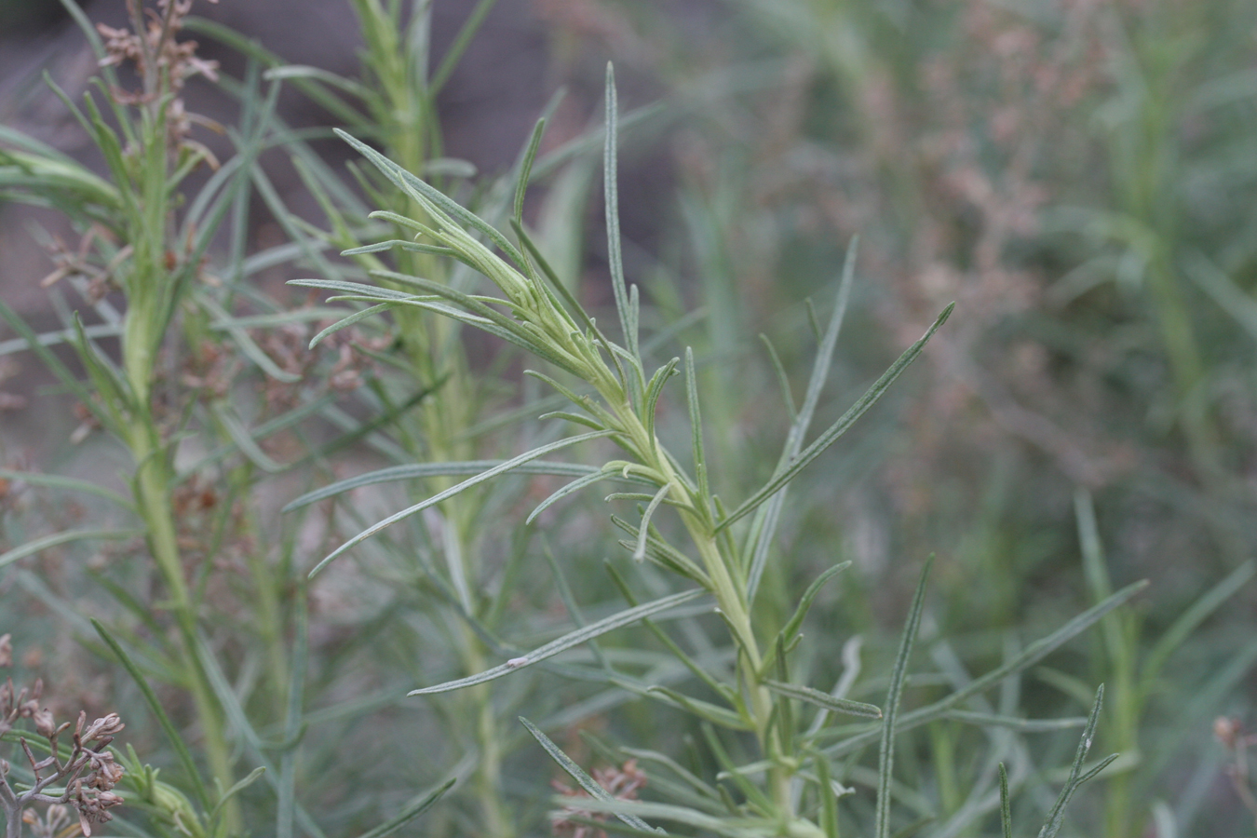
California Sagebrush Artemisia californica

Slide 11
Recipe for California Sagebrush Liniment
From Healing with Medicinal Plants of the West by Garcia and Adams, 2012
86 g of fresh leaves and stems of A californica, Artemisia tridentata can be used
1 leaf of Salvia apiana white sage
1 seed of Persea americana avocado
500 mL of 70% isopropanol
Place in a glass jar for 6 weeks

Slide 12
Patient Treatment
The liniment is applied to a cotton ball and painted onto the skin at sites of pain. Pain relief occurs within 20 min.
Osteoarthritis, rheumatoid arthritis, chronic back pain, fibromyalgia, broken bones, car or bicycle accidents, cancer pain, neuralgia, over exertion, sports injuries, bursitis and other pain has been treated in several hundred patients
Funding is not available to do the tests required by the FDA for investigational new drug application approval for clinical trials.
J Adams and X Wang. Control of pain with topical plant medicines. Asian J Tropical Biomed 5(4) 930-5 (2015).
J Adams. The use of California sagebrush (Artemisia californica) liniment to control pain. Pharmaceuticals 5: 1045-53 (2012).
P Fontaine, V Wong, T Williams, C Garcia, J Adams. Chemical composition and antinociceptive activity of California sagebrush (Artemisia californica) J Pharmacog Phytother 5(1) 1-11 (2013).

Slide 13
The Open Complementary Medicine Journal, 2011, 3, 10-12
1876-391X/11 2011 Bentham Open
Open Access
Adams Disease: Description and Management with Capsaicin and Heat
James D. Adams, Jr.*
Department of Pharmacology and Pharmaceutical Sciences, University of Southern California, School of Pharmacy,
Los Angeles, California, USA
Abstract: Background/purpose: This work describes a new skin disease for the first time, Adams disease, and the management of the disease. Methods: Adams disease is caused by chafing and irritations, causes the skin to form rashes or thickening, crack and bleed. The skin is also sensitive to temperature and moisture changes and responds with itching and pain. Other symptoms include a swollen lower leg and a retina tear. Results: Adams disease of the fingers responds to hot water treatments. Capsaicin cream is effective against rashes anywhere on the body and thickening of the palms and soles of the feet. The swollen lower leg responds temporarily to hot water and oral steroids. Conclusion: Adams disease may be an auto-inflammatory disease caused by dysfunctional transient receptor potential cation vanilloid 1 channels. The disease is chronic, has exacerbations and remissions and can be managed with hot water treatments and capsaicin cream.
Keywords: Adams disease, chronic skin disease, auto-inflammatory disease, TRPV1 receptors, capsaicin, heat.

