Slide 1
CAROTID BLOW OUT SYNDROME Endovascular Management by Stenting and Embolization 20th Euro-Global Summit on Cancer Therapy & Radiation Oncology
Jaime Tisnado, M.D, FACR, FSIR, FACC, FSAR, FAHA
Professor of Radiology, Interventional Radiology, Professor of Surgery, Cardiovascular Surgery
VCU Health Sciences Center, Richmond, Virginia, USA
Interventional Radiologist Memorial University Hospital
Savannah , Georgia, USA
Interventional Radiologist CompHealth
Salt Lake City, Utah, USA

Slide 2
Virginia Commonwealth University Health Sciences Center Richmond-Virginia

Slide 4
Introduction
Carotid blow out syndrome (CBOS) is a catastrophic emergency associated with high Morbidity & Mortality (M&M).
The etiologies are radiotherapy for head and neck tumors, tumor invasion, trauma, inflammatory, post operative, and others.
There are three types (or stages): 1) threatened, 2) impending, and 3) acute.
The conventional surgical management includes carotid artery/branch ligation and/or carotid artery bypass. Both have limited success, fraught with high M&M, and ineffective in some cases.
With the advent of stents (uncovered and covered, self-expanding and balloon expandable), the emergent IR management has improved and, at this time, a fatal entity is managed with temporary success.

Slide 5
Carotid Blow-Out Syndrome
Described in 1962
Mortality 40%
Neurological morbidity 60%
Occurs in 3-4% of patients after H&N surgery
Accounts for 11% of deaths in advanced H&N cancer

Slide 6
Types
1. Threatened
-exposed CA will eventually rupture, if not covered with viable tissue
-angiography shows neoplastic invasion of the CA
-pseudo, not bleeding
Grading
1. no vascular disruption in angiogram
2. focal weakening, irregularity of vessel wall
3. pseudoA
4. extravasation of contrast material
2. Impending
-sentinel bleeding from neck, may precede actual BO
-resolves spontaneously with surgical packing
-variable interval. Short term to months
3. Acute
-acute, profuse hemorrhage, not self-limiting
-not well controlled with surgical packing
-complete rupture of CA
-massive bleeding due to rupture of CA
-high mortality, almost instantaneous death

Slide 7
Radiotherapy
The most common etiology for CBOS
Almost 100% of CBOS occur in irradiated fields
Increased risk if irradiation is close in time to surgery of H&N
8 fold risk of CBOS after radiation for H&N surgery

Slide 8
Other Causes
H&N surgery local or near CA
-radical neck 4% incidence of CBOS
-removal of soft tissue protection to CA
-iatrogenic or mechanical injury to CA adventitia
-decreased healing, removal of lymphatics, increased venous stasis

Slide 9
Increased Risks
Salvage emergency surgery
Necrosis of flaps
Infection
Previous irradiation
Recurrent tumor invasion of Carotid Artery

Slide 10
Risk factors for CBOS in patients with H&N cancer
Pharyngeocutaneous fistula
Wound infection
Exposure to saliva
Radiation therapy (increases risk 7 fold)
Radical dissection and stripping of CA sheath
Flap necrosis with CA exposure
Recurrent tumor

Slide 11
Physiopathology
Decreased blood flow in vasa vasora
Blood flow to CA is reduced to about 50% after 30gy radiotherapy
Adventitial fibrosis
Weakening of arterial wall
Vacuolization, edema, fragmentation of media elastic fibers

Slide 12
Imaging
CT/ MRI
DSA study of choice
Evaluate for signs and symptoms of CBOS
Evaluate for collaterals
Patency and completeness of circle of Willis

Slide 13
Management
Historically managed by open surgical ligation of CA and branches
60% neurological morbidity
40% mortality
Outcome improved with endovascular management
CA balloon occlusion
15%-20% neurological morbidity
CA stenting
8% neurological morbidity

Slide 14
Conventional Management of CBOS is Emergent Ligation of CA
Conventional management of CBOS is emergent ligation of CA
(ICA or CCA and/ or branches)
Neurologic morbidity 60%
Occlusion of the CA associated with 15-20% of immediate or delayed cerebral ischemia

Slide 15
Endovascular Management
Since 1980s
Deconstructive: permanent occlusion of CA and branches
Reconstructive: preserve flow in CA
Percutaneous balloon occlusion
Detachable balloons
Other balloons
Technical success 95%
Embolization
Coils, PVA, glues, cyanoacrylate, onyx
Plugs : Amplatzer

Slide 16
Stenting
Covered or uncovered stents. Balloon expandable or self-expandable.
Promote sluggish flow and thrombosis of lesions around stent
Allows blood flow through stent
Strengthens the vessel wall
Procedure more demanding than occlusion, but relatively simple
Indicated in patients at risk of CA occlusion?
Incomplete circle of Willis
Occluded contralateral CA
May need co-adjuvant embolization as well
Combined procedure may be better: embolization and stenting

Slide 17
Stenting Long-term Outcomes
Stenting achieve hemostasis
Long-term outcomes not well determined
May be it is not ideal management
Unfavorable results have been reported

Slide 18
Problems
Recurrent bleeding
Need of keeping patient on anticoagulation therapy
CA thrombosis
Infection
Brain abscess

Slide 19
Literature Review
8 patients with H&N cancer and CBOS
Hemostasis achieved in 8
Early complications
stroke 1
thrombosis of CA 2
Late complications
rebleeding 4
CA thrombosis 3
Brain abscess
CONCLUSION:
Endovascular is a temporary treatment only
Unfavorable long term safety
Stent patency ?
Permanent hemostasis?
Chang 2007

Slide 20
Literature Review
27 articles on H&N cancer
1554 patients
All received radiation therapy
CBOS 41 (2.6%)
31 (76% fatal)
No difference in frequency of CBOS in:
Irradiated patients with or without chemotherapy
Irradiated patients with or without surgery before radiation
McDonald 2012

Slide 21
Meta-Analysis
Endovascular management of CBOS
comprehensive literature search 2000-2016
outcomes
technical success
post operative (procedural) rebleeding
survival time
perioperative (procedural) complications
25 studies. 559 patients
Technical success 100% (coiling and/or stenting)
Median survival time 3 months (0-96)
Perioperative (procedural) mortality 11%
Perioperative (procedural) rebleeding rate 27%
stroke 3%
infection 1%
At last FU 39% were alive
CONCLUSION
Embolization with coils and other devices and stenting are safe options for CBOS
Operative (procedural) complications relatively low
Success rates relatively high
Prognosis and management remains poor
Bond, JVS 3/2017

Slide 22
Patients & Methods
During the last few years, we have managed many patients (men, women, and children) with CBOS of different etiologies.
Most patients presented a difficult surgical approach or were deemed not appropriate surgical candidates.
Percutaneous insertion of different covered and uncovered, self-expanding and balloon-expandable stents was performed.
Stents used were: Gore Viabahn® Endoprosthesis, iCast™ (Atrium), Fluency® Plus (Bard), Wallstent (Boston Scientific), and Protégé (ev3).

Slide 23
Results
All procedures were done in the IR suite.
The IR management was successful in most patients.
There were no incidence of arterial rupture, occlusion,
thrombosis, stroke, or infection; resulting in a short follow up.

Slide 24
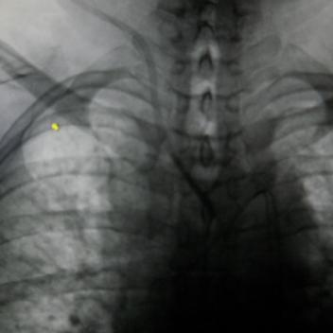
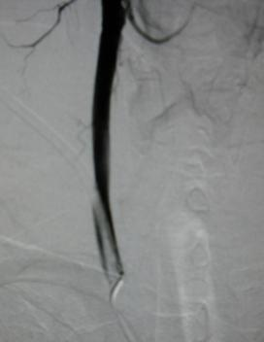
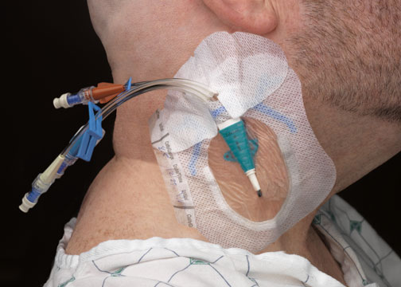
Case 1 (1)
50-year old man with ESRD had depleted central venous accesses, therefore a femoral venous catheter was inserted for HD. The patient presented to an outside institution with concern for a line infection and the femoral catheter was removed with subsequent insertion of a 16F temporary dialysis catheter in the right neck, “without difficulty.” The patient underwent HD with reported difficulty and pain for a couple of weeks until he was referred back to our institution for neck catheter exchange.
Upon fluoroscopy of the chest, it was obvious that the catheter was misplaced with its tip in the midline. Contrast material was injected demonstrating that the catheter had been inserted into the right common carotid artery, with the tip located in the aortic arch. After consultation, surgeons requested IR to remove the catheter and manually compress puncture site to achieve hemostasis. Due to potentially disastrous complications if manual compression failed, puncture was made of the right common femoral artery and wire access was obtained across the puncture site in the common carotid artery. However, upon catheter removal and manual compression, no hemostasis was achieved with evidence of an expanding neck hematoma.

Slide 25
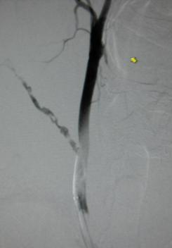
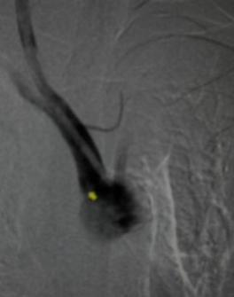
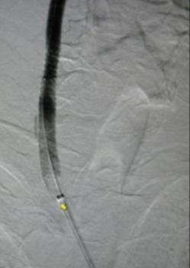
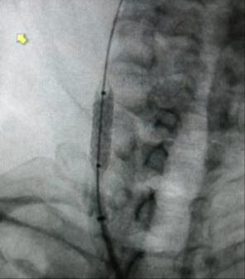
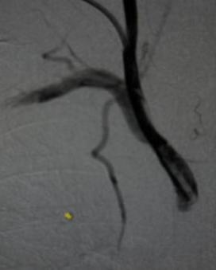
Case 1(2)
A follow-up arteriogram demonstrated free extravasation of contrast from the common carotid artery through the catheter track in the neck, therefore the decision was made to place a covered stent across the lesion.
Using the right common femoral arterial approach, a 6mm x 40mm iCast, covered stent, was deployed at the site of the common carotid artery puncture. The stent was dilated with a 6mm balloon. A small endoleak was noted at follow-up arteriogram, therefore the stent was further dilated with a 7mm balloon.
The follow-up arteriogram demonstrated a small dissection in the right common carotid artery. This was “tacked” with a PTA balloon and another iCast stent inserted overlapping the first one.
The lesion was covered with the two stents. The patient left the room in satisfactory condition.

Slide 26
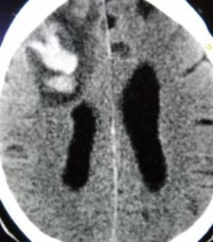
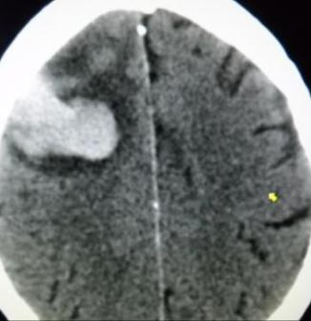
Case 1(3)
Close observation and anticoagulation was given. Unfortunately, a few days later, after anticoagulation, he developed a hemorrhagic stroke. Eventually, he recovered with some residual deficit. Two years later, he was doing well.
Inadvertent puncture of arteries, instead of veins, is an uncommon but serious occurrence by inexperienced personnel. We have seen these events in many instances. We illustrate similar events in another case.
Experience in central venous access is necessary to avoid this serious mishap. US imaging is necessary to puncture the central veins.

Slide 27
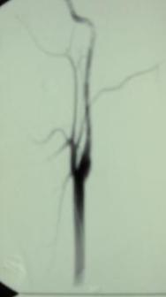
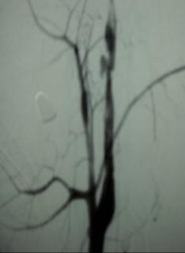
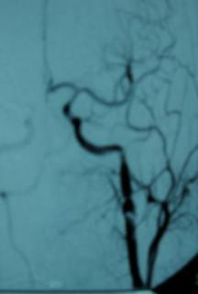
Case 2(1)
18-year-old boy was shot in the right neck and presented with a diffuse hematoma and external bleeding. He was brought immediately to the IR suite for arteriography and endovascular management.
The aortic arch arteriogram demonstrates diffuse distortion of the right common carotid artery.

Slide 28
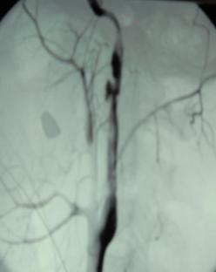
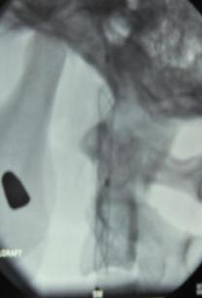
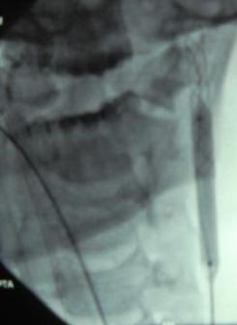
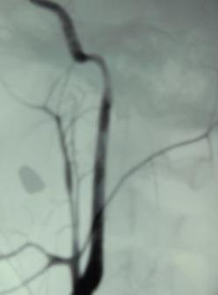
Case 2(2)
Selective common carotid arteriogram demonstrates significant destruction of the wall with irregularity, narrowing, outpouching, and intimal flaps throughout.
Endovascular management consisted of stenting. The common and internal carotid arteries were carefully traversed and a 6mm x 40mm Wallgraft was released in the intended location.
The stent was dilated with a 6mm low-pressure balloon.
A final arteriogram demonstrated excellent reconstitution of the lumen. The boy recovered without neurological deficit.

Slide 29
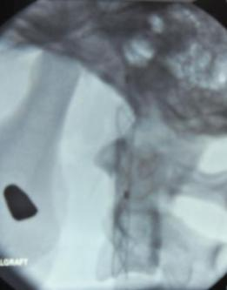
Case 2(3)
Placement of stents is the ideal treatment in selected severe penetrating injuries to the neck arteries, frequently seen in this era of violent behavior.
The lumen is reestablished and a future bypass, if needed, is not precluded.
Before the advent of endovascular management, in selected severe CBOS ligation of the injured arteries has been, and still is, the treatment of choice.
Unfortunately, the M&M of surgery is high. Immediate or delayed cerebral ischemia has been reported in 15%-20% of cases.
In our experience, penetrating injuries to the brachiocephalic arteries are common due to increasing violence; as well as fast, aggressive, and impaired driving.
Fortunately, with the advent of stents, the management of these very complicated injuries has been simplified.
We now manage most traumatic vascular injuries in the IR suite in a short time, with few complications and ligation of the carotid arteries is avoided

Slide 30
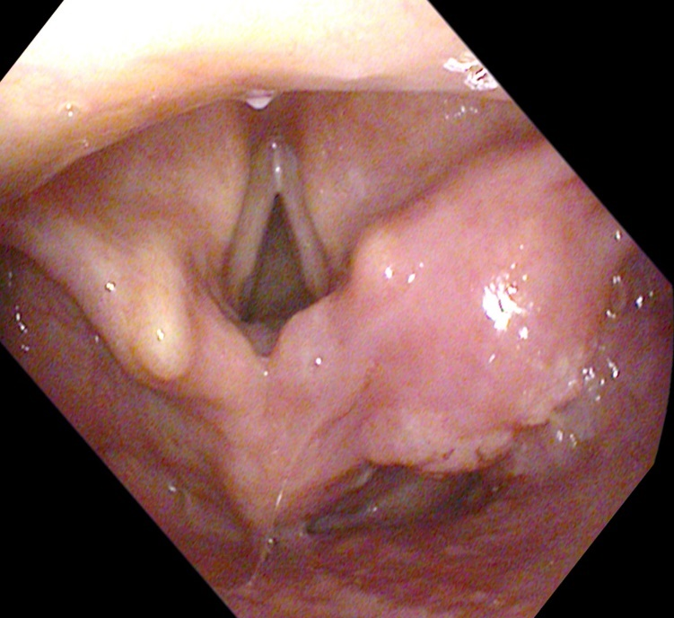
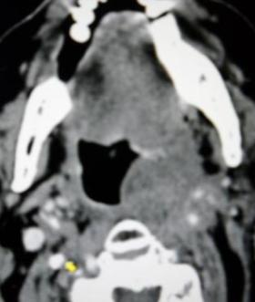
Case 3(1)
55-year-old man with Ca of the pharynx and larynx was being treated with radiation and surgery. His disease process continued to progress and he required further surgical intervention.
Postoperatively, he developed bleeding into the pharynx and externally into the neck, partially managed by packing and external compression.
Therefore, the patient was brought to the IR suite for arteriography and endovascular management.

Slide 31
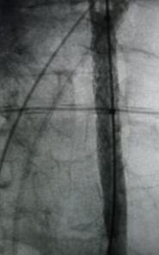
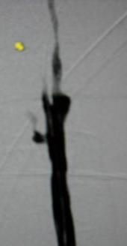
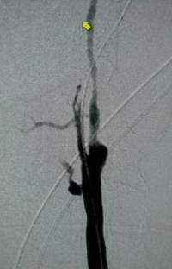
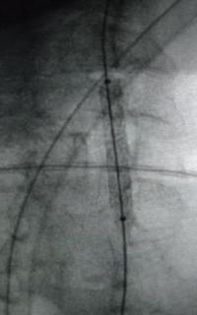
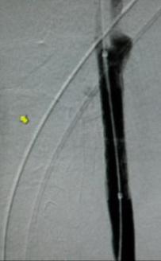
Case 3(2)
An arch arteriogram demonstrated a small pseudoaneurysm from the mid-portion of the right common carotid artery. A selective arteriogram showed the lesion better.
Stenting of the pseudoaneurysm was performed. The common carotid artery was crossed with a Bentson guidewire and a 6mm x 40mm iCast stent was deployed at the site of pseudoaneurysm. The stent was dilated with a 6mm balloon.
Follow-up arteriogram demonstrated a small endoleak, which required placement of another iCast stent 7mm x 40mm overlapping the initial one. This stent was dilated with a 7mm balloon.
A final arteriogram demonstrated successful exclusion of the pseudoaneurysm and no further endoleak. The patient was sent to the ICU for post endovascular management. His bleeding remained controlled without neurological deficit, however the patient died a few days later from his primary disease, unrelated to the stenting.

Slide 32
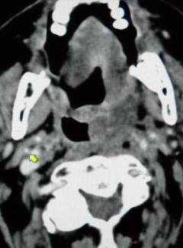
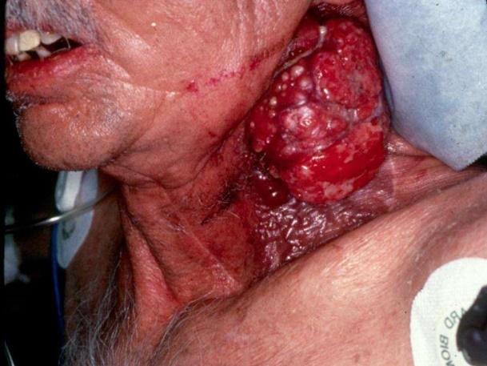
Case 3(3)
Pseudoaneurysms of the carotid arteries (CBOS) are uncommon lesions in patients with diffuse tumor invasion, post irradiation, and post operatively.
The surgical management is difficult and carries a high M & M. The reported incidence of neurologic M & M are 40% and 60% respectively.
The traditional treatment is carotid artery ligation and/or embolization, if feasible, provided that the contra-lateral carotid artery supplies collateral flow via the circle of Willis.
Therefore, stenting is the method of choice in terminal cases.

Slide 33
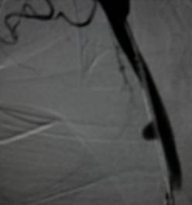
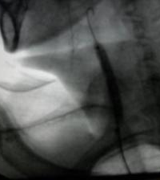
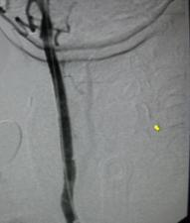
Case 4(1)
This middle-aged man with neck malignancy received radiation therapy and surgery. Eventually he developed recurrent internal bleeding into the pharynx and larynx and external bleeding managed with repeated wound packing. Eventually, arteriography for evaluation and endovascular management was obtained.
An arch arteriogram demonstrated patency of the brachiocephalic arteries. A selective arteriogram demonstrated a small rupture of the carotid artery with contrast material leaking into the soft tissues of the neck. Therefore, endovascular management was performed.
The common carotid artery was carefully crossed with a guidewire and a long vascular sheath advanced into the aortic arch, followed by insertion of a 6mm x 30mm iCast stent, which was dilated to 6mm. A follow-up arteriogram demonstrated coverage of the leak and no further bleeding.

Slide 34
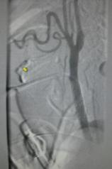
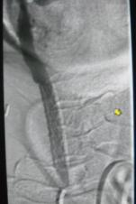
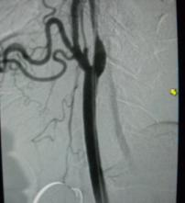
Case 4(2)
The immediate follow-up was uneventful. However, one month later there was neck pain and minor swelling at the site of the stent. A right carotid arteriogram demonstrated a recurring pseudoaneurysm (CBOS) at the distal end of the previous stent. Therefore, re-stenting was performed. The carotid artery was carefully traversed and another iCast 7mm x 30mm stent was released, overlapping the initial stent.
The new stent was dilated to 6mm. The final arteriogram demonstrated excellent reconstitution of lumen and no further filling of the pseudoaneurysm.
The patient did relatively well.

Slide 35
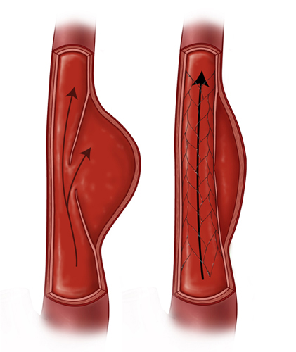
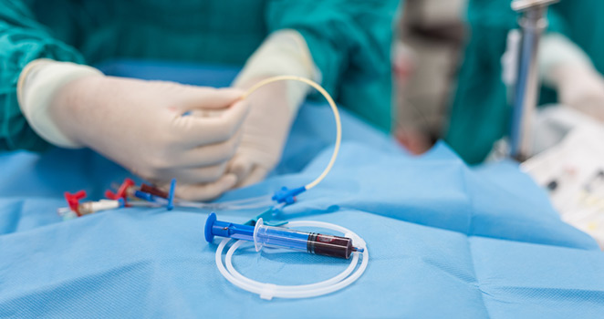
Case 4(3)
Endovascular interventions have become the treatment of choice for most cases of CBOS. The mainstay of therapy is stent placement (covered or uncovered, self-expanding or balloon expandable.) In addition, embolization of the pseudoaneurysm before or after stenting to cover the neck of the pseudoaneurysm may be needed.
Embolization of bleeding branches or main trunk of the external carotid arteries may be also necessary to prevent further bleeding or endoleaks from retrograde flow.
Local recurrences, or residual pseudoaneurysms can also be managed with re-stenting. The endovascular management may be definitive in patients who are terminal to prevent a catastrophic rupture and exsanguination.

Slide 36
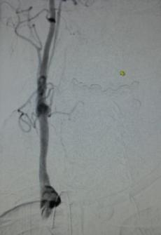
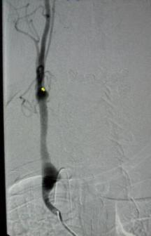
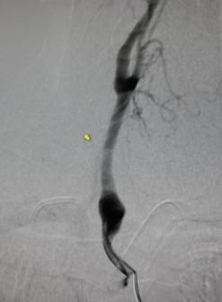
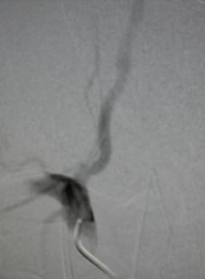
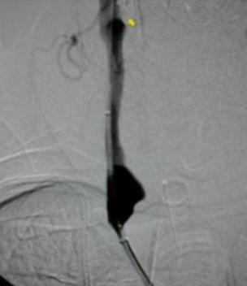
Case 5(1)
This middle-aged man with malignancy of the neck presented with neck pain and swelling of the base of the neck. The possibility of a CBOS was entertained.
Emergency aortic arch arteriogram demonstrated a pseudoaneurysm at the base of the right common carotid artery. A selective common carotid arteriogram demonstrated the pseudoaneurysm at better advantage.
An emergent endovascular management was chosen. A Bentson guidewire was carefully traversed through the right common carotid artery into the internal carotid artery.

Slide 37
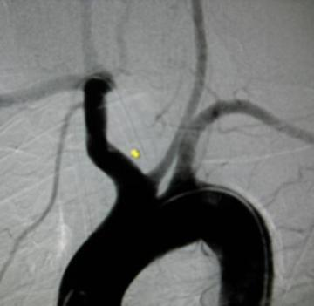
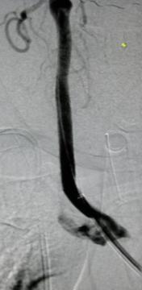
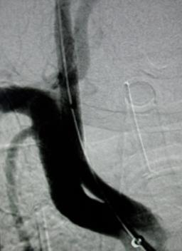
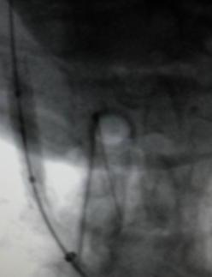
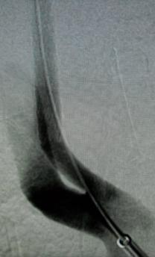
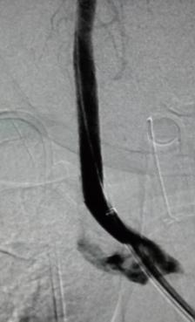
Case 5(2)
A 6mm x 30mm iCast covered stent was deployed at the base of the common carotid artery, exactly at the pseudoaneurysm, making sure that the innominate, subclavian and/or vertebral arteries were not covered. The stent was thereafter dilated with a 7mm balloon.
A carotid arteriogram after stenting demonstrated reconstitution of lumen and no further filling of the pseudoaneurysm. The patient did well.

Slide 38
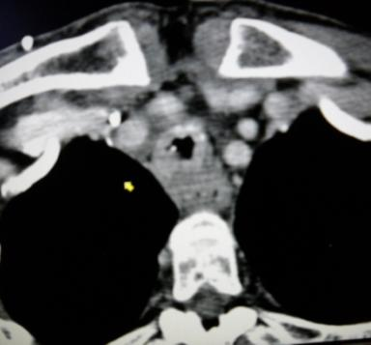
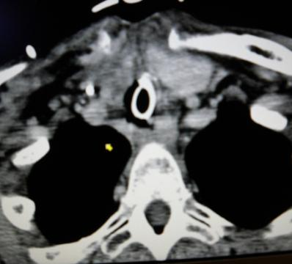
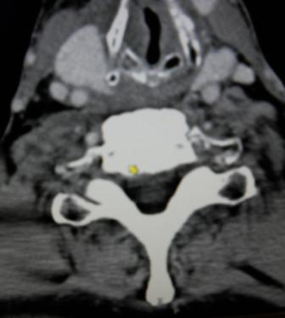
Case 5(3)
With the advent of metallic stents, traumatic vascular lesions at the base of the neck can be managed without encroaching upon the lumen of uninvolved adjacent arteries.
The ideal management of CBOS is endovascular with covered stents.
On occasion, uncovered stents can be used if one does not want to encroach upon arteries not involved.
The endovascular management also includes embolization of a pseudoaneurysm and/or branches of the carotid arteries, if needed.

Slide 39
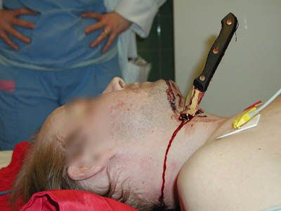
Cases 6–23
Some examples of penetrating injuries to the neck resulting in complete or partial transection of the vertebral or carotid arteries.
The endovascular management of complete or partial injuries of the vertebral arteries is by embolization of the entire lumen of the vertebral artery, rather than by recanalization and stenting.
In the future with development of better, smaller, less thrombogenic drug-eluting and absorbable stents; the management of penetrant neck arterial injuries will be more common.

Slide 40
Cases 6–23
At this time, the endovascular recanalization of vertebral arteries is uncertain. It is preferable to obliterate (occlude), rather than to recanalize traumatized vertebral arteries.
The entire artery must be embolized from proximally to distally to prevent retrograde bleeding, and clot formation distally which may eventually embolize into the posterior (cerebellar) circulation. Before one embolizes the vertebral arteries, one must be sure that collateral flow from the contralateral artery and the carotid arteries is adequate to sustain flow to the posterior circulation.

Slide 41
Cases 6–23
Most patients received penetrating and blunt injuries to the neck, resulting in pseudoaneurysms and/or complete or partial transections. In small partial injuries to the vertebral arteries, we can attempt repair with stents.
Further studies, more experience, and longer follow-up is necessary to assess the role of endovascular management of vertebral artery injuries.

Slide 42
Cases 6–23
Subclavian arterial injuries are not included in this presentation. These are common in our patient population. The management is different. The course is less serious than injuries to the carotid or vertebral arteries.
We have managed many of these in the last two decades with self-expanding or balloon expandable, covered and uncovered stents, with success. We will present this experience in future meetings.

Slide 43
Case 6
.
A patient with a traumatic dissection of the vertebral artery.

Slide 44
Case 7
A patient with similar traumatic lesions common in this era of impaired, aggressive, and fast driving, as well as increasing gun violence.

Slide 46
Case 8
A patient with a traumatic transection of the vertebral artery, gun shot injury.

Slide 47
Case 9
CBOS of traumatic etiology. A pseudoaneurysm of the left common carotid artery is noted.
.

Slide 48
Case 10
Bilateral vertebral arteriography.
The right one is transected and was embolized with numerous stainless steel coils to occlude the entire lumen.

Slide 49
Case 11
CBOS injury to the left common carotid artery managed the "old-way", with surgical occlusion of the artery, rather than with stents. Stents were not available then.

Slide 50
Case 12
.
Traumatic AVF of the left vertebral artery with the internal and external jugular veins managed by embolization of the vertebral artery.
The lesion can also be managed by venous approach. The arterial approach is preferred.

Slide 51
Case 13
A pseudoaneurysm of the internal maxillary artery embolized with permanent particles.
.

Slide 52
Case 14
Traumatic disruption of the left vertebral artery managed by complete embolization.
“

Slide 53
Case 15
“Iatrogenic” CBOS. A pseudoaneurysm of the right common carotid artery due to an inadvertent insertion of a large caliber catheter for hemodialysis.
Lack of experience, and a “blind access” (without US) and other factors may result in serious mishaps during central vein catheterization. We have seen these episodes in several instances (see other cases).

Slide 54
Cases 16 -18
Three patients with penetrating (bullets) transections of vertebral arteries managed with embolization.
16
18
17

Slide 55
Case 19
Traumatic carotid-cavernous AVF, managed with balloon occlusion.

Slide 56
Case 20
Iatrogenic injury to the left vertebral artery during catheterization of a bypass graft managed by embolization with different coils.

Slide 57
Case 21
Injury to the left vertebral artery managed by embolization with stainless steel coils and platinum micro coils.
The artery must be completely occluded to prevent thrombosis in a partially patent vessel, and possible cerebral embolization.

Slide 58
Case 22
Patient with cancer of the thyroid. Arteriography shows bleeding from the inferior thyroid artery. This was embolized with permanent particles.

Slide 59
Case 23
Buckshot injury to the left external carotid artery and transection of the internal maxillary brand. Embolized with permanent particles and coils.

Slide 60
Miscellaneous

Slide 63
CONCLUSIONS
CBOS is a rare entity seen with increasing frequency.
There are three types (or stages): 1) threatened, 2) impending, and 3) acute.
CBOS is a catastrophic emergency with high M&M (40% and 60%).
The surgical management has been, and is, difficult and fraught with high M & M.
The endovascular management is emerging as treatment of choice to prevent a catastrophic rupture and offer an acceptable quality of life.
The etiologic causes are malignant tumor invasion to the arteries, post radiation therapy, vasculitis, infection, post surgery, and blunt and penetrating injuries.
The preferred therapy is endovascular, with stents and/or embolization.
Occlusion of the carotid arteries in certain circumstances is a life-saving procedure.

Slide 64
CONCLUSIONS
The insertion of different types and kinds of stents is safe, effective and easy procedure to temporarily manage CBOS.
A longer follow-up and more patients treated are necessary to assess the long-term role of stenting in CBOS.

