Slide 1
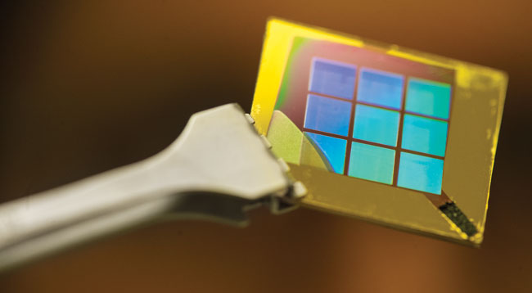

Properties of
Photonic and Plasmonic Resonance Devices
Jae Woong Yoon, Kyu Jin Lee, Manoj Niraula, Mohammad Shyiq Amin,
and Robert Magnusson
Dept. of Electrical Engineering, University of Texas – Arlington, TX 76019, United States
Notes:
Thank you very much for the introduction. The title of my presentation is properties of photonic and plasmonic resonance devices.

Slide 2
Outline
Introduction
Guided-mode resonance bandpass filters.
Broadband omnidirectional Si grating absorbers.
Transmission resonances in metallic nanoslit arrays.
Gain-assisted ultrahigh-Q SPR in metallic nanocavity arrays.
Conclusion
Notes:
To outline my presentation, I’m gonna provide brief introduction to resonance effect occurring in high-index and metallic thin films with subwavelength periodic patterns. And then I’ll show my lab’s recent progresses on photonic resonance devices performing as optical bandpass filters and broadband light absorbers. Next, I’ll explain a suggested theory of resonant light transmission through a mostly opaque metallic films with deep subwavelength apertures. And finally, I’ll suggest one possible mechanism for gain-assisted ultrahigh-Q surface plasmon resonances in metallic nano cavity arrays.

Slide 3
Photonic Resonances in Periodic Thin Films
Thin-film interference
Guided-mode resonance
Guided mode by TIR
Highly controllable with the pattern’s geometry.
Spectral engineering by blending of multiple
guided modes.
Notes:
Basically, a thin-film forms two partially reflecting interfaces that cause multiple partial internal reflections resulting in wavelength-dependent interference in the net reflection and transmission. Confinement is generally weak in this case. So for remarkable interference effects required for practically applicable dielectric mirrors, resonators, and filters, It is necessary to stack multiple thin films with precise thicknesses. Putting periodic pattern in the film changes the situation. We have another light coupling pathways due to well defined diffraction into discrete angles. By matching in-plane phase of a diffracted light with a waveguide mode supported by the total internal reflection, we obtain long-living light confinement and therefore strong resonance effect involving large field enhancement and highly enhanced interaction in the optical near-field of the film. This type of photonic resonance is referred to as guided-mode resonance.

Slide 4
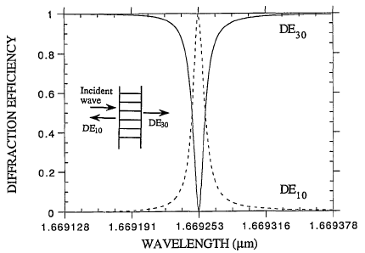
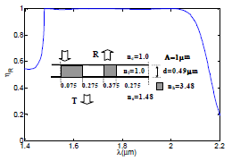
Guided-Mode Resonances in Dielectric and Semiconductor Thin-Film Gratings
Low index-contrast gratings
High index-contrast gratings
[Wang and Magnusson, Appl. Opt. 32, 2606 (1993)]
[Ding and Magnusson, Opt. Express 12, 5661 (2004)]
High-Q, narrow band resonances.
Primarily reflection peaks.
Optical notch filters, biosensors, and so on.
Both broadband + narrow-band effects.
Versatile spectral engineering.
Lossless mirrors/polarizers, flat microlenses, bandpass filters, broadband resonant absorbers, and so on.
Notes:
Guided mode resonances can be classified into two types. One is low-contrast gratings where the index difference in the grating pattern is much smaller than unity. In this case, the resonance feature is generally characterized by narrow bandwidth, reflection peak in a broad low reflection sidebands or transmission dip in a broad low transmission sidebands equivalently. Therefore, this type of guide-mode resonance elements can be used for line-rejection filters and optical biosensors. The other type is high contrast gratings where the index contrast is comparable or larger than unity. For this type, a resonance feature gets much broader due to high diffraction coupling strength and multiple resonance features can constructively build up a flat broad spectral profile as shown in this graph showing broad flat high reflection band. In addition, very narrow, high-Q resonance feature can also be introduced in a high-contrast guided-mode resonance element by carefully designing geometry of the grating pattern. Therefore, it enables spectral profile engineering by properly blending low-Q and high-Q resonance states. Example optical devices obtainable with high-contrast guided-mode resonance elements are …

Slide 5
Bandpass Filters: Theoretical
Multilayer
GMR
Conventional
multilayer
Single-layer GMR
structure
Major advantages
- Simple fab. processes (involves less fabrication errors).
- Stop-bands and pass-line are determined by geometry of the surface texture.
Notes:
This is one nice example of a high-contrast guided mode resonance element replacing a multi-layer-based narrow bandpass filter. In this graph showing transmission spectrum, blue dotted curve corresponds to a multi-layer thin-film consisting of 32 quarter wave layers of alternating HfO2 and SiO2 films. This spectrum has about 100-nm flat low transmission sidebands and about 1-nm-wide peak. This very particular spectrum is reproduced now with single layer Si grating structure as shown here.

Slide 6
Bandpass Filters: Experimental
Surface profiles (AFM)
Performance Parameters
- Pass-line (peak): 0.4 nm FWHM, 83% efficiency.
- Stop-band: < 1% over 100 nm bandwidth.
Angular tunability = 6 nm/deg.
Design
Fabricated
Notes:
We fabricated this design with standard photo lithography and reactive ion etching processes. This shows photographic image of the actual fabricated device. The measured spectrum here shows very good agreement with the theoretical prediction.

Slide 7
Broadband Omnidirectional Absorbers: Theoretical
Planar absorber
340 nm
α-Si:H
SiO₂
GMR absorber
15.5% fill factor
Λ = 419 nm
2000 nm
30 nm
Notes:
Next example of high-contrast guided-mode resonance element is a broadband absorber. This is 340-nm-thick a-Si film on SiO2 substrate. Absorbance spectrum as a function of angle of light incidence is shown here. We see about 50% absorbance on average in the short wavelength range below 650 nm. Remaining 50% of the incident optical energy is mostly reflected due to large impedance mismatch at the top Si surface. An optimized guided-mode resonance absorber with the same amount of a-Si. Angle-spectral absorbance maps here for different azimuth angle of plane-of-incidence with respect to the grating line direction shows very high ligh-absorbing performance for both TE and TM polarizations in the entire visible spectral domain covering 400-to-700 nm range.

Slide 8
Broadband Omnidirectional Absorbers: Theoretical
Resonant Light Trapping
Anti-Reflection Effect
Notes:
There are two major effects behind such high light-absorbing performance of the optimized grating structure. First, the structure supports densely populated guided modes. The top two panels here show field excitation spectrum as a function of incident angle. The bright yellow regions identify dispersion bands of guided modes. Optical intensity distributions in the grating region for four sampled cases show vertical guiding and lateral guiding effects occurring in the grating region. Second major cause is broad anti-reflection effect at the top grating interface. Here, we see the top reflection intensity as a function of polar and azimuth angles of incidence for TE and TM polarizations. We confirm much lower reflection due to small grating ridge width.

Slide 9
Broadband Omnidirectional Absorbers: Experiment
Notes:
We also fabricated the optimized device design as shown in these photographic image, optical microscope image, and scanning electron microscope images here. The fabricated sample is measured with our home-built conical-beam spectrum analyzer and the measured absorbance spectrum shows consistant result with the theoretical prediction.

Slide 10
Surface Plasmon Resonances in Metallic Nanostructures
Collective oscillation of surface free electrons.
Deep subwavelength confinement:
- Metallic metamaterials.
- Optical communication with nanoscopic objects.
- Quantum optical effects.
Highly lossy due to ohmic damping.
Primarily absorption and transmission resonances. (↔ Photonic resonances)

Slide 11
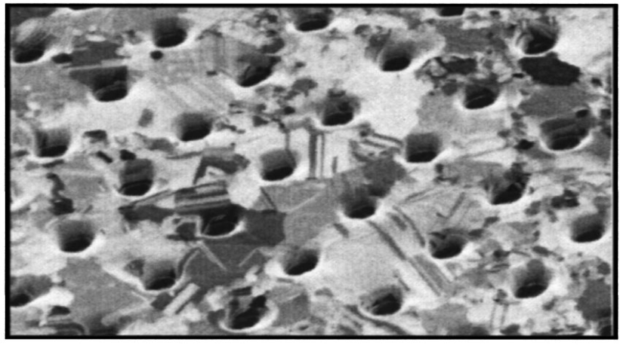
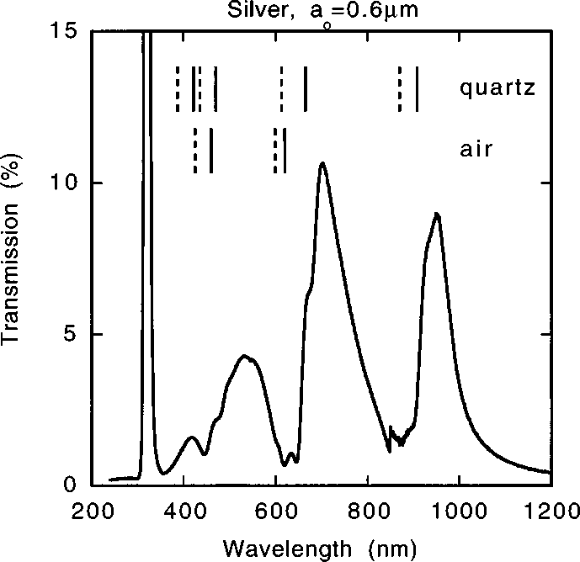

Extraordinary Optical Transmission
Nature 391 667; Phys. Rev. B 58 6779.
SPP
Destructively
interfere
2
0.45
0.14
0.06

Slide 12
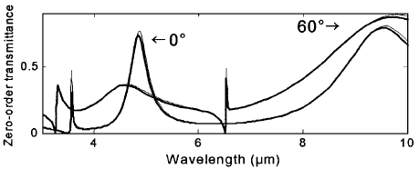

Extraordinary Optical Transmission
Cao et al., Phys. Rev. Lett. 88 057403 (2002)
“Negative role of surface plasmons in the transmission of metallic gratings with very narrow slits”
Fabry-Perot resonance of slit guided mode
CM
Destructively
interfere
SPP resonance condition

Slide 13
Surface and Cavity Plasmonic Resonances in Metallic Nanoslit Arrays

Slide 14
Toward Ultrahigh-Q Metallic Nanocavity Resonances

Slide 15
Conclusion
Demonstrated optical bandpass filters and broadband absorbers based on high-index contrast subwavelength waveguide gratings.
Explained complex resonance effects in metallic nanoslit arrays with a simple model of an optical cavity with Fano-resonant reflection boundaries.
The theory predicts efficient room-T ultrahigh-Q plasmonic nanocavity resonances with the externally amplified intracavity feedback mechanism.

Slide 16
ACKNOWLEDGEMENT
This research was supported, in part, by the UT System Texas Nanoelectronics Research Superiority Award funded by the State of Texas Emerging Technology Fund as well as by the Texas Instruments distinguished University Chair in Nanoelectronics endowment. Additional support was provided by the National Science Foundation (NSF) under Award No. ECCS-0925774 and IIP-1444922.
Publications with these works:
[1] J. W. Yoon, K. J. Lee, W. Wu, and R. Magnusson, “Wideband omnidirectional polarization-insensitive light absorbers made with 1D silicon gratings”, Adv. Opt. Mater. 2014; doi:10.1002/adom.201400273.
[2] J. W. Yoon, J. H. Lee, S. H. Song, and R. Magnusson, “Unified theory of surafce-plasmonic enhancement and extinction of light transmission through metallic nanoslit arrays”, Sci. Rep. 4, 5683 (2014).
[3] J. W. Yoon, S. H. Song, and R. Magnusson, “Ultrahigh-Q metallic nanocavity resonances with externally-amplified intracavity feedback”, Sci. Rep. 4, 7124 (2014).

