Slide 1
Hearing loss in Unilateral cleft lip and palate
Jadranka Handzic M.D., Ph.D.,
Professor of Otolaryngology, Audiology and Vestibulology
Department for Otolaryngology and Audiology
University Hospital Center “Rebro”
Kispaticeva 12
Croatia

Slide 2
Embryology
-Cleft lip and/or palate- one of the most frequent structural defect (1st branchial arch) of the head and neck
- fail of fusion of left and right mesoderm plate in the middle line
primary palate origin at 6th weeks of gestation
-secondary palate - 8-10th hard palate
- 10-12th soft palate

Slide 3
Etiology-incidence
Etiology- multifactorial
-Incidence of isolated cleft lip and palate:
1 in 750 live births
- left unilateral cleft lip and palate occurs twice as many males than females

Slide 4
pathoanatomical craniofacial features-high risk of long-term negative middle ear pressure
Cranial base- changes of the length and angulations of anterior cranial
base, smaller sphenopalatine angle
Eustachian tube - hypoplastic and hypoelastic cartilaginous part, inadequate clearance and ventilation of the middle ear/development connection with growing of the middle face
Maxilla – retrognathia, retarded middle face
Pharyngeal latero-lateral distance- increase, cranio-caudal distance-decrease,pathologic movement of the lateral wall, Passavant or circular ridge during deglutition
Middle ear cavity - “small mastoid and middle ear cavity”-
Cleft palate -short and high positioned-delay in descending
Cleft palate muscles-hypoplastic and malpositioned tensor and levator veli
palatini, neuromuscular delay of maturity of the pharyngeal muscles

Slide 5
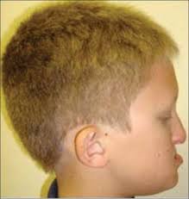
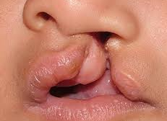
Morphological changes in unilateral cleft lip and palate
-retrognatic and retarded growth of maxilla
-influence on the growth of the Eustachian tube region
-lower position of auricula,
-retarded growth of mandibula
-colapse of the top of the nose and alar rotation,
-relative hypertelorism

Slide 6
Cleft lip and palate children-universality of the otitis media with effusion
-long term negative middle ear pressure leads to edema of the middle ear mucosa and accumulation of the fluid in the middle ear;
Otitis media with effusion (OME)- the most common disease in childhood
- the most frequent cause of communication disorders
OME-usually finding in the left lip and palate children until 3yr.

Slide 7
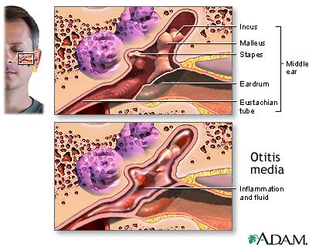
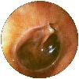
Otitis media with effusion
Otoscopic finding
Accumulation of the middle ear fluid

Slide 8
Conductive hearing loss-effect on central auditory processing –speech discrimination
-distortion of the sound reaching cochlea-interaural delay in sound reaching the brain
-disturbance of binaural central auditory processing ,disturbed inhibitory process on neural synapses
-disturbance in neural encoding and tonotopic organization of primary auditory cortex, making short and long-term auditory working memory
-negative influence on development of speech and language acquisition, phonemic awareness-speech discrimination, cognition, fine motoric function, long term acoustic memory, balance, sound segregation in background noise-
Otitis media with effusion leads to central auditory processing deficit even after the restoration of peripheral function and normalization of the hearing threshold

Slide 9
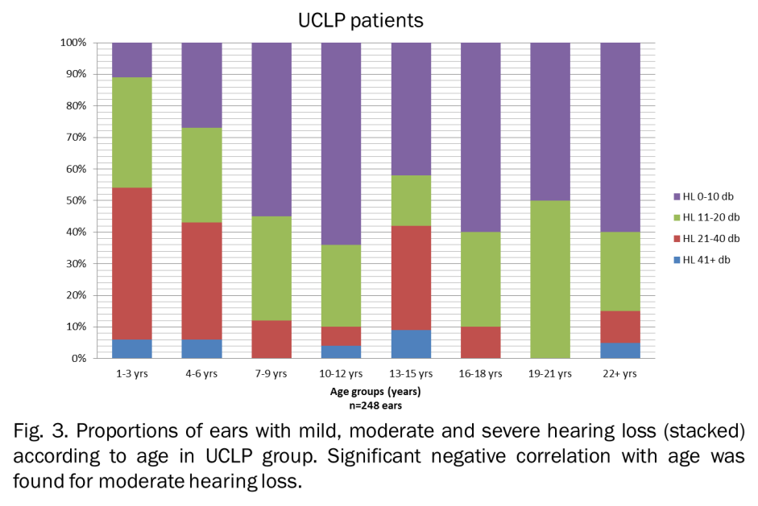
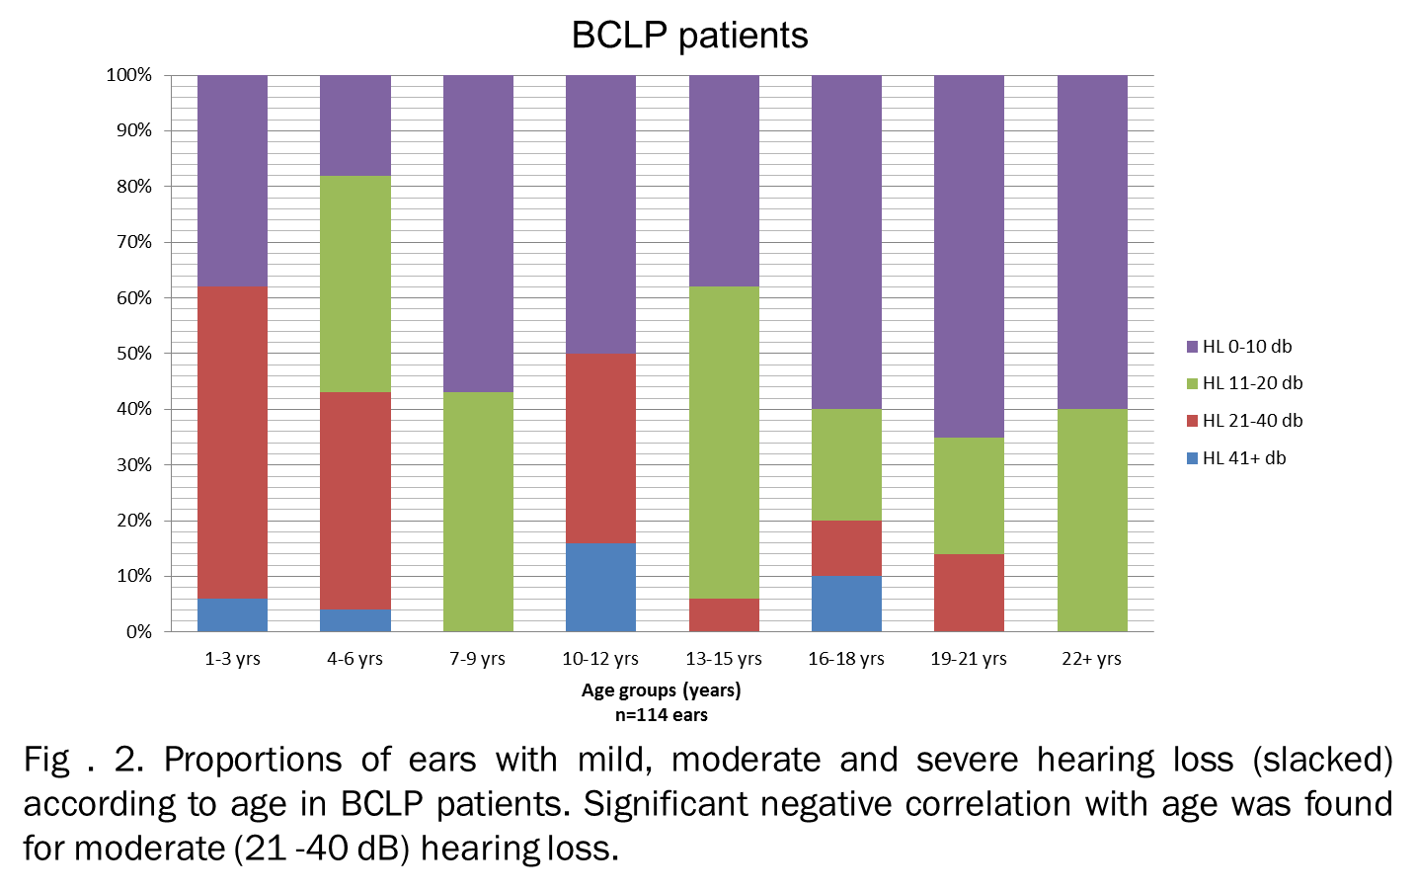
Unilateral cleft lip and palate (UCLP) vs. Bilateral cleft lip and palate (BCLP)–comparative study of hEARING LOSS
1) UCLP -higher incidence of hearing loss ears (89%) at age 1-3yr.than BCLP (62%)
2) UCLP - lower incidence of ears with normal hearing threshold than BCLP
2) UCLP - higher incidence of ears with moderate and severe hearing loss than BCLP
3) UCLP - moderate hearing loss- slower improvement of hearing threshold than BCLP
4)ears with severe hearing loss do not improve hearing threshold with aging

Slide 10
Tympanometric findings in UCLp vs. BCLP ears-comparative study
UCLP- B type – frequency higher at age 1-3yr than in BCLP and ICP
- decreased faster than in the BCLP and ICP
- UCLP decrease of B type from age 7-9yr,BCLP 4-6yr, ICP from 15yr.
UCLP BCLP
.

Slide 11
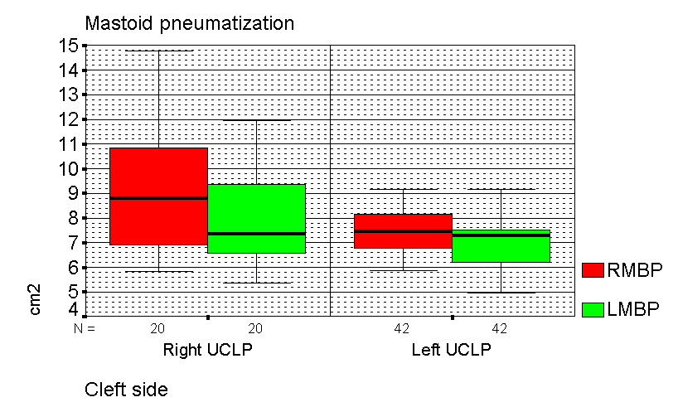
Matoid bone pneumatization in unilateral cleft lip and palate of left vs. RIGHT side
UCLP-right and UCLP-left - mastoid bone pneumatization of left ears - smaller than mastoid bone pneumatization of right ears

Slide 12
Aim of the study and Hypothesis
Different pathoanatomical and developmental characteristics of anatomical structures of cleft vs. non cleft side have different mode of pathopysiological development of middle ear disease

Slide 13
Method
Study included 101 children: median age 6.0 yr.,
- 68 males
-33 females
- Palatoplasty and cheiloplasty performed previously according to standard protocol
Hearing loss (tonal audiometry and tympanometry) analyzed according to age subgroups :
1-3 years,4-7years,8-12 years

Slide 14
Audiologic tests-tympanometry-tonal audiometry
Tympanometry- types according to Jerger; A,C,B
Tonal audiometry;
Tested audiometric frequencies ; 250Hz,500Hz,1000Hz,2000Hz,4000Hz
Normal hearing threshold: 0-10dB
-mid hearing loss; 11-20dB
-moderate hearing loss;21-40dB
-severe hearing loss >40dB
Results described and compared
-median (Md) hearing level for tested frequencies
- average hearing level (AHL) across speech frequencies

Slide 15
Age (years) UCLP | N (76) | Ear side | Hearing level (dB) |  |  |  |  |  | Kruskal-Wallis test (p value)
 |  |  | AHL | 250 Hz | 500 Hz | 1 kHz | 2 kHz | 4 kHz
 |  |  | Md (Min-Max) | Md (Min-Max) | Md (Min-Max) | Md (Min-Max) | Md (Min-Max) | Md (Min-Max)
1-3 yr. | 30 | RIGHT ears LEFT ears | p=0.683 35.0 (16-41) 33.0 (20-42) | p=0.398 30.0 (20-40) 27.5 (20-45) | p=0.043 40.0 (20-50) 30.0 (15-40) | p=0.866 32.5 (15-50) 32.5 (15-45) | p=0.906 30.0 (15-45) 32.5 (15-50) | p=0.612 30.0 (10-50) 32.5 (15-50) | p=0.057 p=0.601
4-7yr. | 57 | RIGHT ears LEFT ears | p=0.039 21.0 (10-47) 25.0 (10-47) | p=0.387 25.0 (10-45) 25.0 (10-50) | p=0.052 25.0 (10-55) 30.0 (10-45) | p=0.054 20.0 (10-45) 30.0 (10-50) | p=0.410 20.0 (10-45) 25.0 (10-50) | p=0.003 20.0 (10-55) 25.0 (10-50) | p=0.001 p=0.003
8-12yr. | 17 | RIGHT ears LEFT ears | p=0.906 20.0 (10-41) 18.0 (10-47) | p=0.790 20.0 (10-45) 20.0 (10-45) | p=0.650 25.0 (10-35) 20.0 (10-45) | p=0.979 20.0 (10-50) 20.0 (10-55) | p=0.875 20.0 (10-30) 15.0 (10-40) | p=0.382 20.0 (10-55) 20.0 (10-55) | p=0.294 p=0.028
>12yr. | 12 | RIGHT ears LEFT ears | p=0.110 16.0 (10-42) 18.0 (10-44) | p=0.787 12.0 (10-35) 17.5 (10-40) | p=0.866 15.0 (10-50) 15.0 (10-40) | p=0.590 17.5 (10-40) 17.5 (10-50) | p=0.043 10.0 (10-40) 17.0 (10-50) | p=0.052 10.0 (10-45) 17.5 (10-60) | p=0.269 p=0.972

Slide 16
results
Age group 1-3yr.
- non cleft side - highest severity of hearing loss (Md) 500Hz severity of hearing loss than lefts
Age group 4-7yr. ;
AHL higher on cleft side
- cleft side ears -higher severity of hearing loss for mid register (Md)(500Hz,1000Hz,4000Hz)
-non cleft side-higher severity of hearing loss for low
register (250Hz and 500Hz)

Slide 17
results
Age group 8-12 yr;
hearing loss cleft vs.non cleft side showed no significant difference
Cleft side ears- higher hearing loss on frequencies 500Hz,1000Hz then on others
Age group >12 yr;
ear side dependence in severity of hearing loss showed frequencies of 2000Hz and 4000Hz-cleft side showed higher severity

Slide 18
UCLP- LEFt ear (cleft side) proportion of ears with mild,moderate and severe hearing loss (average) according to age subgroups
Average hearing loss groups

Slide 19
Results-cleft side ears
-age group 1-3yr. -80% of ears have moderate hearing loss (21-40dB)
-incidence of ears with moderate hearing loss significantly decrease with aging
-no increase of incidence of ears with normal hearing level
with aging
-intergroup comparison of hearing loss ears showed significant difference for moderate category

Slide 20
UCLP- Right ear (NON-cleft side) proportion of ears with hearing loss (average HL)- mild,moderate,severe according to age subgroups
AHL groups

Slide 21
Results-non cleft ears
Non cleft side ears ;
Increased rate of ears with normal hearing threshold with aging
Intergroup comparison showed significant difference for mid and moderate category of hearing loss ears
Intragroup comparison difference showed age group 4-7yr

Slide 22
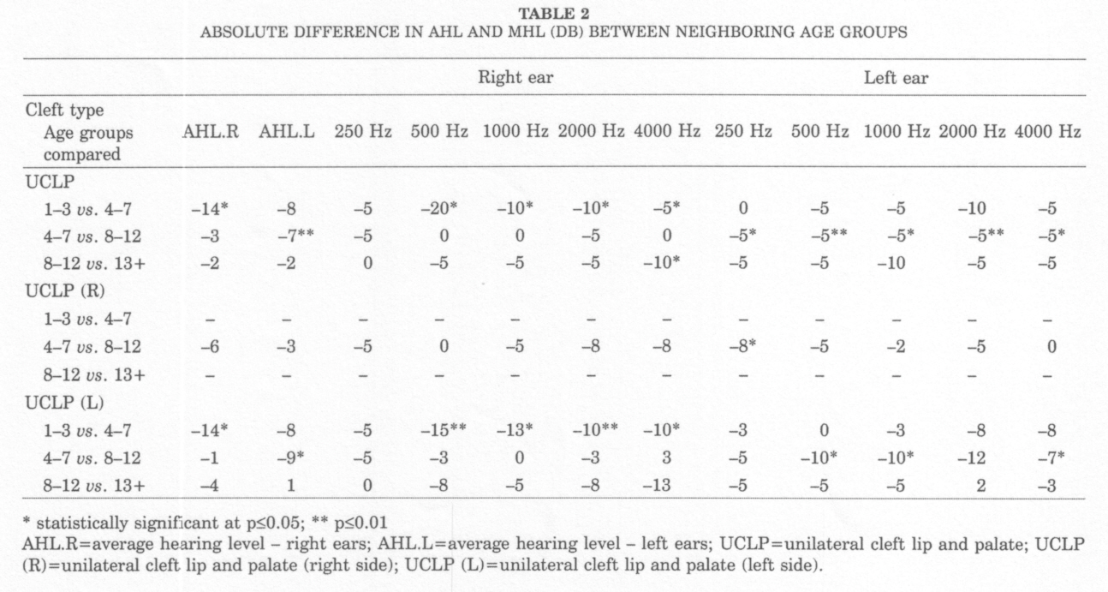
Improvement of hearing threshold with aging

Slide 23
Conclusion
Cleft side ears :
showed different pathophysiology of OME than none cleft side and difference in severity of hearing loss for restrictive frequencies in dependence with ear side and age
characteristics of hearing loss and its improvement with aging determine speech and language habilitation and prevention of central auditory disorders

Slide 24
Warm greetings from zagreb,croatia

