Slide 1
About OMICS Group
OMICS Group International is an amalgamation of Open Access publications and worldwide international science conferences and events. Established in the year 2007 with the sole aim of making the information on Sciences and technology ‘Open Access’, OMICS Group publishes 400 online open access scholarly journals in all aspects of Science, Engineering, Management and Technology journals. OMICS Group has been instrumental in taking the knowledge on Science & technology to the doorsteps of ordinary men and women. Research Scholars, Students, Libraries, Educational Institutions, Research centers and the industry are main stakeholders that benefitted greatly from this knowledge dissemination. OMICS Group also organizes 300 International conferences annually across the globe, where knowledge transfer takes place through debates, round table discussions, poster presentations, workshops, symposia and exhibitions.

Slide 2
About OMICS Group Conferences
OMICS Group International is a pioneer and leading science event organizer, which publishes around 400 open access journals and conducts over 300 Medical, Clinical, Engineering, Life Sciences, Phrama scientific conferences all over the globe annually with the support of more than 1000 scientific associations and 30,000 editorial board members and 3.5 million followers to its credit.
OMICS Group has organized 500 conferences, workshops and national symposiums across the major cities including San Francisco, Las Vegas, San Antonio, Omaha, Orlando, Raleigh, Santa Clara, Chicago, Philadelphia, Baltimore, United Kingdom, Valencia, Dubai, Beijing, Hyderabad, Bengaluru and Mumbai.

Slide 3
Forensic Mental Health Treatment in Juvenile Justice Secure Care Facilities For Juvenile Fire Setters and Bomb Makers: Clinical and Forensic Public Safety Recommendations
Ronn Johnson, Ph.D., ABPP
J.Y. Cindy Kim, M.A. Candidate
Elizabeth Grace, M.A. Candidate
Stephanie Cunningham, M.A. Candidate
Derrick Young, M.A. Candidate
University of San Diego
Notes:
CK

Slide 4
Overview
Juvenile Fire Setters and Bomb Makers
Juvenile Care Facilities
Problem Identification
Mapping of San Diego, CA
Staffing and Training
Evidence-Based Treatment: CBT
Treatment Plans
Familial Involvement
Gender Differences
The approach
Mental Health Practitioner Considerations
Notes:
CK

Slide 5
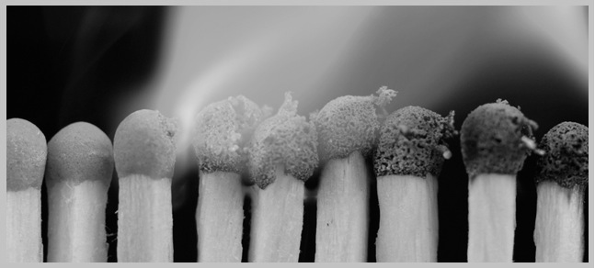
Juvenile Fire Setters and Bomb Makers
Arson is the number one cause of all fires and the second leading cause of residential fire deaths.
(Roe-Sepowitz, 2011)
As forensic mental health services expand, information on the psychiatric morbidity of offenders referred to them can assist in service development.
(Louisiana office of juvenile Justice 2012)
Problems with juvenile fire setting include, but are not limited to, Problems with being successful with school work peer pressure, bullying, unsupervised activities and problems with family dynamics (i.e., divorce, separation).
(Louisiana office of juvenile Justice, 2012)
Notes:
DY

Slide 6
Juvenile Fire Setters and Bomb Makers
Juveniles are responsible for 46% of all fires deliberately set in the U.S. and more than 50% of arson arrests are juveniles.
(U.S. Fire Administration, 2013)
An estimated 282,600 intentional fires were reported to U.S. fire departments each year including $1.3 billion in direct property damage in 2007-2011.
(Campbell, 2014)
Children are consistent with antisocial behaviors as well as truancy, stealing, sexual misbehaviors, and running away from home.
(NY state office of child and family services, 2014)
Notes:
DY

Slide 7
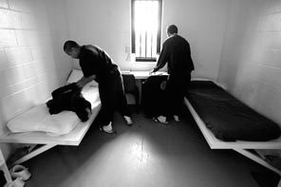
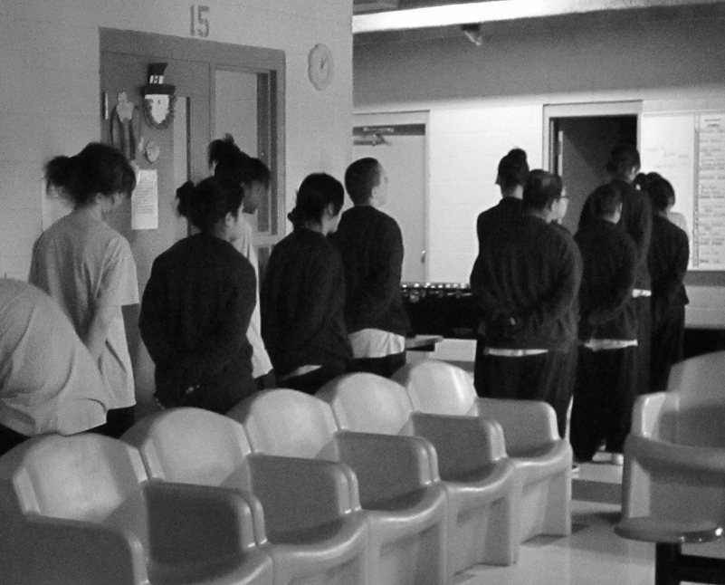
Juvenile Care Facilities
JFSB’s are housed with adolescents with sexual behavior, mental health, and other chronic issues
Mental health professionals, social workers, teachers, probation officers serve as the primary care takers for these individuals
(NJ Department of Law and Public Safety, 2013)
Approximately 93,000 young people are held in juvenile justice facilities across
the United States
(Justice Policy Institute, 2009)
70% of youth are held in state funded residential facilities costing $249 per day per youth
(San Diego county of Education, 2012)
Notes:
DY
Many care facilities are designated for juveniles of both genders
These maximum(two in San Diego county) secure facilities serve as a vocational center to reintegrate with the public (San Diego Probation Department, 2013)
Job placement, GED’s, recreational, and medical services are all provided to juveniles housed in these facilities with opportunities to integrate and progress just as adolescents in the general public (Louisiana Office of Juvenile Justice, 2013)
Youth who are imprisoned have higher recidivism rates than youth who remain in communities (Flores, 2012)
California, Illinois, Ohio, New York, Pennsylvania, and other large states are redirecting funds once spent on large residential facilities (Ford et al., 2012)

Slide 8
Problem Identification
Problem Identification
Information Acquisition
Consensus Building
Community Assessment
An accurate description of the nature and extent of juvenile fire setting and bomb making and a community consensus to take action is the cornerstone of building an effective JFSB intervention program.
Needs Assessment Study/Report
Evaluates whether there is a significant problem in a community that demands attention and action.
Evaluation of collected data
Consensus Building
Risk Assessment
(Gaynor, Hamilton, Poage, & Gallardo, 2002)
Notes:
CK
One way of determining the nature and extent of a community's juvenile firesetting problem is to conduct a needs assessment study.
The first step in a needs assessment study is to identify local sources that may have information relevant to juvenile firesetting.
The fire department is one of the best places to start gathering information.
Fire incident reports, arson investigation reports, and other statistical records can provide data on the involvement of juveniles in reported fire situations.
This evaluation can compare data over a time span to see if there are any trends.
Harnessing the support of key decision-makers to reach an agreement regarding the need for a juvenile fire-setting program.

Slide 9
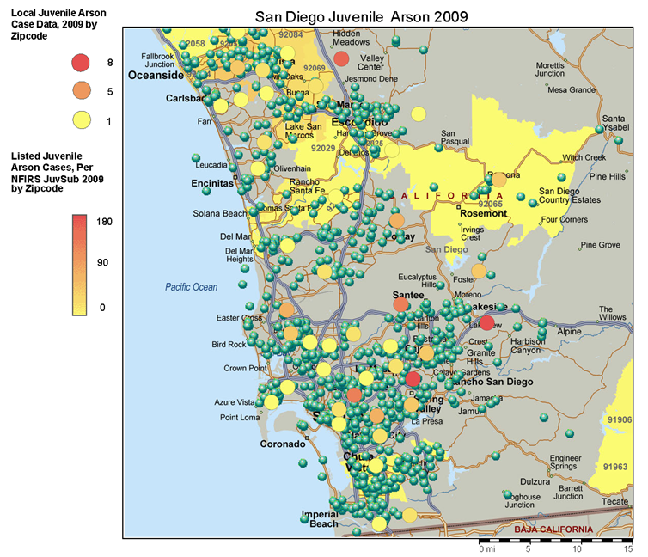
SD Juvenile Arson (2009)
Notes:
CK

Slide 10
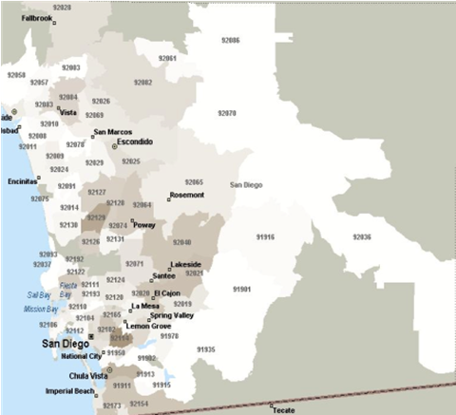
Incidents at School by Zip Code
Notes:
CK

Slide 11
Program Development
Programs offer long-term living arrangements with a highly structured format including individual and group therapy, recreation activities, and vocational training. Often a half-way house placement precedes re-entry.
The size of the staff will depend directly on the size of the JFSB program. For small programs, there may only be a program manager who handles the majority of the responsibilities.
Staffing & Training
Documentation
Confidentiality
Liability
(Gaynor, Hamilton, Poage, & Gallardo, 2002)
Notes:
DY
The best chance of changing the future conduct of juveniles involved in chronic firesetting and arson is to couple secure corrections with intensive rehabilitation services.
Community confinement provides secure confinement in small community-based facilities that offer individual and group counseling, educational programs, medical services, and intensive staff supervision.

Slide 12
Evidence-Based Treatment: CBT
The most efficacious treatment for fire setters involves “multimodal interventions”
A combination of “fire-specific, parent management, and elements of cognitive behavioral therapy (CBT) for children and youth”
Individual CBT Interventions:
Target disruptive behaviors
Identify triggers to linked fire involvement
Building coping and problem solving skills
Develop appropriate strategies for regulating affect and impulse control
(Del Bove &MacKay, 2011)
Notes:
DY
There is general agreement that the most efficacious treatment for fire setters involves “multimodal interventions” including a combination of “fire-specific, parent management, and elements of cognitive behavioral therapy (CBT) for children and youth”

Slide 13
Treatment Plans
Fire Education
(3 Methods):
Answer questions.
Films about fires.
Having child take responsibility for fire safety.
Used for low intensity clients and fire prevention
(Muller et. al., 2007)
Behavioral & Psychosocial Interventions:
Goal is to directly alter fire setting behavior by using positive reinforcement to change the way the client responds to triggers for fire setting.
Used for high intensity fire setters: older juveniles, recidivist FS, convicted arsonists
(Muller et. al., 2007)
Notes:
DY
2 approaches to treatment:
1. Fire Education (Public Safety)
2. Behavioral, social, or psychological

Slide 14
Treatment Plans
Gender Differences: Females
More likely to set fires at school
Recommendations
Greater immediate attention regarding assessment and diagnoses of potential mental health disorders.
Identify patterns of suicidal ideations, absences, and running away from home.
(Roe-Sepowitz & Hickle, 2011)
Notes:
CK

Slide 15
Treatment Plan
Gender Differences: Males
More likely to have a history of arson and to set a fire to a residence
Recommendations
Mental and behavioral treatment to address current mental health needs
Address general delinquency, antisocial behavior, and mental health issues
Targeted fire-safety interventions
(Roe-Sepowitz & Hickle, 2011)
Notes:
CK

Slide 16
Treatment Plans
Familial Involvement
Prevalence of child maltreatment
Increased risk of running away in JFSB
Psychoeducation
Recognize signs to eliminate future fire-setting behaviors
Work alongside Social workers
(Del Bove &MacKay, 2011)
Notes:
CK
Familial-based interventions may be appropriate due to the prevalence of child maltreatment and increased risk of running away in JFS.
Caregivers should be involved in the treatment process in order to receive psychoeducation, and recognize signs to eliminate future fire-setting behaviors.
Social workers and should be involved as part of a comprehensive treatment intervention.

Slide 17
Fire Department
Mental Heath Professionals
Education System
Social Services
Law Enforcement
Community Services
Care Facilities
Juvenile Justice Secure Care Facilities
Notes:
CK
The most effective approach to combating juvenile firesetting and arson is an organized network of community services.
Fire safety education is essential for everyone.
Improving the quality of family life and protecting the community are part of preventing juvenile involvement in firesetting.
(Wilson & Howell, 1994)

Slide 18
Mental Health Practitioner Considerations
Things to consider due to the high prevalence of mental disorders, medication may be appropriate to manage symptoms
Attention Deficit Hyperactivity Disorder (ADHD)
Oppositional Defiant Disorder(ODD)
Conduct Disorder (CD)
Posttraumatic Stress Disorder (PTSD)
Each state has different programs and separate systems for treating JFSB.
Paucity of funding
Inability for families to access services provided
Notes:
DY

Slide 19
References
Baker, A. L., & Calderon, P. (2004). The Role of Group Homes in the Child Welfare Continuum of Care.Residential Treatment For Children & Youth, 21(4), 39-58
Barton, W. H., & Mackin, J. R. (2012). Towards a strength-based juvenile correctional facility: Sustainability and effects of an institutional transformation. Journal Of Offender Rehabilitation, 51(7), 435-452.
Campbell, R. (2014). Intentional fires. National Fire Protection Association. Retrieved from http://www.nfpa.org/research/reports-and-statistics/fire-causes/arson-and-juvenile-firesetting/intentional-fires
Caudill, J. W., Diamond, B., Trulson, C. R., DeLisi, M., & Marquart, J. W. (2012). Sifting through the ashes: Processing arsonists in juvenile justice. American Journal Of Criminal Justice, 37(3), 306-320.
Cruise, K. R., & Ford, J. D. (2011). Trauma exposure and PTSD in justice-involved youth. Child & Youth Care Forum, 40(5), 337-343.
Davidson-Arad, B., & Golan, M. (2007). Victimization of juveniles in out-of-home placement: Juvenile correctional facilities. British Journal Of Social Work, 37(6), 1007-1025.
Del Bove, G., Caprara, G., Pastorelli, C., & Paciello, M. (2008). Juvenile firesetting in Italy: Relationship to aggression, psychopathology, personality, self-efficacy, and school functioning. European Child & Adolescent Psychiatry, 17(4), 235-244.
Del Bove, G., & Mackay, S. (2011). An empirically derived classification system for juvenile firesetters. Criminal Justice And Behavior, 38(8), 796-817.
Desai, R. A., Goulet, J. L., Robbins, J., Chapman, J. F., Migdole, S. J., & Hoge, M. A. (2006). Mental Health Care in Juvenile Detention Facilities: A Review. Journal Of The American Academy Of Psychiatry And The Law, 34(2), 204-214.
Dolan, M., & Smith, C. (2001). Juvenile homicide offenders: 10 years' experience of an adolescent forensic psychiatry service. Journal Of Forensic Psychiatry, 12(2), 313-329.

Slide 20
References
Fossati, A., Borroni, S., & Maffei, C. (2012). Bullying as a style of personal relating: Personality characteristics and interpersonal aspects of self‐reports of bullying behaviours among Italian adolescent high school students. Personality And Mental Health, 6(4), 325-339.
Gaynor, J., Hamilton, P., Poage, C., & Gallardo, M. (2002). Juvenile Firesetter Intervention Handbook. Emmitsburg, Maryland: United States Fire Administration.
Gilman, T. L. & Haden, S. C. (2006). Understanding and treating the juvenile firesetter: A review. The Forensic Examiner, 11-18.
Gruber, A. R., Heck, E. T., & Mintzer, E. (1981). Children who set fires: Some background and behavioral characteristics. American Journal Of Orthopsychiatry, 51(3), 484-488.
Johnson, R. (2010). Forensic assessment and clinical intervention for juvenile fire setters: The san diego model. Matchbook: Journal on the Prevention & Treatment of Youth Firesetting.
Johnson, R. (2014). Towards a Forensic Psychological Evaluation of Juvenile Fire Setters: Parent Power. Journal of Forensic Research, 5(1), 1-6.
Johnson, L. E., Wang, E. W., Gilinsky, N., He, Z., Carpenter, C., Nelson, C., & Scheuermann, B. K. (2013). Youth outcomes following implementation of universal SW-PBIS strategies in a Texas secure juvenile facility. Education & Treatment Of Children, 36(3), 135-145.
Kazdin, A. E., & Kolko, D. J. (1986). Parent psychopathology and family functioning among childhood firesetters. Journal Of Abnormal Child Psychology, 14(2), 315-329.
Kennedy, P. J., Vale, E. E., Khan, S. J., & McAnaney, A. (2006). Factors predicting recidivism in child and adolescent firesetters: A systematic review of the literature. Journal Of Forensic Psychiatry & Psychology,17(1), 151-164
Kolko, D. J., Herschell, A. D., & Scharf, D. M. (2006). Education and treatment for boys who set fires: Specificity, moderators, and predictors of recidivism. Journal of Emotional and Behavioral Disorders, 14(4), 227-239.

Slide 21
References
Lane, C., Goldstein, N. S., Heilbrun, K., Cruise, K. R., & Pennacchia, D. (2012). Obstacles to research in residential juvenile justice facilities: Recommendations for researchers. Behavioral Sciences & The Law, 30(1), 49-68.
MacKay, S., Henderson, J., Del Bove, G., Marton, P., Warling, D., & Root, C. (2006). Fire Interest and Antisociality as Risk Factors in the Severity and Persistence of Juvenile Firesetting. Journal Of The American Academy Of Child & Adolescent Psychiatry, 45(9), 1077-1084.
Matz, A. K., Wells, J. B., Minor, K. I., & Angel, E. (2013). Predictors of turnover intention among staff in juvenile correctional facilities: The relevance of job satisfaction and organizational commitment. Youth Violence And Juvenile Justice, 11(2), 115-131.
Metropolitan Fire and Emergency Services. Juvenile Fire Awareness and Intervention
Program Profile. Victoria, Australia. Retrieved from:
http://www.mfb.vic.gov.au/Community-Safety/Home-Fire-Safety/Juvenile
Fire-Awareness/JFAIP-Program-Profile-.html.
McGlynn, A., Hahn, P., & Hagan, M. P. (2013). The effect of a cognitive treatment program for male and female juvenile offenders. International Journal Of Offender Therapy And Comparative Criminology, 57(9), 1107-1119.
Muller, D. A. & Stebbins, A. (2007). Juvenile arson intervention programs in Australia. Australian Institute of Criminology, 335.
Palmer, E. J., Caulfield, L. S., & Hollin, C. R. (2007). Interventions with arsonists and young fire setters: A survey of the national picture in England and Wales. Legal And Criminological Psychology, 12(1), 101-116.
Roe-Sepowitz, D., & Hickle, K. (2011). Comparing boy and girl arsonists: Crisis, family, and crime scene characteristics. Legal and Criminological Psychology, 16, 277-288.

Slide 22
References
Santtila, P., Häkkänen, H., Alison, L., & Whyte, C. (2003). Juvenile firesetters: Crime scene actions and offender characteristics. Legal And Criminological Psychology, 8(1), 1-20.
Scheuermann, B. K., Duchaine, E. L., Bruntmyer, D., Wang, E. W., Nelson, C., & Lopez, A. (2013). An exploratory survey of the perceived value of coaching activities to support PBIS implementation in secure juvenile educational settings. Education & Treatment Of Children, 36(3), 147-160.
The Burn Institute. (2013). The burn institute juvenile arson and explosives research & intervention center [Pamphlet]. San Diego, CA: The Burn Institute.
United States Fire Administration: FEMA. (2013). Fire statistics. Citation found at http://www.usfa.fema.gov.
Underwood, L. A., Warren, K. M., Talbott, L., Jackson, L., & Dailey, F. L. (2014). Mental health treatment in juvenile justice secure care facilities: Practice and policy recommendations. Journal Of Forensic Psychology Practice, 14(1), 55-85.
Van der Helm, G. P., Wissink, I. B., De Jongh, T. T., & Stams, G. M. (2013). Measuring treatment motivation in secure juvenile facilities. International Journal Of Offender Therapy And Comparative Criminology, 57(8), 996-1008.
Wang, H., Zhou, X., Lu, C., Wu, J., Deng, X., Hong, L., & ... He, Y. (2012). Adolescent bullying involvement and psychosocial aspects of family and school life: A cross-sectional study from Guangdong Province in China.Plos ONE, 7(7),
Whitted, K. S., Delavega, E., & Lennon-Dearing, R. (2013). The youngest victims of violence: Examining the mental health needs of young children who are involved in the child welfare and juvenile justice systems. Child & Adolescent Social Work Journal, 30(3), 181-195.
Wilson, J. and Howell, J.C. Comprehensive Strategy for Serious, Violent, and Chronic Juvenile Offenders. Washington DC: The Office of Juvenile Justice and Delinquency Prevention, 1994.
Zara, G., & Farrington, D. P. (2009). Childhood and adolescent predictors of late onset criminal careers.Journal Of Youth And Adolescence, 38(3), 287-300.

Slide 23
Let Us Meet Again
We welcome you all to our future conferences of OMICS Group International
Please Visit: www.omicsgroup.com
www.conferenceseries.com

