Slide 1
Rice as Medicine
J S Prasad

Slide 2
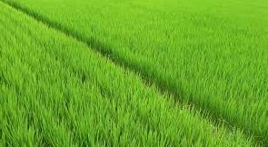
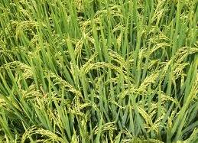
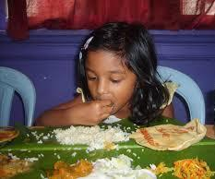
Rice consumption is assumed to be associated with increase in the incidence of diabetes in the rice eating zones of the country
The increased sugar levels in diabetes are attributed to carbohydrates, which could include starches from white rice

Slide 3
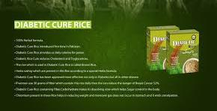
A study of ~230 rice varieties world wide showed that indian rices are within recommended Glycemic index
Glycemic index measures the ability of a food substance to raise blood sugar levels after eating
Foods with a high glycemic index of 70 and above cause blood sugar levels to peak within a short period of time, damaging blood vessels and nerves
Foods with a medium (below 69) or low glycemic index (below 55) are better options for diabetics.

Slide 4
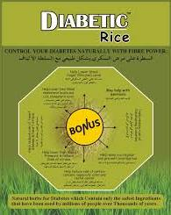
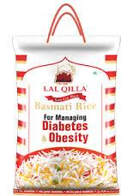
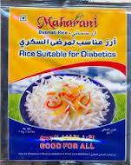
Generally white rice has a glycemic index between 72 - 83
Brown rice GI 48 - 62
Basmati rice GI 78 – 74
Most of the Indian rice varieties GI ~50 (<60)
Swarna and Mahsuri GI 55
Resistant starches play a role in GI

Slide 5
Though alternate foods are suggested/adopted, the satiety (satisfaction) of rice consumers can be full with low GI rice or brown rice
Health aware and diabetes prone rice consumers can switch their rice based diet to low GI rice
Biofortified rice with high zinc and iron is also being developed
Several ‘Diabetic’ rices are available in market, but their bio efficacy need to be certified with competent government body

Slide 6
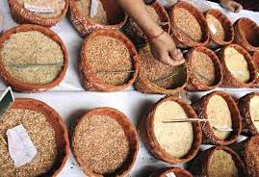
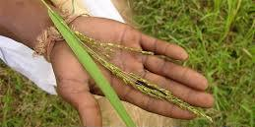
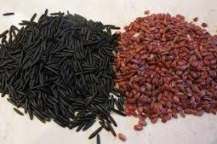
Rice in addition to being staple food crop in India is also known for its medicinal values
Some selected varieties used in specific treatments
Aalcha, Nagkesar, Kari bhatta - Skin problems
Atikaya - health tonic
Kanthi Banko - Medicinal properties
Chinta puvvu, Paccha ganneru - Nutritional & medicinal value
Gathuran - Arthritis, Rheumatism

Slide 7
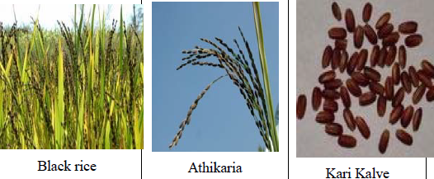
Some popular medicinal rice varieties
Gathuran- arthritis
Aalcha’ - pimples
Maharaji - strength and stamina to ladies post delivery
Baisoor – epilepsy; headache, boils, skin diseases, ringworm infections, conjunctivitis
Laicha – Pre pregancy
Other popular medicinal rices
Jhilli Udan Pakheru
Ramakeli Shyam Lal
Tenduphool Kalama
Pundarika Panduka
Sugandhalaka Kardamaka
Maetunaka Mahasali

Slide 8
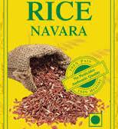
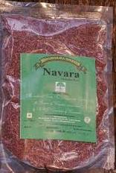
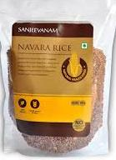
Of all medicinal rices, Njavara is the single largest used rice for medicinal purpose
Njavara rice cultivation is geographically restricted to Kerala (GEOGRAPHICAL INDEX)
The rice in good demand and its present market value is eight to ten folds higher than that of normal rice (Rs 350-400 kg)

Slide 9
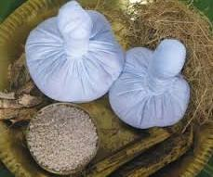
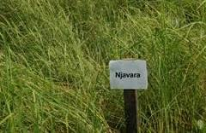
Njavara is used in ‘njavarakizhi’(an Ayurvedic treatments for neural disorders) and ‘marunnukanji’ (in the preparation of a replenishing health drink)
Njavara based treatments form one of the key elements in Ayurveda tourism in Kerala and elsewhere
Njavara rice is also made as powder and eaten with milk as breakfast cereal

Slide 10
Susrutha samhita (Circa 400 BC)
Charakasamhitha (Circa 100 BC)
Ashtanga Hrudayam (Circa 300)
Short duration (= 60days) - Shashtika
S. Indian languages - Njavara
Geographically restricted to Kerala
Several treatment systems in Kerala
Grains both medicinal & nutritive
Njavarakizhi
Njavaratheppu
Neurological disorders
Muscle wasting
Supplementary diet
&
Health drink - marunnukanji
Few thin culms
Short panicle
Small grains

Slide 11
Nutritional status- CFTRI
Components Njavara (% higher than normal rices)
Total protein 16.5%
Thiamine 27-32%
Riboflavin 4-25%
Niacin 2-36%
Dietary fibre 44%
Phosphorus 354 mg/100g Significantly higher
Potassium 304 mg/100g Significantly higher
Magnesium 216 mg/100g Significantly higher
Sodium 30.8 mg/100g Significantly higher
Calcium 11.6 mg/100g Significantly higher
Deepa et al. Food Chemistry 106 (2008): 165-171

Slide 12
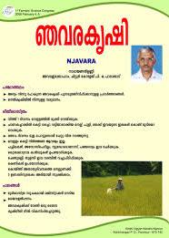
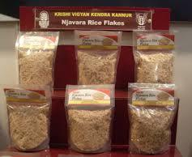
Market potential of medicinal rices in country
50% of Indian consumers are rice based
Satiety with rice consumption
Rise of consumer awareness in health foods and preventive medicine
Availability of medicinal rices and rices with low GI
Njavara farming and GI for Njavara is a proof of concept

Slide 13
Status of Biofortified rice
At DRR since past 10 years, ~2000 genotypes were screened for high zinc and iron in brown and polished rice
In Brown rice, very high zinc and iron lines are available.
But the consumer’s choice is only polished rice
For high zinc in polished rice, several landraces and varieties were identified

Slide 14
Status of Biofortified rice (contd)
Breeding lines with high zinc in polished rice are being developed not only in DRR, but also in UAS Bengaluru, TNAU Coimbatore, CRRI Cuttack and IGKV Raipur
Under AICRIP, a multilocation trial has been constituted since 2013 for identification of promising lines with high zinc in polished rice
However, promising high iron lines in polished rice were not available

Slide 15
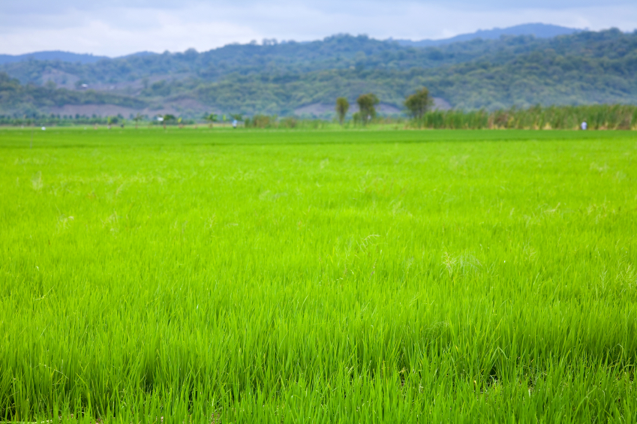
Action points
Identification of low GI rices and specific promotion of them as preferable rices for target consumers
Clinical trials for the proof of the effectiveness of low GI rices
Identification of medicinal rices in all states of Country and evaluation for their efficacy
Clinical trials of medicinal rices for its efficiency
Popularization of zinc-biofortified rices
Thank you…..

