Slide 1
A novel method for the management of mealybug in Cotton.
Gulsar Banu J
Principal Scientist,
Central Institute for Cotton Research,
Regional Station,
Coimbatore-641 003.
Tamil Nadu

Slide 2
Introduction
Due to large scale adoption of Bt cotton, there is a considerable reduction of pesticide usage.
Emergence of sap feeders (jassids, aphids, thrips, whiteflies, mealybugs, mirids and strainers).
Sucking pests pose potential threat to Bt cotton cultivation in India.
Mealybugs (Hemiptera : Psuedococcidae) are small sap sucking insects and are responsible for significant yield loss in many agricultural and horticultural crops.
There are about 2000 species, some of which are major pests of agricultural crops.

Slide 3
The cotton mealybug, Phenacoccus solenopsis Tinsley attacks more than >194 plant species in India.
Both nymphs and adults of mealybugs suck sap from leaves, stems, bolls and twigs.
Severe infestation leads to stunted growth and drying.
Black sooty moulds grow due to honeydew secretions.
It spreads naturally by wind, water, ants and human activities in the form of intercultural operations and movement of infested material leading to its quick colonization in new areas.
It is a polyphagous pest attacking many field and horticultural crops.
Persistent increase in the population of mealybugs, has threatened the economical production of many crops including cotton.

Slide 4
Papaya mealybug, Paracoccus marginatus believed to be originated in Central America.
Recorded in a severe form for the first time on cotton in Coimbatore.
Severe infestation lead to stunted growth and drying of the sympodial branches.
The mealybug infestation can be seen as clusters of cotton-like masses on the leaf, squares and bolls.
Papaya mealybug caused havoc in agricultural and horticultural crops ever since its first report from Coimbatore in 2007.
P. marginatus found to infest over 84 plant species belonging to 35 families in south India

Slide 5
The control of mealybug is very difficult because they are characterized by waxy covering of the body which hinders the penetration of pesticides.
This feature of mealybug makes the application of only a few systemic insecticides for the control of mealybug.
Repeated application of chemical insecticides has disrupted biological control by natural enemies leading to pest outbreak and sometimes in the development of resistance.
These problems high lightened the need for the development of novel insect control alternatives.

Slide 6
Use of entomopathogenic fungi, is a viable alternative to conventional insecticides, by virtue of being ecofriendly nature and compatibility with IPM practices.
Fungal isolates from different geographical regions will have varying virulence and adaptability to environmental conditions like temperature and humidity.
Identification of native isolates will pave way for the development of biopesticides with high virulence and temperature adaptability.
The objectives of this study were to search for novel native fungal pathogens of mealybug under natural field conditions and to evaluate their pathogenicity to mealybug infesting cotton in India.

Slide 7
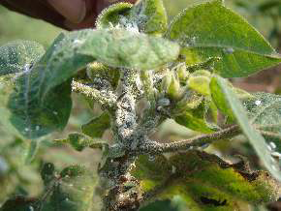
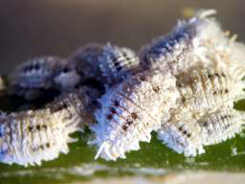
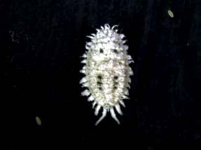
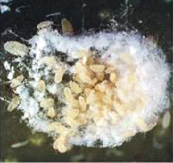
Phenacoccus solenopsis Tinsley

Slide 8
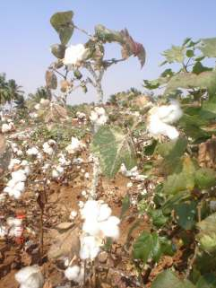
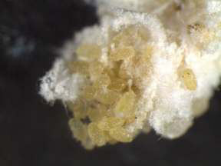
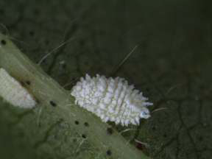
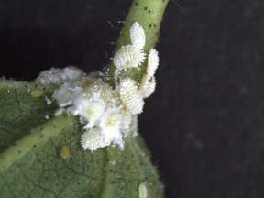
Paracoccus marginatus Williams and Granara de Willink

Slide 9
Materials and methods
Survey -- 2012 in Coimbatore district.
No. of samples-100.
Cadavers were superficially sterilized - 70% ethanol - sterile distilled water - 0.5% sodium hypochlorite -sterilized distilled water.
Sabouraud Dextrose Agar with Yeast extract (SDAY) - 25+1ºC and high humidity (80+10% RH)
The single spore technique was employed to obtain fungal isolates in pure culture.
Identification- Mycology Division of Agharkar Research Institute, Pune, Maharashtra

Slide 10
Pathogenicity studies
The mealy bugs, P.solenopsis and P. marginatus were collected from the naturally infested cotton plants.
Pure cultures of the fungi were subcultured and spores were harvested
Spore count was determined using a double ruled Neubauer haemocytometer using phase contrast microscope (Goettel and Inglis, 1997).

Slide 11
Insect : Nymphs and adults of P.solenopsis and P. marginatus
Fungus : 5 x 10⁵ , 1 x 10⁶ ,5 x 10⁶, 1 x 10⁷, 1 x 10⁷ and 1x10⁸ spores/ml
Control : Sterile distilled water containing Tween 80 solution (0.2 mL L⁻¹)
Observations: Numbers of dead insects at 24 hours interval.
Dead insects were transferred to a Petri dish containing moistened filter paper to observe fungal growth on the insects.
No. of replication: ten
No. of insect/replication: 25

Slide 12
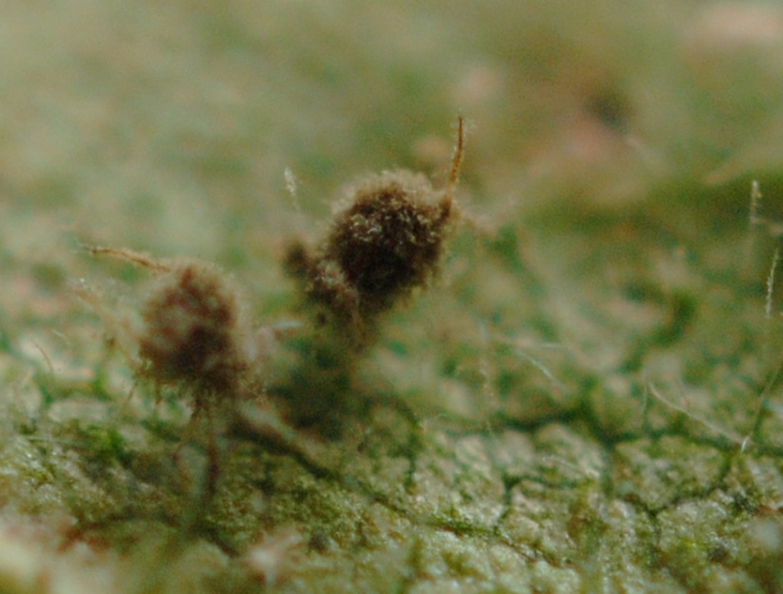
Results and discussion
Survey –occurrence 55-90 per cent in different fields.

Slide 13
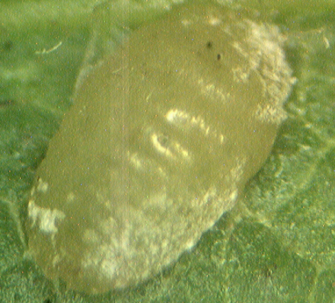
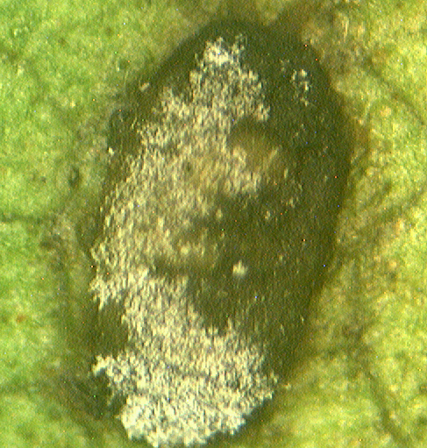
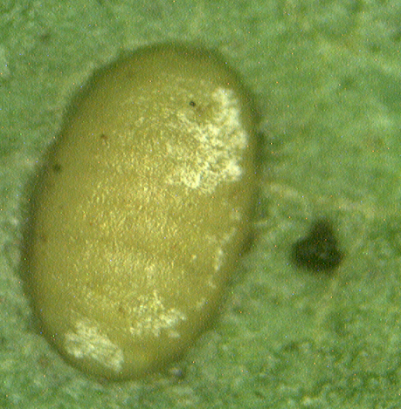
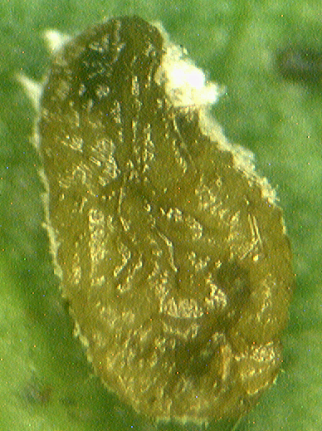
Infection process
24 hrs
96 hrs
48 hrs
72 hrs

Slide 14
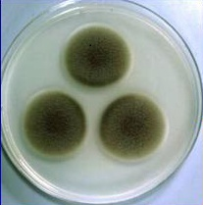
Results and discussion
Colonies on media on 7th day appeared first olive green later turned olive brown, floccose, reverse fuscus black.

Slide 15
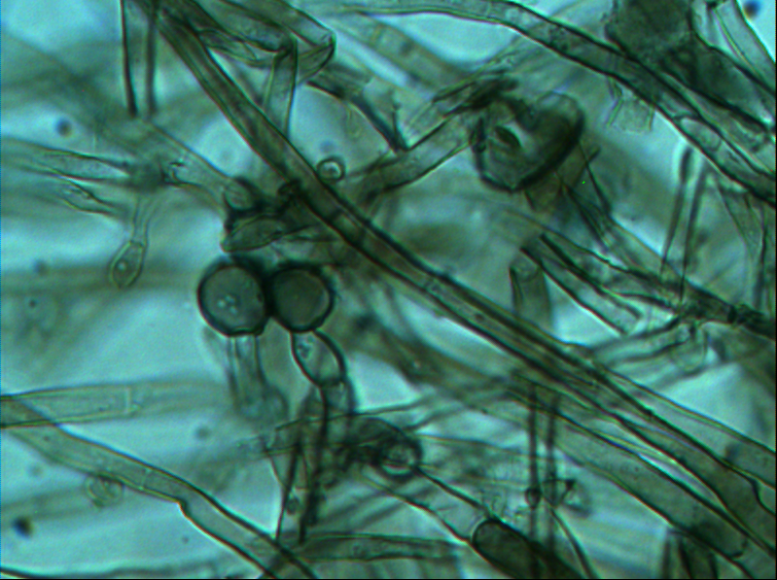
Results and discussion
Hyphae were subhyaline to light olivaceous and smooth.

Slide 16
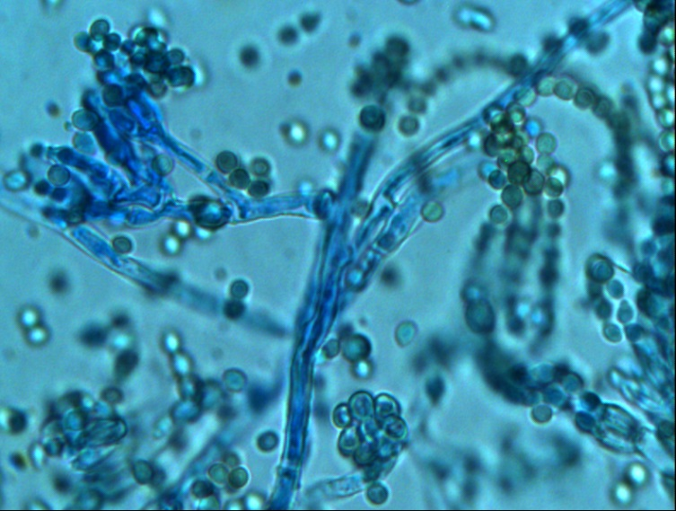
Results and discussion
Conidiophores were macronematous to micronematous, small to large, flexous, wall thickened and darkened, smooth, olivaceous brown.
Condia were catenate, simple, formed in long chains, aseptate to septate (mostly non spectate), limoniform to ellipsoidal, smooth, base thickened and darkened, variable in size up to 2.5-33.5 x 3.75µm.

Slide 17
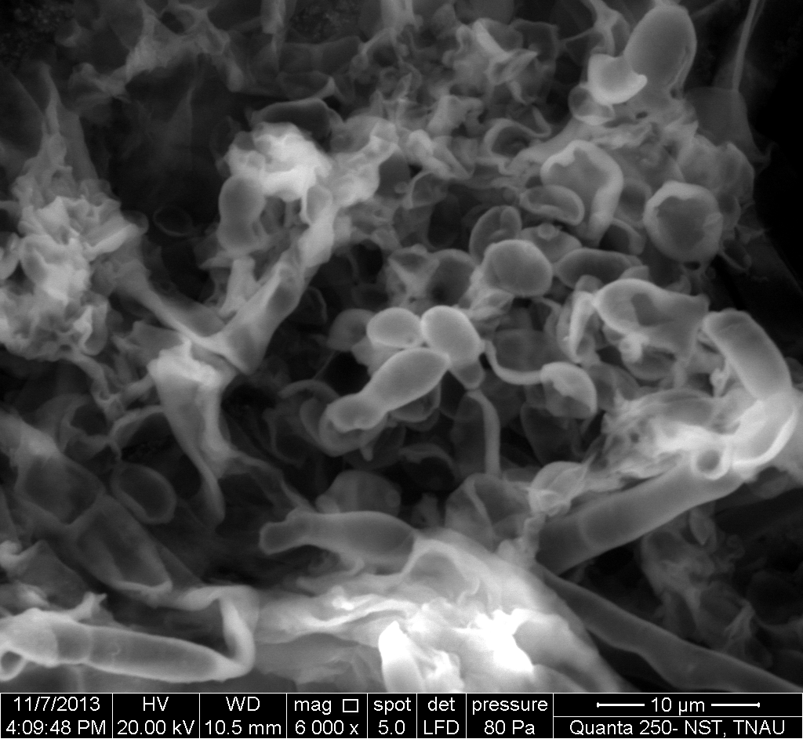
Results and discussion
The isolated fungus was morphologically identified as Cladosporium cladosporioides (Fresenius) de Vries (NFCCI-2958).

Slide 18
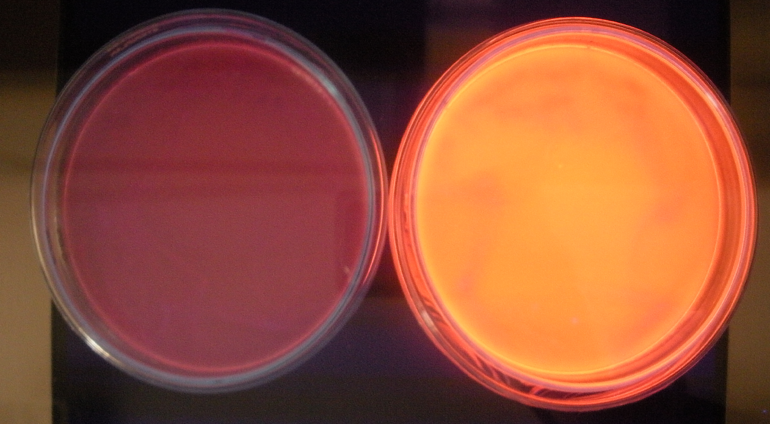
Lipase production

Slide 19
Concentration - Mortality response of different stages of P. solenopsis to C.cladosporioides
Stage | X ² | Regression Equation | LC₅₀ (conidia ml⁻¹) | 95 % Fiducial limit
 |  |  |  | LL ( conidia ml⁻¹) | UL ( conidia ml⁻¹)
Nymph | 1.79 | Y= 1.19-0.86x | 1.6 x 10⁷ | 1.0X10⁷ | 2.7X10⁷
Adult | 1.11 | Y=0.46+0.60x | 3.5 x 10⁷ | 2.0x10⁷ | 6.0x10⁷
Concentration - Mortality response of different stages of
P. marginatus to C.cladosporioides
Stage | X ² | Regression Equation | LC₅₀ (conidia ml⁻¹) | 95 % Fiducial limit
 |  |  |  | LL ( conidia ml⁻¹) | UL ( conidia ml⁻¹)
Nymph | 1.516 | Y=2.45+0.34x | 4.5 x 10⁷ | 1.1X10⁶ | 1.8X10⁷
Adult | 1.099 | Y= 0.91+0.53x | 5.2 x 10⁷ | 1.2 x 10⁷ | 1.9 x 10⁸

Slide 20
Time - Mortality response of different stages of P. solenopsis to C.cladosporioides
Stage | X ² | Regression Equation | LT₅₀ (h) | 95 % Fiducial limit
 |  |  |  | LL | UL
Nymph | 0.90 | Y=1.84+3.85x | 158.40 | 142.8 | 175.68
Adult | 0.18 | Y=1.37+4.21x | 174.96 | 154.56 | 198.00
Time - Mortality response of different stages of
P. marginatus to C.cladosporioides
Stage | X ² | Regression Equation | LT₅₀ (h) | 95 % Fiducial limit
 |  |  |  | LL | UL
Nymph | 0.12 | Y=0.99+4.49x | 188.66 | 152.20 | 216.00
Adult | 0.06 | Y= 0.25+5.28x | 191.04 | 168.48 | 216.96

Slide 21
The entomogenous fungi Cladosporium spp. have been isolated from different insect (Abdel-Baky and Abdel-Salam 2003; Perea et al. 2003) and mite (Pena et al., 1996; Van der Geest et al., 2000) hosts in nature in different regions of the world.
Natural occurrence of Cladosporium oxysporum (Berk. and Curt.) was also reported on Planococcus citri (Risso) (Samways and Grech, 1986).
Natural infection of T. urticae by C. cladosporioides (50.95 to 74.76%) was also reported by Eken and Hayat (2009) in Turkey Jeyarani et al., 2012 in India.
Leanicillium lecanii (Banu et al., 2009)
Fusarium pallidoroseum (Monga et al., 2010)
54 isolates of entomopathogenic fungi from mealy bug.

Slide 22
Conclusion
This is the first record on the natural infection caused by C.cladosporoides on mealy bug from India.
Present investigation demonstrates the effectiveness of the fungus ,C. cladosporioides against both P.solenopsis and P. marginatus under laboratory condition.
Histopathological changes due to C. cladosporioides on mealy bug was described.
Further, research on the field efficacy of this fungus could wide open their potential for the biosuppression of P solenopsis and P. marginatus so as to reduce the dependence on chemical control.

Slide 23
Thank you

