Slide 1
Shifting the Paradigm for Genetic Sample Resources
J. Claiborne Stephens, CEO, Genomics GPS
Ron Bromley, Ena Bromley, BSSI
Ted Kalbfleisch, Intrepid BioInformatics

Slide 2
Disclaimer
Genomics GPS is focused on the strategic application of genomic studies, samples, and analyses in a variety of commercial applications
Clay Stephens, Founder and CEO, is currently the only employee

Slide 3
Overview
Current Process
Proposal for Change
Contrast
Scientific Benefits of New Model
Commercial Benefits
Discussion

Slide 4
Genetic Biosamples
Typically blood
  Treated for clotting
  Antimicrobial
  Frozen
Extracted DNA
  Frozen
  Blotted
Desired data
  Genotype or sequence of one or more loci

Slide 5
Current Model
Sample is
Taken and prepped for storage
Retrieved and prepped for genotyping
Genotyped
Remainder returned to storage
Data obtained
Inventory (where is it, how much is left, what format is it in)

Slide 6
Proposed Model
Sample
Taken and prepped for genotyping
Uniformly genotyped and imputed
  Note: combination of direct and indirect methods
Remainder sent to storage (archival)
Data obtained
Inventory (where is it, how much is left, what format is it in)

Slide 7
Pros and Cons of Current Model
Positives
Negatives
Familiar
No upfront genotyping expense
Obtain only the data desired
Genotyping/sequencing costs
continue to drop
Possibility that sample gets lost or consent expires
Expense in storing/retrieving/ prepping sample
Time lag in above
No/Limited use of sample
Non-uniform data generated

Slide 8
Pros and Cons of New Model
Positives
Negatives
Data available and uniform
Reduced expense for storing/ retrieving/prepping sample
Reduced time lag in above
Maximize use of sample
Sample loss avoided
Data may improve over time as reference panels and imputation algorithms improve
Upfront genotyping expense
May still miss the desired data (e.g., sequence)
Infrastructure for data maintenance and access may be lacking

Slide 9
Perfect Genomic Data
Complete and accurate full sequence
Including simple structural (indel) variation
Including complex structural variation (CNV)
Including phase
Exclusions
  Mosaicism
  Epigenetic phenomena

Slide 10
What is Sacrificed in Proposal?
de novo mutations (single patient)
Private variation (single family)
Rare variants that fail to impute
Common variants that fail to impute
Indels and CNVs that fail to impute
Phase should be accessible as part of imputation process

Slide 11
Commercial Considerations
Per Sample
Incurring upfront genotyping costs in place of sample prep/storage/retrieval costs
Storage and retrieval is now data, not sample
Infrastructure
Freezers and personnel now minimized to storage of archival (non-frozen?) samples
Shift to data infrastructure

Slide 12
Discussion
Thanks!

Slide 13
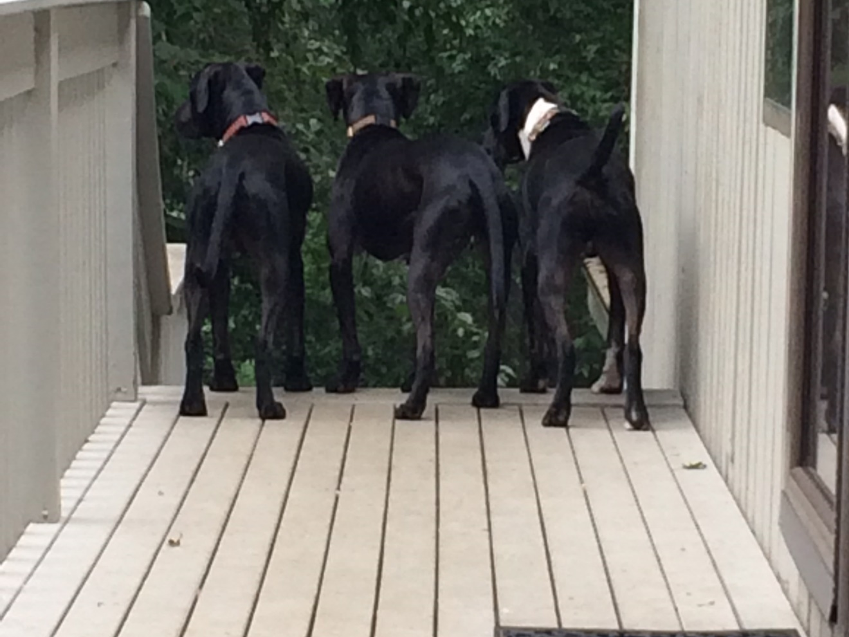
The End(s)

