Slide 1
Islam medhat mahmoud
Cairo University Egypt
Islammedhat36@yahoo.com

Slide 2
ISLAM MEDHAT
Best speaker in international physical therapy conference best student research in Arab world 2013 research team leader in cms , core medical society speaker in 2nd international conference for physical medicine and rehabilitation Baltimore Maryland, usa 2014

Slide 3
For the last 2 years I HAVE BEEN WORKING ON A RESEARCH THAT MAKE A GREAT RESULTS globally ON THE EXPIRMENTAL STUDIES DONE ON RATS TO TREAT DIABETES MELLITUS TYPE 1 AND TYPE 2 WITH THE USAGE OF THE LOW POWER LASER CLINICALLY USED IN FIELD OF PHYSICAL MEDICINE, DENTISTRY, ORTHOPEDICS AND OTHERS

Slide 4
My main area of interest include low power laser and diabetes

Slide 5
In the next slides I will briefly demonstrate the research and it’s results

Slide 6
Note any information shouldn’t be taken without an informed consent from the lecturer

Slide 7
Current role for specialties working in the field of physical medicine in management of dm

Slide 8
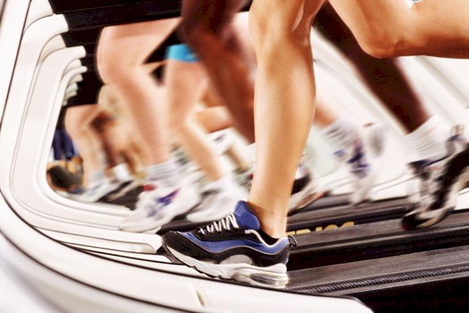
Mainly aerobic exercise prescription

Slide 9
In this presentation I am going to prove to you experimentally that we as a specialties working in this field could reach a cure for diabetes mellitus

Slide 10
Diabetes statistics
204,301 people die every year in usa only because of diabetes the number are pretty much higher in other developing countries
7th leading cause of death, but it is not the case diabetes contributes to other leading causes of death in world
American heart association states that the diabetics have two to four more risk to develop heart disease and stroke which is the leading cause of death in the world

Slide 11
Diabetes considered as a leading cause of renal failure which is the 9th leading cause of death in the world so we can say from that diabetes as a disease is not so dangerous what is the most risk is what develop as a consequence of it’s presence

Slide 12
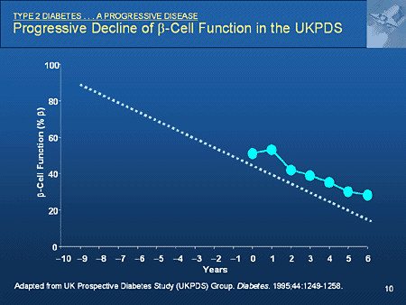
Type 2 Diabetes has progressive nature injection will be the choice sooner or later.

Slide 13
Medical treatment for DM just like a number of other diseases.
Unable to treat the cause so you just keep Treating symptoms and leaving causes growing.

Slide 14
This is such a waste of resources what type of treatment prohibit the patient from most food and give him a life long medication and accordingly a life long side effects that is one day or another will lead him to depend on Insulin injection
In fact it is a very common scenario that a type 2 patient eventually use Insulin.

Slide 15
Complications
.Hyperosmolar hyperglycemic nonketotic syndrome mainly common in Type 2 DM (20%) blood sugar over 600 mg/dl
.Diabetic Retinopathy
.Diabetic neuropathy ( 50% of patients)
.Diabetic immunopathy
.Diabetic nephropathy
.Diabetic foot

Slide 16
This takes me to study more about glucose and beta cell and how they are interconnected in a point called insulin

Slide 17
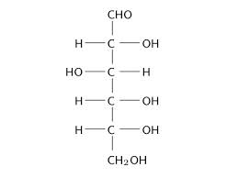
Glucose

Slide 18
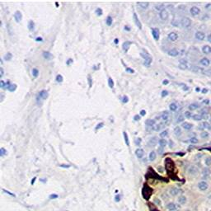
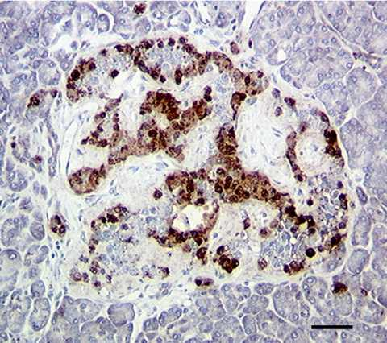
Beta cell Histology

Slide 19
Right now 40% of patients with Type 2 Diabetes uses insulin as a part or as a independent treatment for their case

Slide 20
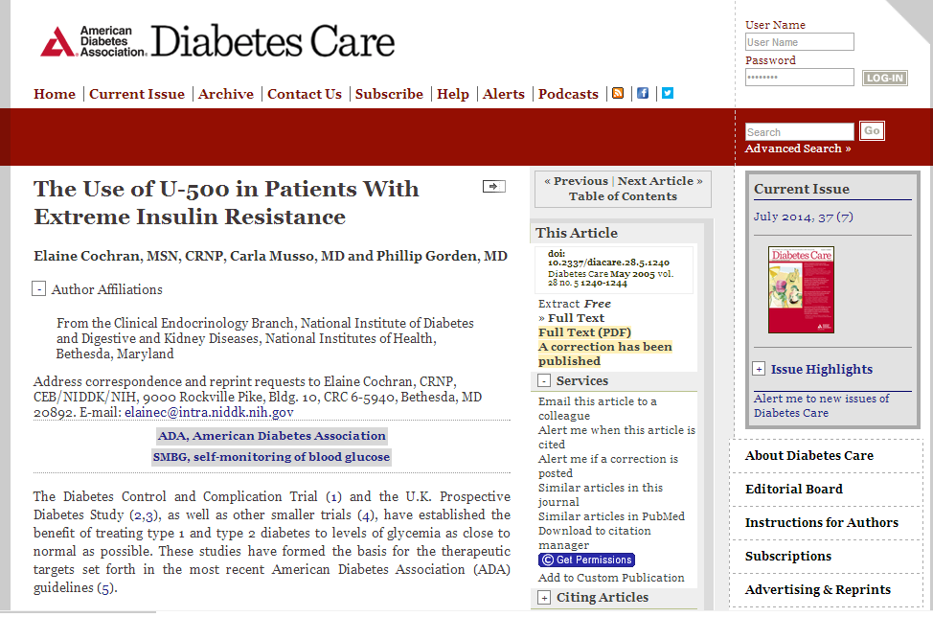
Insulin Resistance treated with INSULIN

Slide 21
In fact Pregnant women who suffer from type 2 DM have to stop taking any hypoglycemic agents –Teratogenicity effects- and depends only on Insulin
Before the discovery of Insulin Diabetics were not allowed to get pregnant
Now most Pregnant women Depend on Insulin with Excellent results

Slide 22
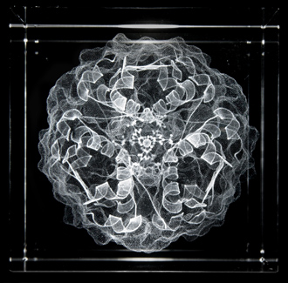
So it is all about Insulin, you increased Insulin you treated Diabetes

Slide 23
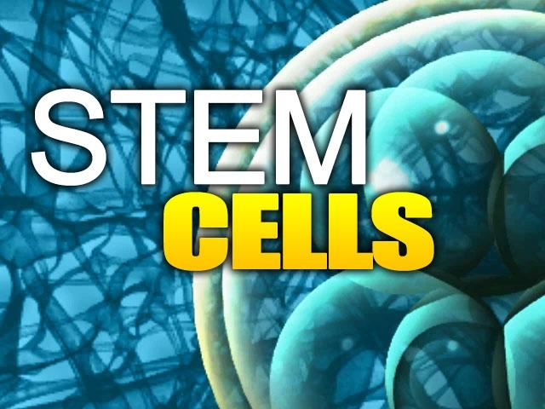
Stem cells treatment increase Insulin in Diabetics with 8% success

Slide 24
So What if we have a modality that could stimulate Insulin Just like the stem cells.
Body’s own systems are stimulated to treat body’s own disease.

Slide 25
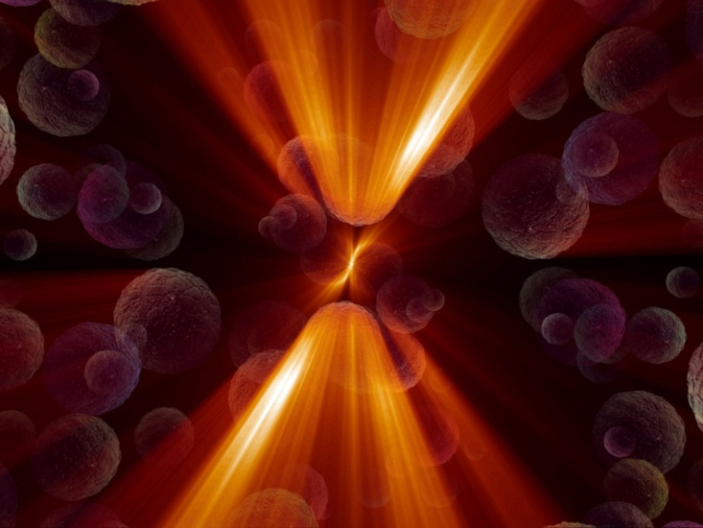
LASER

Slide 26
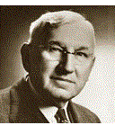
History of LASER
Professor Andrew Mester
Discovered benefits of LASER IN 1964 finding enormous healing ability of LASER

Slide 27
Physiological Effects of LASER
Note all of the following effects won’t happen unless LASER is used correctly.
I started to classify the LASER as follows

Slide 28
Physiological effects of LASER
“LASER is a local treatment that produce a local effect
,Accordingly the effect will vary according to the treated area”
Primary Cellular
Unavoidable(it will happens as soon as LASER touches the cells):
1. Porphyrins
2. Flavoprotiens
3. Catalases
4.Cytochrome c oxidase & Nitric Oxide
5.Oxygen Hypothesis
All of these leads to Mitosis and initiate the secondary effects
Secondary Regional
Avoidable:
High variability
Highly depend on region, skills of the clinician and purpose of TTT
Example
Cartilage Chondrocytes
Bone Osteocytes
Hepatocytes Interferon
Wound BFGF
Liver IGF 1
Pancreas INSULIN

Slide 29
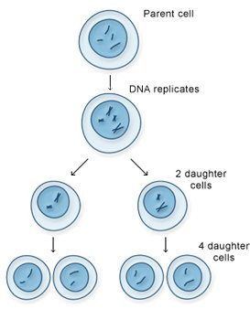
Mitosis
That explain the current indication of LASER

Slide 30
idea
What if we used the LASER in a certain procedure to reach the islets of Langerhans stimulating their mitosis and allowing more insulin to be produced to treat the cause of the disease not just the hyperglycemia which is the symptom

Slide 31
Controversy
One of the obstacles faced me during this research was the huge controversy about LASER

Slide 32
Dr kendric Smith
(Stanford university school of Medicine) Discussed this controversy in a number of papers

Slide 33
Blue light is not of any harm to DNA , But it is destructive for bilirubin in fact it is the first line of treatment for Jaundice

Slide 34
Walker reported that LASER of 633nm is of no effect in treating post herpetic neuralgia while Moore reported that radiation with 830 nm is the treatment of choice for the same pain.
That Explains a lot.

Slide 35
In order for Photo Medicine to be effective
The first law of photochemistry, the Grotthuss-Draper law should be applied, states that light must be absorbed in order for a photochemical reaction to take place.

Slide 36

Wave Length

Slide 37
Since wave length was different it wasn't absorbed by the different tissue this means that every wave length is absorbed by different type of tissue

Slide 38
The Question here is which wave length absorbed by which tissues So stimulate which enzyme

Slide 39
I needed here to develop a chart based on my experiments and other papers published in the field of Photo Medicine in the Last 10 years, based on the results on human beings ONLY
(NOT JUST ANIMAL SAMPLES).

Slide 40
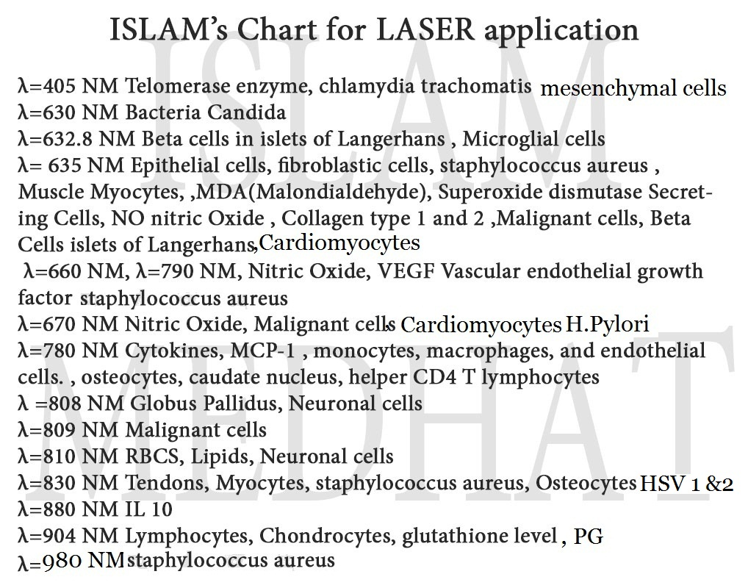
Islam’s Chart for LASER application

Slide 41
References
Tuby H, Trudler D, Doron-Mandel E, Maltz L, Vassar RJ, Frenkel D, Oron U onathan Stone
Kim WT, Bayome M, Park JB, Park JH, Baek SH, Kook YA
Gavish L, Rubinstein C, Bulut A, Berlatzky Y, Beeri R, Gilon D, Gavish L, Harlev M, Reissman P, Gertz SD
Department of Anatomy and Cell Biology, The Hebrew University, Hadassah Medical School, Jerusalem t Denis TG, Dai T, Izikson L, Astrakas C, Anderson RR, Hamblin MR, Tegos GP.
Maisch T.
Bornstein E<>, Hermans W<>, Gridley S<>, Manni J<>.
Araújo PV<>, Teixeira KI<>, Lanza LD<>, Cortes ME<>, Poletto LT<>
Ye L, Kalichman L, Spittle A, Dobson F, Bennell K.
Rubio CR<>, Cremonezzi D<>, Moya M<>, Soriano F<>, Palma J<>, Campana V<>
Rubio CR<>, Simes JC<>, Moya M<>, Soriano F<>, Palma JA<>, Campana V<>
Jamtvedt G<>, Dahm KT<>, Holm I<>, Flottorp S<>.
Castano AP<>, Dai T<>, Yaroslavsky I<>, Cohen R<>, Apruzzese WA<>, Smotrich MH<>, Hamblin MR<>. Wellman Center for Photomedicine, Massachusetts General Hospital, Boston, Massachusetts 02114, USA.

Slide 42
Here comes a question which Intensity will reach which depth and will stimulate which process inhibitory or excitatory

Slide 43
Note
George.S , John.M in Australia paper published in WCPT
World confederation for physical therapy
This equation will have more area for error if the procedure wasn't performed by a person who is able to substitute accurately in the variables of the equation

Slide 44
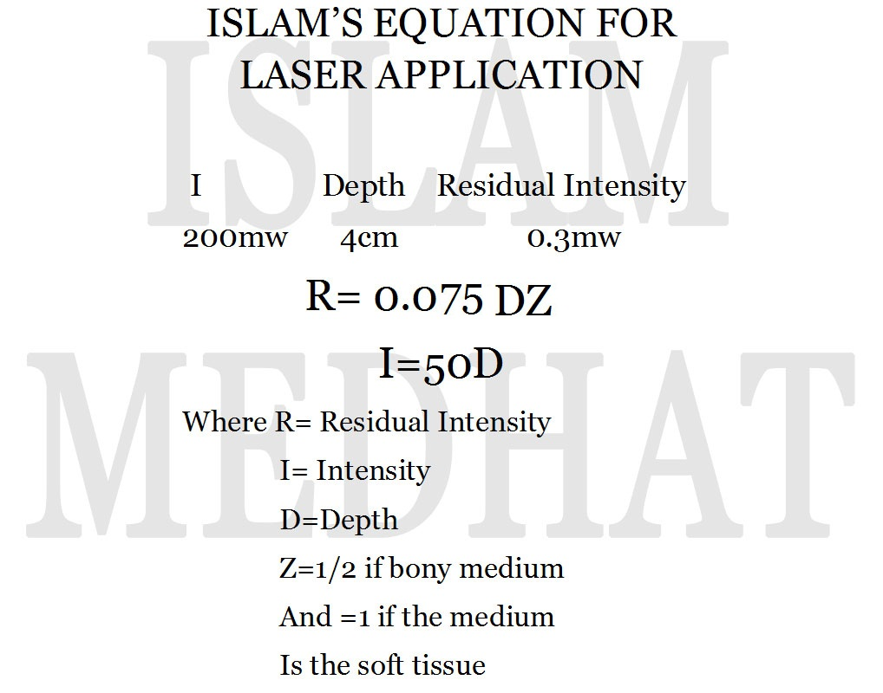

Slide 45
Common number found in a number of research states that the Residual Intensity of 0.3 to 0.5mw is of excitatory effect

Slide 46
This equation is not applicable if the medium separating you from the targeted area to be treated is both bony and soft tissue medium

Slide 47
The following must be taken into consideration during the procedure:
1-Diameter of the beam
2-Amount of HCA hyperosmotic chemical agent
3-Angle between the probe and organ must be 90
4-Even the skin compression done by your hand during the procedure will lead to different depths

Slide 48
Starting experiments:
A Quantitative study used 50 wistar rats
(20 male and 30 females) 635nm LASER used for 15 mins with energy 2.7 Joule
Pancreas was located at about 0.05cm (Approximately) after an upper abdominal opening was made after application of lidocain hydrochloride with SC injection in 2 areas for anesthesia (14 samples required slightly higher doses and IM injection)
Glucose levels was monitored before and after in both 2 hours post prandial and fasting tests for entire 5 weeks for following up

Slide 49
Anesthesia: Lidocain Hydrochloride used 1/10 Diluted S.C injection 2 mg/kg
Note: 14 samples required higher doses
Scale used: 2 hours Post prandial and fasting testing monitoring continued for a whole 5 weeks
Type 2 Diabetes was induced using streptozotocin intra peritoneal injection 25mg/kg

Slide 50
Results was as follows:
Blood glucose levels decreased in fasting testing by 40%( + or _ 10% )
And (35% +or_ 3% ) in post prandial

Slide 51
Vision is to apply the procedure on human beings
Pancreas is located bilaterally in the level of T12 vertebrae
Precautions
Inspect the skin very carefully for any sign of infection if there is an infection cancel the procedure till the infection resolves in order not to activate it with your laser
Measure the patient temperature and take a fully detailed Medical history

Slide 52
2 Things need to be managed in order for this procedure to work

Slide 53
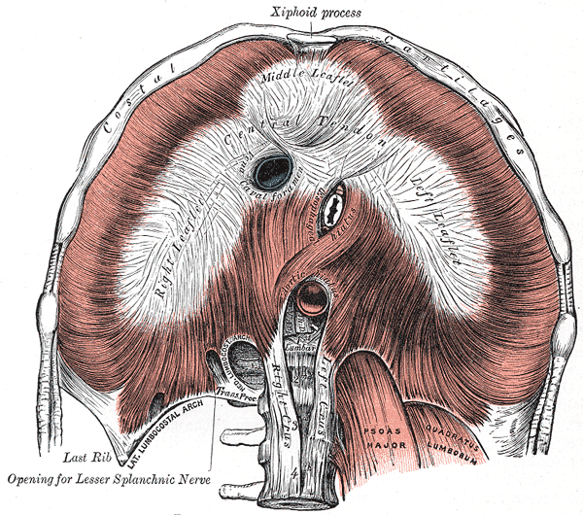
1. Diaphragm pushes the pancreas in every breath

Slide 54
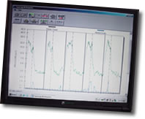
EMG biofeedback will give you an auditory feedback the device will go off that makes you modify the patient respiration when it become increasingly deep

Slide 55
If your EMG device doesn't provide you with an auditory signals get a Physical therapist assistant or nurse to monitor the device, alarming you if the patient is taking deep breathes

Slide 56
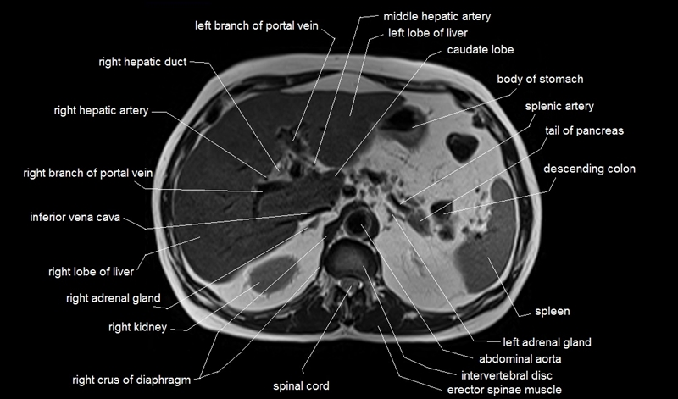
2.Suprarenal gland very near to pancreas

Slide 57
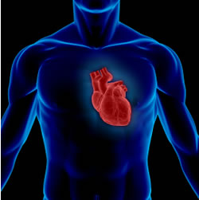
H.R & R.R & B.P
Should all be accurately measured before and after the procedure

Slide 58
Blood sugar should be monitored before and after each session
Drug or insulin doses is with drawn gradually based on the lab readings till blood sugar is normalized
Follow up is needed with you and Gastroenterologist or Endocrinologist

Slide 59
thank you

