Slide 1
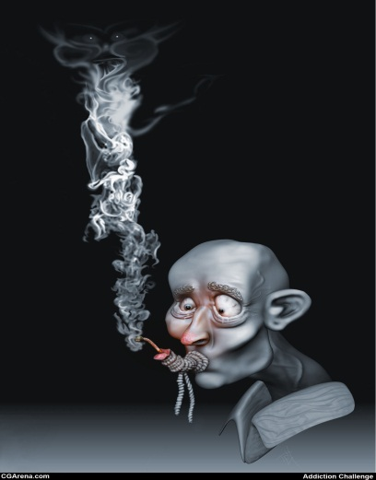
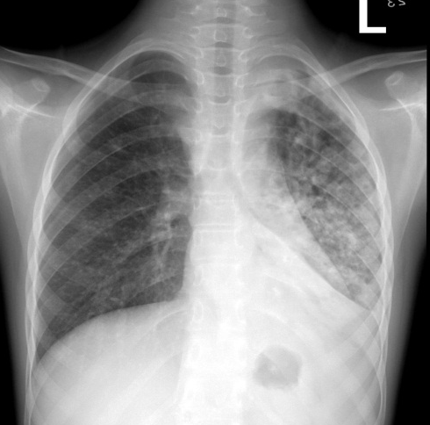
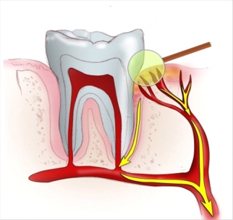
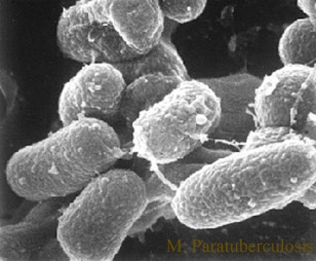
Oral Health, HIV, TB & Smoking: Addressing Behavioral Health
Isabel Rambob, DDS
University of Maryland School of Dentistry
Department of General Dentistry
October 27, 2014

Slide 2
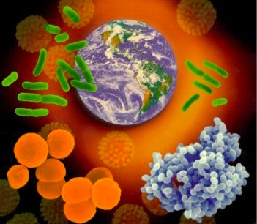
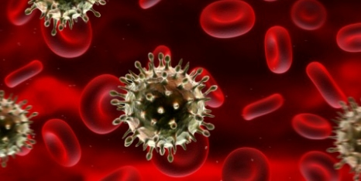
Disease Susceptibility
Worsening Outcomes
irambob

Slide 3
TB or not TB
irambob

Slide 4
According to WHO (2012), TB remains a major global health problem (8.6 million new TB cases). It ranks as the 2nd leading cause of death from an infectious disease worldwide, after HIV.
irambob

Slide 5
TB or not TB
TB is caused by Mycobacterium tuberculosis, which can be present as either latent infection or active disease.
Latent TB infection means that TB bacteria are living in the body but not causing any symptoms.
People with latent TB infection are not sick, do not have symptoms, and cannot spread the disease.
http://www.cdc.gov/hiv/resources/factsheets/PDF/hivtb.pdf
irambob

Slide 6
TB or not TB
TB disease means that the bacteria are multiplying and are destroying body tissues; if not diagnosed and treated properly, it can be fatal (1.3 million deaths in 2012).
People with TB disease are sick, do have symptoms, and can spread the disease. Only TB disease is infectious; latent TB infection is not.
TB disease of the lungs or airways can be spread from person to person through the air when a person with TB disease coughs, sneezes, speaks, or sings.
http://www.cdc.gov/hiv/resources/factsheets/PDF/hivtb.pdf
irambob

Slide 7
TB or not TB
A bad cough
Chest Pain
Weakness
Fatigue
Weight loss
No appetite
Chills
Fever
Sweating at night
irambob

Slide 8
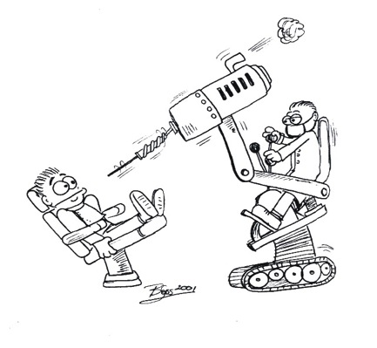
Elective dental treatment should be deferred until the patient has been declared non-infectious by his/ her physician.
irambob

Slide 9
TB or not TB
Diagnosis delay and non-completion of treatment are two central behavioral challenges for TB control.
Patients are expected to seek care and complete treatment.
Success in TB detection and treatment requires specific behaviors from patients and health care providers within contexts that facilitate those practices.
irambob

Slide 10
TB & HIV
HIV has added a new face to respiratory disease with increased rates of TB and pneumonia.
35 million people living with HIV
irambob

Slide 11
TB & HIV
TB is particularly dangerous for people with HIV infection.
People who have both HIV infection and latent TB infection (LTBI) are 20 to 30 times as likely to develop active TB disease as those who do not have HIV infection.
http://www.cdc.gov/hiv/resources/factsheets/PDF/hivtb.pdf
irambob

Slide 12
TB & HIV
All individuals newly diagnosed with HIV infection should be tested for TB ASAP.
http://www.cdc.gov/hiv/resources/factsheets/PDF/hivtb.pdf
irambob

Slide 13
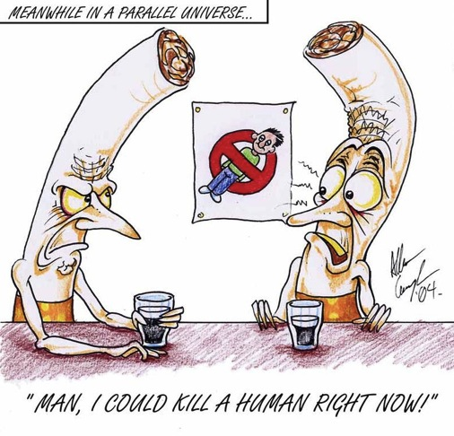
Tobacco use continues to be the leading global cause of preventable death.
irambob

Slide 14
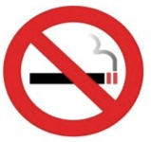
Tobacco Facts
It kills nearly 6 million people and causes hundreds of billions of dollars of economic damage worldwide each year.
Most of these deaths occur in low- and middle-income countries, and this disparity is expected to widen further over the next several decades.
WHO Report on the Global Tobacco Epidemic, 2011.
irambob

Slide 15
Smoking
There is a strong dose-response relationship between the intensity of tobacco dependence counseling and its effectiveness.
Because smoking is a habitual behavior, it is important to encourage patients to alter their daily routines, which helps to disassociate related behaviors.
irambob

Slide 16
HIV/AIDS & Tobacco Use
The proportion of individuals living with HIV/AIDS who are current cigarette smokers is between 47%-65%.
Smoking tobacco has also been found to decrease the effectiveness of HAART therapy.
irambob

Slide 17
HIV/AIDS & Tobacco Use
Smoking further raises the extremely high risk of contracting TB in HIV + individuals.
In addition to increased susceptibility of community-acquired bacterial pneumonia.
HIV-infected patients are 2-3 times more likely to be smokers than their age-matched HIV-uninfected counterparts.
irambob

Slide 18
HIV/AIDS, Smoking & Oral Health
Tobacco use in HIV+ smokers is responsible for increased periodontal disease and tooth loss.
HIV+ smokers also have an increased incidence of cancer of the larynx, pharynx and esophagus.
irambob

Slide 19
HIV/AIDS, Smoking & Oral Health
Smokers have an increased risk of oral candidiasis and oral leukoplakia, as well as decreasing healing of oral lesions.
There is a marked risk of oral cancer in tobacco users and more than 80% is squamous cell carcinoma.
irambob

Slide 20
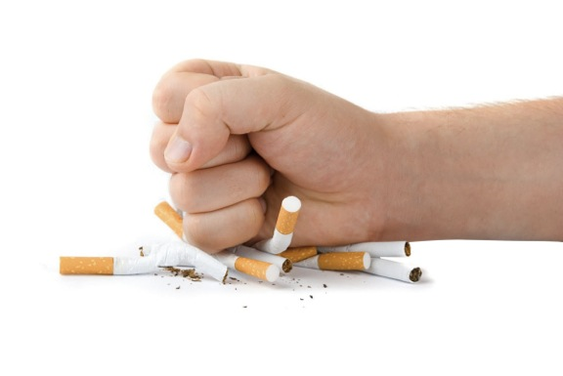
irambob

Slide 21
Smoking Cessation
The high prevalence of smoking among the HIV population, the many health risks that can result from it, and the proven efficacy of cessation interventions in HIV + patients should encourage clinicians to make smoking cessation for their patients a high priority.
irambob

Slide 22
Oral Manifestation of HIV/AIDS
Oral manifestations are an especially important component of HIV disease, because oral lesions are often the first overt clinical feature of HIV infection.
Oral lesions are among the most frequent problems associated with HIV infection, with more than 90% of patients having at least one oral manifestation during the course of their disease.
irambob

Slide 23
Oral Manifestation of HIV/AIDS
Health professionals should be able to recognize HIV-associated oral disease and to provide appropriate care and referral.
Factors that predispose to HIV-related oral conditions include CD4+ cell count of less than 200/μL, plasma HIVRNA levels greater than 3000 copies/mL, xerostomia, poor oral hygiene, and smoking.
irambob

Slide 24
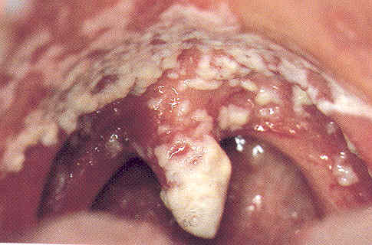
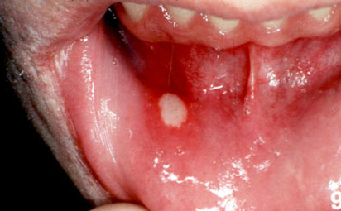
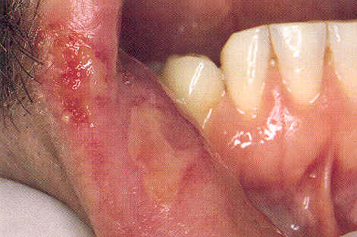
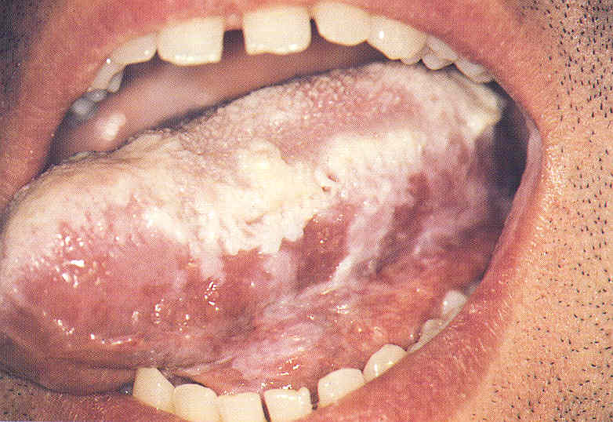
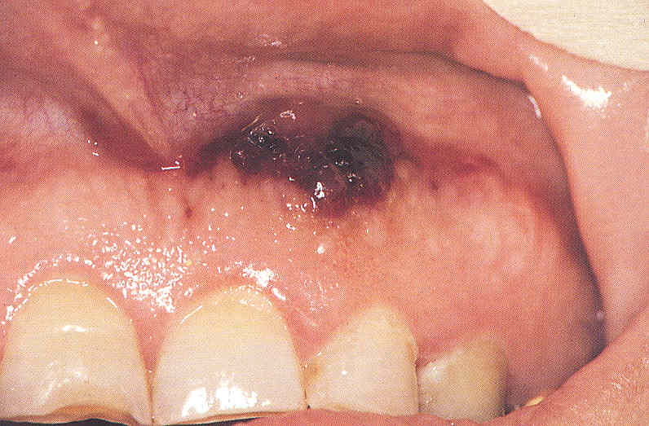
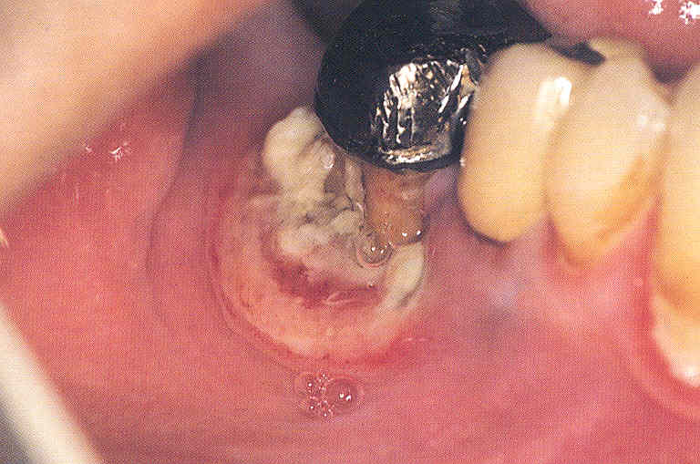
Conditions Found More Often in People With HIV
Conditions Found Primarily in People With HIV
irambob

Slide 25
Multidisciplinary approach is necessary to reduce the impact of these conditions!!!
irambob

Slide 26
References
CDC. HIV and Tuberculosis. March 2013. http://www.cdc.gov/hiv/resources/factsheets/PDF/hivtb.pdf
CDC. HIV/AIDS Surveillance Report. 2011 vol.23.
http://www.cdc.gov/hiv/pdf/statitics_2011_HIV_Surveillance_Report_vol_23.pdf
Lifson A, Neuhaus J, Arribas JR, van den Berg-Wolf M, Labriola AM, Read TR, INSIGHT SMART Study Group: Smoking-related health risks among person with HIV in the Strategies for Management of Antiretroviral Therapy clinical trial. Am J Public Health 2010, 100:1896-1903.
Smoking Cessation
http://hab.hrsa.gov/deliverhivaidscare/clinicalguide11/cg-308_smoking_cessation.html
Smoking and Tobacco Use: HIV and Smoking.
http://aids.gov/hiv-aids-basics/staying-healthy-with-hiv-aids/taking-care-of-yourself/smoking-tobacco-use/
Van Zyl-Smit RN, Brunet L, Pai M, Yew WW. The convergence of the global smoking, COPD, Tuberculosis, HIV, and respiratory infection epidemics. Infect Dis Clin North Am. 2010 September ; 24(3): 693–703
irambob

Slide 27
“Thoughtful reflection is how the human brain begins to store newly acquired information into long term memory.”
irambob

Slide 28
Thank you!
irambob@umaryland.edu
irambob

