Slide 1

Correct atmospheric optics modelling: Theory and Experiment
Irina Melnikova
Observatory
of Environmental Safety
Resource Center, Research Park
St.Petersburg State University
St.Petersburg. Russia. irina.melnikova@pobox.spbu.ru

Slide 2
Objectives:
1. Constructing the simple optical model of homogeneous atmosphere
2. Solution of the direct problem of atmospheric optics with operative varying optical parameters for elucidating the interaction between key atmospheric parameters and radiative characteristics
3. The solution of the direct problem is calculation of radiation characteristics (radiant heat. radiation balance at the tropopause level)
4. Comparison with the results of airborne measurements

Slide 3
Optical parameters
Optical thickness of the clear atmosphere :
τ = τ_{a.sc} + τ_{a.ab} + τ_{R +} τ_{m.ab} .
τ_{a.sc} – the optical thickness of aerosol scattering.
τ_{a.ab} - the optical thickness of aerosol absorption.
τ_{R}- the optical thickness of molecular scattering.
τ_{m.ab} - the optical thickness of molecular absorption;
Cloud optical thickness τ₀
Single scattering albedo: for clear atmosphere
ω = (τ_{a.sc} + τ_{R})/τ ;
For cloudy atmosphere ω = (τ₀ + τ_{a.sc} + τ_{R})/( τ + τ₀) ;
The phase function asymmetry parameter:
g=0.0 for clear atmosphere and g=0.85 for cloud atmosphere;
The ground albedo A_{s}

Slide 4
Spectral dependence of the ground albedo of different surfaces from observational data processing
(C.A. Varotsos. I.N. Melnikova. A.P. Cracknell. C. Tzanis. A.V. Vasilyev. New spectral functions of the near-ground albedo derived from aircraft diffraction spectrometer observations. Atmospheric Chemistry and Physics. v. 13. pp. 16211-16245)

Slide 5
Data of the SPSU RC lidar is used for aerosol optical thickness modelling
Raman channels
Aerosol lidar
Elastic channels
Polarization filter 355 nm
Multiwavelength lidar
Doppler (wind) lidar
Tunable titan-sapphier lasers
(at the mobile complex)

Slide 6
Stationary lidar system:
A Doppler lidar for measuring the wind speed and direction up to 12 km height
An aerosol lidar for measuring the atmospheric aerosol parameters up to 25 km height
1. Provide regular monitoring the dynamics of an atmospheric pollution above the big city center.
2. Retrieving atmospheric dust parameters: size, extinction coefficient, backscattering coefficient, real and imagine parts of the refractive index, and content

Slide 7
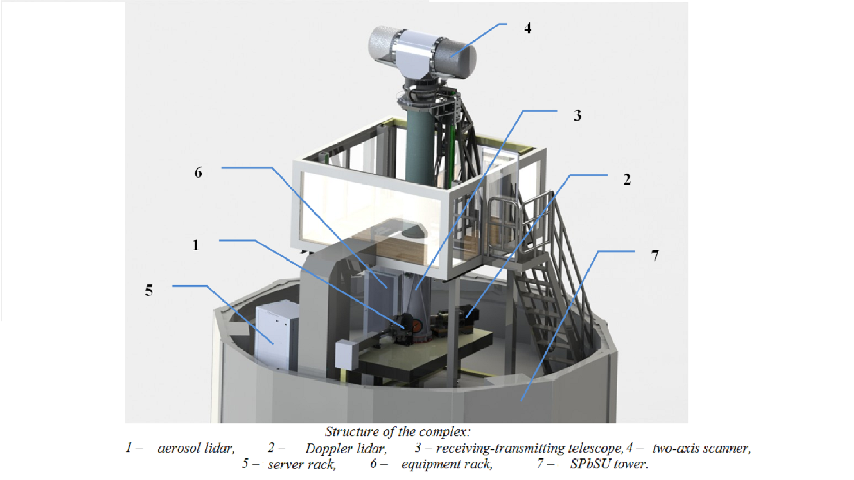
Stationary lidar system

Slide 8
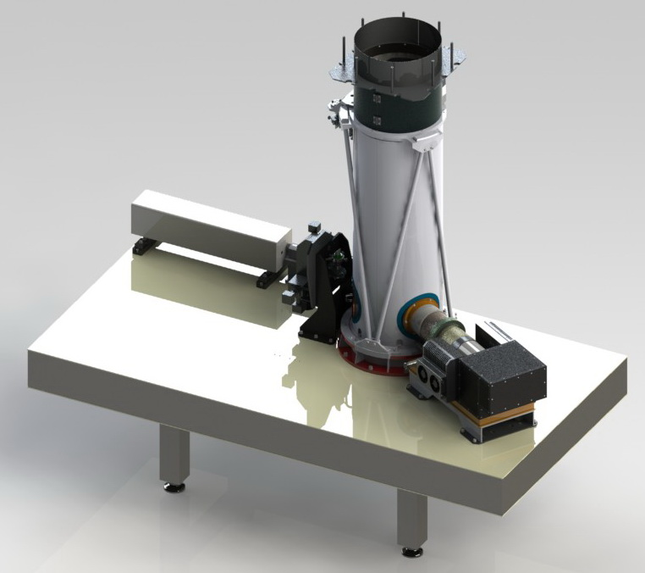
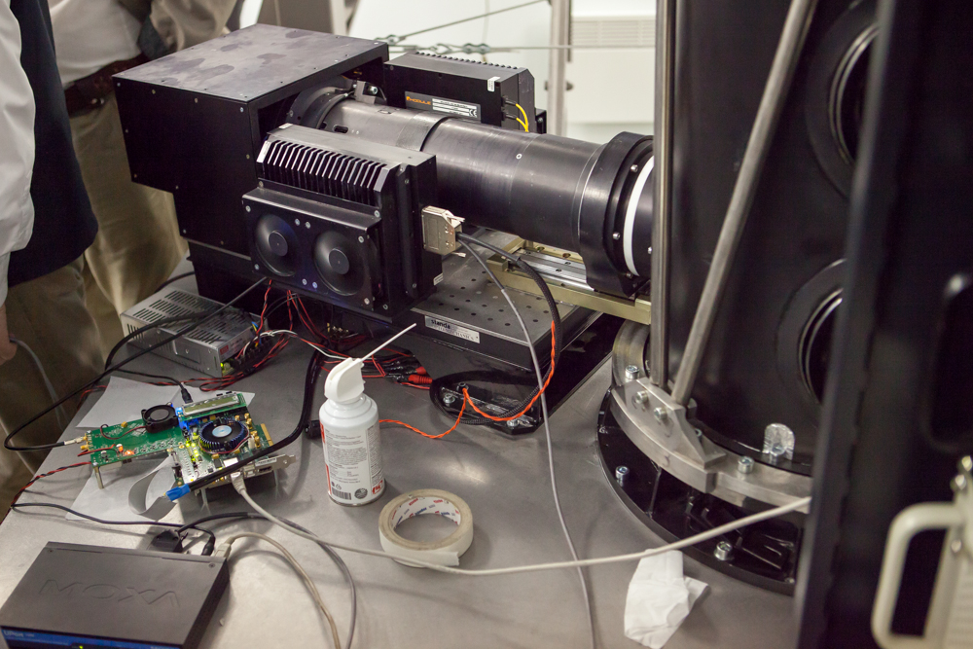
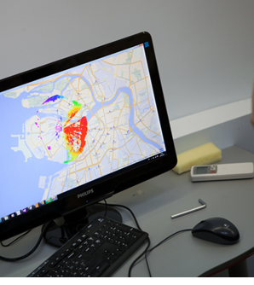
Aerosol lidar
1064 nm - 400 mJ
532 nm - 160 mJ
355 nm - 100 mJ
Doppler (wind) lidar for wind velocity and direction profile
Pulse repetition rate 10kHz

Slide 9
Screenshot of the received Lidar signal 31.10.2013

Slide 10
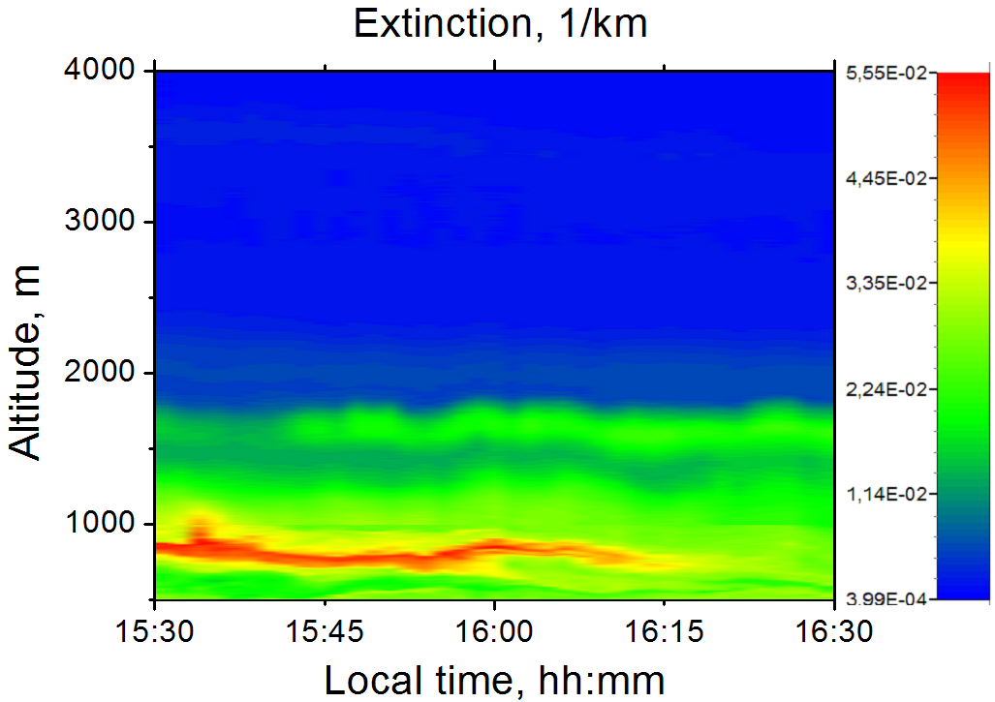
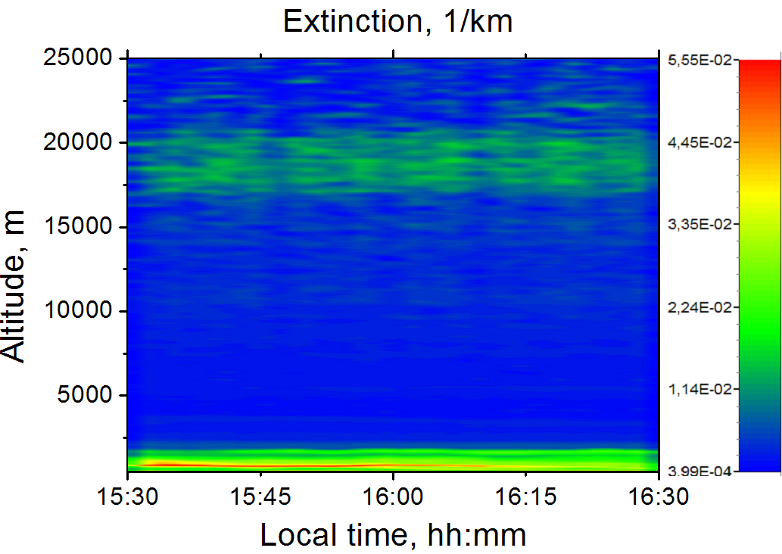
Lidar sounding above St. Petersburg city
The extinction coefficient above St. Petersburg 25 March 2013.
The vertical profile till 4 km and 25 km during 1 hour λ=532 nm
The maximum of hat pollution at 0.7 km, disappeared during 45 min (15:30 - 16:15) α(z)∼0.056km⁻¹
The stratosphere aerosol–Yunge layer at 17-22km α(z)∼0.015km⁻¹
Total optical thickness is τ = 0.0735

Slide 11
VALUES OF OPTICAL PARAMETERS OF THE CLEAR ATMOSPHERE
 | λ. μm | 0.30 | 0.40 | 0.50 | 0.60 | 0.70 | 0.80 | 0.90
Mol scatt | τ_{Rel (z=0)} | 1.222 | 0.364 | 0.14 | 0.067 | 0.036 | 0.021 | 0.013
Aer 0 | τ_{a scatt} τ_{a abs} | 0.0 0.0 | 0.0 0.0 | 0.0 0.0 | 0.0 0.0 | 0.0 0.0 | 0.0 0.0 | 0.0 0.0
Aer I | τ_{a scatt} τ_{a abs} | 0.25 0.01 | 0.18 0.01 | 0.16 0.01 | 0.14 0.01 | 0.13 0.01 | 0.12 0.01 | 0.12 0.01
Aer III | τ_{a scatt} τ_{a abs} | 0.7 0.4 | 0.5 0.4 | 0.5 0.4 | 0.5 0.4 | 0.4 0.4 | 0.3 0.4 | 0.3 0.4
0 I III | ω₀ | 0.26184 0.29876 0.33328 | 1.0 0.98195 0.68354 | 1.0 0.96774 0.61539 | 0.91781 0.93243 0.58757 | 1.0 0.94318 0.52153 | 1.0 0.93378 0.44522 | 1.0 0.93007 0.43899
0 I III | τ | 4.667 4.927 5.767 | 0.364 0.554 1.264 | 0.14 0.310 1.040 | 0.072 0.222 0.965 | 0.036 0.176 0.836 | 0.021 0.151 0.721 | 0.013 0.143 0.713

Slide 12
        Clear atmosphere
        Thin lines –optical thickness of scattering
        Thick lines –optical thickness of absorption
Spectral dependence of the single scattering co-albedo for 4 aerosol models

Slide 13
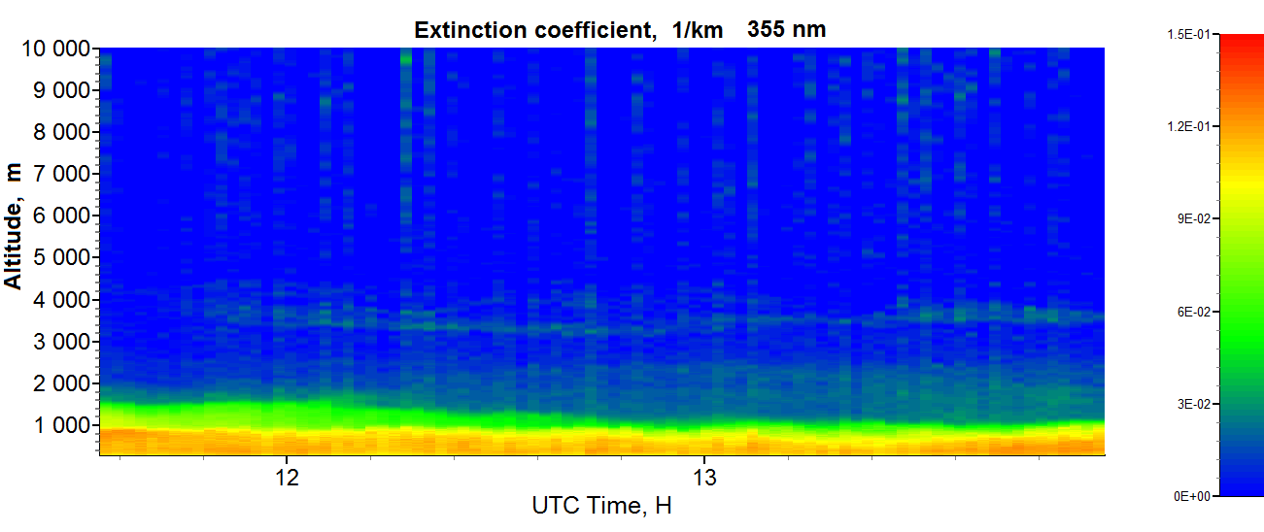
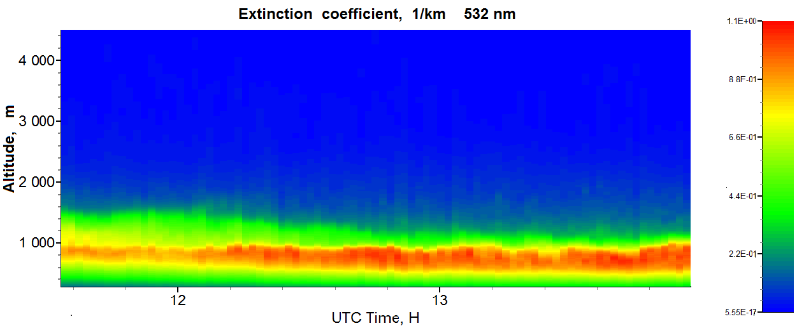
Clear atmosphere. Lidar sounding
Dynamics of the variation of aerosol extinction from lidar observation in SPSU (Donchenko V.K.. Samulenkov D.A.. Melnikova I.N.. Boreysho A.S.. Chugreev A.V. Laser systems of the St.Petersburg State University Resources Center. Possibilities. Problems Statement and the First Results. The contemporary problems of the Earth remote sensing form the Space. Moscow. 2013. Том 10. № 3. p 122-134)

Slide 14
Experimental values of the aerosol optical thickness
in St.Petersburg and suburbs
Wavelength. nm Experiment | 355 | 532 | 700
St. Petersburg city. Lidar sounding | 0.136 | 0.842
The Ladoga Lake Airborne observations | 0.01 | 0.06 | 0.15
Peterhoff city. Ground observations | 0.03 | 0.07 | 0.09

Slide 15
Calculation of radiative characteristics
Clear atmosphere. Radiative divergence
Simulation and airborne observation of radiative divergence for models of Aerosol 0 and 1
Notes:
What are the technical requirements to the mobile ground-based ecological lidar?
For the complex analysis of the atmospheric environment the following parameters should be measured (left)
The following lidar measuring tools should be applied for such type of complex monitoring: (right)

Slide 16
Clear atmosphere. Radiative divergence (continuation)
Simulation (Aerosol 3) and airborne observation of radiative divergence after the sand storm (Melnikova I.. Vasilyev A. Short-wave solar radiation in the Earth atmosphere. Calculation. Observation. Interpretation. Springer-Verlag. Heidelberg. 2004. 350 p.)

Slide 17
CLOUD 1
τ₀= 5 and 10 for all wavelength. added to the scattering optical thickness of the clear atmosphere
CLOUD 2 2-layer atmosphere :
cloud 1 (in layer 0-1 km) + clear layer above the cloud
The partly scattered light falls to cloud top and cloud spherical albedo is assumed as ground albedo for above -cloud layer
CLOUD 3
τ₀ (λ) - Spectral dependent optical thickness

Slide 18
OPTICAL PARAMETERS OF THE CLOUD-1 MODEL
 | λ. μm | 0.30 | 0.4 | 0.5 | 0.6 | 0.7 | 0.8 | 0.9
0 I II III | τ_{Σ} (τ₀=10) CLOUD 1 | 14.667 14.927 15.078 15.767 | 10.364 10.554 10.680 11.264 | 10.140 10.310 10.430 11.040 | 10.117 10.287 10.427 11.037 | 10.036 10.176 10.296 10.836 | 10.021 10.151 10.261 10.721 | 10.013 10.143 10.253 10.713
0 I II III | ω₀ (τ₀=10) CLOUD 1 | 0.76512 0.76854 0.76887 0.75614 | 1 0.99905 0.99626 0.96449 | 1 0.99903 0.99617 0.96377 | 0.99605 0.99222 0.98945 0.95742 | 1 0.99902 0.99612 0.96309 | 1 0.99902 0.99610 0.96269 | 1 0.99901 0.99610 0.96266
0 I II III | τ_{Σ} (τ₀=5) CLOUD 1 | 9.667 9.927 10.078 10.767 | 5.364 5.554 5.680 6.264 | 5.140 5.310 5.430 6.040 | 5.117 5.287 5.427 6.037 | 5.036 5.176 5.296 5.836 | 5.021 5.151 5.261 5.721 | 5.013 5.143 5.253 5.713
0 I II III | ω₀ (τ₀=5) CLOUD 1 | 0.64363 0.65196 0.65420 0.64289 | 1 0.99820 0.99296 0.93614 | 1 0.99812 0.99263 0.93378 | 0.99218 0.98487 0.97973 0.92215 | 1 0.99807 0.99245 0.93146 | 1 0.99806 0.99240 0.93008 | 1 0.99806 0.99240 0.93008

Slide 19
Optical parameters in the clear above-cloud layer (p_{z=1km})
 | λ, μm | 0.30 | 0.4 | 0.5 | 0.6 | 0.7 | 0.8 | 0.9
0 I II III | τ_{Σ} | 4.545 4.805 4.956 5.645 | 0.328 0.518 0.644 1.228 | 0.13 0.300 0.420 1.030 | 0.110 0.215 0.365 0.965 | 0.032 0.172 0.292 0.832 | 0.019 0.149 0.259 0.719 | 0.012 0.142 0.252 0.712
0 I II III | ω₀ | 0.24202 0.28097 0.29681 0.31887 | 1 0.98070 0.93789 0.67427 | 1 0.96667 0.90476 0.61165 | 0.54546 0.93023 0.84932 0.58031 | 1 0.94186 0.86301 0.51923 | 1 0.93289 0.84556 0.44367 | 1 0.92958 0.84127 0.43820

Slide 20
OPTICAL PARAMETERS OF THE CLOUD-3 MODEL
 | λ, μm | 0.30 | 0.40 | 0.50 | 0.60 | 0.70 | 0.80 | 0.90
τ_{scatt} | τ₀ | 58 | 25 | 16 | 12 | 10 | 10 | 10
Rel scatt | τ _{(z>0)} | 1.222 | 0.364 | 0.140 | 0.067 | 0.036 | 0.021 | 0.013
0 I II III | τ_{Σ} | 62.667 62.805 62.956 63.645 | 25.364 25.518 25.644 26.228 | 16.140 16.300 16.420 17.030 | 12.072 12.210 12.350 12.96 | 10.036 10.172 10.292 10.832 | 10.021 10.149 10.259 10.719 | 10.013 10.142 10.252 10.712
0 I II III | ω₀ | 0.945027 0.944988 0.944644 0.939590 | 1 0.999608 0.998440 0.984749 | 1 0.99939 0.99756 0.97651 | 0.99959 0.99918 0.99676 0.96914 | 1 0.99902 0.99611 0.96307 | 1 0.99902 0.99610 0.96268 | 1 0.99901 0.99610 0.96266

Slide 21
Cloudy atmosphere
Optical thickness of Cloud-1 model (τ₀=10) (upper group of curves)
and above-cloud atmosphere (lower group of curves) for 4 Aerosol models
Optical thickness of Cloud-1 and Cloud 3 models

Slide 22
Cloudy atmosphere (continuation)
Single scattering co-albedo for 4 aerosol models and Cloud-1 model with optical thickness 5 and 10
and
experimental data from
(Melnikova I. Vasilyev A.
Short-wave solar radiation in the Earth atmosphere. Calculation. Observation. Interpretation. Springer-Verlag. Heidelberg. 2004. 350 p.)

Slide 23
Cloudy atmosphere. Radiative divergence
Simulation for Aerosol 1.
Cloud 1 (red) and 2 (green) models
and results of
airborne observation of
the radiative divergence
above the Ladoga Lake
(Melnikova I.. Vasilyev A.
Short-wave solar radiation in the Earth atmosphere. Calculation. Observation. Interpretation. Springer-Verlag. Heidelberg. 2004. 350 p.)

Slide 24
Cloudy atmosphere. Radiative divergence (continuation)
Simulation for Aerosol 1 and 3).
Cloud 1 model
and results of
airborne observations of radiative divergence after the sand storm
(Sakhara dust) above the Atlantic Ocean and
in clean atmosphere above the Ladoga Lake
(Melnikova I.. Vasilyev A. Short-wave solar radiation in the Earth atmosphere. Calculation. Observation. Interpretation. Springer-Verlag. Heidelberg. 2004. 350 p.)

Slide 25
Cloudy atmosphere. Relative radiative divergence.
Cloud - 3 model
Simulation (Aerosol 1.2 and 3) for Cloud 3 model and airborne observation of relative radiative divergence in cloudy atmosphere
(Melnikova I.. Vasilyev A. Short-wave solar radiation in the Earth atmosphere. Calculation. Observation. Interpretation. Springer-Verlag. Heidelberg. 2004. 350 p.)

Slide 26
Local instantaneous radiative forcing
(variations of the net flux at the troposphere top)
 | Clear atmosphere |  | Cloud 1 (Smoothed cloud) |  |  | Cloud 2 (2-layer atmosphere)
 | (1-F↑) | forsing Aerosol | (1-F↑) | forsing Aerosol | forsing cloud | (1-F↑) | forsing Aerosol | forsing cloud
Aer=0 W/m² | 0.761 | 0.0 | 0.4843 | 0.0 | -0.2767 -50.152 | 0.7743 | 0.0 | +0.0133 +2.41
Aer=1 W/m² | 0.7586 | -0.0024 -0.435 | 0.4831 | -0.0012 -0.2175 | -0.2755 -49.93 | 0.534 | -0.2403 -43.55 | -0.2246 -40.71
Aer=2 W/m² | 0.768 | +0.0065 +1.178 | 0.492 | +0.0077 +1.396 | -0.2755 -49.93 | 0.5804 | -0.1949 -35.14 | -0.1835 -33.26
Aer=3 W/m² | 0.863 | 0.1021 +18.5 | 0.6788 | +0.1945 +35.25 | -0.1843 -33.40 | 0.8219 | +0.0476 +8.628 | -0.0412 -7.468
f_{aeros}=[(1-F↑)_{Aer 0} - (1-F↑)]F₀↓
f_{cloud}⁼ [(1-F↑)_{clear} -(1-F↑)]F₀↓

Slide 27
Estimating the heating rate of the atmospheric layer
in the shortwave range
S_{λ} = 1000 J/(s m²) - the solar constant in shortwave range (0.3–1.0 μm);
r = 1 kg/m³ - the air density at the level 800 mb;
C_{p} = 1005 J/(kg deg) - the specific heat of the dry air in clear atmosphere
C_{p} = 1952 J/(kg deg) - the specific heat of water vapor at constant pressure;
C_{p} = 4218 J/(kg deg) - the specific heat of liquid water at 0 °C;
The average value C_{p} = 2392 J/(kg deg) in clouds.
Model | dT/dt. degree / day
 | CLEAR |  | CLOUD
A_{S} | 0 | 0.9 | 0 | 0.9
Aerosol 1 | 2.7 | 3.0 | 2.7 | 2.9
Aerosol 3 | 12.3 | 24.5 | 5.6 | 8.3

Slide 28
CONCLUSIONS:
Lidar sounding in the Research Park of SPSU provides the construction of adequate optical models of the atmosphere
The simplest optical model provides suitable results of radiative characteristics calculation that shows an acceptable accordance with airborne observation
These model allows clearly demonstrate influence of chosen optical parameter on radiative characteristics.
The presence of aerosols in the atmosphere greatly affects the optical and radiative properties of clouds
Even the simple models confirm that simulation of the atmosphere optical and radiative characteristics should accurate account for atmospheric pollution and correct forecast of global environmental changes

Slide 29
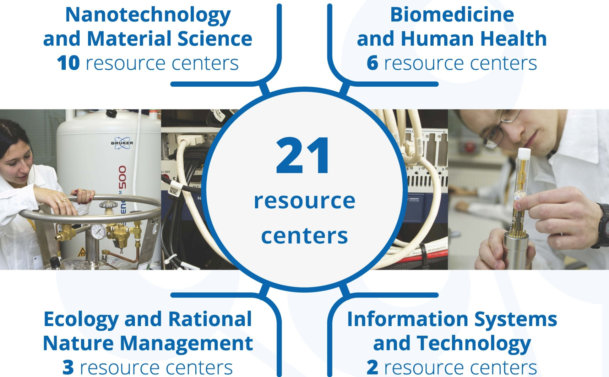
Research Park (100 MEuros, 2010-2012)

Slide 30
Research park portal

Slide 31
Unified electronic system for applications
One time registration
Possibility to work with all the centers "in one window“
The ability to track the status of requests and keep track of time of its execution
Remote getting results
List of publications using equipment Research park
System of assessments and reviews to improve the work of the Research park
http://researchpark.spbu.ru

Slide 32
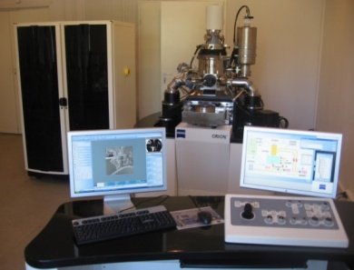
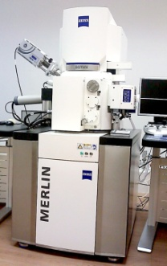
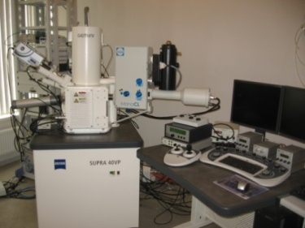
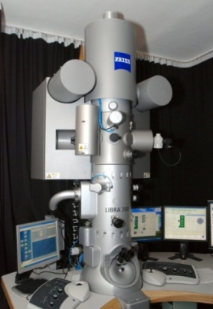
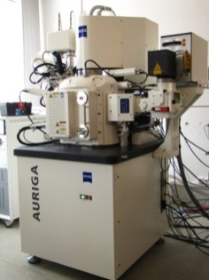
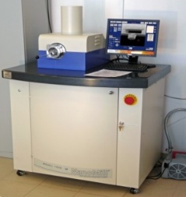
Research Park of SPSU
READY FOR JOINT
RESEARCH PROJECTS!
http://researchpark.spbu.ru/en

Slide 33
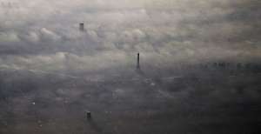
Thanks for your attention

