Slide 1
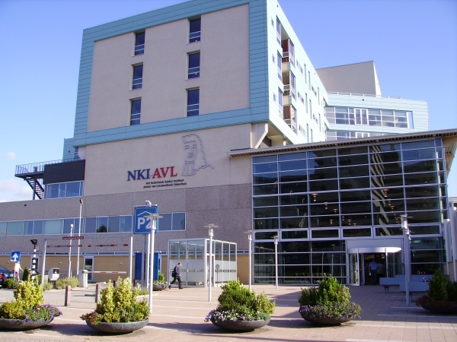
Radio-immunotherapy of cancer
Therapeutic efficacy, underlying mechanisms and potential applications
Paula Kroon, Nicole Haynes, Victoria Iglesias-Guimarais, Ricky Johnstone, Jules Gadiot, Marcel Verheij, Christian Blank, Jacques Neefjes, Jannie Borst, Inge Verbrugge
World Congress on Breast Cancer, Birmingham, August 4th 2015
Notes:
Good afternoon everyone. My story today is about treating (breast) cancer using novel combinations of radiotherapy and immunotherapy, which I will call ‘radio-immunotherapy’. This work was initiated in Melbourne, Australia, and continued at the Netherlands Cancer Institute in Amsterdam.

Slide 2
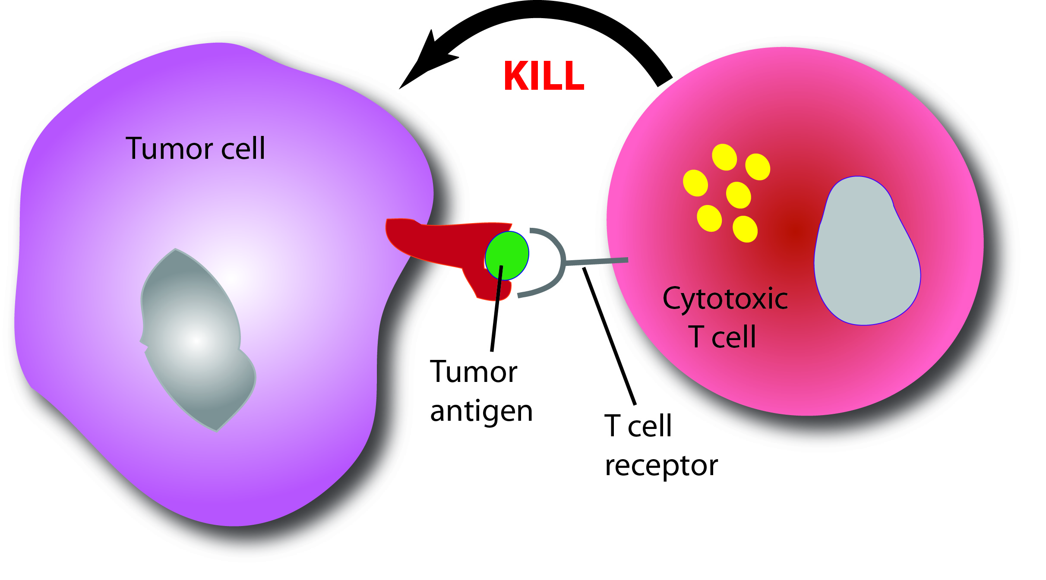
Curing metastatic cancer with systemic therapy
Immunotherapy
Eliciting anti-tumor cytotoxic T cell responses
MHC I
(CTL)
Notes:
2
2
2
As we heard this morning, immunotherapy of cancer is aimed at engaging a patient’s immune system, in particular the cytotoxic T cells to recognize and clear tumors. Since immune cells can go anywhere in the body, these T cells also have the potential to cure metastatic cancer…

Slide 3
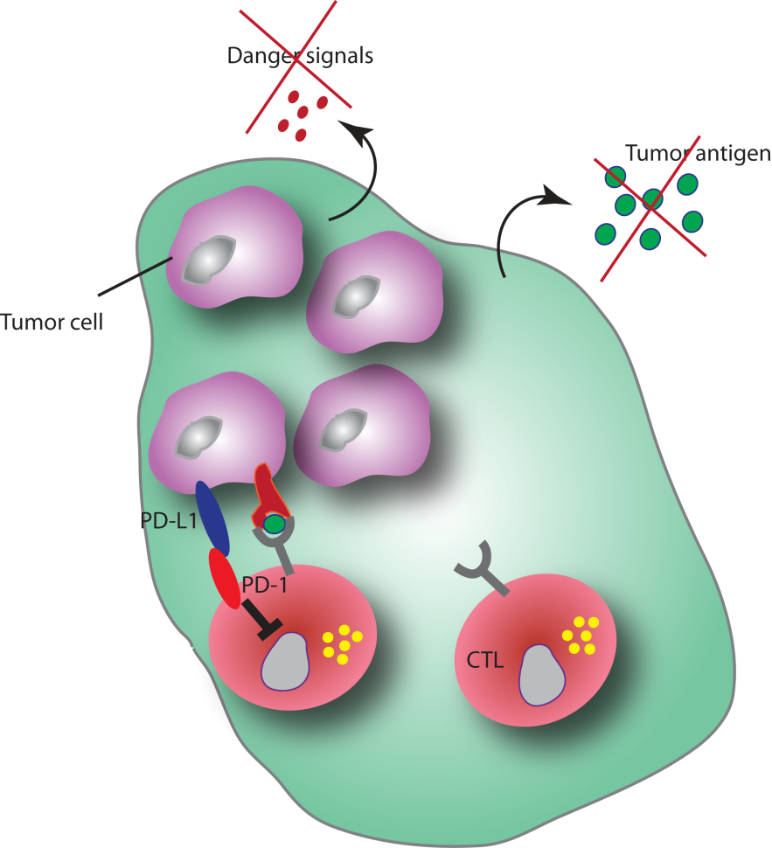
Established tumors are poorly immunogenic
Bottlenecks
Lack of ‘foreign’ antigens
T cells do not recognize tumor cells
Inhibition CTL activity by tumor / tumor micro-environment
PD-1 signaling
MHC I downregulation tumor cells
Inspired by: Grosso JF et al. Can Immunity 2013;13:5-18
Notes:
However, in general, it is very difficult to raise a cytotoxic T cell response against tumors, because there are a number of bottlenecks:
Tumors are derived from our own body, they do not present foreign antigens and are therefore not recognized by T cells. (Since our immune system should not have T cells present that recognize these ‘self’ antigens, our immune system generally does not recognize tumors as foreign.)
But even if tumor-reactive CTLs are raised and are present in the tumor, their activity may be inhibited in the tumor microenvironment. One well-established pathway by which this can occur is via the coinhibitory receptor PD-1 (or downregulation of MHC I).
To overcome some of these bottlenecks, several forms of immunotherapy are in use at the Netherlands Cancer Institute in the treatment of melanoma patients…

Slide 4
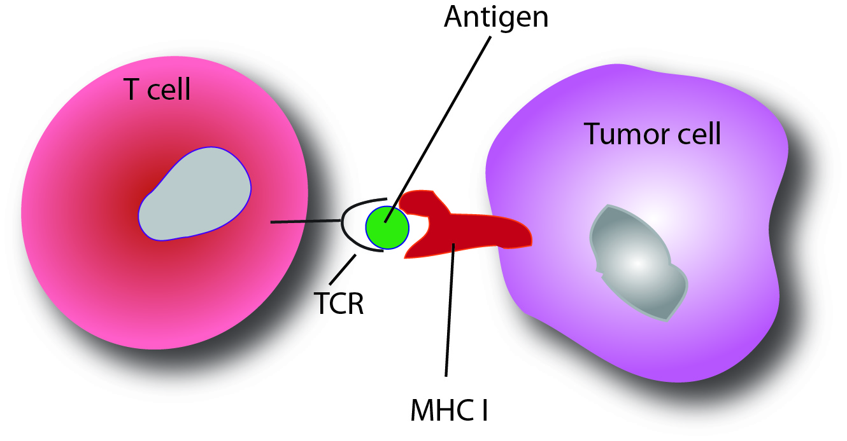
T cell-mediated immunotherapy; Signal (1) TCR triggering
Notes:
4
4
4
… and intended to engage the cytotoxic T cells.
Very briefly back to the basics: In order for a T cell to kill a target cell (tumor cell in this case), the T cell receptor (or TCR) must recognize a tumor antigen (peptide) that is presented on major histocompatibility (or MHC) molecules. This is much like a T cell recognizing a virus-infected cell that needs to be destructed.

Slide 5
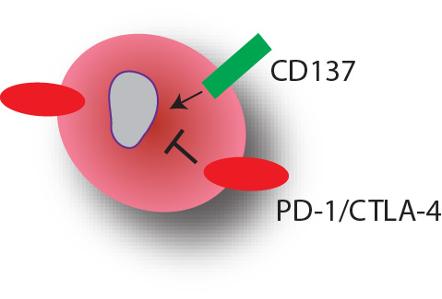
T cell-mediated immunotherapy; Signal (2) co-stimulation
TIL
T cell
Co-stimulatory receptor
e.g. CD137 (4-1BB)
Co-inhibitory receptor
e.g. PD-1, CTLA-4
Notes:
But, in addition, T cells need to have encountered a second, so-called co-stimulatory signal (normally from the APC in the lymph node). Co-stimulation can be achieved through activation of co-stimulatory receptors, such as CD137 (4-1BB), and can be counteracted by inhibitory receptors, of which PD-1 and CTLA-4 are famous examples.
As we already heard, antibodies have been recently generated that allow modulation of these receptors to achieve optimal co-stimulation. An this is the type of immunotherapy that I am particularly interested in.

Slide 6
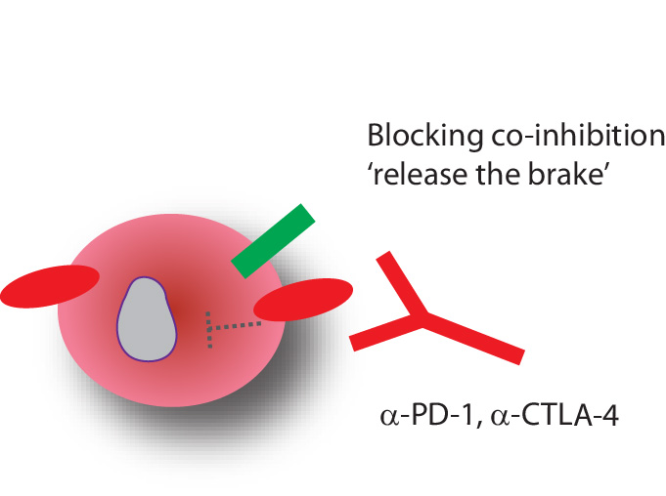
Antibody-based immune-modulation
Pembrolizumab
Nivolumab
Ipilimumab
Notes:
On the one hand, there are antibodies that block co-inhibitory receptors such as PD-1 and CTLA-4, thereby ‘releasing the brake’ on T cells. A number of these antibodies (ipilimumab, pembrolizumab, nivolumab) are now approved to treat patients with metastatic melanoma…

Slide 7
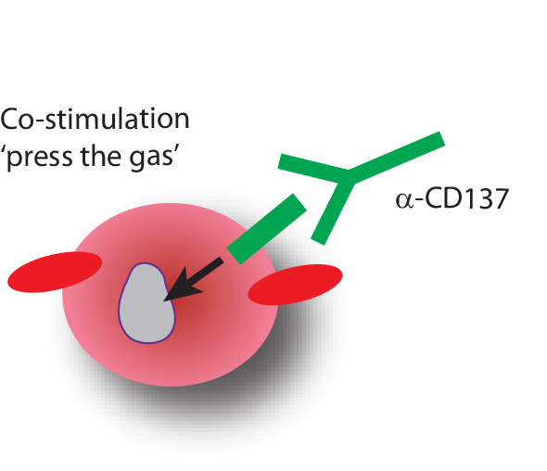
Antibody-based immune-modulation
Notes:
… and the other hand, there are agonistic antibodies, such as those targeting CD137 but there are many others that promote co-stimulation, thereby pressing the gas of these immune cells. These antibodies are currently in clinical development…

Slide 8
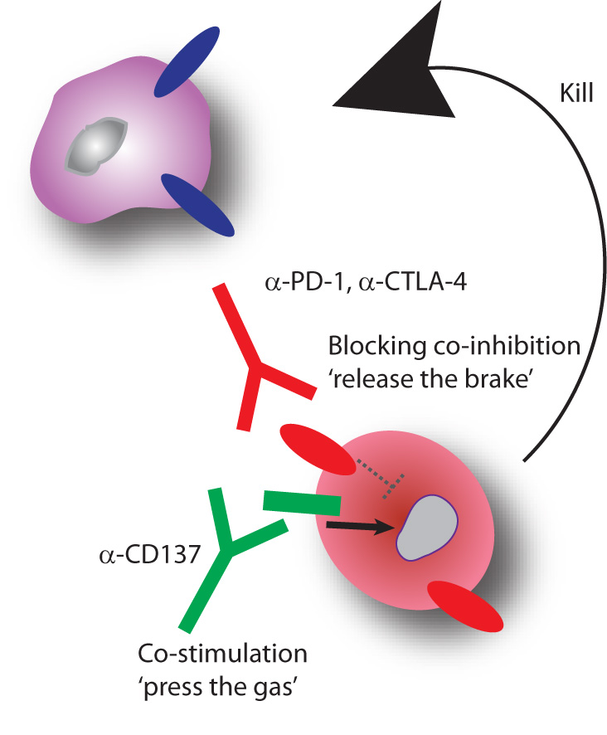
Antibody-based immune-modulation
KILL
Notes:
… so both types of antibodies may enable T cell activation allowing them to kill tumor cells. In my research I focus on the combination of anti-PD-1 and anti-CD137, because this combination was most effective.

Slide 9
Problem:
Immunotherapy as single-agent promising, but sub-optimal
Solution:
Combine immunotherapy with radiotherapy
‘Radio-immunotherapy’
Notes:
Although immunotherapies as single agents are definitely promising and effective in cancer control, particularly melanoma, the response-rates are still sub-optimal. To improve response-rates, we focus on combining immunotherapy with localized (conventional) radiotherapy, which we call radio-immunotherapy.

Slide 10
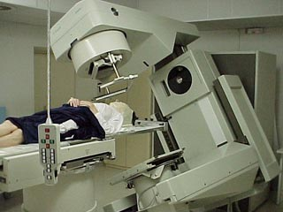
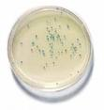
Radiotherapy
1. Reducing tumor cell clonogenicity
(Irreversible) cell cycle arrest
Mitotic catastrophe
Apoptosis
DNA damage
Notes:
Why radiotherapy? Well, practically; radiotherapy has been around for a long time is very common in treatment protocols in a variety of tumor types, so can be relatively easily incoorporated into immunotherapy schedules. Rationally, radiotherapy induces DNA damage and thereby reduces tumor cell clonogenicity, and induces cell death

Slide 11
Radiotherapy
1. Reducing tumor cell clonogenicity
(Irreversible) cell cycle arrest
Mitotic catastrophe
Apoptosis
DNA damage
2. Immunomodulatory effects
Induce anti-tumor immune responses through release of tumor Ags
- Upregulate MHCI
Notes:
... And it has immunomodulatory properties, for instance through the release of tumor antigens from dying tumor cells, and by upregulating MHC molecules on tumor cells, making them better immune targets. Collectively, these properties makes radiotherapy an ideal candidate for combination with immunotherapy.

Slide 12
1) Efficacy?
2) Mechanism?
3) Potential applications?
Notes:
12
12
12
So, I will discuss with you how effective the combination of radiotherapy and immunotherapy is, some of the underlying mechanisms, and at the end touch upon some potential clinical applications
(strong rationale, providing there are T cells in the peripheral repertoire able to recognize tumor cells).

Slide 13
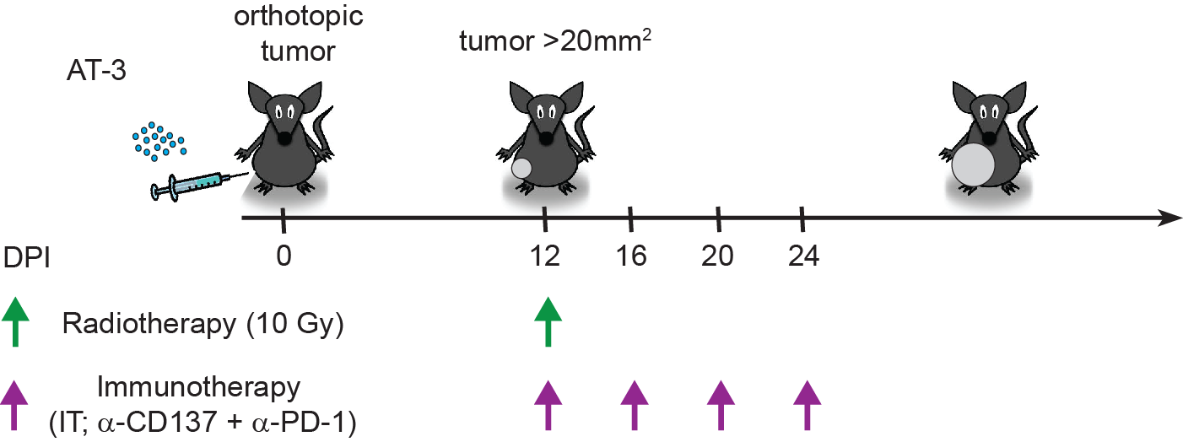
Transplantable AT-3 breast cancer model
Triple-negative breast cancer cell line
(
Notes:
We tested the efficacy of our radio-immunotherapy approach in various tumor models, including the AT-3 tumor model, which is a mouse model for triple-negative breast cancer.
Tumor cells are injected orthotopically, in the mammary fat pad of immunocompetent syngeneic mice. When tumors were established, we treated mice with a single dose of 10 Gy radiotherapy and 4 doses immunotherapy.
(derived from MMTV-PyMT transgenic mouse), where the viral middle-t oncogene drives mammary tumor formation and therefore we expect this foreign protein to be present in tumors.

Slide 14
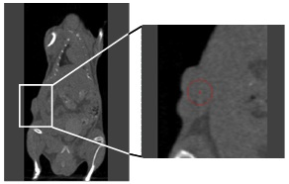
Small animal Image-Guided Radiotherapy
Movie: Jan-Jakob Sonke
Notes:
14
14
Radiotherapy was administered using advanced image-guided radiotherapy with a cone-beam CT scanner for small animals, where mice are placed on this platform and a CT scan is generated. On this scan, we can locate the tumor and target it for radiotherapy with a precision of 0.1mm.

Slide 15
Radiotherapy improves the response to immunotherapy
Control
Immunotherapy
Radiotherapy
Radio-immunotherapy
Verbrugge I et al. Cancer Res 2012;72:3163-3174
Notes:
15
15
Here are the responses to treatment; These are the tumor growth curves for the four groups of mice. In each case, the individual tumor growth curves are the grey lines and the black lines represent the mean of that group. Compared to control treated mice, mice that were treated with immunotherapy or radiotherapy alone show some tumor growth delay, but eventually all tumors relapse. Now, when mice were treated with our radio-immunotherapy combination, tumors were reproducibly eliminated tumors in almost 100% of the mice, indicating that this radio-immunotherapy approach was highly effective.
(Specific to this combination; targeting other receptors less effective, also targeting CD137 or PD-1 alone, much less effective.)

Slide 16
1) Efficacy?
2) Mechanism?
3) Potential applications?
Notes:
16
16
16
Next, we wanted to know, how this type of radio-immunotherapy work?
(strong rationale, providing there are T cells in the peripheral repertoire able to recognize tumor cells).

Slide 17
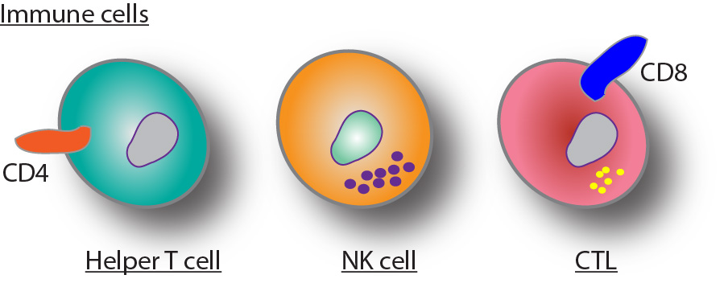
Notes:
17
17
…

Slide 18
Does it work?
How does it work?
Notes:
18
18
… and we started by looking at the immune cells, more specifically which immune cell subsets, CD4+ helper T cells, Natural killer cells, and CD8+ cytotoxic T cells, contributed to the therapeutic response of radio-immunotherapy. And we can do this, by simply using antibodies to deplete these subsets in mice.

Slide 19
CD8+ T cells crucial for radio-immunotherapy
IR+IT: radio-immunotherapy
Start Tx: Day 14
n = 6 mice /group
Verbrugge I et al. (2012) Cancer Research;72:3163-3174
Notes:
19
19
And we see in these tumor growth curves that RIT is still
Effective in control depleted mice
Still effective in CD4 depleted mice
We see that depletion NK: slightly impairs therapeutic effect
Depletion CD8: strongly impairs therapeutic effect. Indicates that a combination of both CD8 and NK cells required for optimal therapeutic response.
In addition, don’t forget that I am only comparing the effect of radio-immunotherapy to control treatment, so part of the effect is probably also that of radiotherapy alone.

Slide 20
Does it work?
How does it work?
Notes:
20
20
So now, what about the other side…
… does radiotherapy also modulate tumor cells to make them better immune targets and if yes, how important is this for the therapeutic effect of radio-immunotherapy?

Slide 21
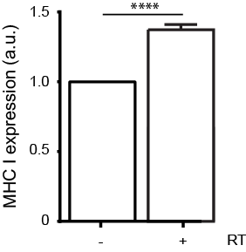
Radiotherapy upregulates surface MHC I on AT-3 tumor cells
Tumor
Antigens
(peptides)
Radiotherapy
Notes:
21
21
21
As mentioned, one of the immunomodulatory properties of radiotherapy, is the upregulation of MHC class I on tumor cells (which present tumor peptide and make tumor cells visible to cyototoxic T cells). Indeed, radiotherapy upregulates MHC I expression on our tumor cells. So the next question was, how does radiotherapy upregulate MHC class I expression?

Slide 22
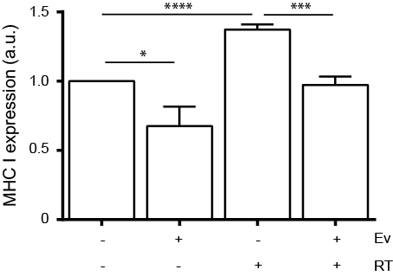
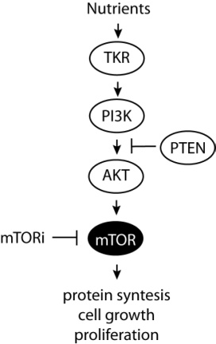
mTOR inhibition abrogates Radiotherapy-induced MHC I upregulation
mTOR inhibitor
Radiotherapy
Verbrugge I et al. (2014) Radiation Research;182:219-229
Reits EA et al. (2006) J Exp Med; 203;1259-1271
Notes:
22
22
Well, to make a long story short, we found that mTOR signaling, a crucial regulator in protein translation, cell growth and proliferation, but also cancer progression, was critical for radiotherapy-induced MHC I upregulation.
In this experiment, mTOR signaling was inhibited using everolimus, or RAD001 and indeed radiotherapy-induced MHC class I upregulation was completely abolished.
Then, the next question of course is: how important is this in vivo? If mTOR-mediated MHC I upregulation following radiotherapy is critical for radio-immunotherapy responses, we predict that inhibition of mTOR signaling during treatment would abrogate therapeutic responses to radio-immunotherapy.

Slide 23
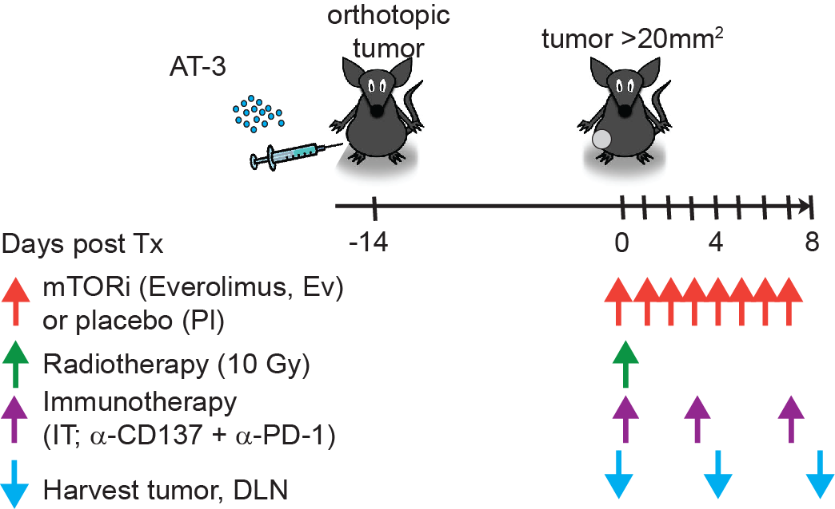
Importance of mTOR signaling to the therapeutic effect
of radio-immunotherapy
Notes:
Therefore, we performed the same radio-immunotherapy experiment as before, but we treated mice with an mTOR inhibitior for 10 days, starting one day prior to radiotherapy.

Slide 24
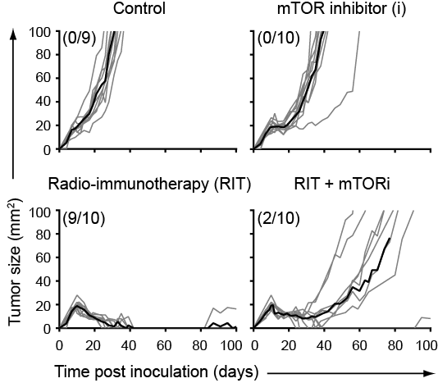
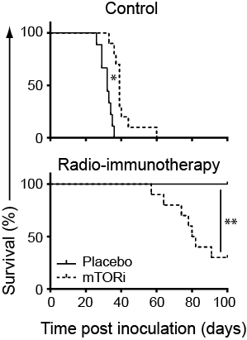
Inhibition of mTOR signaling abrogates the therapeutic response
to radio-immunotherapy
Parentheses: fraction tumor-free mice at day 100
Verbrugge I et al. (2014) Radiation Research;182: 219-229
Notes:
24
24
And while radio-immunotherapy was again highly effective, mTOR inhibition almost completely abrogated the therapeutic effect of radio-immunotherapy and significantly reduced survival, indicating that mTOR signaling is very important for the therapeutic effect of radio-immunotherapy.
(of course consider mTOR inhibitors suppress immune system, which I don’t have time to show, but is also happening… happy to talk about this too…)

Slide 25
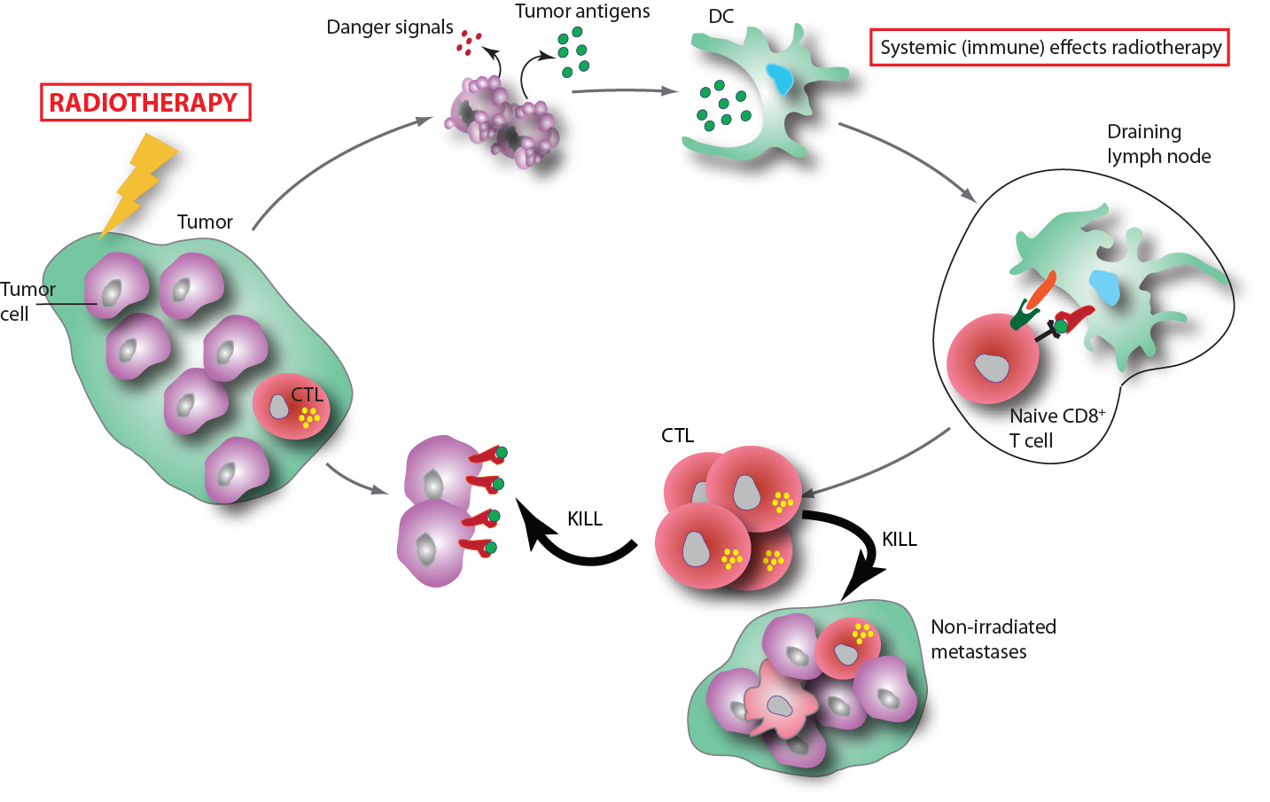
Radio-immunotherapy: summary and potential applications
??
Notes:
So, where do we currently stand and what are the potential applications of radio-immunotherapy?
We showed that radiotherapy kills tumor cells locally and that RT may increase visibility of surviving cells for CTL-killing through mTOR dependent MHC I upregulation. When subsequently combined with aPD-1 and aCD137 antibodies, we showed very good local tumor control, which was dependent on Cytotoxic T cells and mTOR signaling.
In this context, we are very excited to move radio-immunotherapy to the clinic. At the NKI we are running – and preparing to run - a number of clinical trials that focus on enhancing local tumour control with radio-immunotherapy (Christian, Marleen, Marcel) (in this case with anti-PD-1, but I also see great potential for combination with CTLA-4 or CD137).
Experiments are now underway to examine the mechanism of action of radio-immunotherapy in more detail and whether and/or under which conditions an abscopal effect, which is the elimination of non-irradiated metastases can be observed using our radio-immunotherapy approach. And ultimately this is what we want to achieve in patients with metastatic disease.
(in essence turning localized radiotherapy into an in situ vaccine.)
So whether radio-immunotherapy does not only result in enhanced local tumor control, but can also eliminate distant metastases.
(Given that in cured mice a secondary tumor challenge is rejected or strongly delayed in outgrowth also indicates that systemic immunological memory is established.)

Slide 26
Acknowledgements
Netherlands Cancer Insitute (Amsterdam)
Paula Kroon
Jannie Borst
Jacques Neefjes
Victoria Iglesias
Julia Walker
Alessia Gasparini
Javier Salguero
Jan-Jakob Sonke
Marcel Verheij
Blank group
Schumacher group
De Visser group
Clinicians
PeterMac (Melbourne, Australia)
Nicole Haynes
Jim Hagekyriakou
Mark Smyth
Ricky Johnstone
Juntendo University (Tokyo, Japan)
Hideo Yagita (antibodies)
Notes:
26
26
Finally, I’d like to thank these people that contributed to the work as well as the funding agents, KWF/Alpe d’Huzes. From the NKI, I would like to acknowledge especially Paula and Victoria who are currently performing many of the experiments and Jannie and Sjaak for discussions and mentorship. Nicole and Ricky from the PeterMac in Melbourne, where Nicole and I initiated this project.
Of course, many thanks also to the clinicians and of course big thanks to Jannie for mentorship and advice (supervision). Finally, many thanks to KWF/ Alpe d’Huzes for funding. And thank you for your attention, I am very happy to answer any questions.

