Slide 1



éa
International Conference on:
Pollution Control & Sustainable Environment
Water treatment containing organic compounds by coupling adsorption and electrochemical degradation at BDD anode: Sawdust adsorption performance for the treatment of dilute phenol solutions
Ines Bouaziz KARIME, Morched HAMZA, Ahmed SELLAMI, Ridha Abdelhedi,
André SAVALL, Karine GROENEN SerranO
April 25-26, 2016 Dubai, UAE

Slide 2

Contents
1
Introduction-Context
2
Materials and setups
3
  Experimental methods
4
Results and Discussion
5
Conclusion

Slide 3
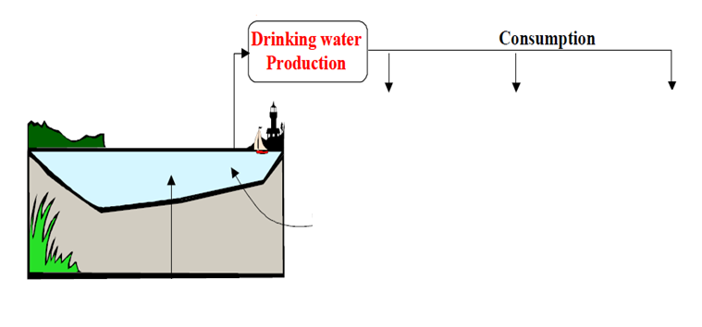




Introduction-Context
Materials and
setups
Experimental
methods
Results and
Discussion
Conclusion
Treatment

Slide 4
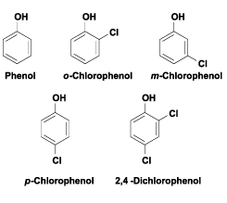




Introduction-Context
Materials and
Setups
Experimental
methods
Results and
Discussion
Conclusion
Phenolic compounds
Origin :pharmaceutical, pesticides, oil, textiles, painting, dyes, plastic, detergent industries …
Dangers:
Highly toxic,
highly oxygen demanding,
Carcinogenic, mutagenic, and can cause a severe health hazard to human beings.

Slide 5

Introduction-Contexte
Dispositif
Expérimental
Démarche
de l’étude
Résultats et
discussions
Conclusion
et perspectives
☹
Biological methods
Main reagent : the electron
⁻
Phenolic compounds are generally Non-biodegradable
Complete oxidation (Mineralization) : possible
Transformation of organic pollutants into biodegradable products: possible
Chemical methods
Waste water treatment processes
Physical methods
☹
cost, secondary waste …
Electrochemical methods

Slide 6





Introduction-Contexte
Dispositif
Expérimental
Démarche
de l’étude
Résultats et
discussions
Conclusion
et perspectives
Electrochemical methods
Degradation of organic compounds(R)
Anode material
Choice of the anode material: high oxygen overpotential

Competing Reactions:
overvoltage for different anode materials 1 A m-2 in sulfuric acid
Anode material | Pt | PbO₂ | SnO₂ | BDD
Overpotential (V) | 0,27 | 0,50 | 0,67 | 1,27

Slide 7



Introduction-Contexte
Dispositif
Expérimental
Démarche
de l’étude
Résultats et
discussions
Conclusion
et perspectives
Electrochemical methods
☹
Low current efficiency for the treatment of dilute solutions
Mass transfer limitations
Not economically viable
Coupling of electrochemical processes with a pre-concentration step is needed
How?
Adsorption- electochemical oxidation coupling
Objective of the work

Slide 8


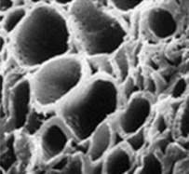
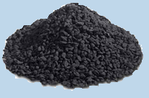
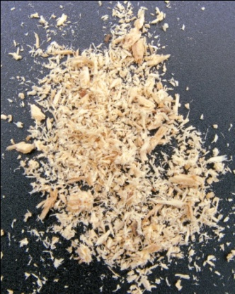
Introduction
Materials and
Setups
Experimental
methods
Results and
Discussion
Conclusion
Adsorbents
Commercial activated carbon
Origin: wood
Particles size: 0.4 mm
Specific area: 980 m²/g
PH_{PZC}= 8,9
Red wood sawdust
Origin : Coniferous trees
(by-product of furniture industry)
Specific area: 0.4 m²/g
Particles size: 0.5-1.12 mm

Slide 9
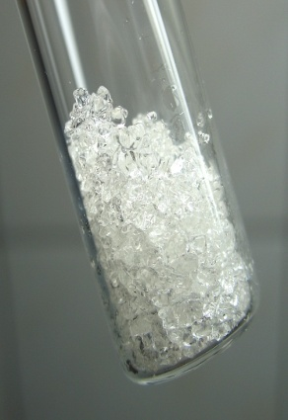
Introduction
Materials and
Setups
Experimental
methods
Results and
Discussion
Conclusion
Model compound
Phenol

Slide 10

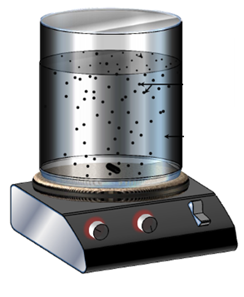
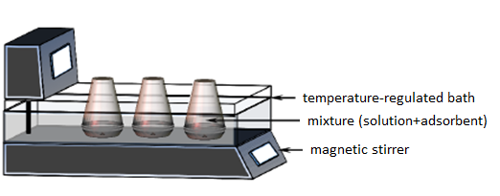
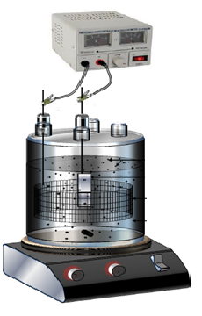
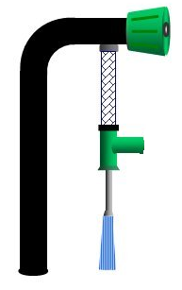
Introduction-Contexte
Dispositif
Expérimental
Démarche
De l’étude
Résultats et
discussions
Conclusion
et perspectives
Experimental setups
Batch adsorption
Column adsorption
Electrochemical degradation
Conditions:
Anode: boron doped diamond (BDD)
Cathode: cylindrical mesh of platinum
Electrolyte: Na₂SO₄

Slide 11
Introduction
Materials and
Setups
Experimental
methods
Results and
Discussion
Conclusion
Analytical techniques
High Performance Liquid Chromatography (HPLC)
Phenol and its oxidation intermediates
Characterization of adsorbents
Automated gas sorption system
BET surface
Cyclic voltammetry
Electrochemical behavior of the activated carbon paste

Slide 12
Introduction
Materials and
Setups
Experimental methods
Results and
Discussion
Conclusion
General approach
Desorption
Electrolysis
Adsorption
Study of the pollutants desorption without polarization
Electro-oxidation of pollutants
Electrochemical regeneration of adsorbent
Kinetics study
adsorption isotherms
Study of the pollutants desorption under polarization
Saturation of adsorbents

Slide 13
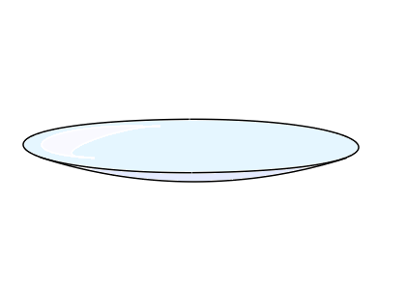
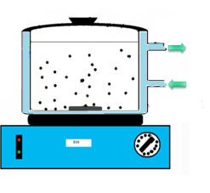

Introduction
Materials and
Setups
Experimental methods
Results and
Discussion
Conclusion
Desorption studies
Quantify the long term desorption without polarization.
Simple desorption
Multiple desorption
Desorption equilibrium
Stirring
Stirring
Dosage of desorbed pollutant
Loaded adsorbent
!
Volume of the solution for each step = 1/4 of the simple desorption volume
In the case of sawdust : Solution used : Na₂SO₄(neutral pH)
In the case of activated carbon: Solution used : Na₂SO₄+ NaOH (pH=13)
The process was repeated 4 times

Slide 14
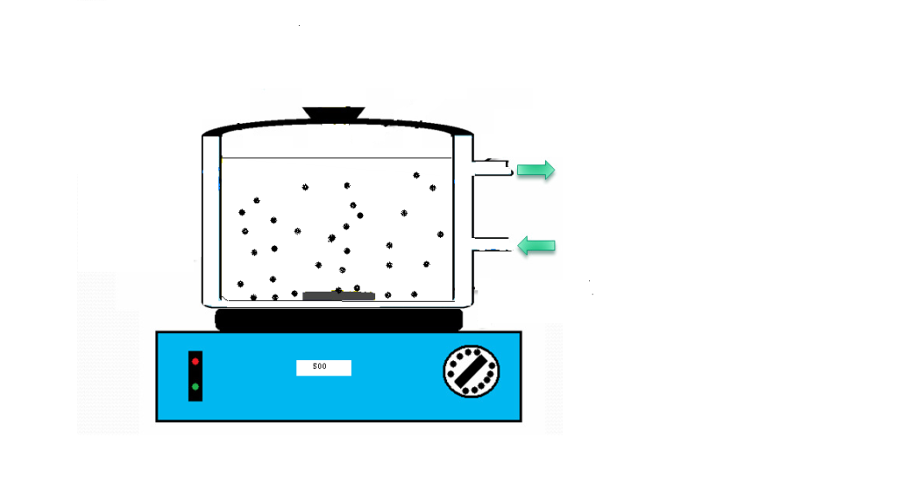
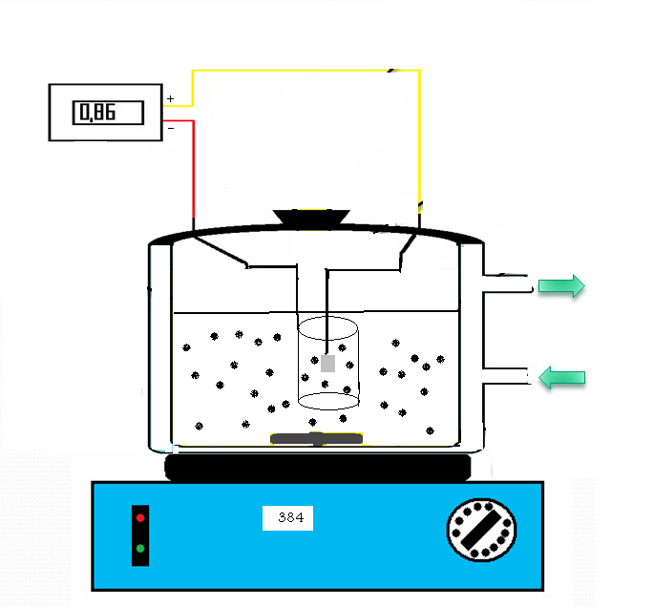
Introduction
Materials and
Setups
Experimental methods
Results and
Discussion
Conclusion
Electrochemical degradation of phenol
Desorption equilibrium
Desorption of the pollutant
Electrochemical degradation
Electrolysis conditions:
Anode: BDD
Cathode: cylindrical mesh of platinum
Electrolyte: Na₂SO₄ (0,1M) of desired pH

Slide 15

Introduction
Materials and
Setups
Experimental methods
Results and Discussion
Conclusion
Adsorption kinetics of phenol onto activated carbon and sawdust
Activated carbon
0.5
Sawdust
0.4
0.3
0.2
0.1
Pseudo-second order model

Activated carbon: equilibrium time=3 days

Sawdust: equilibrium time=20 min
Activated carbon
Sawdust
initial (C₀) and final (C_{f})
concentrations of MB
V :volume of solution
M: weight of adsorbent
The rate of adsorption is much slower for the activated carbon
The phenol adsorption follows a pseudo-second order kinetic for both adsorbents
Internal transport of phenol in the pores of activated carbon reduces the pollutant scavenging rate on the activated carbon adsorption sites.

Slide 16


Introduction
Materials and
Setups
Experimental methods
Results and Discussion
Conclusion
Adsorption isotherms of phenol at 30°C
Linearization of Langmuir equation
C_{e} : equilibrium concentration of the adsorbate (mg/L)
q_{e} :adsorption capacity (mg g⁻¹),
q_{m} : maximum adsorption capacity (mg g⁻¹)
K_{L} : Langmuir isotherm constant (L mg⁻¹).
Equilibrium data are well represented by the Langmuir isotherm equation.

Slide 17
Introduction
Materials and
Setups
Experimental methods
Results and Discussion
Conclusion
Adsorption isotherms of phenol at 30°C
Adsorbent | Langmuir constants |  | q_{m}/S (mg/m²)
 | q_{m} (mg/g) | K_{L} (L/mg)
Sawdust | 18,2 | 0,003 | 45,5
Activated carbon | 333,3 | 0,02 | 0,3
S= 0.4 m²/g
S= 980 m²/g
Activated carbon has the highest specific surface
q_{m} of the activated carbon is the highest
The sawdust is capable to adsorb a higher phenol weight per surface unit

Slide 18

Introduction
Materials and
Setups
Experimental methods
Results and Discussion
Conclusion
Phenol desorption
Desorption kinetics of phenol
Sawdust
Activated carbon
pH of the solution: neutral
pH of the solution: 13
15 min
5 min
In the case of activated carbon: maximum desorption rate =50%
The desorption kinetics of the phenol is very fast.
In the case of sawdust: maximum desorption rate=38%
The phenol retained by the activated carbon comes in two states: strongly adsorbed (chemisorption)and weakly adsorbed (physisorption)
Value relatively high : phenol is still in its undissociated form
-
-
-
-
-
pH˃pK_{a} +1
Solution of pH 13
Hypothesis: an important part of phenol retained on sawdust is rather weakly adsorbed
v
Activated carbon
-
-
-
-
-
pH˃pH_{PZC}

Slide 19
Introduction
Materials and
Setups
Experimental methods
Results and Discussion
Conclusion
Phenol desorption
Multiple desorption
Phenol desorption during multiple desorption steps
The % of the desorbed phenol does not exceed 60%
A part of the phenol adsorption is rather chemical and irreversible
Re-adsorption of phenol on activated carbon obtained after multiple desorption
Regeneration efficiency : E = 73%
Changes in the properties of activated carbon after contact with NaOH during the desorption steps
Adsorptive capacity of the activated carbon after multiple desorption
E obtained (73%) is higher
than expected (60%)
E (%) =
* 100
Initial adsorption capacity of the fresh activated carbon
Fragmentation of the activated carbon particles by stirring

Slide 20
Introduction
Materials and
Setups
Experimental methods
Results and Discussion
Conclusion
Electrochemical degradation of phenol
Oxydation of phenol on BDD anode at i=0.215 A/cm²
`
The experiments of degradation of phenol was carried out in two steps: Simple desorption then Electrolyses with the presence of the adsorbent under galvanostatic conditions.
Electrolysis time =0:
Desorbed phenol in the solution
Electrolysis time=0:
Desorbed phenol in the solution
The total disappearance of the phenol is achieved in the presence of adsorbents
The rate of disappearance of phenol alone ˃ that in the presence of the adsorbent
A part of the initially adsorbed phenol was desorbed during electrolysis.

Slide 21

Introduction
Materials and
Setups
Experimental methods
Results and Discussion
Conclusion
Electrochemical degradation of phenol
Modeling of phenol degradation in the presence of sawdust
k= 0.0252 m.min⁻¹
k_{des}= 0.0516 min⁻¹

Slide 22
Introduction
Materials and
Setups
Experimental methods
Results and Discussion
Conclusion
Adsorption/electrochemical regeneration cycles
Regeneration efficiency ( Re)
(1) Initial adsorption + (2) Electrochemical degradation + (3) Re-adsorption
Adsorption/Regeneration Cycles
Repetition: (2) Electrochemical degradation + (3) Re-adsorption
Electrolysis conditions: i=0.215 A/cm² electrolysis time=5 hours

Phenol/sawdust couple

Phenol/activated carbon couple
Regeneration efficiency= 59,5 %
Regeneration efficiency˃ 100 % after four cycles

Sawdust is more easily regenerated because of its surface properties unlike activated carbon
The remaining chemisorbed phenol is not affected by the electrochemical
regeneration
A possible electro-polymerization of the phenol at the boundary of the activated
carbon grains
Electrochemical treatment seems to activate sawdust by changing its physicochemical properties

Slide 23
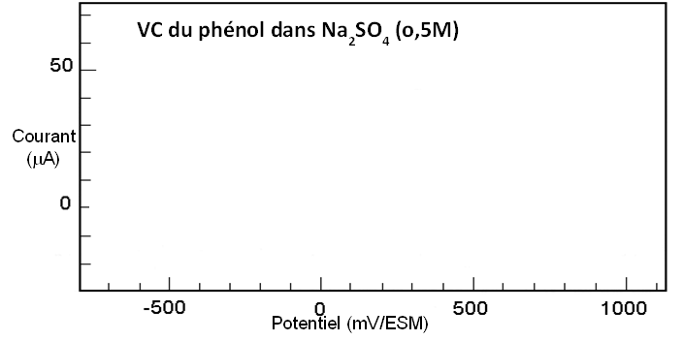
Introduction
Materials and
Setups
Experimental methods
Results and Discussion
Conclusion
Electrochemical behavior study of activated carbon by cyclic voltammetry
Oxidation of phenol solution on a virgin activated carbon paste
CV of phenol in Na₂SO₄ (0.5M)
1st scan
I (µA)
2nd scan
E (mV/ESM)
The oxidation pic of phenol disappears completely from the second cycle

Electro-polymerization of phenol on the surface of activated carbon

Slide 24
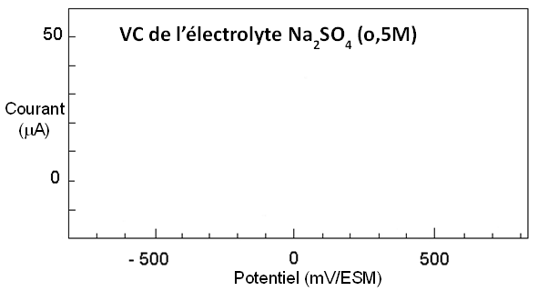
Introduction
Materials and
Setups
Experimental methods
Results and Discussion
Conclusion
Electrochemical behavior study of activated carbon by cyclic voltammetry
Electrolyte oxidation on an activated carbon (obtained after multiple desorption) paste electrode
CV of electrolyte Na₂SO₄ (0,5M)
Hypothesis confirmed: the electropolymerization of the strongly adsorbed phenol can explain the deterioration in performance of activated carbon by the obstruction of its pores during the electrolysis.
I (µA)
1st scan
The Search of other nonconductive adsorbents
E (mV/ESM)
The oxidation pic of adsorbed phenol disappears completely during the following cycles

Sawdust
The deactivation of the activated carbon could be associated to the electropolymerization of the phenol strongly retained by the activated carbon

Slide 25
Introduction
Materials and
Setups
Experimental methods
Results and
Discussion
Conclusion
Conclusion
Adsorption study:
Both adsorbents (activated carbon and sawdust) follow a Langmuir adsorption isotherm.
The maximum adsorption capacity of the activated carbon is 18 times greater than the one obtained with sawdust.
Desorption study:
An important part of phenol retained on the activated carbon is rather irreversible.
An important part of phenol retained on the sawdust is rather weakly adsorbed.

Slide 26
Introduction
Materials and
Setups
Experimental methods
Results and
Discussion
Conclusion
Conclusion
Electrochemical regeneration study:
The regeneration efficiency of the activated carbon is only 59% after 1 cycle of adsorption and regeneration:
Low reversibility of the adsorption.
Electropolymerization of the phenol on the surface of the activated carbon during anodic electrolysis
The regeneration efficiency of sawdust is more than 100% at the end of the fourth adsorption-regeneration cycle:
Sawdust is easily regenerated because of its surface properties.
Electrochemical treatment seems to activate sawdust by changing its physiochemical properties.

Slide 27
Introduction
Materials and
Setups
Experimental methods
Results and
Discussion
Conclusion
Perspectives
Understanding the mechanism of sawdust activation.
The application of this method on other types of organic pollutants.
Studying the competition of several organic compounds which may be present in a real effluent on their abilities to be adsorbed, desorbed and oxidized.
Development of a reactor (adsorption+regeneration):

Slide 28
Publications
I. Bouaziz, C. Chiron, R. Abdelhedi, A. Savall, K. Groenen Serrano, Treatment of dilute methylene blue-containing wastewater by coupling sawdust adsorption and electrochemical regeneration, Environ. Sci. Pollut. Res., 2014, 21, 8565-8572.
I. Bouaziz, M. Hamza, R. Abdelhedi, A. Savall, K. Groenen Serrano, Treatment of diluted solutions of methylene blue by adsorption coupled with electrochemical regeneration: a comparative study of three adsorbents, ECS Trans., 2014, 59(1), 495-502.
Notes:
you can follow our publications on this subject but by using MB as model molecule. The results are very interesting for example thr RE of the sawdusts is more than 400% after 4 cycles and the adsorption capacity of the sawdust can reach vlaue in the same order of AC.

Slide 29
Thank you

