Slide 1
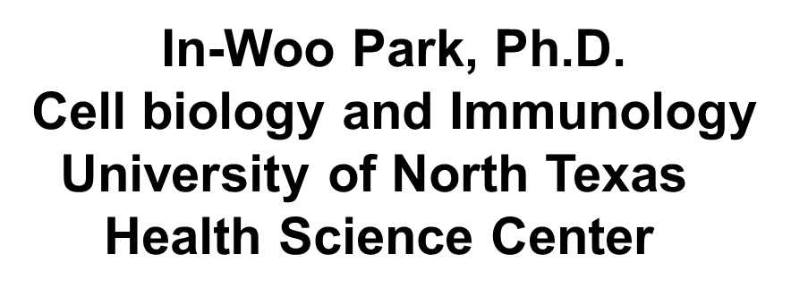

Role of HIV-1 Nef in Acceleration of
HCV-Mediated Liver Disease

Slide 2
HIV-1/HCV co-infection
* Shared routes of infection:
- sexual contact
- blood stream
- IDU
* Common with ~ 30% of all HIV-1-infected persons

Slide 3
Co-infection has profound, adverse consequences.
- elevate HCV viral load.
- expedite HCV-mediated liver disease
progression.
- two-fold acceleration of fibrosis
five-fold higher risk of cirrhosis-related liver
complications, etc.
Cirrhosis and end-stage liver disease – 50% of all deaths in co-infected patients - leading cause of morbidity and mortality in Western countries.

Slide 4
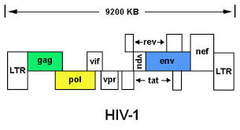
Genomic and virion structure of HIV-1
callutheran.edu
Structural: Gag, Pol, and Env
Regulatory:
Early: Tat, Rev, and Nef
Late: Vpr, Vpu, Vif

Slide 5

Distinct target cells for infection
1. Receptor/co-receptors
A. HIV-1
CCR5
CXCR4
T helper cells
Monocytes/microphage
Dendritic cells, etc
CD4
B. HCV
LDLR
CD81
SR-B1
Claudin-1
Occludin
Hepatocytes
2. Fundamentally different life cycles

Slide 6
Possible mechanisms
Direct infection of HIV-1 into HCV-infected
hepatocytes/HSC
Indirect effect
A. Viral proteins, such as Env, Tat, and Nef
B. Dysfunction immune systems by HIV-1
and/or viral proteins

Slide 7
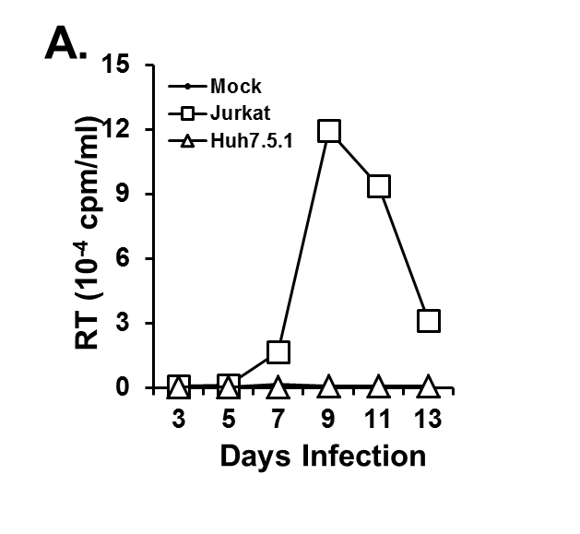
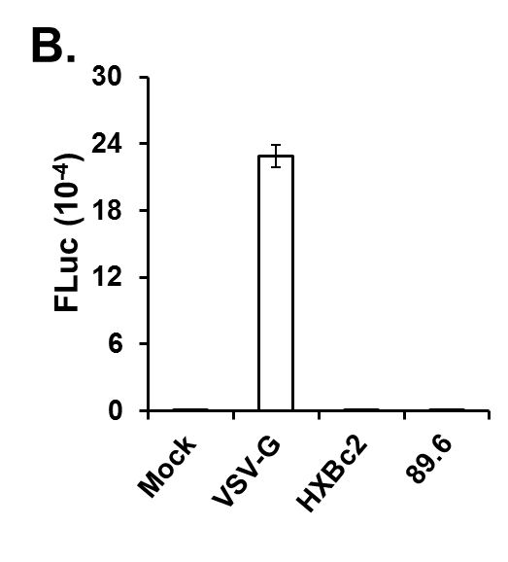
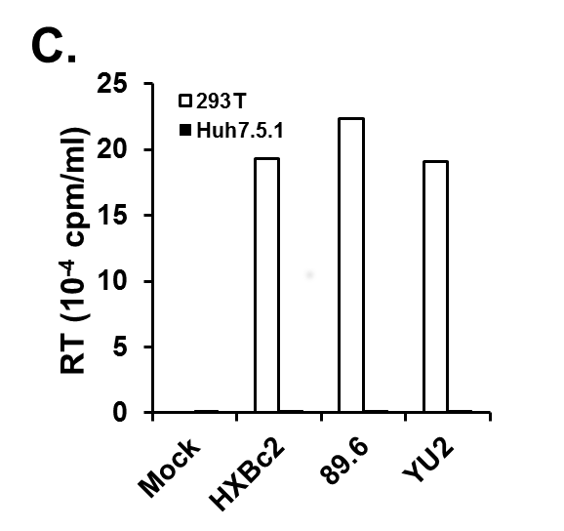
Replication of HIV-1 in human hepatocytes

Slide 8
Viral protein candidates
Env - interact with CXCR4 or CCR5 co-receptor
enhance HCV replication in the replicon
induce apoptosis
Tat - diffusible protein
enhance hepatocarcinogenesis in
transgenic mice

Slide 9
Relevant Nef functions for up-regulation of HCV replication
Induces formation of conduits (filopodia) and
secretion of exosomes.
Regulates the amount of intracellular lipids
by modulating expression of lipid molecules.
Forms complexes with and thereby activates
several cellular kinases, such as the Src
family of tyrosine kinases.
4. Alters host immune responses.

Slide 10
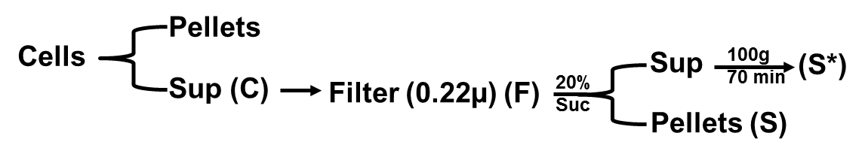
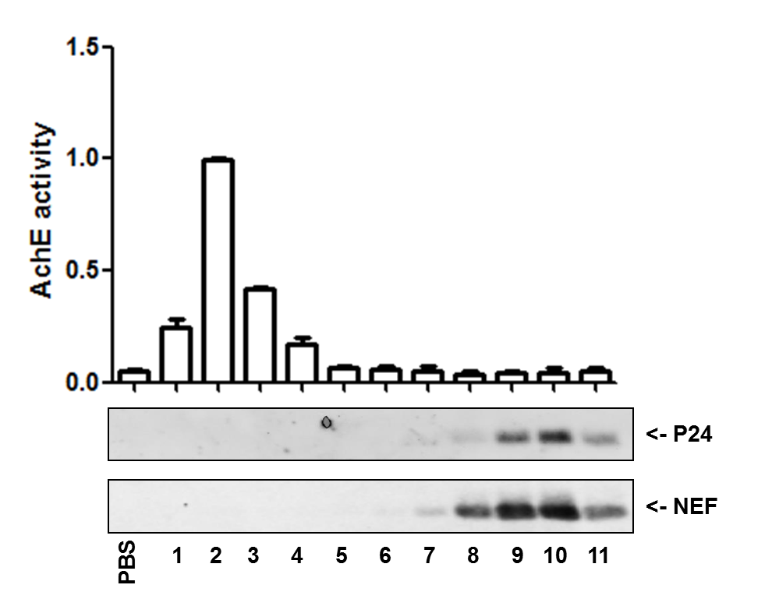
Exosome-mediated Nef transfer?
A.
B.
Virol. J. 2011

Slide 11
Transfer of Nef protein from Jurkat T cells into hepatocytes.

Slide 12
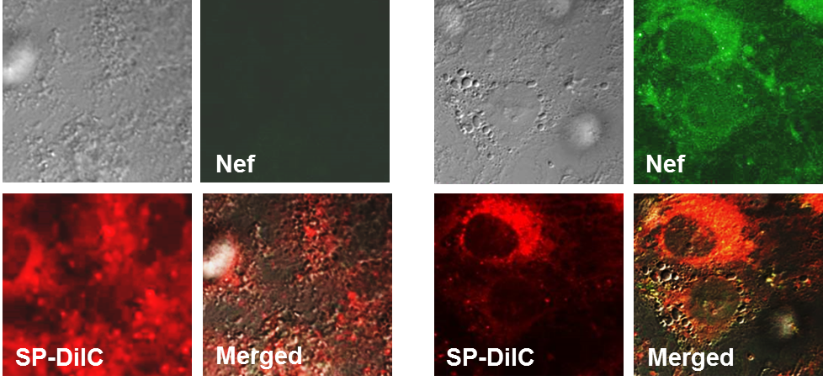
Nef is transferred from HIV-1-infected cells to hepatocytes
∆Nef-HIV-1
wt-HIV-1
Huh7.5.1

Slide 13
Biological significance of Nef transfer
Up-regulation of HCV replication
Generation of ROS
Effect on alcohol-mediated up-regulation
of HCV replication
4. Others

Slide 14
Nef up-regulates HCV subgenomic replicon expression

Slide 15
Nef-mediated induction of ROS

Slide 16
Effect of Nef on ethanol-mediated
up-regulation of HCV replication

Slide 17
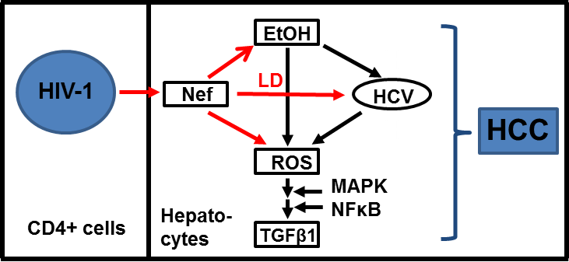
Summary
p53

Slide 18
Acknowledgement
Dohun Pyeon, Ph.D. (UCSM)
Khalid Timami, Ph.D.
Johnny J He, Ph.D
Linden Green, Ph.D. (IUSM)
Jinfeng Wang, Ph.D.
Myeong-Gwi Ryou, Ph.D.
Yan Fan
Xiaoyu Luo

Slide 19
Thank you all!
inwoo.park@unthsc.edu

