Slide 1
About OMICS Group
OMICS Group is an amalgamation of Open Access Publications and worldwide international science conferences and events. Established in the year 2007 with the sole aim of making the information on Sciences and technology ‘Open Access’, OMICS Group publishes 500 online open access scholarly journals in all aspects of Science, Engineering, Management and Technology journals. OMICS Group has been instrumental in taking the knowledge on Science & technology to the doorsteps of ordinary men and women. Research Scholars, Students, Libraries, Educational Institutions, Research centers and the industry are main stakeholders that benefitted greatly from this knowledge dissemination. OMICS Group also organizes 500 International conferences annually across the globe, where knowledge transfer takes place through debates, round table discussions, poster presentations, workshops, symposia and exhibitions.

Slide 2
OMICS International Conferences
OMICS International is a pioneer and leading science event organizer, which publishes around 500 open access journals and conducts over 500 Medical, Clinical, Engineering, Life Sciences, Pharma scientific conferences all over the globe annually with the support of more than 1000 scientific associations and 30,000 editorial board members and 3.5 million followers to its credit.
OMICS Group has organized 500 conferences, workshops and national symposiums across the major cities including San Francisco, Las Vegas, San Antonio, Omaha, Orlando, Raleigh, Santa Clara, Chicago, Philadelphia, Baltimore, United Kingdom, Valencia, Dubai, Beijing, Hyderabad, Bengaluru and Mumbai.

Slide 3
Towards pharmacological validation of MNKs as anti-cancer drug targets
Dr Hugo Albrecht
School of Pharmacy and Medical Sciences
University of South Australia

Slide 4
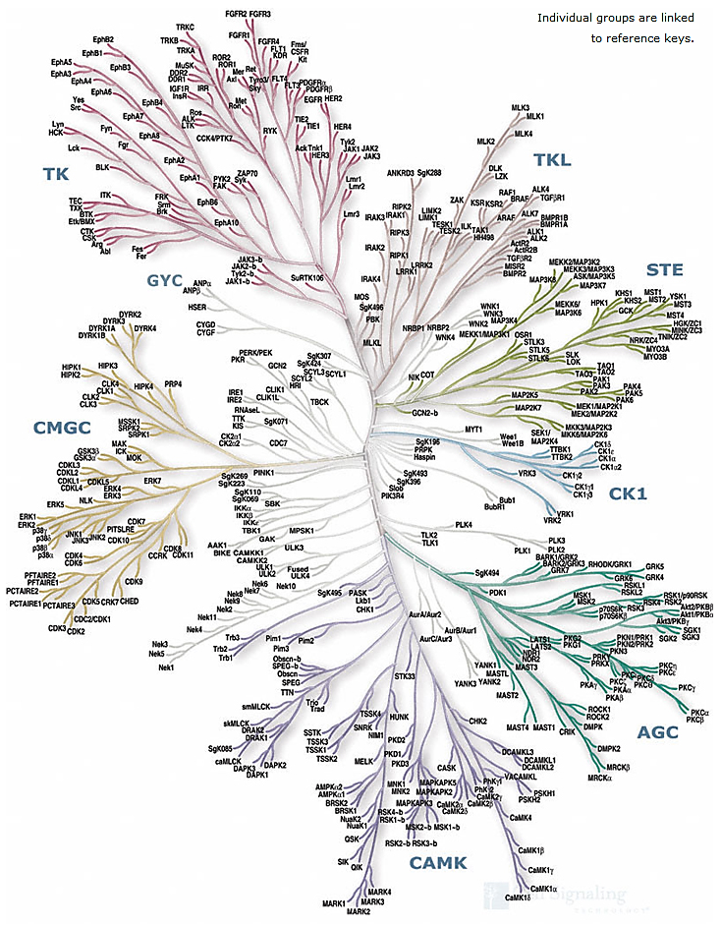
Kinases as Cancer Drug Targets
“Hard Targets”
KO leads to strong or lethal pheno-type (e.g. PLK1)
Adverse effects are expected. Use of advanced formulation to target cancer cells (e.g. nanoparticles, liposomes etc.)
http://www.cellsignal.com/reference/kinase/overview.html
“Soft Targets”
KO with no obvious or mild pheno-type (e.g. Mnk1/2)
4

Slide 5
Anti-cancer strategy
•Targeting cancer cells through block of several pathways
Cancer
Cell
R-point
Mitosis
Cell cycle
Translation
Transcription
5

Slide 6
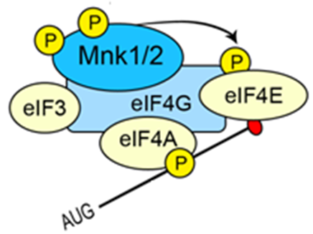
Targeting Translation: Mnk1/2
Growth
Factors
Integrins
Stress
SOS
FAK
PTEN
Src
Grb2
PDK1
PI3K
Ras
mut
Akt
Raf
MEKK
TSC1/2
S6K1
Mek1/2
MKK3/6
mTOR
Rheb
Erk1/2
P38α/β
Cancer
4E-BP
S6Ks
eIF4E
Translation
Notes:
PTEN = phosphatase
S6Ks phosphorylate RPS6 (ribosomal protein S6; a component of the 40S ribosomal subunit)
eukaryotic translation initiation factor 4E (eIF4E)

Slide 7
Phosphorylation of eIF4E by Mnks
Erk1/2, p38
Mnk
1/2
_P
4 A
4E
m⁷G
AUG
AAAAA
3
Ccl2, Ccl7, MMP-3, MMP-9, Mcl1,
Bcl2, Myc, PDGF, FGF2, VEGF,
IL-1B, IL-15, TNF-α
40S
Adapted from Hay N., 2010, PNAS, Vol.107, No. 32, 13975-13976 and Pyronnet, S.; Imataka, H.; Gingras, A. C.; Fukunaga, R.; Hunter, T.; Sonenberg, N. The EMBO journal 1999, 18, 270
7
Notes:
Schematic illustration depicting the cellular pathways that lead to eIF4E activation and phosphorylation by Mnk1/2. The PI3K/Akt/mTORC1 pathway, which is frequently activated in human cancers, releases 4E-BPs from eIF4E, and enables eIF4E to bind eIF4G, which, in turn, assembles the eIF4F complex comprising eIF4E, eIF4G, eIF4A, and eIF3. Mnk1 and Mnk2, which are activated by Erk and by the stress inducible kinase p38, use eIF4G as a docking site to phosphorylate efficiently eIF4E. The phosphorylation of eIF4E is critical for its oncogenic activity, probably through the differential translation of proteins that are required for oncogenesis. The phosphorylation of eIF4E by Mnk1/2 provides a new avenue for cancer therapy. The inhibition of eIF4E phosphorylation could have similar consequences as the inhibition mTORC1 by rapalaogs, but with the advantage that it does not elicit the activation of Akt as a result of the inhibition of the negative feedback loops mediated by mTORC1.

Slide 8
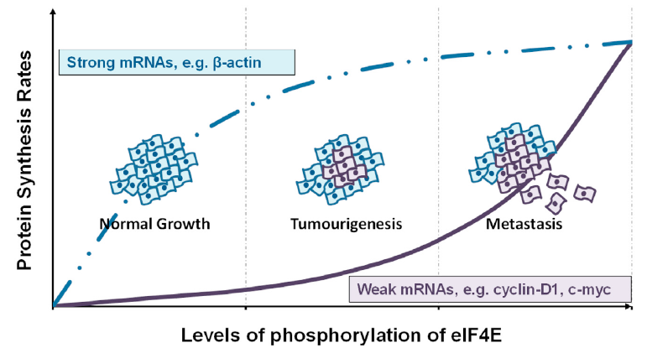
Elevated eIF-4E phosphorylation promotes tumorigenesis
Diab, S.; Kumarasiri, M.; Yu, M.; Teo, T. H. S.; Milne, R.; Proud, C.; Wang, S. Chem. Biol. 2014, 21, 441
Graff, J. R.; Konicek, B. W.; Carter, J. H.; Marcusson, E. G. Cancer research 2008, 68, 631.
8
Notes:
eIF-4E is rate limiting, the intrinsic translatability ranges over 100x, hierarchy of translation, strong mRNAs (house keeping genes with short unstructured 5’-UTR) outcompete weak mRNAs (oncogenes, growth factors, survival genes with long GC-rich 5’-UTR)
eIF-4E phosphorylation: some genes up-regulated some were reported to be down regulated
The ornithine decarboxylation reaction catalyzed by ornithine decarboxylase (ODC) is the first and committed step in the synthesis of polyamines, particularly putrescine, spermidine and spermine. Polyamines are important for stabilizing DNA structure, the DNA double strand-break repair pathway and as antioxidants. Therefore ornithine decarboxylase is an essential enzyme for cell growth, producing the polyamines necessary to stabilize newly synthesized DNA. Lack of ODC causes cell apoptosis in embryonic mice, induced by DNA damage.^{[4]}

Slide 9
Rationale
eIF4E is frequently overexpressed in cancers and is associated with cellular transformation, tumorigenesis and metastatic progression.
In Mnk1/2 DKO mice:
  -eIF4E phosphorylation is completely abolished
-Cells are resistant to transformation by Ras and tumour formation is significantly delayed in PTEN^{-/-} x Mnk DKO mice lymphoma model²⁾
Knock-in mice with a eIF4E S209A mutation are resistant to:
  -Oncogene induced transformation¹⁾
  -PTEN loss-induced prostate cancer¹⁾
Normal growth of Mnk DKO and eIF4E S209A KI mice.
Mnk1 and Mnk2 inhibitors may be effective and
non-toxic anticancer drugs
9
References: 1. Luc Furic et al PNAS 2010, 107 (32), 14134-14139 /.2. Takeshi Ueda et al PNAS 2010, 107 (32), 13894-139908
Notes:
Lymphoma model: conditional T-cell specific PTEN KO (LckCRE)
Prostate cancer model: PB-Cre4 drives PTENflox/flox KO in prostate epithelium

Slide 10
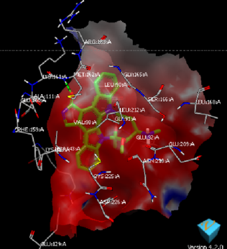
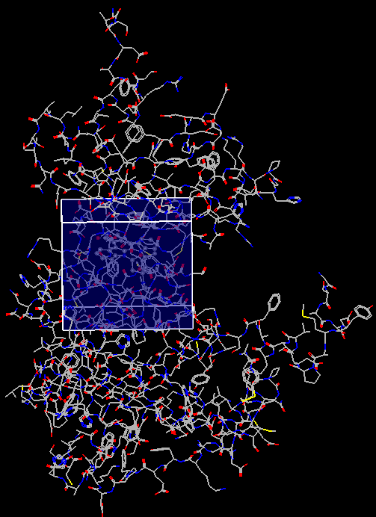
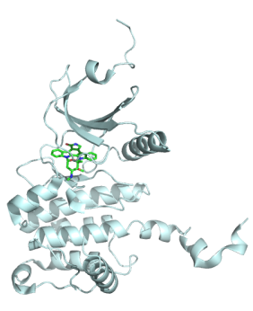
Aim: Design and characterization of Mnk1/2 inhibitors
Compound library
Default active site detected by FRED receptor program as shown in the blue box
IMAP
Primary assay
Quick, robust and cost effective
Primary hits
ADP-Glo
Secondary assay
Dose response and competition assay
Default active site created by FRED receptor program
Mnk1
Dual
Mnk2
3D structure of staurosporine-bound Mnk2-KR obtained from the Protein Databank (PDB: 2HW7)
Competition effect
ATP
-
+
+
-
eIF4E peptide
-
-
+
+
Cytotoxicity
Migration/
Metastasis
Mnk structure
10

Slide 11
Primary compound profiling with IMAP assays
IMAP: Immobilised Metal Ion Affinity Particle Progressive Binding System
high
TR-FRET
PO₄
M^{III}
Mnk
Tb
IMAP
binding
reagent
ATP
PO₄
sensitizer
fluorescent
peptide substrate
phospho-
peptide
Tb-donor
linker
PO₄
M^{III}
11
Notes:
TAMRA = 5-Carboxytetramethylrhodamine
IMAP = Immobilised Metal Affinity for Phosphochemicals
66 compounds total

Slide 12
ADP-Glo Assay
Mnk
eIF4E₂₀₂₋₂₁₄
ADP-Glo
reagent
Kinase
detection
reagent
Luciferase
+ Light
ATP
ADP/ATP
mix
ADP
ATP
Beetle
luciferin
AMP
7 dual inhibitors
13 Mnk2 specific (Mnk1 > 10x Mnk2)
12

Slide 13
Mnk1/2 Crystal Structure Discrepancy
Crystal structure of Mnk1 (PDB entry 2HW6)
Crystal structure of Mnk2 (PDB entry 2AC3)
13
Notes:
Mnk1: Phe 230 stabilises DFD Out conformation; but…..in Mnk2 Phe265 too far from DFD motif
All structures kinase domain only
What can stabilise? I3 too far away, however I1 very close (see next slide)

Slide 14
Identification of Type I/II Mnk inhibitors
eIF4E fixed
at 600 µM (K_{M})
ATP fixed
at 200 µM (K_{M})
MNKI-4-61
14
Data Mean ± SEM, n=2

Slide 15
Identification of Type I/II Mnk inhibitors
eIF4E fixed
at 600 µM (K_{M})
ATP fixed
at 200 µM (K_{M})
MNKI-5-17
15
Data Mean ± SEM, n=2

Slide 16
Identification of Type III Mnk inhibitors
eIF4E fixed
at 600 µM (Km)
ATP fixed
at 200 µM (Km)
MNKI-6
Allosteric inhibitors
16
Data Mean ± SEM, n=2

Slide 17
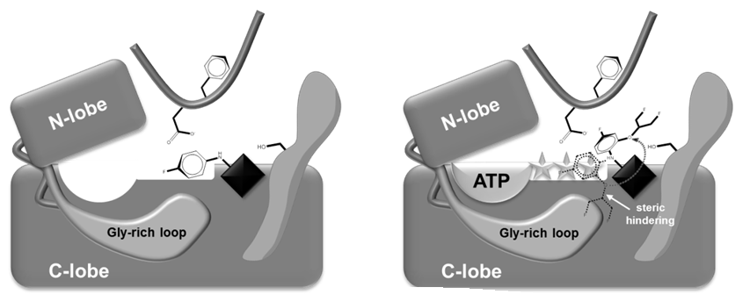
Type I/II vs. Type III inhibitors
ATP Concentration
ATP Concentration
< 6 fold
MNKI-15
MNKI-5
DFD in with MNKI-15 DFD in with MNKI-5
17

Slide 18
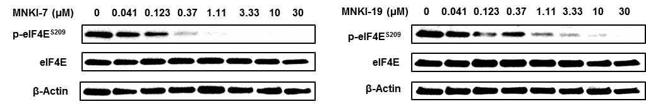
MV4-11 Leukemia cells
r = 0.7276
p = 0.0005
r = 0.4006
p = 0.0780
18
Notes:
biphenotypic B-myelomonocytic leukemia; resazurin assay
R = Pearson correlation
Only leukemia cells get killed!!!

Slide 19
Summary
Compound library
66 compounds
IMAP
inhibition
31
ADP-Glo IC₅₀ < 2 µM
No
Summary
11
Yes
No
10 µM < 10%
or 1 µM < 75%
20
35
Mnk1
Dual
Mnk2
0
13
7
Competition effect
ATP
-
+
+
-
-
+
+
-
eIF4E peptide
-
-
+
+
-
-
+
+
Compounds
8
4
1
0
1
5
1
0
CDK2/9 K_{i} > 15 µM
8
3
1
0
1
4
0
0
MV4-11
cytotoxicity
19
6
0
0
1
1
GI₅₀ < 10 µM
Notes:
GI50: Resazurin assay

Slide 20
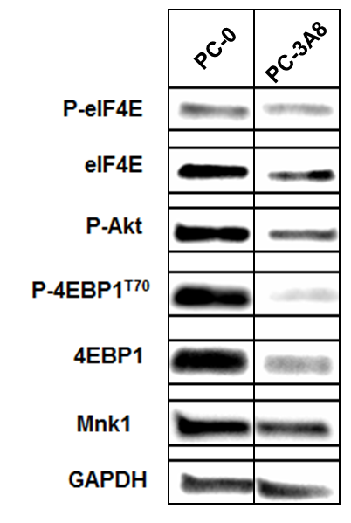
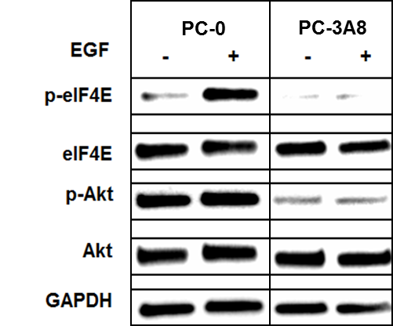
Prostate cancer cells
 | PC-0 | PC-3A8
PTEN | - | -
P-Akt | + | +
Androgen dependent | + | -
Metastatic | - | +
 | Mnk1 | Mnk2 | eIF4E WB | MV4-11 | PC-0 | PC-3A8
MNKI-7 | 83 | 44 | 35 | 0.83 | >10 | 8.65
MNKI-19 | 279 | 136 | 135 | 7.30 | >10 | >10
MNKI-67 | 1400 | 36 | X | 8.84 | >10 | >10
IC₅₀ (nM)
GI₅₀ (µM)
20
Notes:
Phospho-eIF4E rather weak
(PC-0) LNCaP: very strong 4EBP1 band, maybe phosphorylation can be boosted further
(PC3A8) C4-2B: 4EBP1 phosphorylation might be boosted

Slide 21
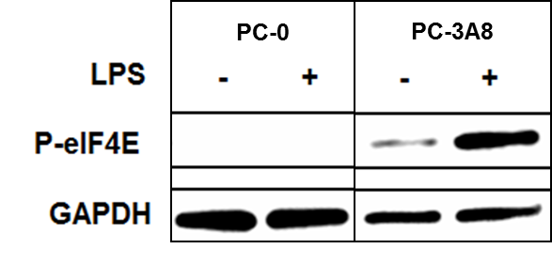
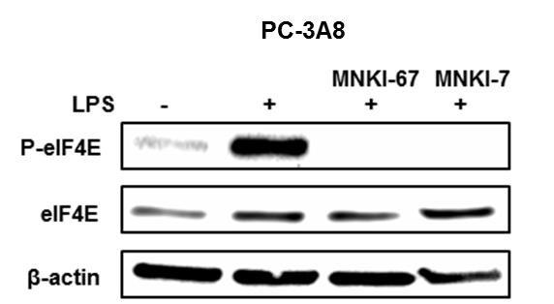
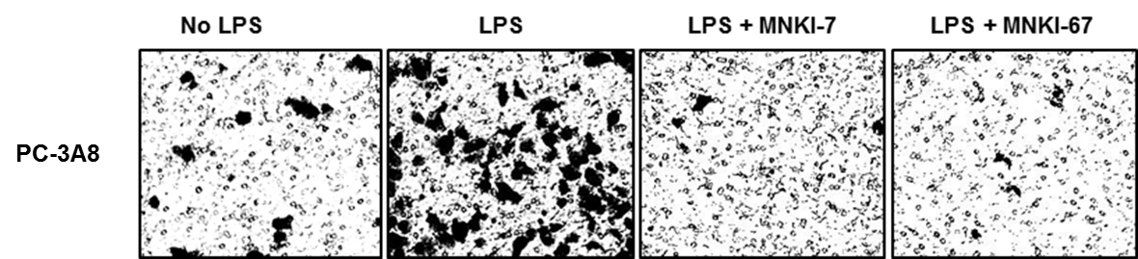
Prostate cancer cells
21
Notes:
MNKI = 5 microM
Scrape cells from culture plates, transfer to transwell with collagen + 10% FBS in lower compartment

Slide 22
Conclusions
Potent Mnk1/2 and selective Mnk2 inhibitors have been identified.
Detailed kinetic studies revealed three types of binding modes.
Our studies confirm different structural properties of Mnk1 and Mnk2 at the ATP-binding pocket.
But they share a common allosteric binding site.
Mnk inhibitors are cytotoxic against some leukemia cells.
No cytotoxicity has been observed against prostate cancer cells.
Mnk inhibitors blocked LPS induced migration of prostate cancer cells.
22

Slide 23
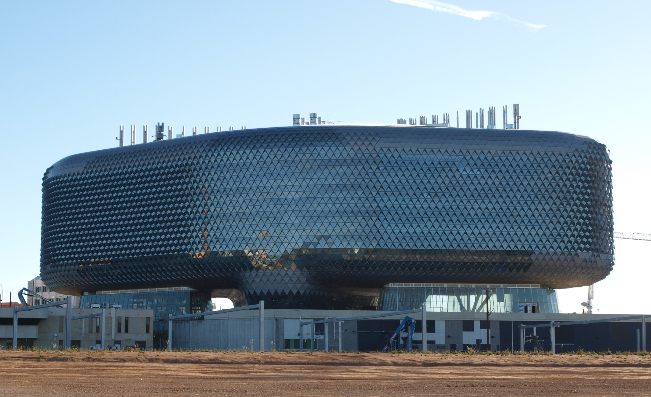
Acknowledgement
Prof Shudong Wang
Dr Matt Sykes
A/Prof Bob Milne
Dr Tom Peat
Biology
Raffaella Schmid
Theodosia Teo
Dr Peng Li
Dr Frankie Lam
Ben Noll
Tracy Lu
Chemistry
Sarah Diab
Dr Mingfeng Yu
Yuchao Yang
Todd Alexander Gillam
23

Slide 24
COMMONWEALTH OF AUSTRALIA
Copyright Regulations 1969
WARNING
This material has been produced and communicated to you by or on behalf of the University of South Australia pursuant to Part VB of the Copyright Act 1968 (the Act).
The material in this communication may be subject to copyright under the Act. Any further reproduction or communication of this material by you may be the subject of copyright protection under the Act.
Do not remove this notice.
24

Slide 25
Major Heading Here
Subheading when required
25

Slide 26
Let us meet again..
We welcome you all to our future conferences of OMICS International
4th Annual Conference on European Pharma Congress
June 18-20,2016, Berlin, Germany.
http://europe.pharmaceuticalconferences.com/

