Slide 1
Cost reduction for biodiesel production from distillery/domestic mixed wastewater by Rhodosporidium toruloides
Jiayin Ling, Renata Alves de Toledo, Yuan Tian, Hojae Shim
Department of Civil and Environmental Engineering
Faculty of Science and Technology
University of Macau
Recycling 2015
World Congress and Expo on Recycling
Spain, Barcelona, July 20th-22nd

Slide 2
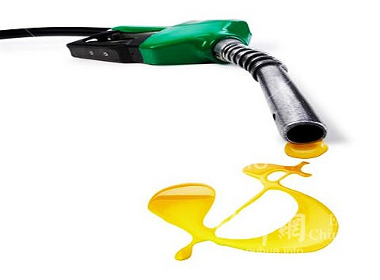
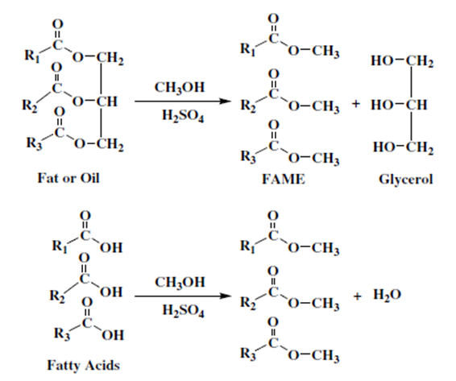
Introduction
Shortage of fossil fuel
Energy crisis & High energy prices
Environmental security
Biodiesel: renewable & environmentally friendly

Slide 3
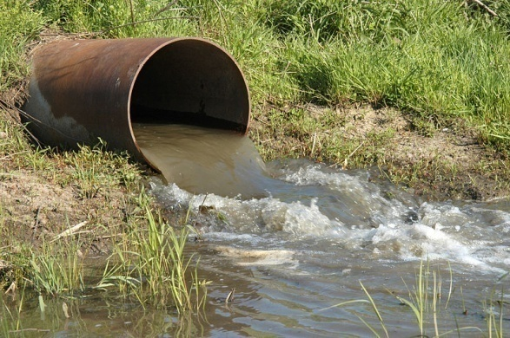
Introduction
Large amount of food industry wastewater generated
Annual wastewater generated from brewery in China:
210,000,000 tons by 2012
Food industry wastewater is difficult to treat
High COD
High TN and TP
Could lead to eutrophication and algal blooms
Cost-effective treatment process is required
Notes:
3

Slide 4
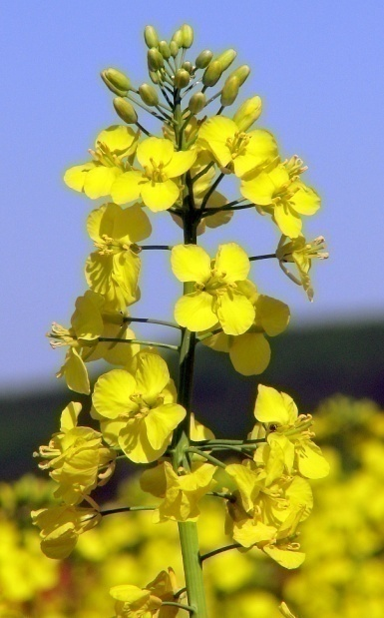
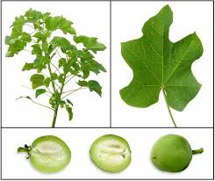
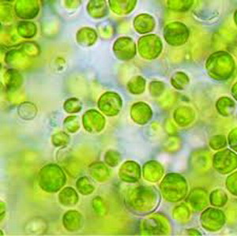
Some Challenges in Biodiesel Industry
1st Generation Biodiesel—derived from vegetable oils
crops (e.g., rapeseed, soybean)
2nd Generation Biodiesel—produced using oils from
non-edible plants (e.g., Jatropha, Ricinus)
Crops for biodiesel production vs. Crops for food supply
More cropland, less forest, more green house gas
3rd Generation Biodiesel—processing oils from
oleaginous microorganisms (e.g., Microalgae, Yeast)
Usage of fertilizer or external carbon source required
Cost of production too high

Slide 5
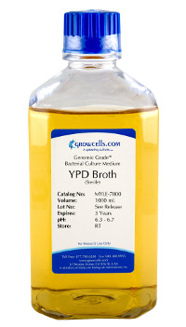
Introduction
High density culture
High lipid production
in real wastewater
YPD medium is rich in glucose and nutrient
(Yeast extract 10 g/L, Peptone 20 g/L,
Glucose 20 g/L)
Large amount of spent YPD medium generated (80-90% of seed culture medium)
Preparation of high cell density seed
culture

Slide 6
Objectives
To explore potential of reusing spent seed culture
medium
To assess lipid productivity and removal efficiencies
for organics and nutrients for cells produced from spent medium, compared to cells
grown in fresh medium

Slide 7
Materials and Methods
Nutrient removal
Yeast
Yeast
36 h
2-5 days
YPD
WW
biomass
lipid
biodiesel
Reuse
Yeast
Yeast
Nutrient removal
Nutrient supplement
36 h
2-5 days
2nd
YPD
WW
biomass
lipid
biodiesel
Reuse
Nutrient removal
Yeast
Yeast
Nutrient supplement
36 h
2~5 days
3rd
YPD
WW
biomass
lipid
biodiesel
Reused YPD medium

Slide 8
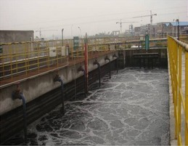
Materials and Methods
Wastewater
Rice wine distillery wastewater (Foshan)
Domestic wastewater (Macau)
Seed Culture Medium (YPD medium)
Yeast extract 10 g/L
Peptone 20 g/L
Glucose 20 g/L
Characteristics of Wastewater
Wastewater | SCOD (mg/L) | TN (mg/L) | TP (mg/L) | NH₃-N (mg/L) | pH
Distillery Wastewater | 59,900 | 2,680 | 380 | 204 | 3.7
Domestic Wastewater | 49 | 11 | 2 | 8 | 7.6
Mixed Wastewater (1:1) | 29,100 | 1,255 | 179 | 107 | 3.7

Slide 9
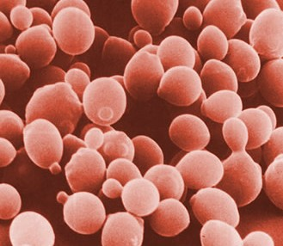
Materials and Methods
Oleaginous Microorganisms
Oleaginous yeast Rhodosporidium toruloides
Experimental Setup
Inoculated to 50 mL sterilized YPD fresh, 2nd, and 3^{r}
time used medium with or without nutrient supplement
Cultured at 30℃, 200 rpm, 36 h
Harvested by centrifuging at 4,000 rpm for 10 min
Dry weights of cells produced by each type of medium were measured

Slide 10
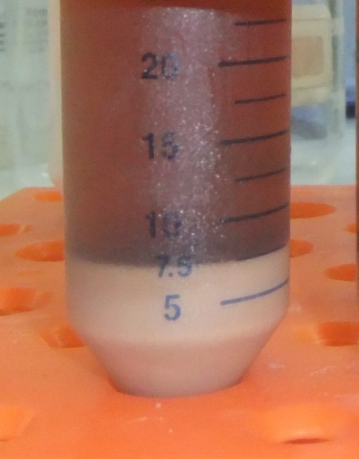
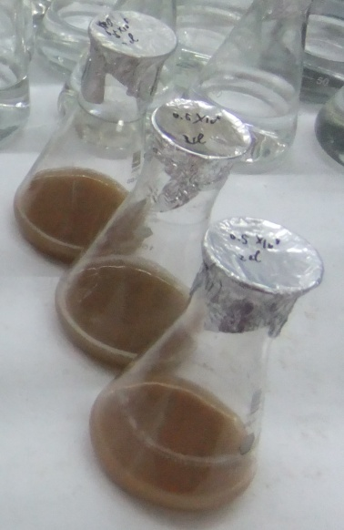
Materials and Methods
Experimental Setup
Different kinds of seed culture were centrifuged at
4,000 rpm for 10 min to cell density of 1.5 X 10⁹ cells/mL
Inoculated in 30 mL real non-sterile distillery/
domestic mixed wastewater with initial cell density of 2 x 10⁷ cells/mL and cultured at 30℃, 200 rpm, 5 day
Yeast biomass was harvested by centrifuging
COD, TN, TP, pH of supernatant measured

Slide 11
Materials and Methods
Analytical Methods
Dry weight of yeast biomass: dried at 80℃ to
constant weight
Lipid yield: acid-heat method
COD, TN, TP: Hach method

Slide 12
Results
Yeast cell yields from fresh and reused media
Medium type | Fresh | Reused (2nd time) |  | Reused (3rd time)
Nutrient addition (%) | 100 | 0 | 10 | 0 | 50
Cell yield (g/L) | 6.04±0.84 | 3.17±1.08 | 3.67±0.31 | 2.65±0.71 | 3.81±0.43

Slide 13
Results
COD in Wastewater (mg/L)
Time (day) | 0 | 2 | 3 | 4 | 5
Fresh YPD | 29,100 | 6,229 | 3,417 | 2,545 | 1,971
2nd time used YPD | 29,100 | 3,938 | 2,903 | 3,250 | 2,100
2nd time used YPD with 10% nutrient supplementation | 29,100 | 3,963 | 3,283 | 2,455 | 2,286
3rd time used YPD | 29,100 | 11,046 | 4,404 | 2,760 | 2,231
3rd time used YPD with 50% nutrient supplementation | 29,100 | 11,250 | 3,158 | 2,556 | 2,471

Slide 14
Results
Total Nitrogen in Wastewater (mg/L)
Time (day) | 0 | 2 | 3 | 4 | 5
Fresh YPD | 1,255 | 659 | 541 | 659 | 726
2nd time used YPD | 1,255 | 618 | 554 | 709 | 794
2nd time used YPD with 10% nutrient supplementation | 1,255 | 634 | 609 | 694 | 823
3rd time used YPD | 1,255 | 798 | 624 | 681 | 675
3rd time used YPD with 50% nutrient supplementation | 1,255 | 808 | 577 | 674 | 641
Total Phosphorus in Wastewater (mg/L)
Time (day) | 0 | 2 | 3 | 4 | 5
Fresh YPD | 179 | 49 | 33 | 35 | 41
2nd time used YPD | 179 | 46 | 51 | 44 | 45
2nd time used YPD with 10% nutrient supplementation | 179 | 50 | 33 | 46 | 47
3rd time used YPD | 179 | 64 | 39 | 31 | 36
3rd time used YPD with 50% nutrient supplementation | 179 | 76 | 43 | 34 | 38

Slide 15
Results

Slide 16
Results

Slide 17
Results

Slide 18
Results
Cost for producing amount of cells produced from
50 L fresh medium
 | Amount of spent medium generated by 1 L fresh medium (mL) | Amount of cells produced by spent medium from 1 L fresh medium (g/L) | Amount of cells produced by 1 L medium (g/L) | Medium amount required to produce the amount of cells produced by 50 L fresh medium (L) | Total cost of materials for medium (USD) | Price for glucose (USD/kg) | Price for peptone (USD/kg) | Price for yeast extract (USD/kg)
Use of fresh medium only | 800 | 0 | 6 | 50 | 389 | 9.8 | 270 | 218.5
Use of fresh and 2nd time used medium | 800 | 2.4 | 8.4 | 35.7 | 278 | 9.8 | 270 | 218.5

Slide 19
Conclusion
The spent YPD medium generated while in preparation of seed culture with high cell density was successfully reused for the 2nd time without further addition of nutrient.
The cells produced by reused medium showed remarkable biomass production with similar lipid productivity and higher removal efficiencies for organics and nutrients in real non-sterile mixed wastewater in shorter cultivation time compared to the fresh medium.
Cells produced from the 3rd time used medium did not show a good performance regardless of nutrient supplementation.
Reutilization of spent medium showed high potential in the reduction of material cost for microbial lipid production process.

Slide 20
Acknowledgements
University of Macau Multi-Year Research Grants:
MYRG204(Y3-L4)-FST11-SHJ, MYRG2014-00112-FST
Macau Science and Technology Development
Fund: FDCT/061/2013/A2
Ms. Ling, PhD student; Dr. Toledo, post-doc;
Ms. Tian, MS student

