Slide 1
بسم الله الرحمن الرحيم

Slide 2
USAGE OF SEA WATER IN AGRICULTURE “An Overview”
By
Dr. Hoda Farouk Zahran
Researcher, Plant Production Department, Water Research, Arid Lands Cultivation Research Institute, City of Scientific Researches and Technological Applications

Slide 3
SEA WATER
Seawater is a complex mixture of
70%
96.5 %
Covering more than 70 percent of Earth’s surface
Water
3.5%
Salts

Slide 4
Salinity and the main salt ions
The salinity of sea water
(Usually 3.5%)
The salinity of sea water is made up by many dissolved salts like, NaCl.

Slide 5
Salinity and the main salt ions
The main nutrients for plant growth
Nitrogen
N as in nitrate NO₃⁻
Nitrite NO₂⁻
Ammonia NH₄⁺
Phosporus (P as phosphate PO₄³⁻)
Potassium (K)
Sulfur (S)
Magnesium (Mg)
Calcium (Ca)

Slide 6
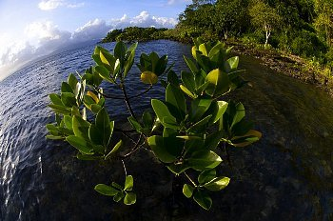
Seawater agriculture
Sea water may be used in plant irrigation especially in arid and semi-arid areas, which falls under biosaline agriculture

Slide 7
Seawater agriculture should fulfill two requirements to be cost-effective
It should produce useful crops at yields high enough to justify the expense of pumping irrigation water from the sea
Researchers should develop agronomic techniques for growing seawater- irrigated crops in a sustainable manner- one that does not damage the environmental saline agriculture
First
Second

Slide 8
The development of seawater agriculture may take a direction of attempting to breed salt tolerance into conventional crops, such as barley and wheat, by genetic engineering for example

Slide 9
Saline agriculture holds promise for biofuels
Around 10,000 salt-loving halophyte plants, which can grow in deserts and thrive on seawater – now at last coming to light
Noting that halophyte plants can provide humans with food, fiber, edible oils and biofuels
Indeed, algae grown on seawater are biofuels based on

Slide 10
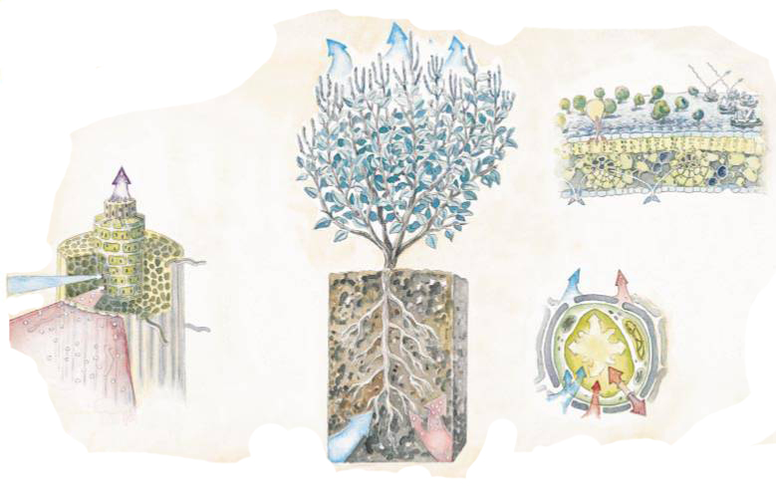
Irrigation crops with sea water
Anatomy of a Halophyte
Some salt-tolerant plants, or halophytes, have evolved mechanisms at the root, leaf and cell levels for thriving in the presence of seawater. The cells that make up the outer layer, or epidermis, of each rootlet are nearly impervious to salt (Na CI).
In addition, the inner layer, or endodermis, has a waxy layer between each cell that forces water to pass through the cells, which filter out more salt.
H₂O
VAPOR
SALT BLSADDERS
H₂O
NaCI
WAXY LAYER
H₂O VAPOR
ATRIPLEX (SALTBUSH)
H₂O
Na⁺CI⁻
H₂O
ROOTLET
TURGOR PRESSURE
H₂O
H₂O
Na⁺CI⁻
CI⁻
Na⁺
LEAF CELL

Slide 11
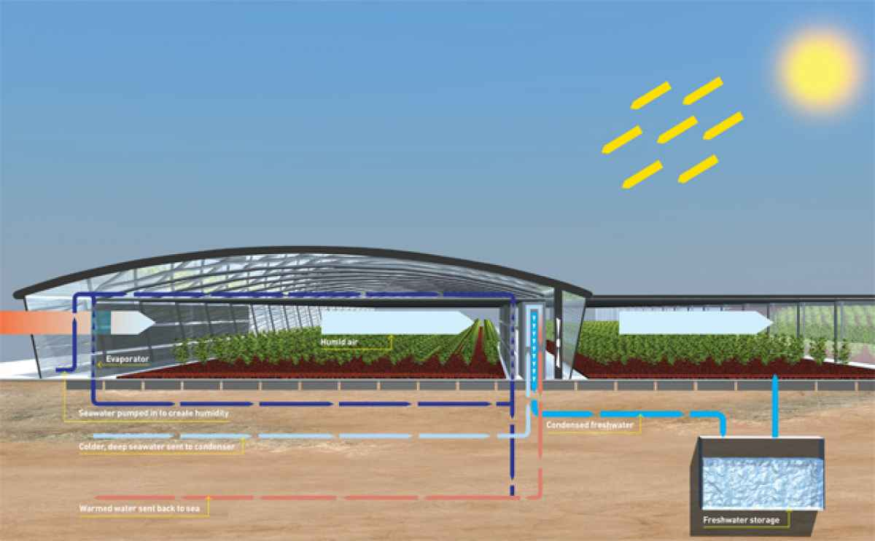
Seawater Greenhouse
A seawater greenhouse is a greenhouse structure that enables the growth of crops in arid regions, using seawater and solar energy

Slide 12
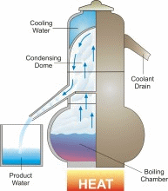
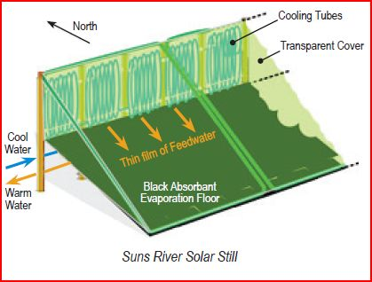
The technique involves pumping seawater (or allowing it to gravitate if below sea level) to an arid location and then subjecting it to two processes:
First
It is used to humidify and cool the air
Second
It is evaporated by solar heating and distilled to produce fresh water
Finally, the remaining humidified air is expelled from the greenhouse and used to improve growing conditions for outdoor plants

Slide 13
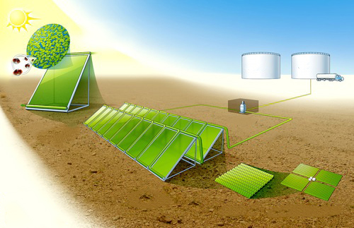
The more concentrated salt water may either be further evaporated for the production of salt and other elements, or discharged back to the sea
The seawater greenhouse is a response to the global water crisis

Slide 14
Seawater active organic substances
]
]
Many gallons of seawater are processed to produce a single gallon of SEA-CROP concentrate.

Slide 15
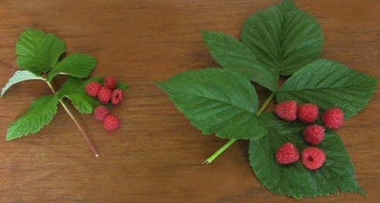
Seawater active organic substances
Without SEA-CROP 8.53 grams
20.66 grams
With SEA-CROP

Slide 16
Salt Tolerance of Selected Plant Species
Three Classes
Moderately salt tolerant plants always need protection from salt spray but will tolerate some inundations by storm surges. They are best used behind fences or buildings
Slightly salt tolerant plants always need protection from salt spray and should be protected by fences and buildings
Salt tolerant plants are resistant to extreme conditions and can be used in exposed environments where salt spray is evident

Slide 17
The following table is grouped by type of plant: trees, palms, shrubs, vines, ground
covers
Salt tolerant
Moderately salt-tolerant
Slightly salt-tolerant
Tree
Southern Magnolia (Magnolia grandiflora)
(Callitris pressii)
Russian Olive
Poplar (Populus alba)
Palms
Cabbage Palm (Sabal palmetto)
Pygmy Date Palm (Phoenix roebellini)
Shrubs
Dwarf Yaupon (Ilex vomitoria varieties)
Hydrangea (Hydrangea macrophylla)
Poinsettia (Euphorbia pulcherrima) (D)
Cactus, Yuccas and Succulents
Nelson’s Blue Beargrass (Nolina nelsonii)
Hedge cactus (Cereus peruvianus)

Slide 18
The following table is grouped by type of plant: trees, palms, shrubs, vines, ground
covers
Salt tolerant
Moderately salt-tolerant
Slightly salt-tolerant
Grasses
Bermuda Grass (Cynodon dactylon)
Centipede Grass (Eremochloa
ophiuroides)
Bahia Grass (Paspalum notatum
Groundcover,
Ferns and
Vines
Algerian Ivy (Hedera canariensis)
Asparagus Fern (Asparagus densiflorus)
Coleus (Coleus blumei)

Slide 19
Seawater for Green Deserts?!
Deserts on earth, in fact, cover a huge surface area
But
In case of work to make the deserts green by seawater irrigation

Slide 20
Seawater for Green Deserts
Advantage
large amounts of water with organic fertilizers.
Disadvantages
Sodium would damage the clay minerals, that good desert soil would be totally and irreversibly spoiled.
It is not economic to pump seawater over long distances (with corrosion problems on pumps and pipes), to accumulate salt in concrete basins in inland deserts and to spoil soils in oasis or lower aquifers of good water.

Slide 21
Seawater for Green Deserts
How greeniﬁcation should occur ?!
Planting long living trees is the only choice for binding CO₂ for a longer period

Slide 22
Management of salinity problems
Objective
Salinity control is to maintain an acceptable crop yield
Requirements
Preceding
Leaching salts out of the root zone
to maintaining adequate soil-water availability at all times
Achieving

Slide 23
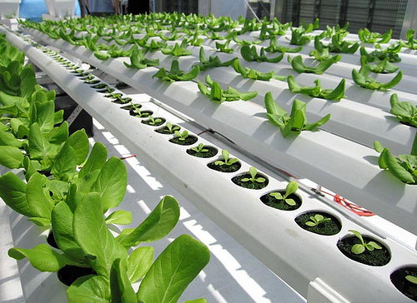
Hydroponics and seawater
Researches proved that great variety of vegetables and flowers grown flourished in the Seaponic solution
For ex., Orchids grew beautifully with the Seaponic solution as an only source of fertility

Slide 24
hfzahran@gmail.com
Thank You

