Slide 1

About OMICS Group
OMICS Group International is an amalgamation of Open Access publications and worldwide international science conferences and events. Established in the year 2007 with the sole aim of making the information on Sciences and technology ‘Open Access’, OMICS Group publishes 400 online open access scholarly journals in all aspects of Science, Engineering, Management and Technology journals. OMICS Group has been instrumental in taking the knowledge on Science & technology to the doorsteps of ordinary men and women. Research Scholars, Students, Libraries, Educational Institutions, Research centers and the industry are main stakeholders that benefitted greatly from this knowledge dissemination. OMICS Group also organizes 300 International conferences annually across the globe, where knowledge transfer takes place through debates, round table discussions, poster presentations, workshops, symposia and exhibitions.

Slide 2
About OMICS Group Conferences
OMICS Group International is a pioneer and leading science event organizer, which publishes around 400 open access journals and conducts over 300 Medical, Clinical, Engineering, Life Sciences, Pharma scientific conferences all over the globe annually with the support of more than 1000 scientific associations and 30,000 editorial board members and 3.5 million followers to its credit.
OMICS Group has organized 500 conferences, workshops and national symposiums across the major cities including San Francisco, Las Vegas, San Antonio, Omaha, Orlando, Raleigh, Santa Clara, Chicago, Philadelphia, Baltimore, United Kingdom, Valencia, Dubai, Beijing, Hyderabad, Bengaluru and Mumbai.

Slide 3
Recent Research on Image Crystals: discovery of shape-controllable cavities surrounded by facets in ceramics
-Artificial formation of Negative Crystal in Ceramics-
Hiroyuki Serizawa
Japan Atomic Energy Agency

Slide 4
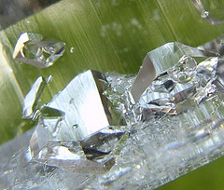
Negative Crystal in crystal
Characteristics of the negative crystal
・Negative crystal is a cavity that has the form of a crystal and
found in a mineral mass by chance.
・The cavity is sometimes filled with liquid containing mineral.
・From a view point of material science, the negative crystal
is a large defect to be improved.

Slide 5
The important point of today’s presentation
Our study clarified that a negative crystal is formed by the precipitation of helium.
The step free energy model is useful to explain the growth shape of the single crystal.
The shape of the negative crystal varies depending on the internal pressure.

Slide 6
Outline of My Presentation
Back ground of this work
–Why we started this work?-
Experimental work
–Helium behavior in UO₂-
Consideration on the shape of the negative crystal
a)Modeling of the shape
b)Relationship of the attachment energy and
the step free energy
☆Recent and future work

Slide 7
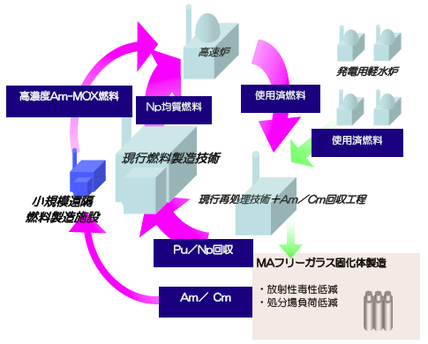
MA(Am & Np)ｰMOX(Mixed Oxide) fuel
Aim of this Research
Reducing the high radiotoxicity of minor actinides accumulated through nuclear power plant operation.
The most feasible plan to realize the new fuel reprocessing cycle by MEXT
(MEXT: Ministry of Education, Culture, Sports, Science and Technology)
・SODIUM-COOLED
FAST BREEDER REACTOR
&
・MA-MOX fuel
Fast Reactor
Spent Fuel of FR
Existing LWR
Am containing MOX燃料
Np containing MOX Fuel
Existing Fuel fabrication Plant
Spent Fuel of LWR
Am containing Fuel fabrication Plant
Reprocessing Plant Am
Reprocessing of Pu & Np
Glass Solidified body without Am
Reprocessing of Am
Reduction of Radiotoxicity
New reprocessing System

Slide 8
Specific Problem on the developing of MA-MOX Fuel
Behavior of helium emitted by MA
When helium precipitates in the fuel matrix
⇒Swelling of the fuel Pellet
⇒Fuel-Cladding mechanical interaction.
When helium is released from the fuel pellet
⇒Internal pressure of the cladding increase
⇒Revision of pressure tightness of the cladding.

Slide 9

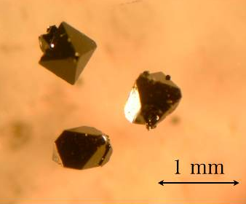
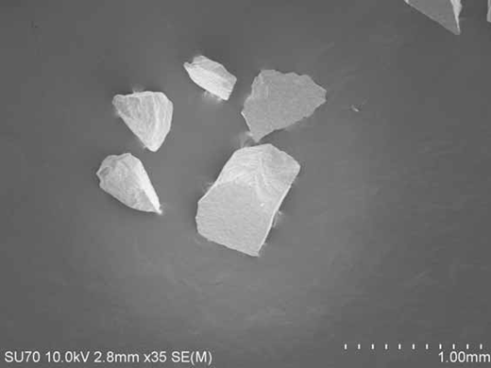
Experimental : Diffusion coefficient of Helium in UO₂
Analysis by High Temperature Mass spectrograph with Booth model
Helium injection by HIP
（ 1473 K 90MPa 100h)
He
He
Diffusion coefficient (m²/s)
He
He
Temperature(10⁴/t(k))
Diffusion coefficient of single-crystal and poly crystalline samples agree in the scatter of the data.
Single-crystal UO₂ Poly crystalline UO₂
Chemical Vapor transport method
Grain boundary of poly crystalline sample can be regarded as a free surface

Slide 10
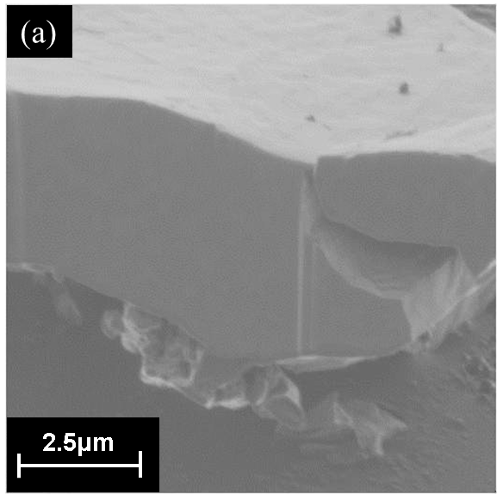
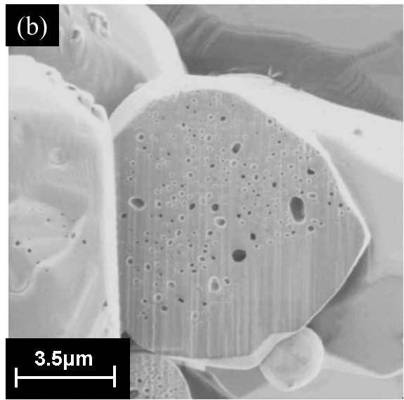
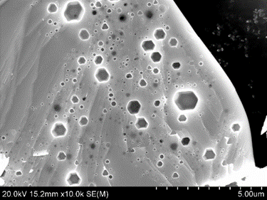

Experimental :
Matrix Observation of Single-Crystal UO₂ by SEM
Section of UO₂ particle before He injection
Section of UO₂ particle just after He injection by HIP
Cleavage surface {111} of UO₂ particle after annealed at high temperature
No gas bubbles and voids are formed
Round Cavities are formed
(Gas bubble is formed)
So many Negative crystal is formed!! on the cleavage {111} surface.
10

Slide 11
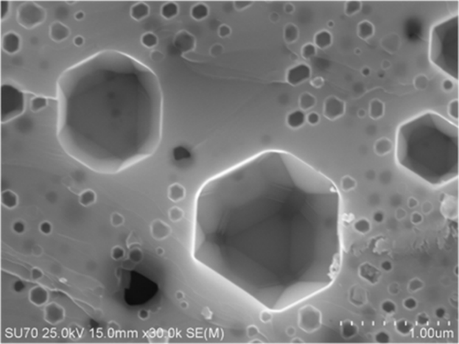
Magnified figure of Typical Cavities seen in UO₂
Negative crystal seen on the broken surface of the sample
SEM image of the high burn up fuels after annealing at 1800 ℃ for 5 h
(a) 44GWd/t; (b) 83GWd/t
Kashibe et al., J. Nucl. Mater 206(1993)22
Typical area of a (111) cleavage surface through UO₂ single crystal produced
by high temperature treatment.
Castel, Phys. Rev. B, 68(2003)235411.

Slide 12
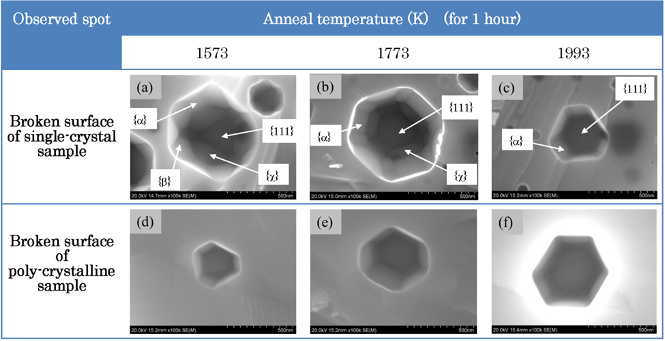
The Shape of the Negative Crystal
Consideration of the difference in the shape
The grain boundary exists or not
Single-crystal Polycrystalline
＞The amount of Residual He＞
Anneal Temp. Anneal Temp.
Low High
The value of the diffusion coefficient
12

Slide 13
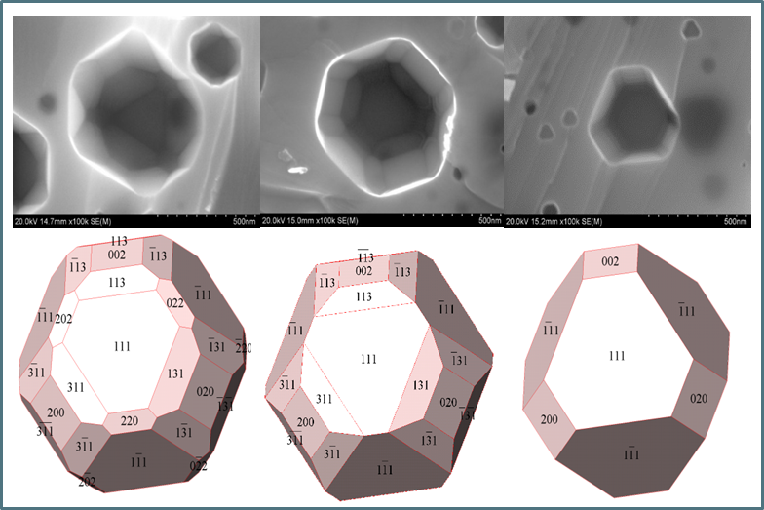
Modelling of the Negative crystal
S. C.1573K S. C. 1773K S. C.1973K & P. C.
Pentacontahedron Octa-Triacontahedron Tuncated Octahedron
Caution!! {113} appears faster than {011} on the surface, which is strange from thermodynamic point of view.
Notes:
We have already modelled the negative crystal.
We found three types of negative crystal in our sample.
They are a Pentacontahedron , octa-triacontahedron and truncated octahedron.
Here I noticed one more interesting subject.
Please give your attention to this model
l.
{113} appears faster than {011} on the surface, which is strange from thermodyanamic point of view.

Slide 14
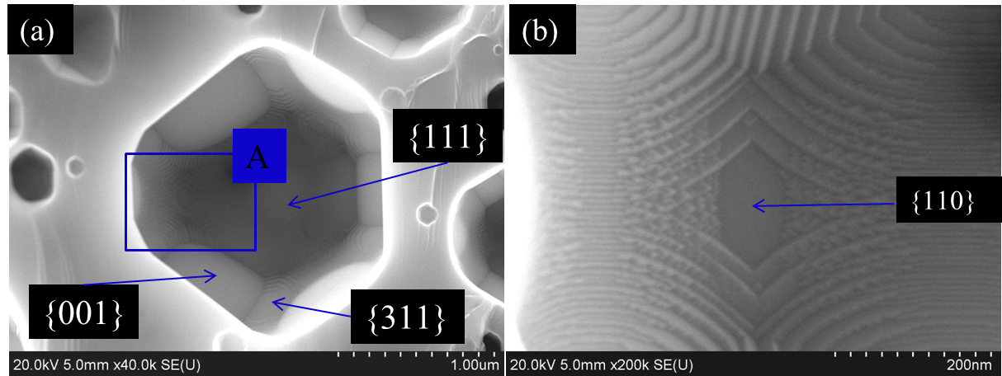
Consideration of free energy
・ Attachment Energy (A.E.)
The A.E. is the energy released when a growth slice of thickness is attached to the surface from infinity.
⇒The material tends to be added
adjacent surfaces with the lower
attachment energy to form the
surface with the highest A. E.
・Step Free Energy (S.F.E.)
The S.F.E is regarded as a 2D or 3D analogue of the surface free energy.
⇒the smaller the step free energy is,
the smaller the size of the critical
nucleus is.
SEM Images of Octa-Triacontahedron
type-negative crystal
A full grown {113} facet appears, whereas the {011} facet is almost invisible. However, a high-magnification SEM image of area A shows that {011}appears where center of the image.
Our work shows
The equilibrium shape of the single crystal is determined by A.E., but we have to take into account S.F.E. when we consider the real shape. S.F.E. corresponding to the activation energy of velocity theory.
Morphological Importance (A.E.)
MI{111}>MI{001}>MI{011}>MI{113}
Experimental (A.E. & S. F. E.)
MI{111}>MI{001}>MI{113}>MI{011}
14

Slide 15
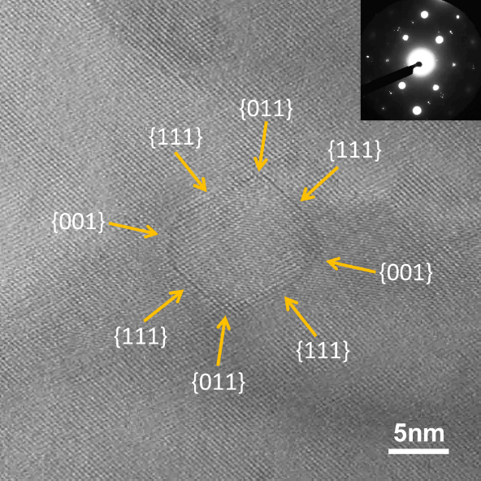

Recent job on Image crystal
Development of Functional Material with Negative Crystal
☆Preparation of CeO₂ thin film containing negative crystal
130-keV He⁴⁺ ions from 400-keV ion (1x1015n/cm²) implanter ( TIARA)
Anneal at high temperature
CeO2Film（800nm)
Nano-scale Negative Crystal was Formed by the precipitated Helium (TEM image).
(Examined by Wakasa Energy Research Center)
SrTiO3

Slide 16
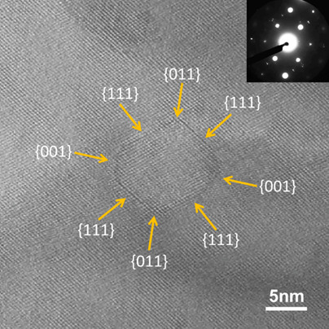
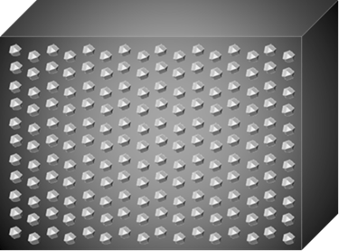
Tow Hot Subjects on Our Research
・Shape Control of Nano-Negative
Crystal
・Size Control of Nano-Negative
Crystal
Evaluation of the Amount of Residual Helium in Negative Crystal By High Temperature Mass Spectrograph
Evaluation of the Size
of Negative Crystal By Neutron Small Angle Scattering beam line
「大観」（TAIKAN）
in J-PARC
The Image of the Thin Film Containing Nano-Negative Crystal
Our Next Target
Invention of New Functional Material

Slide 17



Framework for this Research
Japan Atomic Energy Agency
Wakasa Energy
Research Center
Osaka University
Technological Design Institute of
Scientific Instrument Engineering
(Critical Nucleus)

Slide 18

Our investigation is just getting start.
We welcome your offer of corroboration !
Thank very much for your Attention.

