Slide 1
Stage 4 CKD presentation in patients over 75 Years Old differs from that in patients less than 75 Years of Age
Hiromichi Suzuki, Tsutomu Inoue,Tomohiro Kikuta,
Yusuke Watanabe, Hirokazu Okada
Department of Nephrology, Saitama Medical University

Slide 2
Nephro-2014 COI Author Hiromichi Suzuki
Conflict of Interest
The authors declare that they have no conflict of interest in this study.

Slide 3
Introduction
The proportion of older people in the general population is steadily increasing and the fastest growing segment of that population during the past decade is older than 75 years. With this increases in prevalence of elderly people, proportion of prevalent chronic kidney disease (CKD) increased in parallel. In spite of these situations, the appropriate treatment of older patients with CKD remains unclear. Moreover, there are a lot of unresolved problems in real world.

Slide 4
Aim
The aim of this study is to evaluate the prognosis of patients >75 years in comparison with those between 74 and 65 years, the longitudinal follow-up of elderly patients with CKD stage 4 was carried out in a single center and to characterize patients with CKD stage 4 older than 75 years.

Slide 5
Patients and Methods I
Patients were recruited from specialist renal clinics at Renal Disease Center, Saitama Medical University from January 2004 to December 2005. All participating patients were followed for 5 years or until death, commencement of dialysis therapy, receiving renal transplantation, finding of neoplasm, or occurrence of a cardiovascular event (fatal or non-fatal myocardial infarction, cerebrovascular disease, aortic dissection).

Slide 6
Patients and Methods II
Inclusion criteria were CKD as defined by K/DOQI, not yet on dialysis, stable renal function within the last 3 months (<5 mL/min/1.73 m2 change in GFR), and no change in medication in the preceding 3 months.
Exclusion criteria included known left ventricular dysfunction (ejection fraction <55%), or signs and symptoms of congestive heart failure, significant valvular or coronary heart disease, and use of sedative or hypnotic drugs or any other drugs potentially affecting blood pressure during ambulatory monitoring, e.g., corticosteroids.

Slide 7
Definition
Late referral was defined as the patients who were referred from general physician based clinic during the recruitment of this study.
The cause of CKD was assessed by reviewing the clinical history and investigations. Patients were classified as “hypertensive/glomerulosclerosis” if the patients had no clear evidence of active renal disease but had a history of hypertensive diseases and positive urinary protein excretion without casts.
DM was defined as HbA1c 5.8% or higher, or taking antidiabetics including insulin. GN was defined by biopsy or clinical diagnosis such as urine casts including unregulated red cells.

Slide 8
Patients Characteristics
Variables | Younger Group | Elderly Group
 | N=179 | N=106
Age (years) | 70.8±2.0 | 79.2±2.6*
Male (%) | 106/73 | 58/48
eGFR (ml/min/1.73m2) | 21.6± 3.3 | 22.1 ± 4.1
Underlying disease(male/female)(%)
DM | 91 (60/31)(51) | 24**(15/7)(23)
GN | 41 (25/16)(23) | 24 (17/9)(23)
HT | 44 (18/26)(24) | 54**(25/29)(51)
others | 3 (3/0)(2) | 4 (1/3)(3)
Late Referral (male/female) (%) | 44 (28/16)(25) | 23 (11/12)(22)
eGFR, estimated glomerular filtration; DM, diabetic nephropathy; GN, glomerular nephritis;
HT, hypertensive nephrosclerosis. ** indicates P<0.01 compared with younger group.

Slide 9
Comparison of eGFR between patients
in younger and elderly group
Young
Elderly
mL/min/1.73m²
29
27
25
23
21
19
17
15

Slide 10
Comparison of underlying disease of patients
between younger and elderly group
**
**
DM GN HT others

Slide 11
Baseline characteristics of the study population
Variables | Younger(N=179) | Elderly (N=106)
SBP (mmHg) | 137.5 ± 13.7 | 140.9 ± 18.3
DBP (mmHg) | 81.9 ± 6.1 | 77.9 ± 6.5*
HR (beats/min) | 72.3 ± 8.6 | 68.3 ± 5.4
Serum albumin (g/dL) | 4.0 ± 0.3 | 3.8± 0.6
Hemoglobin (g/dL) | 11.6 ± 0.7 | 11.2 ± 0.8
Total cholesterol (mg/dL) | 189.2 ± 42.3 | 177.2 ± 46.3
Phosphate (mg/dL) | 4.1 ± 1.7 | 4.3± 1.5
Calcium (mg/dL) | 9.1 ± 1.1 | 9.4± 1.0
Urinary protein excretion (g/gCr) | 1.34 ± 0.88 | 1.23 ± 0.90
SBP, systolic blood pressure; DBP, diastolic blood pressure; HR, heart rate.
* indicates P<0.05 compared with younger group.

Slide 12
Comparison of variables between DM and non DM nephropathy
Variables | DM nephropathy |  | Non DM nephropathy
 | N=105 |  | N=170
 | 75< | 75> | 75< | 75>
eGFR (ml/min/1.73m2) | 21.4± 2.3 | 22.1 ± 4.0 | 22.1 ± 4.1 | 22.1 ± 4.5
SBP (mmHg) | 121.6± 32.2 | 133.8 ± 20.2 | 136.5 ± 12.9 | 135.2 ± 19.5
DBP (mmHg) | 82.4 ± 7.0 | 74.4 ± 16.6* | 82.6± 7.2 | 77.1± 12.5*
HR (beats/min) | 71.4± 7.9 | 69.2 ± 4.5 | 73.0 ± 7.6 | 67.8 ± 6.3
Serum albumin (g/dL) | 4.0 ± 0.3 | 3.8± 0.6 | 4.0 ± 0.3 | 3.8± 0.6
Hemoglobin (g/dL) | 12.4 ± 1.8 | 11.2 ± 0.8 | 12.8 ± 0.7 | 12.6 ± 0.8
Total cholesterol (mg/dL) | 189.2 ± 42.3 | 177.2 ± 46.3 | 186.2 ± 32.7 | 175.1 ± 38.7
Phosphate (mg/dL) | 3.7 ± 1.9 | 3.5± 1.0 | 4.1 ± 2.0 | 3.5± 0.9
Calcium (mg/dL) | 9.2 ± 0.6 | 9.0± 0.5 | 9.1 ± 0.7 | 9.6± 0.4
Urinary protein excretion (g/gCr) | 1.34 ± 0.88 | 1.23 ± 0.90 | 0.98 ± 1.22 | 0.88 ± 1.15
HbA1C (%) | 6.3± 0.4 | 6.1± 0.6 | 5.2 ± 0.3** | 5.1± 0.6**
SBP, systolic blood pressure; DBP, diastolic blood pressure; HR, heart rate.
*indicates P<0.05 compared with the values of younger group and
** indicates P<0.01 compared with the patients with DM nephropathy

Slide 13
Comparison of underlying disease of patients
between total population and late referral
DM
GN
HT
others
**
**
**
**

Slide 14
Comparison of eGFR between patients
in total population and late referral
Total
Late
mL/min/1.73m²
30
25
20
15

Slide 15
Comparison of baseline characteristics between total population and patients with late referral
Variables | Total (N=218) |  | Late referral (N=67)
Age (years) | 75< | 75> | 75< | 75>
Gender (male/female) | 135(78/57) | 83(47/36) | 44 (28/16) | 23 (11/12)
eGFR (mL/min/1.73 m2) | 21.7± 4.3 | 22.7 ± 3.9 | 23.1 ± 5.1 | 23.1 ± 4.9
SBP (mmHg) | 128.6 ± 18.2 | 130.5 ± 16.3 | 1145.2 ± 13.1 | 141.2 ± 11.9
DBP (mmHg) | 81.5 ± 6.7 | 75.3 ± 15.9 | 83.6 ± 4.9 | 73.2 ± 11.4
HR (beats/min) | 72.3 ± 6.6 | 68.1 ± 4.3 | 71.6 ± 7.5 | 66.6 ± 7.2
Serum albumin (g/dL) | 4.1 ± 0.4 | 3.9± 0.7 | 3.6± 0.9 | 3.8± 1.2
Hemoglobin (g/dL) | 12.6 ± 0.7 | 12.1 ± 0.9 | 11.3 ± 0.7 | 11.2 ± 0.9
Total cholesterol (mg/dL) | 200.6± 35.3 | 180.8 ± 28.7 | 201.3± 36.7 | 172.1 ± 35.3
Phosphate (mg/dL) | 3.6± 1.1 | 3.3± 1.0 | 5.0± 1.8* | 4.8± 0.7*
Calcium (mg/dL) | 9.6 ± 0.5 | 9.8± 0.3 | 8.1 ± 1.1* | 8.4± 1.5*
Urinary protein excretion (g/gCr) | 1.12 ± 0.66 | 1.00 ± 0.88 | 1.42 ± 1.34 | 1.31 ± 1.21

Slide 16
Comparison of events between patients
in younger and elderly group
**
RRT MI CVD Heart failure Neoplasma others

Slide 17
Kaplan Meier curve of event free for patients
in younger and elderly group
Event free
Event free
1.0
0.8
0.6
0.4
Elderly
Younger
0.2
0.0
0
10
20
30
40
50
60
(month)

Slide 18
Comparison of events between patients with
diabetic nephropathy and non diabetic nephrophathy
**
RRT
MI
CVD
Heart failure
Neoplasma
others

Slide 19
Kaplan Meier Curve of event free in patients with diabetic nephropathy and non diabetic nephropahty
Event free
1.0
0.8
0.6
0.4
0.2
Non DM
DM
0.0
0
10
20
30
40
50
60
(month)

Slide 20
Comparison of events between
total population and late referral patients
RRT
MI
CVD
Heart failure
Neoplasma
others
**
**

Slide 21
Kaplan Meier curve of event free in late referral patients and total population
Event free
1.0
0.8
0.6
0.4
0.2
Total
Late referral
0.0
0
10
20
30
40
50
60
(month)

Slide 22
Selection of Modalities of Dialysis Therapy
*

Slide 23
Selection of Modalities
Number

Slide 24
In Summary
1.This 5-year prospective observation study demonstrated that,
if elderly people>65 years is divided into 2; 65-74 and >75 years in CKD patients, a proportion of the underlying renal disease was completely different. In the elderly patients >75 years, HT nephrosclerosis and GN were predominant. In contrast, in the patients 65 to 74 years, DM nephropathy was predominant.
2. The ratio of development to RRT was higher in the patients 65 to 74 years, probably being due to a large proportion of DM nephropathy as the leading cause of renal disease.
3. A prognosis of DM nephropathy, regardless of age groups, was poor.
4. A prognosis of the late referral patients was also not well.

Slide 25
Conclusion
In conclusion, it is suggested that in the patients >75 years, the values of eGFR may be overestimated and a prognosis of DM nephropathy was poor. And lastly, the early nephrology referral is encouraged.

Slide 26
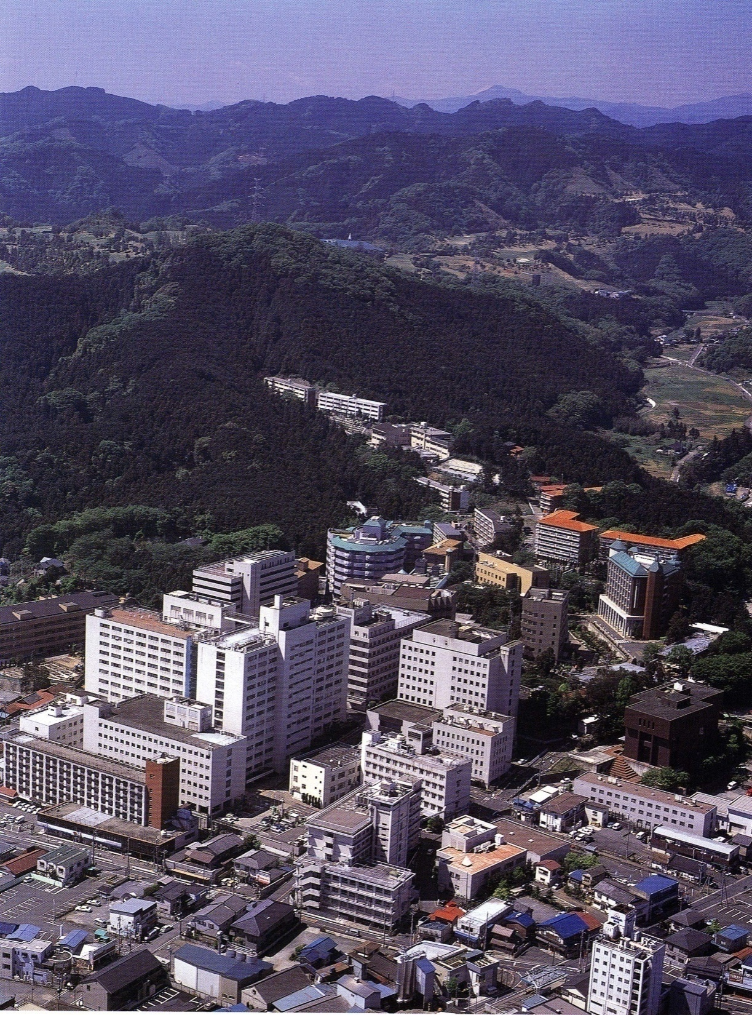
Thank you for your attention.
We are here.

