Slide 1
Otorhinolaryngologic findings in a group of patients with rheumatic diseases
3rd international conference and exhibition on orthopedics & rheumatology

Slide 2
Reinaldo Jordão Gusmão, Henrique Furlan Pauna*, Lutiane Scaramussa, Fernando Laffitte Fernandes, Alexandre Caixeta Guimarães, Zoraida Sachetto, Guilherme Machado de Carvalho
state university of campinas - unicamp - brazil
DATE
july 29th, 2014
CITY
san francisco, ca

Slide 3
Introduction
High prevalence rate worldwide and functional disability index
Systemic changes involving the connective tissue throughout the body
blood vessels, serous and mucous membranes of all aerodigestive tract
Ear, nasal, laryngeal and ocular symptoms may be the first manifestations of various rheumatic diseases
The objective of this work is to identify ENT manifestations in patients with rheumatic diseases in a hospital of high complexity

Slide 4
Materials and methods
Conducted in 2010
Complete clinical and ENT evaluations
detailed history, ENT physical examination, audiometry, imitanciometry and flexible nasofiberlaryngoscopy
Assessment was fully standardized and a normalized filling form was used
Patients were referred from the Department of Rheumatology randomly

Slide 5
Results
32 patients
Mean age was 41.7 years (range 22 - 70)
Mean disease duration was 9.12 years (range 1-40)

Slide 8
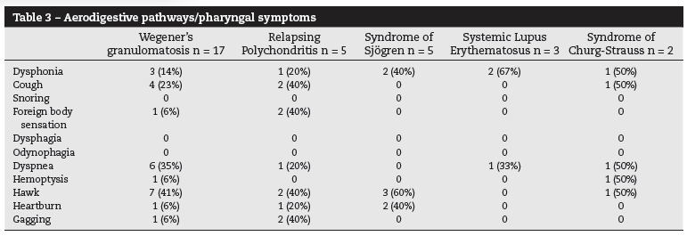

Slide 12
Discussion
ENT symptoms may represent an early sign of an undiagnosed disorder that often requires an immediate and aggressive immunosupressive treatment
Must consider the large time lag between complains and the correct diagnosis
More than one third of patients present systemic manifestations that can include:
vasculitis, cryoglobulinemia, autoimmune hepatitis, pulmonary fibrosis, CNS involvement, renal tubular acidosis, B-cell lymphomas and multiple myeloma

Slide 13
Ear damage
hearing loss with decreased hearing acuity or discrimination of sounds
uni or bilateral, medium or high frequencies
sensorineural, conductive, gradual or sudden
vestibulocochlear system involvement by vascular lesions in the internal auditory artery
auricular chondritis (85% of the cases)

Slide 14
Laryngeal involvement
extremely rare
symptoms can range from hoarseness to respiratory distress
cricoarytenoid ulceration, stenosis and oedema (Smith et al.)
complete vocal fold paralysis (Kraus and Guerra-Batista, 1990)

Slide 15
Nasal involvement
allergic rhinitis, rhinosinusitis, nasal obstrution, epistaxis, ulceration and septal perforation, erosion of the vomer, crust formation
Churg-Strauss:
1) prodromal stage (asthma and allergy)
2) eosinophilic stage (eosinophilia and organic infiltrate)
3) systemic vasculitis

Slide 16
Oral manifestations
xerostomia, dryness of lips, tongue and pharynx, dental caries and periodontal disease
oral symptoms of dry mouth in 86% and eye symptoms in 53% of patients
Schirmer test or Rose Bengal staining (46% of patients)
symmetrical and recurrent parotid gland hypertrophy

Slide 17
Conclusion
This trial demonstrated the various ENT manifestations
The early identification is critical to the early immunosupressive treatment

Slide 18
Obrigado

