Slide 1
A ten-year evolution of a multidrug-resistant tuberculosis (MDR-TB) outbreak in an HIV-negative context, Tunisia (2001-2011)
Naira Dekhil¹, Besma Mhenni¹, Raja Haltiti², and Helmi Mardassi¹ (speaker)
¹Unit of Typing & Genetics of Mycobacteria,
Institut Pasteur de Tunis,
Tunisia
²Hôpital Régional de Menzel Bourguiba,
Tunisia

Slide 2
MDR-TB outbreaks have been mainly described in HIV-positive institutionalized individuals
MDR-TB outbreak
Drug-sensitive and fitness-competent with an epidemic potential MTB clinical strain
INH and RIF resistance-conferring mutations
(MDR phenotype with fitness costs)
HIV + community
fitness
HIV - community
fitness
Could MDR-TB outbreaks emerge and expand in a community strictly negative for HIV?
Acquisition of compensatory mutations

Slide 3
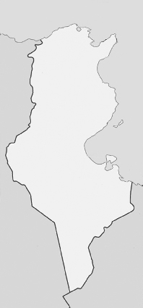
An MDR-TB outbreak emerged in Tunisia and expanded in an HIV-negative context
Mediterranean sea
Bizerte
Tunisia
Mediterranean sea
N° Cases
ALGERIA
LIBYA

Slide 4
The Tunisian MDR-TB outbreak major characteristics
The outbreak expanded in the general community (non institutionalized)
Affected young (mean age ~27 yrs), immuno-competent and HIV-negative individuals
The involved strains grow profisciently « in vitro »
(Mardassi et al., EID 2005)

Slide 5

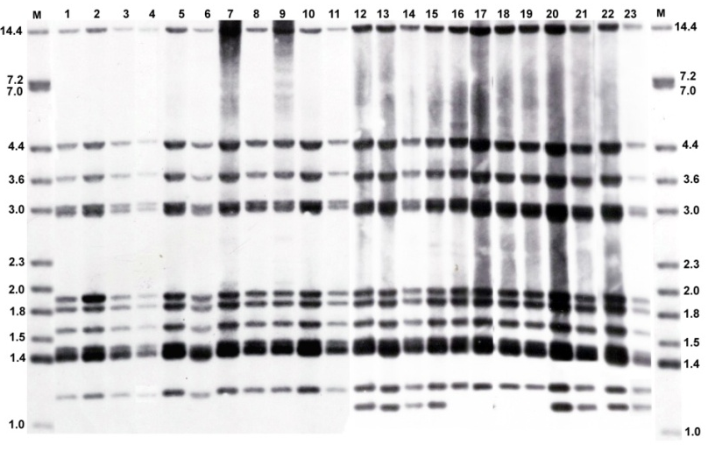
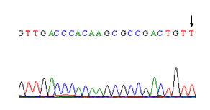
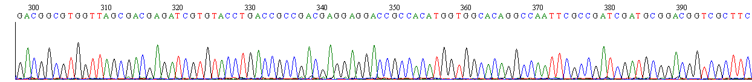
The Tunisian MDR-TB outbreak involved a Haarlem3 genotype clone harboring a rare rpoB secondary site mutation, V615M
Spoligoprofile
IS6110 RFLP
Haarlem3
S531L
V615M
Mardassi et al., EID 2005

Slide 6
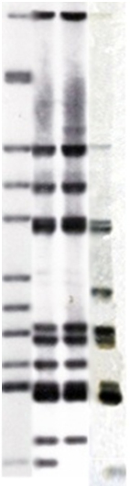
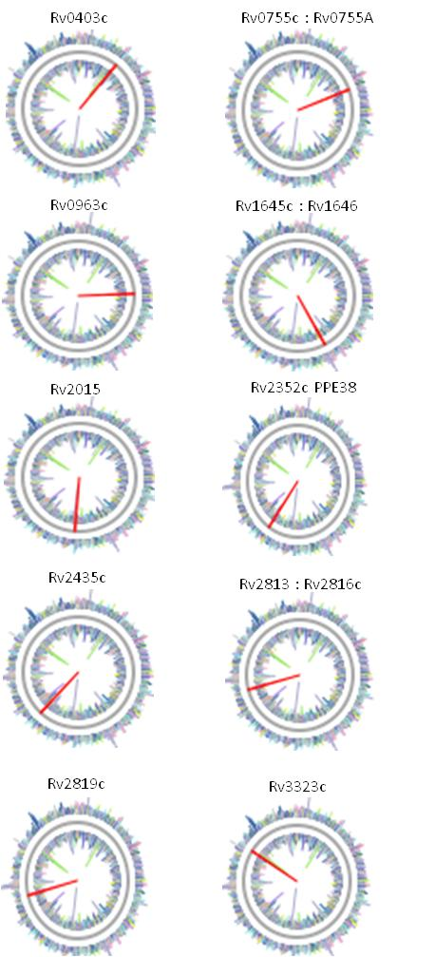
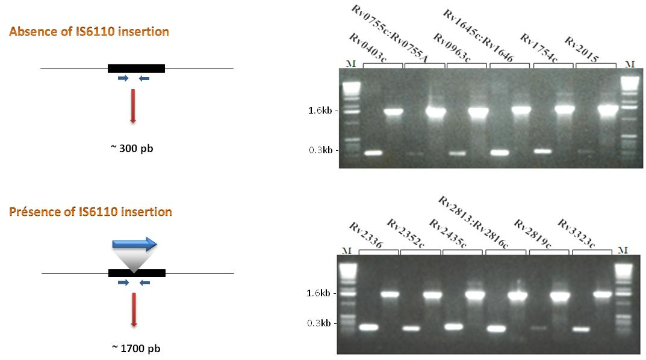
Development of a PCR-based test for the differentiation of the 12- and 11-banded profiles
GL-PCR
12
11
Transposition site | 12-banded | 11-banded
Rv0403c (mmpS1) | + | +
Rv0755c : Rv0755A | + | +
Rv0963 | + | +
Rv1645c : Rv1646 | + | -
Rv1754c | + | +
Rv2015c | + | +
Rv2336 | + | +
Rv2352c (PPE38) | + | +
Rv2435c | + | +
Rv2813 : Rv2816 | + | +
Rv2818c | + | +
Rv3323c (moaX) | + | +
Spacer31* | + | +
Total | 13 | 12
Namouchi et al., JID 2010
Namouchi & Mardassi, JMM 2006

Slide 7
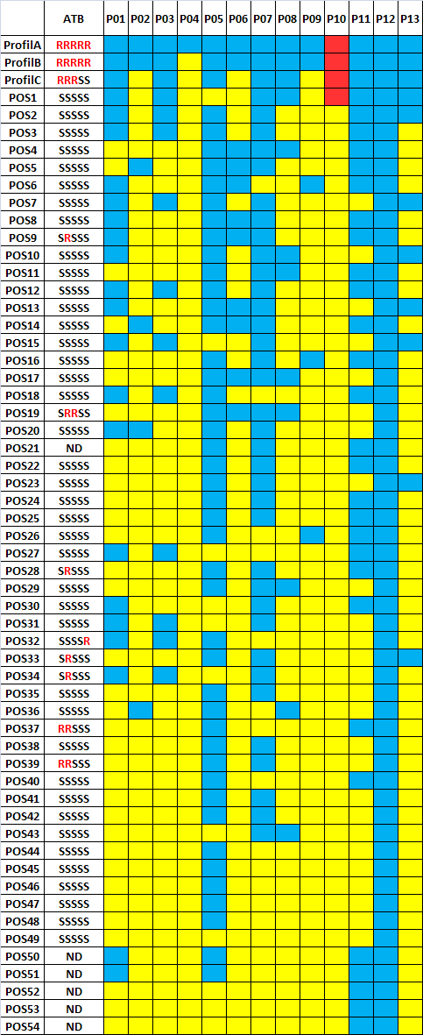
Identification of the closest drug-sensitive pre-outbreak strain
Namouchi et al., JID 2010

Slide 8

Objectives
Appreciate over a 10-year period (2001-2011) the clinical characteristics of the MDR-TB outbreak and the treatment outcome
Carry out a comparative genomics analysis to better understand the molecualr basis undelying the epidemic phenotype
Carry out an in-depth, 10-year spanning, genotypic analysis of the strains circulating in the epidemic region

Slide 9
The MDR-TB outbreak was more frequently associated with the 11-banded IS6110 RFLP profile
11-banded
12-banded

Slide 10
Aside from smear positivity, the 11- and 12-banded outbreak strains behave similarly
Characteristics | All outcomes N=45 (%) | 11-banded IS6110 RFLP N=35 | 12-banded IS6110 RFLP N=10 | Matched OR (95% CI) | P value (Pearson's Chi-square test)
Age (years,means) | 29,72 | 29,46 | 30,63 |  | 0,774
<20 ( | 4 (8,89%) | 3 | 1 | 1,19 (0,107-13,3) | 0,887
20-40 | 27 (60%) | 21 | 6 | 1 (0,163-6,138) | 1
>40 | 5 (11,11%) | 4 | 1 | 0,857 (0,082-8,965) | 0,898
Male | 40 (88,89) | 31 | 9 | 0,861 (0,085-8,706) | 0,899
Smear-positive | 15 (33,33%) | 9 (25,71%) | 6 (60%) | 4,333 (0,992-18,938) | 0,043*
epidemiological link | 10 (22,22%) | 8 | 2 | 0,633 (0,107-3,733) | 0,612
Duration of treatment (months,means) | 30,4 (67,56%) | 29,83 | 32,4 |  | 0,81
Outcome category:
Cure | 17 (37,78%) | 14 | 3 | 0,6 (0,120-3,007) | 0,532
Failure | 6 (13,33%) | 5 | 1 | 0,657 (0,065-6,605) | 0,72
Relapse | 4 (8,89%) | 4 | 0 | 0,750 (0,614-0,916) | 0,257
Death | 9 (20%) | 5 | 4 | 4,6 (0,849-24,929) | 0,064

Slide 11
Treatment outcome: The outbreak proved difficult to treat

Slide 12
Death was significantly associated with relapse and chronic cases
 | Age, mean | Smear positivity | Relapse
Death (N=9) | P = 0,082 | P = 0,197 | P = 0,002
 |  | Matched OR (95% CI) 4 (0,431-3,7) | Matched OR (95% CI) 0,052 (0,00562-0,492)
% |  | 11,11% | 88,88%

Slide 13
Mutational analysis of drug resistance genes
gidB
girA
embB
rpoB
rpsL
H37Rv genome
(4 411 532 bp)
rrs
inhA
eis
pncA
katG

Slide 14
Evolution of the MDR-TB outbreak based on mutations in drug resistance genes

Slide 15
Genome sequencing using the Illumina platform

Slide 16
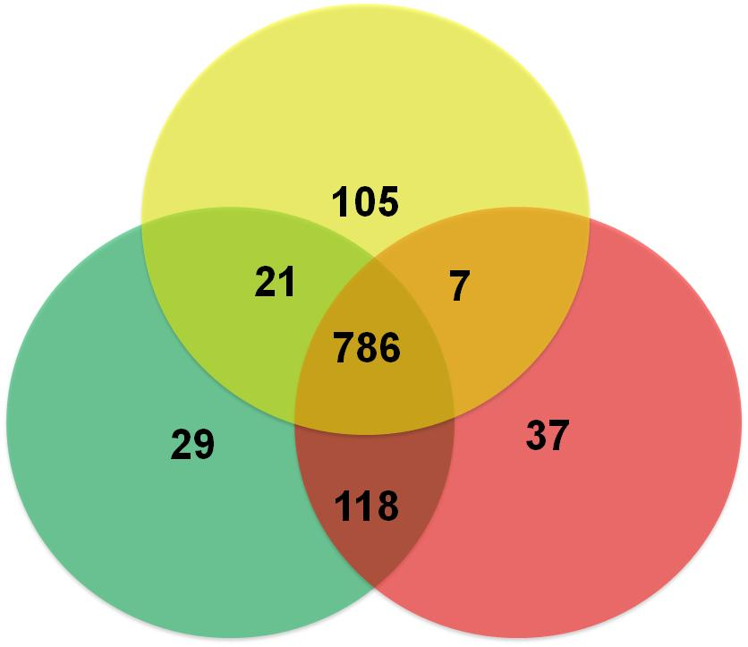
Comparative genomics: Statistics
Whole genome SNPs-based Venn diagram
Whole genome LSPs-based Venn diagram
Drug sensitive pre-outbreak
Drug sensitive pre-outbreak
12
23
44
12
8
MDR Outbreak strains
MDR Outbreak strains
SNP: Single Nucleotide Polymorphism
LSP: Large Sequence Polymorphism (≥ 10 bp)

Slide 17
Few Indel events differentiate other outbreak strains described worldwide
Haarlem3 (Hamburg) N= 89 | Outbreak (San Francisco) N=09 | Beijing (Uzbekistan) N=02
5 SNPs + 5 short deletions | 7 SNPs+ 0 indels | 130 SNPs+ 1 large deletion
(Andreas Roetzer,2013) | Midori Kato-Maeda, 2013) | (Niemann S, 2009)

Slide 18
Indels contributed significantly to the clonal diversification of the MDR-TB outbreak-associated strains
1 2 3 4 5 6 7
1: TUN2412-10
2: TUN1923-01
3: TUN1843-08
4: TUN228-02
5: TUN2078-03
6: TUN1183-02
7: TUN233-02

Slide 19
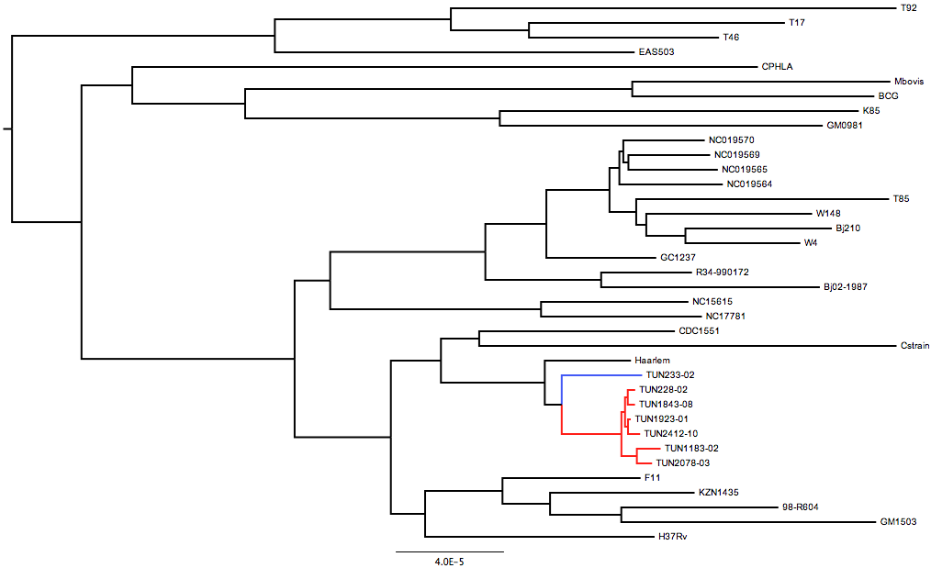
Genome-wide-based Maximum Likelihood phylogenetic tree

Slide 20
What have we learned from microgenomics on the biology of the MDR-TB outbreak?

Slide 21
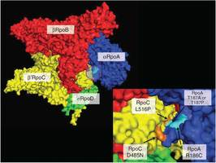
Comparative genomics coupled to structural analysis disclosed the possible role of the rpoB secondary mutation, V615M, in fitness cost compensation
No putative compensatory mutations either in rpoC or in rpoA coud be identified
V615M maps to the flexible bridge helix structure which interact with DNA

Slide 22
The outbreak-restricted secondary site rpoB mutation, V615M, did indeed restore the fitness costs of S531L
Engineered mutant BCG harboring V615M +S531L grows as efficiently as WT-BCG
Engineered mutant BCG harboring V615M +S531L and WT-BCG display comparable fitness

Slide 23
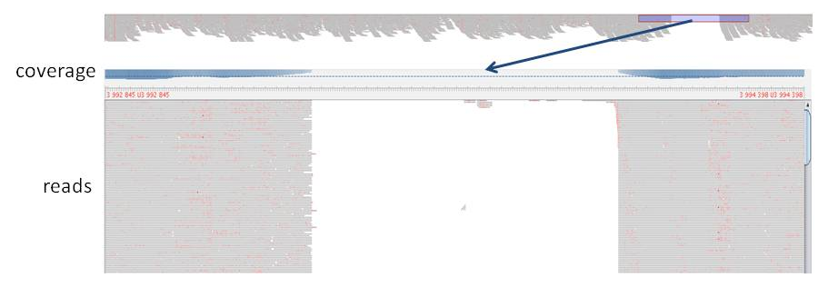
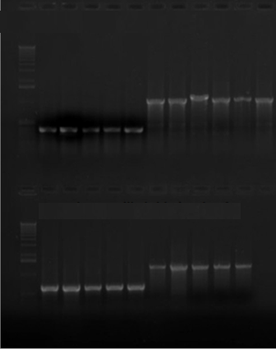
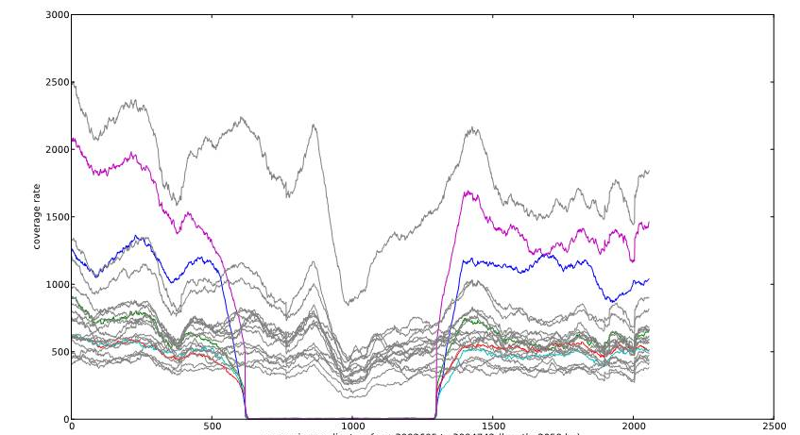
An in-frame deletion in the ferredoxin gene is likely to be critical to the epidemic potential of the Tunisian MDR outbreak strain
1081 pb
400 pb
680 pb

Slide 24
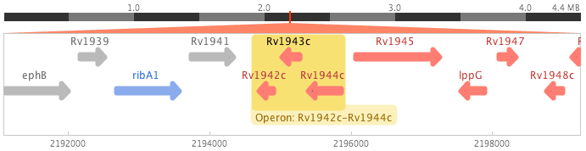
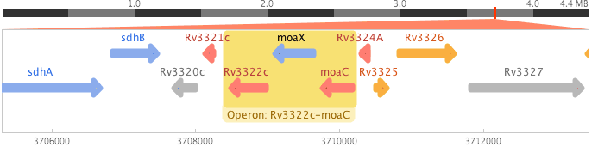
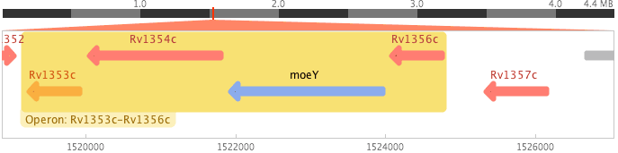
Shared, outbreak-restricted, deletions to be further explored by functional genetics
1.9 kb
I
I
I
1 kb
4.7 kb

Slide 25
Main outputs from comparative genomics
Phylogenomics confirm the relatedness of the Tunisian MDR-TB outbreak strain with the epidemic CDC1551 and C strains
The genome of the MDR-TB outbreak strain appears to evolve rapidly, mainly through frequent indel events
Rationale comparative genomics identified key deletion events which could have contributed to the epidemic phenotype of the Tunisian MDR outbreak strain

Slide 26
An in-depth snapshot of the molecular epidemiology of the M. tuberculosis Haarlem genotype in the epidemic region

Slide 27
All Haarlem strains and variants co-evolving with the MDR-TB outbreak (2001-2011) were included in a MIRU-VNTR24 typing analyses

Slide 28
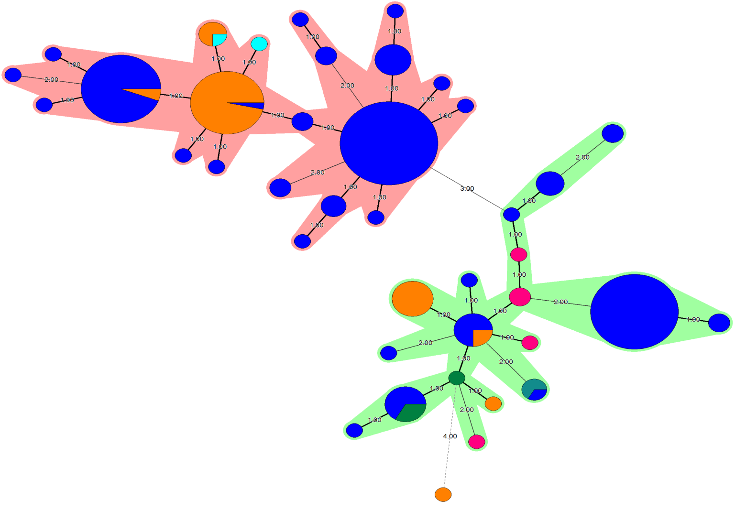
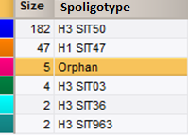
The MTB Haarlem strain family, northern Tunisia, is likely to be intrinsically epidemic and genetically unstable
N=35
N=30
N=53
MDR-TB outbreak
Recent transmission rate: 86%
N=45

Slide 29

Conclusions
MDR-TB outbreaks can emerge and successfully expand in a HIV-negative context
Evolution to the XDR phenotype is likely to be a associated with the genetic trait of the involved strain rather than treatment default
The Tunisian MDR-TB outbreak benefited of an intrinsic epidemic potential coupled to a rapid genomic evolution, mainly through indels

Slide 30


