Slide 1

Ensuring safe food production by providing guidance as an authority on hygienic engineering and design for food manufactured in or imported into Europe

Slide 2






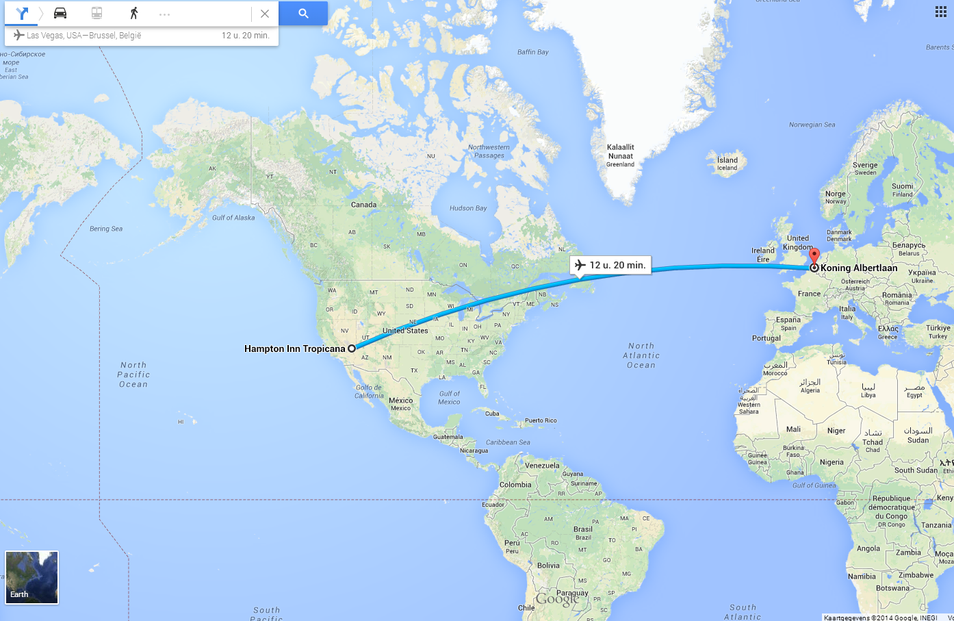


Belgium, land of beer and chocolates...
And also

Slide 3




European Hygienic Engineering & Design Group
Sealed Air
We protect what’s important - helping people live healthier, eat better and ship products safely around the world. We strive to be the global leaders in food safety & security, facility hygiene and product protection.
Approximately 25,000 employees
Net sales of ~ $8 billion
Operations in 62 countries with distribution reaching 175 countries
145 manufacturing facilities
56 Labs/Research Facilities
More than 500 scientists and engineers
More than 1000 equipment and application experts
4,600 patents
More than 9000 trademarks

Slide 4
European Hygienic Engineering & Design Group
Problem Statement
Although manufacturers and food companies comply with standards and regulations, yearly thousands of food-born diseases happen as a result of not hygienically designed food processing equipment, process lines or plants.
The reason is that there are two major gaps:
Lack of practical guidelines
Lack of education

Slide 5
European Hygienic Engineering & Design Group
What is EHEDG?
EHEDG was founded 1989 as a non-profit consortium of:
Equipment manufacturers
Food industries
Suppliers to the food industries
Research institutes and universities
Public health authorities
Since that time, the European Hygienic Engineering & Design Group is guiding the industry in hygienic design solutions by offering practical guidelines, test procedures, training and education.

Slide 6
European Hygienic Engineering & Design Group
EHEDG tasks and objectives
Fill the existing gaps by practical guidelines and education
Offer expertise and networking on a voluntary basis
Discuss and further develop hygienic design issues
Prepare scientific and technical guidelines on all aspects of state-of-the-art hygienic design requirements in accordance to EU legislation
Develop test methods in order to identify and eliminate HACCPs
of equipment used in food production

Slide 7
European Hygienic Engineering & Design Group
EHEDG tasks and objectives
Offer training courses, seminars and workshops on hygienic design
Strengthen the participation in standardisation bodies like CEN,
ISO, DIN, JIS, 3-A, NSF etc.
Strengthen the cooperation with the EU (i.e. food contact material
directive, traceability and other EU-Projects)
Promote and disseminate hygienic design know-how by
print media, congresses, seminars and workshops

Slide 8

European Hygienic Engineering & Design Group
Structure of the EHEDG
Board
President
= Foundation
General
Assembly
Vice President
= Executive
Committee
Secretariat
Treasurer
Sub Committee:
Regional Development
Chair & Co-Chair
Sub Committee:
Product Portfolio
Chair & Co-Chair
Sub Committee:
Communication
Chair & Co-Chair
Members
Members
Members
Regional Sections
Working Groups
Working Groups

Slide 9
European Hygienic Engineering & Design Group
EHEDG Strategy
  "EHEDG enables safe food production by providing guidance as an authority
  on hygienic engineering and design for food manufactured in or imported into Europe" (EHEDG ExCo, mission agreement 2012)

Slide 10
European Hygienic Engineering & Design Group
EHEDG Strategy Discussion
  The Executive Committee is appointed by the Board (every 3 years).
    Members: President, Vice-President, Treasurer as well as the Leaders and Co-Leaders of each Sub-Committee.
    Main tasks: to drive implementation of EHEDG work plans and approved work programmes, develop a strategy for EHEDG with annual budgets, fees and plans, secure approval by the Board. The Executive Committee regularly communicates important decisions, progress and accomplishments to the members.
  In addition, the following Sub-Committees are established to develop the future organisational structure of EHEDG in the following thematic clusters:
    Product Portfolio (Guidelines/Subgroups, Training, Certification)
    Regional Sections
    Communications & Membership relations
    Sub-committees consist of a leader, a co-leader and appointed members (experts in the field). The role of the Sub-Committees is to lead and develop the specific strategies and programs in relation to their own area of responsibility.

Slide 11
European Hygienic Engineering & Design Group
EHEDG Membership Development
July 2014:
about 1,130 persons
234 individual members
302 member companies and institutes

Slide 12
European Hygienic Engineering & Design Group
EHEDG Working Groups
Active:
Air Handling*
Bakery Equipment
Building Design**
Cleaning in Place
Cleaning Validation
Conveyor Systems**
Dry Materials Handling
Fish Processing
Food Refrigeration* (finalization of draft 2005)
Heat Treatment (Update of Doc. 1 and 6)*
Materials of Construction in Contact with Food (update of Doc. 32)*
Mechanical Seals*
Open Equipment*
Seals
Tank Cleaning
Test Methods
Training & Education
Valves*
Welding*
Projected:
Membrane Filtration
Hygienic Equipment (i.e. brushes)
* = Update of existing documents
** = Draft under final review
Today: Over 400 voluntary experts actively involved into 19 Working Groups
42 guidelines published - THANK YOU !
for further information see www.ehedg.org

Slide 13
European Hygienic Engineering & Design Group
EHEDG Working Group Tasks
  The EHEDG Working Groups meet to develop guidelines and revise existing
  documents (based on reference documents, research work and development
  of own test methods).
  The Working Groups highlight selected topics and describe typical problem statements, hygiene risks as well as causes of faults and defects.
  EHEDG guidelines define likely weak points and describe problem solving;
  they are picture-illustrated and practically oriented
  ➔ Keep things simple and easy to understand!
  Where appropriate, guidelines are added by special considerations (i.e. trouble
  shooting, traceability and maintenance tasks)
  EHEDG documents are harmonized with 3-A standards
  Further, the EHEDG Working Groups provide guideline translation by experts who
  are native speaking experts and they publish technical articles
For activities and expertise required, see www.ehedg.org > News > Working Group Activities

Slide 14

European Hygienic Engineering & Design Group
Regional Sections
EHEDG is growing world wide and has members in 55 countries today
Existing Regional Sections (24):
  Armenia, Belgium, Croatia, Czech Republic, Denmark, Germany, France, India, Italy, Japan, Lithuania, Macedonia, Mexico, Netherlands, Nordic (FI, S, NO), Poland, Russia, Serbia, Spain, Switzerland, Taiwan, Thailand, Turkey, Ukraine, Ukraine
Coming soon:
  Brazil, China, U.K., Uruguay
A global network!
for further information see www.ehedg.org

Slide 15
European Hygienic Engineering & Design Group
EHEDG Regional Sections - Tasks
  Disseminate know-how in hygienic design by
    Organization of seminars and workshops
    Organization of local training courses
    Organization of trade shows
  Guideline translation
  Publications and articles
  Activities to gain new members
  Translate EHEDG website contents, publish local news on the web
  and in the Newsletter
  Prepare and fulfil an annual business plan

Slide 16























European Hygienic Engineering & Design Group
EHEDG Regional Sections – YOUR Network
The „Big Thirty“:
Make use of the EHEDG to strengthen your relations with the important market players who are part of our network and also involve your subsidiaries abroad. Please recommend us and let us know of your contacts at site to get them connected to EHEDG
We enhance the reputation of our member companies and help them to become leaders in hygienic design and processing.
We provide networking on an international level, opportunities for the establishment of global contacts and are interlinking our Regional Sections.

Slide 17
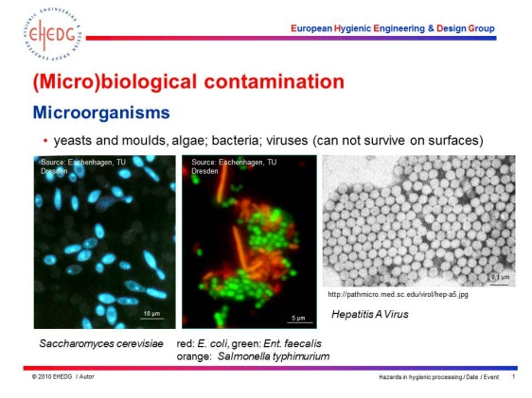
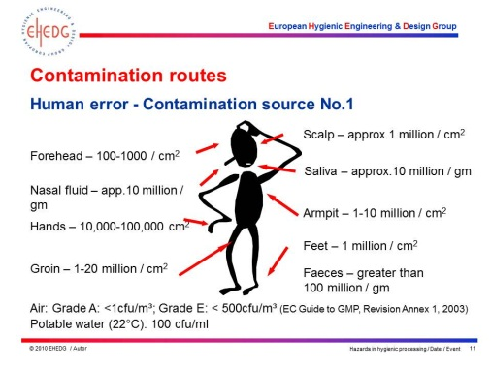
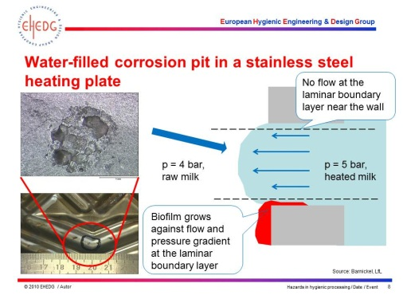
European Hygienic Engineering & Design Group
EHEDG Education and Training
EHEDG provides international, high-level training &
education and our training material is developed by
recognized experts in the field
Translation of the training material into many languages
is in progress by the regions
The ‚International Advanced Course on Hygienic
Design‘ is standardized and offered in many countries
EHEDG courses in 2014:
Germany, Italy, Japan, Mexico, Netherlands, USA,
Spain, Taiwan, Turkey
Attendees who have successfully passed an EHEDG
training course exam are published on our website
(if agreed).

Slide 18
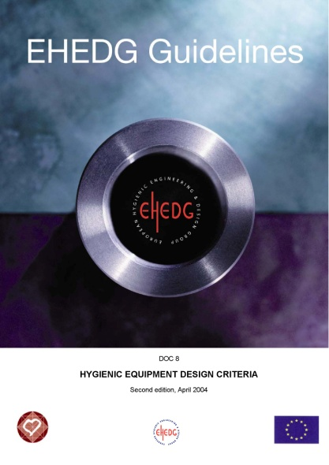
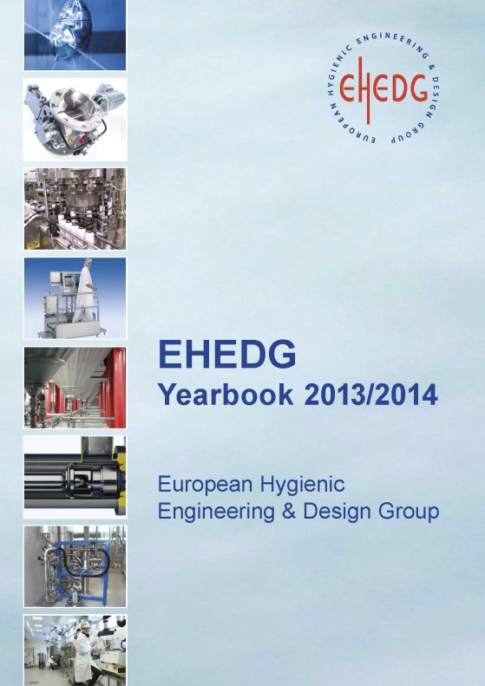

European Hygienic Engineering & Design Group
EHEDG Publications
42 guidelines (many available in different languages)
Extended guideline summaries available in
Trends in Food Science and Technology
Yearbook – new issue 2015/2016 under preparation
Handbooks:
Hygienic Design of Food Factories*
Hygiene in Food Processing *
Handbook of Hygiene Control in the Food
Industry *
Articles in technical press and journals:
New Food, Food Engineering,
Journal on Hygienic Eingeering & Design
and others
EHEDG members receive a 35 % discount on above Woodhead publications

Slide 19
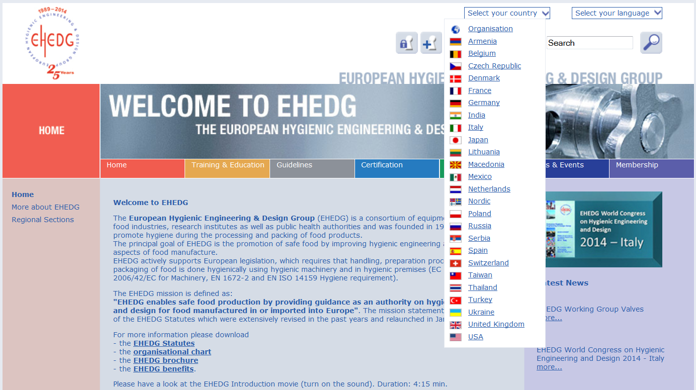
European Hygienic Engineering & Design Group
EHEDG Website
The website www.ehedg.org is the major EHEDG information and communication platform

Slide 20
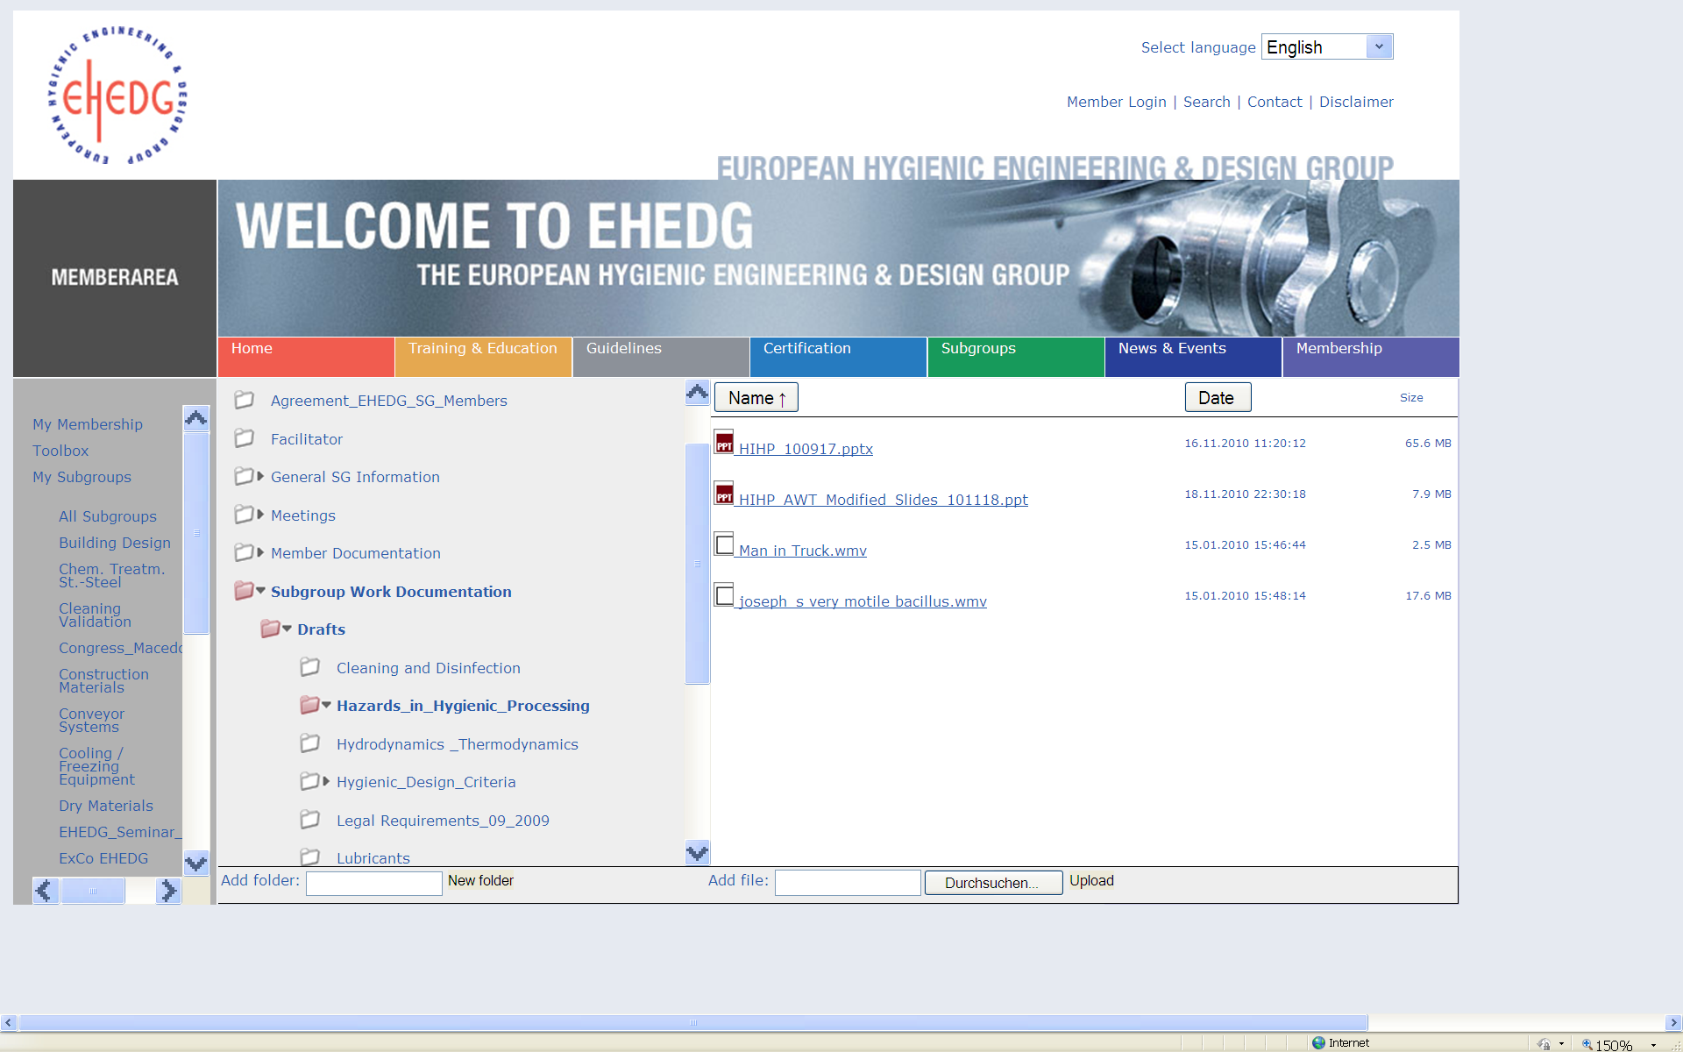
European Hygienic Engineering & Design Group
EHEDG Website
All Working Group information is available from the website back-end download section

Slide 21
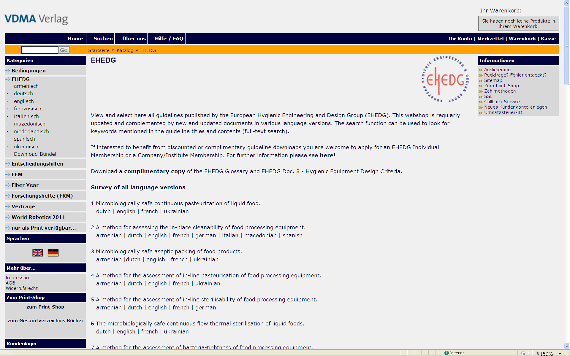
European Hygienic Engineering & Design Group
Webshop
Guidelines can by purchased by non-members and individual members (at a 50% discount) from the webshop which is interlinked from “Guidelines” on the EHEDG website
EHEDG Company and Institute Members have free access to the guidelines by donwload from our website

Slide 22

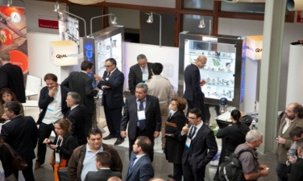
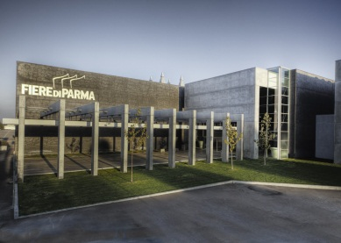
EHEDG Events & Congresses
EHEDG World Congress on Hygienic Engineering & Design,
30 - 31 October 2014 in Parma/Italy in conjunction with Cibus Tec – Food Pack
Topics
The congress will be a ‘summit’ in hygienic design and will highlight the following topics:
Hygienic design of equipment for the food, pharmaceutical and cosmetics industries
Hygienic design of food factories and utilities
New trends in cleaning & disinfection, surface treatments, validation, sustainability and others
Materials in contact with the product
Programme
2 days international congress
Excellent sponsoring opportunities and exhibition area for companies
Call for articles and poster’s area
One-to-One business meetings
Official congress dinner
Guided exhibition tour
Hygienic Study Awards Ceremony
Registration open at discounted rates for EHEDG members

Slide 23
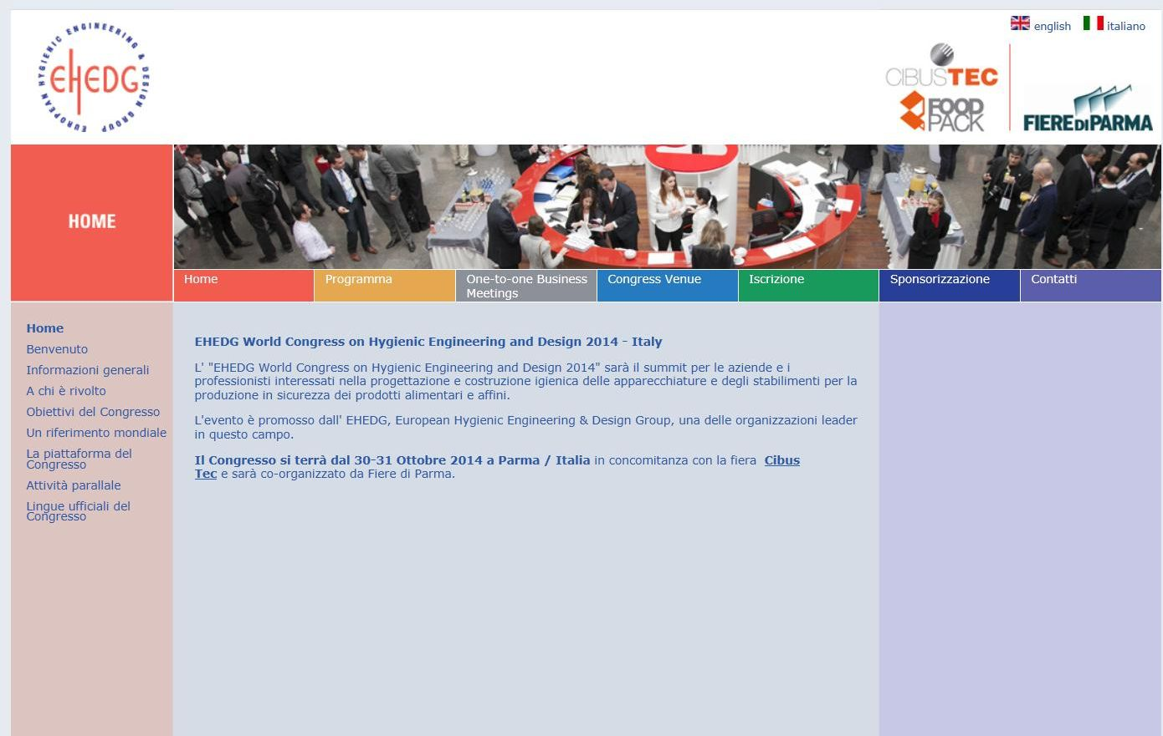
www.ehedg-congress.org
Please visit the congress webpage for all programme details, sponsorship opportunities and registration

Slide 24
EHEDG Individual Membership
50 % discount on the sales price of EHEDG guidelines
Complimentary copies of selected guidelines (for working party members being co-authors)
Discounts on other selected publications
Discount on registration fees to conferences, seminars and training courses
Free copy of EHEDG reports and the yearbook
Networking with other members on issues of common interest
All individual members receive general information about EHEDG and have the option to join
a Regional Section and its activities.
Individual Working Party Members contribute to EHEDG by their know-how and are
addressing themselves to the task of developing and writing up guidelines in a team of
other experts.
Corresponding Members receive minutes of the working group meetings and updates on
the progress of their work.
Individual Membership fee: 100 Euros p.a.
Online Registration:
www.ehedg.org > Membership > Individual Membership

Slide 25

EHEDG Company Membership
Graduated membership fee depending on food-related turnover
Whole series of EHEDG guidelines in all languages including
updates (to be downloaded from the EHEDG website)
available to all staff members
Contribute to work of EHEDG Working Groups and co-decide on
Working Group activities
Use of the EHEDG Company Member Logo under agreed conditions
One to four complimentary staff memberships
Discounts on other selected publications, discounted registration fees to conferences, seminars and training courses
Publication of company logo and link on the EHEDG Website and in
other print media
Discounted or complimentary EHEDG training toolbox
Online Registration:
www.ehedg.org > Membership > Company Membership

Slide 26

EHEDG Institute Membership
Available to institutes, universities, schools, research centres and governmental authorities
Same benefits like company members including use of the
“Institute Member” Logo at a reduced membership contribution
of EUR 500 p.a.
Online Registration:
www.ehedg.org > Membership > Institute Membership

Slide 27
EHEDG Benefits
EHEDG creates a central, internationally recognized source of excellence
on hygienic engineering
We provide networking on an international level, opportunities for the
establishment of global contacts and are interlinking our Regional Sections
We are a platform for an exchange of state-of-the-art know-how and
offer advancement in knowledge
We provide influence in setting global standards and rules and have impact on
regulatory bodies
We are offering a legal basis by practically demonstrating how to follow existing
requirements and standards
Our guidelines are referenced by international organisations and
provide practical know-how
Our guidelines are created by gathering the expert know-how of our members
who are equipment manufacturers of food and packaging machinery as well
as food processing companies, research institutes and health authorities

Slide 28
EHEDG Benefits
We follow up new trends and help to share, disseminate and canalize hygienic
design know-how
We extend the EHEDG mission to “environmental issues” and are aiming to
support food safety and sustainability
We evaluate hygienic design in relation to shelf-life
We provide international, high-level training & education and our training material
is developed by recognized experts in the field
We provide equipment certification by EHEDG-accredited test institutes
Our certification methods are continuously further developed and complemented
by new test methods
We provide reference publications like the EHEDG Yearbook and press articles
in scientific journals and trade magazines
We enhance the reputation of our member companies and help them to
become leaders in hygienic design and processing

Slide 29
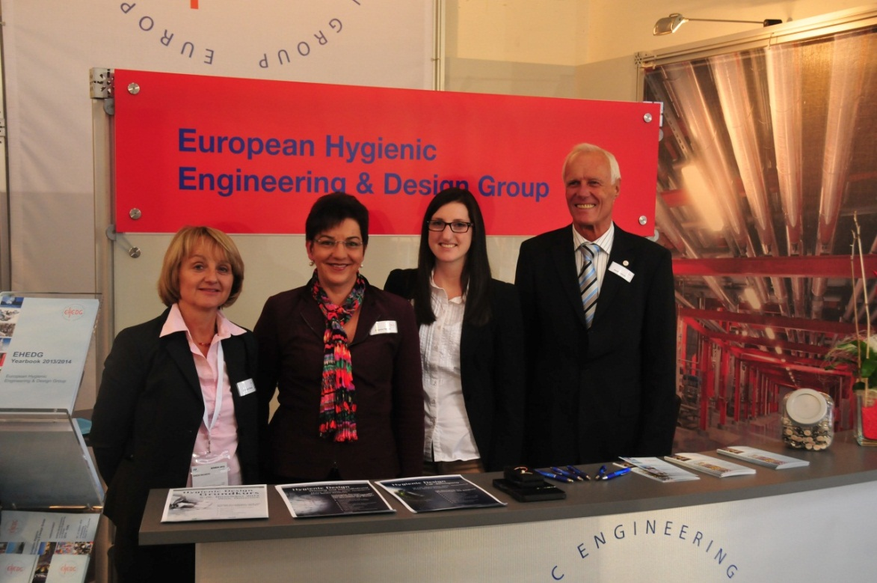
European Hygienic Engineering & Design Group
For questions or further information please contact:
  EHEDG Secretariat, c/o VDMA
  Lyoner Strasse 18
  60528 Frankfurt am Main
  Deutschland
  Susanne Flenner (Office Manager)
  Jana Huth
  Johanna Todsen
  secretariat@ehedg.org
  Phone: +49 69 6603 1217
  www.ehedg.org

