Slide 1
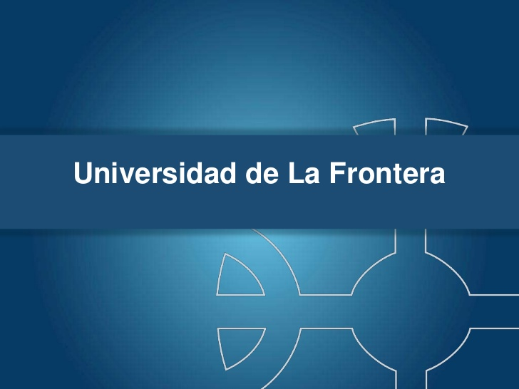
Notes:
Natural resources have a high potential in solving current and future problems.
During the last ten years our research group has studied the ability of WRF for degrading recalcitrant compounds, including pesticides and synthetic dyes.

Slide 2

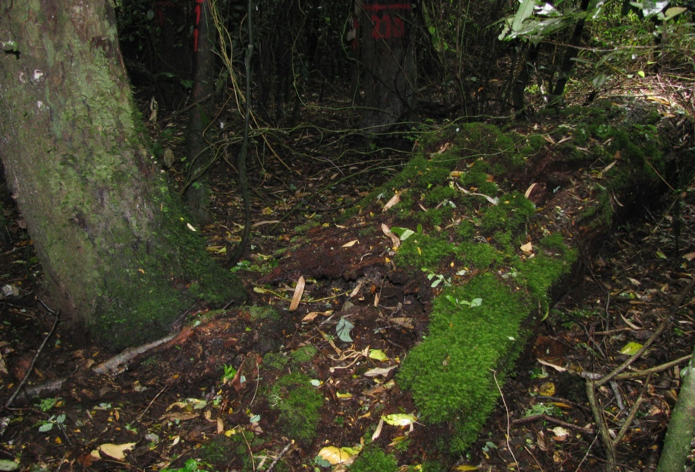
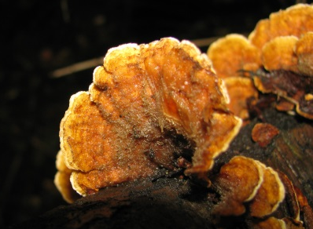
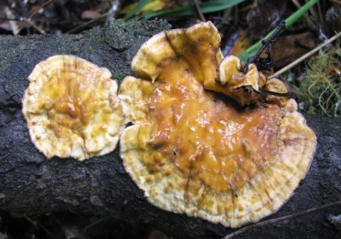
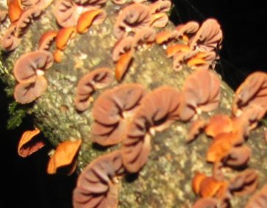
What are the characteristics of white rot fungi that make them interesting candidates for solving some environmental problems?
WHITE-ROT FUNGI
Decomposers of organic matter.
Methyl donors and/or substrates for H₂O₂-generating oxidases.
Antibiotics for protecting fungi.
Ligninolytic enzymes
Secondary metabolites
WRF play important roles in ecosystems
1. INTRODUCTION
Notes:
But, What are the characteristics of white rot fungi that make them interesting candidates for solving environmental problems?
This interesting group of fungi are recognized by their characteristic enzymatic system of non-specific extracellular enzymes and their production of secondary metabolites.
In nature, these compounds play important roles as:
Decomposers of organic matter
Methyl donors and/or substrates for H2O2-generating oxidases.
Antibiotics for protecting fungi

Slide 3
WHITE-ROT FUNGI
ENVIRONMENTAL APPLICATIONS
Ligninolytic enzymes
Bioremediation
- Pesticide degradation
- Detoxification of industrial dyes
Fungal volatile organic compounds (FVOCs)
Chemical markers of fungal presence
Biopesticides
1. INTRODUCTION
Notes:
In general, the environmental application of ligninolytic enzymes include soil and water bioremediation.
Besides, secondary metabolites such as volatile compounds can be used as chemical markers and/or biopesticides.

Slide 4
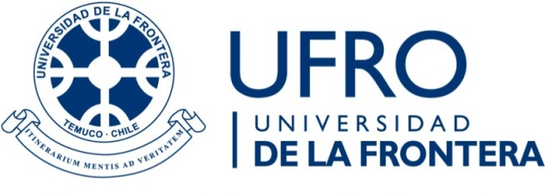

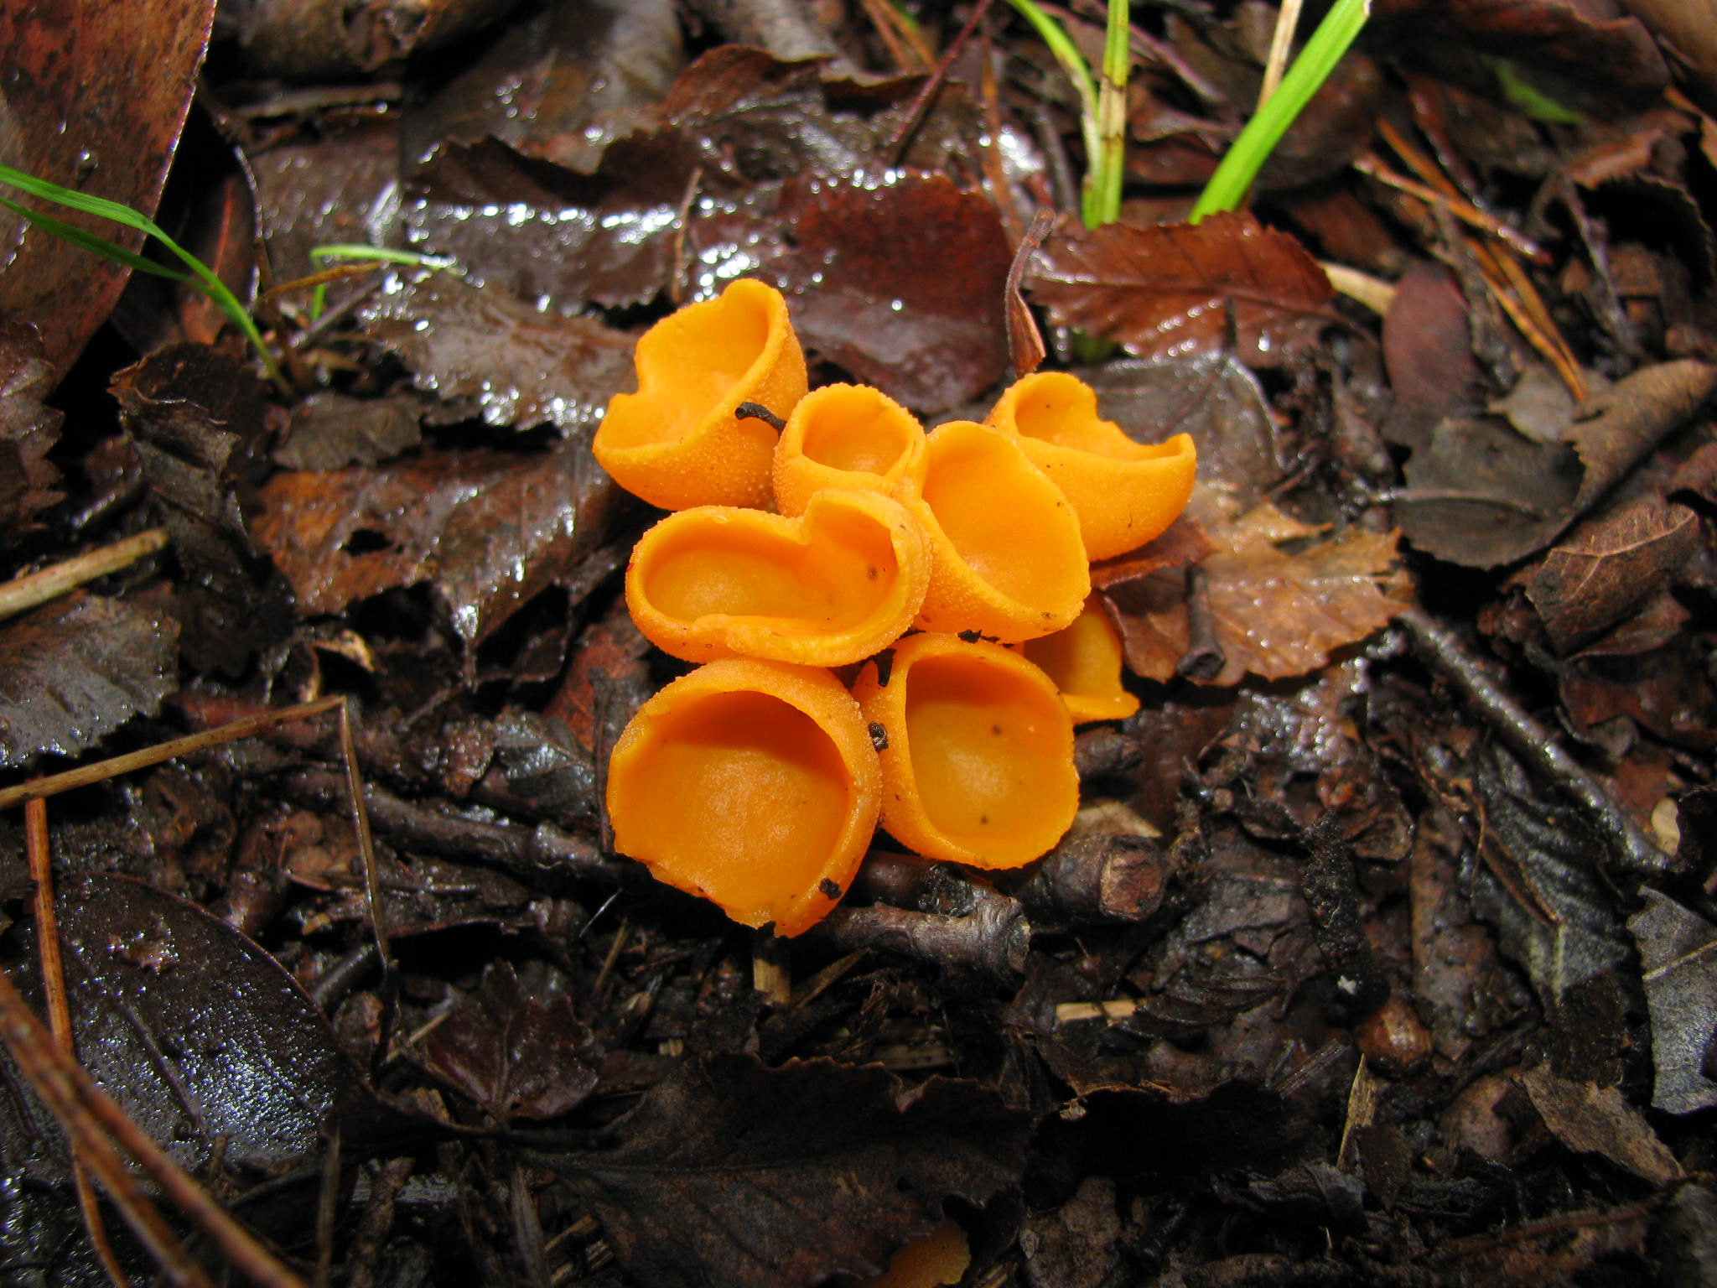
Natural products of Anthracophyllum discolor: ligninolytic enzymes and antifungal volatile compounds
Schalchli, H., Briceño, G., Diez, M.C.
Departamento de Ingeniería Química, Universidad de La Frontera, Temuco, Casilla 54-D
* heidi.schalchli@ufrontera.cl
Frankfurt, 2015
Notes:
In this opportunity I will present the work entitled
Natural products of Anthracophyllum discolor: ligninolytic enzymes and antifungal volatile compounds

Slide 5
Objective
To evaluate the production of ligninolytic enzymes and antifungal volatile organic compounds (VOCs) by A. discolor Sp4 using potato peels (PP) and discarded potato (DP) as low cost nutritional supports.
1. INTRODUCTION
Notes:
The objective was to evaluate the production of ligninolytic enzymes and antifungal volatile organic compounds (VOCs) by A. discolor Sp4 using potato peels (PP) and discarded potato (DP) as low cost nutritional supports.

Slide 6
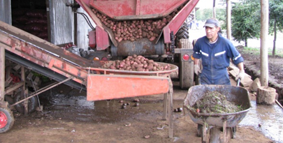
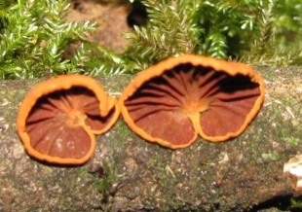
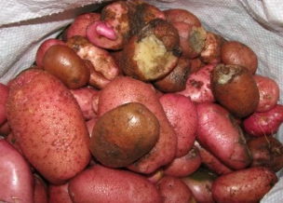
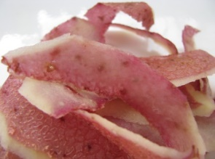
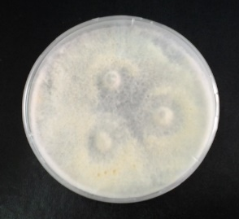
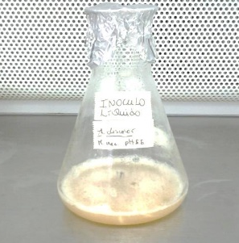
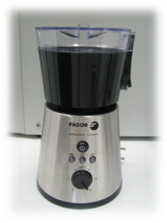
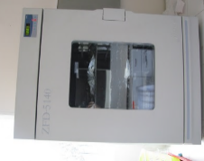
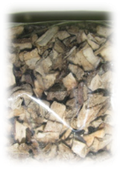
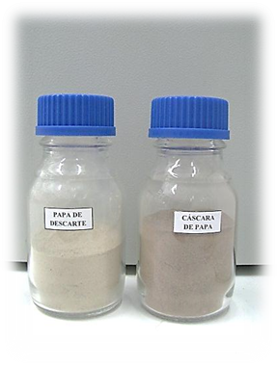
Processing potato wastes
Inoculum
1. Production of ligninolytic enzymes
Laccase
Manganese peroridase
Lignin peroxidase
A. discolor
2. Production of antifungal volatile compounds
Agar media
Liquid media
2. Methodology
Notes:
The potato wastes used in the preparation of culture media were discarded potatoes and potato peels obtained from a local potato-producing industry.
These wastes were processed until obtain an homogenous powder.
The Antracophyllum discolor strain cultured in agar and liquid media was used as inoculum for evaluate the production of ligninolytic enzymes and volatile compounds.

Slide 7
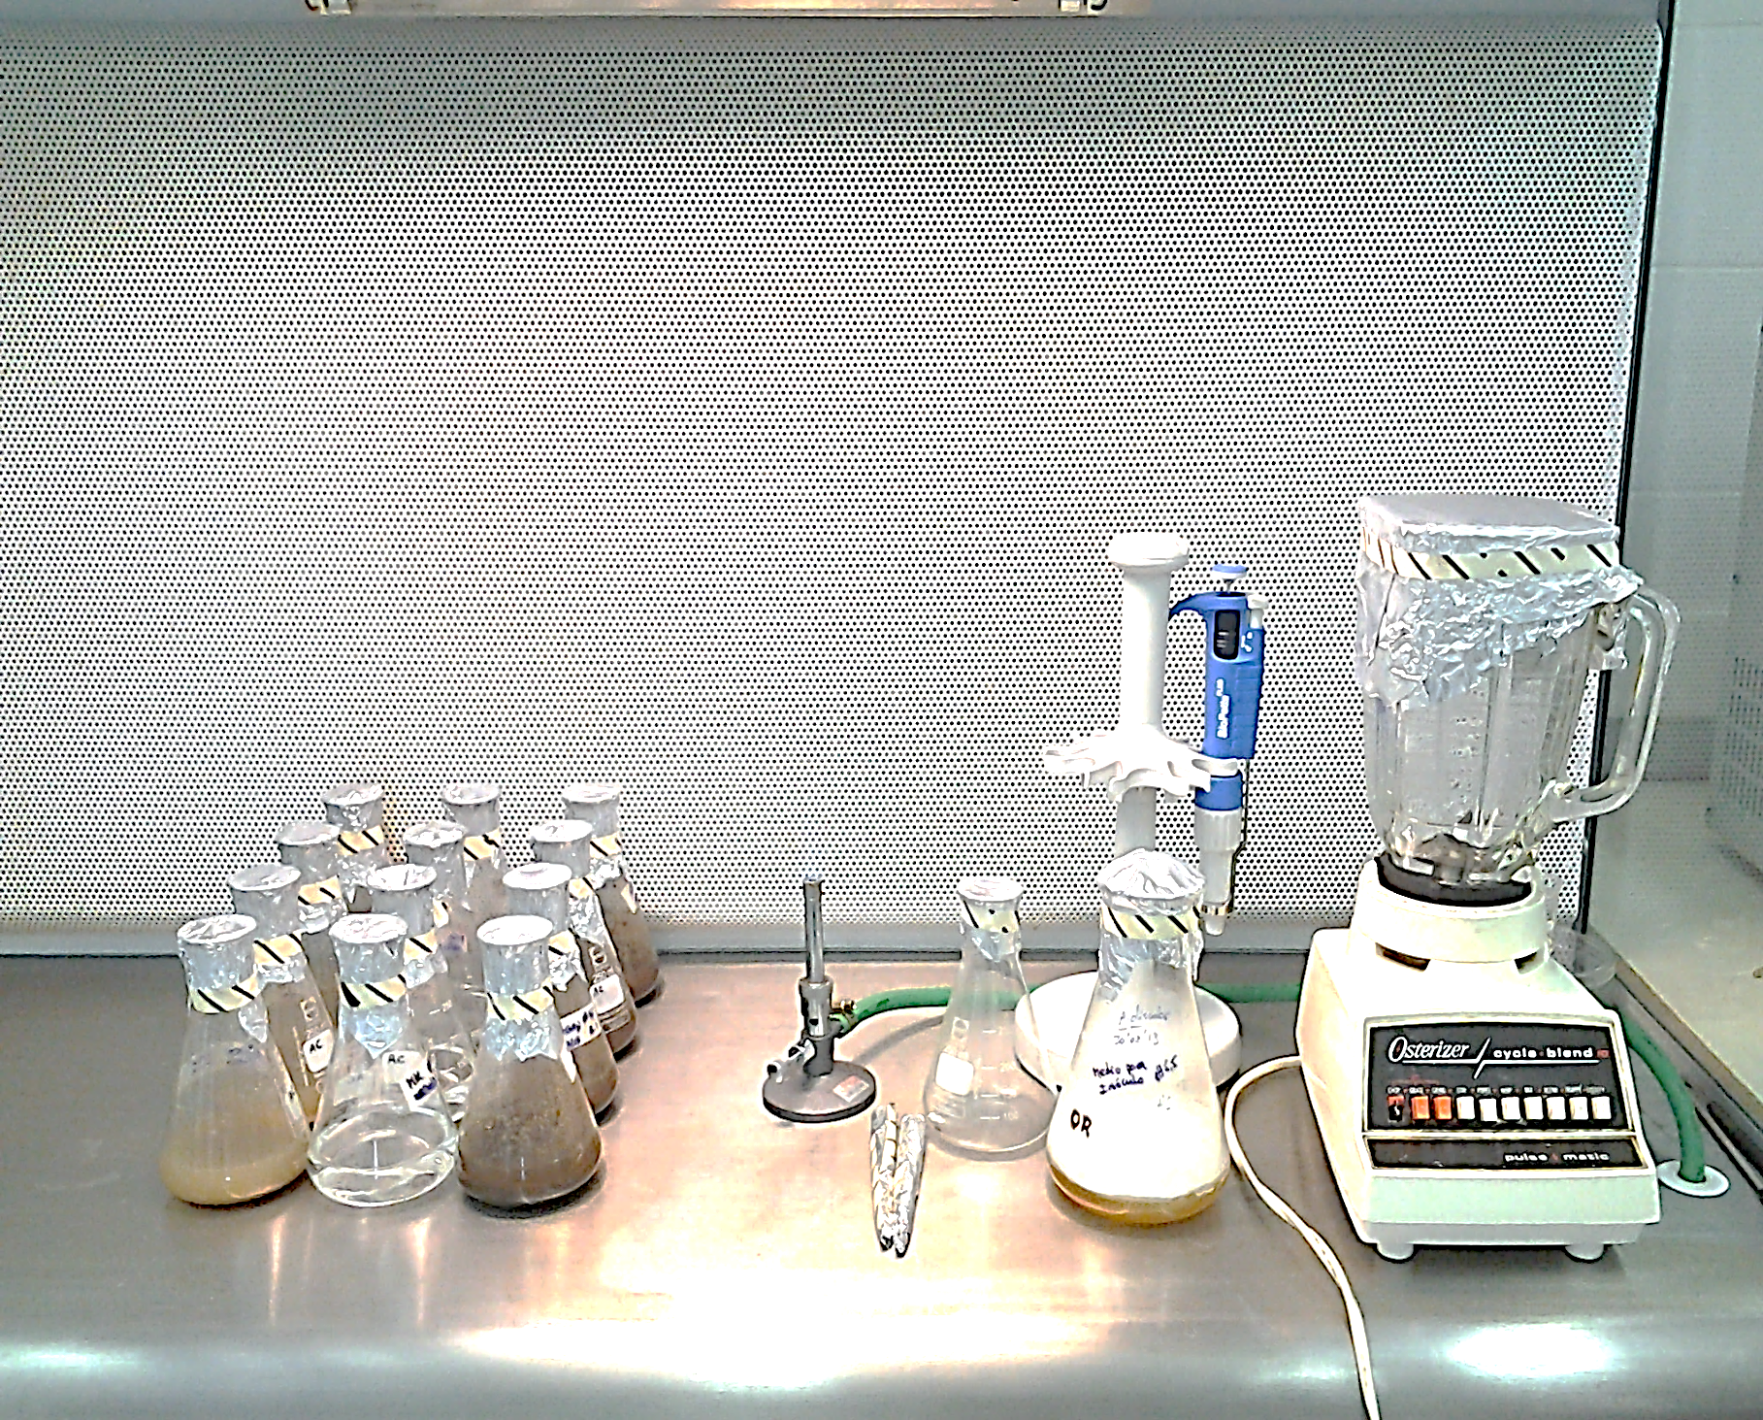
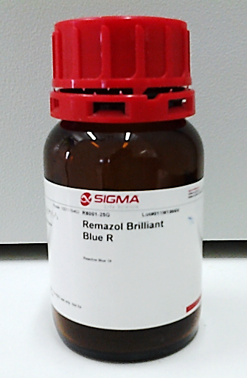
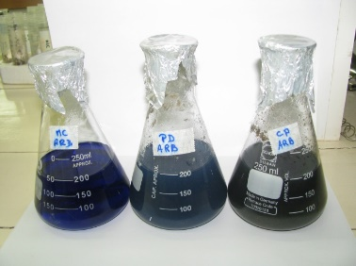
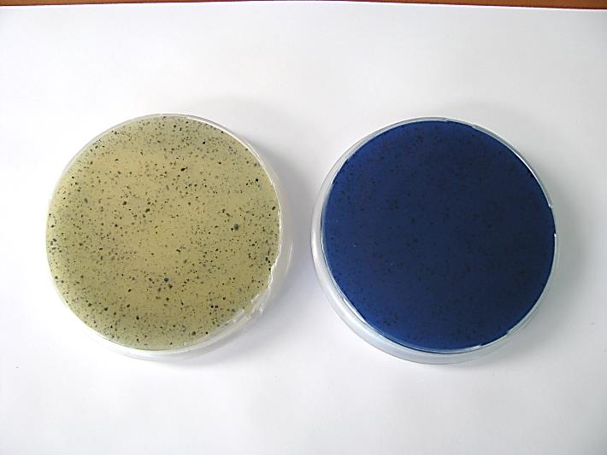

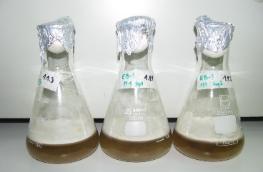
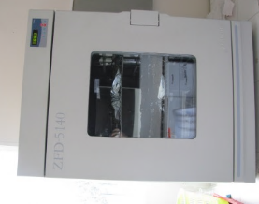
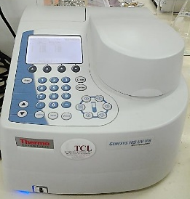
1. Production of ligninolytic enzymes
1.1. Dye decolorization test
1.2. Ligninolytic enzyme activities
Remazol Brilliant Blue R (RBBR)
(0.05% w/v)
Kirk + agar
Discarded potato agar (DPA)
Potato peel agar (PPA)
Lac activity was determined as peroxide-independent degradation of 2.6-dimethoxyphenol (DMP) at 465 nm
MnP activity was determined monitoring the oxidation of DMP. The reaction was initiated by adding H₂O₂.
LiP activity was measured by monitoring the oxidation of veratryl alcohol to veratraldehyde at 310 nm
2. Methodology
Notes:
The decolorization of Remazol Brilliant Blue R by the fungal strain using the potato wastes as nutritional support was used as a simple test to detect ligninolytic enzymes.
After confirming qualitatively the enzyme production, these were quantified by means of spectrophometrical methods.

Slide 8
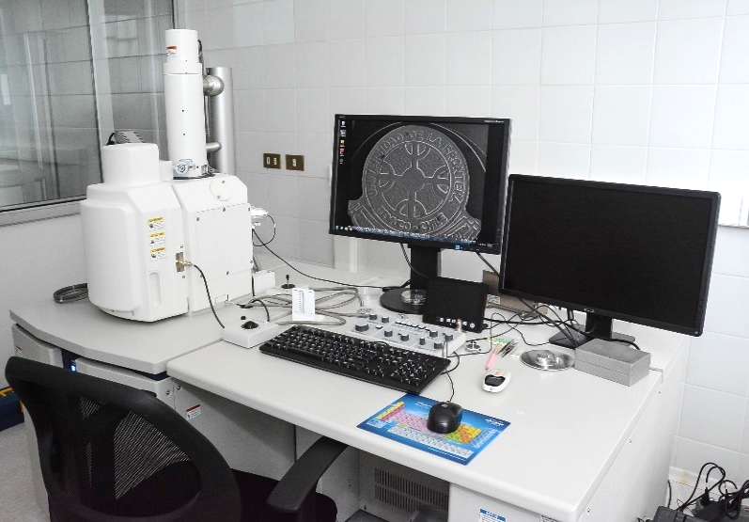
2. Production of antifungal volatile compounds
DPA/PPA
PDA (Merck)
WRF
A. discolor
Target fungus
Botrytis cinerea
Fusarium oxysporum
Mucor miehei
Analisys of VOCs effect by screening electron microscopy (SEM).
Bi-compartmented Petri dish assay
2. Methodology
Notes:
The effect of A. discolor cultured on potato wastes against the mycelial growth of Botrytis cinerea, Fusarium oxysporum and Mucor miehei was investigated using a bi-compartmented Petri dish assay.
At the end of the study, the anthagonized hyphae were analyzed using a variable pressure scanning electron microscope.

Slide 9
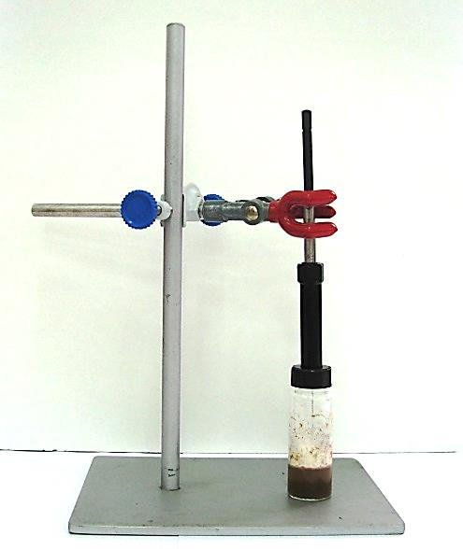
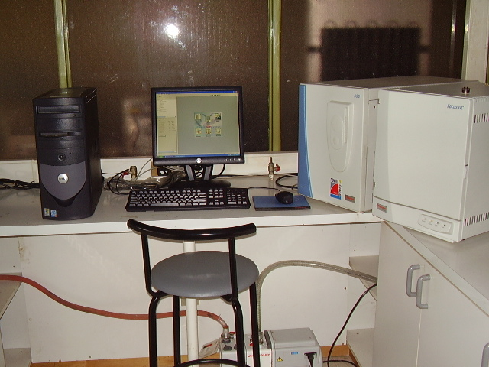
2. Production of volatile compounds
SPME manual holder
SPME glass vial with 10 mL of potato waste media
PDMS/DVB fiber
Solid phase micro-extraction (SPME)
Analisys of VOCs by gas chromatography coupled to mass spectrometry (GC-MS)
2. Methodology
Notes:
The chemical composition of VOCs released from A. discolor was investigated by headspace solid-phase microextraction (SPME) and gas chromatography/mass spectrometry (GC-MS) analysis.

Slide 10
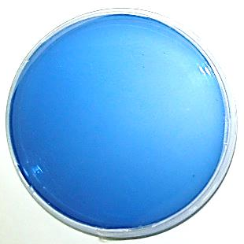
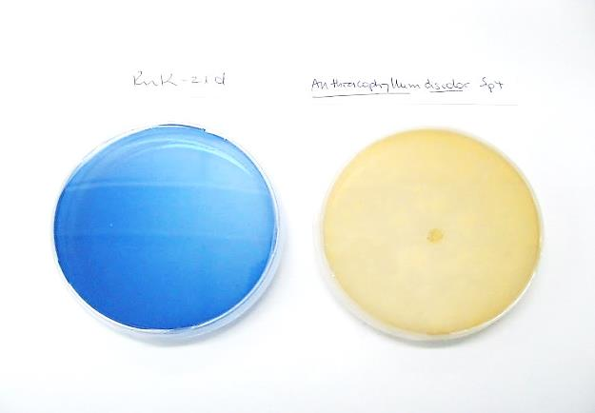
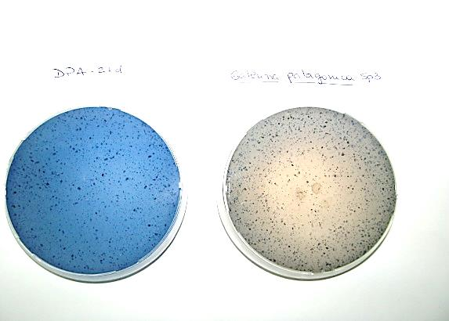
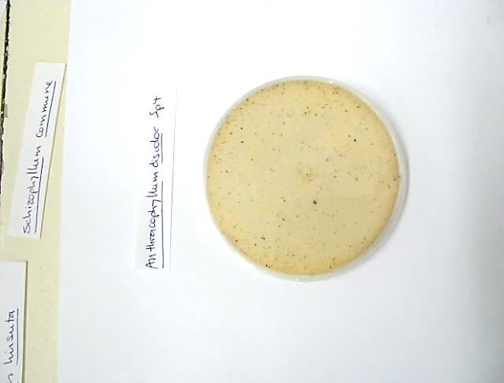
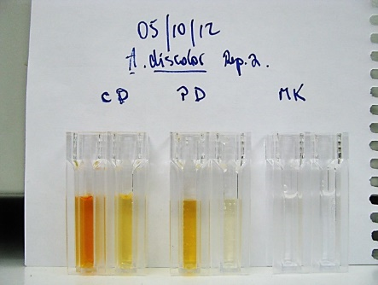
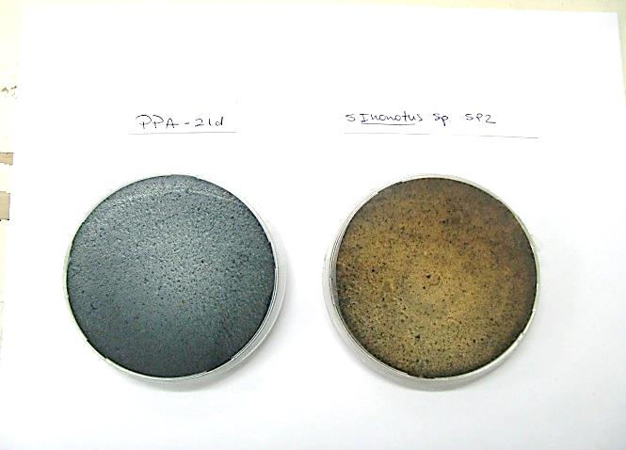
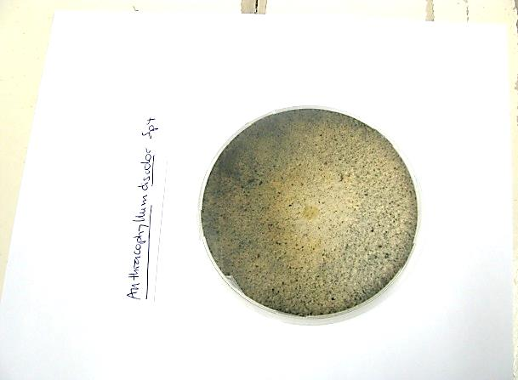
1. Production of ligninolytic enzymes
1.1. Dye decolorization test
1.2. Ligninolytic enzyme activities
Control
Treatments
Kirk
DPA
PPA
Figure 1. Decolorization RBBR (0.05% w/v) by A. discolor incubated during 21 days on discarded potato agar (DPA), potato peel agar (PPA) and modified Kirk medium.
Figure 2. Manganese peroxidase (MnP) and manganese-independent peroxidase (MiP) activities by A. discolor Sp4 cultured in potato peel broth (PPB) and discarded potato broth (DPB) at two potato powder concentrations.
3. Results
Notes:
After 21 (twenty one) days of incubation, A. discolor was able to decolorize the dye RBBR using the three tested culture media s nutritional supports.
In addition we observed an adsorption of the dye in the particles of potato peel.
The Figure 2 shows the production of Manganese and pmanganese independent peroxidase by A. discolor at two powder concentrations.
The highest MnP activity was obtained in PPB medium with 64 g L-1 of potato peel powders at day 15 of incubation (162 ± 11 U L-1).
The results showed that the fungus produced a significantly lower MnP activity in DPB than PPB medium.

Slide 11
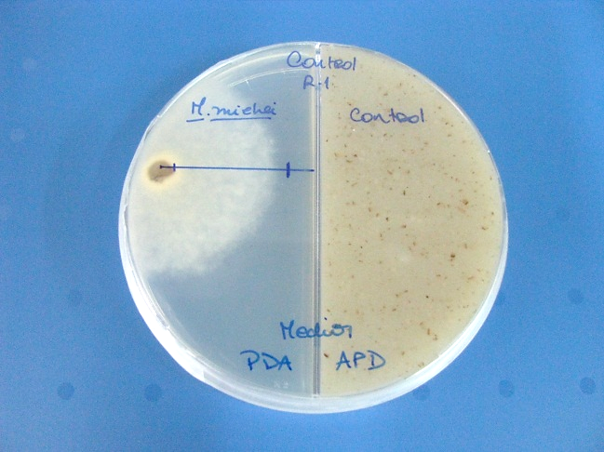
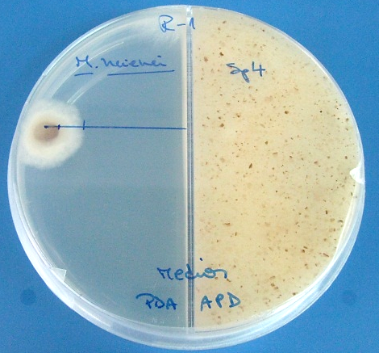
2. Production of volatile compounds
Control
Treatment
Figure 3. Antifungal activity of volatile compounds released from A. dicolor against B. cinerea, F. oxysporum and M. miehei.
3. Results
Notes:
discolor Sp4 showed a high inhibitory activity against M. miehei (about seventy six percent, 76%) and B. cinerea (about twenty percent, 20%).
Fusarium oxysporum was inhibited in a lesser extent (about 10%) by the A. discolor volatiles.
This images show the growth inhibition of M. miehei by the antigungal volátiles released by the White-rot fungi.

Slide 12
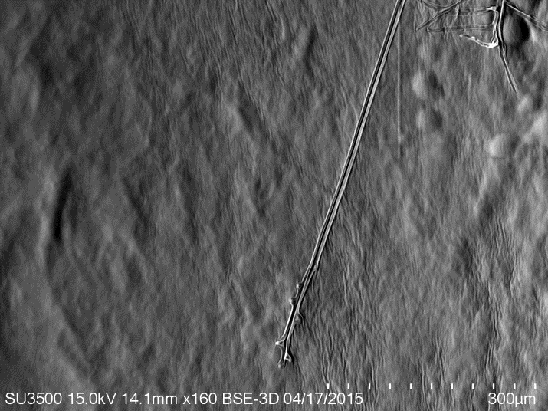
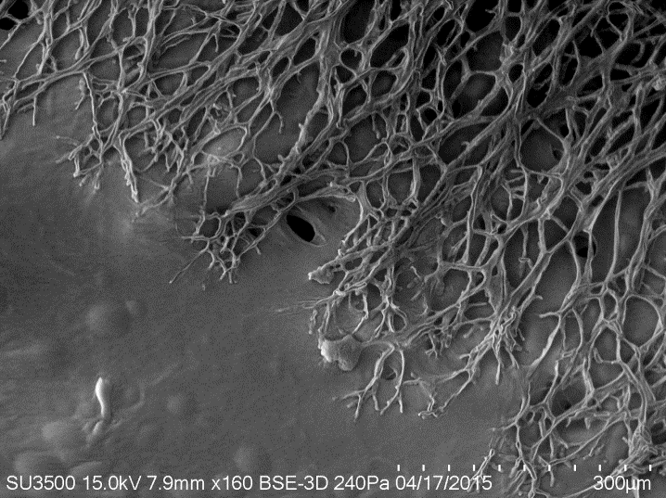
2. Production of volatile compounds
CONTROL
ANTAGONIZED HYPHAE
Figure 4. SEM images of untreated control hyphae of the target fungus M. miehei (left) and the antagonized hyphae of M. miehei exposed to the antifungal volatiles of A. discolor Sp4 (right).
3. Results
Notes:
The images revealed well developed and branching mycelia from the untreated control M. miehei; therefore the hyphae tended to elongate away from their neighbors and grow away from the centre of the colony.
On the contrary, cessation of hyphal elongation the target fungus exposed to the antifungal volatiles of A. discolor Sp4 was observed.

Slide 13
2. Production of volatile compounds
3500000
The mass spectrums of peaks pointed to the structures of:
[1] 1-heptanol
[2] 2-butyl-1-octanol
[3] 3-ethyl-1,2-dihydroquinoxalin-2-one
[4] α-bisabolene
[5] 1,2,4a,5,6,8a-hexahydro-4,7-dimethyl-1-(1-methylethyl)-naphthalene
[6] bulnesene
[7] 1,5-dichloro-2,3-dimethoxybenzene*
[8] 3,5-dichloro-4-methoxybenzaldehyde
[9] 3-chloro-4-methoxybenzaldehyde.
3000000
8
[7*]
1
2500000
9
Abundance
[8]
2000000
1500000
7*
[9]
1000000
6
2
3
4
5
500000
8.00
10.00
12.00
14.00
16.00
18.00
20.00
22.00
24.00
Figure 5. Gas chromatogram of VOCs released from A. discolor Sp4 cultured on DPA medium (discarded potato agar). Peaks appearing in the control vial were omitted from the list (N=3).
3. Results
Notes:
The GC-MS analysis showed nine main volatile compounds released from A. discolor Sp4, among them two sesquiterpenes and three chlorinated aromatic compounds.
In the case of white-rot fungi (WRF), the production and release of various VOCs seems to be directly related to their enzymatic activity, for example organohalogen volatile metabolites which have important physiological roles as antibiotics for protecting fungi, methyl donors and substrates for peroxide-generating oxidases.

Slide 14
Conclusions
The fungus Anthracophyllum discolor Sp4 are able to produce ligninolytic enzymes using potato wastes as nutritional support.
VOCs released from A. discolor Sp4 showed antifungal activity against Mucor miehei and Botrytis cinerea. The antifungal activity seems to be related to the production of sesquiterpenes and chlorinated aromatic compounds.
4. Conclusions
Notes:
From these previous results, we can conclude that…

Slide 15
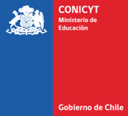

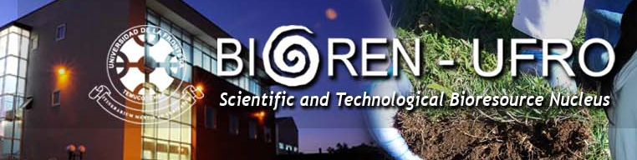
ACKNOWLEDGEMENTS
Postdoctoral FONDECYT Project N° 3130650
Acknowledgements
Notes:
This study was supported by a postdoctoral Project, CIDGRO, BIOREN… and of course by La Frontera University which you can see here..

Slide 16
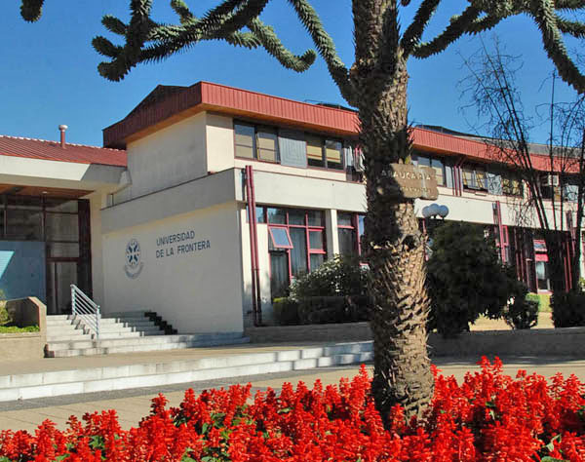
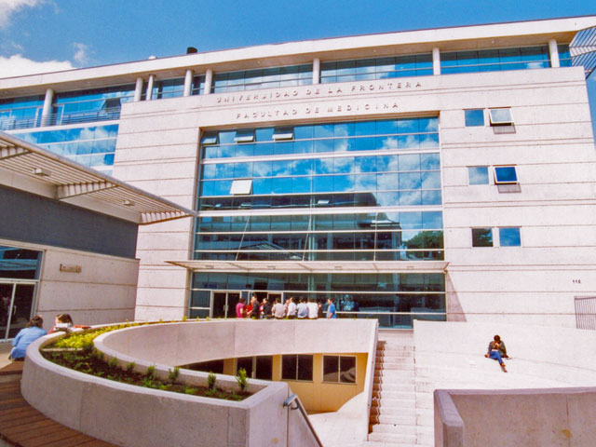
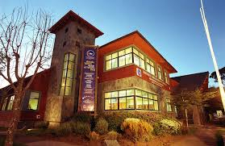
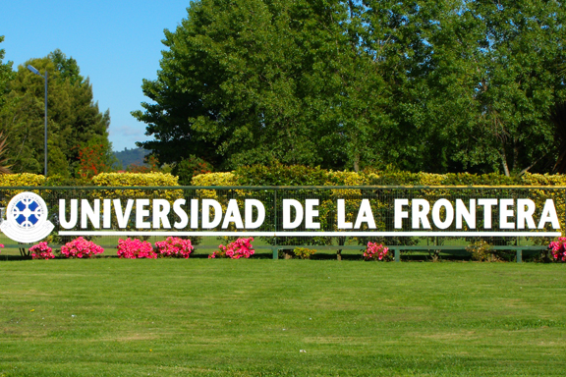
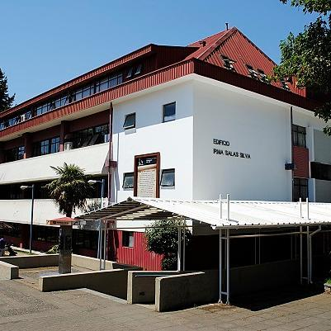
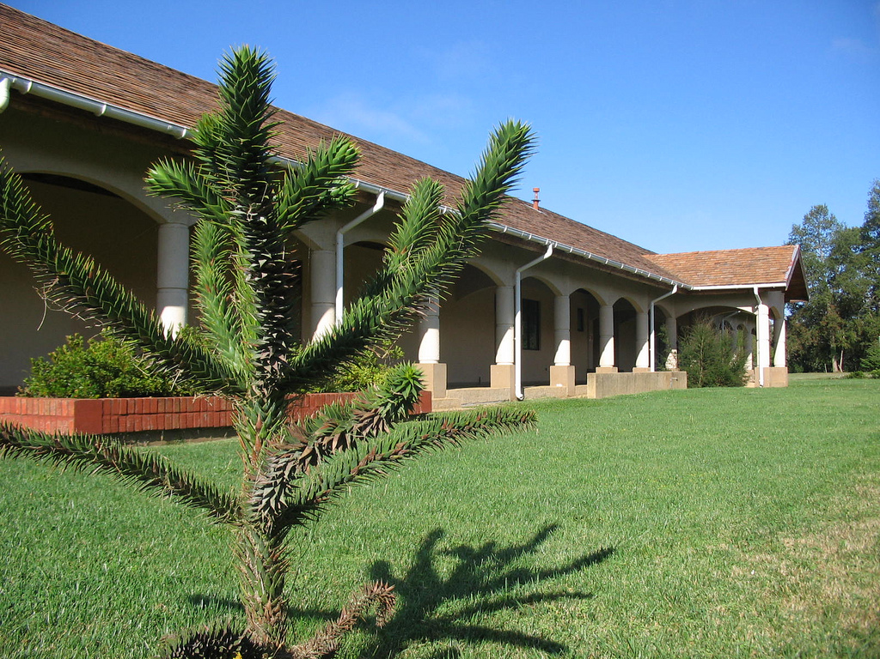
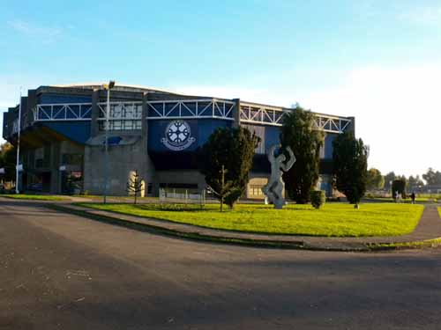
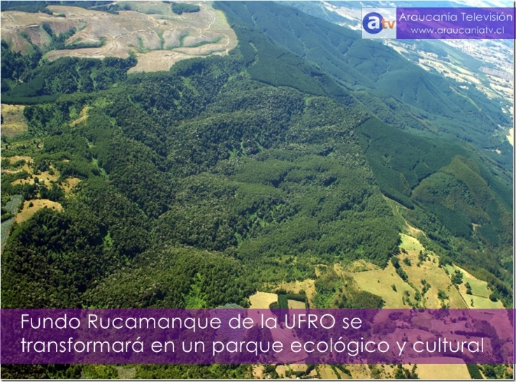
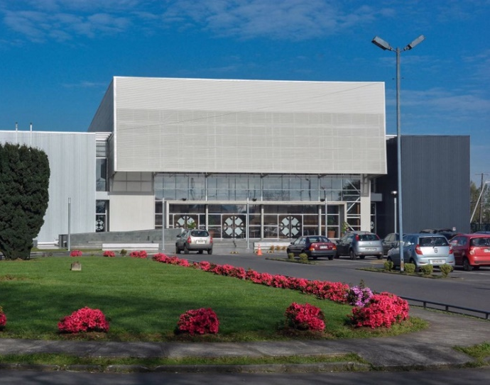
Acknowledgements
Notes:
Thank you for your attention!!

