Slide 1
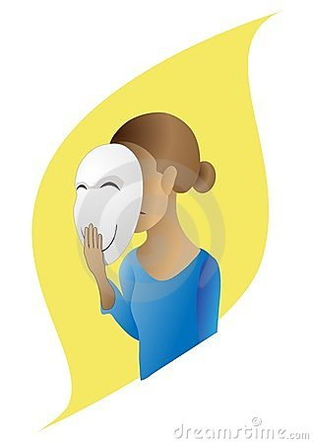
Returning to work after depression: Implications for women’s health
Heather MacDonald RN PhD, Judith MacIntosh RN PhD, Michelle LaFrance PhD
URF & CIHR Funded

Slide 2
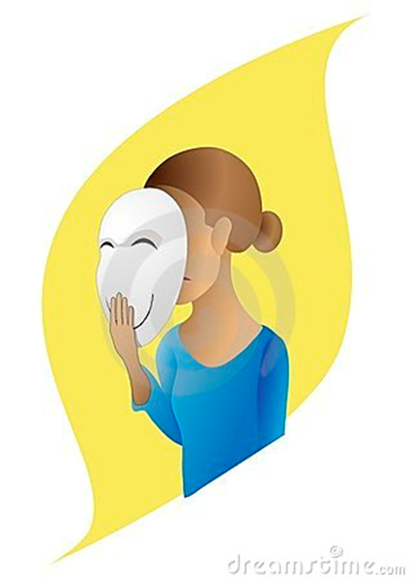
Literature on Depression
Urgent and complex
Leading cause of disease worldwide
70% of million Canadians with depression are working
Productivity plummets
More lost work days than any other medical conditions
5 to 10 times more common than
other diseases
Length of episodes longer
Depression affects more women than men
at a ratio of 2:1
May be due to multiple roles

Slide 3
Purpose
The purpose of this grounded theory study is to expand our gender-based knowledge, inform policy and practice by exploring the experiences and implications of workplace re-entry for women’s health and well being following a lapse in employment due to depression.

Slide 4
Methodology
Qualitative Research
Grounded Theory
In-depth Interviews with 40 women who have returned to work after depression
Used an interview guide
Conversational approach
Pilot project with 10 women

Slide 5
Sample
English speaking women over 19 years of age who have returned to work following depression. Age range 23 to 64. Mean age 46.5
15 Single – 16 Married
One First Nation, 5 Francophone
Ten were mothers
Currently employed full-time, part-time or seasonal
At least a 3 month lapse from work that was due to depression

Slide 6
Sample
Theoretical sampling
Convenience and purposive sampling techniques – posters, newspapers
Wanted a community sample rather
than a single workplace
Sample included women from
universities, hospitals, government
offices, retail businesses,
teachers, etc.

Slide 7
Data Collection and Analysis
Audio recorded interviews
Transcribed verbatim
Used data analysis platform Nvivo
Line by line open coding
Constant comparison
Categories
Theoretical sampling
Theory development

Slide 8
The Depression Experience
“Black Hole”
Overwhelming Fatigue and Sadness
Poor Memory and Inability to
Concentrate
Changes in Eating and Personal
Grooming
Disinterest in Normal Activities

Slide 9
How Depression Affected Work
“Couldn’t get out of bed. Lived on the couch”
“Got really behind at work. Couldn’t keep up
with e-mail”
“Avoided social contact”
“Had to put on a face”
“Overwhelmed by the amount of
work”
“Couldn’t focus”
“No attention span”

Slide 10
Experiences Being Off Work
“Relief that I didn’t have to go out of my house”
“Didn’t have to put on a face”
“No more acting”
“Worried about what people
would think”
“No contact from work”

Slide 11
Returning to Work
“Need a gradual return”
“Memory poor and no concentration”
“No support. If I had had a broken leg there would have been support.”
“Once you’re back the work is
piled on as if you’re fixed”
“Was put at a desk with nothing
to do”
Notes:
The women spoke of needing to be re-integrated into work. This was facilitated by a gradual return but they also required social support from their peers and management. This was not forthcoming.
Still not completely well. The literature refers to this as sickness presence. This sickness presence presents before the women leave work on sick time and it exists when they return so they are not necessarily “fixed”.
Doing nothing was very difficult for the women as they were already struggling with a sense of worth.

Slide 12
Returning to Work
“I am at the end of a hallway and I don’t see anyone. I only see them if they go to the photocopier. I have nothing to do and no one to talk to. It is very strange. A broken boardroom chair that I’m sitting on and a 1960 desk. “ Interview 27

Slide 13
Barriers Returning to Work
Stigma and discrimination
Fear of self-disclosing
Concentration and memory issues

Slide 14
Stigma
“Because once you are tagged with mental illness you’re a problem to the corporation. You are either going to be laid off or fired or you are just seen as somebody that cannot handle responsibility, that’s too fragile. I cannot tell you the amount of prejudice in the workplace.” Interview 3

Slide 15
Stigma
“…one person that I told that I was off for anxiety and depression said oh yeah we’re all stressed here but we don’t get to take the summer off.” Interview 1

Slide 16
Benefits of Returning to Work
Economics
Structure helpful in recovery
Combats social isolation

Slide 17
Reoccurring Theme “Battling Adversity”
Battling Depression
Battling the Workplace
Battling the Institution
Institutional Focus
- institution
- workplace
- health care system
Notes:
Women spoke of being in a constant battle: They battled the depression not wanting to give in to their symptoms yet immobilized by the symptoms. They ballted the workplace that wanted to continue to add work to their already busy agenda, that pushed them into life in the fast lane. They had to fight to receive accomodation in the workplace.
They battled the bigger institution that had policies related to sick benefits and return to work procedures. They had to wage battle to draw on benefits that they had paid into for years.
Women lost their jobs or were moved to different departments where they had to start anew. This was difficult when they weren’t feeling well. In cases where their jobs were lost they had couriers deliver all of their belongings out of their offices. They were too tired to fight.

Slide 18
Battling Adversity
“I was told by the insurance company that I had to return to work or my benefits would be cut off. I wasn’t ready but I went back. After my 30 day progressive return I met with HR and they told me that my corporate values differed from theirs and that they were laying me off. Then the security guard accompanied back to my office and I picked up my stuff. They gave me $25,000 dollars to shut up. I was disgusted but too weak to fight them.” Interview 7

Slide 19
Reoccurring Theme: The Active Practice of Silence
Concealing their Depression
Strategic Disclosure
Secrecy within workplace

Slide 20
Concealing Depression
“So I didn’t tell them I had a depression I just told them I had surgery, it’s easier that way.” Interview 8

Slide 21
Concealing Depression
“I didn’t disclose. I had taken some time off and so they knew I was taking off for sick reasons, initially it was just vacation days and stuff like that and in all honesty I wasn’t getting any support.” Interview 6

Slide 22
Secrecy within Workplace
“ Yeah, it’s the silence. If I had arthritis they would be saying hey you want to check out this book or that site but with depression it is so silent.” Interview 9

Slide 23
Secrecy in Workplace
“ Part of my depression was a feeling of loneliness and so I’m still feeling lonely within my work environment. I’ve been back now for 3 weeks , nobody has come down to my office to see how I’m doing.” Interview1

Slide 24
Where to go from here
Continue analysis
Theoretical sampling – HR’s, etc
Theory Development
Develop manuscripts
Apply for funding

Slide 25
Questions?

