Slide 2
Dr. Hayam Gad Associate Professor of Physiology College of Medicine King Saud University
Effects of pravastatin or 12/15 lipoxygenase pathway inhibitors on indices of diabetic nephropathy in an experimental model of diabetic renal disease

Slide 3
INTRODUCTION

Slide 4
Diabetic nephropathy (DN)
DN is defined as the appearance of persistent ‘clinical’ albuminuria in an individual with diabetes for more than 5 years and concomitant retinopathy, in the absence of urinary tract infection, other renal diseases and heart failure.
People with both type 1 and type 2 diabetes are at risk.
The risk is higher if blood-glucose levels are poorly controlled.

Slide 5
Significant structural changes, particularly thickening of the glomerular basement membrane and mesangial expansion occur only after several years of diabetes.
At this stage, the kidney may start allowing more serum albumin than normal in the urine (microalbuminuria).
As DN progresses, increasing numbers of glomeruli are destroyed by nodular glomerulosclerosis. Now the amounts of albumin being excreted in the urine increases, and may be detected by ordinary urine analysis techniques.

Slide 6
Therefore, DN is categorized into two stages:
Microalbuminuria: (urinary albumin excretion [UAE] >20 μg/min and ≤199 μg/min)
Macroalbuminuria: (UAE ≥200 μg/min).

Slide 7
Lipoxygenases (LOs)
LOs are a family of non-heme iron containing enzymes that insert molecular O₂ into polyunsaturated fatty acids.
They are classified as 5-,8-,12-, and 15-LOs according to the carbon atom of arachidonic acid at which oxygen is inserted.
Three major isoforms of 12-LO are:
Platelet-type
Macrophage- or leukocyte-type
Epidermal-type

Slide 8
Human and rabbit 15-LOs, as well as leukocyte-type 12-LO have high homology, and are classified as 12/15 LOs.
Studies have indicated the presence of leukocyte-type 12/15-LO in various cells, including vascular smooth muscle cells, brain, and kidney.

Slide 9
Substantial evidence suggests that 12/15-LO play an important role in systemic homeostasis and renal-cardiovascular pathology, through mediating growth factor effects in vascular smooth muscle cells, fibroblasts, and mesangial cells, as well as responses to vascular injury.
Deletion of the 12/15-LO gene is associated with reduced atherosclerosis in animal models.

Slide 10
High glucose levels have been shown to directly increase 12/15-LO expression in cultured mesangial cells.
Glomerular 12/15-LO is found to increase in streptozotocin (STZ)-induced diabetic rats associated with an early increase in glomerular activated nuclear transcription factor cyclic-AMP-responsive binding protein, thereby implicating the 12/15-LO pathway in the pathogenesis of the expanded mesangial matrix characteristic of DN.

Slide 11
Moreover, 12/15-LO pathway has been shown to be a critical mediator of angiotensin II-induced mesangial cell hypertrophy and extracellular matrix accumulation.
Therefore, 12/15-LO inhibition by NDGA may be useful as a therapeutic strategy for prevention or amelioration of DN

Slide 12
Nordihydroguaiaretic acid (NDGA)
NDGA is a lignan found in large amounts in the “Larrea tridentate” plant.
NDGA is a potent LO inhibitor that specifically inhibits the leukocyte 12/15- LO pathway.
Research on this compound and its natural and synthetic derivatives has shown them to be potentially useful in the treatment of cancer, diabetes, viral, and bacterial infections.

Slide 13
Three-HMG-CoA reductase inhibition
Three-hydroxy 3-methylglutaryl Co-enzyme A reductase inhibition also has been shown to provide protection against a variety of renal diseases characterized by inflammation or enhanced cellular proliferation.
Many of the beneficial effects occur independently of cholesterol lowering effects because they can alter cellular proliferation/apoptosis, reduce reactive oxygen species generation, and inhibit neutrophil and macrophage recruitment.
More important is their action in increasing expression and activity of endothelial nitric oxide synthase, even under hypoxic conditions.

Slide 14
AIM OF THE STUDY

Slide 15
In light of these findings, the aim of this study is to:
Evaluate the effects of early STZ-induced diabetes on renal functions.
Attenuate the diabetic renal inflammatory and vasomotor injury through supplementation with either pravastatin or NDGA, which specifically inhibits the leukocyte 12/15-LO pathway.
Elucidate the effect of 12/15-LO inhibition on key indices of DN and its relation to inflammatory mediators of renal injury (as VEGF).
Gain insight into the possible beneficial effects of pravastatin and NDGA in regulation of renal function, and so their use as therapeutics for DN.

Slide 16
MATERIALS & METHODS

Slide 17
Eighty eight male Wistar rats were housed in a controlled environment with free access to water ad libitum.
To induce diabetes, rats were injected with STZ 65 mg/kg intraperitonealy.
The development of diabetes was confirmed by tail-vein blood glucose levels (glucometer) on the third day after STZ injection.
Rats whose blood glucose levels were between 300-500 mg/dl were selected.

Slide 18
Urinary albumin and creatinine were measured in each sample for selection of normoalbuminuric and microalbuminuric rats that were divided according to the following categories:
Non-diabetic control rats with normal ACR. Those rats received neither STZ nor any medication.
Normoalbuminuric diabetic rats with urinary ACR <30 μg/mg.
Microalbuminuric diabetic rats with urinary ACR in the range of 30-299 μg/mg in at least 2 urine samples.
The microalbuminuric group was defined as a DN group.

Slide 19
Male rats were assigned into 3 groups:
Group I: included 8 control rats receiving vehicle.
Group II: (8 rats/subgroup): included normoalbuminuric diabetic rats receiving vehicle (IIa), NDGA (IIb), both NDGA and insulin (IIc), pravastatin (IId), or both pravastatin and insulin (IIe).
Group III: (8 rats/subgroup): included microalbuminuric diabetic rats receiving vehicle (IIIa), NDGA (IIIb), both NDGA and insulin (IIIc), pravastatin (IIId), or both pravastatin and insulin (IIIe).
All the drugs and chemicals were supplied from Sigma (St. Louis, MO, USA).

Slide 20
Drug Regimen
Long acting insulin (ultralente) was administered subcutaneously at a dose of 3-4 U/day immediately after induction of diabetes and continued up to the end of the study (for 4 months).
NDGA was injected subcutaneously, 5 mg/kg, daily for 4 months.
Pravastatin was gavaged at a dose of 0.4 mg/kg in dilution of normal saline daily for 4 months

Slide 21
The measured parameters
Urine volume, creatinine clearance and urinary ACR were measured.
Blood samples were analyzed for:
Glycosylated hemoglobin (HbA1c)
Cholesterol & triglycerides
Total nitric oxide (NO) products as the sum of nitrite and nitrate
Lipid peroxide
Vascular endothelial growth factor (VEGF)
Homocysteine (Hcy)

Slide 22
RESULTS

Slide 23
Notes:
Non treated, NDGA, and pravastatin treated normo- and microalbuminuric diabetic rats showed a significant increase in urine volume as compared to controls, NDGA+insulin, and pravastatin+insulin treated normo-, and microalbuminuric diabetic rats. Moreover, a significant increase was found in non treated, NDGA, and pravastatin treated microalbuminuric rats as compared to non treated, NDGA, and pravastatin
treated normoalbuminuric rats.

Slide 24
Notes:
Creatinine clearance significantly decreased in all non treated, and treated normo- and microalbuminuric diabetic rats as compared with controls. Insulin treatment in combination with either NDGA, or pravastatin in normo- and microalbuminuric rats increased creatinine clearance as compared with treatment by NDGA or pravastatine alone both in normo- and microalbuminuric rats. While no significant changes were found between NDGA+insulin and pravastatin+insulin treated diabetic rats.

Slide 25
Notes:
Urinary ACR was significantly increased in all microalbuminuric rats as compared with controls and normoalbuminuric rats. Treatment of microalbuminuric rats with either NDGA, NDGA+insulin, pravastatin, or pravastatin+insulin significantly decreased urinary ACR compared with non treated microalbuminuric rats. Although the precise mechanism involved in the statin effect on extracellular matrix proteins at the cellular and molecular level is not known, it appears that statins lead to an increase in extracellular matrix-degrading enzymes and reduce accumulation of extracellular matrix proteins.

Slide 26
Notes:
A significant increase of HbA1c was detected in non treated, NDGA, and pravastatin treated normo- and microalbuminuric diabetic rats as compared with controls, and those rats treated by insulin concomitantly with either NDGA or pravastatin both normo- and microalbuminuric.
HbA1c levels increased in non treated microalbuminuric rats as compared with controls. Neither NDGA nor pravastatin could affect HbA1c levels, while combined insulin+NDGA, or insulin+pravastatin treatment of diabetic rats could normalize HbA1c levels.

Slide 27
Notes:
Dyslipidemia has been found to be an important predictor of renal function loss and progression of albuminuria. Serum triglycerides showed significant increases in normo and microalbuminuric (non treated, NDGA treated, NDGA+insulin treated) diabetic rats as compared with controls, normo-and microalbuminuric (pravastatin treated and pravastatin+insulin treated) diabetic rats with no statistical difference between normo and microalbuminuric rats.

Slide 28
Notes:
Serum cholesterol showed significant increases in normo and microalbuminuric (non treated, NDGA treated, NDGA+insulin treated) diabetic rats as compared with controls, normo-and microalbuminuric (pravastatin treated and pravastatin+insulin treated) diabetic rats with no statistical difference between normo and microalbuminuric rats.

Slide 29
Notes:
Enhanced generation or actions of NO have a role in the pathogenesis of preferential afferent arteriolar dilatation, glomerular hyperfiltration and hyperperfusion, and glomerular enlargement that occurs in the early stages of DN. The significant increase in serum NO among non treated microalbuminuric diabetic rats, compared with control rats, and non-treated normoalbuminuric rats, strongly suggested that high levels of NO might play a role in increasing albumin excretion. Thus, NO overproduction reflect tissue attempt to overcome vascular dysfunction. Hyperglycemia may be responsible for the increased NO levels in diabetic rats as evidenced by the normalized serum NO level in
microalbuminuric rats treated with NDGA+insulin or pravastatin+insulin.

Slide 30
Notes:
Lipid peroxidation, owing to free-radical activity, plays an important role in the development of complications of diabetes. Serum lipid peroxide levels were significantly increased in non treated rats, whether normo- or microalbuminuric as compared with controls, NDGA, NDGA+insulin, pravastatin, pravastatin+insulin treated normo- and microalbuminuric rats. In the present study, not only pravastatin and pravastatin+insulin treatment of diabetic rats improved serum lipid peroxide level, but also NDGA and NDGA+insulin could normalize serum lipid peroxide in diabetic rats. This proves that both NDGA and statins have antioxidant properties that can improve DN.

Slide 31
Notes:
The field of VEGF has recently witnessed a surge of research into its role in development of DN. In the early diabetic subjects with microalbuminuria, up-regulation of VEGF, and the expression of its receptor can be markedly increased. Podocyte-derived VEGF is believed to participate in the glomerular capillary hyperpermeability of macromolecules that potentially underlies the pathogenesis of diabetic albuminuria. Elevated VEGF levels also cause renal hypertrophy, increase glomerular permeability, and GFR. Our results revealed that plasma VEGF was significantly increased in both non treated normo and microalbuminuric rats as compared with controls, NDGA, NDGA+insulin, pravastatin, pravastatin+insulin treated normo- and microalbuminuric rats. Treatment of diabetic rats with NDGA or NDGA+insulin normalized plasma VEGF level to the same extent as pravastatin or pravastatin+insulin treatment.

Slide 32
Notes:
Homocysteine is not usually present as a direct result of type 2 DM unless there is an associated development of impaired renal function. As nephropathy develops, there is an associated elevation of total Hcy associated with a decline in GFR. The precise kinetic mechanism(s) leading to the hyperhomocysteinemia of DN is unknown. It may be caused by increased production, decreased removal, or both. Treatment of diabetic rats with NDGA or NDGA+insulin normalized plasma homocysteine level to the same extent as pravastatin or pravastatin+insulin treatment.

Slide 33
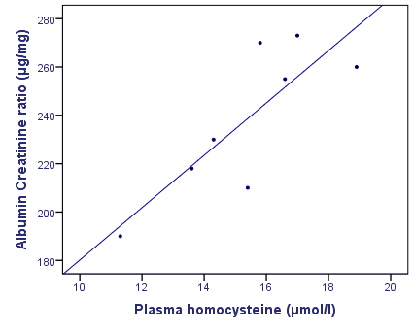
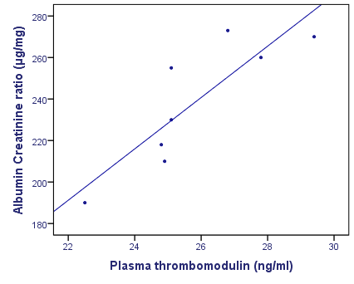
R= 0.820, P= 0.013**
R= 0.858, P= 0.006**
Correlations between ACR and each of plasma homocystine and thrombomodulin in gp IIIa (non treated microalbuminuric rats)

Slide 34
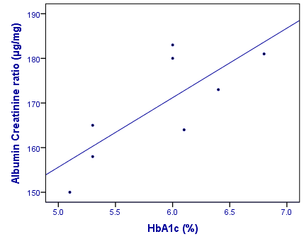
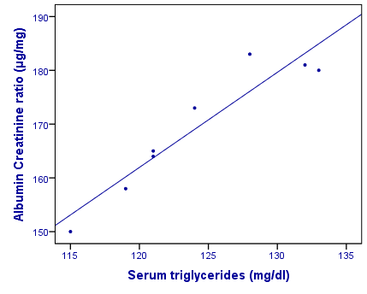
R= 0.775, P= 0.024*
R= 0.944, P= 0.000**
Correlations between ACR and each of HbA1c and triglyceride in gp IIIb & IIId (NDGA and pravastatin treated microalbuminuric rats)

Slide 35
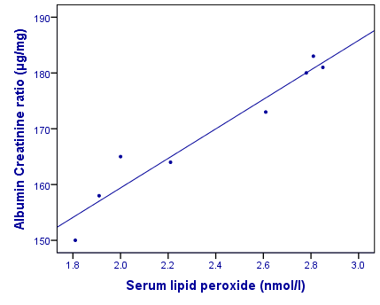
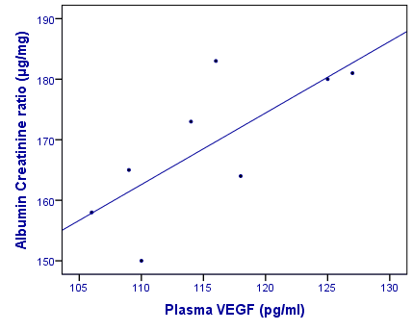
R= 0.967, P=0.000 **
R=0.742, P=0.035**
Correlations between ACR and each of lipid peroxide and plasma VEGF in gp IIIb & IIId (NDGA and pravastatin treated microalbuminuric rats)

Slide 36
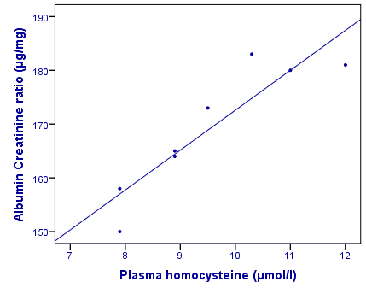
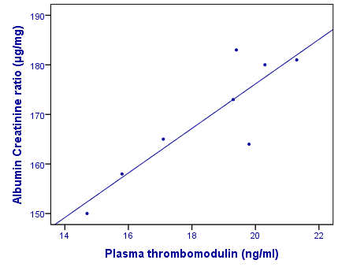
R= 0.875, P=0.004**
R= 0.908, P= 0.002**
Correlations between ACR and each of plasma Hcy and thrombomodulin in gp IIIb & IIId (NDGA and pravastatin treated microalbuminuric rats)

Slide 37
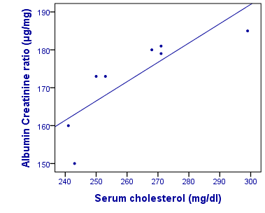
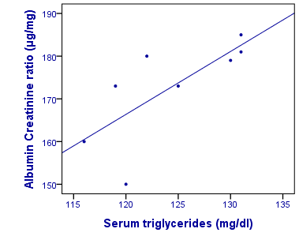
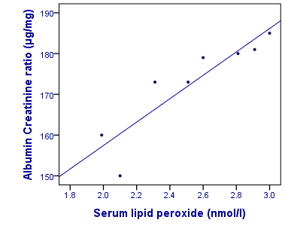
R= 0.825, P=0.012**
R= 0.731, P=0.039*
Correlations between ACR and each of serum cholesterol, TG and lipid peroxide in gp IIIc (NDGA+insulin treated microalbuminuric rats)
R= 0.901, P=0.002**

Slide 38
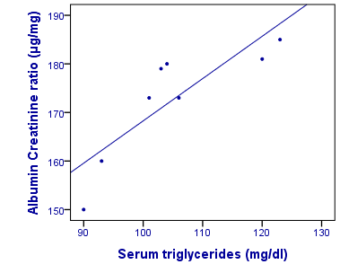
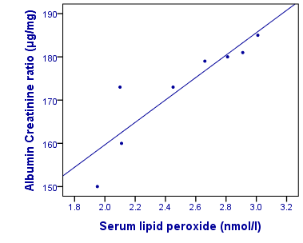
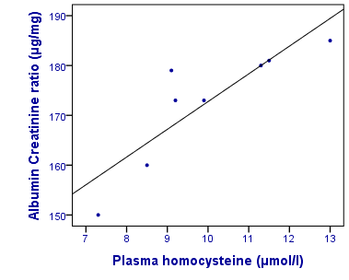
R= 0.840, P=0.008**
R=0.890, P=0.003**
Correlations between ACR and each of serum TG, lipid peroxide and Homocysteine in gp IIIe (pravastatin+insulin treated microalbuminuric rats)
R= 0.866, P=0.005**

Slide 39
CONCLUSION

Slide 40
Pravastatin and the 12/15 LO inhibitor, NDGA, have beneficial effects on STZ induced DN by improvement of renal function, decreasing urinary ACR, and indices of DN in microalbuminuric rats.
A strategy of 12/15 LO inhibition with a drug regimen capable of more sustained 12/15 LO inhibition may improve albuminuria in DN.
These findings may provide insight into the feasibility of clinical use of pravastatin or 12/15-LO pathway inhibitors as a complementary therapy for the prevention/treatment of DN.
Despite the possible theoretic benefit, long-term, prospective clinical trials are needed before clarifying the medical and, perhaps, economic benefits of statins or 12/15-LO inhibitors for DN.

